Slide 1
ETSI-Alignment Architecture and Roadmap
- ETSI Package Onboarding, Management, Catalog Manager
- SOL003/SOL005 Adapter
July 16th, 2019
Byung-Woo Jun, Ericsson Software Technology

Slide 2

Agenda
SOL003 VNF Adapter Features and Candidates
SOL003 VNFM Adapter Architecture for Frankfurt
SDC VNF/PNF Onboarding Enhancement and Distribution
ETSI Package Management Architecture
ETSI Package and Security via SOL005 and SOL003
SO ETSI Catalog DB Support for NS, VNF and PNF
SDC – SO SDC Controller – ETSI Catalog Manager
ETSI Catalog Manager – SOL003/SOL005 Adapter
OOF-based Granting (HPA Support)
Authentication and Authorization

Slide 3

SO VNFM Adapter Features and Candidates
List of Features and Candidates
Features included in Dublin Create VNF, Instantiate VNF, Terminate VNF and Delete VNF, including Granting, Subscription and Lifecycle Notifications Tracking capability: which VNFM instance has handled which VNF instance. BPMN Building Block Workflows and Java-based recipes for Create (Create+Instantiate) and Delete (Terminate+Delete) VNF VNFM Simulator, which is used for Integration Testing
Feature Candidates for El Alto Authentication between the VNFM Adapter and the VNFM VNFM Simulator enhancement and refactoring CSIT of SOL003 ETSI Alignment (SDC → SO → SOL003 VNFM Adapter → VNFM) SO-Monitoring HTTPs Support Preload using user_param (without UI changes) Add support of Query
Feature candidates for Frankfurt VNFM Adapter exposes its NBI to any VNFM Adapter client Package Management of SOL004 including SOL001, based on SOL005 and SOL003 Mapping between ScalingAspect+Delta and VF-Module for Scaling Policy-based Scaling (with VNF Indicator & VES event handling) SO ETSI Catalog DB handling for NS and VNF packages Addition of ETSI SOL003 operations (Modify, Scale, Operation Status, FM, PM, Heal, VNF Indicator, Grant enhancement, & retry, rollback, failing, cancelling, Resource Quota Available Notification – to be determined for operation selections and priorities)
Other Related Feature Requests (SDC Enhancement Requests) for El Alto or Frankfurt SOL004 VNF onboarding and distribution support (SDC-2072, SDC-2282) Mapping between SOL001 VNFD to SDC AID DM, including ScalingAspect+Delta and VF-Module - Not all VNFD needs to be transformed to the SDC AID DM

Slide 4

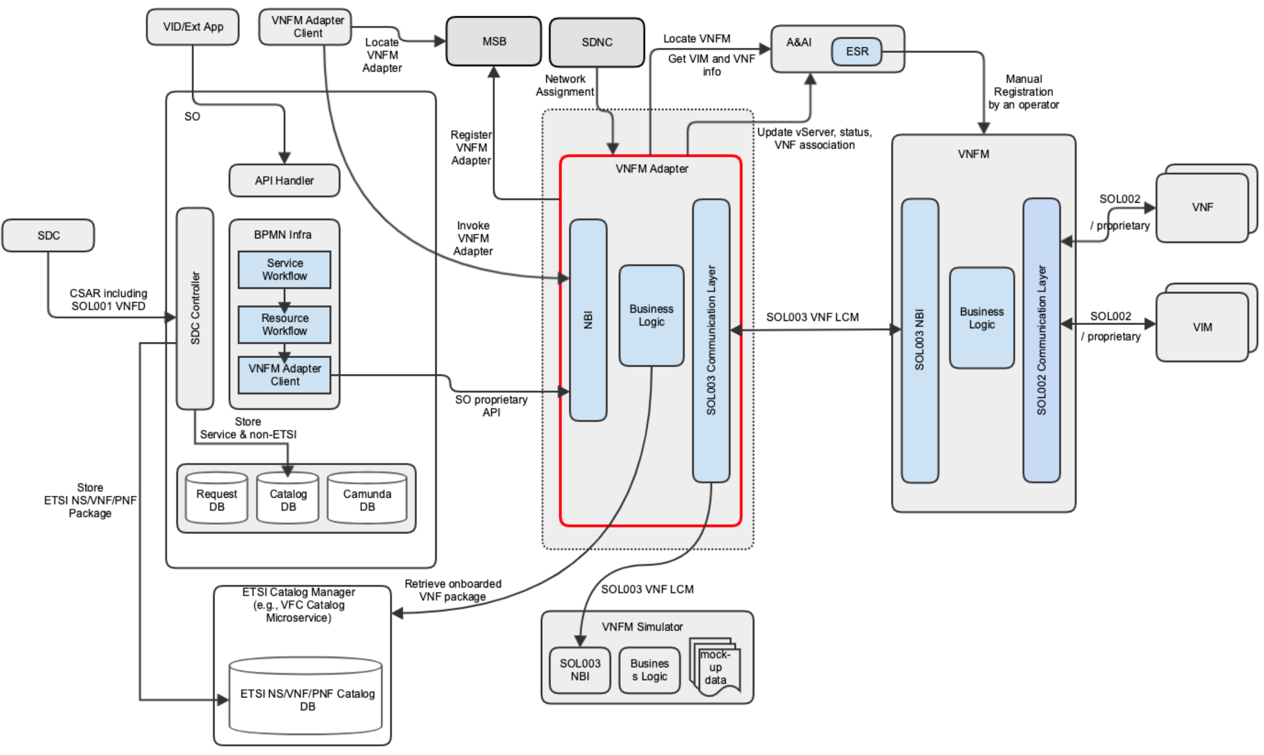
SOL003 VNFM Adapter Architecture For Frankfurt
VNFM Adapter exposes its NBI to any VNFM Adapter client
Interfaces are refactored to be generic (accessed by other ONAP/External components) - TBD
SDC CSAR including the SDC internal model and the vendor original SOL004 package is supported
SO leverages ETSI Catalog Microserve for ETSI-based NS, VNF and PNF
VNFM Adapter retrieves VNF package from Catalog Manager
VNFM Adapter Client uses MSB to locate the VNFM Adapter
VNFM Adapter locates a VNFM based on a better VNFM locating mechanism
VNFM Adapter and SVNFM support additional SOL003 operations, possibly including modification for configuration
VNFM Adapter and SVNFM support authentication and authorization
  AAF will be used for authentication and authorization
  But, vendor SVNFMs may use their own AA mechanism
6
7
1
8
3
2
9
5
4

Slide 5
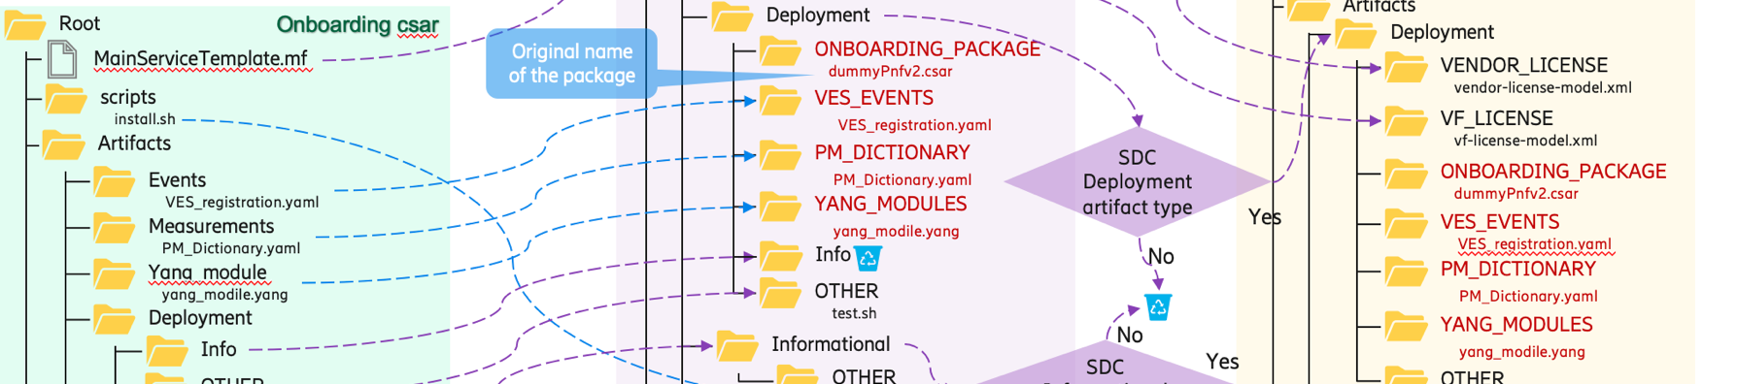
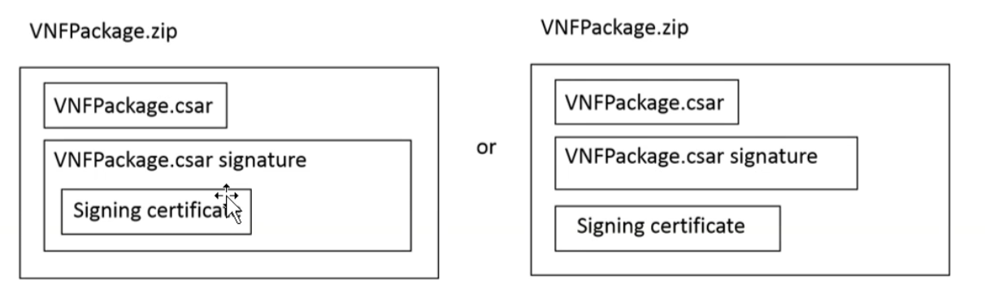
SDC VNF/PNF Onboarding Enhancement and Distribution
SDC takes the vendor provided package and adds some files or changes files and meta data according to SDC procedure.
Enhancement (Ericsson contribution) was made to the SDC Dublin to support SOL004 PNF onboarding with .zip and .csar file extensions.
  The enhancement can be used for VNF onboarding – it is being tested.
  SDC VSP and Resource csar files have the ONBOARDING_PACKAGE, which contains the original vendor VNF package.
    The VNFM and external NFVO use the original vendor VNF/NS packages.
At onboarding, SDC checks the file extension and performs the following procedures
  If the file is .zip, SDC unzips
    If it has .cert & .cms, it is a package with security and security validation will be performed.
    If it does not include .cert & .cms, it is an existing Heat template onboarding, and SDC follows the Heat template onboarding procedure
  If the file is .csar, it is a package without security.
  Next, SDC will check the TOSCA.meta file.
  If it contains SOL004v2.?.1 keywords, the package will be handled as SOL004v2.?.1.
  Otherwise, it will be handled as existing TOSCA (non SOL004) package onboarding which will not have the ONBOARDING_PACKAGE artifact.
Distribution of vendor VNF packages with certificates and signatures to SVFNM need to be sorted out.
Note:
  currently, VF-C supports CSAR-format without certificate or signature – TBD
  SOL003 Adapter needs to support ETSI package management – see next pages
  Mapping SOL001 VNFD into SDC AID DM is not yet defined.
Onboarding vendor csar
VSP csar
Resource csar
Supported VNF Package security in SDC Dublin – option 2
SDC
SO
VF-C
SOL003
Adapter
?
ONAP internal package with the original vendor CSAR/Zip
Vendor package including certificate
Vendor package CSAR
SVNFM

Slide 6
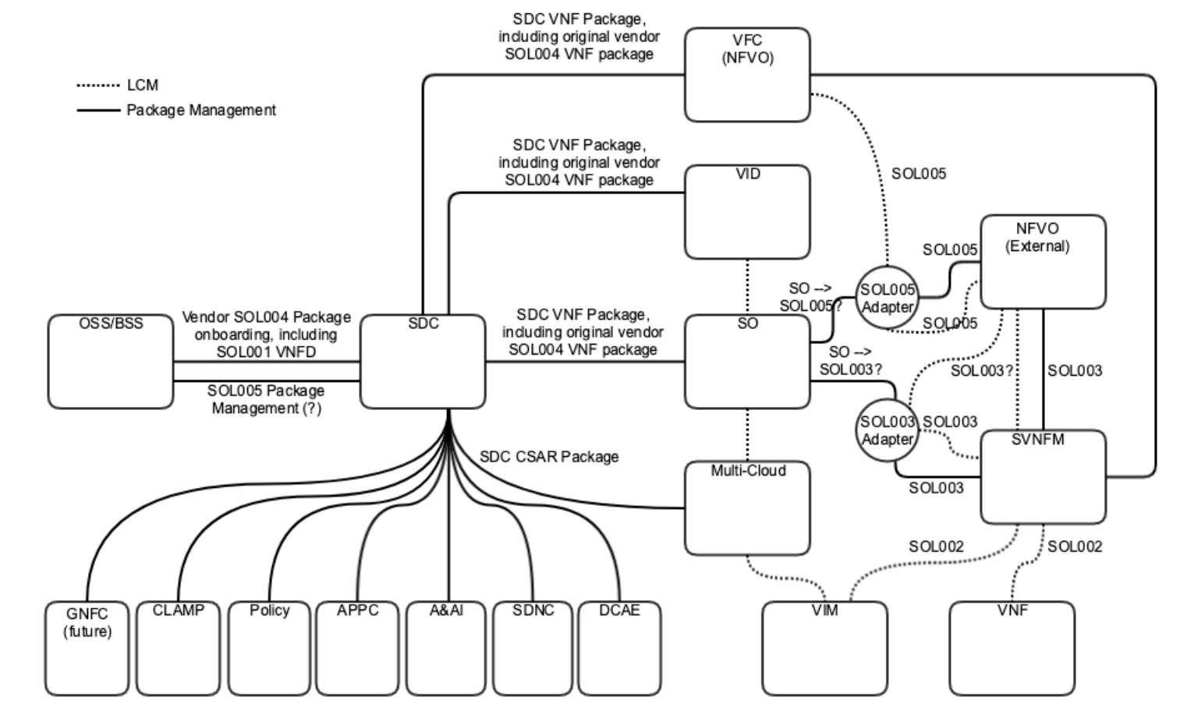


ETSI Package Management Architecture
The diagram depicts a possible package management architecture. It is posted in ONAP Wiki, https://wiki.onap.org/display/DW/SOL005+and+SOL003+Package+Management
SDC supports SOL004 VNF/PNF package onboarding, and stores the original vendor VNF/PNF package inside the SDC package – Ericsson contribution in Dublin
  PNF onboarding was tested
  VNF onboarding is being tested in El Alto / Frankfurt
SDC supports VNF/PNF package onboarding and/or accepts VNF/PNF package management interfaces from OSS/BSS via SOL005 Package Management APIs (TBD)
ONAP Runtime components store SOL004 Packages as needed
  For the SO case, see the subsequent page, SO ETSI Catalog DB Support for NS, VNF and PNF
SOL003 VNFM Adapter provides VNFMs Query/Fetch VNF packages/contents/artifacts, Reading VNFD and subscription/notification services – see the following page
SOL005 Adapter provides NSD/PNFD management and SOL005 VNF package management – see the following page
Note:
SOL007 (NS package) support is under discussion.
To simplify the package distribution and storage, the Runtime Catalog Manager is suggested for the future.
4
2
1
3
5
ETSI View
OSS/BSS
SOL005
NFVO
NFVO
SOL003
VNFM
ONAP realization
{SDC, SO, SOL005 Adapter}
{SDC, SO, SOL003 Adapter}

Slide 7
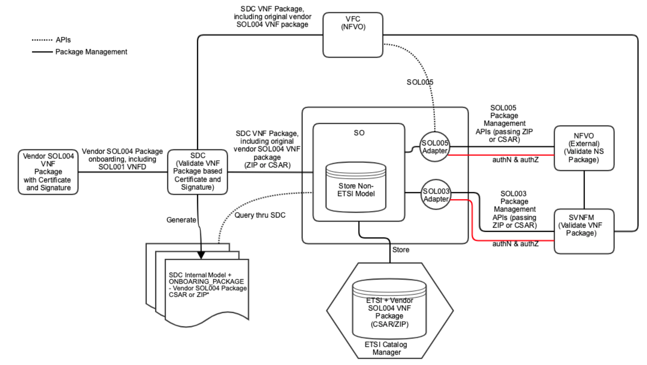
ETSI Package and Security via SOL005 and SOL003
Requirement: External NFVO and SVNFM need to validate incoming ETSI package
Vendor SOL004 VNF Package with certificate and signature is onboarded into SDC
  ZIP-format VNF package includes CSAR, Signature and Certificate
SDC validates VNF package based on the certificate and signature
SDC generates SDC internal model plus the vendor SOL004 package CSAR and ZIP (with certificate and signature) – the supported format is TBD based on the security requirement
SO queries the package thru SDC
SO stores Service + Non ETSI model
  Not all VNFD needs to be transformed to the SDC AID DM - TBD
SO stores ETSI / vendor VNF package CSAR or ZIP – the supported format is TBD based on the security requirement
SOL003 Adapter provides VNF package management APIs
SOL005 Adapter provides NS package management APIs
If CSAR-format is chosen, NFVO/SVFNM trusts integrity (authN and authZ) between the Adapters and NFVO/SVNFM.
For certificate validation, we need to resolve Certificate Authority (CA) placement.
Certificate
Authority
Pass VNF package including software image

Slide 8
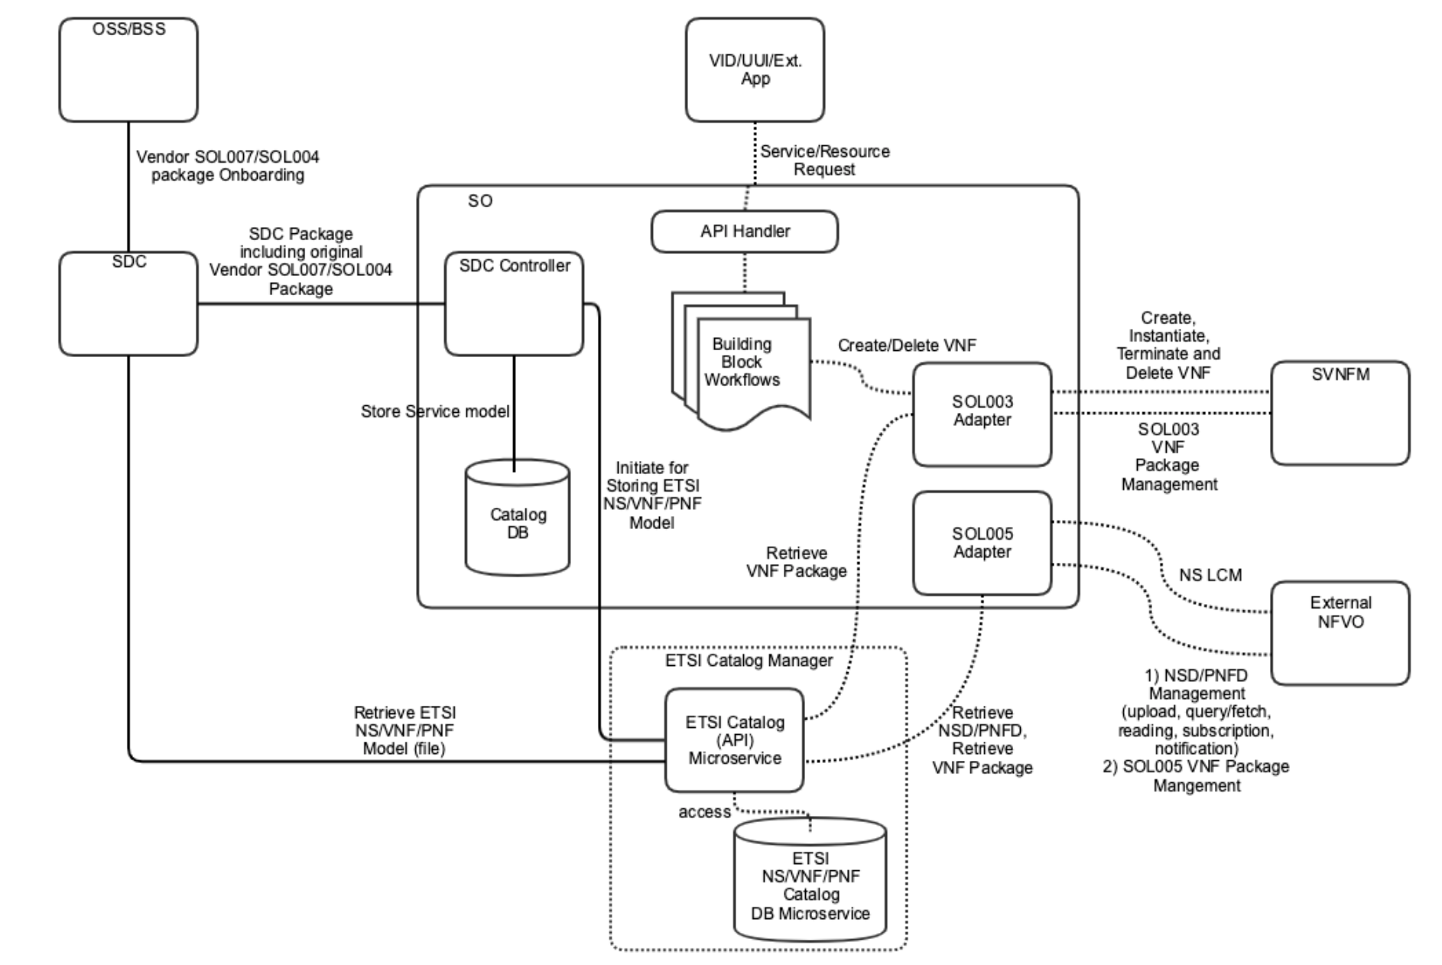
SO ETSI Catalog DB Support for NS, VNF and PNF
Instead of building ETSI Catalog management in SO, leverage the existing ETSI Catalog Manager function – Working with CMCC and plan to discuss with CMCC sometime next week
Consideration of leveraging VF-C Catalog Microservices for the NS, VNF and PNF catalog support, https://wiki.onap.org/pages/viewpage.action?pageId=63996543
  VFC Catalog Manager function consists of two microservices: VF-C DB and VF-C Catalog. Deployment of these microservices is independent of VF-C, and the microservices have no dependency on other VF-C components – a good stepping stone towards common ETSI Catalog management
  VF-C Catalog DB Microservice
    Database: nfvocatalog (vfc-nfvo-catalog-createdb.sql // create db scripts)
    Database Table (vfc-nfvo-catalog-createobj.sql // create tables scripts)
      Catalog_NSPackage
      Catalog_VNFPackage
      Catalog_PNFPackage
      Catalog_SoftwareImageModel
  VF-C Catalog (API) Microservice
    vfc-catalog docker
  VFC Catalog REST APIs (following is part of Swagger REST APIs), https://docs.onap.org/en/latest/_downloads/0fea611e8b07fb4042e1a66ce202898c/CATALOG_API_Specification_v1.json
2
1
NS Package Management | VNF Package Management | PNF Management
GET /nspackages // query NS package info POST /nspackages // NS package distribute / create GET /nspackages/{csarId} // query NS package info DELETE /nspackages/{csarId} // delete NS package | GET /vnfpackages //query vnf package info POST /vnfpackages // vnf package distribute / create GET /vnfpackages/{csarId} // query vnf package info DELETE /vnfpackages/{csarId} // delete vnf package PUT /vnfpackages/{csarId}. // create/upload vnf package | GET /pnf_descriptors POST /pnf_descriptors GET /pnf_descriptors/{pnfdInfoId} DELETE /pnf_descriptors/{pnfdInfoId}
Model Parsing | Job Management (used for async LCM) | More…
POST /parsernsd // NS package model POST /parservnfd // VNF package model | GET /jobs/{jobId} // Job Status POST /jobs/{jobId} // Update Job Status

Slide 9
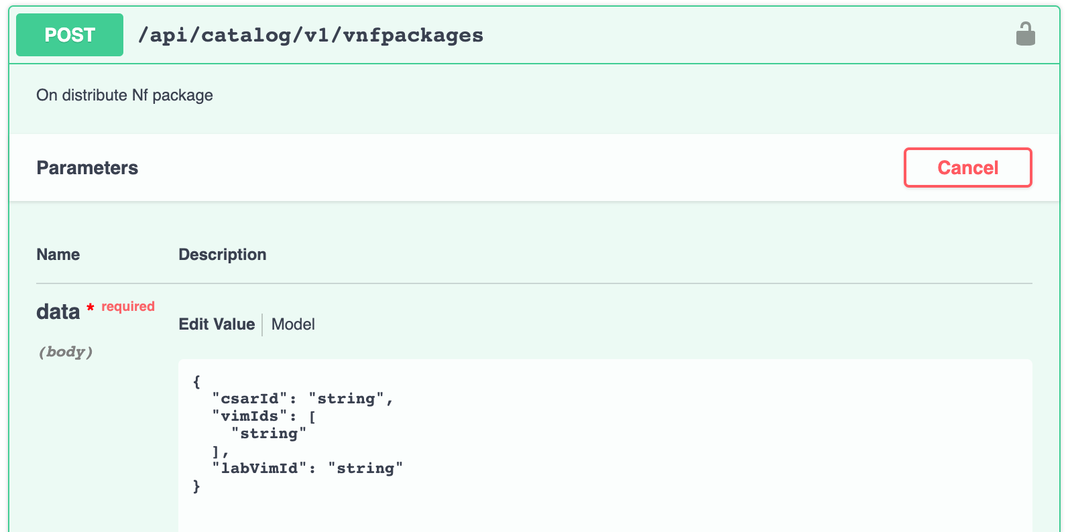
SDC – SO SDC Controller – ETSI Catalog Manager
SO SDC Controller module (ASDCController and ToscaResourceInstall) needs to be updated for handling SOL004 packages including SOL001 VNFD and PNFD.
Service-level catalog and other non-ETSI catalog (SDC AID DM) will be stored in SO Catalog DB.
VNF/PNF/NS-level catalog handling would be simplified:
  By using the ETSI Catalog Manager, ETSI VNF/PNF/NS-level catalogs (i.e., original vendor packages) will be stored in ETSI Catalog DB
  SO itself does not need to manage ETSI-based VNF LCM; i.e., delegates the LCM to VNFM through the SOL003 VNFM Adapter
In Frankfurt, VNF package management is the first focus.
ETSI Catalog Manager POST API will be used to store the VNF packages
  POST /api/catalog/v1/vnfpackages // passing csarId, vimIds and labVimId
Q&A:
  How does VFC handle VNF packages from SDC? Does it use SDC AID DM? Does it use VF-Modules?
  Answer:
    VF-C supports SDC internal models with the original vendor package and ETSI-based VNF package
    Currently, no VF-Module support from VF-C and SOL003 VNFM Adapter
    VF-Module mapping and handling need to be sorted out.

Slide 10
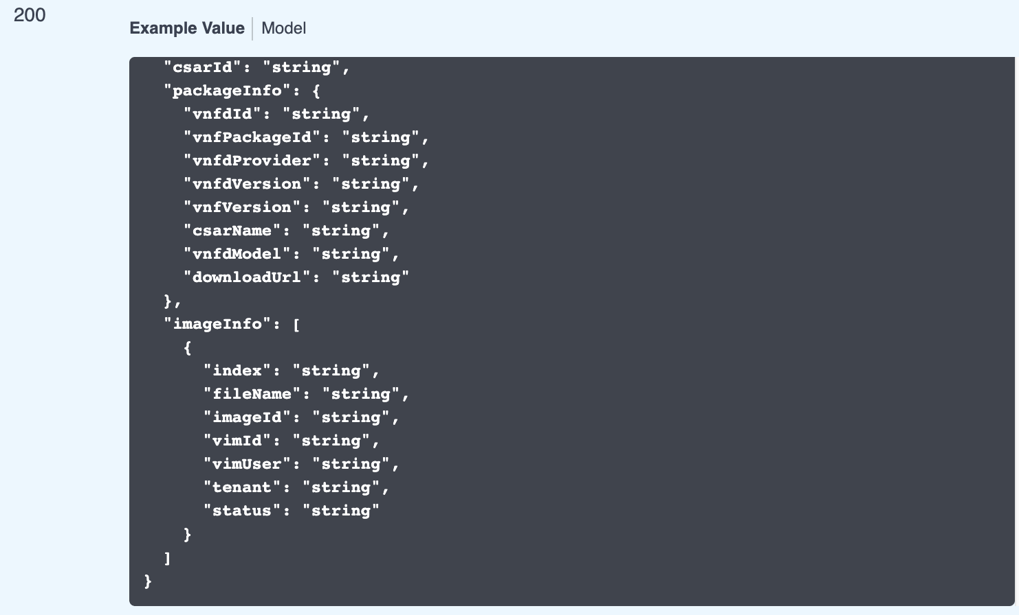
ETSI Catalog Manager – SOL003/SOL005 Adapter
ETSI Catalog Manager consists of two microservices:
  ETSI Catalog API
  ETSI Catalog DB
ETSI Catalog Manager provides RESTful services to Adapters:
  ETSI package management for the Adapters.
    GET /api/catalog/v1/vnfpackages/{csarId}
    Need to pass artifacts (images) to VIM thru the Adapter
    Get the original vendor VNF package
      ETSI Catalog APIs will be enhanced to extract the original vendor VNF package from the ONBOARDING_PACKAGE directory
      Does the vendor original package include VNF software image or path?
  Retrieving VNFD for SOL003 Adapter
  Retrieving NSD/VNFD for SOL005 Adapter
    GET /nspackages/{csarId} // query NS package info
    More SOL005 Adapter requirements are being collected.

Slide 11
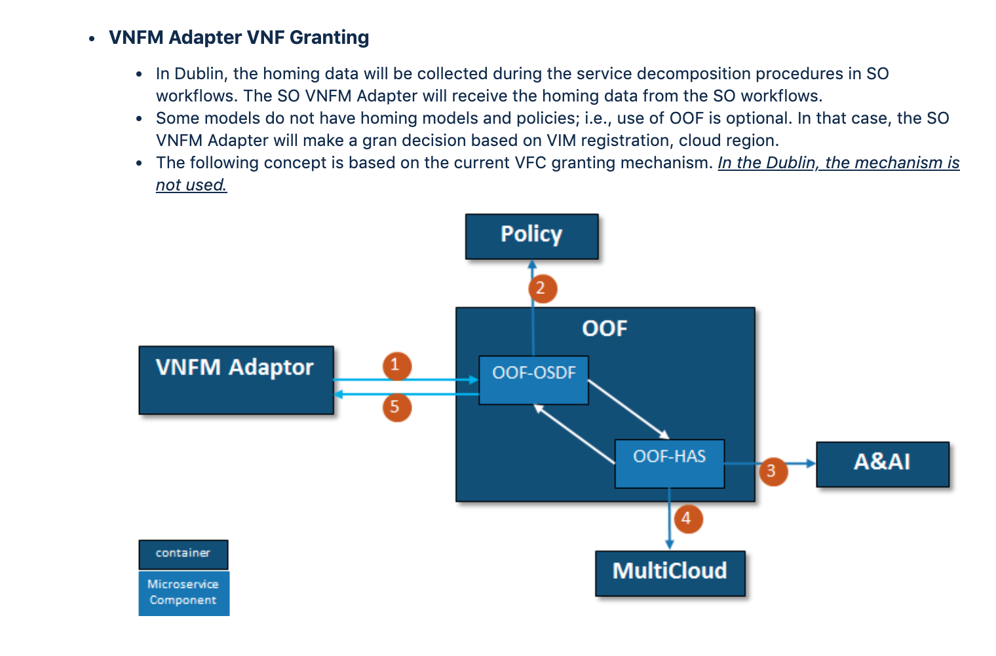
OOF-based Granting (HPA Support)
During SO decompose, SO calls OOF for collecting homing information for the service.
VNFM Adapter - OOF
          VNFM Adapter sends out homing requests to OOF (OSDF) containing resource info
          OOF (OSDF) pulls all the related homing constraints from Policy
          OOF (HAS) checks AAI database to pull region (flavor) information
          OOF (HAS) communicates with Multi-Cloud to check cloud capacity (vims which fulfill the requirements)
          OOF (OSDF) returns homing allocation solution to VNFM Adapter
            OOF collects information as following:
            Service and Resource Info, from: AAI
            HPA Flavors/Capabilities/Capacity Info, from: AAI
            Policy Models (Homing, PCI) from: Policy
            Infrastructure Metrics Info (capacity), from: MultiCloud
            Cloud Agnostic Intent Info, from: MultiCloud
            PCI configuration data (not yet a part of SDC model)

Slide 12
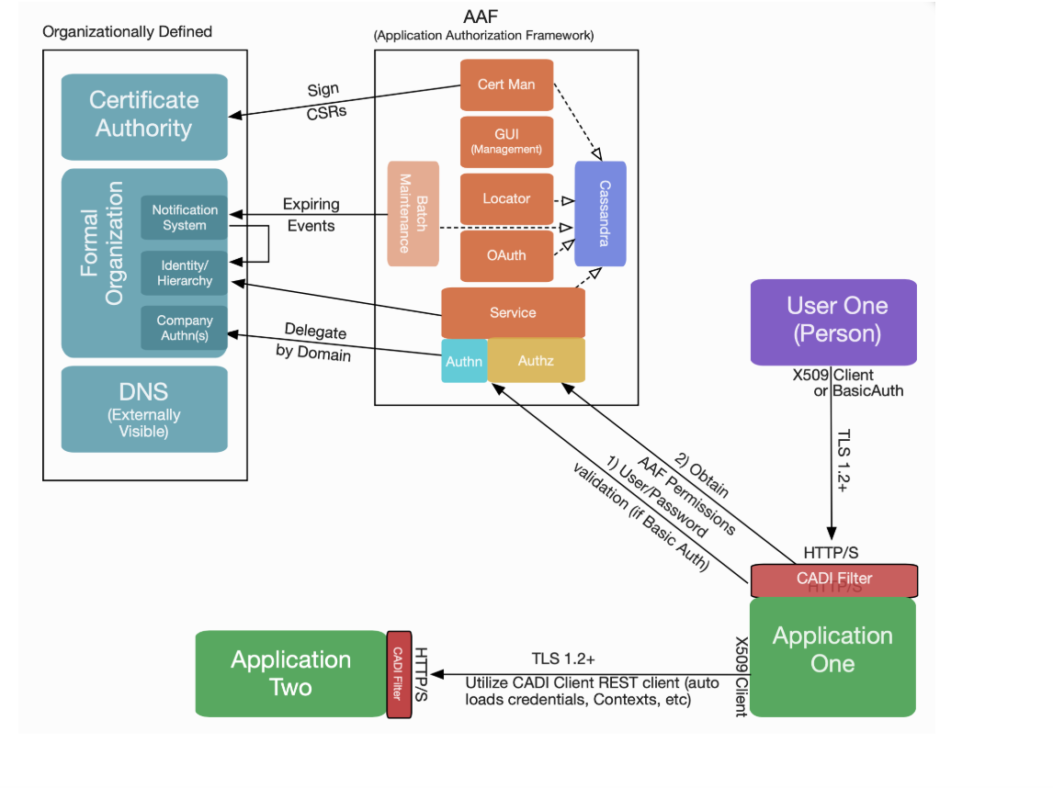
Authentication and Authorization
Leverage AAF for authentication and authorization to secure communications among ONAP components and SVNFM and external NFVO (App-to-App AA). The following is input from AT&T. More to discuss…
  OAuth2 is not yet used in ONAP. Start with HTTP Basic Authentication with HTTPS
  Update an application pom file and add properties; i.e., no application code changes?
    Remove Spring Security as well, as we cannot have both in place
  There is no need to use the CADI Rest Client at all
  The CADI filter can be configured to handle authorization; that is the method AT&T uses, or the application can enforce the authorization. It supports basic URI matching semantics
  Generate certificates by AAF for HTTPS is the current gap.
Authentication and Authorization on SOL003 and SOL005 APIs need to be supported.
  HTTP Basic Authentication + TLS
  OAuth2
  Two-way TLS
How does ONAP support vendor-specific SVNFM security (authentication/authorization)? It is under discussion.
  Security between SOL003/SOL005 and SVNFM/NFVO
  Each SVNFM can use their own security mechanism; i.e., non-AAF based
Note:
Communications between SOL003/SOL005 Adapter and SVNFM/NFVO must be secured through HTTPS
SOL002 Adapter is facing the similar security requirements.
Which AA will be used?
SVNFM/
NFVO
SOL003/SOL005
Adapter

Slide 13
Open Issues
Storing the original vendor VNF package with certificate and signature?
Mapping between SOL001 VNFD to SDC AID DM, including ScalingAspect+Delta and VF-Module - Not all VNFD needs to be transformed to the SDC AID DM
Deployment location of SOL003 Adapter
How does ONAP support vendor-specific SVNFM security (authentication/authorization)?
SOL007 (NS package) support is under discussion
Certificate generation and distribution by AAF
SOL005 Adapter requirements for the ETSI Catalog Manager
Where (SOL003 Adapter, or SO NFVO) do we support VNF software image transfer to VIM?

Slide 14
References
SO Plug-in Support for VNFM (SO VNFM Adapter), https://wiki.onap.org/pages/viewpage.action?pageId=48529911
SO VNFM Adapter APIs, https://wiki.onap.org/display/DW/SO+VNFM+Adapter+APIs
SO VNFM Adapter Test Case, https://wiki.onap.org/display/DW/SO+VNFM+Adapter+Test+Case
SO VNFM Adapter Feature Candidates for Frankfurt, https://wiki.onap.org/display/DW/SO+VNFM+Adapter+Feature+Candidates+for+Frankfurt
SO ETSI Catalog DB handling for NS and VNF/PNF packages, https://wiki.onap.org/pages/viewpage.action?pageId=63996543

Slide 15
Thank you!

