Slide 1
PNF Onboarding
& PNFD Translation
Ericsson
2019-01-28

Slide 2
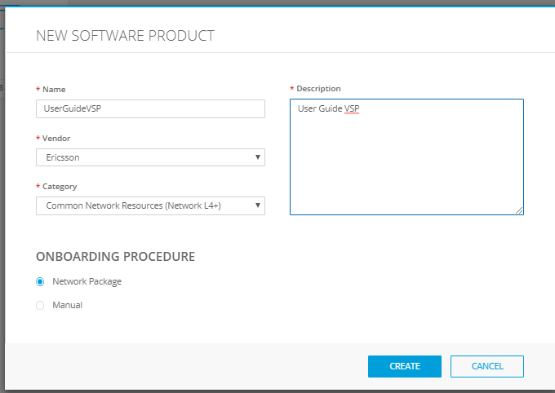
R3 VNF Onboarding using Package
VNF onboarding can be performed with very little manual input by using a vendor VNF Package.
Only properties that cannot be specified by vendor need to be entered by hand
  Category/subcategory, which are SDC-specific UI properties
  License information not yet standardized by ETSI
Example from SDC UI
Notes:
Ref: https://wiki.onap.org/display/DW/Onboarding+Services+into+SDC+and+Instantiating+through+VID
Ref: https://wiki.onap.org/display/DW/Resource+Onboarding
Ref: https://wiki.onap.org/pages/viewpage.action?pageId=1018618

Slide 3
R3 VNF Onboarding using Package – Detailed Steps
Define the VSP (Vendor Software Product)
  The VSP in SDC corresponds to the VNFD in ETSI NFV
  Provide name and description
  Select existing licensing model & category/subcategory
    This is ONAP-specific and not included yet in any ETSI NFV specification
  Choose onboarding procedure using Network package
    Other choice is manual onboarding
Upload the vendor VNF package into the VSP definition
  Most of the VF properties in the ONAP DM should be imported directly from the vendor VNFD
  Onboarding artifacts are imported from the package for distribution by SDC
Notes:
Ref: https://wiki.onap.org/display/DW/Onboarding+Services+into+SDC+and+Instantiating+through+VID
Ref: https://wiki.onap.org/display/DW/Resource+Onboarding
Ref: https://wiki.onap.org/pages/viewpage.action?pageId=1018618

Slide 4
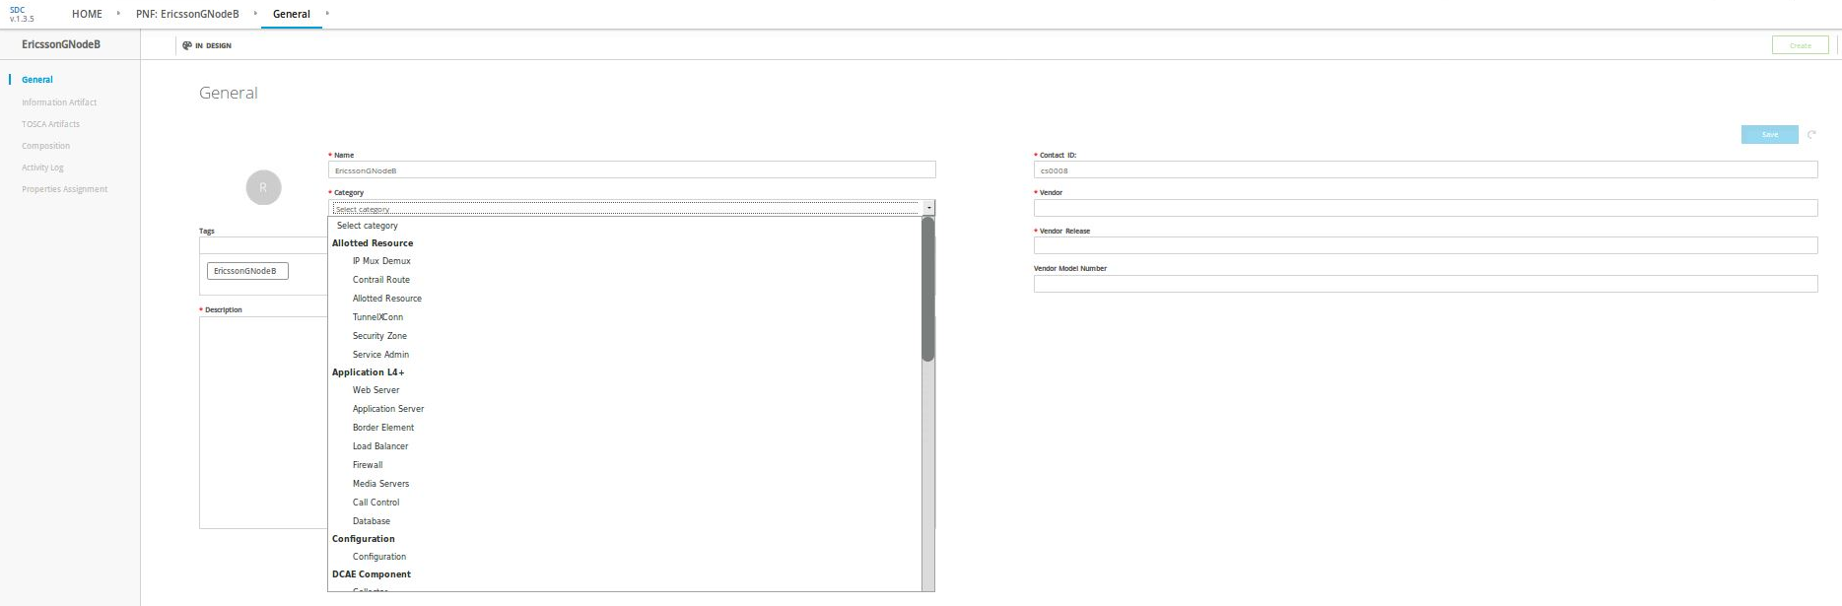
R3 PNF Onboarding – Manual Definition
For PNF onboarding in R3, all information needs to be added manually.
  Ex. PNFD properties need to be copied manually from vendor CPI
  Ex. Artifact files need to be imported manually
Example from SDC UI
In R4 the same onboarding procedure should be used for both PNFs and VNFs!

Slide 5
R3 PNF Onboarding – Detailed Steps
Define the PNF resource
…
Notes:
Ref: https://wiki.onap.org/display/DW/5G+-+PNF+PnP+-+Integration+Test+Cases

Slide 6



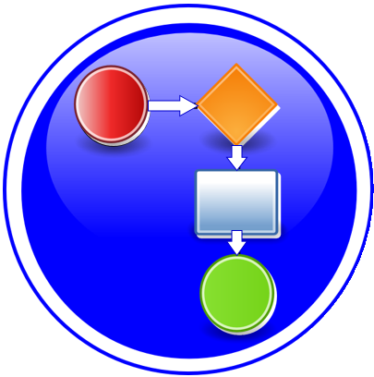
ETSI PNF Descriptor → ONAP Platform Data Model
PNFD DESCRIPTOR
PLATFORM MODEL (INTERNAL MODEL)
PNF
TOSCA Root
Node
Properties:
NODE
Service
1
1
DependsOn
Ns Virtual
Link
N
N
Connection
Point
PNF
Device
1
1
Network
Function
Virtual
Link
VirtualLinkable
Ports / NICs
Connectivity
PnfExtCp
NODE
NF
Component
LEGEND:
Complex
VirtualLinkable
Capabilities
Requirements

Slide 7
Current ETSI PNFD in SOL001
Name | Required | Type | Constraints | Description | Comments
descriptor_id | yes | string | GUID | Identifier of this PNFD information element. It uniquely identifies the PNFD. The format will be defined in the data model specification phase. | Not possible for the vendor to guarantee their value is unique within SDC
function_description | yes | string |  | Describes the PNF function. | OK to use within SDC
provider | yes | string |  | Identifies the provider of the PNFD. | OK to use within SDC
version | yes | string |  | Identifies the version of the PNFD. | OK to use within SDC
descriptor_invariant_id | yes | string | GUID | Identifier of this PNFD in a version independent manner. This attribute is invariant across versions of PNFD. | Not possible for the vendor to guarantee their value is unique within SDC
name | yes | string |  | Name to identify the PNFD. | OK to use within SDC
geographical_location_info | no | tosca.datatype.nfv.LocationInfo |  | Provides information about the geographical location (e.g. geographic coordinates or address of the building, ...) of the PNF. | Not required by ETSI. Not expected to be specified in vendor PNFD. Should be OK to omit from SDC in R4, revisit in a later release.

Slide 8
Current ETSI SOL001 LocationInfo datatypes
tosca.datatypes.nfv.LocationInfo: geographical information on the location where a PNF is deployed
Name | Required | Type | Constraints | Description
country_code | yes | string |  | Shall be a two-letter ISO 3166 [10] country code in capital letters.
civic_address_element | no | list of tosca.datatypes.nfv.CivicAddressElement |  | Elements composing the civic address where the PNF is deployed.
tosca.datatypes.nfv.CivicAddressElement: an element of a civic location as specified in IETF
Name | Required | Type | Constraints | Description
ca_type | yes | string |  | Describe the content type of caValue. The value of caType shall comply with Section 3.4 of IETF RFC 4776 [11]. → A one-octet descriptor of the data civic address value. (NB: enum, see below)
ca_value | yes | string |  | Content of civic address element corresponding to the caType. The format caValue shall comply with section 3.4 of IETF RFC 4776 [11] → The civic address value, as described in detail in IETF RFC 4776.

Slide 9
IETF RFC 4776 definition of CAtype
This document specifies a Dynamic Host Configuration Protocol (DHCPv4 and DHCPv6) option containing the civic location of the client or the DHCP server.
  Civic information is useful since it often provides additional, human-usable information, particularly within buildings.
CAtype | label/ NENA/PIDF | description | examples
1 | A1 | national subdivisions (state, canton, region, province, prefecture)
2 | A2 | county, parish, gun (JP), district (IN)
3 | A3 | city, township, shi (JP)
4 | A4 | city division, borough, city district, ward, chou (JP)
5 | A5 | neighborhood, block
6 | A6 | group of streets below the neighborhood level
16 | PRD | leading street direction | N
17 | POD | trailing street suffix | SW
18 | STS | street suffix or type | Ave, Platz
19 | HNO | house number | 123
20 | HNS | house number suffix | A, 1/2
21 | LMK | landmark or vanity address | Columbia University
22 | LOC | additional location information | South Wing
23 | NAM | name (residence and office occupant) | Joe’s Barbershop
24 | ZIP/PC | postal/zip code | 10027-1234
25 |  | building (structure) | Low Library
CAtype | label/ NENA/PIDF | description | examples
26 |  | unit (apartment, suite) | Apt 42
27 | FLR | floor | 4
28 |  | room | 450F
29 |  | type of place | office
30 | PCN | postal community name | Leonia
31 |  | post office box (P.O. Box) | 12345
32 |  | additional code | 13203000003
33 | SEAT | seat (desk, cubicle, workstation) | WS 181
34 |  | primary road name | Broadway
35 |  | road section | 14
36 |  | branch road name | Lane 7
37 |  | sub-branch road name | Alley 8
38 |  | street name pre-modifier | Old
39 |  | street name post-modifier | Service
0 |  | language
128 |  | script | Latn
255 |  | reserved
“NENA” correspond to items from the National Emergency Number Assocation, "NENA Recommended Formats and Protocols For ALI Data Exchange, ALI Response and GIS Mapping", NENA NENA-02-010, January 2002.
“PIDF” indicates the element name from Peterson, J., "A Presence-based GEOPRIV Location Object Format", RFC 4119, December 2005.

Slide 10
Current AAI Complex datatype
Description: Collection of physical locations that can house cloud-regions.
Name | Required | Type | Constraints | Description
physical-location-id | no | string | key | Unique identifier for physical location, e.g., CLLI
data-center-code | no | string |  | Data center code which can be an alternate way to identify a complex
complex-name | no | string |  | Gamma complex name for LCP instance.
identity-url | no | string |  | URL of the keystone identity service
resource-version | no | string |  | Used for optimistic concurrency. Must be empty on create, valid on update and delete.
physical-location-type | no | string |  | Type, e.g., central office, data center.
street1 | no | string
street2 | no | string
city | no | string
state | no | string
postal-code | no | string
country | no | string
region | no | string
latitude | no | string
longitude | no | string
elevation | no | string
lata | no | string
tns:ctag-pools
tns:relationship-list

Slide 11
ETSI SOL001 PNFD LocationInfo vs. AAI Complex (1/3)
ETSI SOL001 PNFD LocationInfo | description | AAI Complex | Handling
country_code | Shall be a two-letter ISO 3166 [10] country code in capital letters. | country | Convert from ISO 3166 code to string?
civic_address_element.ca_value, where ca_type=1 | national subdivisions (state, canton, region, province, prefecture) | state | Copy from PNFD
civic_address_element.ca_value, where ca_type=2 | county, parish, gun (JP), district (IN) | region | Copy from PNFD
civic_address_element.ca_value, where ca_type=3 | city, township, shi (JP) | city | Copy from PNFD
civic_address_element.ca_value, where ca_type=4 | city division, borough, city district, ward, chou (JP) | - | Add to AAI? Or include in ”city”?
civic_address_element.ca_value, where ca_type=5 | neighborhood, block | - | Add to AAI? Or include in ”city”?
civic_address_element.ca_value, where ca_type=6 | group of streets below the neighborhood level | - | Add to AAI? Or include in ”city”?
civic_address_element.ca_value, where ca_type=16 | leading street direction | street1/street2 | Need to define in which order to copy fields from PNFD
civic_address_element.ca_value, where ca_type=17 | trailing street suffix | street1/street2 | Need to define in which order to copy fields from PNFD
civic_address_element.ca_value, where ca_type=18 | street suffix or type | street1/street2 | Need to define in which order to copy fields from PNFD
civic_address_element.ca_value, where ca_type=19 | house number | street1/street2 | Need to define in which order to copy fields from PNFD
civic_address_element.ca_value, where ca_type=20 | house number suffix | street1/street2 | Need to define in which order to copy fields from PNFD
civic_address_element.ca_value, where ca_type=21 | landmark or vanity address | street1/street2 | Need to define in which order to copy fields from PNFD
civic_address_element.ca_value, where ca_type=22 | additional location information | - | ?
civic_address_element.ca_value, where ca_type=23 | name (residence and office occupant) | - | New for PNFs, add to AAI?
civic_address_element.ca_value, where ca_type=24 | postal/zip code | postal-code | Copy from PNFD
civic_address_element.ca_value, where ca_type=25 | building (structure) | street1/street2 | Need to define in which order to copy fields from PNFD

Slide 12
ETSI SOL001 PNFD LocationInfo vs. AAI Complex (2/3)
ETSI SOL001 PNFD LocationInfo | description | AAI Complex | Handling
civic_address_element.ca_value, where ca_type=26 | unit (apartment, suite) | - | New for PNFs, add to AAI?
civic_address_element.ca_value, where ca_type=27 | floor | - | New for PNFs, add to AAI?
civic_address_element.ca_value, where ca_type=28 | room | - | New for PNFs, add to AAI?
civic_address_element.ca_value, where ca_type=29 | type of place | physical-location-type | Copy from PNFD
civic_address_element.ca_value, where ca_type=30 | postal community name | - | Add to AAI? Or include in ”city”?
civic_address_element.ca_value, where ca_type=31 | post office box (P.O. Box) | - | ?
civic_address_element.ca_value, where ca_type=32 | additional code | - | ?
civic_address_element.ca_value, where ca_type=33 | seat (desk, cubicle, workstation) | - | New for PNFs, add to AAI?
civic_address_element.ca_value, where ca_type=34 | primary road name | street1/street2 | Need to define in which order to copy fields from PNFD
civic_address_element.ca_value, where ca_type=35 | road section | street1/street2 | Need to define in which order to copy fields from PNFD
civic_address_element.ca_value, where ca_type=36 | branch road name | street1/street2 | Need to define in which order to copy fields from PNFD
civic_address_element.ca_value, where ca_type=37 | sub-branch road name | street1/street2 | Need to define in which order to copy fields from PNFD
civic_address_element.ca_value, where ca_type=38 | street name pre-modifier | street1/street2 | Need to define in which order to copy fields from PNFD
civic_address_element.ca_value, where ca_type=39 | street name post-modifier | street1/street2 | Need to define in which order to copy fields from PNFD
civic_address_element.ca_value, where ca_type=0 | language | N/A | How does AAI support multiple languages?
civic_address_element.ca_value, where ca_type=128 | script | N/A | How does AAI support multiple scripts?
civic_address_element.ca_value, where ca_type=255 | reserved | N/A

Slide 13
ETSI SOL001 PNFD LocationInfo vs. AAI Complex (3/3)
ETSI SOL001 PNFD LocationInfo | AAI Complex | description | Handling
- | physical-location-id | Unique identifier for physical location, e.g., CLLI | Generate witin ONAP
- | data-center-code | Data center code which can be an alternate way to identify a complex | ?
- | complex-name | Gamma complex name for LCP instance. | ?
- | identity-url | URL of the keystone identity service | ?
- | resource-version | Used for optimistic concurrency. Must be empty on create, valid on update and delete. | Generate witin ONAP
- | latitude |  | Geospatial coordinates not included in ETSI PNFD, needs to be added? (See RFC3825)
- | longitude |  | Geospatial coordinates not included in ETSI PNFD, needs to be added? (See RFC3825)
- | elevation |  | Geospatial coordinates not included in ETSI PNFD, needs to be added? (See RFC3825)
- | lata | Local access and transport area | Specific to USA (Canadian equivalent is Local interconnection region, LIR. Unclear what equivalents exist in other countries/areas.)

Slide 14
ONAP R3 SDC AID data model: PNF org.openecomp.resource.abstract.nodes.PNF, derived_from: tosca.nodes.Root
Name | Required | Type | Description | Specified in | Value currently set by
invariantUUID | Yes | string | Constant identifier of the resource model. Ex.: AA97B177-9383-4934-8543-0F91A7A02836 | SDC DM, Node Type Metadata | SDC sets at resource creation
uuid | Yes | string | Versioned identifier of the resource model (this uuid is changed for every major version of the resource) Ex.: b8ff69ca-786d-479e-9f9c-217a90ee0ebc | SDC DM, Node Type Metadata | SDC sets at resource creation
customizationUUID | Yes | string | Identifier of the resource instance (uuid of the specific use of the resource model in this service). This identifier is regenerated whenever a user makes a change on the resource instance. Ex.: 38e5fb81-5e8c-479b-9140-38786db19967 | SDC DM, Node Type Metadata | SDC sets at resource creation
version | Yes | string | The resource version in SDC catalog. Two digit blocks separated by a dot (“.”). Ex. : “2.0” | SDC DM, Node Type Metadata | SDC sets at resource creation
type | Yes | string (enum) | The type of resource. Resource type can be either VF, VFC, VFCMT, CP or VL. Ex. “VF” | SDC DM, Node Type Metadata | SDC sets at resource creation (enum hardcoded)
name | Yes | string | The name of the resource. Ex. “vMME” | SDC DM, Node Type Metadata | Using SDC UI, at PNF resource def.
description | Yes | string | Description of the resource | SDC DM, Node Type Metadata | Using SDC UI, at PNF resource def.
resourceVendor | Yes | string | String value that specifies the vendor providing this asset | SDC DM, Node Type Metadata | Using SDC UI, at PNF resource def.
resourceVendorRelease | Yes | string | String value that specifies the release version given by the vendor (no exact correlation to the version of the asset in the SDC catalog) | SDC DM, Node Type Metadata | Using SDC UI, at PNF resource def.
resourceVendorModelNumber | No | string | The value for this field is the part number defined by the vendor, e.g. “MX960” | SDC DM, Node Type Metadata | Using SDC UI, at PNF resource def.
category | Yes | string (enum) | Category of the resource. Ex. “Application L4+” | SDC DM, Node Type Metadata | Using SDC UI, at PNF resource def. (enum also managed in SDC UI)
subcategory | Yes | string (enum) | Sub-category of the resource. Ex. “Load Balancer” | SDC DM, Node Type Metadata | Using SDC UI, at PNF resource def. (enum also managed in SDC UI)
nf_function | No | string | String property defining a generic type (like category) of the PNF. | PNF node type and VF | Using SDC UI, at service definition
nf_role | No | string | String property for short code that defines a Network function that the Vendor Software or PNF is providing. E.g. vCE, vARM | PNF node type and VF | Using SDC UI, at service definition
nf_type | No | string | String property that provides English description of the functionality of the PNF in the Service context | PNF node type and VF | Using SDC UI, at service definition
software_versions | No | list of string | ? | PNF node type (but not in the AIM Word doc!) | Using SDC UI, at service definition
Notes:
Ref: https://wiki.onap.org/display/DW/ONAP+SDC+AID+Data+Model

Slide 15
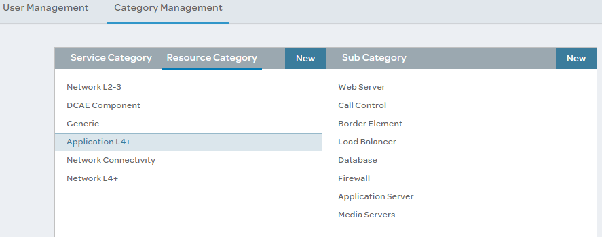
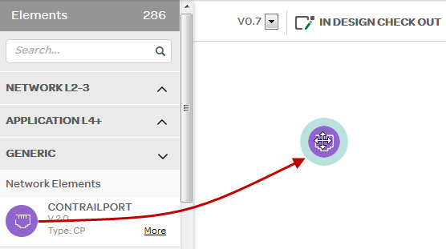
ONAP R3 SDC AID data model:
Resource Category/Subcategory
Resource category & subcategory are local to SDC and managed through SDC UI
  Used as grouping for resources in several places in SDC UI
  Default values hardcoded, see: https://wiki.onap.org/display/DW/Categories+to+use+in+SDC+project
Category | Sub Category
Network L2-3 | LAN Connectors WAN Connectors Router Gateway Infrastructure
Network L4+ | Common Network Resources
Application L4+ | Border Element Database Application Server Web Server Call Control Media Servers Load Balancer Firewall
Generic | Infrastructure Database Abstract Rules Network Elements
Network Connectivity | Connection Points Virtual Links
DCAE Component | Analytics Policy Utility Collector Source Microservice Database
Template | Monitoring Template
Allotted Resource | Tunnel XConnect IP Mux Demux Allotted Resource Security Zone Contrail Route Service Admin
Notes:
Ref: https://wiki.onap.org/display/DW/ONAP+SDC+AID+Data+Model
Ref: https://wiki.onap.org/display/DW/Composition+%28Service+design%29+tab

Slide 16
Mapping: SOL001 PNFD vs. ONAP R3 SDC AID DM PNF
Current PNFD, SOL001 | Current PNF, AID DM | Handling
descriptor_id | uuid | Needs to be generated by SDC to be unique
version | resourceVendorRelease | ??? (Not really equivalent)
provider | resourceVendor | Can be copied from PNFD
name | name | Can be copied from PNFD
function_description | description | Can be copied from PNFD
descriptor_invariant_id | invariantUUID | Needs to be generated by SDC to be unique
geographical_location_info | - | Add to SDC DM?
- | nf_function | Specified as part of service def → not from vendor PNFD
- | nf_role | Specified as part of service def → not from vendor PNFD
- | nf_type | Specified as part of service def → not from vendor PNFD
- | software_versions | Specified as part of service def → not from vendor PNFD
- | customizationUUID | ID of resource instance, set internally by SDC → not from vendor PNFD
- | version | Resource version in SDC catalog, set internally by SDC → not from vendor PNFD
- | type | Hardcoded to PNF based on TOSCA node type in PNFD
- | category | Local to SDC UI, needs to be entered in SDC
- | subcategory | Local to SDC UI, needs to be entered in SDC
- | resourceVendorModelNumber | Add to SOL001?

Slide 17
Mapping: SOL001 PNFD vs. TPDM PNFD
Current PNFD, SOL001 | Current PNFD, TPDM (onap.datatypes.ProviderDetails) | Handling
descriptor_id | descriptor_id | Can be copied from PNFD
version | descriptor_version | Can be copied from PNFD
provider | provider | Can be copied from PNFD
name | product_name | Can be copied from PNFD
function_description | product_info_description | Can be copied from PNFD
descriptor_invariant_id | product_invariant_id | Can be copied from PNFD
geographical_location_info | - | Add to TPDM?
- | software_version | Add to SOL001?
- | product_info_name | Add to SOL001? (How is this used?)

Slide 18
Mapping: ONAP R3 SDC AID DM PNF vs. TPDM NetworkFunction
Current PNF, SDC AID DM | Current PNF, TPDM (onap.nodes.NetworkFunction) | Handling
uuid | provider_details.descriptor_id AND/OR catalog_info.uuid | Duplicated
resourceVendorRelease | provider_details.descriptor_version | Not really equivalent?
resourceVendor | provider_details.provider | Direct copy
name | provider_details.product_name | Direct copy
description | provider_details.product_info_description | Direct copy
invariantUUID | provider_details.product_invariant_id AND/OR catalog_info. invariant_uuid | Duplicated
nf_function | - | Properties within service → assumed not in NF
nf_role | - | Properties within service → assumed not in NF
nf_type | - | Properties within service → assumed not in NF
software_versions | provider_details.software_version | Properties within service → mismatch
- | provider_details.product_info_name | Not present in SDC → How is this used?
customizationUUID | catalog_info.customization_uuid | Direct copy
version | catalog_info.version | Direct copy
type | - | Hardcoded to PNF? → Implicit in node type(?)
category | - | Missing from TPDM?
subcategory | - | Missing from TPDM?
resourceVendorModelNumber | - | Missing from TPDM?
Notes:
Ref: https://wiki.onap.org/display/DW/Target+Internal+DM+Reference

Slide 20
AAI Complex datatype (raw info)
<xs:element name="complex">
<xs:complexType>
<xs:annotation>
<xs:appinfo>
<annox:annotate target="class">@org.onap.aai.annotations.Metadata(description="Collection of physical locations that can house cloud-regions.",indexedProps="identity-url,data-center-code,complex-name,physical-location-id",searchable="physical-location-id,data-center-code,complex-name,street1,street2,postal-code",uniqueProps="physical-location-id",container="complexes",namespace="cloud-infrastructure",uriTemplate="/cloud-infrastructure/complexes/complex/{physical-location-id}",requiredProps="physical-location-id,physical-location-type,street1,city,postal-code,country,region")</annox:annotate>
</xs:appinfo>
</xs:annotation>
<xs:sequence>
<xs:element name="physical-location-id" type="xs:string" minOccurs="0">
<xs:annotation>
<xs:appinfo>
<annox:annotate target="field">@org.onap.aai.annotations.Metadata(isKey=true,description="Unique identifier for physical location, e.g., CLLI")</annox:annotate>
</xs:appinfo>
</xs:annotation>
</xs:element>
<xs:element name="data-center-code" type="xs:string" minOccurs="0">
<xs:annotation>
<xs:appinfo>
<annox:annotate target="field">@org.onap.aai.annotations.Metadata(description="Data center code which can be an alternate way to identify a complex")</annox:annotate>
</xs:appinfo>
</xs:annotation>
</xs:element>
<xs:element name="complex-name" type="xs:string" minOccurs="0">
<xs:annotation>
<xs:appinfo>
<annox:annotate target="field">@org.onap.aai.annotations.Metadata(description="Gamma complex name for LCP instance.")</annox:annotate>
</xs:appinfo>
</xs:annotation>
</xs:element>
<xs:element name="identity-url" type="xs:string" minOccurs="0">
<xs:annotation>
<xs:appinfo>
<annox:annotate target="field">@org.onap.aai.annotations.Metadata(description="URL of the keystone identity service")</annox:annotate>
</xs:appinfo>
</xs:annotation>
</xs:element>
<xs:element name="resource-version" type="xs:string" minOccurs="0">
<xs:annotation>
<xs:appinfo>
<annox:annotate target="field">@org.onap.aai.annotations.Metadata(description="Used for optimistic concurrency. Must be empty on create, valid on update and delete.")</annox:annotate>
</xs:appinfo>
</xs:annotation>
</xs:element>
<xs:element name="physical-location-type" type="xs:string" minOccurs="0">
<xs:annotation>
<xs:appinfo>
<annox:annotate target="field">@org.onap.aai.annotations.Metadata(description="Type, e.g., central office, data center.")</annox:annotate>
</xs:appinfo>
</xs:annotation>
</xs:element>
<xs:element name="street1" type="xs:string" minOccurs="0"/>
<xs:element name="street2" type="xs:string" minOccurs="0"/>
<xs:element name="city" type="xs:string" minOccurs="0"/>
<xs:element name="state" type="xs:string" minOccurs="0"/>
<xs:element name="postal-code" type="xs:string" minOccurs="0"/>
<xs:element name="country" type="xs:string" minOccurs="0"/>
<xs:element name="region" type="xs:string" minOccurs="0"/>
<xs:element name="latitude" type="xs:string" minOccurs="0"/>
<xs:element name="longitude" type="xs:string" minOccurs="0"/>
<xs:element name="elevation" type="xs:string" minOccurs="0"/>
<xs:element name="lata" type="xs:string" minOccurs="0"/>
<xs:element ref="tns:ctag-pools" minOccurs="0"/>
<xs:element ref="tns:relationship-list" minOccurs="0"/>
</xs:sequence>
</xs:complexType>
</xs:element>

Slide 21
AAI Complex example values (raw info)
AAI Complex:
"physical-location-id": "clli2",
"data-center-code": "example-data-center-code-val-6667",
"complex-name": "clli2",
"identity-url": "example-identity-url-val-28399",
"physical-location-type": "example-physical-location-type-val-28399",
"street1": "example-street1-700MountainAvenue",
"street2": "example-street2-GlenSideRoad",
"city": "example-city-MurrayHill",
"state": "example-state-NewJersey",
"postal-code": "example-postal-code-07974",
"country": "example-country-UnitedStates",
"region": "example-region-val-28399",
"latitude": "111.1",
"longitude": "234.2",
"elevation": "example-elevation-538feet",
"lata": "example-lata-val-28399"

Slide 22
onap.datatypes.ProviderDetails (from TPDM)
onap.datatypes.ProviderDetails:
description: |
Information provided in the onboarding model which is static and the same for every instance created from the descriptor's internal model.
derived_from: tosca.datatypes.Root
properties:
descriptor_id:
type: string # GUID
description: Globally unique identifier of the descriptor
descriptor_version:
type: string
description: Identifies the version of the descriptor
provider:
type: string
description: Provider of the asset and its descriptor
product_invariant_id:
type: string # UUID
description: a universally unique identifier that is the same across all versions of the descriptor for this asset
product_name:
type: string
description: Short name for the Product
software_version:
type: string
description: Software version of the asset
required: false
product_info_name:
type: string
description: Human readable name for the Product
required: false
product_info_description:
type: string
description: Human readable description of the Product
required: false
Notes:
Ref: https://wiki.onap.org/display/DW/TIDM+onap.datatypes.ProviderInfo

Slide 23
Example PNFD generated by SDC
tosca_definitions_version: tosca_simple_yaml_1_1
metadata:
invariantUUID: 999c43a1-23eb-46f0-9945-4666f27eeaf3
UUID: ec336fb8-f6c3-4de0-99ad-ea72c5702803
name: test
description:
type: PNF
category: Application L4+
subcategory: Application Server
resourceVendor: '123445'
resourceVendorRelease: '12344'
resourceVendorModelNumber: ''
imports:
- nodes:
file: nodes.yml #Mix of TOSCA normative types and OPEN ECOM types
- datatypes:
file: data.yml
- capabilities:
file: capabilities.yml
- relationships:
file: relationships.yml
- groups:
file: groups.yml
- policies:
file: policies.yml
topology_template:
inputs:
nf_function:
type: string
nf_role:
type: string
nf_type:
type: string
node_templates:
substitution_mappings:
node_type: org.openecomp.resource.abstract.nodes.PNF
pnf_test:
type: org.openecomp.resource.abstract.nodes.PNF
metadata:
invariantUUID: 999c43a1-23eb-46f0-9945-4666f27eeaf3
UUID: ec336fb8-f6c3-4de0-99ad-ea72c5702803
customizationUUID: 710fa64a-ef68-47b6-947d-7a4acb8a1093
version: '0.2'
name: test
description:
type: PNF
category: Application L4+
subcategory: Application Server
resourceVendor: '123445'
resourceVendorRelease: '12344'
resourceVendorModelNumber: ''
properties:
nf_function: { get_input: nf_function }
nf_role: { get_input: nf_role }
nf_type: { get_input: nf_type }
software_versions:
- abc
- def
Notes:
Credit to Steve B. (Chapter 8 of ”Basic Onap Descriptor for PNF” study)

