Slide 1
Driving Superior Isolation for Tiered Services

Slide 2
Driving Superior Isolation using Resource Reservation
Driving Superior Isolation for Tiered Services using Resource Pool Minimum Guarantee
Upstream OpenStack with KVM
VMware Integrated OpenStack (VIO) with VMware ESXi
Resource Pools per Tenants Reference [1]:
Unallocated Resource; used for backward compatibility
Total Resource
Quotas define maximum, but doesn’t guarantee availability
Resource Pool guarantees resource availability
“Noisy Neighbor” impacts performance as no isolation
Strong isolation differentiates tiered services
Sub-optimal capacity planning as tenant’s growth plan unknown
Optimal capacity planning as each tenant sizes individual Resource Pool for projected growth
Reference [1]: Multi-Cloud Object Hierarchy & Capability Information Model: https://docs.google.com/document/d/1iOb8SymGoK7U6N5ZcYtrIPh_LaJMW_UHYdFWe7UOBNk/edit#

Slide 3
Residential vCPE Example

Slide 4
Applying Resource Pools for Residential vCPE Service
Exemplary Tiered Residential vCPE Services
  Gold – “Residential Broadband with Parental Control” - Enforce higher min guarantee under traffic bursts using Resource Reservation
  Silver – “Residential Broadband” - Enforce lower min guarantee under traffic bursts using Resource Reservation
HW Capacity | vCPU | Mem (GB)
Resource Cluster 1 [Upstream OpenStack and VIO Terminology: Host Aggregate] | 1000 | 2000
Resource Cluster Group 1 (maps to Resource Cluster 1) [Upstream OpenStack and VIO Terminology: Set of Host Aggregates] | 1000 | 2000
Object Configuration
Tenant 1 [Upstream OpenStack and VIO Terminology: Project]
Note: For a given resource, sum of Minimum Guarantees cannot exceed physical capacity
Object Configuration | Assoc. | Service | Min Guarantee vCPU | Min Guarantee Mem (GB) | Max vCPU | Max Mem (GB)
Resource Slice 1 [VIO Terminology: Tenant Virtual Data Centers (vDC), Upstream OpenStack Terminology (Project - referring to resource management attributes such as Quota or Resource Pool – work in progress)] | Tenant 1 | Gold | 700 | 1300 | 1000 | 2000
Resource Slice 2 | Tenant 1 | Silver | 300 | 700 | 1000 | 2000

Slide 5
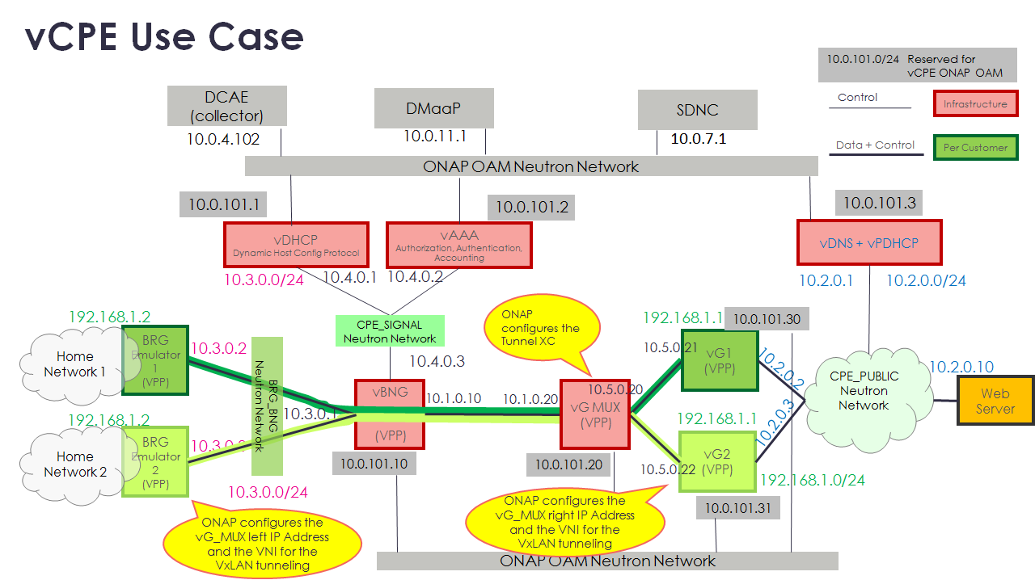
Residential vCPE ONAP Example (1)
Cloud Region Capabilities used by ONAP OF
Min Guarantee Capability - Min, Max per resource (CPU, Memory) for Resource Pool and VM
Constraints used by OF
VBNG location is fixed based on subscriber
VG MUX to VBNG Data Center connectivity latency cannot exceed certain value
Optimization Policies (in prioritized order) used by OF for per service VG VNF placement
Choose Cloud Region based on the above constraints
Prefer Cloud Region with Min Guarantee Capability for Gold Service
Prefer Cloud Region with least average/peak utilization at a Cloud Region, Tenant and Resource Pool (if Cloud Region has min guarantee capability) level
Source: ONAP R1 vCPE use case – Illustrative sequence diagrams (https://wiki.onap.org/display/DW/Residential+Broadband+vCPE+Drafts+for+discussion?preview=%2F10783327%2F16005563%2FvCPE+Use+Case+-+Customer+Service+Instantiation+-+171103.pptx)

Slide 6
Residential vCPE ONAP Example (2)
ONAP OF<->Multi Cloud Work in Progress
  https://wiki.onap.org/display/DW/vCPE+Homing+Use+Case
  https://wiki.onap.org/display/DW/OOF+-+MultiCloud+interaction+in+R2
VMware VIO configuration for min guarantee
  Resource Pool
    https://docs.vmware.com/en/VMware-Integrated-OpenStack/4.1/com.vmware.openstack.admin.doc/GUID-D2C17D33-EC6C-4B8C-A9A3-25417917461F.html
  VM
    https://docs.openstack.org/nova/pike/admin/flavors.html

Slide 7
Enterprise Mobile vEPC Example (todo)

