Slide 1
ONAP Casablanca – Change Management Traffic Distribution
AT&T, Orange Poland
Ajay Mahimkar
Łukasz Rajewski
Tomasz Osiński

Slide 2
VNF Change Management
Coordinated change of software of existing VNF instance with LCM operations
Update
    Functionality is the same
    Bug Fixes, patches
    Security Issues
    Simple
Upgrade
    New functionality
    Significant improvements
    Migration of Configuration
    Complex
VNF Package Change
    New deployment models
    New decomposition
    + New software
    Very Complex
Change scenario depends on Change type and VNF type

Slide 3
ZDD VNF Change
VNF Change?
010010010011100100010100011001001
010010010011100100010100011001001
V1.0
V2.0
VNF Update
NFVO
VNFM
EMS
VNF Upgrade
ZDD?
Zero Downtime Deployment
Near-ZDD
Near - Zero Downtime Deployment

Slide 4
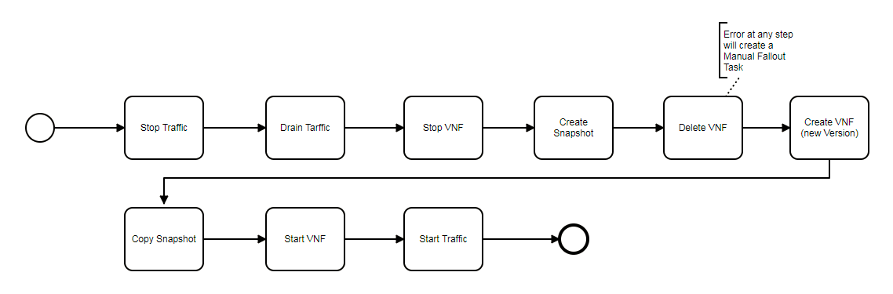
Change Management Workflows
Change process workflow
    Different operations that should be performed on VNF instance (new, old or modified)
    Operations must by executed in specified order – only then change can be successful
    Performed automatically in time of change that must be scheduled before
    Workflow can be different for each type of VNF and for different versions (v1.0 -> v2.0 != v1.0 -> v1.2 )
© ONAP Wiki 2018

Slide 5
Change Management – Beijing – In-System Software Upgrade
…
…
…
…
…
…
Upgrade Backup
UpgradePreCheck
Upgrade Software
UpgradePostCheck
Upgrade Backout
In-System Software Upgrade
Custom Upgrade WorkFlow

Slide 6
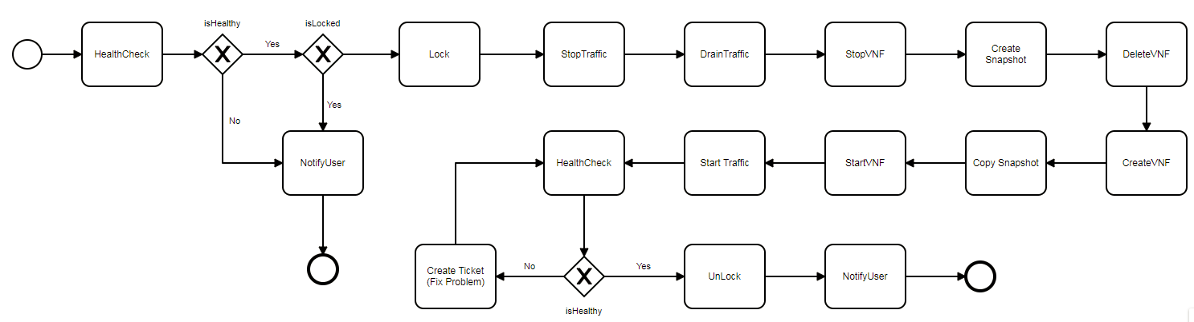
Change Management – Casablanca – Flexible Workflow Designer
NOT ONLY FOR UPGRADE
Design of WorkFlow in SDC
Distribution of WorkFlow to SO
Execution of WorkFlow by SO i.e.
  Update of A&AI
  Invoke LCM operation by Controller (StartVNF, StopTraffic, DistributeTraffic, etc…)
© ONAP Wiki 2018

Slide 7
Change Management – Casablanca – Beijing Extensions
Build and Replace VNF Upgrade Inspiration
      Create new VNF instance with upgraded software
      Copy relevant configuration from original VNF
      Migrate traffic to new VNF instance
      Delete old VNF instance
Traffic Migration LCM API
Flexible workflow design and orchestration
      CM workflow as a composition of building blocks
        Lock/unlock, health check, conflict check, etc.
      Orchestrate the workflow execution
      Re-use of building-blocks and provides flexibility to users to dynamically adapt their workflow
Simplified (time-based) scheduling of Workflow (OOF)
5G PNF Software Upgrade (In-place SW)
3
3
Traffic flow
2
VNF v1
VNF v2
Config
4
1

Slide 8
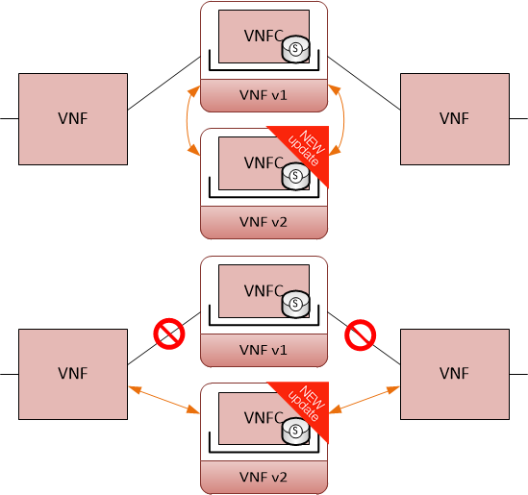
Traffic Distribution – Casablanca – Scenario
      Traffic Distribution
        New LCM Operation in ONAP
        Application Level – Beyond NFV MANO
        Traffic Distribution Patterns
      Other Cases
        ScaleOut - VNF is created
        ScaleIN - VNF is removed
        VNF Upgrade
        VNF Evacuation – VNF Failure
        Load Optimization

Slide 9
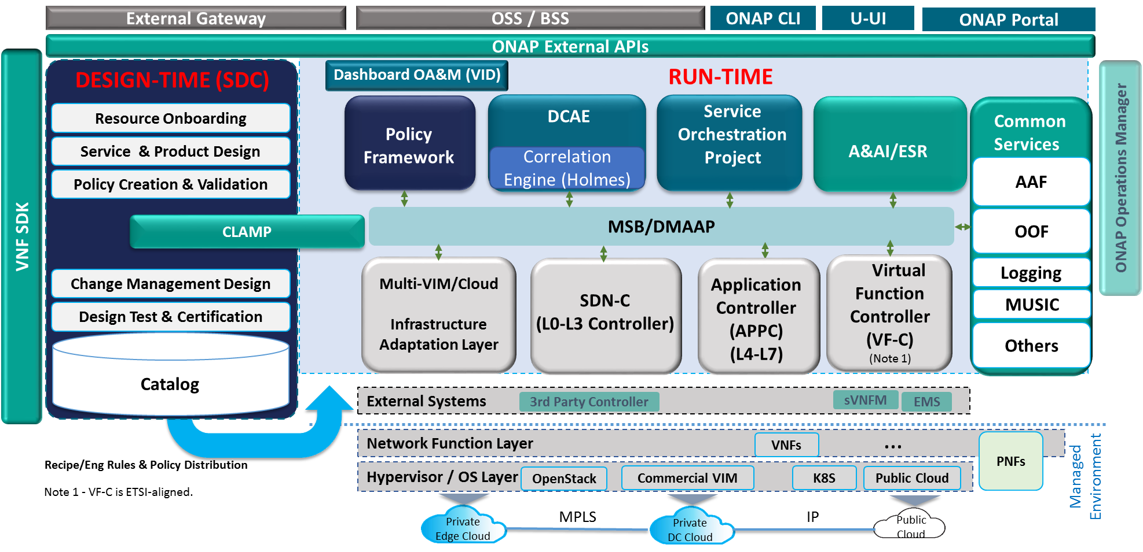
Traffic Distribution – Casablanca – Changes in ONAP
vFW TD
New API
New API
© ONAP Wiki 2018

Slide 10
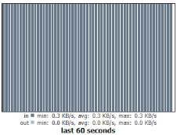
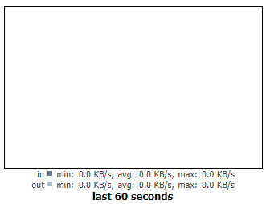

Traffic Distribution – Casablanca – vFW Use Case
TD
LCM
APP-C
ANSIBLE
FW 1
SINK 1
vFW TD Scenario
      Invoke DT LCM operation
      Execute Dedicated Ansible Playbook
      Change route with FW 2 gateway
      Reconfigure streams in VPP packet generator to destination SINK 2
      Restart VPP streams
PKG
192.168.10.100
192.168.20.250
FW 2
SINK 2
192.168.10.110
192.168.20.240

Slide 11
ONAP Dublin – Change Management Traffic Distribution Requirements v1.2
28.01.2019

Slide 12
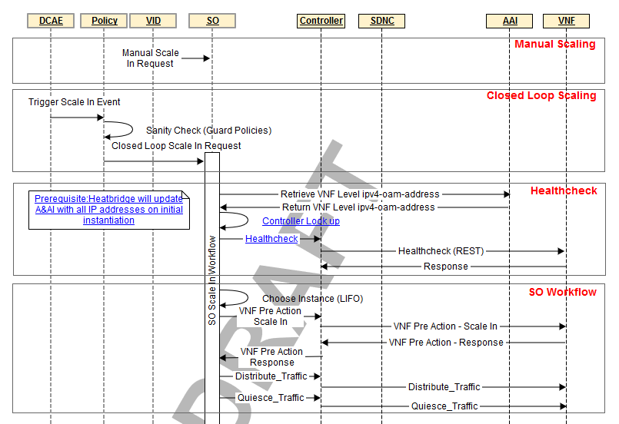
Traffic Distribution WorkFlow in ScaleIn use case context (1)
Traffic Distribution is part of Scale In workflow
In order to Scale In instance Traffic must be migrated before
Must be preceded by
    Selection of VF instance
    Selection of VF instance destinations
    Selection of anchor points
    Identification of distribution policy: distribution weights
    Gathering of necessary configuration input
© ONAP Wiki 2018

Slide 13
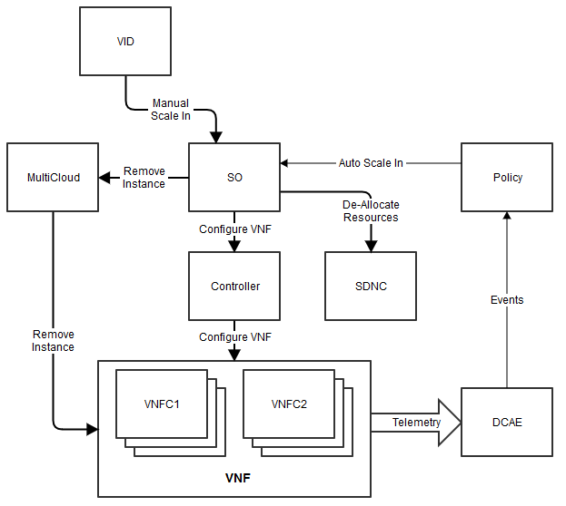
Distribution WorkFlow in ScaleIn use case context (2)
Scale In operation is triggered by policy or VID portal
SO coordinates whole process and executes necessary action of sub-flows
Traffic Distribution is an LCM action and is invoked by controller
OOF delivers input parameters for DT Action: Anchor, Destinations, Distribution Policy
Anchor point performs distribution of traffic. Examples:
      VNF(C) – sub-component or other VNF in service (Dublin)
      SDNC – network controller
      MultiCloud – e.g. LB, SCF, DNS on VIM level
OOF
Anchor, Destinations
SCALEOUT INTEGRATION ALSO POSSIBLE
3
2
1
© ONAP Wiki 2018

Slide 14
Anchor Point, Destination point and distribution policy
An anchor point is responsible for distribution of a traffic
A destination point is responsible for traffic handling
Rollback should be handled also by an anchor point
There is a need to remember a result of distribution: distribution policy, anchor point and distribution points: for a rollback purpose or for a future distributions
DNS 1
40%
DT Destination Point
PKG
LB
traffic
DT Anchor Point
DT LCM Req
DNS 2
60%

Slide 15
OOF (El Alto)
action-identifiers header
Algorithm for Traffic Distribution Workflow in OOF
  Traffic Distribution Optimization algorithm aims to deliver extra information for DistributeTraffic LCM in APPC – requires an access to some database (distribution history)
  Anchor Point – Firstly VF-module instance that will perform an operation of Traffic Distribution. In the future other methods
  Destination Point - VF-module instance(s) that will take a traffic
  A&AI delivers an information about existing VNF instances and VF instances, vnf-type for anchor point, and vnf-type for traffic distribution destination
  Policy delivers an information about traffic distribution policies
  Algorithm delivers an anchor point and list of destinations (format of action-identifiers for APPC LCM)
"action-identifiers": {
"vnf-id": "<VNF_ID>",
"vnfc-name": "<VNFC_NAME>",
"vserver-id": "VSERVER_ID"
}
SDC
distribute
service
A&AI
vnf-list, vf-instance-list
OOF
anchor point
SO
APPC
Ansible Server
anchor point vnf-type
destination vnf-type
DT LCM Req
TDO
destinations list
with weights
DT Check LCM Req
Policy
traffic distribution policies
A&AI

Slide 16
OOF (Dublin)
action-identifiers header
Algorithm for Traffic Distribution Workflow in OOF
  Traffic Distribution Optimization algorithm aims to deliver extra information for DistributeTraffic LCM in APPC – requires an access to some database (distribution history)
  Anchor Point – Firstly VF-module instance that will perform an operation of Traffic Distribution. In the future other methods
  Destination Point - VF-module instance(s) that will take a traffic
  A&AI delivers an information about existing VNF instances and VF instances
  (Stretch) Policy delivers an information about traffic distribution policies
  Algorithm delivers an anchor point and list of destinations (format of action-identifiers for APPC LCM)
  Priority is to build SO workflow – OOF algorithm can be simplified but must be present
"action-identifiers": {
"vnf-id": "<VNF_ID>",
"vnfc-name": "<VNFC_NAME>",
"vserver-id": "VSERVER_ID"
}
A&AI
vnf-list, vf-instance-list
OOF
anchor point
SO
APPC
Ansible Server
simplified
DT LCM Req
TDO
destinations list
with weights
DT Check LCM Req
anchor point vnf-type
destination vnf-type
(hardcoded, policy or from workflow input)
Policy
traffic distribution policies (stretch )
A&AI

Slide 17
SDC, A&AI, SO & Policy
SDC (Deferred for El Alto)
  An ability to define dt-anchor-point dt-destination-point on the level of VNF in Virtual Service composition (or in the other more convenient way)
Changes in A&AI (Deferred for El Alto)
  Change in the VNF model to introduce an dt-anchor-point capability to vnf of vf
  Change in the VNF model to introduce an dt-destination-point capability to vnf of vf
  Perhaps there is a need to hold pairs of (dt-anchor-point, dt-destination-point) to allow ScaleOut/In for any VNF in Virtual Service
Changes in SO
  New dedicated workflow for Traffic Distribution
  Integration with TDA algorithm from OOF
Changes in Policy (Stretch goal for Dublin)
  Dedicated policy for specification of traffic distribution weight, destination point selection and anchor point selection

Slide 18
APPC – Manual Ansible Server Configuration Today
Copy Playbook into Ansible Server
Copy Private Key File of VM(s)
Edit Inventory file adding VMs
Test Configuration of Ansible for new VMs
New step for VNF Instantiation, ScaleOut and ScaleIN procedure?
What about NetConf and Chef? Do we need to configure here APPC manually also?
REQUIRED AUTOMATION
+ APPC MySQL DB Configuration…

Slide 19
APPC
Distribute Traffic LCM (and not only) should work with VNFC
  Now vnf-id only is supported in LCM actions
  vnfc-name or vserver-id from Dublin
New LCM Operation: DistributeTraffic-Check (used for postcheck and precheck operations) – maybe some extra requirement for payload
Playbook for Distribute Traffic for vFW should be modified
  No need of extra payload file with input parameters for Ansible Playbook
  All parameters can be specified in request template in CDT
  Playbook input parameters will come from APP-C request
Automation of Ansible Server configuration (for all instances of server)
  Automation of private key file upload
  Automation of Inventory file update
  Automation of Ansible script upload
  Fix of issue with Ansible access and credentials for created VNF Type

Slide 20
Test Case - Casablanca and Dublin Release – vFW DT
Only traffic migrations is possible
No ScaleOUT and no ScaleIN
  vFW1, vFW2, vSINK 1 and vSINK 2 already present
  No need to make ScaleIN, ScaleOUT
Can be used for simple tests of Traffic Distribution LCM and TD Workflow
vFW + vSINK allows to observe traffic on Dashboard
  Good for demonstrations
  Easy to check distribution
FW 1
SINK 1
DT Destination Point
DT Destination Point
PKG
DT Anchor Point
FW 2
SINK 2
We have to change next hop (vFW IP) AND destination (SINK IP) to perform Traffic Migration

Slide 21
vLB/vDNS – Test Case for Scale and Change Management (El Alto?)
LB allows to Distribute Traffic
ScaleOut used
  New Instance of vDNS
  vDNS 2 in can have different version than vDNS 1
  Extra step req. for DT test
ScaleOut + ScaleIn allows to realize Build and Replace Software Upgrade Scenario
It is not so easy to show result of Traffic Distribution
  Lack of dedicated Dashboard
  Not so nice for demonstrations
  Need to monitor traffic in DNS
DNS 1
DT Destination Point
PKG
LB
DT Anchor Point
DNS 2

Slide 22
vLB/vFW – Test Case for Scale and Change Management (El Alto?)
LB allows to distribute traffic
NAT allows to change destination for PKG
ScaleOut used
  New Instance of vFW + vSINK
  vFW 2 in can have different version than vFW 1
  Extra step req. for DT test
ScaleOut + ScaleIn allows to realize Build and Replace Software Upgrade Scenario
vFW + vSINK allows to observe traffic on Dashboard
  Good for demonstrations
  Easy to check distribution
FW 1
SINK 1
DT Destination Point
PKG
LB/NAT
DT Anchor Point
FW 2
SINK 2
We don’t want to change destination (SINK IP here)

Slide 23
vLB/vFW – Reference Use Case for El Alto
Purpose: to have a use case that shows the newest functions of ONAP
CDS Blueprint for easy deployment of the use case
Improved Heat templates
  An automatic allocation of IP addresses
  vPKG, vLB, vFW, vSINK in separate Heat templates
Scripts for LCM actions prepared in APPC/CDT
  Ansible/NETCONF scripts prepared
  APPC/CDT request templates with exemplary input parameters
Customized Build & Replace Software Upgrade Workflow
Exemplary analytical application for DCAE – Monitoring of traffic load
CLAMP – Triggers Traffic (Re)Distribution and/or ScaleIn, ScaleOut
Other required features should be added to the list by respective team

Slide 24
Traffic Distribution – Sequence Diagrams with Description
v1.1
28.01.2019

Slide 25
Traffic Distribution Workflow – Preparation Phase (1)
Purpose: preparation of necessary input parameters for execution of phase
Goal is to determine:
  Destination Point VNFC List
  Anchor Point VNFCs Map (for each Destination VNFC can be different)
  Distribution Weights or Distribution Policy for each Destination VNFC and its Anchor Point
Dependencies
  SO – Coordinates whole process of preparation for traffic distribution
  OOF – It is used to retrieve required input parameters
  AAI – Has information about current topology and anchor VNF type for VNF type being distributed. It allows also to retrieve additional properties that could be used for selection of destination or anchor point
  Policy – selection of distribution point and anchor point, distribution policy (i.e. distr. weights)
Should be ready for a future use in a distribution rollback process (to revert a partial distribution)

Slide 26
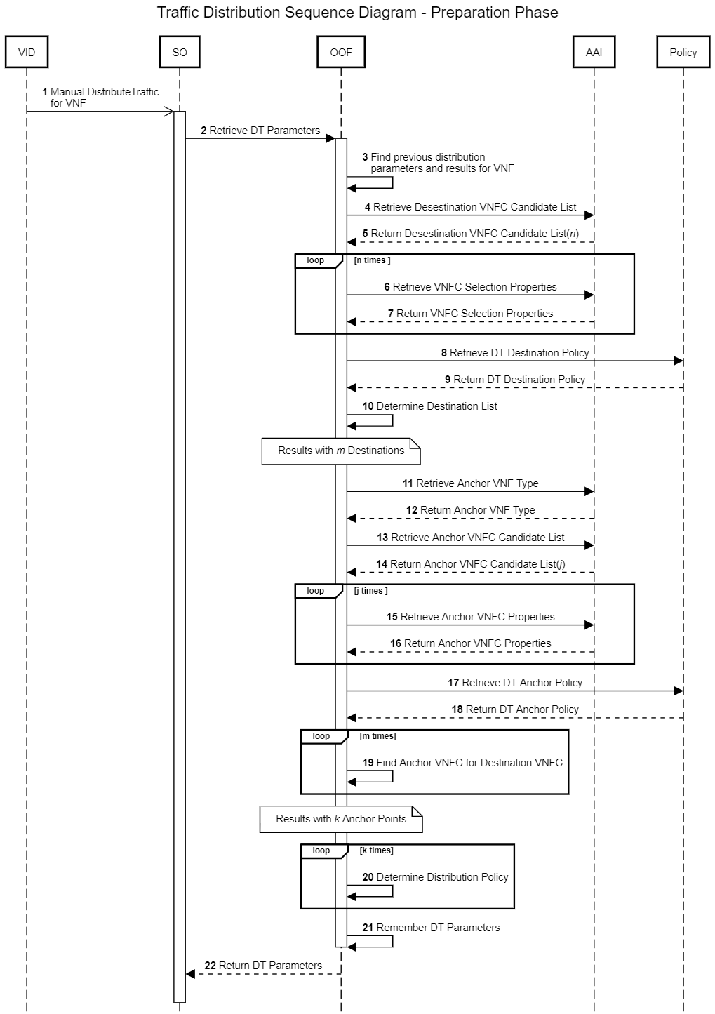
Traffic Distribution Workflow – Preparation Phase (2)

Slide 27
Traffic Distribution Workflow – Preparation Phase (3)
DT Workflow is triggered manually from VID – alternatively can be triggered by DMaaP event. Action is invoked for specific VNF Instance (VNF that traffic should be distributed) and Service Instance which holds this VNF instance. Some extra parameters could be specified at this stage to influence a generic way how OOF calculates conditions for distribution i.e.
  List of VNFC that should be excluded from a distribution
  List of VNFC that should be included in a distribution
  DistributionId (some identifier of TD being kept in OOF) to revert previous result of previous distribution – for rollback of previously failed traffic distribution
  Mode: Distribution/Reverse Distribution
SO asks OOF to retrieve parameters required for distribution: destinations, anchor points and distribution policy (e.g. distribution weights, load balancing mode – specific to anchor point)
  Alternatively A&AI can be considered to store this information
Retrieve remembered values of previously calculated destinations, anchor points and distribution policy (for specified DistributionId, VnfId)
  Useful for Reverse Distribution
  May be useful for calculation of future distribution parameters for particular VnfId on historical distributions basis

Slide 28
Traffic Distribution Workflow – Preparation Phase (4)
4-5. Retrieve a list of all VNFC that belong to the specified VnfId. This list of candidates for distribution must be filtered later on
6-7. For each VNFC Destination candidate we retrieve some properties from A&AI that may be useful for their filtering
  This properties will be determined later on – when first algorithm for destination selection will be designed. If there will be no such properties for Dublin this step will be omitted
8-9. From Policy we take values of some policies for destination selection algorithm
  TBD: what policy should be used here for? Maybe something similar to ConfigScaleOut should be considered instead?
OOF executes an algorithm that selects a list of destination VNFCs. It results with m VNFC Destination points. Algorithm will use following information
  List of n VNFC Candidate
  Results of past distribution (if specified in the request)
  Distribution policy, like preferred regions
  Additional properties from A&AI when required by the algorithm

Slide 29
Traffic Distribution Workflow – Preparation Phase (5)
11-12. Retrieve a VNF Type of Anchor point that is specific to the Destination VNF type
  VNF must belong to the same Virtual service like the one that destination VNF belongs to
  Anchor VNF type should be defined in the design time in SDC
  Information about the Anchor VNF type should be kept in A&AI
13-14. Retrieve a list of all VNFC that are a type of Anchor VNF type. This list of candidates for distribution must be filtered later on
15-16. For each VNFC Anchor point candidate we retrieve some properties from A&AI that may be useful for their filtering
  This properties will be determined later on – when first algorithm for destination selection will be designed. If there will be no such properties for Dublin this step will be omitted
17-18. From Policy we take values of some policies for anchor point selection algorithm
  TBD: what policy should be used here for? Maybe something similar to ConfigScaleOut should be considered instead?

Slide 30
Traffic Distribution Workflow – Preparation Phase (5)
19. For each VNFC Destination point candidate OOF executes an algorithm for anchor point determination. It results with k VNFC Anchor points. Algorithm will use following information
  List of m Destination Points
  List of j Anchor Point candidates
  Results of past distribution (if specified in the request) – i.e. already distributed VNFC by this Anchor point
  Anchor point selection policy, like preferred regions
  Additional properties from A&AI when required by the algorithm
20. For each VNFC Anchor point OOF executes an algorithm for distribution policy determination
  Expression of policy may vary depending on the Anchor type (percentage, explicit like least connections, round robin etc.) but Ansible/Chef script should receive always the same format
  How to unify it?
21. Determined list of Destinations, associated Anchor Points and Distribution policies
  Useful to build future rollback mechanism based on the same procedure
  Information must be stored in some database. But where? Local DB of OOF?
  There must mechanisms that will clear this data on regular basis
  Parameters are remembered under one identifier: DistributionId
22. Result is returned from OOF to SO, preparation phase is completed

Slide 31
Traffic Distribution Workflow – Execution Phase (1)
Purpose: execution of traffic distribution workflow base on information calculated by OOF
  Loop: for each destination the same set o operations
  Question is if procedure should not be grouped by anchor points
Procedure must determine
  Destination VNFCs
  Anchor Point VNFCs (for each Destination VNFC can be different)
  Distribution Weights or Distribution Policy
Dependencies
  SO
  OOF
  Controllers(APPC, SDNC)
  Anchor VNFCs
  Destination VNFCs
Should be ready for future use in distribution rollback process (to revert partial distribution)

Slide 32
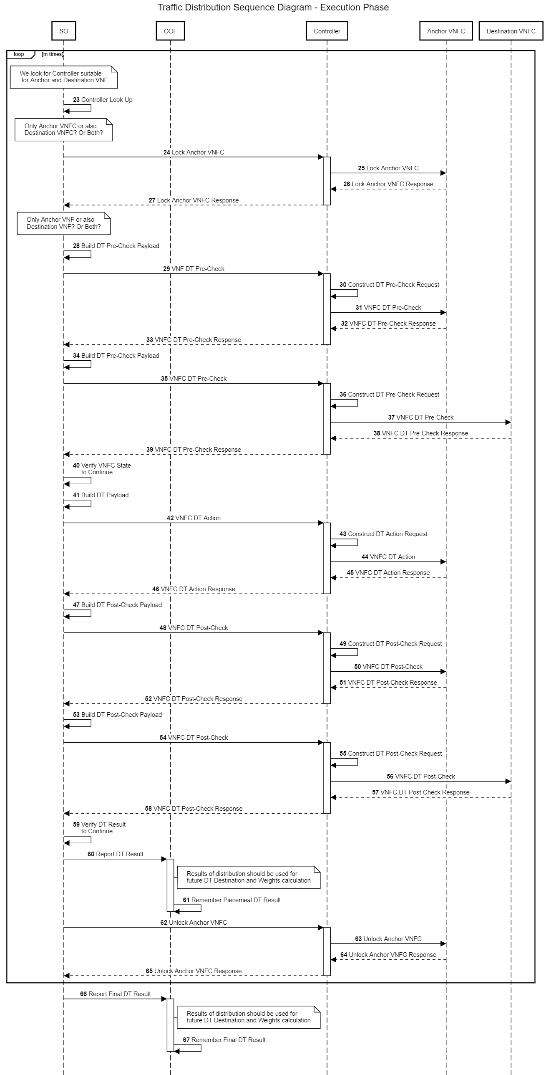
Traffic Distribution Workflow – Execution Phase (2)

Slide 33
Traffic Distribution Workflow – Execution Phase (4)
23. We look up for controller (SDNC, APPC) specific for Anchor VNFC and Destination VNFC
24-27. SO Locks Anchor Point VNFC and? Destination VNFC – to avoid any concurrent changes
28-33. SO Executes DT Pre-Check LCM action on Anchor Point VNFC with help of Controller
  As input Ansible/Chef script will receive proposed parameters for future distribution
  When Pre-Check fails distribution should be stopped. If some distributions were already performed rollback should be invoked
34-39. SO Executes DT Pre-Check LCM action on Destination Point VNFC with help of Controller
  As input Ansible/Chef script will receive proposed parameters for future distribution
  When Pre-Check fails distribution should be stopped. If some distributions were already performed rollback should be invoked
40. Pre-Check status is verified – if it failed distribution is stopped and rollback is triggered
42-46. SO Executes Distribute Traffic LCM action on Anchor Point VNFC with help of Controller
  Anchor Point performs the distribution on associated destination
  When distribution fails further steps should be stopped. If some distributions were already performed rollback should be invoked

Slide 34
Traffic Distribution Workflow – Execution Phase (5)
47-52. SO Executes DT Post-Check LCM action on Anchor Point VNFC with help of Controller
  As input Ansible/Chef script will receive proposed parameters of already performed distribution
  When Post-Check fails (result is different than expected) further distribution should be stopped. If some distributions were already performed rollback should be invoked
53-58. SO Executes DT Post-Check LCM action on Destination Point VNFC with help of Controller
  As input Ansible/Chef script will receive proposed parameters of already performed distribution
  When Post-Check fails (result is different than expected) further distribution should be stopped. If some distributions were already performed rollback should be invoked
59. Overall result of distribution to particular Destination VNFC is verified – rollback is invoked when some steps were not completed successfully
60-61. Result of distribution (successful or not) is remembered in OOF (to reuse is in further preparation phase i.e. during rollback)
62-65. SO Unlocks Anchor Point VNFC and? Destination VNFC – to allow further changes

