Slide 1
5G Use Case
Proposal for Dublin
- Bulk PM
Ericsson

Slide 2
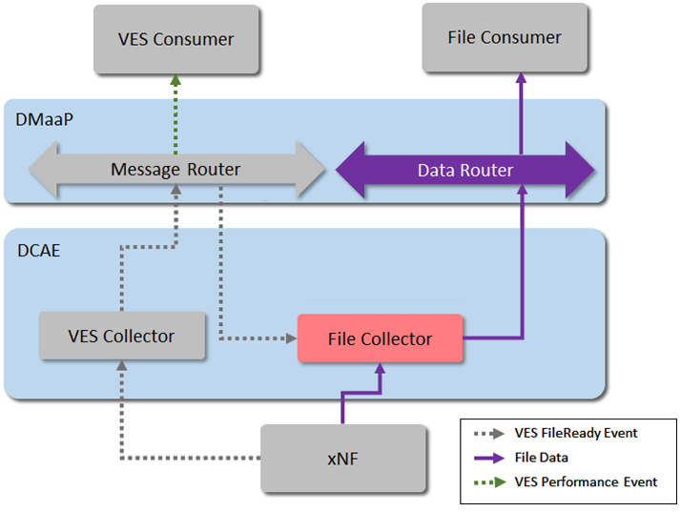
Overview - Casablanca
PM support in Casablanca includes:
Data File Collector microservice
Notification: fileReady VES event
UC to collect PM files and distribute via Data Router
  DFC listens for 'FileReady' VES events sent from an xNF via the VES collector.
  as files become available DFC fetches them.
  the collected data files are published internally on a DMaaP Data Router (DR) feed.

Slide 3
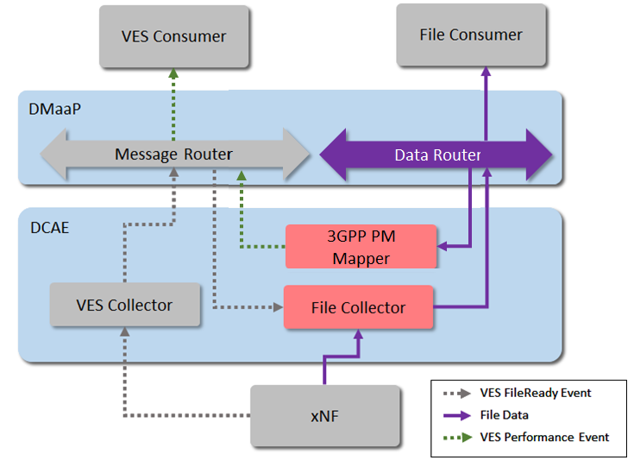

Overview – Dublin
PM support in Dublin proposal:
3GPP PM Mapper microservice
perf3gpp: pmMeasResult VES event
UC to convert PM data from 3GPP XML input to VES pmMeasResult output:
  micro-service subscribes to PM feed from DR
  measurements from the PM files are extracted and mapped to VES pmMeasResult events

Slide 4
PM related Use Cases
UC1: 3GPP PM Counter collection and VES creation in ONAP
  3GPP PM Mapper microservice
  VES pmMeasResult (run-time, data flows and handling)
  PM Dictionary handling (SDC-DS mapping config, artifact distribution)
UC2: Closed Loop support using 3GPP PM data
  TBC: PM trigger policy to perform CM update (depends on the NETCONF work in Dublin)
Additional requirements: PM Handling enhancements
  DFC robustness enhancement (file collection retry handling)
  DMaaP DR enhanced handling (support for Bulk PM UC; optional DR consumer specified feed encoding)

Slide 5

Bulk PM File Upload and Performance Event Generation
VES
Collector
Message
Router
File
Collector
Data
Router
Analytics
Application
Authenticate connection
PM
Mapper
VNF
PNF
VES
Collector
HTTP/TLS
Bulk PM File Upload and Performance Event Generation
Network Function (NF) establishes a HTTP/TLS connection to the DCAE VES Collector.
NF sends FileReady notification Event to DCAE VES Collector. Event is encoded in JSON and sent via HTTP/TLS. HTTP/TLS connection is set up and torn down every time a FileReady notification event is sent.
DCAE VES Collector publishes the event to appropriate topic in DMaaP Message Router (MR).
DCAE File Collector retrieves the FileReady notification event from DMaaP MR.
File Collector uploads PM File from NF using a secure file transfer protocol; FTPES supported in Casablanca. NF authenticates the connection.
File Collector publishes PM Data to DMaaP Data Router (DR).
PM Mapper retrieves PM Data from DR and generates 3GPP Performance events as configured by PM Mapper File.
PM Mapper publishes Performance events to MR.
Analytics Applications (AA) retrieve the 3GPP Performance events of interest from MR. AA analyze the data to produce statistics and KPIs and optimization recommendations.
1
1
HTTP/TLS
2
Send FileReady event
Publish Event
Upload PM file
2
3
Retrieve Event
4
3
FTPES
5
Publish PM Data + metadata
4
6
Publish 3GPP Performance Event
Retrieve PM Data +metadata
Retrieve 3GPP Performance Event
5
7
8
6
7
9
8
9

Slide 6
3GPP PM Mapper microservice (Dublin perf3gpp domain specific interactions)
Casablanca
Dublin
Message Router
Data Router
3GPP PM XML
DMaaP
VES perf3gpp pmMeasResults
VES sample
file
metadata
DCAE
XML sample
3GPP PM Mapper
create
PM event(s)
XML
data
3GPP PM XML
DFC
Source XML data is converted to VES PM events but content (e.g. counter names, units) are unchanged.
metadata
Validation:
- XML schema
compliance
file
metadata
Mapping
config
Design Studio (DCAE-DS)
Mapper
config
PM
Dictionaries
PM
Configuration
Policy
Service design selects counters for specific NF and PM dictionary version.
Instantiate new
or update existing

Slide 7
pmMeasResult event schema (json)
{
"$schema":"http://json-schema.org/draft-04/schema#",
"title":"VES Event Listener Common Event Format",
"type":"object",
"properties":{ },
"definitions":{
"commonEventHeader":{ },
"event":{ },
"eventList":{ },
"internalHeaderFields":{ },
"hashMap":{ },
"perf3gppFields":{ },
"measDataCollection":{ },
"measInfo":{ },
"iMeasInfoId":{ },
"measInfoId":{ },
"iMeasTypes":{ },
"measTypes":{ },
"compactMeasValue":{ },
"measValue":{ },
"integerMeasResult":{ },
"numberMeasResult":{ },
"nullMeasResult":{ }
}
}
Schema:
Version proposed for Dublin, includes generic
stringMeasResult to support vendor specified
counter types.
JSON schema updated to match rtPM proto as of 10-05, based on proto to json mapping as defined in:
https://developers.google.com/protocol-buffers/docs/proto3#json

Slide 8
PM Dictionary support
PM Dictionary artifact proposed for Dublin (Nokia contrib)
  PM Dictionary provides detailed information about each Measurement that a NF produces, including Measurement Name, Measurement Family, Measured Object Class, Description, Collection Method, Value Ranges, Unit of Measure, Triggering Conditions and other information.
A common schema for the PM Dictionary is used by each vendor
  PM Dictionary to be included in PNF Package
For Bulk PM, the PM Dictionaries are used to allow service designer to select which PM Counters they want mapped to VES PM Events
  e.g. PM Dictionaries used during service definition to create the 3GPP PM Mapper configuration needed at instantiation
Further information: 5G - FM Meta Data / 5G - PM Dictionary

Slide 9
Datafile Collector Enhancements
Improve DFC file collection robustness, i.e. missed collection handling
  In Casablanca xNF are required to send only new files available for collection in the fileReady notification. As a result, files may be potentially missed e.g. if a fileReady message is lost
  fileReady notification update: recommend that as long as a file is still available on the xNF it should be included in the fileReady notification
    do not propose change to fileReady message, only the contents
  xNF which sends only new files in the fileReady still works, but will not benefit from the enhanced handling at DFC
    add new VNF req to define the improved handling

Slide 10
DMaaP Data Router Enhancements
DMaaP DR: optional support will allow consumers to specify the encoding for their DR feed:
    If DR has support, then content is encoded and sent to consumer in requested format
    If DR has no support, error indicating unsupported encoding requested
  DCAE DFC: Small impact.
    DFC publishes in source format from NF. Same behaviour as Casablanca.
    DFC provides metadata in DR feed
DMaaP DR will introduce a new API minor version update that will A) deprecate ATT specific headers, B) introduce new headers replacing the ATT specific ones, C) pass through header "content-encoding" if supplied by the producer.
Producer or Subscriber will be able to use either the old version or new version of the interface. This allows DMaaP to be updated and existing Producers and Subscribers do not need to be updated.

Slide 11
3GPP PM Mapper microservice (consumer specified content encoding)
Encoding/Decoding handler
DMaaP Data Router
Casablanca
Dublin
Files are published from
NFs in their native format
3GPP PM XML
consumer spec.
encoding (e.g. gzip)
file
metadata
Consumers specify
preferred encoding
3GPP PM XML
Files are collected from
NFs in their native format
file
metadata
DFC
3GPP PM XML
E.g. 3GPP PM Mapper
NF (e.g. 5G PNF)

Slide 12
Thank You!

