Slide 1
ONAP trapd
SNMP Trap Reception for ONAP
October 2018

Slide 2
SNMP Overview
Simple Network Management Protocol, or “SNMP”
Initial signs of SNMP appear in 1988 with SMI RFC (rfc1065); followed by SNMP RFC (rfc1157) in 1990; since then have been over 30 RFC’s contributing to the standard’s evolution/expansion
Proven - SNMP is the most pervasive & longstanding network management protocol
Original design was a “simple protocol” (limited API set, etc), but enabled/expected complex solutions to be developed with those API’s

Slide 3
SNMP Dissected
Based on interactions between agents and managers
  Agents:
    Respond to queries from managers
    Send unsolicited/autonomous notifications (“SNMP traps”) to managers
  Managers:
    Polls agents for configured information
    Receive SNMP traps ← ONAP trapd !

Slide 4
SNMP Versions
SNMP Version 1 (SNMPv1)
  Straightforward and simple to deploy, but at a “cost”
  Despite weaknesses, still widely used and supported
    Clear text security, single-mode (non-bulk), no acknowledgement of message receipt
SNMP Version 2
  Initial release included “party based” security model (unpopular & abandoned)
  Several successive releases to V2 (SNMPv2u, SNMPv2*, ..); SNMPv2c “won”
    Kept popular V2 features, but left off the unpopular “party based” security
  Added acknowledged message receipt (informs), bulk actions (getbulk), etc
SNMP Version 3
  Authorization and Privacy well thought out/implemented
  MD5 and SHA authentication
  DES and AES privacy

Slide 5
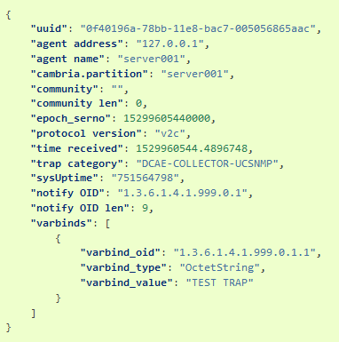
ONAP trapd
Runs in a docker container
Gets configuration from Config Binding Service
  Can be overridden to run in a “standalone” mode for testing/etc
Capable of receiving SNMPv1, V2c and V3 traps
  V3 requires specific configuration in CBS transaction
Supports IPv4 and IPv6 transports
Decomposes SNMP trap messages and publishes as JSON message to DMAAP/MR

Slide 6
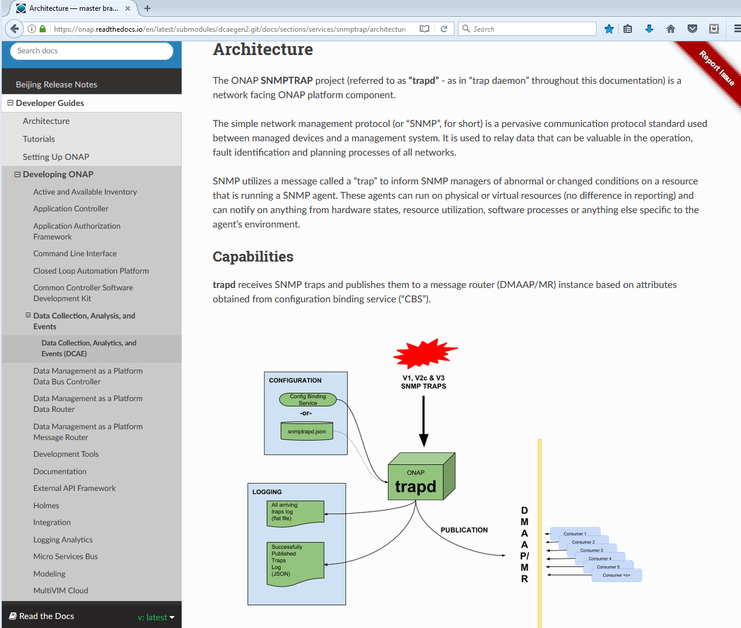
Documentation
ONAP trapd documentation available on readthedocs.io
  https://onap.readthedocs.io/en/latest/submodules/dcaegen2.git/docs/sections/services/snmptrap/index.html

Slide 7
ONAP trapd
DEMO !

Slide 8
Additional Resources

Slide 9
ONAP trapd images
Docker
docker pull nexus3.onap.org:10001/onap/org.onap.dcaegen2.collectors.snmptrap:latest
GIT
git clone ssh://<yourLinuxFoundationId>@gerrit.onap.org:29418/dcaegen2/collectors/snmptrap master

Slide 10
SNMPv1 RFC’s
RFC 1155 Structure and Identification of Management Information for TCP/IP-based internets
RFC 1157 A Simple Network Management Protocol
RFC 1212 Concise MIB Definitions

Slide 11
SNMPv2 RFC’s
RFC 1901 Introduction to Community-based SNMPv2
RFC 1902 SMI for SNMPv2
RFC 1903 Textual conventions for SNMPv2
RFC 1904 Conformance statements for SNMPv2
RFC 1905 Protocol operations for SNMPv2
RFC 1906 Transport mappings for SNMPv2
RFC 1907 MIB for SNMPv2
RFC 1908 Coexistence between SNMPv1 and SNMPv2

Slide 12
SNMPv3 RFC’s
RFC 3410. Introduction to SNMPv3
RFC 3410. Introduction and Applicability Statements for Internet Standard Management Framework
RFC 3411. An Architecture for Describing SNMP Management Frameworks
RFC 3412. Message Processing and Dispatching
RFC 3413. SNMP Applications
RFC 3414. User-based Security Model
RFC 3415. View-based Access Control Model
RFC 3416. Version 2 of SNMP Protocol Operations
RFC 3417. Transport Mappings
RFC 3584. Coexistence between Version 1, Version 2, and Version 3 of the Internet-standard Network Management Framework
RFC 3826. The Advanced Encryption Standard (AES) Cipher Algorithm in the SNMP User-based Security Model

Slide 13
Contributors
Dave LaDue/AT&T dl3158@att.com
Dan DiFlora/AT&T dd8745@att.com

