Slide 1
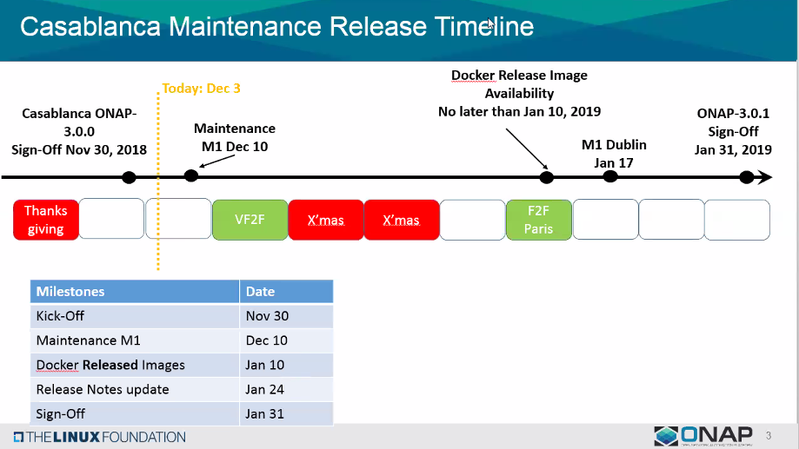

Slide 2
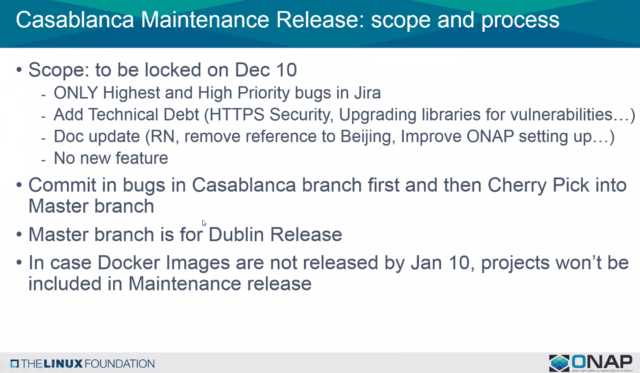

Slide 3
DCAE R3 - Maintenance release
Repository/component | JIRA | Remarks | Deliverables
dcaegen2/deployment Demo/heat | DCAEGEN2-1007 | Removing obsolete services configuration | Raw artifacts (nexus)
dcaegen2/collectors/datafile | DCAEGEN2-940 DCAEGEN2-941 DCAEGEN2-1001 | larger files of size 100Kb publish to DR DFC error after running over 12 hours Multiple Fileready notification not handled | Java jar + Docker
dcaegen2/collectors/hv-ves | DCAEGEN2-976 | - HV-VES not fully complaint to RTPM protocol (issue with CommonEventHeader.sequence) | Java jar + Docker

Slide 4
Service component – version update ownership
Gerrit repository – Component owner
  pom.xml & version.properties
Blueprint – Component owner
  https://git.onap.org/dcaegen2/platform/blueprints (k8s)
OOM Charts - PTL
  https://git.onap.org/oom/tree/kubernetes/dcaegen2/charts/dcae-bootstrap/values.yaml
Docker manifest (staging) - PTL
  https://git.onap.org/integration/tree/version-manifest/src/main/resources/docker-manifest-staging.csv
Docker manifest (Release) – PTL/LF
  https://git.onap.org/integration/tree/version-manifest/src/main/resources/docker-manifest.csv?h=master
Note: Above process to apply for R3 maintenance and continue for R4 (unless OOM changes chart ownership)

Slide 5
DCAE Committer change
Name | Repository | Wiki Evidence
Piotr Jaszczyk | dcaegen2/collectors/hv-ves, dcaegen2/services/sdk, dcaegen2/services/prh | https://wiki.onap.org/display/DW/Committer+Promotion+Request+for+%5BDCAE%5D%3A+Piotr+Jaszczyk
Piotr Wielebski | dcaegen2/collectors/hv-ves, dcaegen2/services/sdk, dcaegen2/services/prh | https://wiki.onap.org/display/DW/Committer+Promotion+Request+for+%5BDCAE%5D%3A+Piotr+Wielebski
Wasala, Przemyslaw – Committer role to be removed

