Slide 1
OOF-PCI: PCI and ANR Optimization using ONAP Optimization Framework (OOF):
ONAP Dublin Proof of Concept
Jan 17, 2019

Slide 2




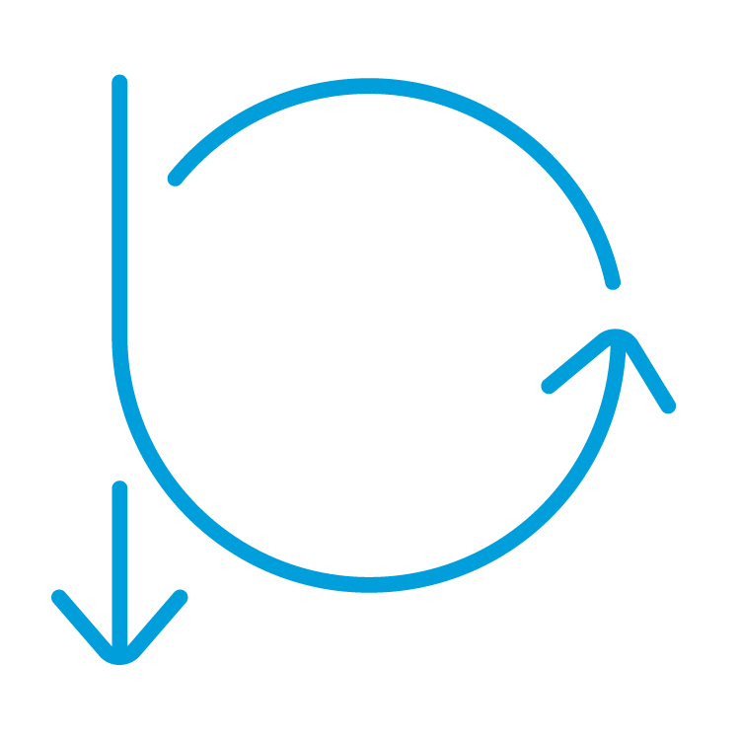


ONAP-Based SON (Self Organizing Networks)
Optimization (OOF)
Co-ordination, Decisions
(Policy)
Analytics (DCAE)
SON ⬄ Control Loop (CL)
OOF-PCI in Casablanca release is first ONAP SON 5G use case!
Open-source platform, with simple open-source algorithm
Companies can use framework to add proprietary SON solutions
Closed Loop Co-ordination (CLC) in Policy for co-ordination
Data Sources
(DCAE)
Control loop
Action
(SDN-R)
5G/4G Radio Network

Slide 3
ONAP 5G Use Case Approach for SON
ONAP Casablanca OOF-PCI - focus on Minimum Viable Product
Leverage ONAP Optimization Framework (OOF) for SON, since provides a policy-driven and model-driven framework for creating optimization applications for a broad range of use case
Build PoC to demonstrate disaggregation of the PCI SON functionality,
Focus on data flow and interfaces for:
OOF, new PCI-Handler-MS, Policy, SDN-C/SDN-R Controller
ONAP Dublin – work towards deployment-ready framework
Complete carryover work from Casablanca release
Add centralized ANR functionality support
Include DCAE: Onboard SON-Handler-MS*, add new VES Collector, add PM/FM database
(*Team has renamed PCI-Handler MS as SON-Handler-MS to reflect broader role)
Add SON flows for FM/PM data (e.g. PCI Confusion alarm, Handover KPI)
Support demonstration of Control Loop Co-ordination in Policy

Slide 4
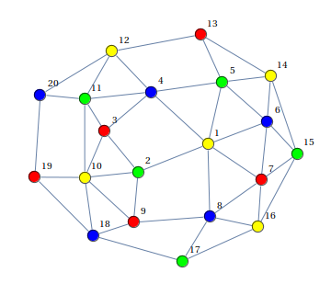
PCI and ANR optimization – 4G/5G SON functionality
Physical cell ID (PCI) is a locally unique integer ID in 4G/5G
Used for handoff and physical layer design
PCI ranges:
LTE: 0 to 503
5G: 0 to 1007
PCI optimization: Assign PCI values to avoid PCI collision and minimize PCI confusion
PCI is re-optimized if neighbor relationship changes, (e.g. during distributed Automation Neighbor Relation (ANR) function in RAN)
Centralized ONAP ANR optimization
is best done jointly with PCI
Cell: C1
PCI: 3
PCI confusion
Cell C9 has two
neighbors with PCI = 1
Cell: C2
PCI: 8
Cell: C5
PCI: 4
Cell: C3
PCI: 2
Cell: C4
PCI: 1
Cell: C10
PCI: 10
Cell: C7
PCI: 7
Cell: C9
PCI: 5
Cell: C8
PCI: 6
PCI collision
Cell C3 has a neighbor
with the same PCI=2
Cell: C11
PCI: 2
Cell: C12
PCI: 1
Graph Coloring
Problem

Slide 5
ONAP Dublin PoC: PCI & ANR Optimization using OOF
SO
Query to allocate PCI for new cell (optional)
REST API
DMaaP Message
(Netconf/Yang)
7
12
4b
Config Value
Change Notifn
4a
ConfigDB
6
Simulated RAN
~2000 Cells
Nbr_list, PCI values
OOF
Policy
10
SDN-C*
(SDN-R)
3a
DCAE
1d
1c
8
SON Handler MS
9
11
1b
1a
5
2
Config Value
Changes
PCI enhancements
Add ANR function
4d
4c
SDC & CLAMP
(CL setup)
FM/PM
Data
FM/PM Database
DCAE Collector
(VES)
3b
1e
FM/PM KPIs
FM/PM Collector and Database
(*Note: Team has renamed Casablanca PCI-Handler MS as SON-Handler-MS to reflect broader role of MS)

Slide 6
OOF-PCI: ONAP Dublin Scope
Complete Casablanca carryover work and add enhancements (SDN-R)
Onboard SON-Handler-MS* (DCAE, SDC, Policy)
Add VES Collector (DCAE, SDC?)
Add FM/PM database (DCAE)
Add SON flows for FM/PM data (e.g. PCI Confusion alarm, Handover KPI) (DCAE, RAN-Sim)
Add centralized ANR functionality support (RAN-Sim, DCAE, OOF)
Support demonstration of Policy Control Loop Co-ordination in Policy (Policy)
CLAMP – follow up with Control Loop Subcommittee
(*Note: Team has renamed Casablanca PCI-Handler MS as SON-Handler-MS to reflect broader role of MS)

Slide 7
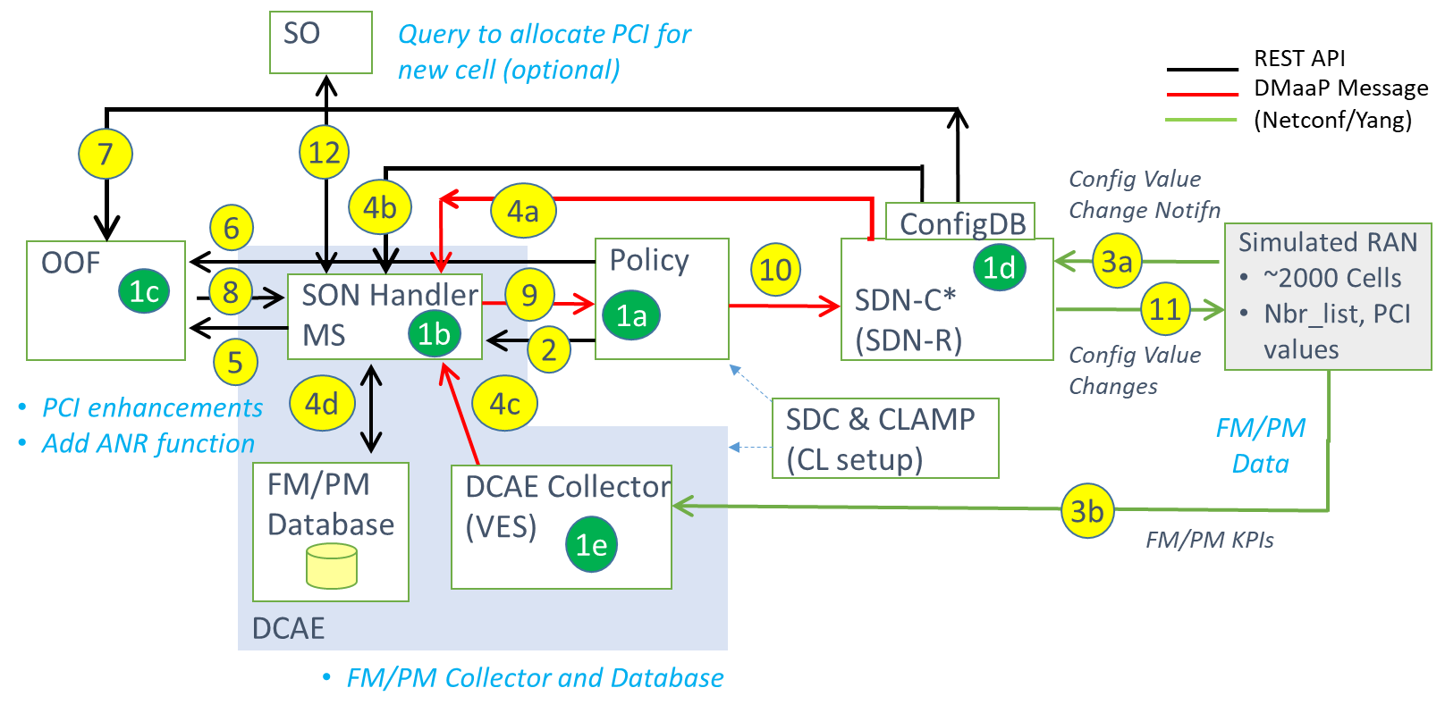
ONAP Dublin PoC for OOF-PCI SON 5G Use Case
Step | Functionality
1a-1e | All modules loaded to support CL, including SDC/CLAMP
2 | SON-Handler MS* fetches configuration policies from Policy
3a | Config change notification from RAN to SDN-C (e.g. Nbr list change)
3b | FM/PM data sent from RAN (PNFs) to VES Collector
4a | SDN-C publishes config data change on DMaaP to SON-Handler-MS.
4b | SON-Handler MS reads relevant info from ConfigDB
4c | SON-Handler MS receives FM trigger (e.g. PCI Confusion alarm)
4d | SON-Handler MS writes/reads FM/PM database for historical info
5 | SON-Handler MS invokes OOF for PCI / ANR Optimization
6 | OOF gets PCI / ANR optimization policies from Policy
7 | OOF queries ConfigDB database to fetch data for cells in the region
8 | OOF provides PCI / ANR Optimization result to SON Handler MS
9 | SON-Handler-MS provides PCI / ANR recommendation to Policy
10 | Policy sends instruction for configuration changes to SDN-C
11 | SDN-C applies config changes in RAN via Netconf
12 | (Optional) SON Handler MS API to support PCI allocation for new cells
*Note: Team has renamed PCI-Handler MS as SON-Handler-MS to reflect broader role of MS
Text in red indicates changes flows added to Casablanca solution

Slide 8
OOF-PCI items deferred to Dublin Release
Onboard SON Handler MS to DCAE, and include in SDC Catalog
SDN-R use cases moved from Casablanca to Dublin
  SDNC-430: Modify RAN informational model and yang model for RAN
  SDNC-431: Implement config DB and REST API (SDN-R / OOF interface)
  SDNC-432: Interfacing SDN-R with Policy
    Receive DMaaP message in CL format from Policy (Modify Config message using existing LCM API), send netconf message changing PCI value to cellID as specified, update config DB, and publish change on DMaaP (DMaaP client is available and can be called)
  SDNC-432: Receive netconf notification from RAN, update configDB, and publish change on DMaaP

Slide 9
OOF-PCI items deferred to Dublin Release
Complete the data flows for PCI use case
Include FM/PM input for SON:
  Enhance SON Handler MS to receive FM/PM data from DMaaP
  Send FM/PM data from RAN Simulator to DCAE Collector (e.g. PCI confusion alarm)
Include flow to request PCI assignment for new cell (optional)
  Enhance SON Handler MS to receive request for PCI allocation for new cell
  Enhance ConfigDB to support active, activation-pending, and non-active cells
  Orchestration for new cell addition is out of scope

Slide 10
OOF Enhancement for Dublin Release
Add optimization for centralized ANR (Automated Neighbor Relations) SON functionality, which is closely coupled to PCI SON
Changes to: SON Handler MS, Policy, SDN-R, RAN Simulator
Add RAN Simulator functionality to provide data
  Add metrics for neighboring cell pairs needed for ANR, e.g. handover KPIs
  Implement messages between SDN-R and RAN Simulator to support ANR function (e.g. cell relationship table, neighbor add and delete actions)

Slide 11
Policy Enhancement for Dublin for SON Coordination
Enhance the Policy functionality for Control Loop Coordination (CLC) – build on basic functionality in Casablanca
POC to implement two Control Loops (one could be PCI-SON) and demonstrate coordination using CLC

Slide 12
5G Configuration Management: SDN-R Enhancements for Dublin Release
Common RAN Information Model
  Build on Casablanca RAN Information Model, and target consensus among vendors for complete common RAN information model
SDN-C/SDN-R Controller enhancements
  Implement both Configuration Database and Operational Database as per ODL industry practice, leveraging Casablanca POC work on ConfigDB database
  Configuration Database – values needed to perform / initiate configuration
  Operational Database – dynamically changing network parameters relevant to ONAP and SDN-C/SDN-R
  Support history of config state as needed for Change Management
  Support both reactive and predictive network change actions
Inventory & Configuration Management synchronization
  Develop models and relationship between A&AI Database and SDN-C Configuration Database and Operational Database
  A&AI is primary reference for inventory and id of VNF, PNF, elements

Slide 13
Thank You!

Slide 14
Backup (ONAP Casablanca PoC)

Slide 15
OOF-PCI Casablanca PoC Highlights
OOM-based ONAP Casablanca installation in Rutgers Winlab OWL
OOF enhanced with solver and API for PCI Optimization
Policy enhanced for PCI Control Loop
New PCI Handler microservice – interfaces with OOF, Policy, SDN-R
SDN-R enhancements for PCI Control Loop (receiving CL msg from Policy, DG for CL, netconf notifications from RAN, DMaaP notifications to MS)
New ConfigDB with query API as part of SDN-R
RAN Simulator for ~350 cells and ~27 Honeycomb netconf servers (pnfs); with GUI to change/view cells, and PCI collisions/confusions.
Common RAN Yang model for PCI

Slide 16
ONAP Casablanca PoC: PCI Optimization using OOF
REST API
7
DMaaP Message
Config Value
Change Notifn
(Netconf/Yang)
4b
4a
6
ConfigDB
Policy
SDN-C
3
RAN Simulator (w/GUI)
~350 Cells
Nbr_list, PCI values
OOF
10
1d
1c
8
PCI Handler MS
9
11
1a
1b
2
5
Config Value Change
(SDN-C work done in SDN-R team)
Simulated RAN with
large number of
netconf servers
New basic PCI
optimization solver
New handler
microservice
Enhancements
in Policy CL
Enhancements in SDN-R,
new ConfigDB
Developed core part of SON control loop for PCI using generic SON data flows
Casablanca Proof of Concept (PoC)/Live Demo on Dec 13, 2019

Slide 17
Contributors – ONAP Casablanca POC
Organization | Contributor(s) | Topic(s)/Area(s)
AT&T | N. K. Shankaranarayanan, Sarat Puthenpura, P. N. Shankaranarayanan, Carlos de Andrade, Vikas Varma, George Clapp, Tracy van Brakle, Pam Dragosh, Dan Timoney, Brian Freeman | Use case lead & conceptualization, OOF, SDN-R, ONAP setup at Winlab, Policy and SDN-C/SDN-R support
Nokia | Ferri Tafreshi | Use case conceptualization
Reliance Jio | Dilip Krishnaswamy | Use case conceptualization
Rutgers University | Ivan Seskar, Mohit Sheth, Aayush Shah | ONAP setup at Winlab
highstreet technologies | Martin Skorupski, Herbert Eiselt, Hanif Kukkali | ONAP setup at Winlab, support for SDN-R and RAN-Sim
Tech Mahindra | Sandeep Shah, Vineeth Agarwal, Devendra Chauhan | SDN-R, Config DB
Lumina Networks | Jeff Hartley | Support for SDN-R
Wipro | Swaminathan S, Saravanan A, Krishna Moorthy, Mehreen K, Ramya R, Phunith Kumar, Ramesh R | Policy, PCI-Handler Microservice, RAN-Sim, RAN-Sim GUI, Honeycomb enhancements

Slide 18
ONAP Wireless Lab Installation

Slide 19
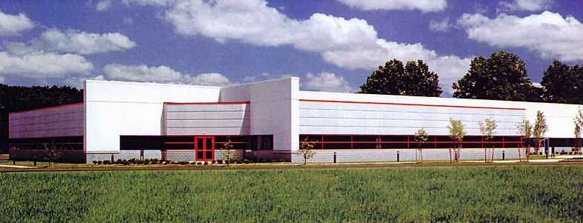

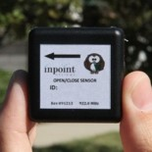
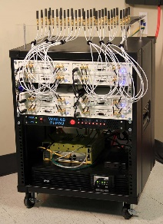
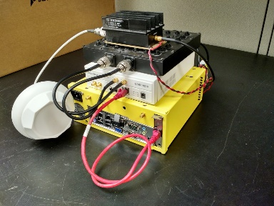
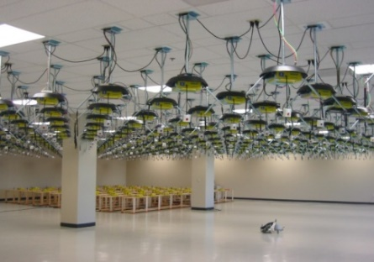
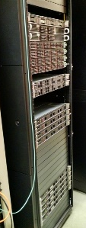
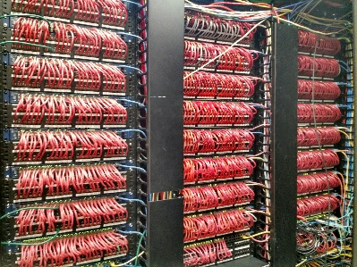
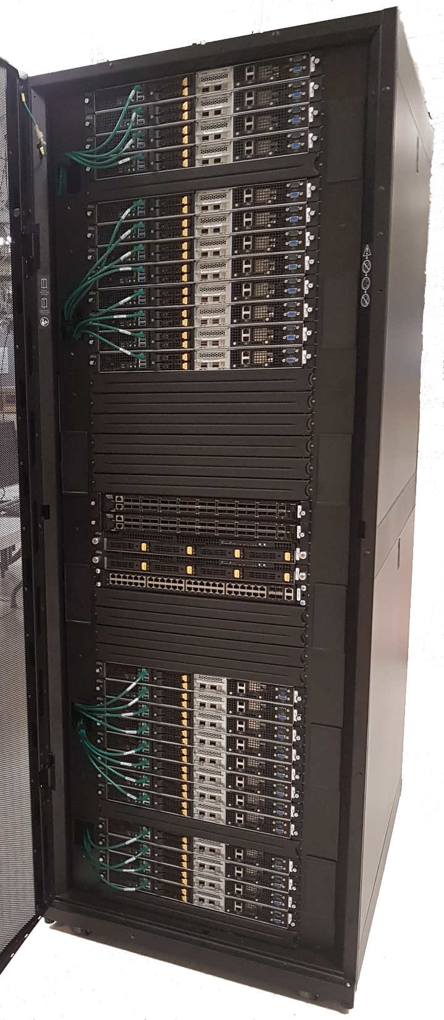
WINLAB at Rutgers University
WINLAB founded in 1989 as a collaborative
industry-university research center with
specialized focus on wireless networking
~25 faculty/staff, most from the ECE and CS departments at Rutgers
~40-50 grad students (80% PhD, 20% MS)
WINLAB Tech Center Facility
Center’s research portfolio spans information theory, radio technology, wireless systems, mobile networks and computing
Extensive experimental research infrastructure including ORBIT & GENI testbeds, SDR, SDN, …
Low Power IoT Device
Massive MIMO
SDR
ORBIT Radio Grid Testbed
GENI Rack
SDN
CloudLab Rack
Selected as an ONAP integration and testing laboratory for North America

Slide 20

Laboratory Environment for OOF PCI Demonstration
control
10.30.0.0/16
data
10.31.0.0/16
10.50.30.0/16
10.1.110.0/16
10.50.30.10
console.sb10.orbit-lab.org
10.30.0.10
enp2s0
enp3s0
node1-1
10.31.1.1
cons1-1
enp2s0
enp3s0
10.30.1.1
node2-1
HP Proliant Gen 9
10.31.2.1
cons2-1
eno49
eno50
10.30.2.1
cons2-2
node2-2
HP Proliant Gen 9
10.31.2.2
eno49
eno50
10.30.2.2
10.1.110.1
sw-rt1-top
10.50.30.1
10.30.0.1
10.31.0.1
NAT
Firewall

Slide 21
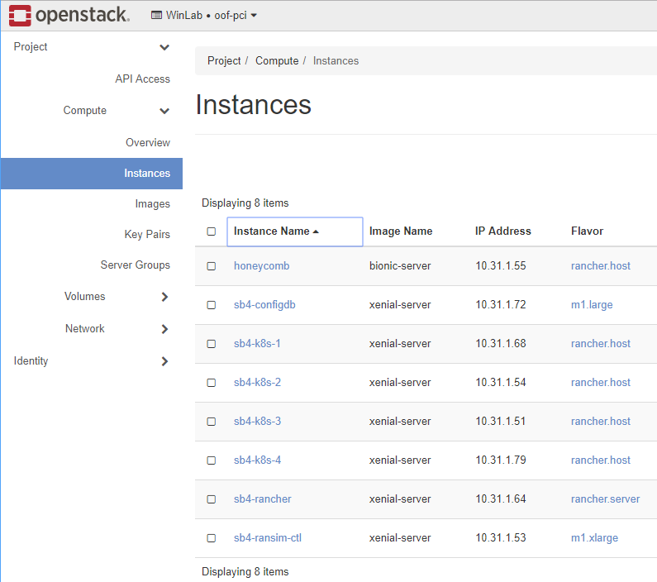
OpenStack Environment
Configuration database
VMs for Rancher/Kubernetes installation of ONAP
NETCONF server simulators

Slide 22
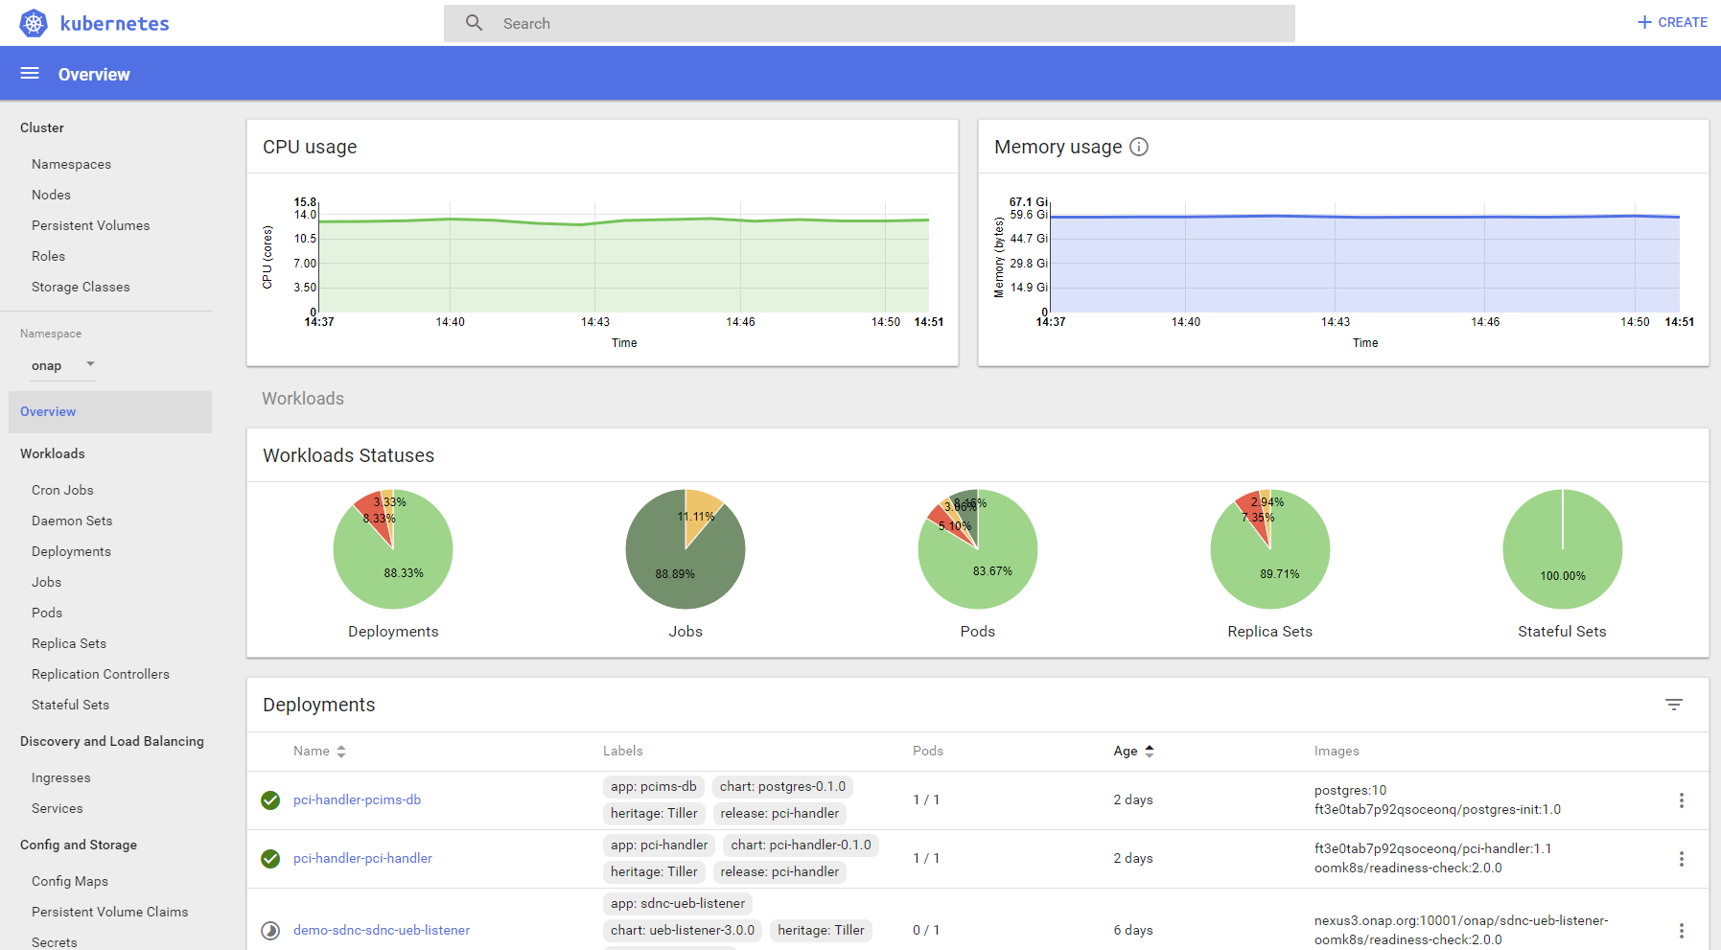
ONAP Installation
Used the method created by the ONAP Operations Manager (OOM) project
Rancher/Kubernetes environment

Slide 23
Policy component

Slide 24
Policy Impacts
Policy (Drools)
Policy GUI
VNFs, NW
Drools controller
Fetching of config policy
PolicyConfig :
{
policyType: Config,
policyConfigType: Base,
Param1: Value1,
Param2, Value2
}
PCIAction:
{
controlLoopName: ControlLoop-vPCI-fb41f388-a5f2-11e8-98d0-529269fb1459
timeout: 1200
abatement: false
policies:
name: modify PCI config
description:
actor: SDNR
recipe: ModifyConfig
}
Data Change Notifn
OOF
SDN-R
PCI HandlerMS
Changed PCI values (DMaaP notification)
Note: DMaaP is not shown here.
Call Recipes of SDN-R

Slide 25
Policy Component - Impacts
Provision new config policies for PCI-MS operation (PCI optmn. algo name, conditions for triggering OOF) via REST; condition for approving PCI changes, etc.) as Drools policy via REST/GUI, and store it in DB
Subscription to new DMaaP topic for ‘PCI change action trigger’ (PCI-MS notification).
Upon reception of information from PCI-MS on ‘PCI change action trigger’ (via DMaaP), trigger SDN-R by invoking relevant SDN-R recipes.
Send DMaaP message to SDN-R with the PCI changes (if allowed by policy rules).

Slide 26
PCI Microservice (MS) and OOF Config policies:
Commands for creation and pushing the config policies into Policy module are available in "policy-docker/config/pe/push-policies.sh"
PCI MS Config Policy:
{
"PCI_NEIGHBOR_CHANGE_CLUSTER_TIMEOUT_IN_SECS": 60,
"PCI_MODCONFIG_POLICY_NAME": "ControlLoop-vPCI-fb41f388-a5f2-11e8-98d0-529269fb1459",
"PCI_OPTMIZATION_ALGO_CATEGORY_IN_OOF": "OOF-PCI-OPTIMIZATION",
"PCI_SDNR_TARGET_NAME": "SDNR"
}
OOF Config Policy:
{
"ALGO_CATEGORY": "OOF-PCI-OPTIMIZATION",
"PCI_OPTMIZATION_ALGO_NAME": "OOF-PCI-OPTIMIZATION-LEVEL1",
"PCI_OPTIMIZATION_NW_CONSTRAINT": “network constraints",
"PCI_OPTIMIZATION_PRIORITY": 2,
"PCI_OPTIMIZATION_TIME_CONSTRAINT": “time constraints"
}

Slide 27
PCI-Handler Micro-service (PCI-MS)

Slide 28
PCI-MS architecture
Spring boot application
PostgreSQL
database
Core Logic
REST Interface
DMaaP client
RAN nodes
Could be a CU/DU or a traditional BS.
OOF
SDN-R
Policy
Other ONAP components
Note: This architecture depicts a standalone PCI micro-service. When this is moved to DCAE, the interfaces will be adapted appropriately.
Config information
Processed notifications (but not sent to OOF)
Buffered notifications
State information
RAN nodes

Slide 29
PCI-MS - Functions
Setup and initialization, fetch config policy via REST interface
Upon reception of notification from SDN-R:
  Fetch additional info from ConfigDB (REST APIs)
  Pre-processing logic: Determine if OOF has to be triggered, wait for more notifications in a given time period, temporary storage of notifications in database, wait for new results to get assimilated, etc.
  If OOF has to be triggered, invoke a REST API call to OOF to trigger PCI optimization, along with relevant details (algorithm name, impacted cells, etc.), and a callback URL.
While waiting for response from OOF
  Buffer/queue any new notifications from SDN-R for the same cluster
Upon receipt of response from OOF, prepare DMaaP notification for Policy and send it
After sending DMaaP message to Policy, check for any pending notifications in the buffer/queue, if present, go to Step 3, else wait for next notification from SDN-R.

Slide 30
RAN Simulator

Slide 31
Approach for RAN Simulator (RANSim)
Simulated Network
  Yang model defined by SDN-R module will be used for simulation
  Honeycomb simulator will be used to simulate the RAN. It will be extended to update the phy-cell-id values , to send ran-neighbor-list change notifications
  Each netconf server will run as standalone java process or Docker container
  The netconf servers will be spawned using a script
  ran-neighbor-list update notification will be sent by netconf server to SDN-R based on the trigger from RANSim Controller GUI
  Will be able to accept phy-cell-id update request from SDN-R and forward same to RANSim Controller
ONAP
PCI MS
Policy
SDN-R
Web GUI
Netconf
Simulated Network
Netconf server 1
RANSim
Controller
Netconf server n
Honeycomb
Honeycomb
Extension
Config DB
(MariaDB)
Extension
Yang Model
Yang Models

Slide 32
Approach for RAN Simulator (RANSim)
ONAP
RANSim Controller
  Spring Boot based micro service
  RAN topology of ~350 nodes is defined in a dump file and gets loaded
  Exposes following rest APIs to
    Retrieve the current topology
    Update phy-cell-id and neighbour list of a node to simulate collision or confusion
    Drop a cell
    Retrieve the new phy-cell-id set by SDN-R to a node
    Start/Stop the network simulation
  MariaDB will be used as the config database to store the topology
  Web GUI will show the current topology, phy-cell-id collision/confusions, ran-neighbor-list changes, updates from SDN-R, etc.
PCI MS
Policy
SDN-R
Web GUI
Netconf
Simulated Network
Netconf server 1
RANSim
Controller
Netconf server n
Honeycomb
Honeycomb
Extension
Config DB
(MariaDB)
Extension
Yang Model
Yang Models

Slide 33
RANSim GUI Illustration – Initial view
Initial canvas view
Select cell and “show neighbors”
1
4
10
1
4
10
21
21
42
165
42
165
4
4
10
10
240
240
149
149
76
150
76
150
4
4
Neighbor with no collision/confusion
Cells not selected, and is not a neighbor of selected cell
PCI
Cell which is selected
PCI
Neighbor of the cell which is selected

Slide 34
GUI Illustration - Neighbor List Change & PCI Optimization
Update neighbor list for selected cell
Neighbor list of selected cell after PCI optimization
1
4
10
1
12
20
21
21
42
165
65
165
4
10
30
10
240
240
149
149
76
150
76
150
4
4
PCI
Cell whose neighbor list is updated
Neighbor of selected cell with no collision/confusion
PCI
Initial neighbor of blue cell
Neighbor which causes a confusion
PCI
New neighbor of blue cell
Neighbor which has a collision
PCI
PCI value changed after OOF PCI optimization
Cell is not selected, and not a neighbor of selected cell

Slide 35
OOF

Slide 36
ONAP Optimization Framework – OOF (R3)
ONAP Optimization Framework (OOF) provides a declarative, policy-driven approach for creating and running a wide variety of optimization applications like Homing/Placement, PCI optimization, etc.
Policy Models
HAS
PCI
SDNC
CM Portal simulator
SO
PCI Handler MS
CMSO
OOF
Route
CMSO
HAS
PCI*
Actual policies
API
OSDF
Policy
PCI Optimizer
CMSO Optimizer
Route Optimizer
Homing/Placement Optimizer (HAS)
Dependencies on other ONAP Projects
SDNC ConfigDB
A&AI
Multi Cloud
MUSIC
=> PCI-related modules are part of ONAP Casablanca release
* See OOF-API spec at https://wiki.onap.org/display/DW/PCI+Optimization+API
PCI

Slide 37
Physical Cell ID (PCI) Optimization – 4G/5G SON functionality
Physical cell ID (PCI) is a locally unique integer ID in 4G/5G
Used for handoff and physical layer design
PCI ranges:
LTE: 0 to 503
5G: 0 to 1007
PCI optimization: Assign PCI values to avoid PCI collision and minimize PCI confusion
Maps to graph coloring problem
PCI is re-optimized if neighbor relationship changes, (e.g. during Automation Neighbor Relations (ANR))
Cell: C1
PCI: 3
PCI confusion
Cell C9 has two
neighbors with PCI = 1
Cell: C2
PCI: 8
Cell: C5
PCI: 4
Cell: C3
PCI: 2
Cell: C4
PCI: 1
Cell: C10
PCI: 10
Cell: C7
PCI: 7
Cell: C9
PCI: 5
Cell: C8
PCI: 6
PCI collision
Cell C3 has a neighbor
with the same PCI=2
Cell: C11
PCI: 2
Cell: C12
PCI: 1
Graph Coloring
Problem

Slide 38
OOF optimization result
Summary of results: OOF recommends PCI change for 7 cells
Netconf Server | Cell Id | Old PCI value | New PCI value
ncserver3 | Chn0044 | 10 | 11
ncserver4 | Chn0045 | 11 | 10
ncserver22 | Chn0327 | 4 | 12
ncserver22 | Chn0328 | 5 | 4
ncserver22 | Chn0329 | 6 | 5
ncserver23 | Chn0330 | 7 | 6
ncserver23 | Chn0331 | 8 | 7
Green: Cells which were newly added as neighbors to Chn0025

Slide 39
ConfigDB

Slide 40
ConfigDB System Architecture
Implemented to maintain configuration information of objects (e.g. cell) associated with the RAN network
Initial version in Casablanca; will support all CRUD operations in Dublin (including PUT, PATCH )
ONAP Components
Swagger API JSON spec (Casablanca)
GET API’s
GET /SDNCConfigDBAPI/getCellList/{networkId}/{ts}
GET /SDNCConfigDBAPI/getPCI/{cellId}/{ts}
GET /SDNCConfigDBAPI/getNbrList/{cellId}/{ts}
GET /SDNCConfigDBAPI/getPnfName/{cellId}/{ts}
Bulk Upload API
PUT /SDNCConfigDBAPI/insertData
N
Web Server
REST Interface for READ and BULK UPLOAD
(Java, Spring, Hibernate)
Maria DB

Slide 41
Config-DB Data Model and APIs
  Config DB (MariaDB) used by PCI-H-MS (step 4b) and OOF (step 7)
  Query API (swagger JSON spec) exposed to other ONAP modules
  cellId needs to be globally unique (assumed eCGI) and align with ONAP YANG model, ORAN, 3GPP
  pnf-name indicates netconf server to be used for interactions regarding cells
  Pnf object (pnf-name, pnf-id) to be aligned with A&AI (A&AI/ConfigDB interaction to be finalized in Dublin release)
Cell (Object)
pnf (Object)
ConfigDB API
Attribute | Format
networkId | string
cellId | string
pciValue | uint64
nbrList | list of cellId
lastModifiedTS | timestamp
pnf-name | string
Attribute | Format
pnf-name | String
cells | List of cellID’s
lastModifiedTS | timestamp
API | Input | Output
GET cellList | networkId, ts | List of cellIds
GET PCI | cellId, ts | PCI Value
GET nbrList | cellId, ts | List of cellIds and their PCI values
GET pnf-name | cellID, ts | pnf-name

Slide 42
SDN-R

Slide 43
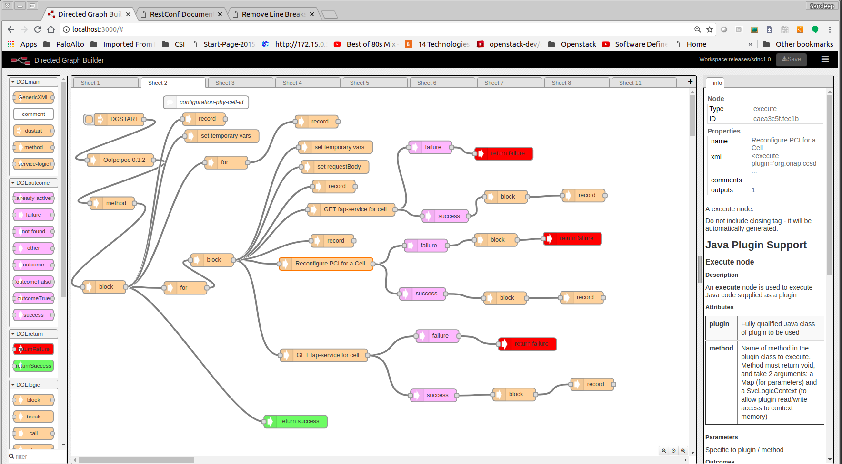
SDNR Development in Support of PCI/OOF POC
YANG Model (ver1.1) - (Tree, RPC, Notification)
Leveraged existing ONAP components – CCSDK/SDN-C and DMAAP-Listener
Integrated Oofpcipoc YANG model
Leveraged DG Builder to implement logic for Restconf transactions
Identified few areas/gaps that we will address in Dublin (Restconf PATCH support thru DG (RFC 8072), Netconf Notifications, DMAAP producer in SDN-C)
Create a Karaf Feature “oofpcipoc”
Repo: CCSDK/features
Folder: features/sdnr/northbound
sdnr is a component-meta feature
Create SLI/DG’s to support:
Notification from RAN simulator and generate DMAAP event (3 and 4a)
DMAAP event from Policy to initiate NETCONF based configuration (10 and 11)
Required update of JAVA provider classes
SDN-C Docker Build (based on CCSDK docker image)
Netconf Mount of RAN simulator onto SDN-C platform

Slide 44
OOF-PCI Casablanca PoC Highlights
OOM-based ONAP Casablanca installation in Rutgers Winlab OWL
OOF enhanced with solver and API for PCI Optimization
Policy enhanced for PCI Control Loop
New PCI Handler microservice – interfaces with OOF, Policy, SDN-R
SDN-R enhancements for PCI Control Loop (receiving CL msg from Policy, DG for CL, netconf notifications from RAN, DMaaP notifications to MS)
New ConfigDB with query API as part of SDN-R
RAN Simulator for ~350 cells and ~27 Honeycomb netconf servers (pnfs); with GUI to change/view cells, and PCI collisions/confusions.
Common RAN Yang model for PCI

