Slide 1
DataLake AdminUI
Architecture and Demo
Ekko Chang (QCT)
Participation Team: China Mobile and QCT
May 22, 2019

Slide 2
Agenda
Admin UI Architecture
Admin UI Features
Demo
  Todo: 3rd Party Tools Configuration Implementation

Slide 3

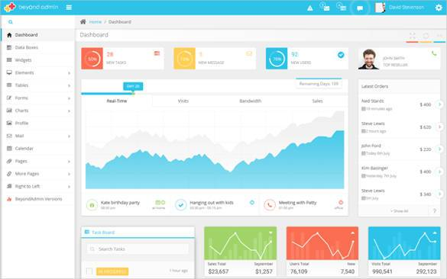


Admin UI Architecture
Frontend
(Bootstrap4 + Angular7)
REST API
API Prefix | /datalake/v1/
Header | Content-Type: application/json
Method | GET | List Data
 | POST | Add Data
 | PUT | Update Data
 | DELETE | Delete Data
AdminUI
Feeder

Slide 4
Admin UI Features
Admin UI
Feeder Operation
Feeder Settings
Pre-configured 3rd Party tools
Start
Stop
Status
Dashboard templates
Query Scripts
Database Settings
Topic Settings
Database
Host
Port
Authentication Key
SSL
Enable/Disable
Which Dbs to Store the Data
Authentication Key
ID Extraction
Data Format (JSON, XML)
TTL
Save Raw Data
Correlate Cleared Message
Default act configurations
Notes:
Feeder Operation
Start/stop Feeder
Show Feeder status and statistics
Feeder Settings
DB Connections
Topic Configurations
Pre-configured 3rd Party Tools Dashboard and query scripts

Slide 5
Thank You
Demo

