Slide 1
DCAE Weekly Meeting
2019-05-09
Vijay Venkatesh Kumar
(vv770d@att.com)

Slide 2
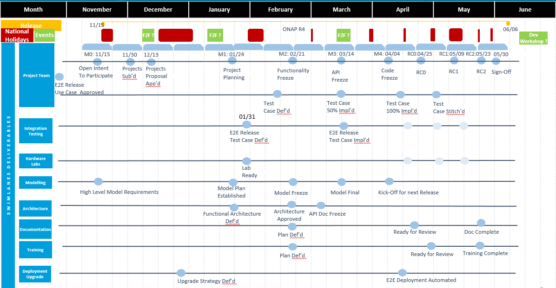
Dublin Schedule
RELEASE MILESTONE
M1- 01/16-01/24
M2 - 02/21*
M3 -03/14
M4 - 04/04 (04/11) 04/17
RC0 - 4/25 (05/02), 05/09
RC1 - 05/09
RC2 - 05/23
05/30 - Release sign off
Notes:
RELEASE MILESTONE M1- 01/16-01/24 M2 - 02/21 M3-03/14 1-week; M4 - 04/04 RC0 - 4/25 RC1 - 05/09 RC2 - 05/23 05/30 - Release sign off

Slide 3
DCAE R4 RC0 Status
  RC0 checklist
    https://wiki.onap.org/pages/viewpage.action?pageId=63996527
  Pairwise test
    https://wiki.onap.org/display/DW/DCAE+Pair+Wise+Testing+for+Dublin+Release
  Released Images (next)
  Branching Status
  CSIT
    “dublin” branch created for the integration/csit repo; Dublin CSIT jobs to be added to branch CSIT tests when needed
  Release notes (RTD)
    Deployment - https://wiki.onap.org/display/DW/DCAE+R4+Service+Component+%28On-demand%29+deployment+Instruction
    https://git.onap.org/dcaegen2/tree (mapper, pm-mapper, dfc, son-handler, BBS-ep, RESTConf, heartbeat)
  Jenkins job (https://jenkins.onap.org/view/dcaegen2/)
  CSIT (https://jenkins.onap.org/view/CSIT/)
  Sonar (https://sonar.onap.org/projects?search=dcaegen2&sort=-analysis_date)

Slide 4
DCAE ARTIFACTS (DOCKER) – RELEASED TAGS
onap/org.onap.dcaegen2.analytics.tca-gen2.dcae-analytics-tca-web:3.0.0-SNAPSHOT | DEFERRED
onap/org.onap.dcaegen2.collectors.datafile.datafile-app-server:1.1.1 | 5/3 - Change merged for 1.1.2 (DCAEGEN2-1466); DFC container + blueprint in dpo
onap/org.onap.dcaegen2.collectors.hv-ves.hv-collector-main:1.1.0
onap/org.onap.dcaegen2.collectors.restconfcollector:1.1.0 | 5/8 - 1.1.1 (bug-fix + blueprint in dpo)
onap/org.onap.dcaegen2.collectors.snmptrap:1.4.0 | R3 image
onap/org.onap.dcaegen2.collectors.ves.vescollector:1.4.4
onap/org.onap.dcaegen2.deployments.cm-container:1.6.2
onap/org.onap.dcaegen2.deployments.consul-loader-container:1.0.0
onap/org.onap.dcaegen2.deployments.healthcheck-container:1.2.4
onap/org.onap.dcaegen2.deployments.k8s-bootstrap-container:1.4.16 | 5/7 - Requested LF to release 1.4.16 5/3 - Need to bumped to 1.4.16 to include new PRH blueprint (DCAEGEN2-1465)
onap/org.onap.dcaegen2.deployments.multisite-init-container:1.0.0
onap/org.onap.dcaegen2.deployments.redis-cluster-container:1.0.0 | R3 image
onap/org.onap.dcaegen2.deployments.tca-cdap-container:1.1.1
onap/org.onap.dcaegen2.deployments.tls-init-container:1.0.3
onap/org.onap.dcaegen2.platform.configbinding.app-app:2.3.0
onap/org.onap.dcaegen2.platform.deployment-handler:4.0.1
onap/org.onap.dcaegen2.platform.inventory-api:3.2.0
onap/org.onap.dcaegen2.platform.policy-handler:5.0.0
onap/org.onap.dcaegen2.platform.servicechange-handler:1.1.5 | R3 image
onap/org.onap.dcaegen2.services.components.bbs-event-processor:1.0.0
onap/org.onap.dcaegen2.services.heartbeat:2.1.0
onap/org.onap.dcaegen2.services.mapper.vesadapter.universalvesadaptor:1.0.0
onap/org.onap.dcaegen2.services.pm-mapper:1.0.0 | 5/8 - 1.0.1 - dockerfile change for Dublin
onap/org.onap.dcaegen2.services.prh.prh-app-server:1.2.2 | 1.2.2 (requires version upgrade in blueprint)
onap/org.onap.dcaegen2.services.son-handler:1.0.0

Slide 5
EL-ALTO PLANNED ITEMS
  https://wiki.onap.org/display/DW/El-ALTO+DISCUSSION+ITEMS

