Slide 1
ONAP Dublin Release update
06-06-2019
Vijay Venkatesh Kumar (vv770d@att.com)

Slide 2
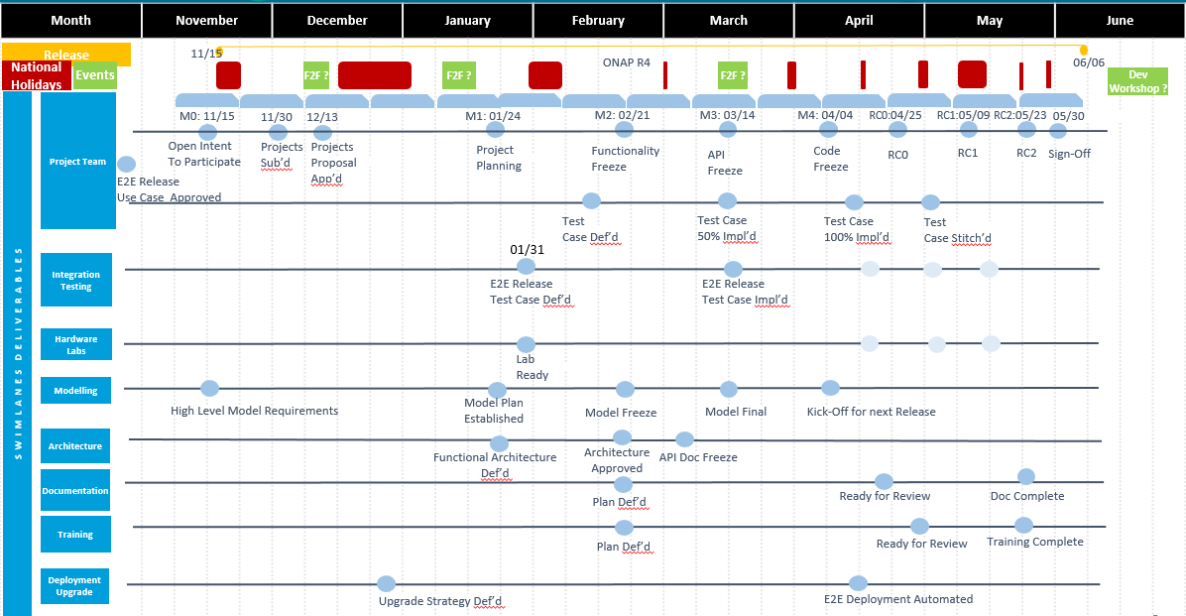
Dublin Schedule
RELEASE MILESTONE
M1- 01/1601/24
M2 - 02/21*
M3 -03/14
M4 - 04/04 (04/11) 04/17
RC0 - 4/25 (05/02), 05/09
RC1 - 05/09 05/16
RC2 - 05/23, 05/30, ?
Release sign off - 05/30, 06/06,?
Notes:
RELEASE MILESTONE M1- 01/16-01/24 M2 - 02/21 M3-03/14 1-week; M4 - 04/04 RC0 - 4/25 RC1 - 05/09 RC2 - 05/23 05/30 - Release sign off

Slide 3
ONAP/DCAE R4 Project status
  ONAP Project Tracker
    https://wiki.onap.org/display/DW/Project+Status+in+Dublin+Release
    34 use cases/functional/non-functional requirements require E2E testing.
      20 out of 34 are completed (including N/A)
      5 out of 34 are at >=80% test completion
      9 out of 34 <80% test completion
  ONAP Defect
    https://wiki.onap.org/display/DW/Defect+Status+for+Dublin
      7 issues tracked by integration as blockers
      28 issues tracked as non-blocking high defects
        DCAEGEN2-1596 [BBS] PRH attachmentPoint --> attachment-point
  ONAP Documentation
    https://jira.onap.org/browse/DCAEGEN2-1593 - CLOSED
    https://jira.onap.org/browse/DCAEGEN2-1541 - OPEN
  Release Sign-off
  https://wiki.onap.org/display/DW/DCAE+R4+Release+Sign-Off+Milestone+Checklist
Notes:
RC checklist
https://wiki.onap.org/pages/viewpage.action?pageId=63996527
Pairwise test
https://wiki.onap.org/display/DW/DCAE+Pair+Wise+Testing+for+Dublin+Release
Released Images
Branching Status
Release notes (RTD)
Deployment - https://wiki.onap.org/display/DW/DCAE+R4+Service+Component+%28On-demand%29+deployment+Instruction
https://git.onap.org/dcaegen2/tree
On-demand deployment steps
https://wiki.onap.org/display/DW/DCAE+R4+Service+Component+%28On-demand%29+deployment+Instruction

Slide 4
EL-ALTO
https://wiki.onap.org/display/DW/El-ALTO+DISCUSSION+ITEMS
https://wiki.onap.org/display/DW/R5+JIRA%27s+Tracker
Notes:
https://wiki.lfnetworking.org/display/LN/2019+June+Event+Topic+Proposals

