Slide 1
DCAE Weekly Meeting
2019-01-24

Slide 2
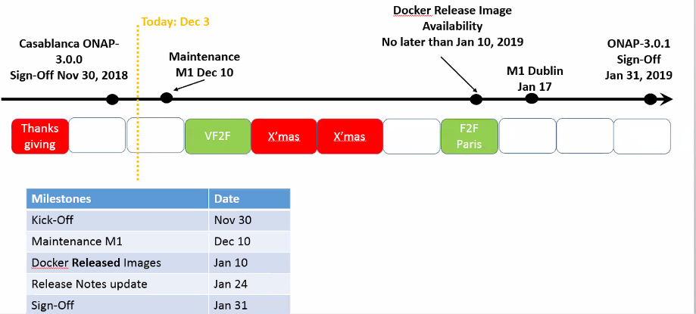
DCAE Weekly meeting
Casablanca Maintenance Release status
  https://wiki.onap.org/display/DW/Casablanca+Maintenance+Release+Integration+Test+Blocking+Issues
  https://jira.onap.org/browse/DCAEGEN2-1106

Slide 3
DCAE Weekly meeting – R4
R4 M1 Status
  https://wiki.onap.org/display/DW/Dublin+Release+Requirements
  https://wiki.onap.org/display/DW/DCAE+R4+M1+Release+Planning
  MS Pre-requisite for DCAE
New Repository request
son-handler → dcaegen2/services/son-handler (5g – PCIHandler)
Resource updated into ONAP wiki
  https://wiki.onap.org/display/DW/Resources+and+Repositories

Slide 4
DCAE MS List for Dublin
Static ONAP Deployment
  VESCollector
  HV_VES?
  SNMPTrap
  Holmes Rules/Engine
  RESTConf (New) - BBS
  TCA
Dynamic Deployment (requires Policy model)
  TCA (optional based on UC by integration)
  PRH/Extension? - 5G and BBS
  DFC - 5G
  VES-Mapper (New) - BBS
  PM-Mapper (New) – 5G
  SON Handler (New) – 5G
  Heartbeat* (New)
  TCA-GEN2* (New)
Notes:
Generic services; support multiple flows; no dynamic policy configuration support needed.
CL flows

Slide 5
DCAE MS – Onboarding flow for Static Components
Static ONAP Deployment - Onboarding
  Component spec creation
  Validation of spec using dcae_cli
  Blueprint creation
    (manual for R4; new tool will be available post R4)
  Validation of blueprint/deployment in K8S
  DCAE bootstrap deployment integration
    Define the new cloudify blueprint here - https://gerrit.onap.org/r/gitweb?p=dcaegen2/platform/blueprints.git;a=tree;f=blueprints;hb=refs/heads/master
    Add any corresponding inputs under OOM https://gerrit.onap.org/r/gitweb?p=oom.git;a=tree;f=kubernetes/dcaegen2/charts/dcae-bootstrap/resources/inputs;h=214a9cff1cb73a3367192ff595937e8a11be7fed;hb=refs/heads/master
    Once above are merged, update DCAE bootstrap to include Service part of OOM DCAE instantiation
    https://git.onap.org/dcaegen2/deployments/tree/k8s-bootstrap-container/bootstrap.sh
      https://git.onap.org/oom/tree/kubernetes/dcaegen2/charts/dcae-bootstrap/values.yaml
Notes:
Generic services; support multiple flows; no dynamic policy configuration support needed.
CL flows

Slide 6
DCAE MS – Onboarding flow for Dynamic Instantiated Components
Dynamic ONAP Deployed MS
  Component spec creation
  Validation of spec using dcae_cli
  Blueprint and Policy Model creation
    (manual for R4; SDC/DCAE-DS post R4)
  Validation of blueprint/deployment in K8S
  SDC/CLAMP Integration
    Ensure new models and blueprints are in gerrit repo
    Work with Integration team/usecase owner to upload the artifacts (blueprints & policy model) into SDC and trigger Service creation and distribution from SDC.
    Work with CLAMP team to trigger the MS deployment.

Slide 7
DCAE Weekly meeting
Security Report (WIP)
  https://wiki.onap.org/pages/viewpage.action?pageId=51282478

