Slide 1
DCAE Weekly Meeting
2019-02-21
(Revised 2019-02-28)

Slide 2
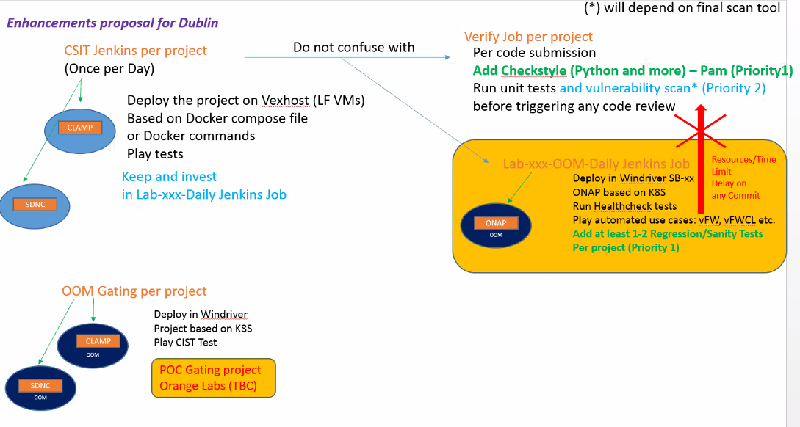
CSIT related updates
Notes:
https://git.onap.org/testsuite/tree/robot/testsuites

Slide 3
DCAE Repository consolidation
DCAE repository > 30
For future release, looking at consolidation on the DCAE repositories.
Rather than introducing separate repository for each service component, I’m considering to have multiple MS share a common repository.
For e.g – dcaegen2/services repo (currently empty) can be targeted to host multiple ms (under same technology) with below structure.
  dcaegen2/services
  └── components
  ├── datalake-handler
  │ ├── admin
  │ └── feeder
  ├── bbs-event-processor
  ├── microservice2 (future)
  └── microservice3 (future)

