Slide 1
DCAE Weekly Meeting
2019-04-11

Slide 2
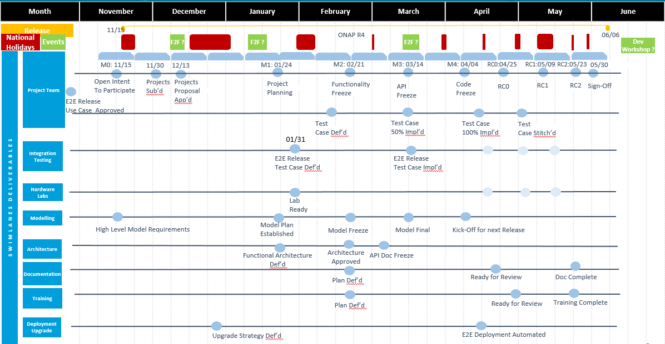
Dublin Schedule
RELEASE MILESTONE
M1- 01/16-01/24
M2 - 02/21*
M3 -03/14
M4 - 04/04 (04/11)
RC0 - 4/25
RC1 - 05/09
RC2 - 05/23
05/30 - Release sign off
Notes:
RELEASE MILESTONE M1- 01/16-01/24 M2 - 02/21 M3-03/14 1-week; M4 - 04/04 RC0 - 4/25 RC1 - 05/09 RC2 - 05/23 05/30 - Release sign off

Slide 3
DCAE R4 M4 Status
  https://wiki.onap.org/display/DW/DCAE+R4+M4+Code+Freeze+Milestone+Checklist
  https://wiki.onap.org/display/DW/Project+Status+in+Dublin+Release
  Dashboard
  Dmaap plugin integration/test
  Jenkins job (3/160+) failing
  CSIT (https://jenkins.onap.org/view/CSIT/job/dcaegen2-collectors-datafile-master-csit-Functional-suite/)
  Sonar (20/20)
  Pending updates
    SON-Handler – Policy Update flow
    ?
  On-demand/Dynamic deployment steps
  https://wiki.onap.org/display/DW/DCAE+R4+Service+Component+%28On-demand%29+deployment+Instruction

Slide 4
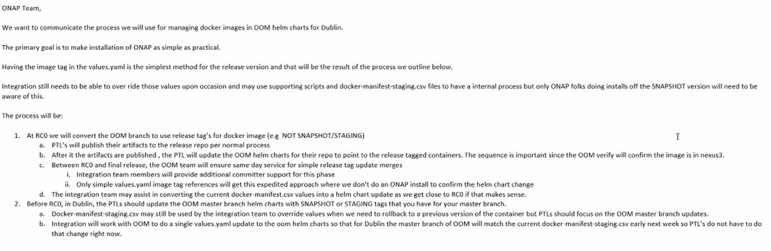
OOM – charts/values
Note: OOM to have only released images post RC0

Slide 5
DCAE Committer updates
Committer role extensions (to additional DCAE repositories) - Jaszczyk, Piotr & Wielebski, Piotr
https://wiki.onap.org/display/DW/Committer+Extension+Request+for+%5BDCAE%5D%3A+Piotr+Jaszczyk
https://wiki.onap.org/display/DW/Committer+Extension+Request+for+%5BDCAE%5D%3A+Piotr+Wielebski
New committer promotions - Henrik Andersson B & Murgoski, Zlatko
https://wiki.onap.org/display/DW/Committer+Promotion+Request+for+%5BDCAE%5D%3A+Henrik+Andersson
https://wiki.onap.org/display/DW/Committer+Promotion+Request+for+%5BDCAE%5D%3A+Zlatko+Murgoski
Notes:
From Jessica to Everyone: 09:27 AM
https://jenkins.opendaylight.org/releng/view/odlparent/job/odlparent-maven-stage-3.1.x/
From Jessica to Everyone: 09:35 AM
https://jenkins.onap.org/job/ccsdk-utils-maven-stage-master/4/console
Maven-staging-plugin - nexus-staging-maven-plugin:1.6.7:deploy
Nexus2 migration ticket: https://jira.onap.org/browse/CIMAN-234

Slide 6
F2F – El Alto Updates
Release timeline change
Security (java script coverage)

Slide 7
ONAP Timeline Evolution – El Alto
El Alto
8w 4w 3w 4w 2.5w 2w 3w 1w
M0
Kick-Off
M1
Planning
Freeze
M2
Functionality
Freeze
M3
APIs
Freeze
M4
Code
Freeze
RC0
RC1
RC2
Sign Off & Release
Scope Def. & Design
Development
Require Significant Code Changes (>4 Weeks)
Use Cases
Functional and Non-Functional Requirements
1
1W 4W 4 W 1W
Tests and bug fixes
E1 Release Candidate
E2
E3
E1-3 Release Candidates
included in El Alto Release until Release Code Freeze
10 W
5 W
5 W
...
Def. E1
Dev E1
Test E1
Rel. E1
Limited Code Change (Max. 4 weeks)
No or limited cross-applications dependency
Non-Functional Requirements (Security/Vulnerability issues, Code Optimization, Sev2 Defect Backlog Reduction, etc.)
PTL Enhancements
Documentation Enhancements
Def. E2
Dev E2
Test E2
Rel. E2
Def. E3
Dev E3
Test E3
Rel. E3

Slide 8
ONAP Release cycle Evolutions
ONAP Releases Timeline/focus
  El-Alto release - ~4 months (June-Sept)
    Maintenance
    Project back logs
  Frankfurt release (Extended planning, but release 1Q20)
Edge Automation – ARC Next Steps
  Requirement clarification to be finalized by 04/16/2019
  Finalized Architecture Presentation to Arch. Sub Committee on 04/23/2019

Slide 9
El-Alto Items (Deferred from Dublin)
  SEC-COM Open items
    Secure communication
      Topic/feed
      CBS (dependency on Consul)
    Non-root container
    Security Vulnerability (review Dublin exception list and close)
  CIA
  S3P
    Documentation/Usability
    Performance test/bench-marking (such as response time, transaction/message rate, latency, footprint, etc. to be defined on per component)
    Application logging consistency (Manageability)
    API Standardization (Usability)
  Jenkins job alignment (moving to common template)
  CSIT improvement
  Platform components (security/csit/jjb)
  Blueprint generator/Dmaap plugin integration
    (Topic standardization – pre-requisite)
  SDK library integration (Except PRH/HV-VES)
  Policy Integration for dynamic components

Slide 10
Acumos-ONAP Integration Phase 1 Process Steps (3Q 2019)
Describe the Use Case of a ML-assisted ONAP Control Loop that provides values to Operations
Acumos designer onboard a ML model that contains sufficient data to support ONAP DCAE/CL in Design time & Runtime.
Acumos distributes the ML model to ONAP via E5 federation.
ONAP E5 Receiver uses µS Adaptor to transform and onboard into SDC catalog as Analytic µS.
ONAP user selects the ML Analytic µS into a DCAE flow template and attaches to a service (SDC/DCAE-DS). A blueprint is auto-generated* and distributed to CLAMP & DCAE-C.
ONAP user uses CLAMP to further configure an operational policy to fix the problem as identified by the ML Analytic µS.
ONAP user deploys the CLAMP blueprint to implement the control loop.
Overtime the collected network data will be used to enhance & retrain the ML model.
New
Work
ONAP
BAU
Process
*broken in ONAP Casablanca release

Slide 11




Acumos-ONAP Integration Phase 1 Dataflow (3Q 2019)
Demonstrate with a Control Loop Use Case
Legend
ONAP
5
SDC Catalog
SDC/DCAE-DS
Existing SDC/DCAE tools
VNF
VNF
SDC Blueprint Generator
New Work
VNF
Collector
MS
Analytic
MS
2018 ONS POC
(with modifications)
Analytic MS
Tosca Format
DCAE Blueprint
ONAP µS Adaptor
4
VNF
Collector
MS
Analytic
MS
Acumos
µS in Tosca Format
3
6
Acumos
Federation
Pub
SDC Tosca Tool
CLAMP Design GUI
Sub
2
DCAE-CLI validation
VNF
Collector
Analytic
MS
Policy
Acumos Catalog
Onboard ML model & validate it has all data required by ONAP
DCAE µS
Generate
DCAE MS Metadata (DCAE component spec + Data format)
Acumos
ML Model
DCAE Blueprint
Policy
Repo
VNF
Collector
MS
Analytic
MS
Policy
url reference
1
DCAE Docker Generation
Docker Repository accessible from DCAE environment where you are deploying into
Identify a real Operations problem
Develop & train a ML model with ONAP production data
Data Lake
DCAE
Runtime Registry
7
DCAE Deployment
MANUALLY DEPLOYED
VNF
DCAE
Runtime
8
11

