Slide 1
VNF Placement Decision in ONAP
OOF - Valet

Slide 2
What is the Placement Decision?
Homing for a given VNF instance
  Select a target cloud site (or a region)
  Implemented in OOF-HAS as a policy-driven homing service
Placement for virtual servers (e.g., VMs) in each VF module of the VNF instance
  Precisely check capacities of nodes & Select target nodes in the cloud site
  Here, a node is either a cluster of compute hosts (e.g., AZ) or a compute host
Certain placement decisions for tenant’s need are missed between ONAP and platform’s scheduler (e.g., OpenStack Nova)
  e.g., Who will decide a target AZ of a VM for Tenant, who does not know the AZ’s configuration, such as available remaining CPUs, available Host-Aggregates etc.
Notes:
These are tenant-level options, instead of platform

Slide 3
VNFs Placement Requirements
Based on our experience with real VNFs, richer placement capabilities are required
Grouping rule: affinity, anti-affinity, exclusivity (i.e., don’t share resources with others)
  Each group rule is about multiple virtual servers together
  Each virtual server can be involved in multiple grouping rules
Scope of grouping rule:
  e.g., datacenters, AZ, power domain (rack), host
Scope of application:
  VMs within a single VF module, within a single VNF instance, or across VNFs

Slide 4
VNFs Placement Requirements
Example in OpenStack Cloud
VF Module (Heat Template)
Core
Anti-affinity
across power domains
ToR
ToR
ToR
Placement Policies/Rules
VM1
VM2
VM3
VM1
VM3
VM4
VM5
Valet
Host1
HA1
Host1
Host1
VM5
VM4
Vol
VM3
VM5
VM6
VM2
Exclusivity
within
a Host
Vol
HA2
Resource information
VM6
Host2
Host2
Host2
Affinity within
an AZ
Rack1
Rack2
Rack3
AZ1
AZ2

Slide 5
A VNF Placement Use Case
A real VNF placement requirement (5G Mobility VNF):
Checking capacity and then placing VNF instances, each of which consists of 3 VMs,
in a way of anti-affinity (across AZs or compute hosts) among VNF instances but affinity (within an AZ or a compute host) among 3 VMs of each VNF instance
VNF-1
VM
VM
VM
Affinity
VNF-2
VM
VM
VM
Affinity
VNF-3
VM
VM
VM
Affinity
Anti-affinity
Anti-affinity
Anti-affinity

Slide 6


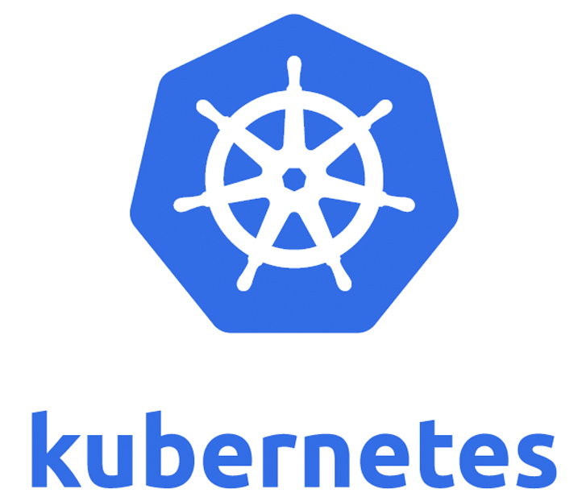
Why a Placement Decision in ONAP?
Consistently deal with different underlying clouds with high-level policies/requirements
  private, public, or hybrid clouds
  different platforms such as OpenStack, variant of OpenStack, Kubernetes, etc.
Smoothly combining Placement with Homing decision

Slide 7
Placement Decision Functions
To connect high-level VNF placement requests into underlying cloud resources
Providing precise capacity/quota check (and reservation capability)
Meeting placement requirements/policies (Affinity, Anti-affinity, Exclusivity)
  Constraints Solving
Translating universal requirement specification into native cloud specification
  e.g., Affinity and Anti-affinity -> Azure: Fault-Domain, AWS: Placement-Group
  e.g., Exclusivity -> Azure: Isolated VM, AWS: Dedicated Host

Slide 8
A Homing & Placement Flow
OOF/HAS+Valet
For Homing &
Placement decision
Policy
A&AI
SDNC
SO
MultiCloud
…
OpenStack
PlugIn
Azure
PlugIn
Homing or Capacity check
Placement of VF module

