Slide 1
LFN June DTF: 5G OOF SON Use case - Physical Cell ID (PCI) Optimization and centralized Automated Neighbor Relations (ANR) using ONAP Optimization Framework (OOF):
June 24, 2020
PoC Collaborators: AT&T, Wipro, IBM,
highstreet technologies, Lumina Networks, Nokia,
Reliance Jio, Rutgers Winlab
Acknowledgments: Feedback and support from participants
in ONAP OOF-PCI team calls
Presenters : N.K. Shankaranayaranan, Swaminathan S

Slide 2
OOF-SON PoC Demo - Outline
OOF-SON Overview – N. K. Shankar (5’)
Component Enhancements & Demo introduction - Swaminathan S (3’)
Demo – Reshma (20’)
Conclusion – (2’)

Slide 3
Contributors – Frankfurt Release
Organization | Contributor(s) | Topic(s)/Area(s)
AT&T | N. K. Shankaranarayanan, Carlos de Andrade, P. N. Shankaranarayanan, Vikas Varma, Pam Dragosh, Pramod Jamkhedkar, Jim Hahn, Dan Timoney, Vijay Venkatesh | Use case lead & conceptualization, OOF, Policy, DCAE, CCSDK, Integration Test support
Wipro | Swaminathan S, Saravanan A, Reshmasree C, Niranjana Y, Dhebeha Mj, Krishna Moorthy, Priyadharshini B | Use case co-lead & conceptualization, Policy discussions, DCAE, OOF, RAN-Sim, Integration Test Lead
IBM | Sandeep Shah | SDN-R, Config DB
highstreet technologies | Martin Skorupski, Hanif Kukkalli | ONAP setup at Winlab, SDN-R
Lumina Networks | Jeff Hartley | SDN-R support
Nokia | Ben Cheung | Use case guidance
Reliance Jio | Dilip Krishnaswamy | Use case conceptualization
Rutgers University | Ivan Seskar, Michael Sherman, Mohit Sheth, Aayush Shah | ONAP setup at Winlab

Slide 4



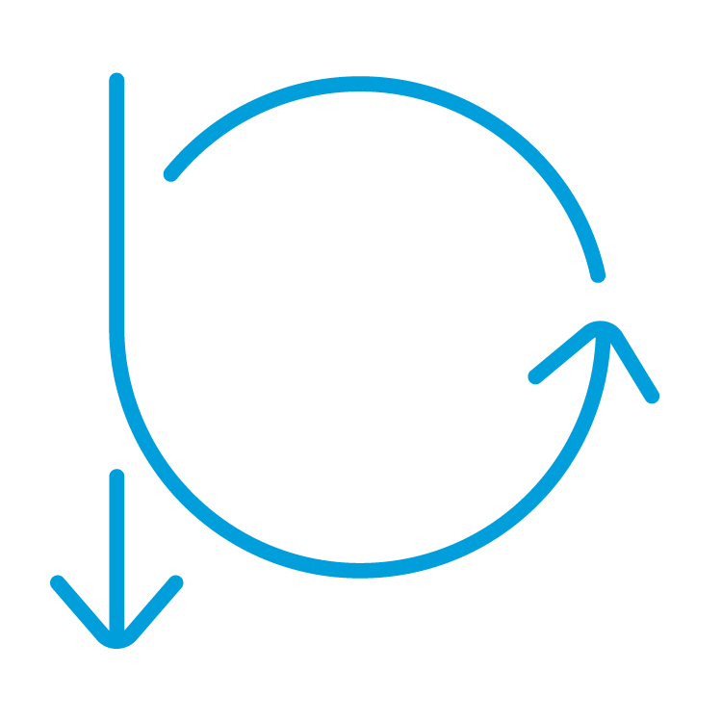



ONAP-Based SON (Self-Organizing Networks)
SON ⬄ Control Loop (CL)
ONAP: Open-source platform, with basic open-source code
Companies can use framework to add proprietary SON solutions
Optimization (OOF)
Co-ordination, Decisions
(Policy)
Data Collection,
& Analysis
(DCAE)
OOF-PCI Casablanca
  First ONAP SON PCI use case
  PoC Demo in Dec 2018
OOF-SON Dublin
  Added SON function: ANR
  More SON data flows: FM, PM
  New SON-Handler MS in DCAE
  OOF-SON Frankfurt
  CM-Notify handling
  Control Loop Co-ordination (CLC)
  Introduced Adaptive SON functionality
  Checked in RAN-Sim into ONAP repo
Action
(SDN-R)
Control loop
Data, FM, PM
Config status
5G/4G Radio Network

Slide 5
ONAP-Based SON & ORAN interfaces
Optimization (OOF)
Co-ordination, Decisions
(Policy)
OOF-SON use case has built a foundation for ONAP/ORAN integration
Radio network uses common netconf/yang model
Data flows:
SDN-R to RAN: netconf-based configuration
RAN to DCAE: VES format for
FM alarms, PM KPI, CM Notifn
RAN to SDN-R: Netconf ack
Data Collection,
& Analysis
(DCAE)
RIC (non-RT)
Action
(SDN-R)
Control loop
Data, FM, PM
RIC (near RT)
A-1/O-1
A-1/O-1
Config ack
Config notify
ORAN Radio Network

Slide 6
ONAP SON aligning with ORAN - Release 6 POC
CM notification as VES msg
Config DB (RCDB) model based on network yang
DMaaP
Simulated RAN
~2000 Cells
Nbrlist, PCI
4d
13
9
10
12
4a
4c
10
12
4a
9
4c
13
OOF
DCAE
Policy
SDN-R
(SDN-C)
Config Change
O1 - Netconf interface
1c
8
SON Handler MS
1d
11
5
1b
2
1a
6
4b
ORAN O1
interface
4e
ConfigDB
Cells/GNBs
RIC
Yang model
7
1f
4d
3a
4f
FM/PM DB
VES Collector
CM
O1 - VES
outputs
1e
3d
ORAN O1 interface
Interface
enhancements
FM/PM KPIs
n
FM/PM Collector and Database
REST API
DMaaP Control Loop messages
CM-FM-PM messages from RAN
Config updated to RAN (netconf)

Slide 7
OOF-SON Frankfurt Use Case / PoC Highlights
Handling of CM-Notify from RAN by SDN-R (for neighbor list update), and update of Config DB
    Use a yang-aligned VES msg format, and send it as a DMaaP message (POC only) to SDNR. SDNR processes this message, and updates RCDB (Config DB). This is a first step towards ORAN CM-Notify alignment & precursor to Configuration & Persistency Service work planned in Guilin release.
    Reason: CM-Notify in VES standard and DCAE implementation of CM notification via VES are not available yet
  Control Loop Co-ordination (CLC): SON use case has two control loops (CL) – PCI and ANR (CL1 and CL2). CLC objective for CL1 and CL2:
    Policy receives CL_Request messages for both CLs (step 9)
    Policy send CL action messages to SDNR for one CL at a given time (step 10), and waits for response from SDNR
    Deny messages for CL2 while CL1 actions are outstanding, and vice versa
Adaptive SON: For cells whose PCI values cannot be changed (e.g., policy, connectivity, etc.), ensure that PCI of those cells are kept fixed during PCI optimization (“Fixed PCI” cells)
Completed Integration Tests as per ONAP process
Checked in RAN-Simulator code into ONAP simulator repo
Use case is a catalyst for, and early adopter of, upgraded Rutgers Winlab OWL

Slide 8
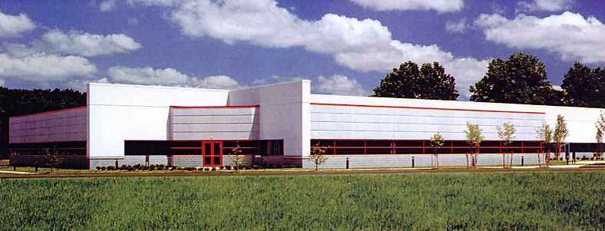
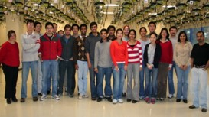
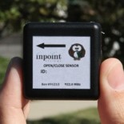
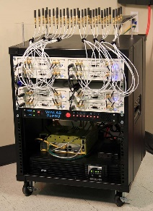
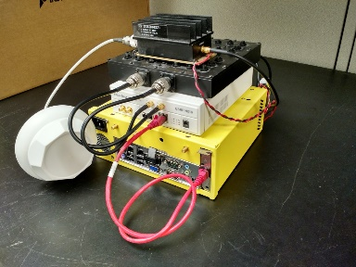
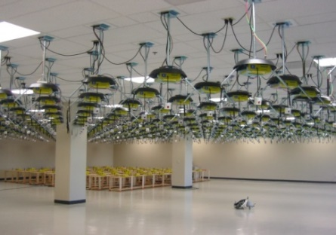
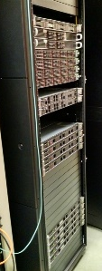
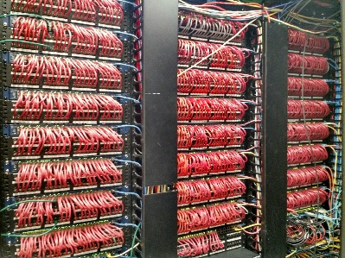
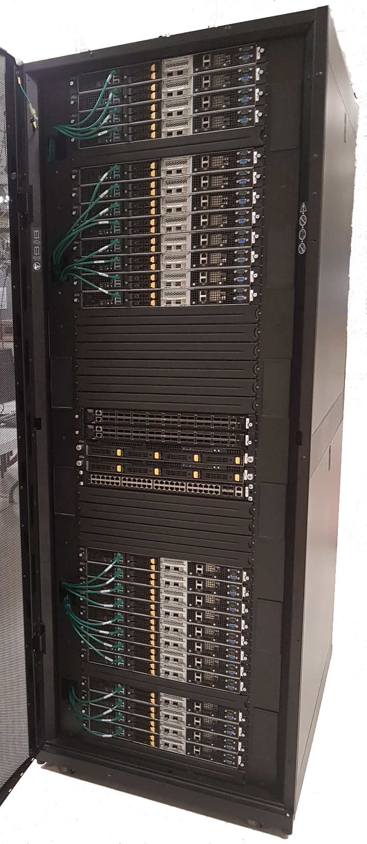
WINLAB at Rutgers University
WINLAB founded in 1989 as a collaborative
industry-university research center with
specialized focus on wireless networking
~25 faculty/staff, most from the ECE and CS departments at Rutgers
~40-50 grad students (80% PhD, 20% MS)
WINLAB Tech Center Facility
Center’s research portfolio spans information theory, radio technology, wireless systems, mobile networks and computing
Extensive experimental research infrastructure including ORBIT & GENI testbeds, SDR, SDN, …
Low Power IoT Device
Massive MIMO
SDR
ORBIT Radio Grid Testbed
GENI Rack
SDN
CloudLab Rack
Selected as an ONAP integration and testing laboratory for North America

Slide 9
OOF-SON Frankfurt Use Case: Impacts
OOF
Solver enhanced for consider cells whose PCI cannot be modified during PCI optimization
DCAE (SON-Handler MS)
Keeping track of cells whose PCI values could not be updated
Policy
Control Loop Co-ordination actions to deny the second control loop when first one is active
SDN-R/SDN-C
RAN-Sim and GUI
Interface with SON-Handler MS enhanced to obtain inputs of “Fixed PCI” cells
Updates for handling CM-Notify
Updates to make it ONAP compliant and check it into ONAP repo
Update of Config DB based on CM-Notify contents
Triggering OOF with details of cells whose PCI values should not be changed during PCI optimization
Enhancements for CLC
Ensuring response from SDN-R is sent to SON-Handler MS on completion of Control Loop
Enhancements to ensure proper SDNR-CL-RSP is sent back to policy
Notes:
https://wiki.onap.org/display/DW/CM+Notification+Support+in+ONAP

Slide 10
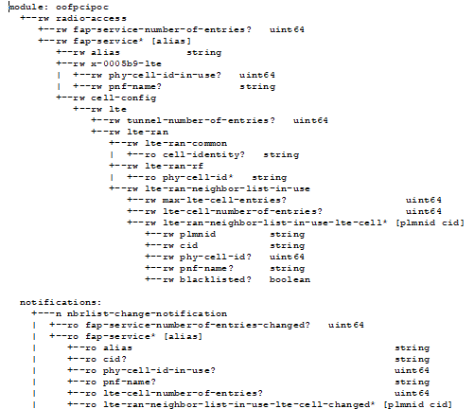
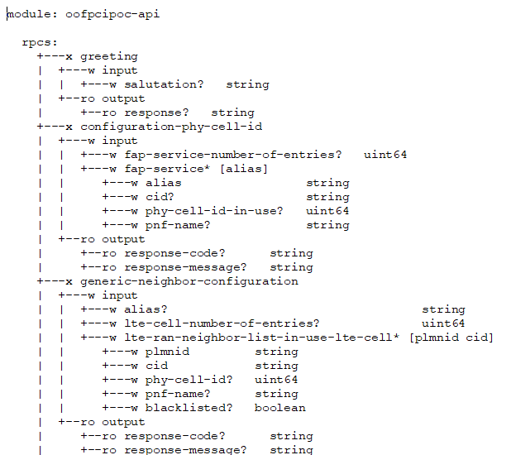
YANG Model Tree for OOF PCI/ANR POC¹
The platform ready to support any YANG Model
Number & List of Cells
PCI and PNF-NAME for a Cell
List of Neigbors
RPC
RPC
Netconf Notification
¹ https://gerrit.onap.org/r/gitweb?p=ccsdk/features.git;a=tree;f=sdnr/northbound/oofpcipoc/model/src/main/yang;h=5b3ef2c03cf516ba716f69076a780a95e96fadc2;hb=refs/heads/dublin

Slide 11
Demo

Slide 12
OOF-SON Frankfurt Demo: Use case flows
Step 1
Steps 2,4,5,9
= DEMO Highlights
Steps 3,6
Step 1
DMaaP
Simulated RAN
~2000 Cells
Nbrlist, PCI
4d
13
9
10
12
4a
4c
10
12
4a
9
4c
13
OOF
DCAE
Policy
SDN-R
(SDN-C)
Config Change
O1 - Netconf interface
1c
8
SON Handler MS
1d
11
5
1b
2
1a
6
4b
ORAN O1
interface
4e
ConfigDB
Cells/GNBs
RIC
Yang model
7
1f
4d
Step 8
3a
4f
FM/PM DB
VES Collector
CM
O1 - VES
outputs
1e
3d
ORAN O1 interface
Interface
enhancements
FM/PM KPIs
n
FM/PM Collector and Database
REST API
DMaaP Control Loop messages
CM-FM-PM messages from RAN
Config updated to RAN (netconf)

Slide 13
Demo Sequence
Frankfurt enhancements
Step 3: Show Control Loop triggered
Step 4: Show PCI issue solved (UI)
Step 5: Trigger PM data generation
Step 2: Neighbor list update (UI)
Step 1: CM-Notify handling
1. Show Control Loop getting triggered
2. Show Control Loop getting completed after successful actions
1. Show PCI collision/confusion problem getting solved (in UI)
1. Show neighbor list of a cell getting updated via UI (PCI use case)
2. Show how it results in a PCI/collision
1. Show PM data generation to report HO metrics (in UI)
2. Explain its relevance to C-ANR and joint PCI-ANR optimization
1. Send CM-Notify message(s) on DMaaP (to SDN-R)
2. Show ConfigDB before and after update
CM-Notify
PCI optimization
C-ANR

Slide 14
Demo Sequence (continued)
Frankfurt enhancements
Step 7: PCI optimization update failure
Step 8: Considering “Fixed PCI” cells for PCI optimization
Step 9: C-ANR outcome
Step 6: Control Loop Co-ordination actions
1. Trigger PCI optimization and activation of Control Loop for PCI updates.
2. Simulate failure to update PCI for some cell(s)
1. Show SON-Handler MS triggering OOF with “Fixed PCI” cell list next time for PCI optimization (logs)
1. Trigger a Control Loop (say CL1), and show its state in Policy DB
2. Trigger another Control Loop (CL2) and show its denial by Policy (logs)
1. Show blacklisting of neighbors due to C-ANR (UI)
CLC
Adaptive SON
C-ANR

Slide 15
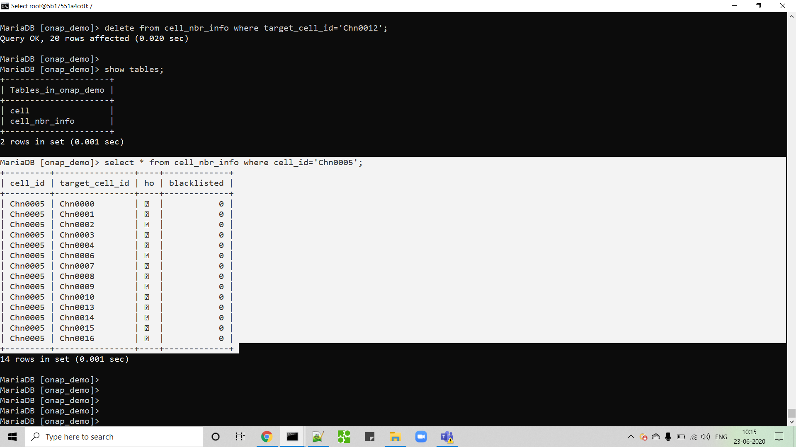
Step 1: Config DB (before CM-Notify)

Slide 16
Step 1: CM-Notify contents (Sample)
{
"event": {
"commonEventHeader": {
"version": "4.0.1",
"vesEventListenerVersion": "7.0.1",
"domain": "notification",
"eventName": "Notif_RansimAgent-Wipro_RanPCIProblem",
"eventId": "Notif000001",
"sequence": 1,
"priority": "High",
"reportingEntityId": "de305d54-75b4-431b-adb2-eb6b9e546014",
"reportingEntityName": "ncserver1",
"sourceId": "cc305d54-75b4-431b-adb2-eb6b9e541234",
"sourceName": "Chn0001",
"startEpochMicrosec": 1451772223000000,
"lastEpochMicrosec": 1451772403000000,
"timeZoneOffset": "UTC-05:30",
"nfNamingCode": "RansimAgent",
"nfVendorName": "Wipro"
},
"notificationFields": {
"notificationFieldsVersion": "2.0",
"changeType": "Neighbour list changed",
"changeIdentifier": "ncserver1",
"additionalFields": {
"networkId": "NTWK005",
"configurationChange": "{ \"fap-service-number-of-entries-changed\":1, \"fap-service\":[ { \"alias\":\"Chn0001\", \"cid\":\"Chn0001\", \"lte-cell-number-of-entries\":1, \"lte-ran-neighbor-list-in-use-lte-cell-changed\":[ { \"plmnid\":\"ran-1\", \"cid\":\"Chn0002\", \"phy-cell-id\":4, \"pnf-name\":\"ncserver1\", \"blacklisted\":false } ] } ] }"
}
}
}
}

Slide 17
Step1: SDN-R -> Config DB update
curl --location --request PUT 'http://10.31.3.182:8080/api/sdnc-config-db/v3/createNbr/Chn0005' \
--header 'Accept: application/json' \
--header 'Content-Type: application/json' \
--header 'Cache-Control: no-cache' \
--header 'Content-Type: text/plain' \
--data-raw '{
"ho": true,
"targetCellId": "Chn0012"
}'
curl --location --request PUT 'http://10.31.3.182:8080/api/sdnc-config-db/v3/createNbr/Chn0005' \
--header 'Accept: application/json' \
--header 'Content-Type: application/json' \
--header 'Cache-Control: no-cache' \
--header 'Content-Type: text/plain' \
--data-raw '{
"ho": true,
"targetCellId": "Chn0071"
}'
curl --location --request PUT 'http://10.31.3.182:8080/api/sdnc-config-db/v3/createNbr/Chn0005' \
--header 'Accept: application/json' \
--header 'Content-Type: application/json' \
--header 'Cache-Control: no-cache' \
--header 'Content-Type: text/plain' \
--data-raw '{
"ho": true,
"targetCellId": "Chn0116"
}'

Slide 18
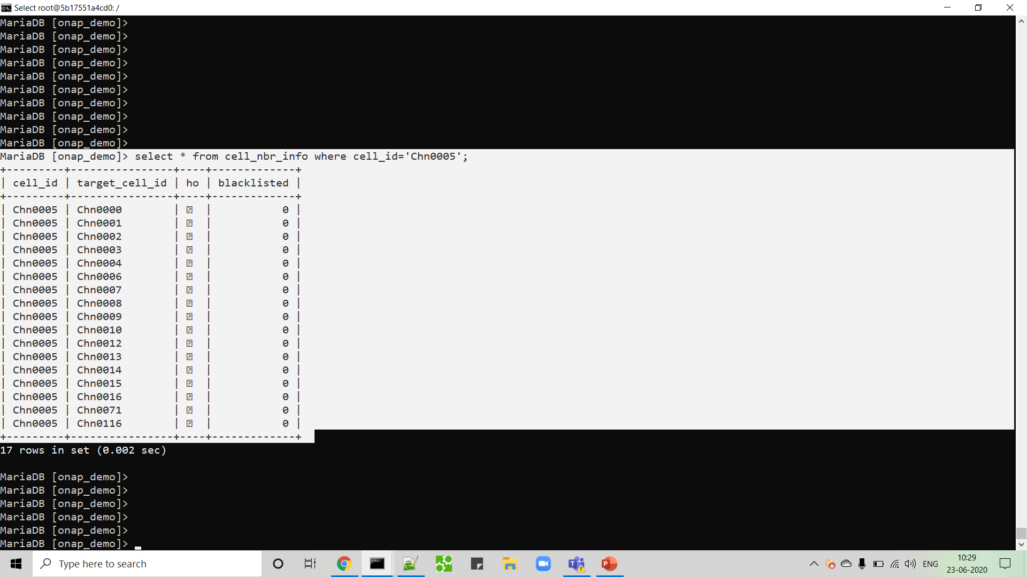
Step 1: Config DB (after CM-Notify)
Added:
Chn0012
Chn0071
Chn0116

Slide 19
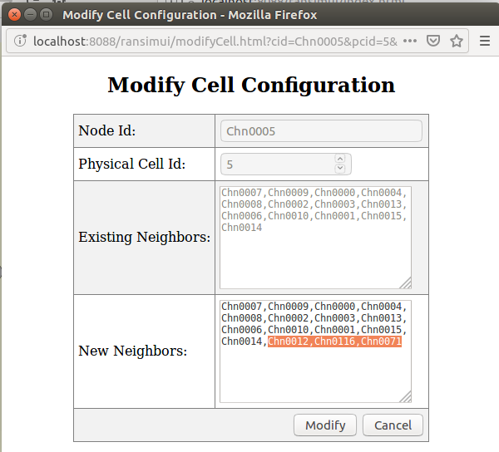
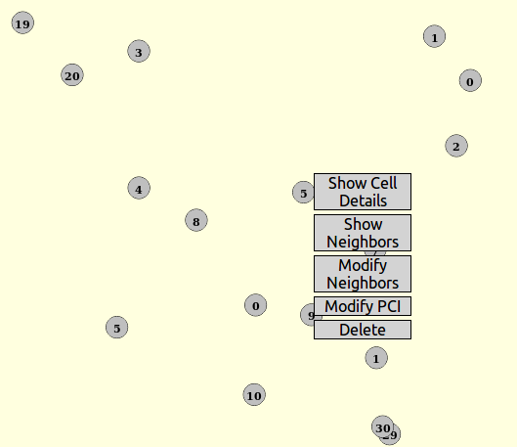
Step 2: Modify Neighbors - Illustration

Slide 20
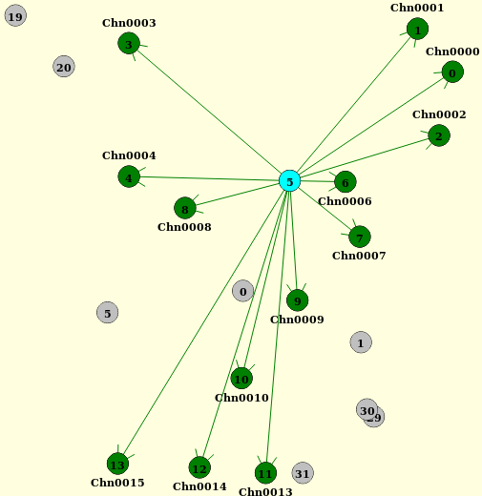
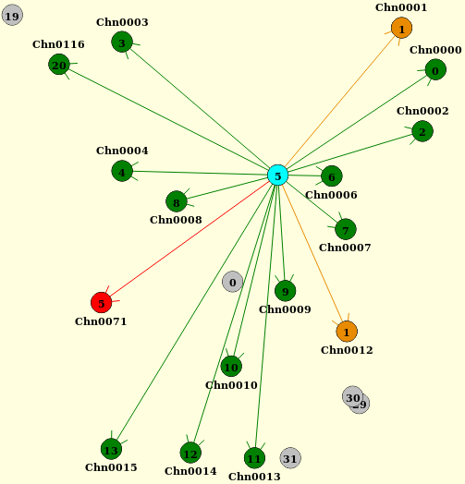
Step 2: Add neighbors to Cell with PCI = 5 (collision/confusion)
Original neighbors
After addition of 3 neighbors
Collision
Confusion

Slide 21
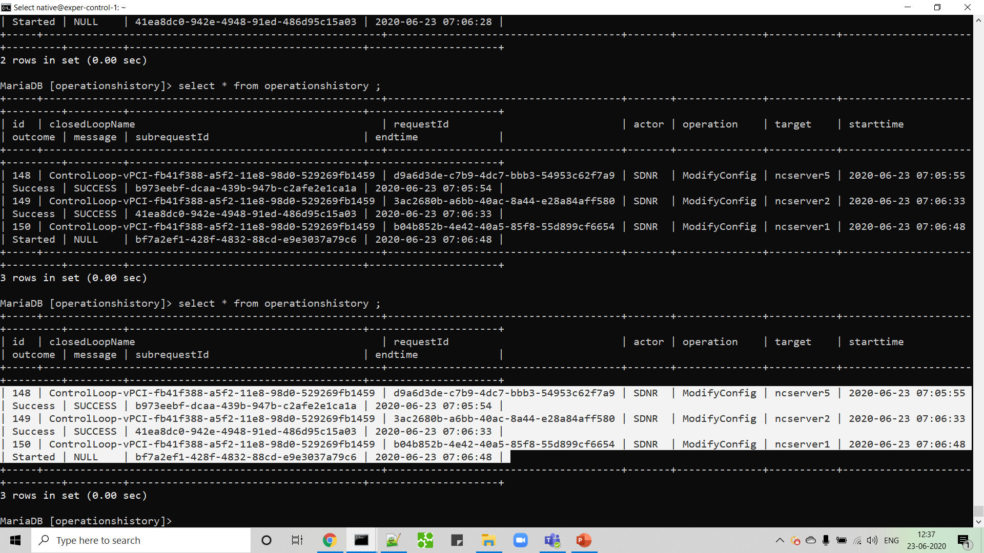
Step 3: Control Loop triggered

Slide 22
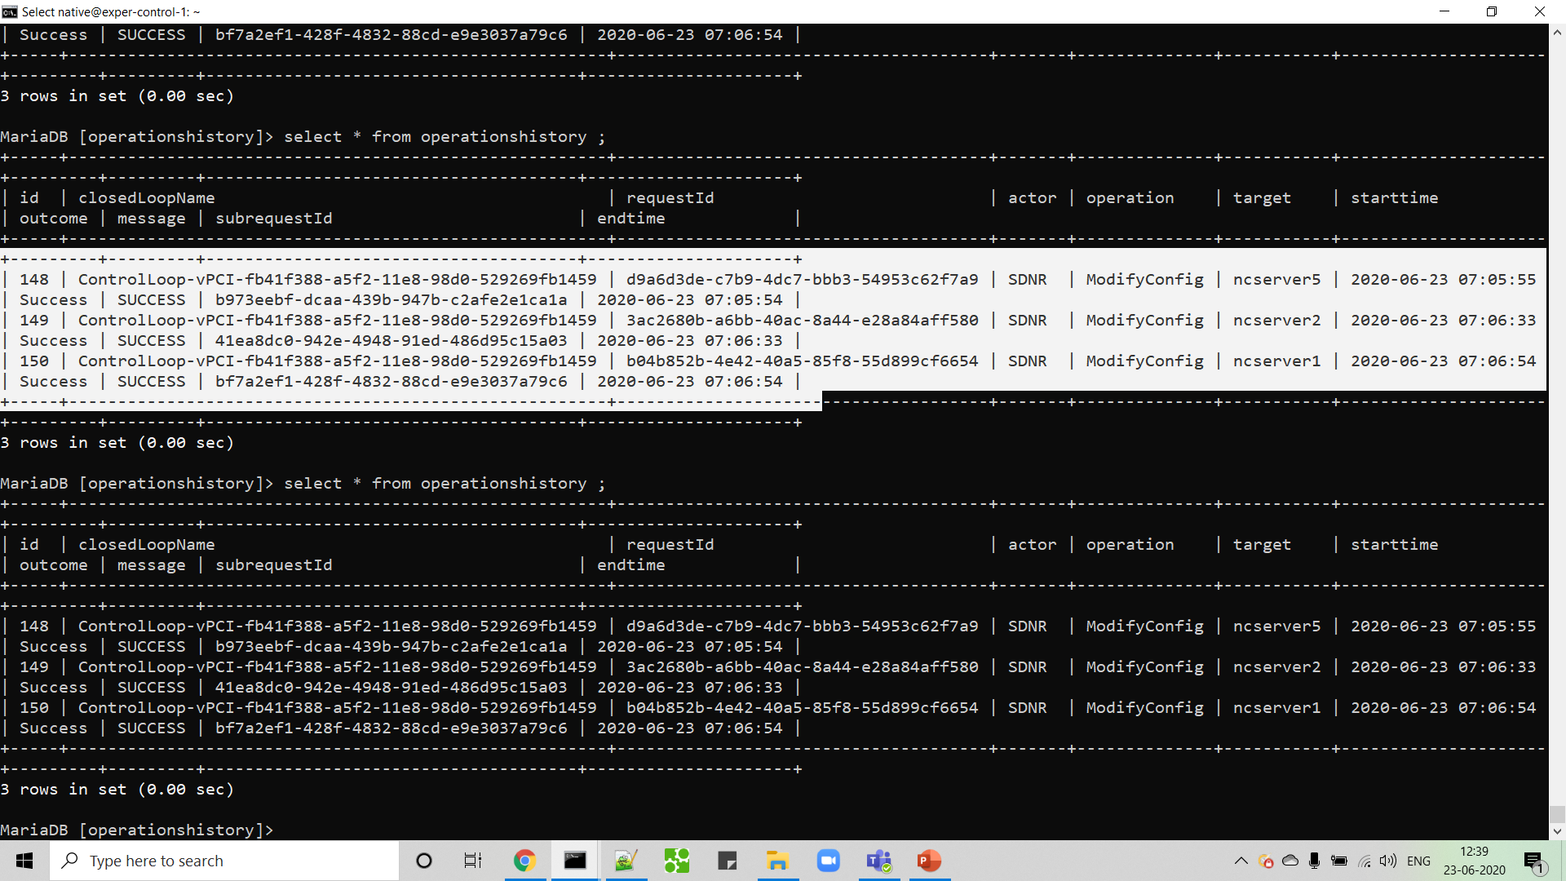
Step 3: Control Loop completed

Slide 23
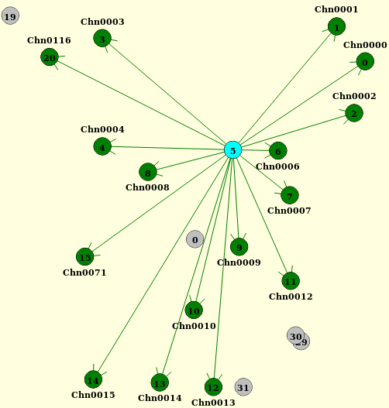
Step 4: PCI optimization completed
Before optimization
After optimization

Slide 24
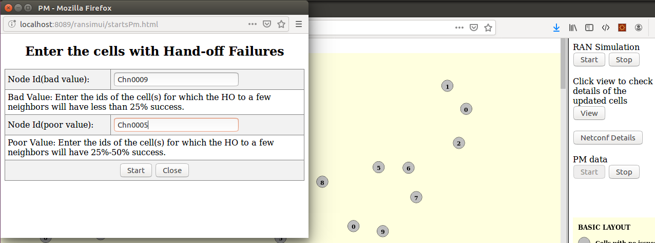
Step 5: Trigger PM Generation
Specify HO from which cells should be bad/poor.
Relevant for Centralized ANR update
Relevant for joint PCI-ANR optimization
Click “Start” to open the window shown on the left

Slide 25
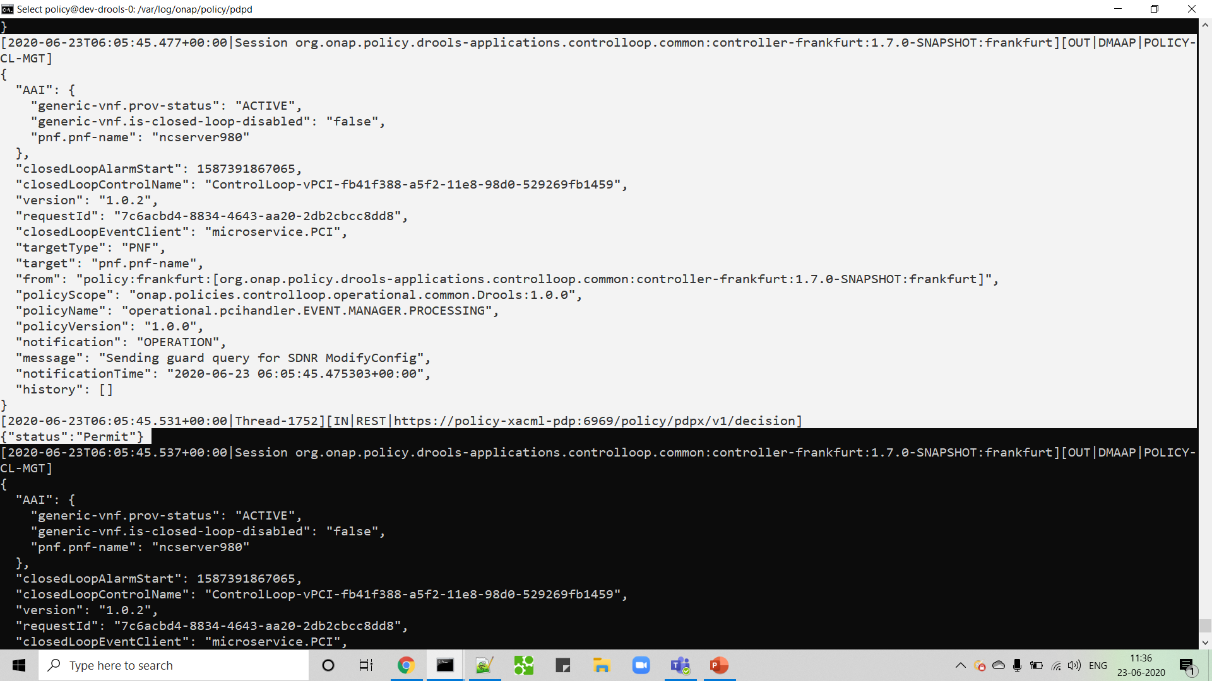
Step 6: Control Loop Coordination (Permit 1st Control Loop)

Slide 26
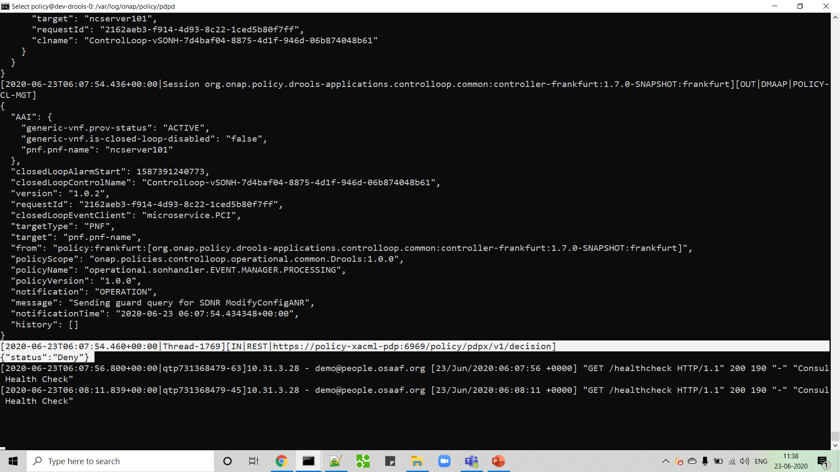
Step 6: Control Loop Coordination (Deny 2nd Control Loop)

Slide 27
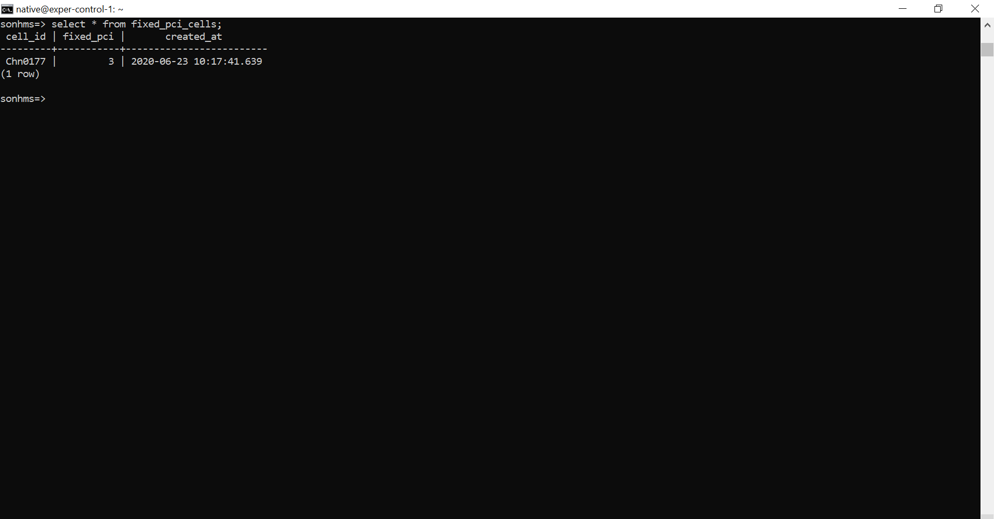
Step 8: Keep track of “Fixed PCI cells” (SON-Handler MS)

Slide 28
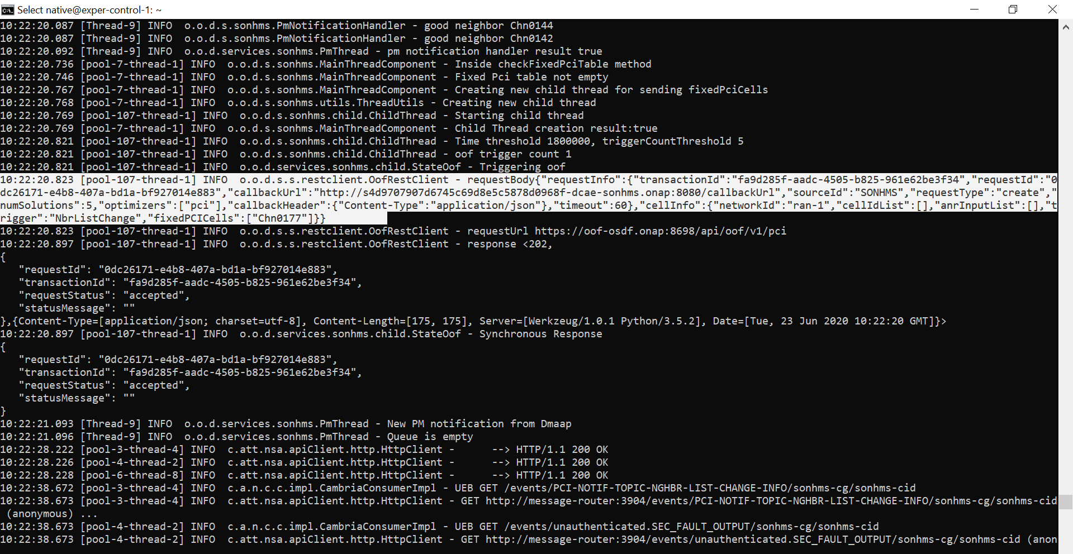
Step 8: Trigger OOF for PCI Optimization with “Fixed PCI cells”

Slide 29
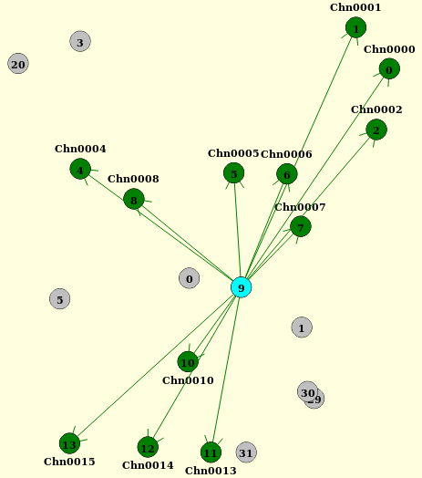
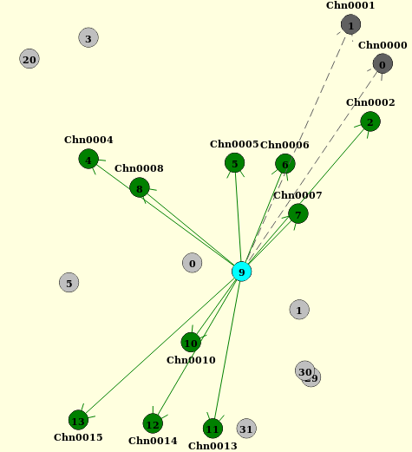
Step 9: Centralized ANR update completed
Original list of neighbors
HO blacklisted to 2 neighbors after ANR update
HO blacklisted
to chn0001 &
Chn0000 after
centralized
ANR update

Slide 30
Links for More Information
Description | Link
OOF-SON Main Wiki Page | https://wiki.onap.org/display/DW/5G+-+OOF+%28ONAP+Optimization+Framework%29+and+PCI+%28Physical+Cell+ID%29+Optimization
OOF-SON Dublin Release (Requirements and Test Cases) | https://wiki.onap.org/display/DW/OOF-PCI+Use+Case+-+Dublin+Release+-+ONAP+based+SON+for+PCI+and+ANR (See the child wiki pages for functional & implementation details)
OOF-SON Dublin Release Plan | 5G - OOF and PCI (Casablanca carry-over items)
OOF-SON Dublin PoC Demo video recording | https://wiki.onap.org/download/attachments/68539437/zoom_0.mp4?version=2&modificationDate=1563985740000&api=v2
OOF-SON Frankfurt Release (Requirements and Test Cases) | https://wiki.onap.org/display/DW/OOF+%28SON%29+in+R5+El+Alto%2C+OOF+%28SON%29+in+R6+Frankfurt (See the child wiki pages for functional & implementation details)
OOF-SON Frankfurt PoC Demo video recording | https://wiki.lfnetworking.org/download/attachments/40370243/ONAP_5G_OOF_SON_use_case_demo.mp4?api=v2

Slide 31
Thank You!

