Slide 1
Import TOSCA
Tali Orenbach

Slide 2
Agenda
During onboarding process, we wanted to give the ability to upload a CSAR file into a VSP.
This VSP got submitted, and its package got translated into a CSAR, which its structure is identical to the one that the catalog is expecting to get.

Slide 3
Input CSAR structure
!----- MainServiceTemplate.mf
!--- MainServiceTemplate.yaml
!------Definitions
  !----- OtherTemplates (e.g., type definitions)
!------Artifacts
  !----- install.sh
  !----- other artifacts
the structure of the CSAR files is very important,
and should be as follows –
  Manifest (.mf) file, named MainServiceTemplate.mf
  Definitions (directory)
  Artifacts (directory)
  MainServiceTemplate.yaml (root file)
  (The csar can contain also licenses and
  TOSCA-metadata directories)

Slide 4

Input CSAR structure
!----- MainServiceTemplate.mf
!----- MainServiceTemplate.yaml
!------Definitions
  !----- OtherTemplates (e.g., type definitions)
!------Artifacts
  !----- install.sh
  !----- other artifacts

Slide 5
Manifest file
Should include metadata section –
metadata:
vnf_product_name: <name>
vnf_provider_id: <id>
vnf_package_version: <version>
vnf_release_data_time: <time>

Slide 6
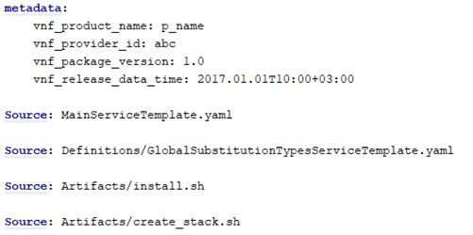
Manifest file
For every file that’s in the CSAR, we need to include a “source” line
source: MainServiceTemplate.yaml
source: Definitions/GlobalSubstitutionTypesServiceTemplate.yaml
This is neccessary for us to locate the files inside the csar.
if we will find a file that’s mentioned in the manifest,
but not in the csar (or the opposite),
we will throw an error.

Slide 7
Main service template
Need to be in the root of the csar
The yaml file contains a metadata section with template_name and template_version metadata. This file is the CSAR Entry-Definition file
This file uses as entry for parsing the contents of the overall CSAR archive
Inside it, we will have the topology_template definition

Slide 8
Definitions directory
Any TOSCA definitions file besides MainServiceTemplate.yaml can be found by processing respective imports statements in the entry definitions file (or in recursively imported files)
In these files, we will have node_types definitions

Slide 9
Artifacts directory
Any artifact file (e.g. scripts, binaries, configuration files) can be either declared explicitly through blocks in the manifest file or pointed to by relative path names through artifact definitions in one of the TOSCA definitions files contained in the CSAR file.

Slide 10
Upload network package
Reminder –
When we upload a network package into a VSP, we do :
Upload → save candidate
When the user presses on “proceed to validation”, we do :
Get candidate → validate → save TOSCA file

Slide 11
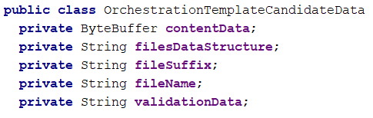
Import flow
When we import a network package, we recognize the import scenario that we need to do by the file extension
We save this information during upload
HEAT process and CSAR process have different flows

Slide 12

OrchestrationTemplateProcessHandler
When we press on “proceed to validation”, we call the “process” scenario
Since we have different flows for HEAT and CSAR, we call the corresponding OrchestrationTemplateProcessHandler
We get the handler by looking at the file extension we uploaded earlier

Slide 13
Process CSAR
No content validations
We have structure validations
Call to ToscaConverter

Slide 14
ToscaConverter
The yaml files inside the CSAR are in a different structure than what we work with in SDC catalog
We convert these files, so at the end the CSAR that we will send to catalog side will be valid

Slide 15
ToscaConverter
We convert MainServiceTemplate to look as expected in catalog side
We take all of the node types from the files under Definitions directory, and write them to GlobalSubstitutionTypesServiceTemplate
Artifacts are getting copied as is into Artifacts directory
The new CSAR is getting saved in the DB like the one that’s getting generated in HEAT scenario

Slide 16
ToscaTree
Right now, we don’t have TOSCA validations for the file content
We do return a files tree to present in UI validation screen

Slide 17
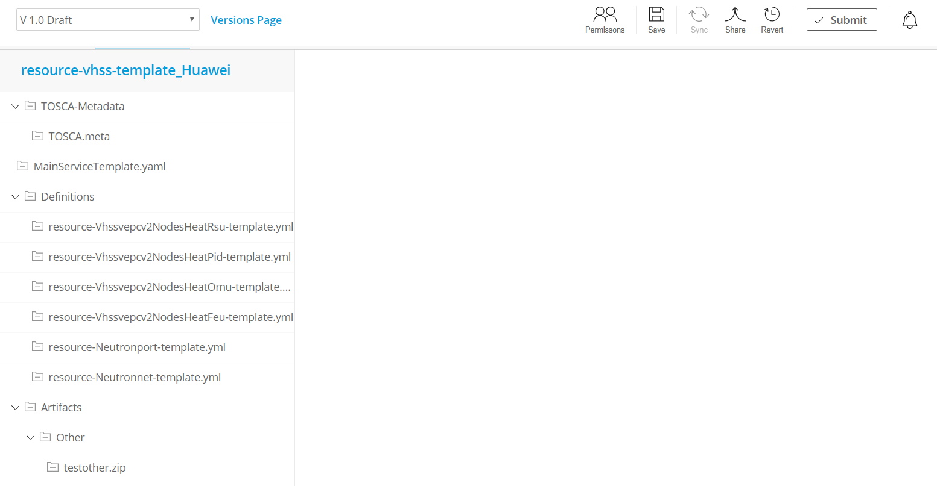
ToscaTree

