Slide 1
HLD - Cross-domain E-LINE Services with OTN NNI
CMCC, Huawei

Slide 2

Use Case Description
Portal
API
SDC
Changes Description:
  NNI handover between 2 OTN domain.
  E2E OTN tunnel across multiple domains
  E2E E-LINE service
SO
A&AI
SDN-C
Changes
RESTCONF protocol +
Standard transport NBI (e.g. IETF ACTN, T-API)
OTN topology YANG
OTN tunnel YANG
Client service YANG
Path computation YANG
SOTN Controller
SOTN Controller
UNI
OTN/DWDM
NNI
OTN/DWDM
UNI
100G+ Grey OTN
CPE
Ethernet
Ethernet
CPE
100G+ Grey OTN
Transport Domain
Transport Domain
OTN Tunnel
E-LINE
End-to-end VPN service

Slide 3
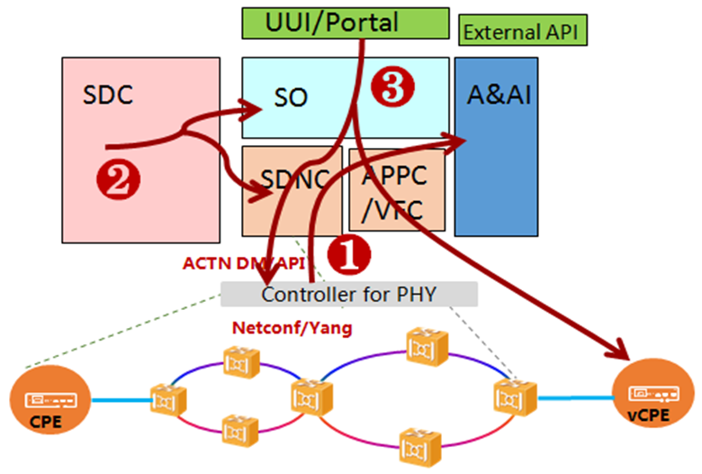
ONAP SOTN
Topology Discovery
Service Design
Service Provisioning

Slide 4
Topology Discovery
Current
Required
ONAP Topology
ONAP Topology
ETH topology 1
ETH topology 2
Abstract Ethernet Node1
Abstract Ethernet Node2
OTN topology 1
OTN topology 2
Standard NBI
Ethernet (topo)
Standard NBI
Ethernet (topo)
Standard NBI
Ethernet (topo)
OTN (topo, tunnel)
Standard NBI
Ethernet (topo)
OTN (topo, tunnel)
SOTN Controller
SOTN Controller
SOTN Controller
SOTN Controller
ETH
OTN NNI
ETH
OTN NNI
ETH
ETH
CPE
CPE
CPE
CPE
OTN NNI
OTN NNI
Transport Domain
Transport Domain
Transport Domain
Transport Domain

Slide 5
Topology Resources
ETH Topology
TP
ETH Node
TP
ETH Link
TP
ETH Node
TP
ETH Link
ETH Link
inter-layer-lock-id
inter-layer-lock-id
OTN Topology
OTN Node
TP
OTN Node
TP
TP
TP
LLCL
OTN Link
LLCL
TTP
TTP
AAI needs to have two layers (Eth and OTN) of topology.
Need to add Tunnel Termination Point (TTP) attribute to Topology Node.
TP in upper layer node (ETH Node) are associated with TTP in lower layer node (OTN Node) by inter-layer lock ID

Slide 6
Topology Resources in AAI
Ethernet Topology
Network-Resource
Note:
If network-resource can’t be extended, use a new type.
Also define a new type for TP if TP can’t be extended.
TP
(P-Intf)
TP
(P-Intf)
TP
(P-Intf)
TP
(P-Intf)
Node (PNF)
Link
(Logical-Link)
Node (PNF)
Ethernet Topology could be either comprised of abstract Ethernet nodes, or native Ethernet Nodes, or mix of both. For this we add an addition parameter “isAbstract” in Ethernet Node.
Logical link could be intra optical domain or inter optical domain or inter operator domain for this we add a new attribute
“LinkType” in Logical Link.
TP to have a new attribute “inter-layer-lock-id” to associate with OTN topology.

Slide 7
Topology Resources in AAI
TP
(P-Intf)
Ethernet Topology
OTN Topology
Network-Resource
Note:
If network-resource can’t be extended, use a new type.
Also define a new type for TP if TP can’t be extended.
TTP
TTP
TP
(P-Intf)
TP
(P-Intf)
TP
(P-Intf)
TP
(P-Intf)
Node (PNF)
Link
(Logical-Link)
Node (PNF)
Re-use network-resource and add a new attribute “NetworkType” to differentiate whether it’s a Ethernet topology of OTN topology
Re-use PNF as a OTN node & P-Intf as TP.
A new TTP node type is required in AAI. It should have OneToMany relation with TP
Also PNF needs to have OneToMany relation with TTP

Slide 8
Service Design
Beijing Approach
Dublin Approach
Requirement
CCVPN service
CCVPN Service
CCVPN Service
sdwan vpn resource
sdwan vpn resource
subnet
*
subnet
*
Site Service
SOTN Infra Service
*
*
subvpn
1
subvpn
1
SOTN VPN_Infra
site resource
sotn vpn resource
tnp
1-4
l2vpn
1
*
service
SPPartner
Site Service
site
1
site resource
SOTN Connectivity
*
Site Service
tnp
1-4
device
1-2
service
site
site NS
1
*
1
Internet Cloud Access
device
1-2
Device
Site
SD-WAN VPN Attachment
WAN
LAN
SOTNVPN Attachment
site NS
1
SPPartner

Slide 9
Service Design
Beijing
Change
SOTNConnectivity
SOTNConnectivity
Site
Name
Description
tenantId
vpnType
startTime
endTime
COS
Reroute
SLS
dualLink
Cir
Eir
Cbs
ebs
colorAware
couplingFlag
Name
Description
tenantId
vpnType
startTime
endTime
COS
Reroute
SLS
dualLink
Cir
Eir
Cbs
ebs
colorAware
couplingFlag
siteId
name
Description
location
clientSignal
CVLAN
sotnVpnAttachment
vpnName
tpId
CVLAN
Whether CVLAN needs to be specified
by user?
Site
siteId
name
Description
location
clientSignal

Slide 10
Service Provisioning
Involved & Impacted Components
UUI to adapt the new model and make request to SO accordingly.
AAI changes as depicted in next page
OOF changes for OTN path computation, Ethernet path computation?
SO only test efforts.
UUI
SO
AAI
SDNC resumes the responsibility of a super controller. SDNC retrieves both the OTN and the ETH topology from the NCE.
SDNC converts OTN and ETH topology from ACTN to AAI format and writes them to AAI
For E-Line service creation, SDNC sends down the OTN tunnel creation request to NCE, and then sends the E-Line service creation request.
SDNC
OOF

Slide 11
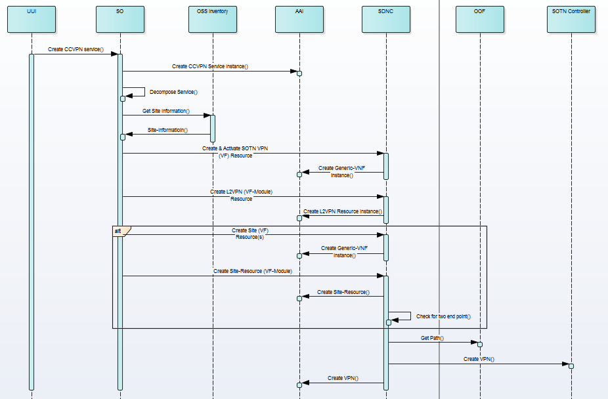
Service Provisioning Flow - Flow & APIs
API Details
UUI-SO:
/onap/so/infra/serviceInstantiation/e2eServiceInstances/v3
SO-SDNC:
Service Creation
/operations/GENERIC-RESOURCE-API:service-topology-operation
VNF Creation
/operations/GENERIC-RESOURCE-API:vnf-topology-operation
VF-Module Creation
/operations/GENERIC-RESOURCE-API:vf-module-topology-operation
SO-OOF:
/api/oof/v1/route

Slide 12
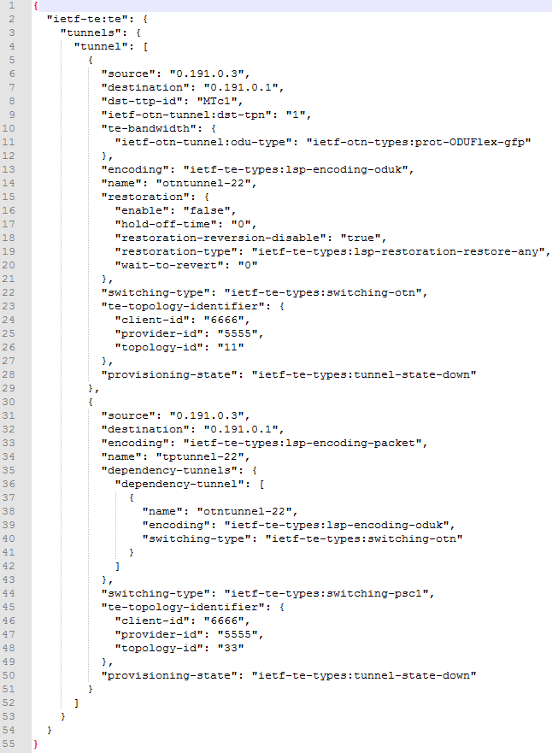
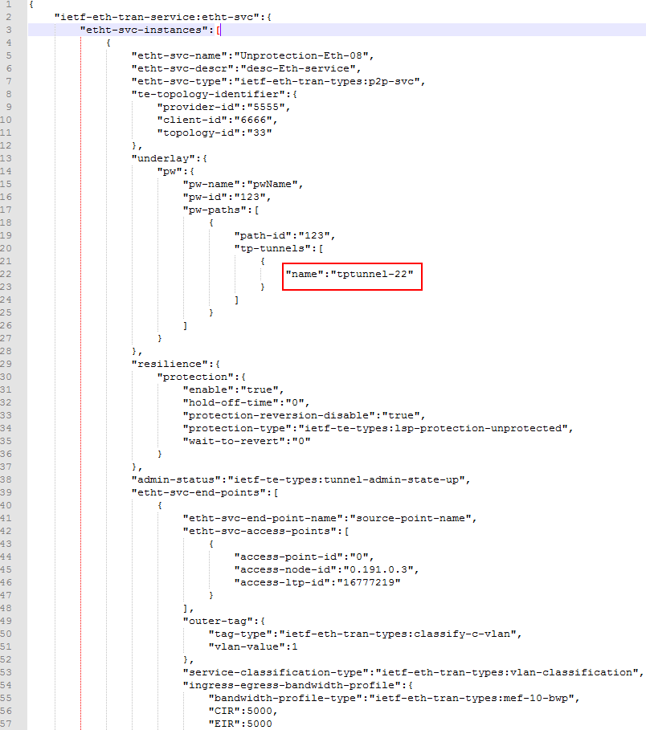
Service Provisioning – SB Request

Slide 13
Service Provisioning – E2E AAI View?
CCVPN Service
Site (Generic-VNF)
SOTN VPN (Generic-VNF)
Site (Generic-VNF)
Site-Resource
L2VPN (SOTN-Connectivity)
Site-Resource
vpn-resource
vpn-resource
TP
(P-Intf)
TP
(P-Intf)
TP
(P-Intf)
TP
(P-Intf)
TP
(P-Intf)
TP
(P-Intf)
Node (PNF)
Link
(Logical-Link)
Node (PNF)
Link
(Logical-Link)
Node (PNF)
Inter Domain Link
Created by SDNC
Intra Domain Link
No Change

Slide 14
Project Changes
Project | Code Change | Change Description
A&AI | Yes | OTN resources & Native Ethernet topology
SDC | No | SOTN based on new CCVPN Dublin model
UUI | Yes | Change in UUI Backend to adapt new template. UUI Frontend from VDF JIS can be re-used
SO | No | Ideally only Test efforts
SDN-C | Yes | OTN Topology discovery, Native Ethernet Topology discovery, Service provisioning based on NNI
OOF | Yes | OTN Path computation
Remark: Closed loop is kept out of current scope. Not a priority currently.
To be discussed further based on resource availability and interest from partners.

Slide 15
Thanks

Slide 16
Reference: IETF ACTN YANG Models as Standard
RFC
ACTN Information Model
draft-ietf-teas-actn-info-model
RFC
ACTN Framework
draft-ietf-teas-actn-framework
RFC
ACTN Requirements
draft-ietf-teas-actn-requirements
Reference
Augmentation
Topology Models
Network Topology Model
RFC 8345
Transport Client Service Model
RFC
WG
Client Service Model (ETH, client service)
draft-ietf-ccamp-client-signal-yang
RFC*
YANG Data Model for TE Topologies
draft-ietf-teas-yang-te-topo
Tunnel Models
Generic Models
WG
WG
YANG Data Model for TE Tunnel
draft-ietf-teas-yang-te
WG
Generic Scheduling Model
draft-liu-netmod-yang-schedule
OTN TE Topology Model
draft-ietf-ccamp-otn-topo-yang
WG
WG
OTN TE Tunnel Model
draft-ietf-ccamp-otn-tunnel-model
WSON TE Topology Model
draft-ietf-ccamp-wson-yang
WG
Generic Notification Model
draft-ietf-netconf-restconf-noti
WG
WSON TE Tunnel Model
draft-ietf-ccamp-wson-tunnel-model
ID
Ethernet TE Topology Model
draft-zheng-ccamp-client-topo-yang
OAM
WG
YANG Alarm Module
draft-ietf-ccamp-alarm-module
ID
ETH TE Tunnel Model
draft-zheng-ccamp-client-tunnel-yang
These models are deployed between ONAP SDN-C and transport SDN controller
SDN-C internal models for the modeling for PNF and abstract topologies are aligned with the IETF YANG models

