Slide 1
WhiteSource scan tool progress
Apr 08 , 2019

Slide 2
Background
ONAP using Sonatype Nexus IQ Server (CLM)
    Scan code policies and license threats.
    Jobs can be found: https://jenkins.onap.org/view/CLM/
CLM limitations:
    Has been working for Java, still giving few false positives
    JS scanned, not so good
    Lacks Python, C, C++, Go support
We need to introduce a tool that can cover these languages too.
<number>

Slide 3
Introduction to WhiteSource (Attributes)
WhiteSource is an open source security and license compliance management platform.
https://www.whitesourcesoftware.com/
Integrates with Jenkins among other CI servers
Uses Unified Agent
    Supports scanning of multiple package managers, build tools, source files, containerized environments and archives.
    Supports automatic dependency resolution.
    Binaries supported: jar, egg, tar.gz, tgz, zip, whl, gem, apk, air, dmg, exe, gem, gzip, msi, nupkg, swc, swf, tar.bz2, pkg.tar.xz, deb, rpm
    Languages supported: c, cc, cp, cpp, cxx, c++, goc, h, hpp, hxx, m, mm, c#, nupkg, cs, csharp, java, js, php, py, rb, swift, and many more.
    Tech support fast and responsive.
https://whitesource.atlassian.net/wiki/spaces/WD/pages/33718339/Unified%2BAgent
<number>

Slide 4
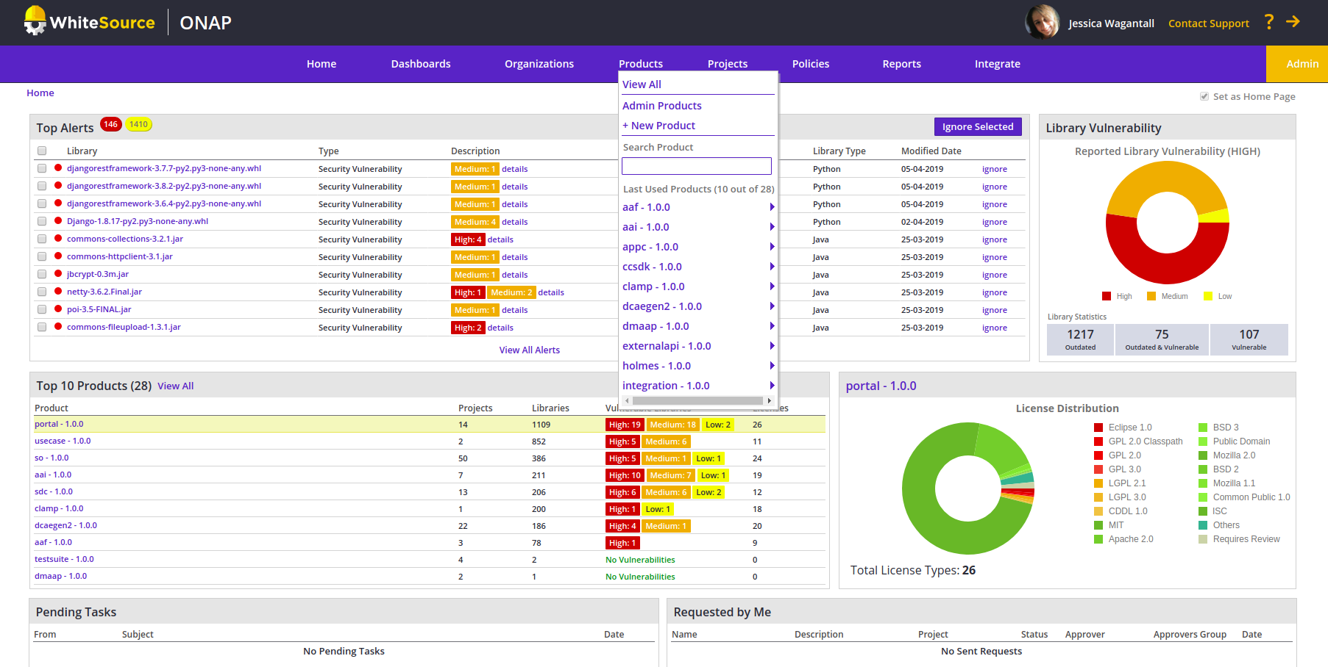
Dashboard Overview
<number>

Slide 5
Current work, challenges and next steps
Work done:
    Beta Global-jjb templates available: https://github.com/lfit/releng-global-jjb/blob/master/jjb/lf-whitesource-jobs.yaml
    All ONAP repos scanned, looking at dependency detection issues
    Steve W, reviewing results
Challenges:
    LDAP integration
    Dependency detection issues for some repos
Next steps:
    Review dependency issues with WS team
    Continue to improve global-jjb templates
    Unified Agent options under test
<number>

Slide 6
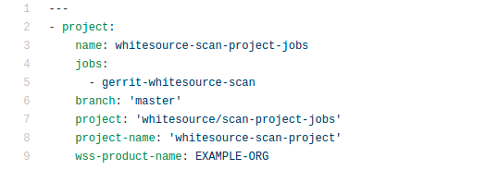
How can teams participate?
PTLs can be granted access. (RT)
WhiteSource job can be added in Jenkins.
Unified Agent adjustments can still be done:
https://whitesource.atlassian.net/wiki/spaces/WD/pages/489160834/Unified+Agent+Configuration+File+Parameters
CLM stays.
<number>

