Slide 1
MDONS
Status / Guilin requirements
April 2020

Slide 2
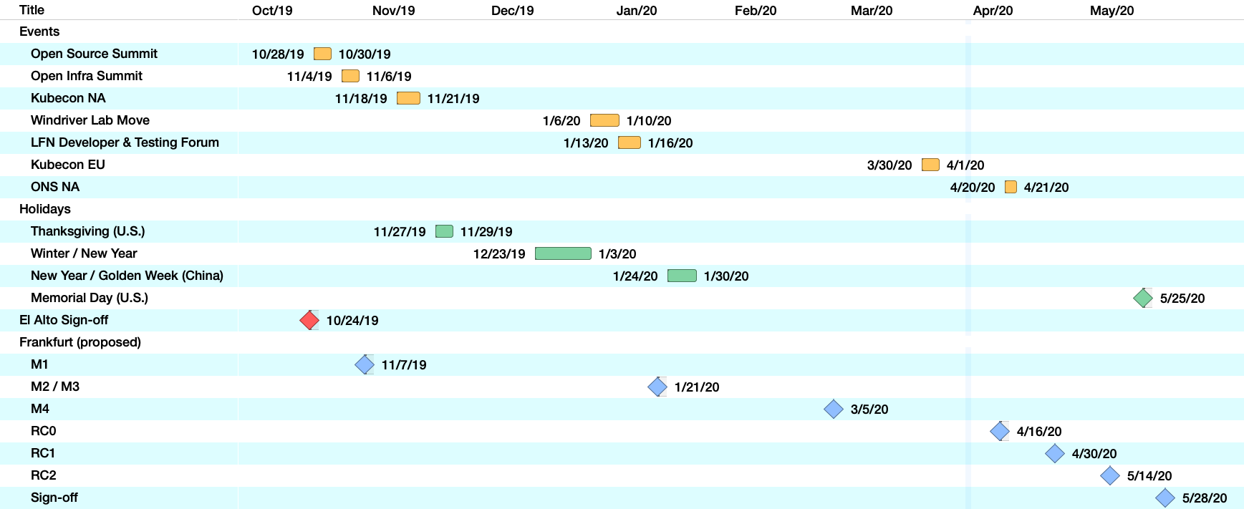
Frankfurt timeline (latest)

Slide 3
Frankfurt Rel. Status
Work Item | Status Update
MDONS Integration Testing Testbed setup in community Local verification in master branch Component branch out | Windriver connection set up – ongoing E2E LCM master branch verification – ongoing UUI, OOF, Policy, APPC, Multi-cloud, etc – Not yet branched
Controller API Simulator (integration) DC Simulator for NB API verification Enables integration test automation | Merge in progress
Documentation Enhance MDONS wiki page Potentially include sample service templates | Ongoing
ONAP Marketing Solution brief addition for MDONS Frankfurt Rel. Arch. white-paper updates | Provided updated info on MDONS to ONAP marketing team for inclusion in Frankfurt sol. Brief.

Slide 4
MDONS Guilin Work Items
Feature | Priority
Inter-domain optimizations (OOF) API to support IDL selection SDNC/DG interfacing OOF | 1
Asynchronous service activation handling (SO / SDNC) OpenROADM notification | 3
Service Assurance support (DCAE) Alarms / PMs – OpenROADM, T-API Notifications, Alarm types, Data collectors / adaptors (VES, JSON) Event types - Fault handling, OTN restoration | 2
Inter-carrier / ONAP instances support (External-API) Cross-carrier service decomposition Supporting endpoint/ENNI topology updates MEF Legato / Interlude enhancements | 2
Note: Adding supporting Virtuora NC enhancements for OpenROADM & T-API

