Slide 1
ONAP Dublin Release Highlights

Slide 2
Dublin Highlights - Use Cases
Use Case | Value in Dublin release
BBS (New) | Multi-gigabit residential connectivity over PON, Orchestration & LCM, change of location support for ONT (nomadic)
5G Enhancements | Better configuration and PNF support (including upgrade), perf. mgmt. & fault mgmt. (PM, FM) improvements, modeling progress for network slicing
CCVPN Enhancements | Dynamic addition of services, bandwidth on demand

Slide 3
Dublin Highlights – Requirements
Functionality | Value in Dublin release
k8s based cloud region support | Container based Network function support in Multicloud. We do not provide the full capability to onboard and deploy a CNF using ONAP
Control Loop Requirements | Common notification across all orchestrators/controllers Model Driven Control Loop based on Policy Model of DCAE micro-services
Consistent ID of cloud region | Simplified operations by ONAP users; previously cloud region ID between different modules was not consistent
VSP Compliance check | While VSP on-boarding in SDC, operator specific VNF compliance check is enabled using VNF Test Platform (VTP)
Scaling Enhancements (Continuation) | Ease of use enhancements
HPA Enhancements (Continuation) | Ease of use enhancements
Change Management - Extensions | Model-driven change schedule optimization, traffic migration and user-defined workflows, PNF software upgrade and roll-back
Distributed Analytics as a service (POC) | Metric/log collection and correlation/analysis are performed closer to the data

Slide 4
Dublin Release – Non-functional requirements
E2E Automation – Zero Touch Provisioning
  ONAP has extend the use of SO macro orchestration building blocks to include post instantiation configuration for any config provisioning Network Function operation, such as day0, day1 or day2 leveraging the CDS run time capabilities.
  Dublin has evolved the controller design studio, as part of the controller framework, which enables a model driven approach for how an ONAP controller controls the network resource
Foot print optimization
  Docker optimization
  Sharing DB
Security
  xNF communication security enhancements.
  O-Parent Integration to fix vulnerabilities
  Security by design improvements
CI/CD Improvement with OOM gating

Slide 5

Functional Capability — Controller Design Studio (CDS)
ONAP community in Dublin release has evolved Controller Design Studio (CDS) to cloud native microservice’s solution.
CDS part of the CCSDK controller framework, is a mean to provide Generic NF Controller functionalities with it's plugin/extensible architecture.
The design time content of the controller blueprint package (CBA) is driven from a controller catalog of reusable data dictionary, component and workflow enabling the promise of Zero Touch Declarative Provisioning.
Runtime Architecture
Blueprint Processor
Dublin Platform Use Cases
Self Service API
GRPC
Process
HTTPs
Instantiation
  vDNS
  Post-instantiation (VNF)
    vDNS
  Manual Scale Out
  vDNS
  Closed Loop Scale Out
  vDNS
  5G Plug & Play (PNF)
    Config Assign & Config Deploy
Workflow Engine
Component (execution)
Resource Resolution
Scripts (Python, Kotlin)
Velocity
Jinja
DB
Rest
Netconf
Restonf
ONAP / 3rd party systems
Networks / xNFs / Devices
AAI
Netbox
…

Slide 6
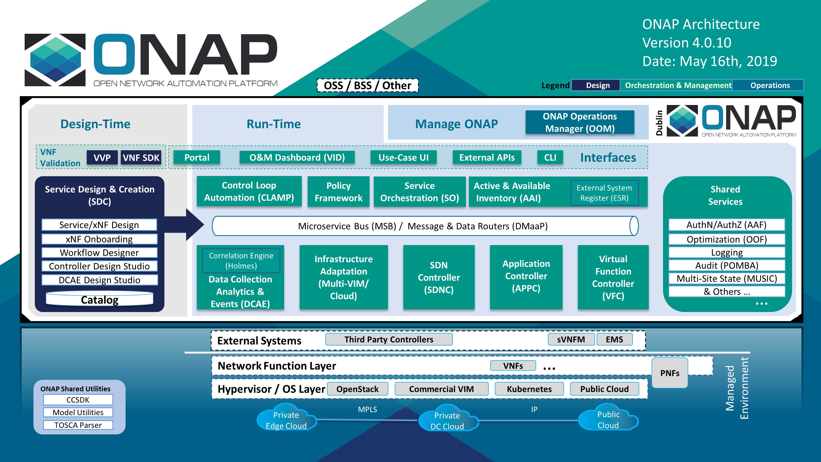
ONAP Dublin Architecture Block Diagram

Slide 7
New Use case — BBS
BBS Broadband Service
  Multigigabit residential connectivity
  Using PON
ONAP integration
  Design, provisioning, lifecycle management
  Subscriber’s HSIA (High Speed Internet Access) service
  Change of location of ONT (nomadic ONT)
  HSIA service subscription plan changes & service assurance

Slide 8
Use case enhancements — 5G
PNF Support
  PNF package pre-onboarding and onboarding (using SDC)
  Configuration with NETCONF
  PNF plug and play
  PNF software upgrade with rollback (using Ansible)
Optimization
  Bulk performance measurement
  OOF & PCI
Network Slicing
  Modeling to support Network Slicing

Slide 9
Use case enhancements — CCVPN
Service change management to allow the customer to dynamically add branch sites or value-added services (e.g. vFW)
Intelligent bandwidth on demand
Allow third party analytics applications to trigger ONAP close loop for adjusting the running CCVPN service instances
  e.g. the bandwidth between specified sites

Slide 10
Functional Capability — k8s region
Support for deploying Containerized Network Functions (CNFs) alongside VM based VNFs
  Using Helm Charts
  Kubernetes based cloud region support through MultiCloud/k8s plugin
Scope includes vFirewall use case
  Hybrid model of Firewall and Traffic Generator as Containers, and Sink as a VM.
Scope also includes Linux Foundation EdgeXFoundry project use case

Slide 11
Functional Capability — Control Loop
Unified APIs used by Controllers and Orchestrators
  Before Dublin, API for Control Loop actions (reboot, scale out, modify config, etc.) varied by the controllers/orchestrators (eg. SO, VFC, APPC)
  Goal was to develop Event based Common Notification messaging format for Control Loop Operations
  Model Driven Control Loop using Policy model of DCAE Micro services
Note: It still needs to be confirmed on what has been accomplished in Dublin

Slide 12
Functional Capability — Change Management
Model-driven change schedule optimization to discover conflict-free schedules conforming to concurrency constraint
Workflow for traffic migration with discovery of destination nodes and anchor points
Invocation of user-defined workflow for executing the change
Ansible-based 5G RAN PNF software upgrade and roll-back (see also 5G Use Case)

Slide 13
Functional Capability — VSP Compliance Check
Adds dynamic checks within SDC to (1) Query a certification repository such as OVP to what certification a VNF has undergone and (2) invoke VTP to run custom Ad-hoc testing (checks) against VSP (VNF) prior accepting the VSP (VNF).
metadata values passed by the VSP package can contain values that are not compliant with either general ONAP requirements or specific requirements of the CSP installed deployment environment. That can lead to VNF deployment failure. Reducing the risk of such failure can be achieved by checking the metadata passed by the VSP against criteria in VTP or third-party testing frameworks. Examples of metadata passed by the VSP to be checked for compliance against a specific deployment environment are:
  Compute flavor check as to whether it is supported by underlying NFV Infrastructure.
  SR-IOV PCIe Pass through to a specific Network Interface Card as to whether that is available in the underlying NFV Infrastructure.

Slide 14
Project by Project Updates

Slide 15
A&AI
Enhancements primarily related to the functional use cases
All changes are backward compatible except for changing the key of the PNF object to pnf-id from pnf-name

Slide 16
APPC
Platform maturity (S3P)
OpenDaylight (ODL) Fluorine SR1 upgrade
Multiple standalone ansible server support
Documentation updates such as:
  LCM API Guide
  Release Notes
  CDT GUI Guide

Slide 17
CLAMP
Platform maturity (S3P)
Make the support of new micro-service generic by implementing policy-models concept together with DCAE-DS/SDC and Policy-engine
Opendaylight fluorine SR1 upgrade
Multiple standalone ansible server support

Slide 18
CLI
Enabled service specific CLI commands
VNF Test Platform (VTP) is using the Open Command Platform (ocomp) provided by this CLI project to model and run the test cases for compliance and life-cycle actions
End-End service provisioning using CLI is enabled, useful for automations and CI/CD

Slide 19
CCSDK
New Controller Design Studio (CDS) for model driven configuration and lifecycle management via APP-C/SDN-C
Upgrade to ODL Fluorine release
Support following VNF’s from previous releases:
  VNF: vFW -> Use case: VNF configuration change
  VNF: vLB/vDNS -> Use case: VNF (or VF module) scale out
  VNF: vCPE -> Use case: VM reboot (more generally, infrastructure management)
  VNF: VoLTE
  VNF: CCVPN

Slide 20
DCAE
  New microservices suite of collectors/event processors/analytics:
  Collectors: RESTConf collector
  Event Processors: VES/Universal Mapper, PM-Mapper
  Analytics/RCA: SON-Handler (former PCI-Handler), Heartbeat, TCA-Gen2
Common SDK for DCAE services
DCAE component enhancements for security, logging, resilience
Support HELM chart deployment using Helm Cloudify Plugin
Healthcheck enhancement
Multisite K8S cluster deployment support for DCAE services (via K8S plugin)
Dynamic AAF based topic provisioning support through Dmaap cloudify plugin
Dashboard Integration (UI for deployment/verification)
PolicyHandler Enhancement to support new Policy Lifecycle API’s
Blueprint generator tool to simplify deployment artifact creation

Slide 21
DMaaP
Message Router enhancements
  Upgrade Kafka to v1.1.1
  Support for Authenticated topics
  Add scaling support
  Support for multi-site applications
  Added MirrorMaker to allow for message replication across Kafka clusters
Data Router enhancements
  Data Router updates to support Bulk PM use cases
Bus Controller enhancements
  DMaaP Provisioning via Bus Controller

Slide 22
External API
Service Inventory API enhancements
  Notifications
  Additional enhancements
Application status API enhancements
Allow internal components of ONAP such as SO to communicate externally
Service Order API enhancements
SDC TOSCA jar to parse Service CSARs

Slide 23
Holmes
Integration with AAF to implement authorization and authentication

Slide 24
MSB
Provide access to new version of ONAP APIs
S3P requirements
Support Service Mesh efforts
Continue to support all use cases

Slide 25
Modeling
Microservice based TOSCA Parser
Foundational work for 5G Network Slicing

Slide 26
MUSIC
Provide MUSIC as a fully sharded, scale out common service
  Many ONAP sites/component replicas can be added as required for performance
Ease of deployment, performance
Foundational work for edge computing
Seed code for RDBMS clustering

Slide 27
MultiVim / MultiCloud
Continued enhancements for OpenStack StarlingX, Lenovo ThinkCloud, Azure, k8s, WindRiver, VIO Add SDC client to retrieve of workload artifacts from SDC
Security improvements and footprint reduction

Slide 28
OOM
Improving platform health monitoring
Starting migration to single "shared" database instances that will also reduce footprint
Initial multi-site Kubernetes Cluster support

Slide 29
OOF
Extend Homing/Placement optimization workflows to Traffic Distribution optimization required by the change management use case.
  This also opens up opportunities for placement to happen at the granularities of VF Modules, and integration with Fine Grained Placement Service (F-GPS) in subsequent releases.
Extend PCI (Physical Cell ID) optimization to include optimization for ANR (Automated Neighbor Relations)

Slide 30
Policy
Reliability improvements
New APEX Policy Decision Point (PDP) Engine
  Supports policies in Javascript, Python, Ruby, and MVEL
Policy API - Lifecycle API that supports onboarding Policy models/templates and the creation of raw policies from the models/templates.
Policy PAP (2nd Gen) - PAP component that allows PDP engines to be grouped
Policy XACML (2nd Gen) - lightweight XACML PDP

Slide 31
Pomba
SDNC Context Builder, including support for multiple APIs
Native discovery from Network (Openstack) via Network Discovery Context Builder
Support for additional resource types (PNF, pserver, network, logical link, l-interface, P-interface)
Additional report fields
Additional security (https)
End to end transaction tracing
Error reporting enhancements
Dictionary integration (Proof of Concept)

Slide 32
Portal
I18N/L10N support
Reporting feature enhancement in portal/sdk
Angular 6 Upgrade of Portal and SDK
Improved logging
Additional testing for new features, platform level soak with random transactions

Slide 33
SDC
VSP Compliance check for operator specific VNF testing
PNF Onboarding & package security
SOL001 v2.5.1 support
CDS integration
S3P related changes

Slide 34
SO
Standards alignment
  VNFM SOL003 adapter support
Extensions/enhancements to support
  CCVPN
  Change Management
  PNF
  BBS
  HPA
  5G Support
Support Multi Cloud for cloud agnostic orchestration
S3P, documentation updates

Slide 35
SDNC
SDNC Network Discovery enhancements
  Native support for OpenStack
  Discovery of attributes for the following resources
    VM
    Network
    Port
Platform maturing (S3P) enhancements

Slide 36
VF-C
Functional Enhancement
  Upgrade Multicloud API to support consistent identification of cloud region
  OOF Integration Optimization of methodology for VNF(vdu) placement, add the process for placement with selected candidates(VIM)
  Align VNFD SOL2.5.1 and model multi-version support
Standard Alignment
  SOL005 Alignment
    Existing APIs alignment
    Add the APIs which supported in SOL005, such as package subscription and notification
    Maturity Enhancement
  Mysql DB migrate to OOM shared MariaDB Galera Cluster
  Configuration inject automatically
  Add data persistent storage to avoid data loss due to pod restart
UUI
SDC
SO
Catalog
NSLCM
GVNFM
Driver
OOF
Drivers
DB
ESR/AAI
Multivim
SVNFM
EMS
Note1: components listed here don’t contain all VF-C components, only used to highlight Dublin work .

Slide 37
VNFREQ
Bug fixes, maintenance and feature alignment of VNF Guidelines, VNF Requirements and VNF Test Descriptions
Documentation updates:
  The VNF Provider use cases for autoscaling documented
  The VNF Test Descriptions to reflect test implementations planned by other projects ( VVP, VNFSDK, etc.)
  Categorization of VNF Requirements to support ONAP VNF Badging & certification initiatives

Slide 38
VNFSDK
  Support PNF Package basic Validation
  Additional APIs to streamline test triggering and information gathering
  VNF Test Platform (VTP) is enabled with scenario and test casse execution management
  VTP is integrated with SDC to support VSP compliance check

Slide 39
VVP
  S3P

Slide 40
VID
  Initiate workflows designed in SDC
  Change Management Dublin Extensions
  Utilize SO as a repository of workflows, instead of VID's workflows' configuration
  S3P improvements

Slide 41
UUI
  Integration with data lake for VM/VNF monitoring via alarm/perf. data search
  New Customer management UI
  Use Portal I18N/L10N features
  Platform maturity (S3P)

Slide 42
Backups

Slide 43
Project Impact due to Use Cases
Use case
 | SDC | VID | Port | SO | AAI | SDNC | APPC | DCAE | OOF | Policy | CLAMP | DMaaP | AAF | VNFSDK | REQ | Model | OOM | VIM | PNDA | CIA | CLI | Consul | VFC | MCloud | UUI
5G
CCVPN
BBS
OSAM
Note: CCVPN functionality is not completed – code not merged in SDC in Dublin so it might not be green

Slide 44
Project Impact due to added Functionality
Feature
 | SDC | VID | Port | SO | AAI | SDNC | APPC | DCAE | OOF | Policy | CLAMP | DMaaP | AAF | VNFSDK | REQ | Model | OOM | VIM | PNDA | CIA | CLI | Consul | VFC | MCloud | UUI | CDS
k8s based cloud region support
Control Loop Requirements
Scaling Enhancements
HPA Enhancements (Continuation)
Change Management - Extensions
SO-VNFM Plugin

