Slide 1


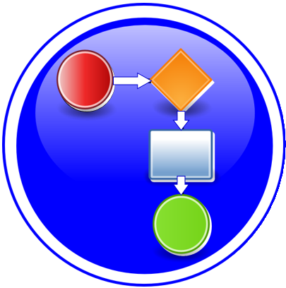


Modeling, Use Case and Architecture Process
ONAP Way of Working
Benjamin Cheung, PhD
May 06, 2019 version 1

Slide 2
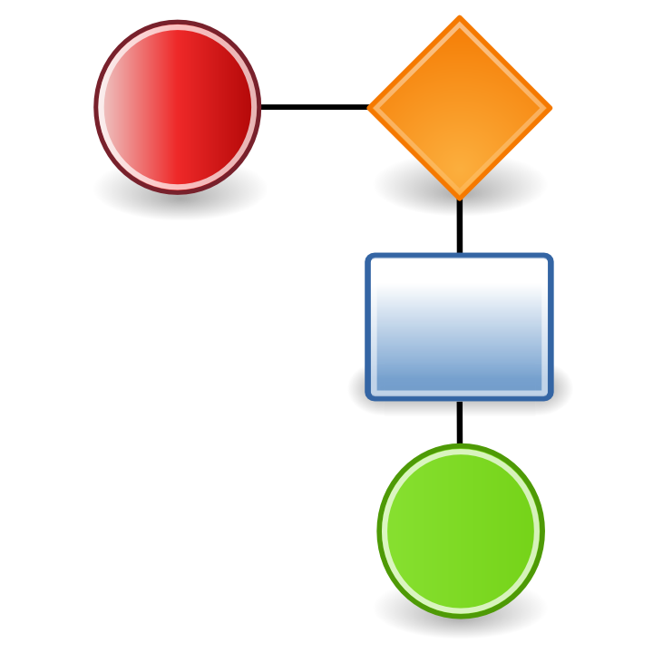









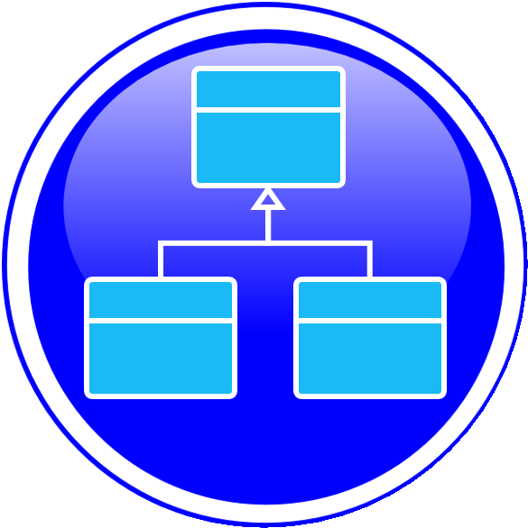

Modeling Process
High Level Model Req
Experimental Model
Preliminary Model
Approved Model
Approved Model
WHAT
Model Planning
Input model
Discussion Model
Data Model Freeze
Clean Model
High Level Model
Requirements
Model Plan Work
Refine Model
Approve Model
Model Launch
Model Final
Model Freeze
M0 Kickoff
M1 Planning
M2 Functionality
M3 API Freeze
WHEN Timeline
Model S/C
Model S/C
Use Case Team
Model S/C
Architecture
Model S/C
Use Case Team
WHO
Model S/C
Model S/C
Use Case Team
Model S/C
Model S/C
Use Case Team
Use Case Team
Platform Project Teams
Architecture
Use Case Team
Before M0 to
M0 Kickoff
From M0 Kickoff to
M1 Project Planning
-
M1 Project Planning to
M2 Functionality Freeze
M2 Functionality Freeze to
M3 API

Slide 3

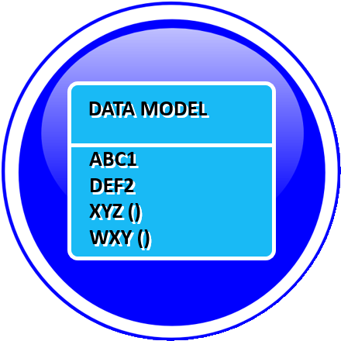
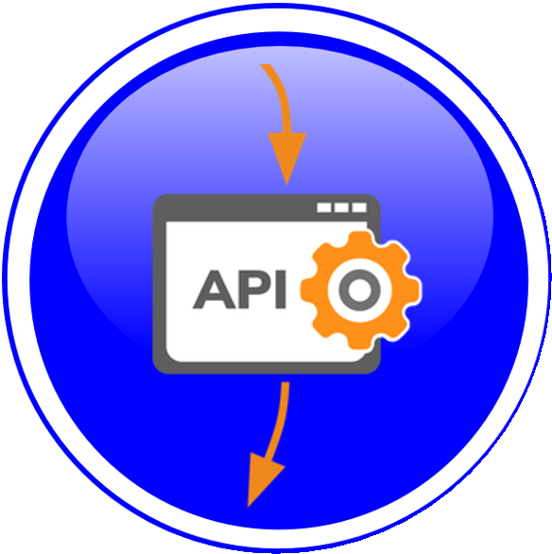
Modeling Process
High Level Info
Requirements
Introduce
Info Model
Refine
Info Model
Info Model
Freeze Final
Tweaks on
Info Model
M0 Kickoff
M1 Planning
M2 Functionality
M2 Functionality
M3 API Freeze
INFO MODEL
Model Planning
Input model
Discussion Model
Clean Model
Refinements /update from
Build team
Use Case
Proposal
U/C Definition
Refine Data
Work
Refine Data
Model
Data Model
Freeze
M0 Kickoff
M1 Planning
M2 Functionality
M2 Functionality
M3 API Freeze
DATA MODEL
Input Data Model
Discussion Data Model
Clean Data Model
Use Case
Proposal
U/C Definition
U/C Design
API Approve
API Freeze
U/C Design
M0 Kickoff
M1 Planning
M2 Functionality
M2 Functionality
M3 API Freeze
API
Preliminary API
API
eCOMP Models

Slide 4


Architecture Process
U/C Proposal
Drafting Func
Arch
Refining Func
Arch
Review Func
Arch
Review with TSC
M1 Planning
-
M3 API
-
M2 Functionality
TSC
Functional Arch
Draft Functional
Architecture
Recommended Functional
Architecture
Approved Functional Arch
(Arch S/C)
TSC Approval of
Functional Architecture
U/C Proposal
Draft Component
Arch
Refine Component
Arch
Review with
Arch S/C
Review with TSC
M1 Planning
-
M3 API
-
M2 Functionality
Arch review process
Look at APIs
Joint arch/Modeling
aspects API review
Component Arch
Draft Component
Architecture (PTLs)
Updated Component
Architecture
Recommended Component
Architecture
(Arch S/C approval)
Approved Component Arch
(Milestone Review)
Use Case
Proposal
U/C Definition
U/C Design
API Approve
API Freeze
U/C Design
M0 Kickoff
M1 Planning
M2 Functionality
M2 Functionality
M3 API Freeze
Arch Enhancements
Story & Jiras
Architecture requirements
Approved enhancements
Integrated into Arch
Enhancement Proposals
Testing of Enhancements
Modularity
Arch improvements
Treated like a U/C

Slide 5
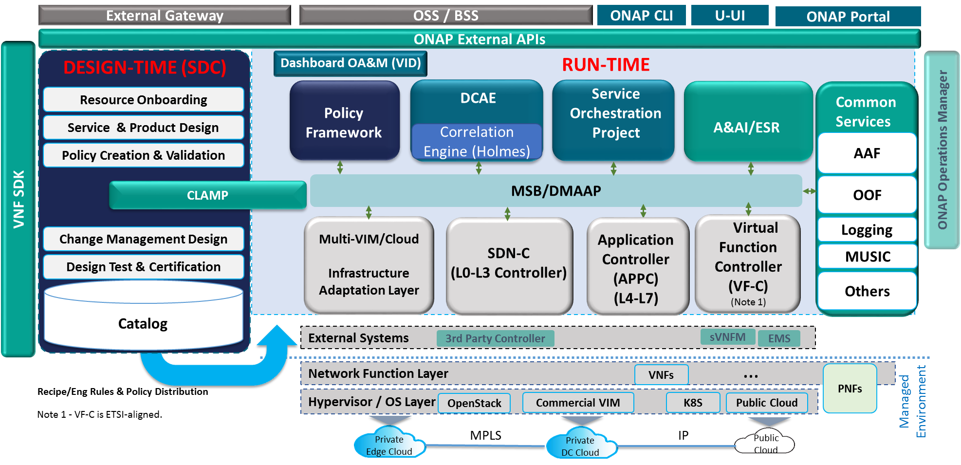

Slide 6



Use Case (U/C) Process
U/C Proposal
U/C Definitions
U/C Design
U/C Software
Test Integration Plans
WHAT
U/C S/W deliverables
VNFRQTS Requirements
Data Model (Defined)
U/C Proposal Approved
& base Wiki U/C page
Epics, Stories (“HiLvl Req”),
Business Drivers
APIs, S/W design,
Platform S/W
Test/Integration plans
U/C Proposal
U/C Design
API Model
U/C Definition
U/C Develop
U/C Test
M0 Kickoff
M1 Planning
M2 Functionality
WHEN Timeline
M3 API M4 Code Freeze
Seq interaction diagrams
Shared info across component
U/C Team
Model S/C
Use Case Team
Model S/C
Architecture
Model S/C
Use Case Team
Use Case Team
WHO
Use Case Team
Model S/C
Use Case
Team
Use Case Team
Use Case Team
Use Case Team
Architecture
Platform Project Teams
Platform Project Teams
Platform Project Teams
Before M0 to
M0 Kickoff
From M0 Kickoff to
M1 Project Planning
M1 Project Planning to
M2 Functionality Freeze
M2 Functionality Freeze to
M3 API M4 Code
M3 API M4 Code to
RC0 Integration

Slide 7


Architecture Process
U/C Proposal
U/C Definitions
U/C Design
U/C Software
Test Integration Plans
WHAT
Component Architecture Reviews
U/C Proposal
Functional Architecture
Functional Architecture Approved
API Documentation Freeze
Test/Integration plans
U/C Proposal
Arch Definition
Arch Refined
Arch Reviewed
U/C Develop
U/C Test
M0 Kickoff
M1 Planning
M2 Functionality
M3 API M4 Code
WHEN Timeline
U/C Team
Model S/C
Use Case Team
Model S/C
Architecture
Model S/C
Use Case Team
Use Case Team
Use Case Team
WHO
Use Case
Team
Model
Use Case
Team
Architecture
Use Case
Team
Architecture
Architecture
Architecture
Before M0 to
M0 Kickoff
From M0 Kickoff to
M1 Project Planning
M1 Project Planning to
M2 Functionality Freeze
M2 Functionality Freeze to
M3 API M4 Code
M3 API M4 Code to
RC0 Integration

Slide 8
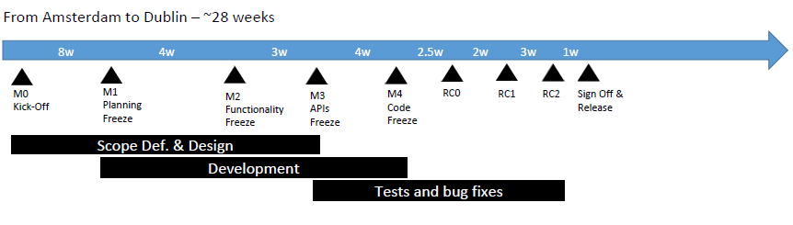
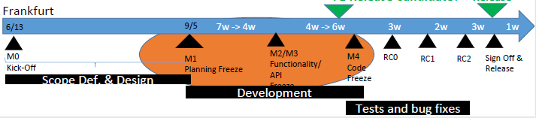
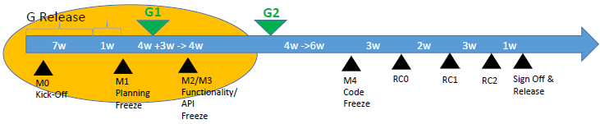
Release D/(E)/F/G Timelines
R4 DUBLIN
R6 FRANKFURT
R7 GUILIN
-

Slide 9
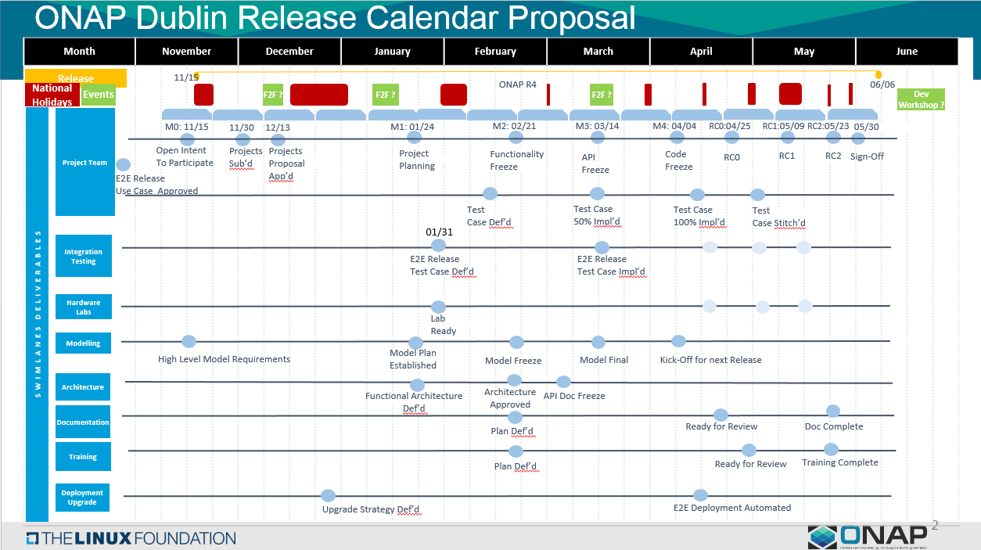
Data Model Final
Data Model Approved/Freeze
Info
Info
M3: Architecture reviews (project by Project)
M3: Project review + Arch Review
What you produce/consume models
Info Model Launch/Clean/Approved
Freeze under change control
Info Model Freeze
Done no more changes

Slide 10
Model & Use Case Development
M0 Kickoff
M1 Planning
M2 Functionality
M3 API Freeze
M4 Code Freeze
RC0 Integration
M0 Kickoff
M1 Planning
M2 Functionality
M3 API M4 Code
MILESTONES
U/C Proposals
Design,
Platform S/W
API, S/W deliverables
Test/Integration
Definition
U/C Proposal
U/C Definition
U/C Design
U/C Develop
U/C Test
USE CASE Timeline
U/C Proposals
U/C Definition
U/C Design
U/C S/W deliverables
U/C Test/Integration
Model Discussion
Model Definition
Refine, Approve,
Employ Model
-
-
MODELING Timeline
-
-
-
-
-

Slide 11
Model & Use Case Development
Proposals
Planning
Functionality Define
API Develop
S/W Coding
Integration
M0 Kickoff
M1 Planning
M2 Functionality
M3 API M4 Code
RC0, RC1, RC2
MILESTONES
U/C Proposals
Design,
Platform S/W
API, S/W deliverables
Test/Integration
Definition
U/C Proposal
U/C Definition
U/C Design
U/C Develop
U/C Test
USE CASE Timeline
U/C Proposals
U/C Definition
U/C Design
U/C S/W deliverables
U/C Test/Integration
Model Discussion
Model Definition
Refine, Approve,
Employ Model
-
-
MODELING
Model Planning
Input model
Clean Model
Discussion Model
-
Functional
Arch. Def
Arch Approved
API Doc Freeze
-
ARCHITECTURE
Func. Architecture Define
Component Architecture
Architecture Approved
Component Architecture
API Documents Freeze

Slide 12
Modeling Process
Discussion Notes
Input Info Model
Discussion Info Model
Clean Info Model
Approved Model
M0 Kickoff
M1 Planning
M2 Functionality
M2 Functionality
M3 API Freeze
WHAT
Model Planning
Input model
Discussion Model
Clean Model
Refinements /update from
Build team
Info Model Discussion
Info Model Definition
Refine Info Model
Info Model Launch
Employ Model
WHEN Timeline
- Add “High Level Infomodel Requirements”
Engage Use Case Team (evaluating U/C proposals)
Add “Infomodel Plan Established”
Note: Info model Updates Begin / Data Model Refinements Begin (M1.5)
Model Requirements”
Arch S/C engaged
Use Case Project, Platform Teams review Model impacts.
Discussion Info Model & Data model development with input from the Model S/C.
Reviews of Data Model with Project Teams
Info Model changes/ updates can happen
Info Model is Launched.
Info Model is reviewed and approved (Clean Info Model)
Info Model Frozen (Clean Info Model)
Working w/ Project teams’ Data Model to approve
Modeling S/C reviews of Data Models
Joint Arch S/C + Model S/C API Review
Post-M3 Model updates can happen but are very limited. (Jira Tickets)
Updates to the Data Model (project/ U/C teams) as needed
Feed into API Model Freeze
WHAT DETAILS
Before M0 to
M0 Kickoff
From M0 Kickoff to
M1 Project Planning
-
M1 Project Planning to
M2 Functionality Freeze
M2 Functionality Freeze to
M3 API M4 Code Freeze

Slide 13
Use Case (U/C) Process
U/C Proposal
U/C Definitions
U/C Design
U/C Software
Test Integration Plans
M0 Kickoff
M1 Planning
M2 Functionality
M2 Functionality
M3 API Freeze
WHAT
Epics, Stories,
Business Drivers
APIs, S/W design,
Platform S/W
U/C Proposal & base Wiki
U/C S/W deliverables
Test/Integration plans
U/C Proposal
U/C Definition
U/C Design
U/C Develop
U/C Test
WHEN Timeline
WHAT DETAILS
Before M0 to
M0 Kickoff
From M0 Kickoff to
M1 Project Planning
M1 Project Planning to
M2 Functionality Freeze
M2 Functionality Freeze to
M3 API M4 Code
M3 API M4 Code to
RC0 Integration

Slide 14
https://wiki.onap.org/display/DW/Proposed+ONAP+Release+Process+Updates+for+Information+and+Data+Modeling
Created by Andy Mayer, last modified by Kevin Scaggs on Mar 24, 2018
Go to start of metadata
Proposed ONAP Process Improvements
No Modeling Presence
  Add Modeling Swim Lane
  Add Modeling Artifacts for appropriate milestones to Modeling Swim Lane
MO
  Only Item in M0 timeframe is “Open Intent To Participate”
  Add “High Level Info model Requirements”
M1
  Project Planning / Functional Architecture Defined / Architecture Approved
  Add “Infomodel Plan Established”
  Note: Infomodel Updates Begin / Data Model Refinements Begin (M1.5)
  Note: Development Commitments for Infomodel Requirements?
M2
  Functionality Freeze
  Add “Infomodel Freeze” (Approval)
  Add “Data Model Freeze” (Approval)
  Note: Feed to Data Dictionary??
M3
  API Freeze
  Add “Infomodel Final”
  Add “Component Data Model Final” (Approval – Design Level Compliance)
M4
  Code Freeze
  Kickoff Information Model Requirements for Next Release
RCx
  Runtime Compliance
Observations
  Establishes and Evolves a Common Model
  Project (Component) Team Involvement in Modeling Solution
  Governance of Common Model and Corresponding Component Models
  Update possible in M3 and M4 (bug fixes) per exception process
Artifacts
Information Model Artifact Contains
  Classes
  Relationships with Multiplicity
  Important Attributes with Multiplicity
  Definitions
  Data Types
  Feed to Data Dictionary
  Tooling - Papyrus with GitHub
Component Data Model Artifacts (Implementation Specific)
  Component Data Model
    Contains objects, attributes, & relationships (more detail than information model)
  Mapping to Information Model
  Feed to Data Dictionary?
API Artifacts
  API Model
  Mapping to Information Model
New Roles – Model Governance
Information Model
  Internal Committers
  Internal Approvers
  Impacted Project (Component) Approvers
  Impacted API Approvers
  Architecture Group Approvers
Component Data Models
  Internal Committers
  Modeling Team Approvers
  Architecture Approvers
  Impacted API Approvers
API Definitions
  Modeling Team Approvers
  Impacted Project (Component) Approvers
  Architecture Approvers
Benefits
Establishment and Evolution of a Common Model (Model Consistency)
Continue Move Toward a Model Driven Design
Improve Data Quality

Slide 15
Example (Failed) in R4 Dublin
PNF S/W Model Version – PNF Resource Model
- M0, M1, M2, M3, M4 (R3) – Defined
- M3 Well-Defined
- M4 – never got approved (not included), Use Case Usage
The PNF model was approved WITHOUT the PNF S/W Model Version
R4 start of R4 the PNF S/W Upgrade was one scope; and end of R4 change scope
Example A&AI PNF-Name & PNF-ID
- M0, M1, M2, M3, M4 (R3) – Defined
- M3 Well-Defined
- A&AI Schema impact
Example (Worked)
PnP
AT&T would like to put License Model wo/ a Use Case.
Case 1 U/C starts before Modeling
Case 2 U/C co-evolves
Case 3 modeling starting U/C after (5G modeling, multi-release)
Thinh, Michela’s view is that there should be no APPROVED model before a Use Case proposal
is approved

Slide 16
1 U/C – Arch S/C - Model S/C present SOCIALIZE
2 Details -
3 Wiki -

