Slide 1
5G Run-Time Data Persistency (Config DB/CM) in
ONAP Frankfort Release
Joanne Liu-Rudel (jl1325@att.com)
Ben Cheung (ben.cheung@nokia.com)
Shankar N K (shankar@research.att.com)

Slide 2
Business Drivers
The ability to configure a RAN network (CU/DU) PNF and VNF with ONAP is a critical business function because configuration management is a core LCM/OAM operation. Config DB contains the instance/presentation of real time 5G network.
  Support the existing use cases e. g SON & Plug & Play.
  Support the 5G network topology
  Support 5G Data Migration
  Provide operation view for the network provisioning

Slide 3
Scope
Config DB
Provide a real time instance/presentation of 5G RAN network for Configuration Database (Config DB)
  Contain Configuration data, which includes logical objects, logical/physial connection and exo-inventory data
  One Micro Service for configDB and one micro Service PNF inventory
  Keep the data consistency
  Notes: Config dB is not duplicate A&AI. A&AI contains the virtual objects /virtual services (VNF, VFC/VF module, P-Server).

Slide 4
Configuration Database (Config DB)
Collect Configuration data in two ways
  Collect configuration via Netconf with Front Haul M plane and generate VES CM event notification According to O1 specification
  (2) Collect configuration data via VES collector (DCAE) /JSON interface and VES CM event notification per O1 specification
  (3) Collect configuration via Netconf with front haul Management-Plane interface
  Netconf CM notification as an existing capability. i.e PNF software upgrade usecase uses the Netcon notification.
Construct logical data model for physical and logical connection.

Slide 5
EXO physical inventory
  Retrieve physical inventory data from A&AI if existing.
  Pull data from network devise if the data is not A&AI.
  Data Field will be defined later.

Slide 6

System flow (Architecture)
SDC posts Onboard Yang model to DMaaP.
Config DB retrieves Yang model from DMaaP.
Config DB pulls run time Yang model and config information from SDN-R
Config DB builds the logical model
A&AI
SDC
DMaaP (MR)
Restful API
mS PNF Inventory
mS Config DB
CM Notificaiton
Device can send a notification event to DCAE Collector
DCAE Collector receives notification and publish the event to Dmaap MR
Config DB shall subcribe this event for config data and store Config DB based on Scheme in Config DBSDC posts Onboard Yang model to
Config data DB
Runtime config data
Realtime logical connection
EXO-Inventory
Netconf/O 1 CM and VES CM event Change notification
VES Collector and VES Config change event notification
Config DB
SDN-R
DMaaP (MR)
Json
DMaaP (MR)
Netconf
O1 CM
Json
PNF,VM,VNF
DCAE/VES
DU
O1 Notify
CU
Json
Courtesy to valuable inputs from David Kinsey & Alok Gupta
Configure

Slide 7
Application Impacts and Requirements (HL)
SDN-R: (Code)
  Get configuration data from Network devise via Netconf/ Yang and O1 interface
  Support all vendor specific Configuration Information Model ( CIM)
  Dynamic adaptation to changes in CIM
  Configuration changes on single NF Entity and multiple network elements
DCAE: (Code)
  DCAE Collector shall create a DMaaP topic for configuration
  Support VES config event notification
  Publish data to DMaaP (MR)

Slide 8
Config DB: (Code)
  Leverage Maria DB to support the logical data model/Resource/devise model.
  Build the data model for real time presentation of 5G network and store the data to the database
  Get physical devise inventory information from A&AI
  Provide config information to OOF and other applications if needed.
  Receive Config information from SDN-R via Nectconf and VES notification.
  Modify all configurable parameters as defined in data model.
  Support all vendor specific Configuration Information Model ( CIM)
  Dynamic adaptation to changes in CIM
  Configuration changes on single NF Entity and multiple network elements

Slide 9
  A&AI: (Code )
  Provide 5G physical inventory information to Config dB if data is existing in A&AI.
  DMaaP (MR) (Test)
    Subscribe the VES Config event notification and then publish Config Data to Config DB.
SDC (Code)
    Enhance VES (CM) model work.

Slide 10
Sample of Configuration dB
Configuration data
  5G Cell objects – logical object which is not part of (PNF, VNF, VM and VFC) – SON usecase
  Dynamically changing attributes of 5G Cell object: e.g. PCI, nbrList, nbrRelation.blacklist - SON usecase
  Operation status, class services, heartbeat,

Slide 11
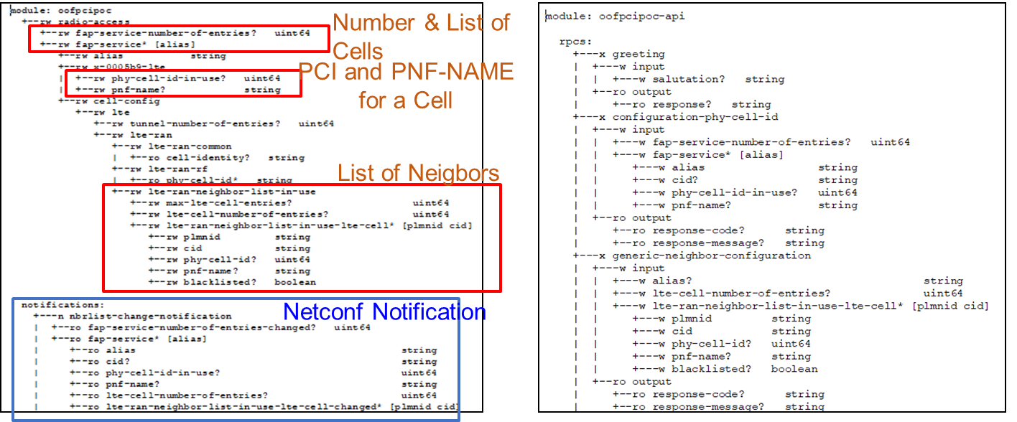
An Example of SON usecase

Slide 12
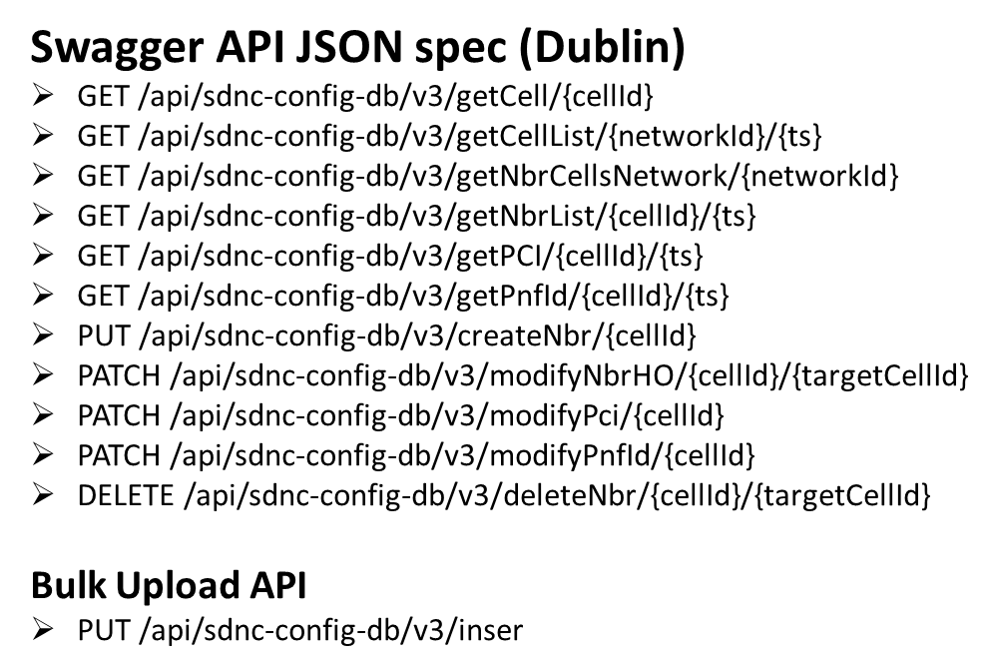
Config DB (Maria dB)
Implemented to maintain configuration information of objects (e.g. cell) associated with the RAN network
CRUD operations supported for the POC (for updating ConfigDB)
ONAP Components
REST Interface for READ and BULK UPLOAD
(Java, Spring, Hibernate)

Slide 13
Example of SON Attributes
Cell (Object)
Cell_Nbr_Info (Object)
Attribute | Format
networkId | string
cellId | string
pciValue | uint64
nbrList | list of cellId
lastModifiedTS | timestamp
pnf-id | string
Attribute | Format
cellId | String
target_cell_id | String
ho | BIT(1)

Slide 14
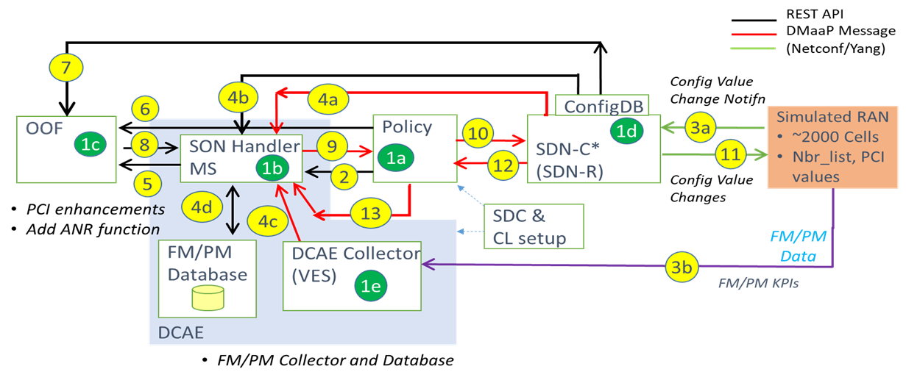
SON Dublin Use Case

