Slide 1
Run-Time Data Persistency (Runtime Config DB) Technology Choices
Ciaran Johnston <ciaran.johnston@ericsson.com>
Tony Finnerty <tony.finnerty@ericsson.com>

Slide 2
Business Drivers
RunTime Config DB contains the instance/presentation of real time 5G network and store information to Runtime Config DB. Runtime Config DB is not duplicated from A&AI.
  Support the existing use cases e. g OOF/PCI/SON, Network Slicing, ORAN (3GPP) & ONAP Harmonization.
  Provide operation view for the network provisioning
  Support the 5G network topology
  Support 5G Change Management

Slide 3
Run Time Database (DB) Component
For Persistency of Run-Time Information
Data | Deployment | Access | Other
Types: Related to services and network functions, but is not inventory Real-time / near-real-time replication of network data Configuration data Operational parameters Historical Golden templates Normalized? | Central. A single centralized deployment of the runtime DB | CRUD Query REST (Swagger/OpenAPI) Asynchronous (DMaaP) pub/sub for updates | Mastership. Configurable master (DB/External) with support for reconciliation
Structure: Hierarchal Tabular Connected | Distributed Multiple federated? Partitioned? Hierarchal? Instances Read replicas? | Access control Object/attribute Target Role/application | Sync: Bulk (Netconf) Attribute Value Change (VES) AAI (ONAP REST)
Dynamic: Schema Data sources (AAI; xNF; Controllers; …) | Dynamic deployment of models/data – flexible partitioning | Model driven | Autonomy Remove data related to removed inventory Automate reconciliation

Slide 4

RunTime DB System flow (Architecture)
RunTime DB( Config DB)
Real time config data
Realtime logical connection
EXO-Inventory
Netconf/O 1 CM and VES CM event Change notification
VES Collector and VES Config change event notification
A&AI
SDC
DMaaP (MR)
DMaaP
mS Config DB
CM Notificaiton
Device can send a CM notify event to DCAE VES Collector
DCAE VES Collector receives CM notification and publish the CM event to Dmaap MR
RumTime DB shall subscribe this event for config data and store Config DB based on Scheme in Config DB.
SDC posts Onboard CSAR/Yang model to DMaaP.
RunTime DB retrieves CSAR/Yang model from DMaaP.
RunTime DB pulls run time Yang model and config information from SDN-C/R
RunTime DB builds the logical model
RunTime DB
SDN-C/R
DMaaP (MR)
Netconf
O1 CM
PNF,VM,VNF
DU
O1 Notify
DCAE/VES
CU
Json
Configure

Slide 5
Runtime DB Component View
Model Deployment / Query
Data CRUD Application
Event Driven Application
Transactional CRUD API
Data Persistence Service
Event Bus
Transactional CRUD API
Model Service
Pluggable Persistence Backend
YANG Models
SNMP Models
Ansible Playbooks
Application Models ; service models ; NF models
Graph Database (Neo4J)

Slide 6
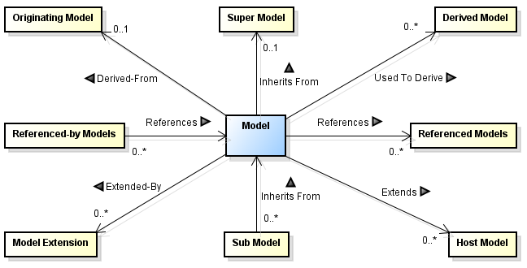
Model Service
All models can be uniquely identified by the combination of the following:
The kind of the model (the schema name)
The model's namespace. This is optional; some types of models do not support namespaces, in which case the model namespace is "global“
The model's name
The model's version. This is optional; some types of models do not support versions, in which case the model version is omitted
A model typically has relationships to other models. The following is supported:
Model Inheritance - A model may inherit from another model
Model References - A model may reference another model
Model Derivation - A model may be derived from another model
Model Extensions - A model may extend another model

Slide 7
Data Persistence Service
All data stored in the DPS is held within persistence objects (POs). The API defines PO as an interface, and the methods supplied allow access to and modification of the data held within a PO
Type - the type of the PO, as defined in the model to which it belongs
Namespace - the namespace of the PO, as defined in the model to which it belongs
Version - the version of the type of the PO, as defined in the model to which it belongs
PoId - a unique identifier for the PO. This is assigned within the DPS, not by client applications. However applications can obtain and use it
Attributes - attributes available on a PO are defined by the model used to create the PO
Associations - Instances of POs can be modeled to be associated to each other (uni-directional, bi-directional, cardinality)

