Slide 1
5G Run-Time Data Persistency (Runtime Config DB)
ONAP Frankfort Release
Joanne Liu-Rudel (jl1325@att.com)
Ben Cheung (ben.cheung@nokia.com)
Shankar N K (shankar@research.att.com)

Slide 2
Business Drivers
RunTime Config DB contains the instance/presentation of real time 5G network and store information to Runtime Config DB. Runtime Config DB is not duplicated from A&AI.
  Support the existing use cases e. g OOF/PCI/SON, Network Slicing, ORAN (3GPP) & ONAP Harmonization.
  Provide operation view for the network provisioning
  Support the 5G network topology
  Support 5G Change Management

Slide 3
Scope
Runtime Config DB
Provide a real time instance/presentation of 5G RAN network for Configuration Database
Contain Configuration data, which includes logical objects, logical/physial connection and exo-inventory data
  Micro Services for configDB
  Keep the data consistency
  Notes: Config dB is not duplicate A&AI. A&AI contains the virtual objects /virtual services (VNF, VFC/VF module, P-Server).

Slide 4
Configuration Database (Config DB)
Collect Configuration data with notification
  (1) Collect configuration data via VES collector (DCAE) /JSON interface and VES CM event notification per O1 specification (Targeted direction)
  (2) Collect configuration via Netconf with front haul Management-Plane interface (Temporary Solution)
  Notes: Netconf CM notification as an existing capability. i.e PNF software upgrade usecase uses the Netcon notification.
Construct logical data model for physical and logical connection.

Slide 5
EXO physical inventory
  Retrieve physical inventory data from A&AI if existing.
  Pull network element data from network devise if the data is not A&AI.

Slide 6

RunTime DB System flow (Architecture)
RunTime DB( Config DB)
Real time config data
Realtime logical connection
EXO-Inventory
Netconf/O 1 CM and VES CM event Change notification
VES Collector and VES Config change event notification
A&AI
SDC
DMaaP (MR)
DMaaP
mS Config DB
CM Notificaiton
Device can send a CM notify event to DCAE VES Collector
DCAE VES Collector receives CM notification and publish the CM event to Dmaap MR
RumTime DB shall subscribe this event for config data and store Config DB based on Scheme in Config DB.
SDC posts Onboard CSAR/Yang model to DMaaP.
RunTime DB retrieves CSAR/Yang model from DMaaP.
RunTime DB pulls run time Yang model and config information from SDN-C/R
RunTime DB builds the logical model
RunTime DB
SDN-C/R
DMaaP (MR)
Netconf
O1 CM
PNF,VM,VNF
DU
O1 Notify
DCAE/VES
CU
Json
Configure

Slide 7
Data Flow for RunTime Config DB

Slide 8
Application Impacts and Requirements (HL)
SDN-R: (Code)
  SND-R shall get CM Event fortification from DMaaP when VES collector posts the CM event to DMaap
  SDN-R shall get configuration and Yang model from the network device via Netconf.
  SDN-R shall update RunTime DB with configuration data change via an existing rest interface.
DCAE: (Code)
  VES Collector shall add new CM notify event (new CM domain) to VES collector.
  VES collector shall receive CM notificaiton via O1 notify (Jason interface)
  VES Collector shall post a new CM event to DMaaP

Slide 9
RunTime Config DB: (Code)
  Leverage Maria DB as mS RunTime Config DB to support the logical data model/devise model.
  Build the data model for real time presentation of 5G network and store the data to the database
  Get All PNF objects from A&AI
  Receive Config information from SDN-R via Nectconf and with VES notification.
  Support all vendor specific Configuration Information Model ( CIM/Yang)

Slide 10
  A&AI: (Test Only)
  A&AI shall provide all PNF objects to Runtime Config DB (initial loading) if data is existing in A&AI.
  A&AI shall add RunTime Config DB 'mechID to A&AI topic subscriber Role in AAF instances.
SDC (Test Only)
  SDC shall provide the CSAR file and post it to DMaaP as BAU.

Slide 11
A sample of Configuration dB
Configuration data
  5G Cell objects – logical object which is not part of (PNF, VNF, VM and VFC) – SON usecase
  Dynamically changing attributes of 5G Cell object: e.g. PCI, nbrList, nbrRelation.blacklist - SON usecase
  Operation status, class services, heartbeat,

Slide 12
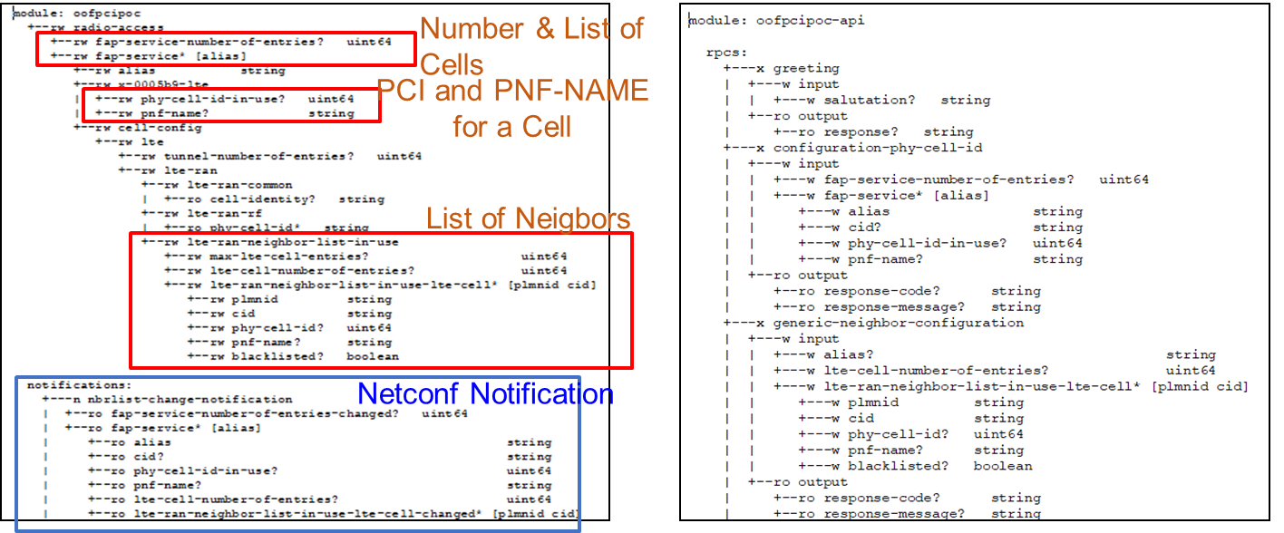
An Example of SON usecase

Slide 13
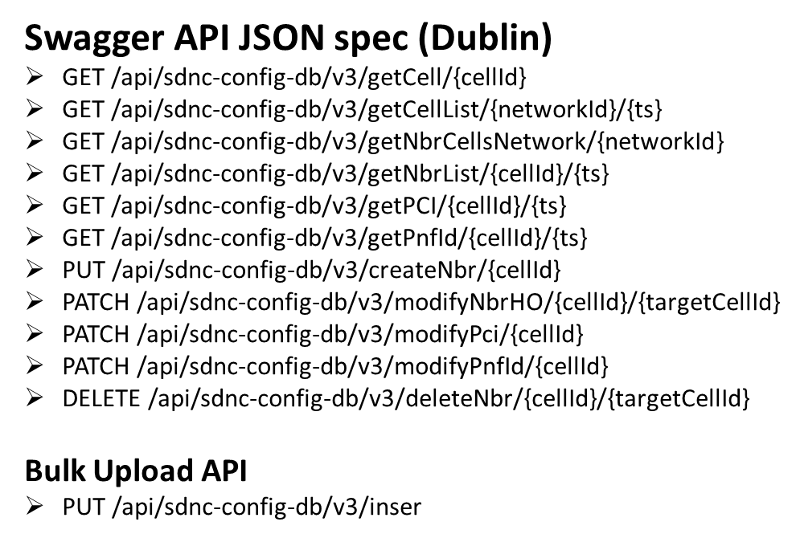
Config DB (Maria dB)
Implemented to maintain configuration information of objects (e.g. cell) associated with the RAN network
CRUD operations supported for the POC (for updating ConfigDB)
ONAP Components
REST Interface for READ and BULK UPLOAD
(Java, Spring, Hibernate)

Slide 14
Example of SON Attributes
Cell (Object)
Cell_Nbr_Info (Object)
Attribute | Format
networkId | string
cellId | string
pciValue | uint64
nbrList | list of cellId
lastModifiedTS | timestamp
pnf-id | string
Attribute | Format
cellId | String
target_cell_id | String
ho | BIT(1)

Slide 15
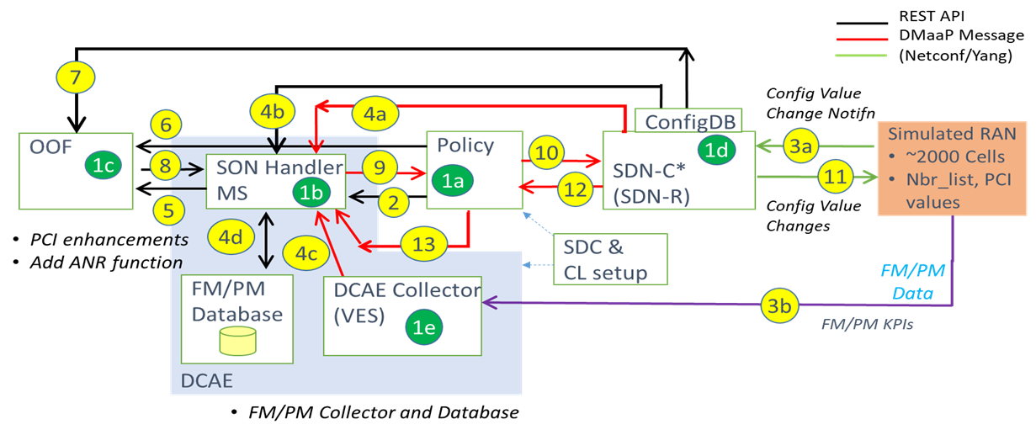
SON Dublin Use Case

