Slide 1
VF-C Weekly Meeting
Yan Yang
June 3, 2019

Slide 2
Agenda
1.VF-C Dublin Project Status (Yan)
Sign-Off (June 6) :https://wiki.onap.org/display/DW/VF-C+Dublin%3A+Deliverables+for+Release+Sign-Off+Milestone+Checklist+Template
2.E release Timeline (Yan)
3. VF-C requirements collection for E release
4. Refactor common api for nslcm and vnflcm(Haibin)
5. Coming DDF VF-C session

Slide 3
1VF-C Status and Highlights in Dublin
Functional Enhancement
    Upgrade Multicloud API to support consistent identification
    of cloud region functional requirement
    OOF Integration Optimization
    Optimize the methodology for VNF(vdu) placement, add the process for placement with selected candidates(VIM)
    Align VNFD SOL2.5.1 and model multi-version support
Standard Alignment
    SOL005 Alignment
      Existing APIs alignment
      Add the APIs which supported in SOL005, such as package subscription and notification
    Maturity Enhancement
    Mysql DB migrate to OOM shared MariaDB Galera Cluster
    Configuration inject automatically
    Add data persistent storage to avoid data loss due to pod restart
UUI
SDC
SO
Catalog
NSLCM
GVNFM
Driver
OOF
Drivers
DB
ESR/AAI
Multivim
SVNFM
EMS
Note1: components listed here don’t contain all VF-C components, only used to highlight Dublin work .

Slide 4
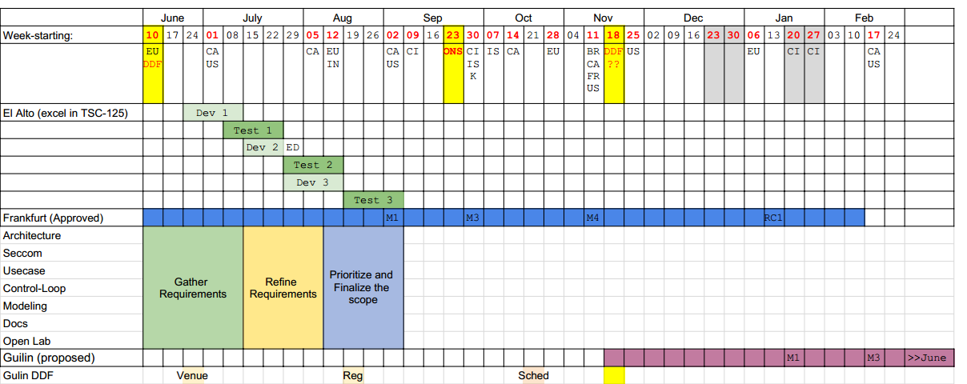
2 E Release Time Line

Slide 5
3 VF-C requirements collection for E release
https://wiki.onap.org/display/DW/VF-C+requirements+collection+for+E+release

Slide 6
4 Refactor common api for nslcm and vnflcm(Haibin)

Slide 7
5 Coming DDF VF-C Session
VF-C Dublin highlights
VF-C automation –CLI, testsuit
VF-C commercial application
VF-C development experience

Slide 8
Other Topics

