Slide 1
VNFC Support in ONAP on APPC Example
Łukasz Rajewski (Orange)
05.12.2019

Slide 2
Different types of VNF models in ONAP
UC #1
UC #2
UC #2’
VNFC1
VNFC1
VNFC2
VNFC1
VNFC2
vserver-id
vnfc-name
vserver-id
vnfc-name
vserver-id
vnfc-name
vserver-id
vnfc-name
vserver-id
vnfc-name
vf-module-id
vf-module-id
vf-module-id
vnf-id
vnf-id
vnf-id
UC #3
UC #4
VNFC1
VNFC1
VNFC1
VNFC2
VNFC3
VNFC4
VNFC2
VNFC2
vserver-id
vnfc-name
vserver-id
vnfc-name
vserver-id
vnfc-name
vserver-id
vnfc-name
vserver-id
vnfc-name
vserver-id
vnfc-name
vserver-id
vnfc-name
vserver-id
vnfc-name
vf-module-id
vf-module-id
vf-module-id
vf-module-id
vnf-id
vnf-id

Slide 3
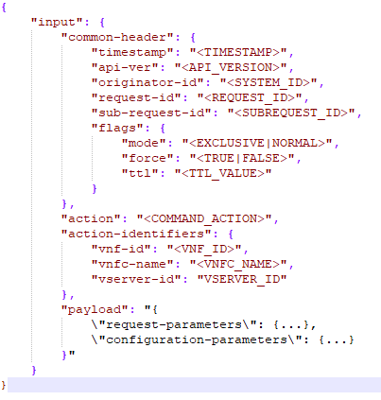
LCM Execution on APPC Example Today
action – LCM action to execute
action-identifiers – identifies object to be modified – Today only vnf-id is accepted
request-parameters [Optional] – request specific parameters i.e. like vf-module-id in ConfigScaleOut – interpreted by APPC
configuration-parameters [Optional] – action specific parameters – merged with CDT template
We always want to execute LCM operation of concrete device(s) – VMs/PNFs
Determination how to access the device should be internal to the controller

Slide 4
LCM Execution on VNFC Level – How it should be
Orchestrator should not be responsible for determination of the parameters for communication with the device like IP address, port, device name – it should be internal to the controller
SO should only determine well known common identifiers of the device like vnf-id, vf-module-id, vserver-id, vnfc-name, vnfc-type
SO should determine only action specific parameters which are resolved in workflow’s context (or come from the input)
Device communication parameters should be common and should not be model specific – it simplifies controller – the best source of this data is AAI i.e. for IP addresses
  ipv4-oam-address – VNF level
  ipaddress-v4-oam – PNF level
  ipaddress-v4-oam-vip - VNFC level – the best source for VNFC OAM
  CDS can assure proper setup of this parameters delivering their values

Slide 5
LCM Execution on VNFC Level – How it should be
How SO should determine the vf-module-id?
  Well known from the context in the instantiation time
  Well known from the context in the ScaleOut time
  There are situations when it should be resolved in a dynamic way
    For ScaleIn (analysis of resources consumed, FIFO, FILO, etc..)
    For Traffic Distribution – proportional distribution among modules, equal, only selected modules
HOW SO should determine VNFC type in vf-module for LCM operation
  No problem when there is only one VNFC type in vf-module
  When there is more than one:
    From the workflow input?
    Base on the policies?
    Custom decision policy/mechanism coming from the CDS service model

Slide 6
Examples of VNFC support for APPC and CDS

Slide 7
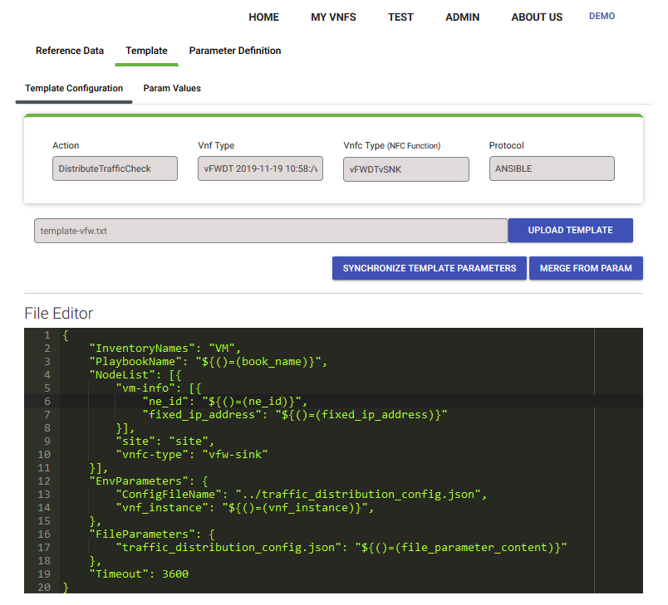
CDT Template Definition - DistributeTraffic Ansible Action (1)
book_name – name of Ansible playbook – may be a fixed value
vnf_instance – should be a name of vnf instance
NodeList – list of VM on which ansible playbook will be executed
  ne_id – host name of VM – must be configured before in Ansible inventory file
  fixed_ip_address – IP Address of VM – should be ONAP OAM address because Ansible must be able to reach this IP

Slide 8
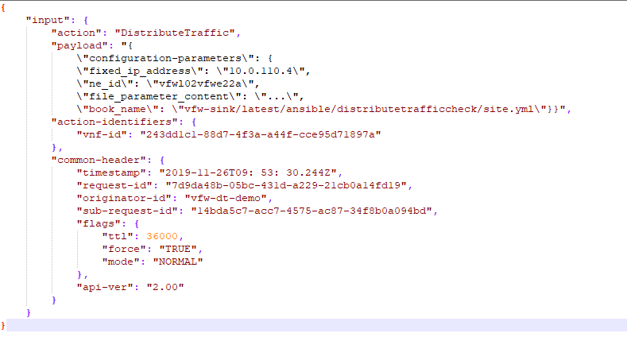
LCM Execution Example - DistributeTraffic Ansible Action (2)
Concrete device is being identified by vnf-id + configuration-parameters
SO needs to find IP address, Hostname or receives this information from workflow input parameters
Above requires to identify concrete vf-module and vnfc-instance if there is more than one VM in VNF
Identification may be much simpler if VNF would have its own VNFC controller
    None of ONAP use cases (vLB/DNS, vFW) has it

Slide 9
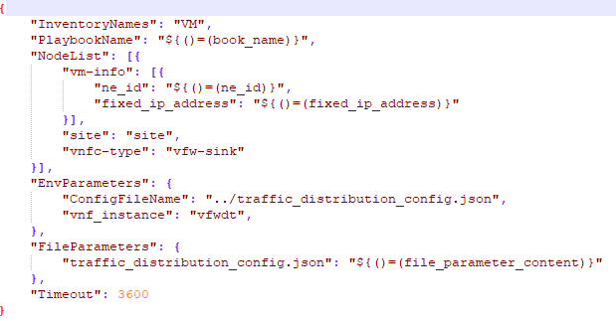
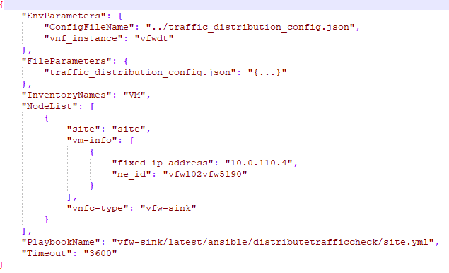
LCM Execution Example - DistributeTraffic Ansible Action (3)
      Ansible Request Template in CDT
      Request merged with configuration-parameters

Slide 10
CDT Template Definition for VNFC - Options
On next slides different options for template creation in CDT will be presented
Depending on request parameters and template formulation different use cases will be supported
Some options consider modifications in APPC
All options can be applied for Ansible or NetConf because they consider how configuration parameters are delivered for merging with template
The assumption is to support all 4 use cases
Configuration-parameters should be used only for action specific configuration
The same approach could be applied for CDS instead od CDT

Slide 11
APPC – Integration with AAI
2019-11-20T14:18:05,498 | AAIResourceNode | Populating Final Context
2019-11-20T14:18:05,499 | AAIResourceNode | Populating Context Key = tmp.vnfInfo.vm[0].vnfc-count Value = 1
2019-11-20T14:18:05,499 | AAIResourceNode | Populating Context Key = tmp.vnfInfo.vm[0].vnfc-name Value = vfwl01pgne22a
2019-11-20T14:18:05,499 | AAIResourceNode | Populating Context Key = tmp.vnfInfo.vm[0].cloud-region-id Value = RegionOne
2019-11-20T14:18:05,499 | AAIResourceNode | Populating Context Key = tmp.vnfInfo.vm[0].vserver-selflink Value = http://192.168.186.11:8774/v2.1/1f6284684eb44ae79a0a5677e
2019-11-20T14:18:05,500 | AAIResourceNode | Populating Context Key = tmp.vnfInfo.vm[0].tenant-id Value = 1f6284684eb44ae79a0a5677e12da7eb
2019-11-20T14:18:05,500 | AAIResourceNode | Populating Context Key = tmp.vnfInfo.vm[0].group-notation Value = null
2019-11-20T14:18:05,500 | AAIResourceNode | Populating Context Key = tmp.vnfInfo.vm[0].cloud-owner Value = CloudOwner
2019-11-20T14:18:05,500 | AAIResourceNode | Populating Context Key = tmp.vnfInfo.vm[0].vserver-name Value = vfwl01pgne22a
2019-11-20T14:18:05,500 | AAIResourceNode | Populating Context Key = tmp.vnfInfo.vm[0].vnfc-ipaddress-v4-oam-vip Value = null
2019-11-20T14:18:05,500 | AAIResourceNode | Populating Context Key = tmp.vnfInfo.vm[0].vf-module-id Value = b8c1d740-164d-4ca4-9314-a7406041cde9
2019-11-20T14:18:05,500 | AAIResourceNode | Populating Context Key = tmp.vnfInfo.vm[0].vnfc-type Value = vFWDTvPKG
2019-11-20T14:18:05,501 | AAIResourceNode | Populating Context Key = tmp.vnfInfo.vm[0].vnfc-function-code Value = vFWDTvPKG
2019-11-20T14:18:05,501 | AAIResourceNode | Populating Context Key = tmp.vnfInfo.vm[0].vserver-id Value = 8ed45a28-ae08-4f75-824c-d8db78af1c2c
2019-11-20T14:18:05,501 | AAIResourceNode | VNFCNAME 0vfwl01pgne22a
2019-11-20T14:18:05,501 | AAIResourceNode | VMCOUNT IN GETALLVSERVERS 1
2019-11-20T14:18:05,501 | AAIResourceNode | VMSWITHNOVNFCSCOUNT IN GETALLVSERVERS 0
2019-11-20T14:18:05,502 | AAIResourceNode | VMSWITHNOVNFCSCOUNTFOR VFMODULE IN GETALLVSERVERS 0
2019-11-20T14:18:05,502 | AAIResourceNode | VMCOUNT FOR VFMODULE IN GETALLVSERVERS 0

Slide 12
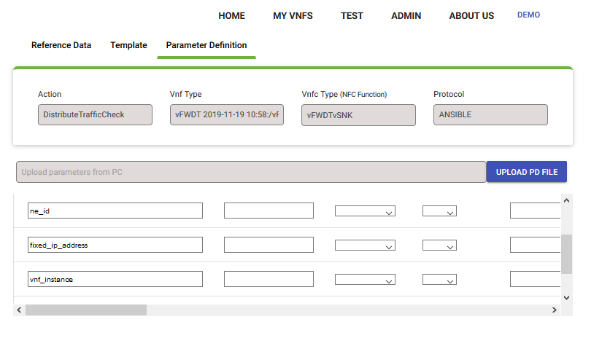
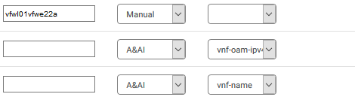
CDT Template Definition for VNFC - Option 1
ne_id – fixed value
fixed_ip_address – APPC resolves from AAI -> generic-VNF -> ipv4-oam-address
action-identifiers: vnf-id
Can be applied for:
  UC #1
  UC #2 when only one VNFC can be reconfigurable
  UC #2, 3, 4 when one VNFC acts a role of VNFC controller in VNF – ne_id ipv4-oam-address must point this controller
  UC #2, 3, 4 when VNF has external VNFC controller (VNF Manager) – ne_id ipv4-oam-address must point this controller

Slide 13
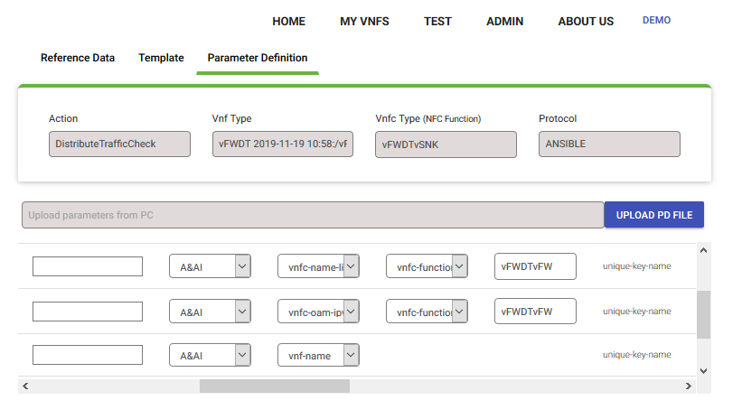
CDT Template Definition for VNFC - Option 2
Requires vnfc info in AAI
ne_id – APPC resolves from AAI -> VNFC -> vnfc-name
fixed_ip_address – APPC resolves from AAI -> VNFC -> vnfc-ipaddress-v4-oam-vip
action-identifiers: vnf-id
VNFC type selected by nfc-function type
Can be applied for:
  UC #1
  UC #2 – when each action type executed on different vnfc-type
  UC #4 like UC #2 + only one instance of VNFC type in VNF

Slide 14
CDT Template Definition for VNFC - Option 3
Requires vnfc info in AAI
ne_id – APPC resolves from AAI -> VNFC -> vnfc-name
fixed_ip_address – APPC resolves from AAI -> VNFC -> vnfc-ipaddress-v4-oam-vip
action-identifiers: vnf-id
VNFC type selected by nfc-function type
Requires APPC would have many templates for one VNF selected by vnfc type
Can be applied for:
  UC #1
  UC #2
  UC #4 only one instance of VNFC type in VNF

Slide 15
CDT Template Definition for VNFC - Option 4
Requires vnfc info in AAI
ne_id – APPC resolves from AAI -> VNFC -> vnfc-name
fixed_ip_address – APPC resolves from AAI -> VNFC -> vnfc-ipaddress-v4-oam-vip
action-identifiers: vnf-id, vnfc-name
VNFC type selected by nfc-function type
Requires VNFC support enabled in APPC
SO finds VNFC instance (vnfc-name)
Can be applied for:
  UC #1
  UC #2
  UC #3
  UC #4

Slide 16
CDT Template Definition for VNFC - Option 5
Requires vnfc info in AAI
ne_id – APPC resolves from AAI -> VNFC -> vnfc-name
fixed_ip_address – APPC resolves from AAI -> VNFC -> vnfc-ipaddress-v4-oam-vip
action-identifiers: vnf-id
filtering by request-parameters: vf-module-id, vnfc-type.
SO determines vf-module-id and vnfc-type. Most likely vnf-type can come from input
Can be applied for:
  UC #1
  UC #2
  UC #3
  UC #4
request-para
request-para

Slide 17
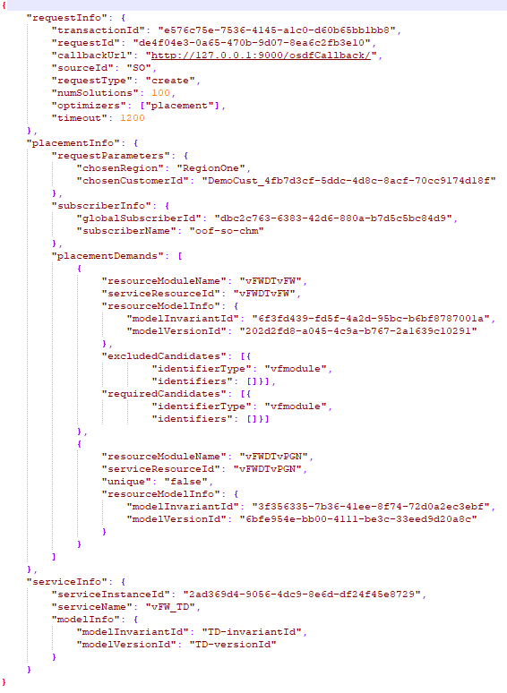
SO – How to determine vf-module-id dynamically
Can come from the SO request input as well as vnfc-type
Can be determined by OOF
  OOF HAS (Homing, Allocation, Selection) since Dublin can resolve vf-module-id
  Determined by standard HAS policies which in our case could be service, vnf, vnfc-type or action specific.
OOF not needed when
  Only one vf-module with specified vnfc-type in VNF
  Vf-module comes from workflow input or is determined by workflow (i.e. as a result of ScaleOut operation)

