Slide 1
Open Wireless Lab
@ Open-Access Research Testbed for Next-Generation Wireless Networks (ORBIT)
@ Wireless Information Network Laboratory (WINLAB)
@ Rutgers, The State University of New Jersey -Technology Centre of New Jersey

Slide 2
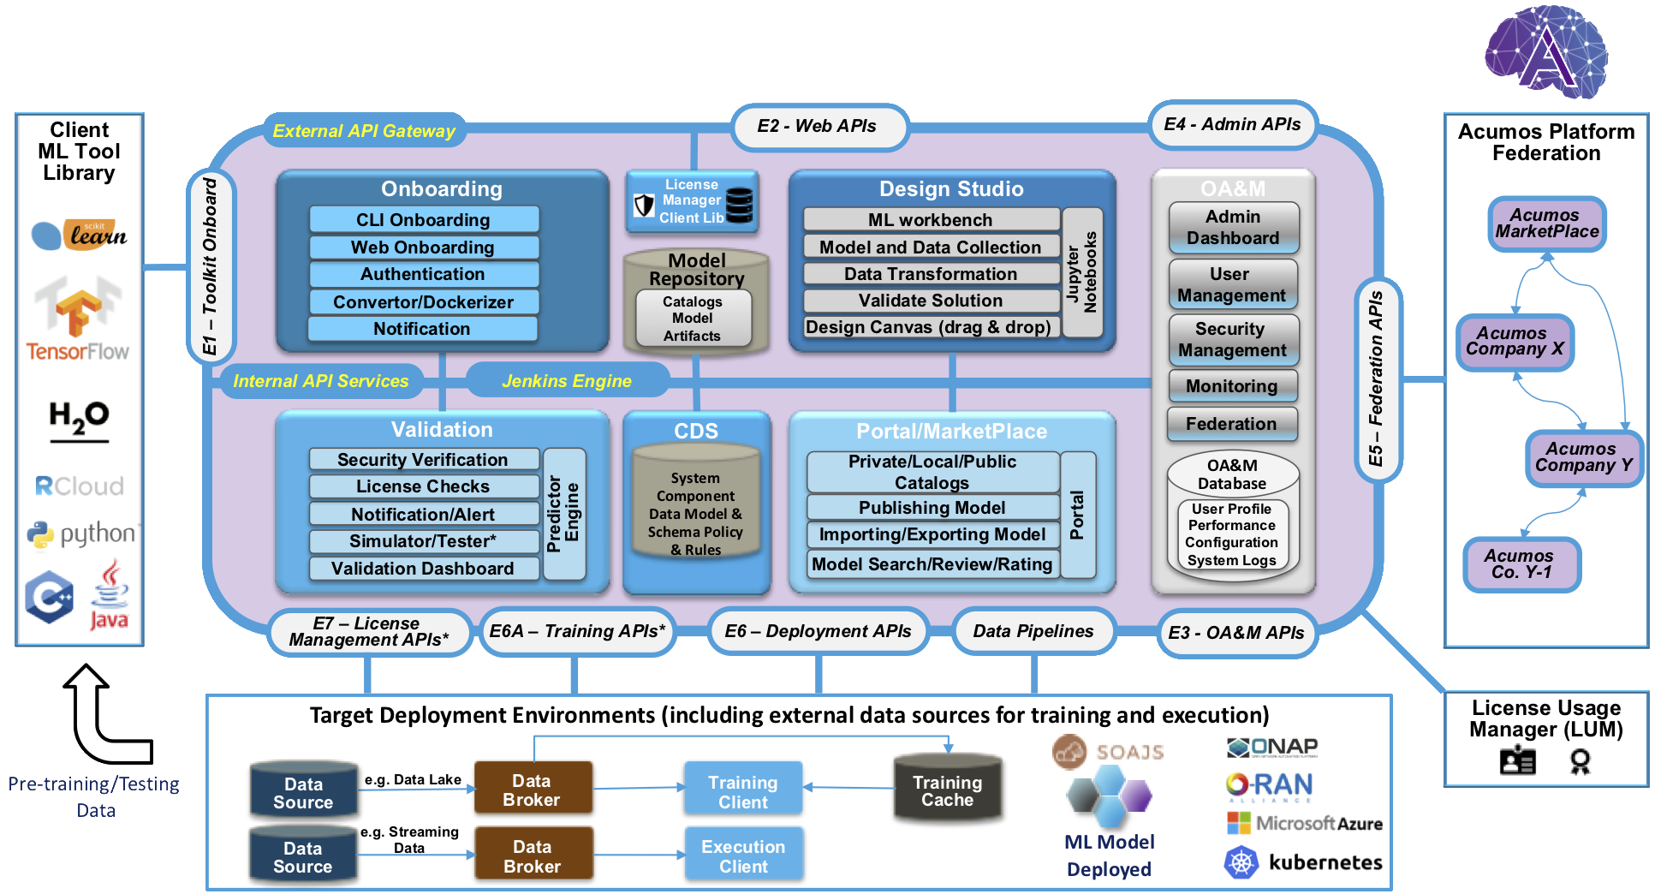
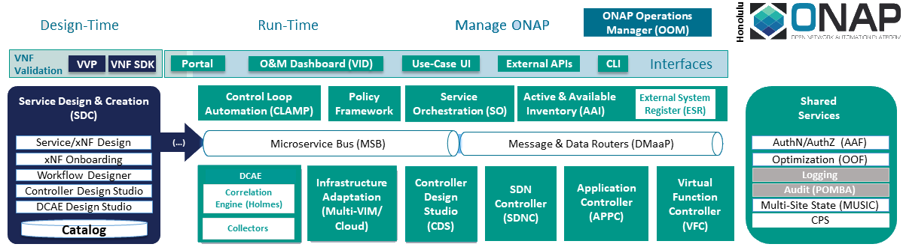
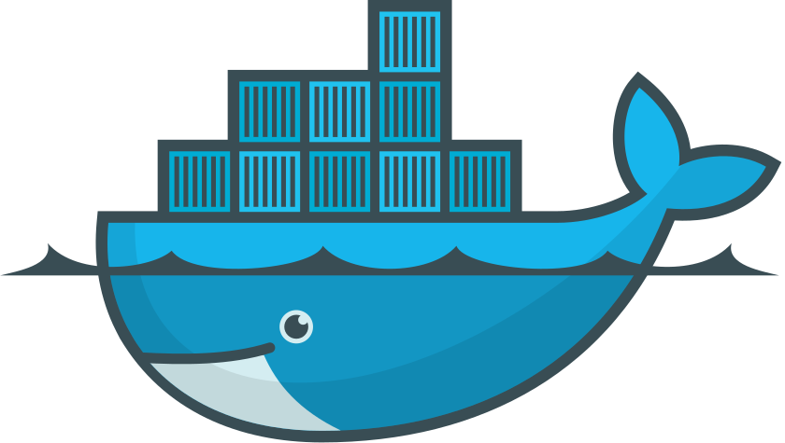


Cloud stack for ONAP and Acumos
docker engine
Private vendor sandbox
(VMs)
control nodes bare metal compute nodes

Slide 3
Orbit-lab SB10 – bare metal
Internet gateway :console
Experimental (exper-…)
Horizon control-1 :node1-5
node2-1: compute-1
??? :node1-6
node2-2: compute-2
node2-3: compute-3
Stable (stable-…)
control-1 :node1-1
node2-4: compute-1
control-2 :node1-2
node2-5: compute-2
control-3 :node1-3
node2-6: compute-3
Horizon control-4 :node1-4
node2-7: compute-4
node2-8: compute-5
node2-9: compute-6

Slide 4
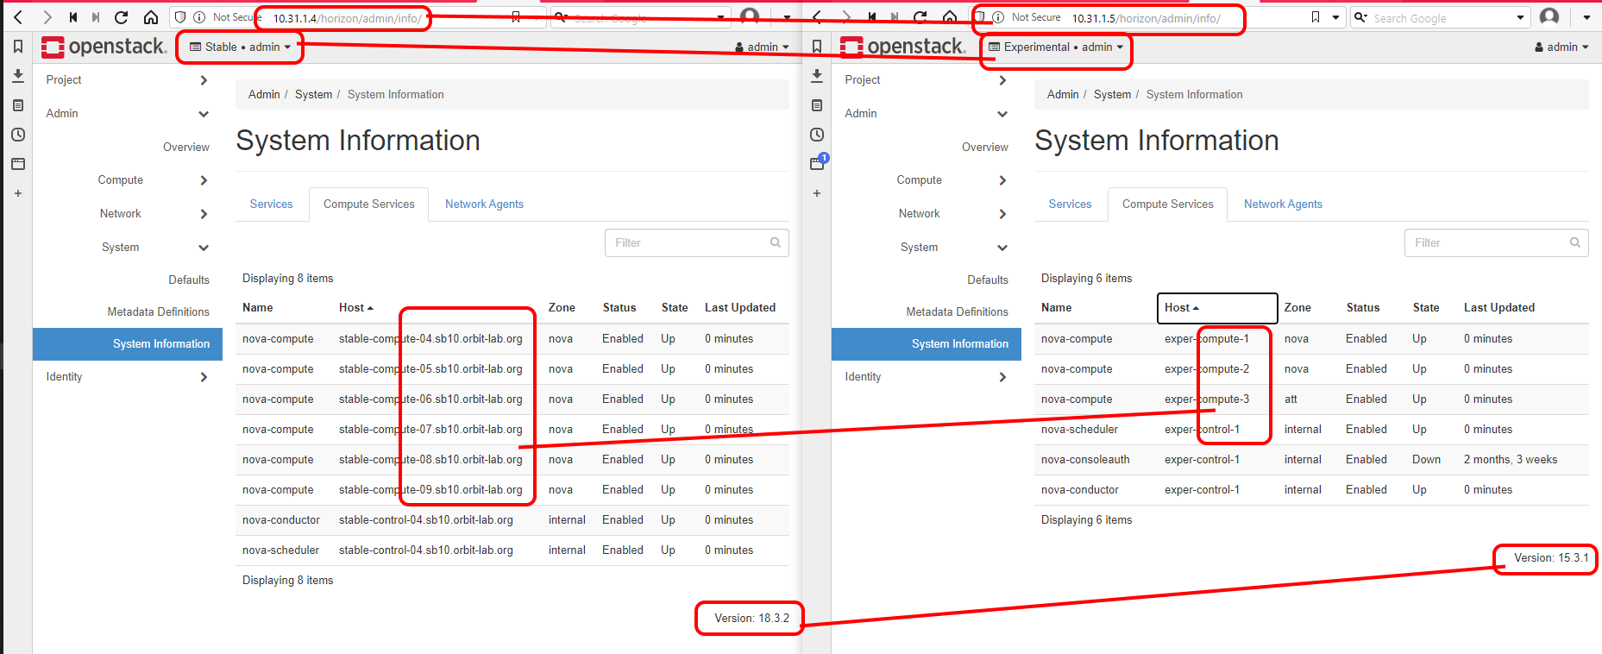
System Information by OpenStack

Slide 5
Thank you!

