Slide 1
SO – deploying custom workflow applications
Proposal and PoC
Lukasz Grech (Nokia)
June 26th, 2019

Slide 2
Primary problem
How to:
deploy additional SO workflows
…along with Java code
…preferably in runtime
Without a need to:
modify SO code
rebuild SO image
restart SO application
Custom implementation
BPMNs
Java/Groovy code
BPMNs
Java/Groovy code
SO

Slide 3
Additional goals
How to:
separate custom (use case specific) workflows from core SO implementations
increase SO modularity
increase SO maintainability
make integration testing of new workflows easier

Slide 4

Current SO deployment
Holds BPMN-related stuff
so
so-bpmn-infra
so-sdc-controller
app.jar
app.jar
app.jar
so-sdnc-adapter
so-vfc-adapter
…
app.jar
app.jar
app.jar

Slide 5

Current SO deployment (so-bpmn-infra container)
so-bpmn-infra container
(Practically) no way to:
modify SO Springboot app in run-time
introduce new BPMNs
introduce new code
SO BPMNs
SO Java/Groovy code
Embedded Camunda
engine
Embedded Tomcat
app.jar
Single Springboot app

Slide 6
Proposed SO deployment (so-bpmn-infra container)
so-bpmn-infra container
Possibility to add new applications in run-time
SO is just one of the applications
No need to modify SO codebase in order to add new workflows
Better separation between SO core implementation and custom use-cases
BPMNs
Java/Groovy code
Custom app (war)
SO BPMNs
SO Java/Groovy code
SO app (war)
Shared Camunda
engine
Problem to solve: Custom apps will be wiped out by Kubernetes during image reinstallation
Stand-alone Tomcat

Slide 7
Proposed SO deployment in details
Persistent storage (NFS)
so-bpmn-infra container
webapp directory
Stand-alone Tomcat
BPMNs
Java/Groovy code
lib directory
Common Java/Groovy code
uses
Custom app (war)
SO BPMNs
SO Java/Groovy code
SO app (war)
Shared Camunda
engine

Slide 8
PoC – things to check
Call own Spring beans and Groovy code
Call common Spring beans and Groovy code
Use common Java classes
Call BPMNs from other apps…
… even if they’re using own Spring beans and Groovy code
Pass execution parameters from one BPMN to another
Common Spring beans
BPMNs
Spring beans
Groovy code
Common Groovy code
x=10
z=myObj
local Java classes
some app (war)
Common Java classes
BPMNs
Spring beans
Groovy code
common code (lib)
local Java classes
another app (war)

Slide 9
PoC – things checked
Call own Spring beans and Groovy code
Call common Spring beans and Groovy code
Use common Java classes
Call BPMNs from other apps…
… even if they’re using own Spring beans and Groovy code
Pass execution parameters from one BPMN to another
Common Spring beans
BPMNs
Spring beans
Groovy code
Common Groovy code
x=10
z=myObj
local Java classes
some app (war)
Common Java classes
BPMNs
Spring beans
Groovy code
common code (lib)
local Java classes
another app (war)

Slide 10
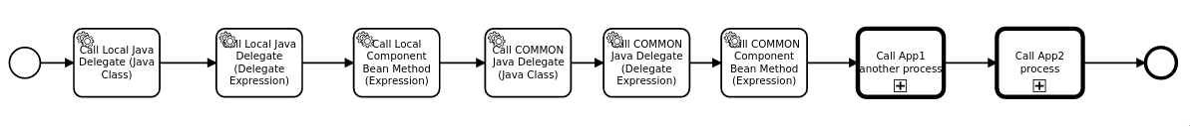
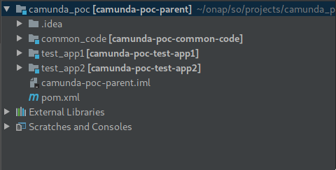
PoC presentation
29-May-2019 13:19:15.869 INFO [ContainerBackgroundProcessor[StandardEngine[Catalina]]] org.camunda.commons.logging.BaseLogger.logInfo ENGINE-08023 Deployment summary for process archive 'camunda_poc_app1':
app1_groovy_process.bpmn
app1_process.bpmn
app1_variable_test.bpmn
>>>>>>>>>> App1LocalDelegateBean invoked
>>>>>>>>>> App1LocalComponentBean.beanMethod() invoked
>>>>>>>>>> COMMON Delegate Bean invoked
>>>>>>>>>> COMMON SpringBean.beanMethod() invoked
>>>>>>>>>> App2LocalDelegateBean invoked
>>>>>>>>>> App2LocalComponentBean.beanMethod() invoked
>>>>>>>>>> COMMON Delegate Bean invoked
>>>>>>>>>> COMMON SpringBean.beanMethod() invoked
>>>>>>>>>> App2LocalGroovyClass.someMethod() invoked
>>>>>>>>>> CommonGroovyClass.someMethod() invoked

Slide 11
Next steps
Prepare next PoC which will use:
actual SO code
OpenStack infrastructure
If everything works well then prepare final solution in El Alto/Frankfurt(?)

Slide 12
Thank you

