Slide 1
SOL003 Adapter Architecture, Technical Debt and Roadmap
Kista, 11-14 June, 2019
Byung-Woo Jun, Michael Morris, Gareth Roper, Waqas Ikram, Ericsson
Seshu Kumar, Huawei
Yan Yang, CMCC

Slide 2







Agenda
SOL003 Adapter Requirements
SO VNFM Adapter Architecture in Dublin
SO VNFM Adapter Features and Candidates (Dublin, El Alto, Frankfurt)
SO VNFM Adapter Components and Testing & Sequence Diagrams
SO VNFM Adapter Architecture Technical Debt in Dublin
VNFM Adapter –Refactoring for Frankfurt
Roadmap Proposals and Discussions
(Package Management, ETSI Catalog, SOL003 Adapter Placement)

Slide 3
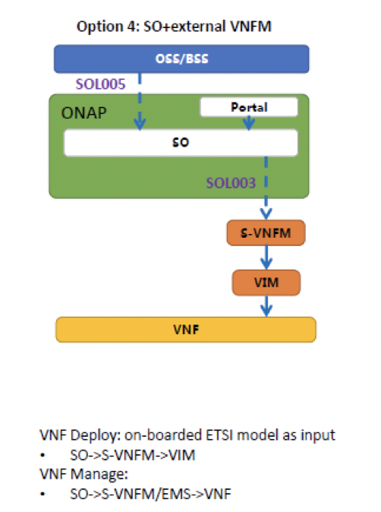
SOL003 Adapter Requirements
SO VNFM Adapter supports the following requirements:
ONAPARC-310: SO Adapter which uses SOL003 to connect to S/G VNFM
ONAPARC-315: ONAP interfaces with an external VNF Manager using ETSI NFV SOL003
ONAPARC-390: ONAP tracking of VNF dependency on an external ETSI compliant VNF Manager (VNFM)
SO-1508: ETSI Alignment – SO SOL003 plugin support to connect to external VNFMs Leverage ETSI standards for VNF LCM Generic VNFM Adapter, supporting SOL003-compliant SVNFMs Support SOL003 APIs for VNF LCM Create/Instantiate/Terminate/Delete (including Granting/Subscription/Notification) in Dublin More APIs to support in El Alto & Frankfurt
Note: it is one of the VNF provisioning options (option #4)
- source: VNF Management in ONAP

Slide 4
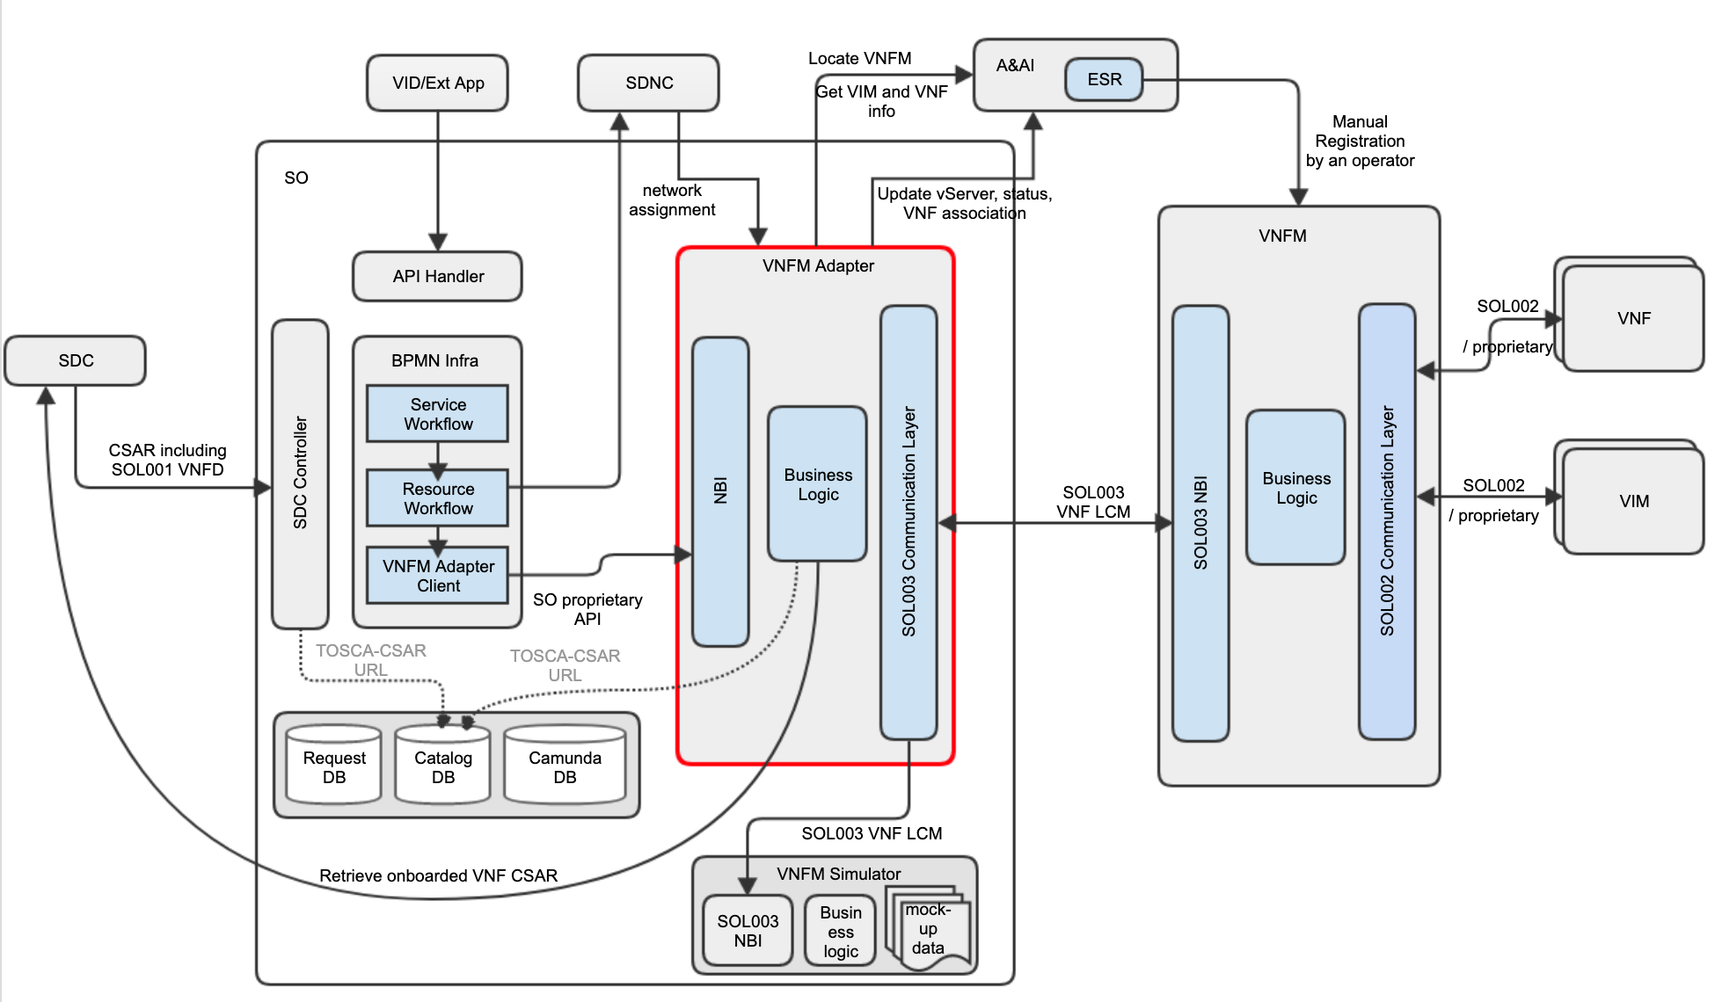
SO VNFM Adapter Architecture in Dublin
VNFM Adapter is an SO Microservice component, running in a container (minor coupling with SO, & its relocation is under discussion)
SO gets CSAR including SOL001 VNFD and the original vendor VNF package
SO stores CSAR to Catalog DB, and VNFM Adapter retrieves CSAR from Catalog DB (it did not happen in Dublin and design will be updated)
Network Assignment is handled to/from SDNC
Interfaces between SO BPMN Infra (VNF-level) and VNFM Adapter are SO-specific
VNFM Adapter gets VNFDs from SDC directly (Dublin restriction; SOL004 Package Management /Distribution is under discussion – see proposals)
Operator registers VNFMs into A&AI ESR, and VNFM Adapter locates a proper VNFM based on VNF NF Type – see technical debt
Associations between VNFM and VNF instances are made in A&AI.
Interfaces between VNFM Adapter and SVNFM are SOL003-based (2.5.1)
For integration testing, VNFM Simulator is used (currently, it is an SO microservice component)
7
4
8
1
2
5
9
3
10
6
For more architecture and design details: https://wiki.onap.org/pages/viewpage.action?pageId=48529911

Slide 5
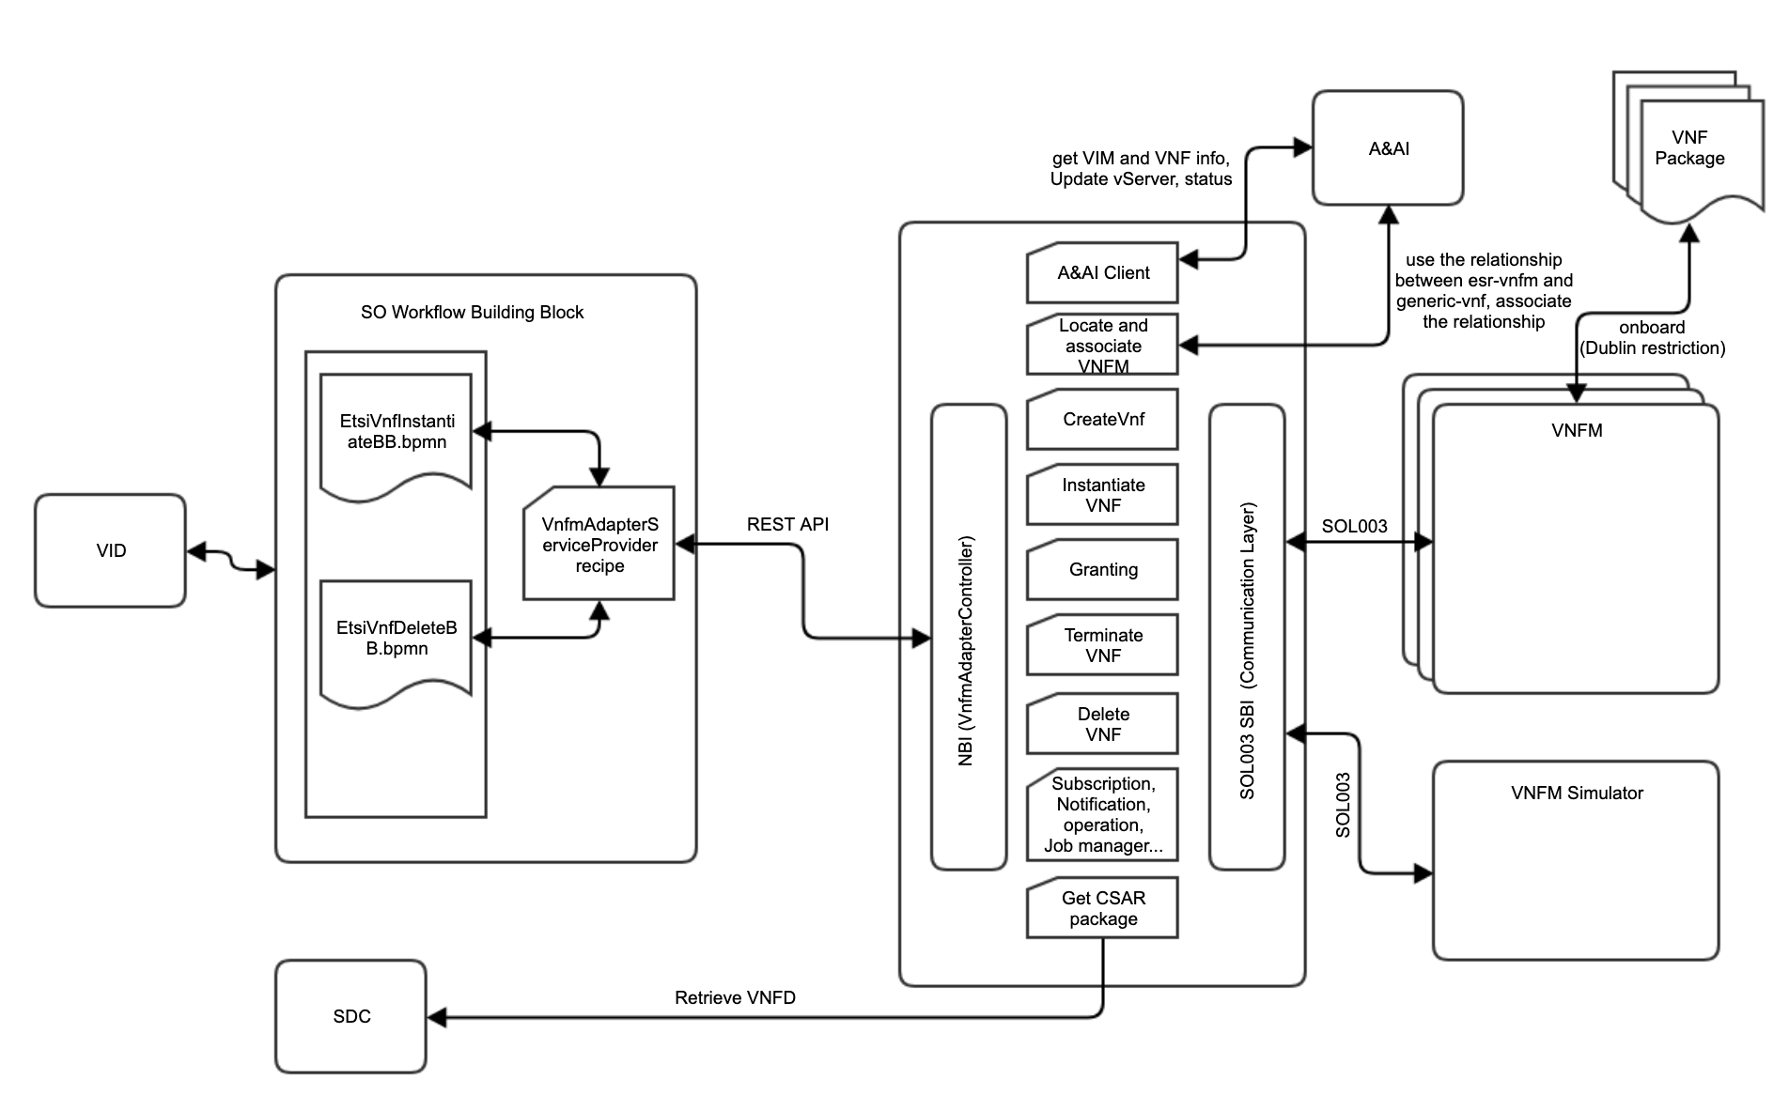
SO VNFM Adapter Components and Testing
VID sends Ala Carte-based VNF requests to SO over GR-API
SO Workflow Building Blocks support 1) Create and Delete VNF and 2) Monitor VNF LCM.
  SO CreateVNF Workflow handles both Create and Instantiate VNF operations in the VNFM Adapter
  SO DeleteVNF Workflow handles both Terminate and Delete VNF operation in the VNFM Adapter
VNFM Adapter retrieves VNFD directly from SDC
VNFM Adapter locates VNFM, based on A&AI ESR VNFM registration.
VNF Package is onboarded to the vendor VNFM directly because the the SOL004 package distribution is broken (Frankfurt enhancement point) – Dublin restriction
VNFM vendors test VNF LCM with their SVNFMs
ONAP integration testing tests VNF LCM by using the VNFM Simulator
Vendor Internal Testing
5
2
4
1
6
7
3
ONAP Integration Testing

Slide 6
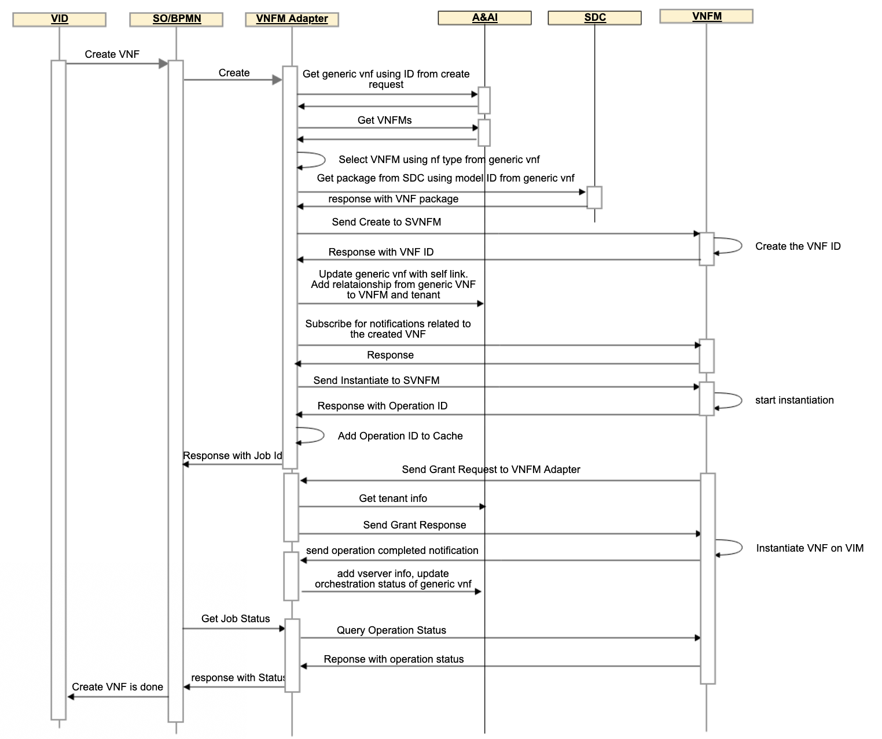
SO VNFM Adapter Run-Time Sequence Diagram
The diagram depicts VNF Creation and Instantiation run-time sequences.

Slide 7
SO VNFM Adapter Architecture Technical Debt in Dublin
SOL004 and SOL001 VNF distribution is only partially supported due to SDC limitations
  Only PNF onboarding was tested in Dublin
  No proper SOL001 mapping to/from SDC AID DM
VNFM Adapter by default looks for the “TOSCA.meta” file in the TOSCA-metadata directory (as per Sol004), however this can be configured to look for the file in a different directory in order to support SDC Package Structure.
SO does not support ETSI Catalog - needs proper ETSI package management
VNFM Adapter gets VNFDs directly from SDC
MSB could be used for locating VNFM Adapter in the future
Selecting a VNFM is based on VNF NF Type (this can be enhanced with vnfm info:type, Cloud Region, FM & PM data and others)
Authentication between the VNFM Adapter and the VNFM is needed
Only Ala Carte-based requests are supported by SO over GR-API; End-to-End use cases were not tested
6
8
2
1
5
7
3
4
Package distribution path is broken

Slide 8
SO VNFM Adapter Features and Candidates
List of Features and Candidates
Features included in Dublin Create VNF, Instantiate VNF, Terminate VNF and Delete VNF, including Granting, Subscription and Lifecycle Notifications Tracking capability: which VNFM instance has handled which VNF instance. BPMN Building Block Workflows and Java-based recipes for Create (Create+Instantiate) and Delete (Terminate+Delete) VNF VNFM Simulator, which is used for Integration Testing
Feature Candidates for El Alto Authentication between the VNFM Adapter and the VNFM VNFM Simulator enhancement and refactoring CSIT of SOL003 ETSI Alignment (SDC → SO → SOL003 VNFM Adapter → VNFM) SO-Monitoring HTTPs Support Preload using user_param (without UI changes) Add support of Query
Feature candidates for Frankfurt VNFM Adapter exposes its NBI to any VNFM Adapter client Package Management of SOL004 including SOL001, based on SOL005 and SOL003 Mapping between ScalingAspect+Delta and VF-Module for Scaling Policy-based Scaling (with VNF Indicator & VES event handling) SO ETSI Catalog DB handling for NS and VNF packages Addition of ETSI SOL003 operations (Modify-Scale-Operation Status, FM, PM, Heal, VNF Indicator, Grant enhancement, & retry, rollback, failing, cancelling, Resource Quota Available Notification – to be determined for operation selections and priorities)
Other Related Feature Requests (SDC Enhancement Requests) for El Alto or Frankfurt SOL004 VNF onboarding and distribution support (SDC-2072, SDC-2282) Mapping between SOL001 VNFD to SDC AID DM, including ScalingAspect+Delta and VF-Module - Not all VNFD needs to be transformed to the SDC AID DM

Slide 9
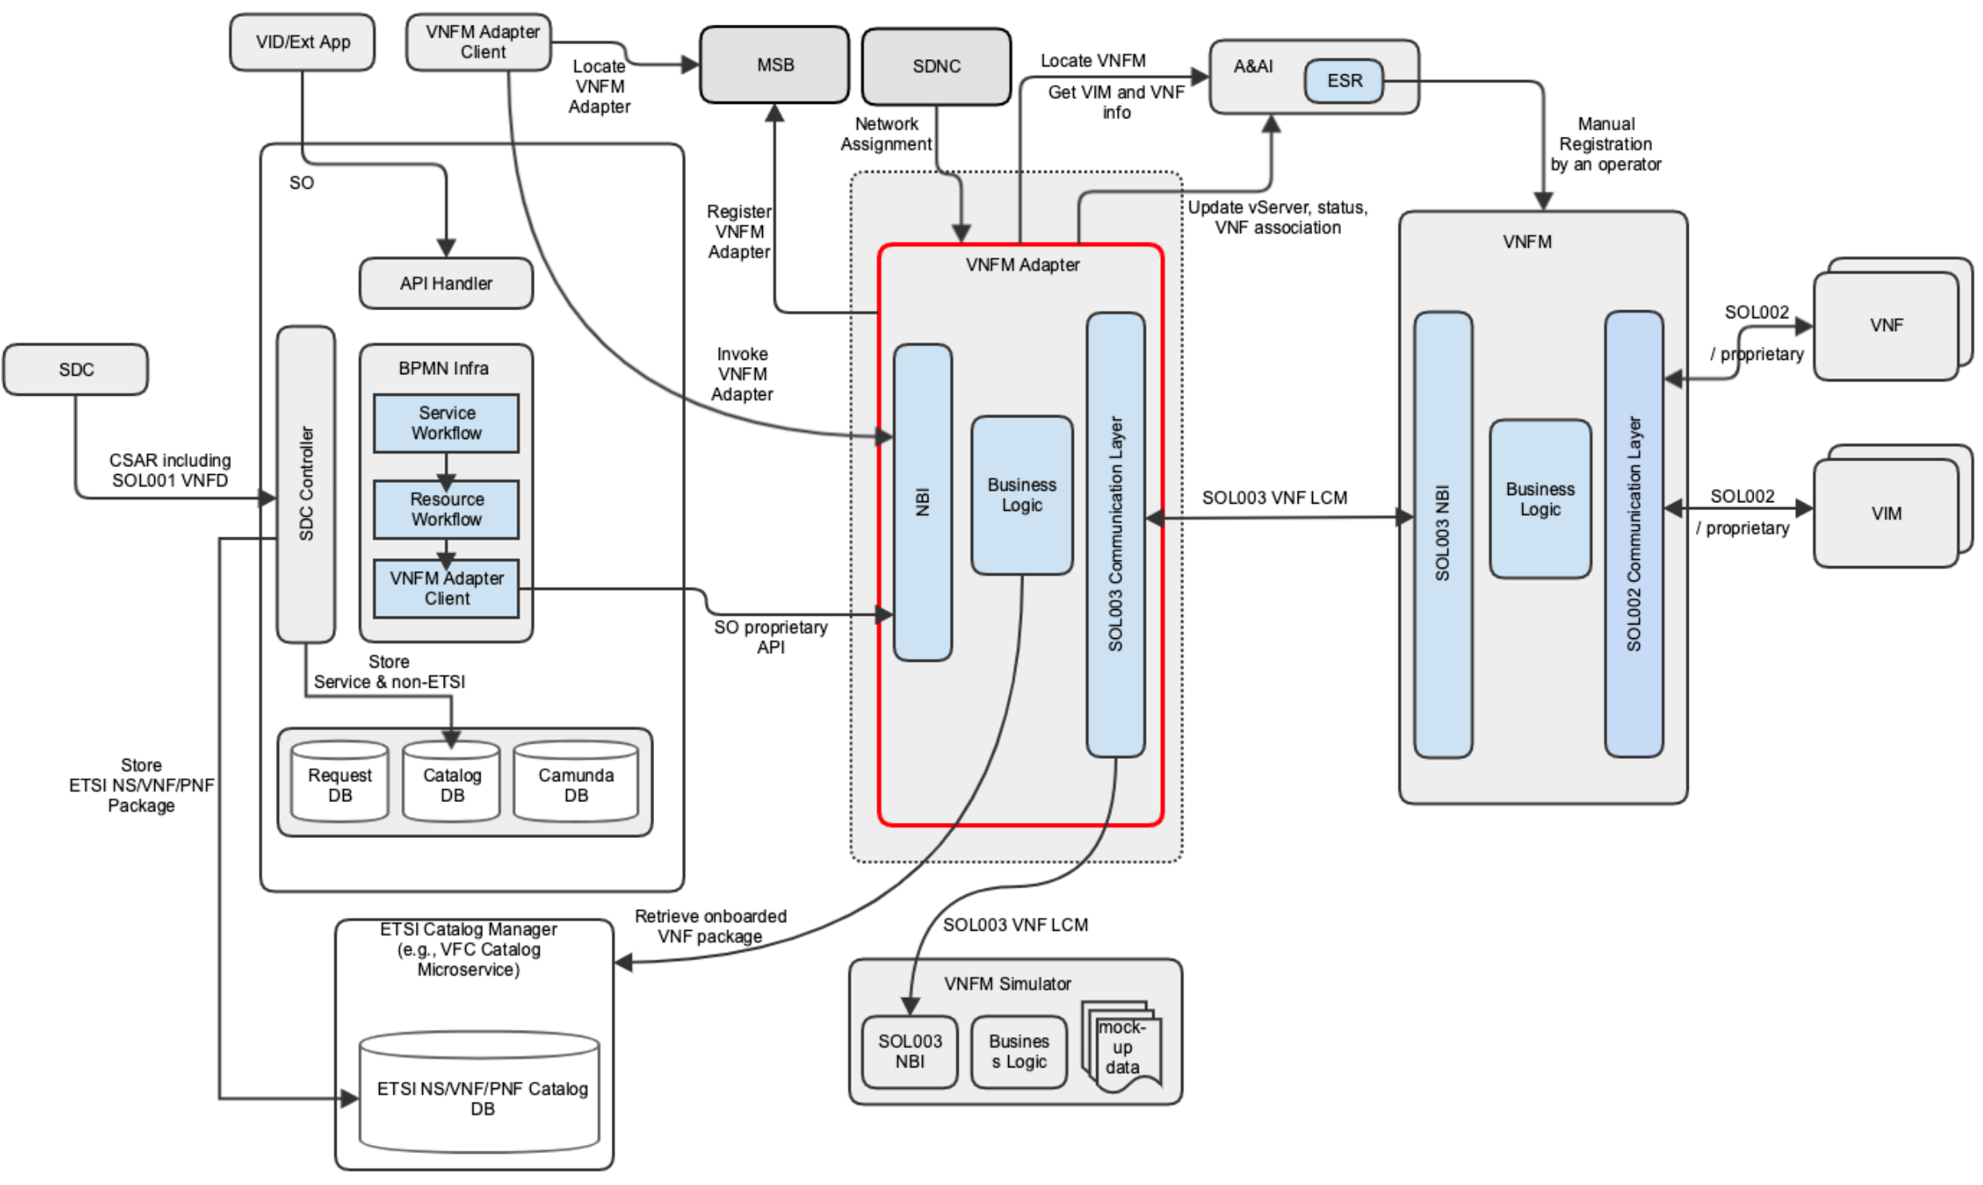
VNFM Adapter Enhancements For Frankfurt
VNFM Adapter exposes its NBI to any VNFM Adapter client
Interfaces are refactored to be generic (accessed by other ONAP/External components) - TBD
SDC CSAR including the SDC internal model and the vendor original SOL004 package is supported
SO leverages ETSI Catalog Microserve for ETSI-based NS, VNF and PNF
VNFM Adapter retrieves VNF package from Catalog Manager
VNFM Adapter Client uses MSB to locate the VNFM Adapter
VNFM Adapter locates a VNFM based on a better VNFM locating mechanism
VNFM Adapter and SVNFM support additional SOL003 operations, possibly including modification for configuration
VNFM Adapter and SVNFM support authentication and authorization
  AAF will be used for authentication and authorization
6
7
1
8
3
2
9
5
4

Slide 10
Discussion Agenda – July 8th, 2019
SDC SOL004 VNF support
SDC – ONAP SDC Controller
ONAP SDC Controller – ONAP SO Catalog DB (for service and non-ETSI Catalog)
ONAP SDC Controller – ONAP ETSI Catalog Manager (storing contents such as the vendor original package and APIs)
SOL003 VNFM Adapter – ETSI Catalog Manager (package and other APIs)
VF-C VNF package handling
ETSI Catalog Manager APIs and DB enhancement
Others

Slide 11
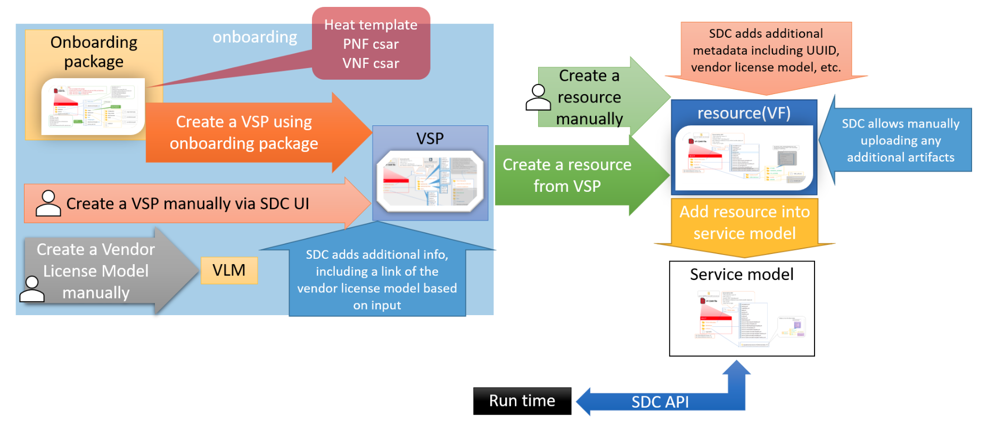
ONAP Onboarding procedure
SDC takes the vendor provided package and adds some files or changes files and meta data according to SDC procedure.
The diagram depicts SDC Onboarding procedure.
For more details, https://wiki.onap.org/pages/viewpage.action?pageId=45303641

Slide 12
SDC VNF/PNF Onboarding Flow
SDC supports VNF/PNF onboarding with .zip and .csar file extensions
During the onboarding process, SDC checks an onboarding file extension.
  If the file has .csar extension, SDC considers it as non-SOL004 csar and processes the existing VNF TOSCA CSAR onboarding procedure.
  If the file has .zip extension, SDC unzips it and checks if it contains .cert and .cms.
    If not, SDC processes the existing Heat template onboarding procedure
    If yes, SDC retrieves root certificate and validates security.
      If the security validation is OK, SDC
        validates packages,
        maps SOL001 VNFD into SDC AID DM
        adds the original CSAR as onboarding package artifacts.
Question: Vendor VNF package certificate and signature need to be sorted out.
Note: currently, VF-C supports CSAR-format without certificate or signature

Slide 13
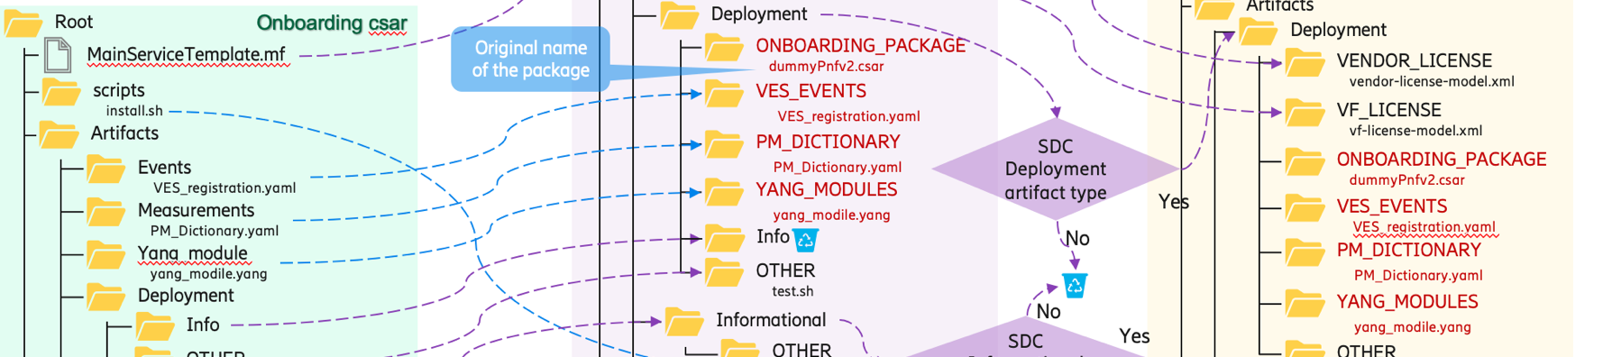
SDC Package Transformation
From the Ericsson package transform slide deck for PNF
  Applicable to VNF packages
SDC VSP and Resource csar files have the ONBOARDING_PACKAGE, which contains the original vendor VNF package
SOL001 VNFD mapping to SDC AID DM needs to be defined
The VNFM and external NFVO use the original vendor VNF/NS packages.
Source: the Ericsson package transform slide deck
Onboarding vendor csar
VSP csar
Resource csar

Slide 14
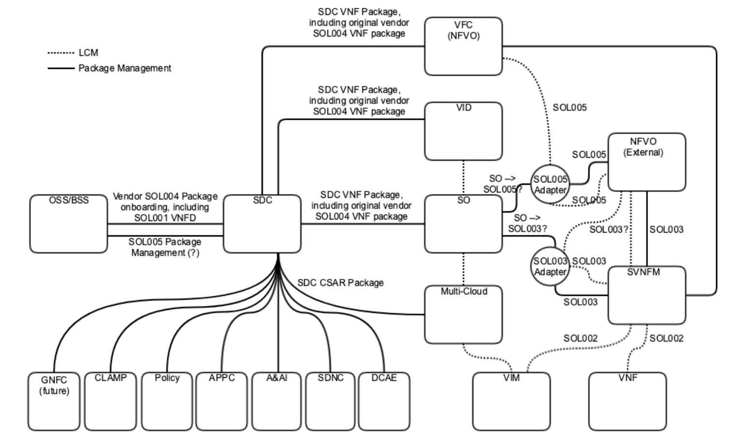
Package Management based on SOL005 and SOL003
The diagram depicts a possible package management architecture. It is posted in ONAP Wiki, https://wiki.onap.org/display/DW/SOL005+and+SOL003+Package+Management
SDC supports SOL004 VNF/PNF package onboarding, and stores the original vendor VNF/PNF package inside the SDC package – Ericsson contribution in Dublin
  PNF onboarding was tested
  VNF onboarding is being tested in El Alto / Frankfurt
SDC support VNF/PNF package onboarding and/or accepts VNF/PNF package management interfaces from OSS/BSS via SOL005 Package Management APIs (Create…)
ONAP Runtime components store SOL004 Packages as needed
  For the SO case, see the subsequent page, SO ETSI Catalog DB Support for NS, VNF and PNF
SOL003 VNFM Adapter provides VNFMs Query/Fetch VNF packages/contents/artifacts, Reading VNFD and subscription/notification services – see the following page
SOL005 Adapter provides NSD/PNFD management and SOL005 VNF package management – see the following page
Note:
SOL007 (NS package) support is under discussion.
Location of SOL003 and SOL005 Adapters are under discussion, and where/how the adapters get packages is under discussion
4
2
1
3
5
ETSI View
OSS/BSS
SOL005
NFVO
NFVO
SOL003
VNFM
ONAP realization
{SDC, SO, SOL005 Adapter}
{SDC, SO, SOL003 Adapter}

Slide 15
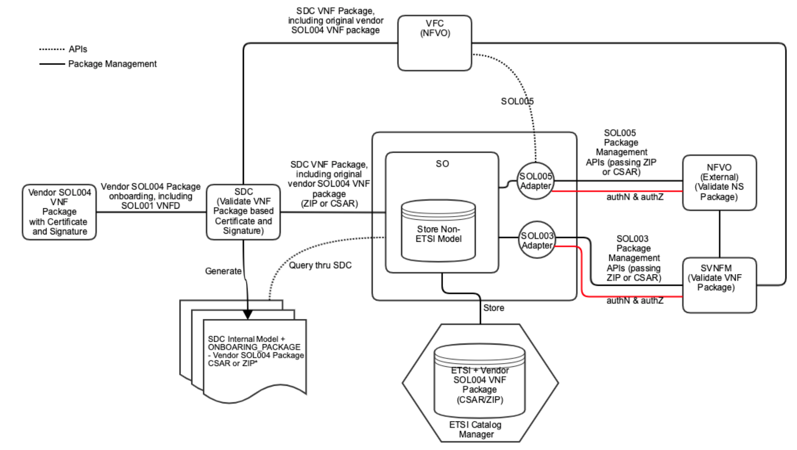
Package Security on SOL005 and SOL003
Requirement: External NFVO and SVNFM need to validate incoming ETSI package
Vendor SOL004 VNF Package with certificate and signature is onboarded into SDC
  ZIP-format VNF package includes CSAR, Signature and Certificate
SDC validates VNF package based on the certificate and signature
SDC generates SDC internal model plus the vendor SOL004 package CSAR and ZIP (with certificate and signature) – the supported format is TBD based on the security requirement
SO queries the package thru SDC
SO stores Service + Non ETSI model
  Not all VNFD needs to be transformed to the SDC AID DM - TBD
SO stores ETSI / vendor VNF package CSAR or ZIP – the supported format is TBD based on the security requirement
SOL003 Adapter provides VNF package management APIs
SOL005 Adapter provides NS package management APIs
If CAR-format is chosen, NFVO/SVFNM trusts integrity (authN and authZ) between the Adapters and NFVO/SVNFM.
For certificate validation, we need to resolve Certificate Authority placement.
Certificate
Authority

Slide 16
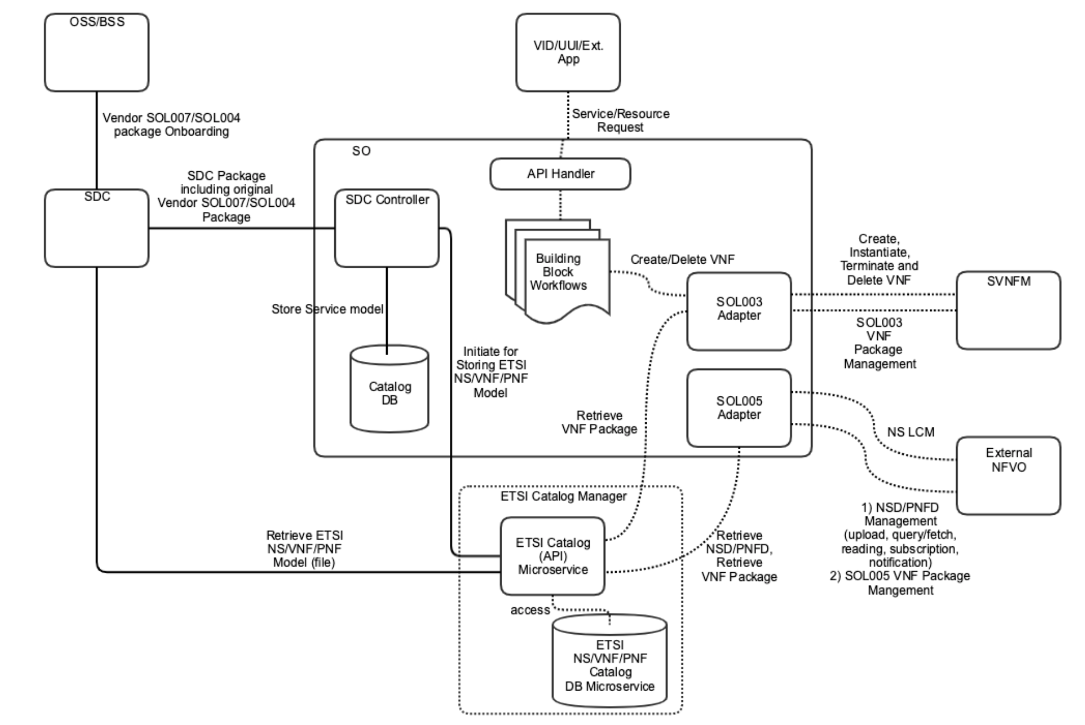
SO ETSI Catalog DB Support for NS, VNF and PNF
Instead of building ETSI Catalog management in SO, leverage the existing ETSI Catalog Manager function – Working with CMCC and plan to discuss with CMCC sometime next week
Consideration of leveraging VF-C Catalog Microservices for the NS, VNF and PNF catalog support, https://wiki.onap.org/pages/viewpage.action?pageId=63996543
  VFC Catalog Manager function consists of two microservices: VF-C DB and VF-C Catalog. Deployment of these microservices is independent of VF-C, and the microservices have no dependency with other VF-C components – a good stepping stone towards common ETSI Catalog management
  VF-C Catalog DB Microservice
    Database: nfvocatalog (vfc-nfvo-catalog-createdb.sql // create db scripts)
    Database Table (vfc-nfvo-catalog-createobj.sql // create tables scripts)
      Catalog_NSPackage
      Catalog_VNFPackage
      Catalog_PNFPackage
      Catalog_SoftwareImageModel
  VF-C Catalog (API) Microservice
    vfc-catalog docker
  VFC Catalog REST APIs (following is part of Swagger REST APIs), https://docs.onap.org/en/latest/_downloads/0fea611e8b07fb4042e1a66ce202898c/CATALOG_API_Specification_v1.json
2
1
NS Package Management | VNF Package Management | PNF Management
GET /nspackages // query NS package info POST /nspackages // NS package distribute / create GET /nspackages/{csarId} // query NS package info DELETE /nspackages/{csarId} // delete NS package | GET /vnfpackages //query vnf package info POST /vnfpackages // vnf package distribute / create GET /vnfpackages/{csarId} // query vnf package info DELETE /vnfpackages/{csarId} // delete vnf package PUT /vnfpackages/{csarId}. // create/upload vnf package | GET /pnf_descriptors POST /pnf_descriptors GET /pnf_descriptors/{pnfdInfoId} DELETE /pnf_descriptors/{pnfdInfoId}
Model Parsing | Job Management (used for async LCM) | More…
POST /parsernsd // NS package model POST /parservnfd // VNF package model | GET /jobs/{jobId} // Job Status POST /jobs/{jobId} // Update Job Status

Slide 17
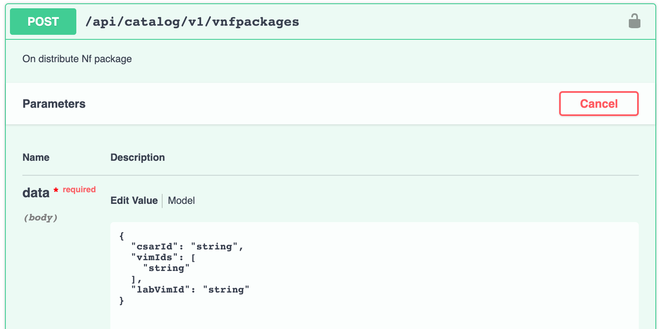
SDC – SO SDC Controller – ETSI Catalog Manager
SO ASDCController and ToscaResourceInatall code needs to be updated for handling SOL004 packages including SOL001 VNFD and PNFD.
Service-level catalog and other non-ETSI catalog (SDC AID DM) will be stored in SO Catalog DB.
VNF/PNF/NS-level catalog handling would be simplified:
  By using the ETSI Catalog Manager.
  ETSI VNF/PNF/NS-level catalogs (i.e., original vendor packages) will be stored in ETSI Catalog DB
  SO itself does not need to manage VNF LCM (delegates the LCM to VNFM through the SOL003 VNFM Adapter)
In Frankfurt, VNF package management is the first focus.
ETSI Catalog Manager POST API will be used to store the VNF packages
  POST /api/catalog/v1/vnfpackages // passing csarId, vimIds and labVimId
Question:
  How does VFC handle VNF packages from SDC? Does use SDC AID DM? Does use VF-Modules?
    Currently, there is NO VF-Module support from VF-C and SOL003 VNFM Adapter
  VF-Module mapping and handling need to be sorted out.

Slide 18
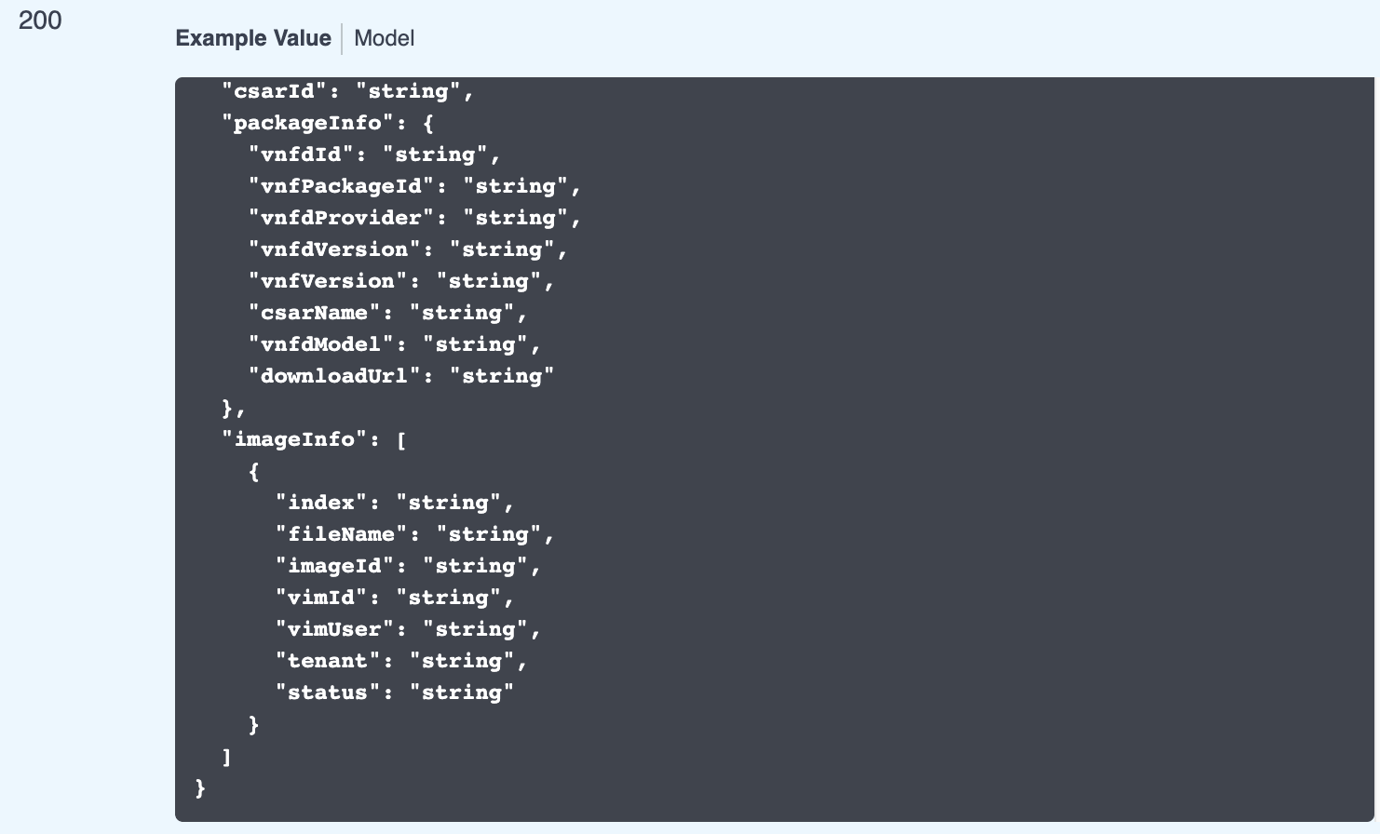
ETSI Catalog Manager – SOL003/SOL005 Adapter
ETSI Catalog Manager consists of two microservices:
  ETSI Catalog API
  ETSI Catalog DB
ETSI Catalog Manager provides RESTful services:
  ETSI package management for the Adapters.
    GET /api/catalog/v1/vnfpackages/{csarId}
    Get the original vendor VNF package
      ETSI Catalog APIs will be enhanced to extract the original vendor VNF package from the ONBOARDING_PACKAGE directory
  Retrieving VNFD for SOL003 Adapter
  Retrieving NSD/VNFD for SOL005 Adapter

Slide 19
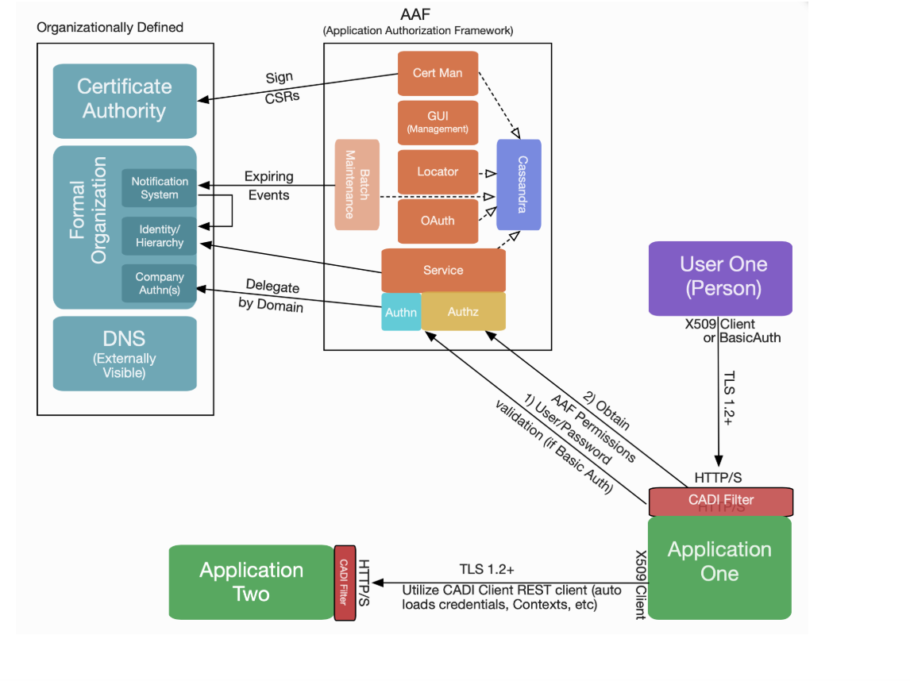
Authentication and Authorization
Leverage AAF for authentication and authorization to secure communications among ONAP component and SVNFM and external NFVO. The following is input from Steve Smokowski.
  OAuth2 is not yet used in ONAP. Start with HTTP Basic Authentication with HTTPS
  Update an application pom file and add properties; i.e., no application code changes?
    Remove Spring Security as well, as we cannot have both in place
  There is no need to use the CADI Rest Client at all
  The CADI filter can be configured to handle authorization, that is the method AT&T use, or the application can enforce the authorization. It supports basic URI matching semantics
  Generate certificates by AAF for HTTPS is the current gap.
    We plan to resume the discussion with Elena, Steve and others sometime next week to learn AT&T implementation for this.
Authentication and Authorization on SOL003 and SOL005 APIs need to be supported.
How does ONAP support vendor-specific SVNFM security?
Verizon (John D’Elia) input, https://wiki.onap.org/pages/viewpage.action?pageId=50202249&preview=%2F50202249%2F63998229%2FVerizon+RBAC+Requirements+for+ONAP+-+042619.pptx
  Roles - One or more roles are assigned to each user (managed in external IdP)
  A role maps to a set of ONAP-specific permission groups
  Each permission group maps to a set of permissions
  ONAP applications guard access based on permissions
  Permissions are triplets of the form: basename|resource|actions

Slide 20
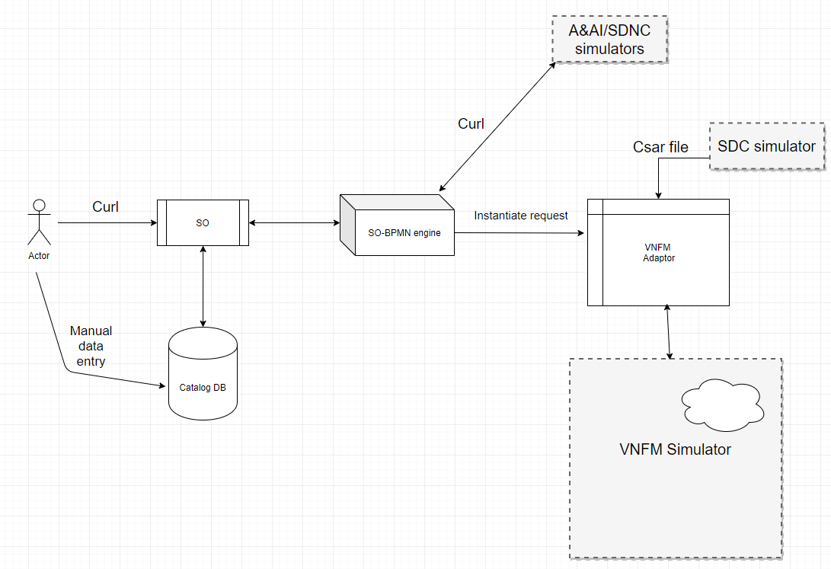
CSIT for ETSI Alignment
Task list
Simulate Request for SDC in catalog DB
  CSIT does not have DMAAP and real SDC, so it will update service information manually
Compose a curl command mimicking the data sent from VID to SO and send it to the running SO container
Create entries in Database as needed according to the request from the user
Simulate A&AI, SDNC and enable interactions in A&AI & SDNC to communicate with SO-BPMN: A&AI and SDNC simulators must have a URL matching every call that is required in the BPMN flow being invoked.
Update BPMN to point to the simulated A&AI and SDNC : Update curl request to point to Simulators
Setup the VNFM Simulator for SOL003 operations
Create SDC simulator to respond to a request with a CSAR file.
Evaluate on what is considered as an acceptance criteria test cases
Spike: Expose REST interface for SO to give it notification instead of polling.
Note: detailed design needs to be settled.

Slide 21
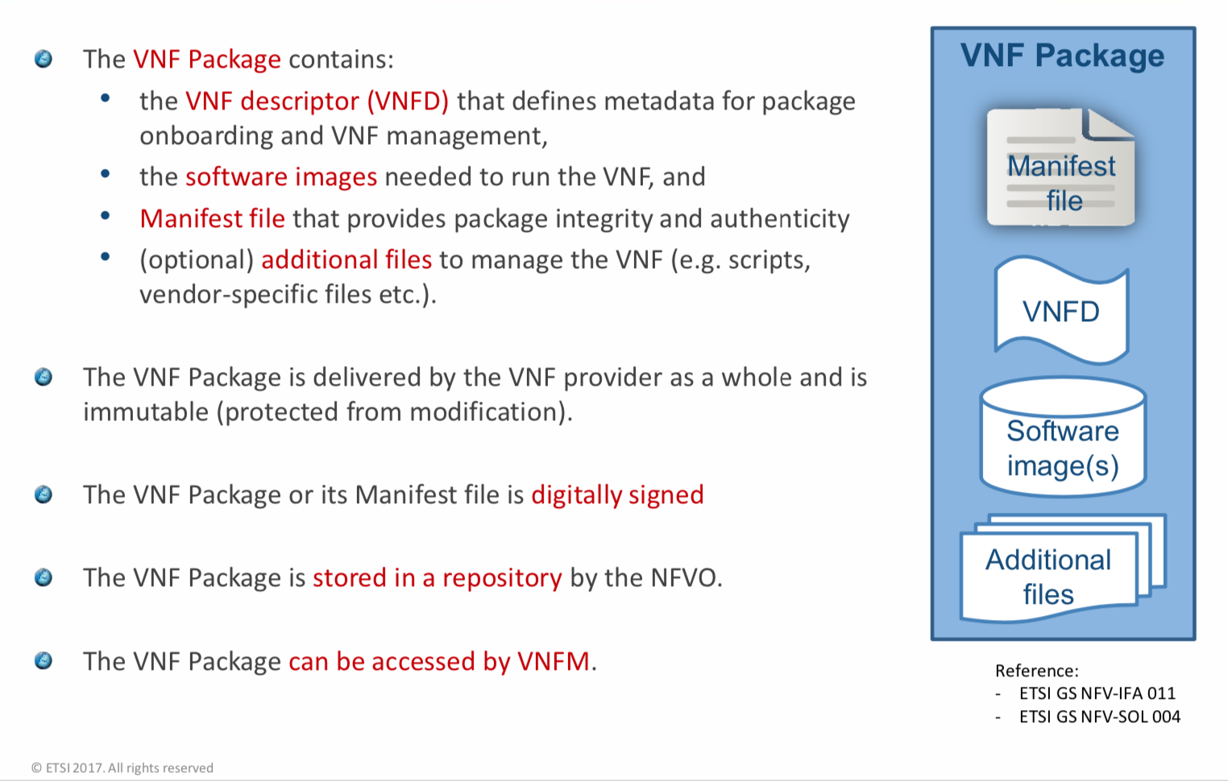
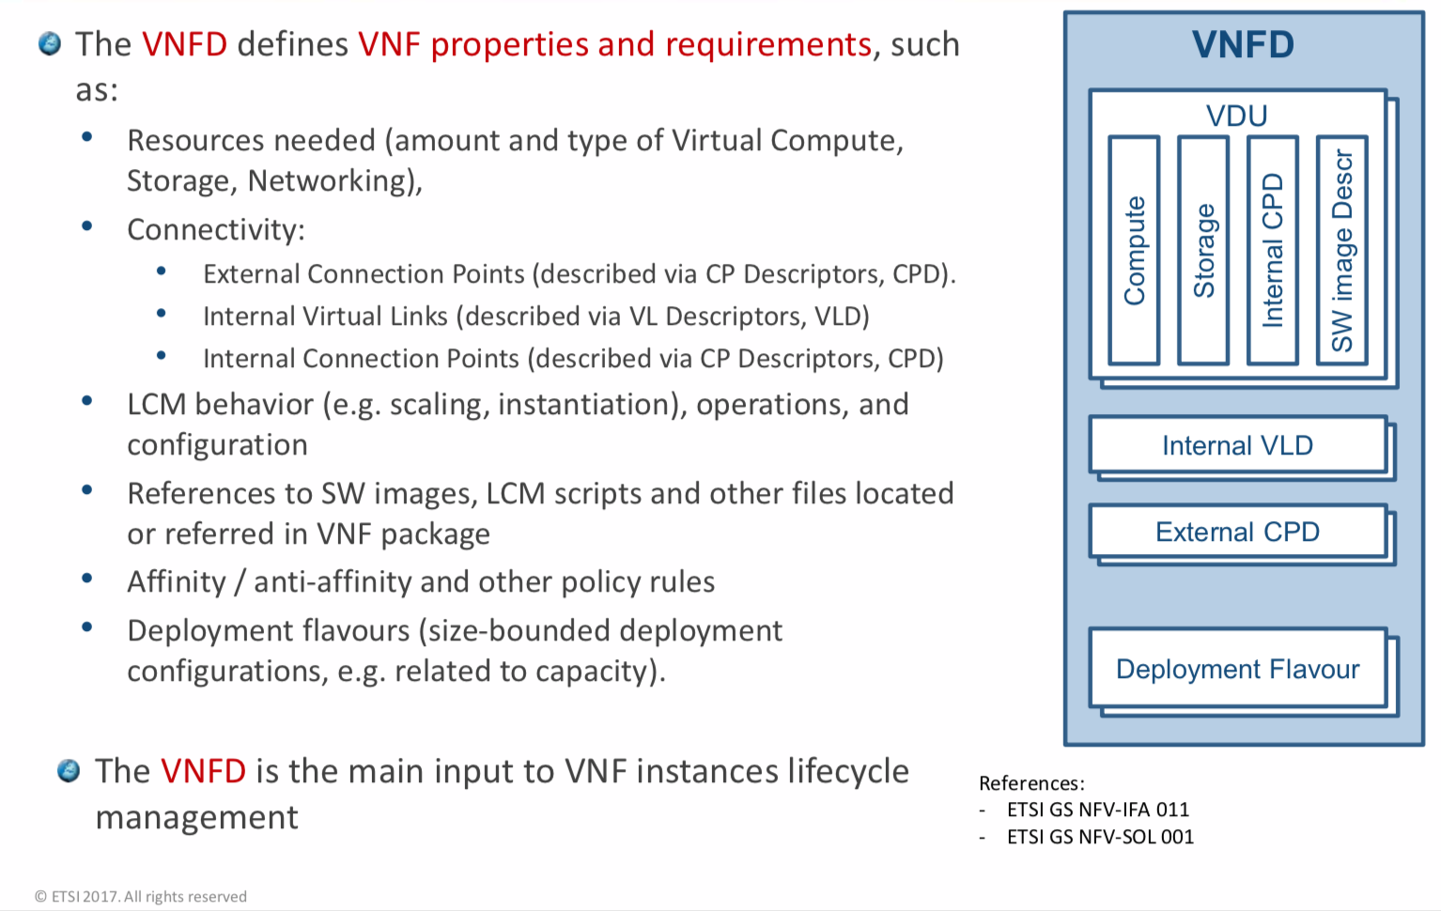
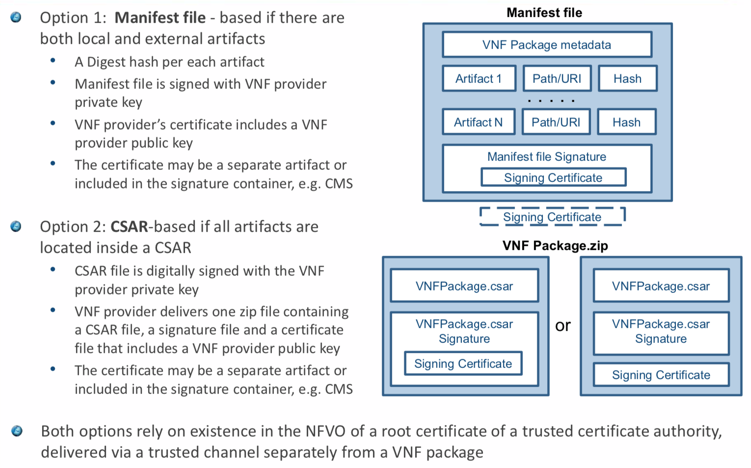
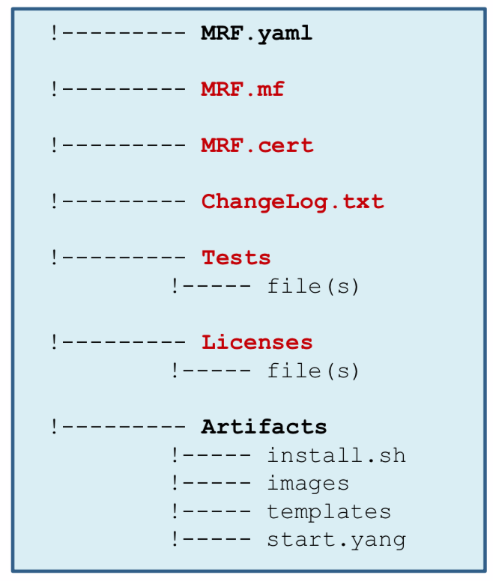
ETSI VNF Package and VNFD

Slide 22
ETSI SOL003 Adapter, Possible Placement Options
One SOL003 Adapter or Two SOL003 Adapters?
  Case #1: One SOL003 Adapter: a proposal for GNFC has an external SOL003 Adapter, which supports create/instantiate/terminate/scale/heal VNF and LCN, and also configurations.
    For this, the current SO VNFM Adapter needs to be decoupled from SO
    The SOL003 Adapter supports all the SOL003 operations including configuration
  Case #2: Two SOL003 Adapters: a proposal that one SOL003 adapter which is attached to SO handles VNF LCM and LCN; another SOL003 adapter in the GNFC handles configurations - allowing separate evolutions of LCM and Configurations
For the GNFC use case,
  CE-2 NBI needs to be enhanced to support VNF LCM
  Connections/Paths between CE-2 and CI-06 need to be defined/designed
  SOL003 Adapter NBI needs to be adjusted, based on CI-6
Key
Case #2
CE-x
Controller External API
CI-x
Controller Internal API
Artifact Distribution
Closed Loop Actions
Orchestration
Inventory
Updates
Controller Design Extensions**
OOF (for queries)
Policy
Run time catalog
Service Design & Creation
Orchestration
Data Collection, Analytics & Events
Active & Available Inventory
MSB/Data Movement
CE-1
CE-2
CE-3
CE-4
Generic NF
Controller
API Handler
CI-1
CI-2
CI-3
Repository
Operational Tree/Config Tree (Service Model)
Service Logic
CI-5
VNF Descriptors
CI-4
Service Logic Processing
Assigned Resources Inventory:
Service* Topology & VNF/PNF State
Config Templates
Service Logic
Supports Model-Driven Lifecycle Mgmt.
Engineering Rules
Service Logic
Configure
Audit
SW upgrade
Scale in/out
Stop/start
Health check
L4-7 Service Create
MSB/Data Movement
Service Logic
…
OSS / BSS
Policy Cache/Event Match
…
CI-7
*Not E2E service view. The “Service” view in the Generic NF Controller is limited in its scope of control
Case #1
SOL005
Os-Ma-nfvo
1
CI-6
CLI
U-UI
ONAP Portal
Adapters
ONAP External APIs
DESIGN-TIME
Dashboard OA&M
RUN-TIME
…
Resource Onboarding
Data Collection, Analytics, and Events
Correlation
2
Common
Services
Multi-Cloud Adapter
Netconf
Chef
Ansible
Others
External SOL003 Adapter
External SOL002
Adapter
Service Design
Policy Framework
Service Orchestration
Active & Available Inventory
External Registry
Common Services
3
Application
Authorization
Framework
1
Policy Creation & Validation
ONAP Operations Manager
Analytic Application Design
Micro Services Bus / Data Movement
ONAP Optimization Framework
CE-5
CE-6
CE-7
VNF / PNF Onboarding
2
Closed Loop Design
4
Generic NF Controllers
Logging
MSB/Data Movement
Change Management Design
Multi-Cloud
Adaptation
SDN
Controller
SOL003
Adapter
Applications
VNFs
PNFs
VNF or
External
EMS
Design Test & Certification
SDN
Controller
Configuration
Others
Multi-VIM/Cloud
External
Specific VNF Managers
3
CCSDK
Catalog
5
6

Slide 23
References
SO Plug-in Support for VNFM (SO VNFM Adapter), https://wiki.onap.org/pages/viewpage.action?pageId=48529911
SO VNFM Adapter APIs, https://wiki.onap.org/display/DW/SO+VNFM+Adapter+APIs
SO VNFM Adapter Test Case, https://wiki.onap.org/display/DW/SO+VNFM+Adapter+Test+Case
SO VNFM Adapter Feature Candidates for Frankfurt, https://wiki.onap.org/display/DW/SO+VNFM+Adapter+Feature+Candidates+for+Frankfurt
SO ETSI Catalog DB handling for NS and VNF/PNF packages, https://wiki.onap.org/pages/viewpage.action?pageId=63996543

Slide 24
Thank you!

