Slide 1
OOF-PCI: Physical Cell ID (PCI) Optimization and centralized Automated Neighbor Relations (ANR) using ONAP Optimization Framework (OOF):
ONAP Dublin Proof of Concept
July 24, 2019
PoC Collaborators: AT&T, Wipro, TechMahindra,
highstreet technologies, Lumina Networks, Nokia,
Reliance Jio, Rutgers Winlab
Acknowledgments: Feedback and support from participants
in ONAP OOF-PCI team calls

Slide 2
OOF-PCI PoC Demo - Outline
OOF-SON Overview – N. K. Shankar (12)
Demo introduction - Swaminathan S, Saravanan A (5)
Demo – Krishna Moorthy (20)
Open Platform for Advanced Wireless Research East Coast – Tracy van Brakle / Ivan Seskar (3)
ONAP Component Enhancements – (10)
  DCAE / SON Handler Microservice – Swaminathan S
  RAN Simulator, Policy - Saravanan A
  SDN-R & ConfigDB – Sandeep Shah
  OOF enhancement for PCI – Vikas Varma / Carlos de Andrade
  Integration Testing – Krishna Moorthy
ONAP SON Frankfurt Plans – (5)
Conclusion – (5)

Slide 3



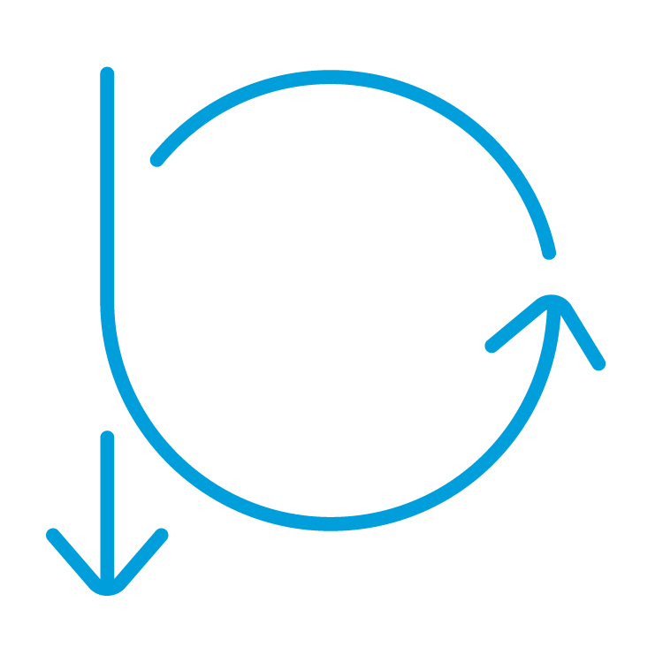



ONAP-Based SON (Self Organizing Networks)
Optimization (OOF)
Co-ordination, Decisions
(Policy)
SON ⬄ Control Loop (CL)
ONAP: Open-source platform, with basic open-source code
Companies can use framework to add proprietary SON solutions
OOF-PCI Casablanca –
  First ONAP SON PCI use case
  PoC Demo in Dec 2018
OOF-PCI Dublin
  Added SON function: ANR
  More SON data flows: FM, PM
  More ONAP code integration
Data Collection,
& Analysis
(DCAE)
Action
(SDN-R)
Control loop
Data, FM, PM
Config status
5G/4G Radio Network

Slide 4
ONAP-Based SON & ORAN interfaces
Optimization (OOF)
Co-ordination, Decisions
(Policy)
OOF-PCI use case has built a foundation for ONAP/ORAN integration
Radio network uses common netconf/yang model
Data flows:
SDN-R to RAN: netconf-based configuration
RAN to DCAE: VES format for
FM alarms and PM KPI
RAN to SDN-R: netconf notifications for configuration changes within RAN
Data Collection,
& Analysis
(DCAE)
RIC (non-RT)
Action
(SDN-R)
Control loop
Data, FM, PM
RIC (near RT)
A-1/O-1
A-1/O-1
Config status
ORAN Radio Network

Slide 5
ONAP SON Release planning
ONAP Casablanca - focus on Minimum Viable Product and PoC
Focus on data flow and interfaces for: OOF, new PCI-Handler-MS, Policy, SDN-R, new RAN-Sim
ONAP Dublin – add functionality, integrate into ONAP codebase
Fully compliant DCAE implementation
Add centralized ANR functionality to PCI, including joint optimization
Add SON flows for FM/PM data (e.g. PCI Confusion alarm, Handover KPI)
Focus on integration testing, and inclusion in ONAP Dublin release
PoC in newly upgraded Rutgers Winlab OWL
ONAP Frankfurt – deployment readiness
Alignment with ORAN/3GPP common model
PoC with SDN-R and DCAE interacting with real gNodeBs
Include other ONAP modules: A&AI, SO, SDC, CLAMP

Slide 6
Contributors
Organization | Contributor(s) | Topic(s)/Area(s)
AT&T | N. K. Shankaranarayanan, Sarat Puthenpura, P. N. Shankaranarayanan, Carlos de Andrade, Vikas Varma, George Clapp, Tracy van Brakle, Marco Platania Pam Dragosh, Dan Timoney, Brian Freeman, Vijay Venkatesh | Use case lead & conceptualization, OOF, SDN-R, ONAP setup at Winlab; Policy, DCAE, SDN-C/SDN-R and Integration Test support
Wipro | Swaminathan S, Saravanan A, Krishna Moorthy, Reshmasree C, Ramya R, Phunith Kumar | Use case enhancements, DCAE (new SON-Handler MS), Policy, RAN-Sim, RAN-Sim GUI, Honeycomb enhancements, Integration Test Lead
Tech Mahindra | Sandeep Shah, Vineeth Agarwal, Devendra Chauhan | SDN-R, Config DB
highstreet technologies | Martin Skorupski, Herbert Eiselt, Hanif Kukkalli | ONAP setup at Winlab, SDN-R and RAN-Sim
Lumina Networks | Jeff Hartley | SDN-R support
Nokia | Ben Cheung, Ferri Tafreshi | Use case guidance and conceptualization
Reliance Jio | Dilip Krishnaswamy | Use case conceptualization
Rutgers University | Ivan Seskar, Michael Sherman, Mohit Sheth, Aayush Shah | ONAP setup at Winlab

Slide 7
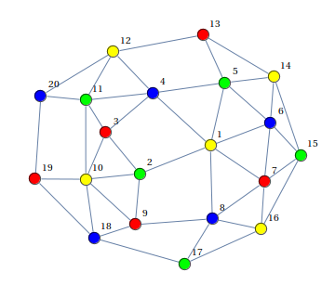
PCI and ANR optimization – 4G/5G SON functionality
Physical cell ID (PCI) is a locally unique integer ID in 4G/5G
  Used for handoff and physical layer design
  PCI ranges: (LTE: 0-503, 5G: 0-1007)
PCI optimization: Assign PCI values to avoid PCI collision and minimize PCI confusion
Automated Neighbor Relations (ANR) builds & maintains neighbor relation tables in eNodeB and gNodeB
  Distributed ANR in eNodeB, gNodeB
  Centralized ANR optimizes neighbor tables based on global information
PCI needs to be re-optimized if neighbor relationship changes, (e.g. during distributed ANR function in RAN)
Centralized ONAP ANR optimization
is best done jointly with PCI - blacklisting neighbors from HO based on HO metrics over a period of time
Cell: C1
PCI: 3
PCI confusion
Cell C9 has two
neighbors with PCI = 1
Cell: C2
PCI: 8
Cell: C5
PCI: 4
Cell: C3
PCI: 2
Cell: C4
PCI: 1
Cell: C10
PCI: 10
Cell: C7
PCI: 7
X
Cell: C9
PCI: 5
Cell: C8
PCI: 6
Cell: C11
PCI: 2
ANR action
Cell C11 is blacklisted from HO from Cell C9.
PCI collision
Cell C3 has a neighbor
with the same PCI=2
Cell: C12
PCI: 1
Graph Coloring
Problem

Slide 8
ONAP Dublin PoC: PCI & ANR Optimization using OOF
REST API
DMaaP Message
(Netconf/Yang)
7
4b
Config Value
Change Notifn
4a
ConfigDB
6
Simulated RAN
~2000 Cells
Nbr_list, PCI values
OOF
Policy
SDN-C*
(SDN-R)
3a
DCAE
10
1d
1c
8
SON Handler MS
9
11
1b
1a
12
5
2
Config Value
Changes
PCI enhancements
Add ANR function
4d
13
4c
SDC &
CL setup
FM/PM
Data
FM/PM Database
DCAE Collector
(VES)
3b
1e
FM/PM KPIs
FM/PM Collector and Database
(*Note: Team has renamed Casablanca PCI-Handler MS as SON-Handler-MS to reflect broader role of MS)

Slide 9
OOF-PCI Dublin Use Case / PoC Highlights
New SON optimization triggers: FM data / alarms, PM KPIs
New SON functionality - joint PCI-ANR optimization by OOF, handoff blacklist in Cell Neighbor table
New data flows - Receiving and handling FM/PM data using VES Collector in DCAE
SON-Handler MS on-boarded on DCAE and is part of ONAP Dublin distribution
SDN-R implementation integrated with CCSDK and DG requirements – includes netconf notification handling, part of ONAP El Alto distribution
SDN-R, RAN-Sim, ConfigDB designed around common netconf/yang model
New control loop for ANR in Policy, and model alignment with Dublin Policy architecture
RAN-Sim enhancements – generate/send PM/FM data, handle ANR updates, 60+ netconf servers controlling 1000 cells realized successfully
Completed Integration Tests as per ONAP process
Use case is a catalyst for, and early adopter of, upgraded Rutgers Winlab OWL
– new ONAP Test lab, focused on Mobile networks, OOM-based ONAP Dublin installation

Slide 10
Demo

Slide 11
ONAP Dublin OOF-SON Demo : PCI & ANR Optimization
= DEMO Highlights
REST API
DMaaP Message
(Netconf/Yang)
7
4b
Config Value
Change Notifn
4a
ConfigDB
Simulated RAN (GUI)
~1000 Cells
Nbr_list, PCI values
FM alarms for PCI confusion/collisions
HO KPIs
6
OOF
Policy
SDN-C*
(SDN-R)
3a
DCAE
10
1d
1c
8
SON Handler MS
9
11
1b
1a
12
5
2
Config Value
Changes
PCI enhancements
Add ANR function
4d
13
4c
SDC &
CL setup
FM/PM Database
DCAE Collector
(VES)
3b
1e
FM/PM KPIs
FM/PM Collector and Database
(*Note: Team has renamed Casablanca PCI-Handler MS as SON-Handler-MS to reflect broader role of MS)

Slide 12
Demo Sequence: Joint PCI-ANR optimization
Step 2: RAN-Sim UI (Neighbors)
Step 3: SON-Handler MS Logs
Step 4: Policy Logs
Step 5: SDN-R and RAN-Sim UI
Step 1: RAN-Sim UI (PM)
1. Show RAN topology in UI
2. Add neighbors to a cell and show collision/confusion in UI, FM data sent from RAN-Sim
1. Show SON-Handler MS receiving info from RAN (FM->VES and netconf->SDN-R)
2. Show OOF triggered by SON-Handler MS & OOF response with optimization results
1. Show Control Loop in Policy getting activated
2. Show message flowing from Policy to SDN-R
1. Show karaf and DG logs in SDN-R
2. Show refreshed RAN-Sim GUI with problems solved.
1. Trigger PM data generation, specifying for which source cells, HO success should be bad/poor to ‘some’ of its neighbors

Slide 13
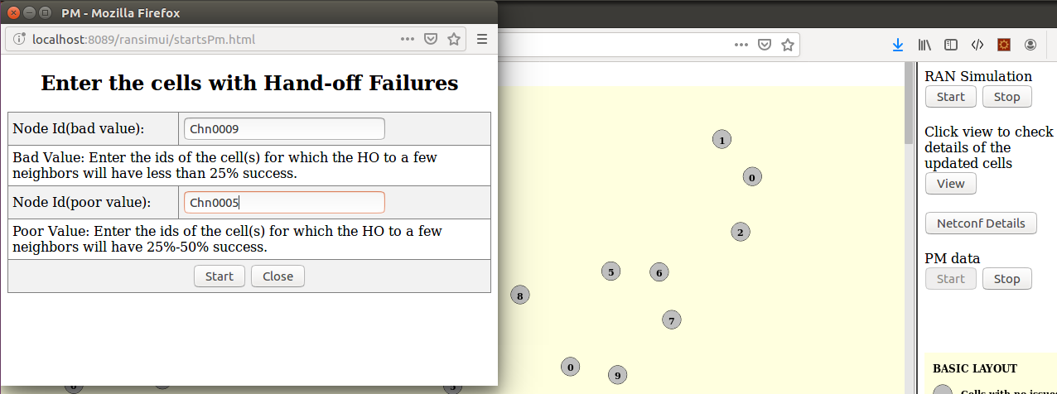
Trigger PM Generation
Specify HO from which cells should be bad/poor.
Relevant for Centralized ANR update
Relevant for joint PCI-ANR optimization
Click “Start” to open the window shown on the left

Slide 14
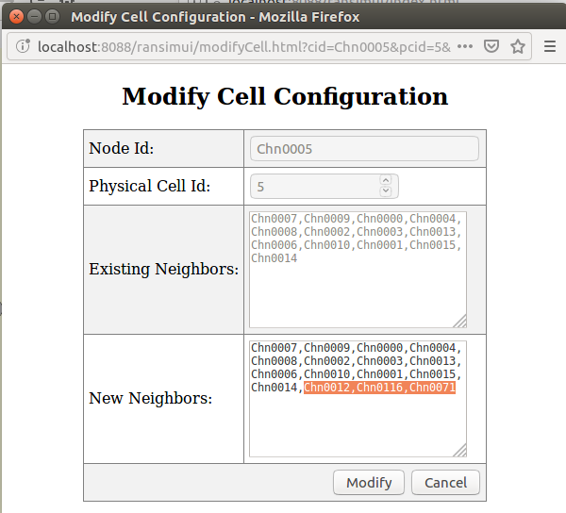
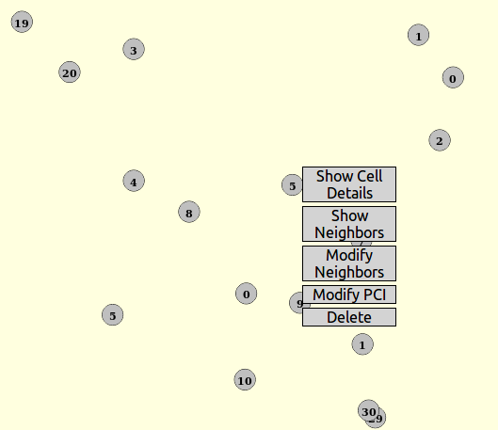
Modify Neighbors - Illustration

Slide 15
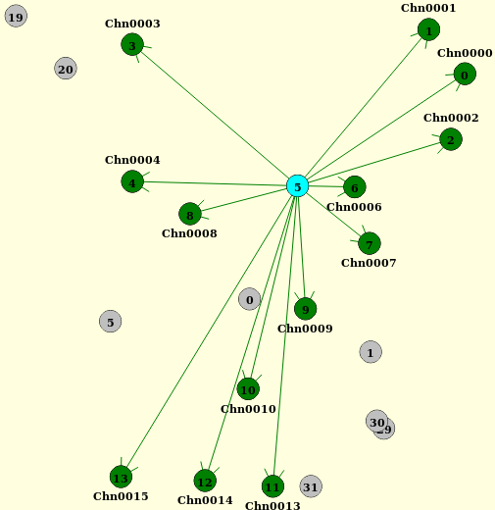
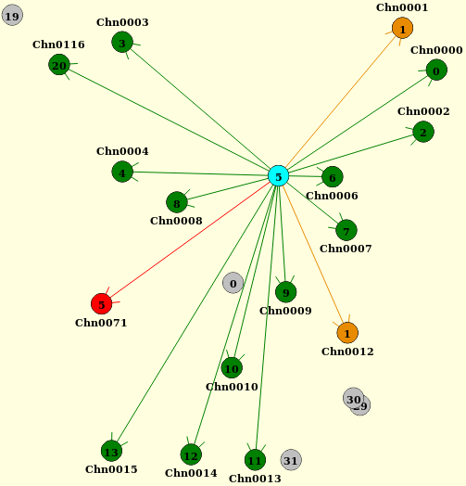
Demo Steps – Add neighbors to Cell with PCI = 5
Original neighbors
After addition of 3 neighbors
Collision
Confusion

Slide 16
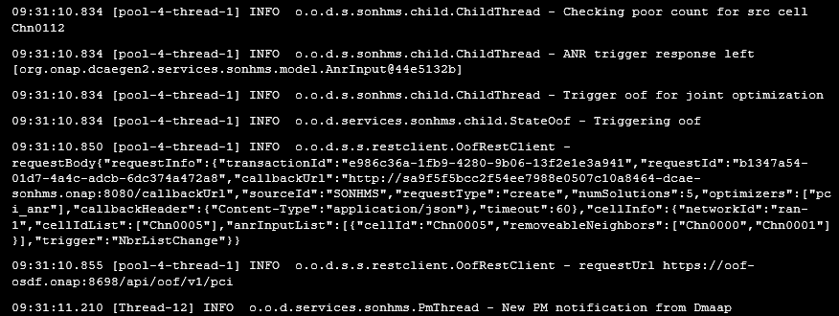
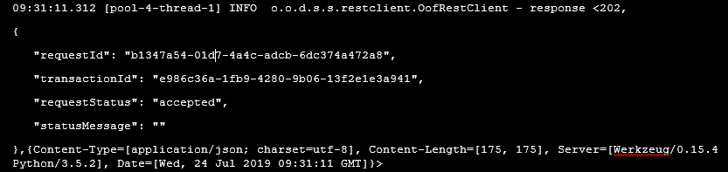
SON-Handler MS Logs (OOF trigger and acknowledgement)
Request to OOF
Ack from OOF

Slide 17
OOF Enhancements for PCI and ANR
Enhancements in SON Optimization Solver and API:
PCI Optimization (optimizer = pci)
  Input: Set of cells, PCI values, neighbor relations
  Output:
  pciSolutions: Optimized PCI assignment without PCI Collision and Confusion
Joint PCI/ANR Optimization (optimizer = pci_anr)
  Input: Set of cells, PCI values, neighbor relations,
  removeable neighbors (neighbor links with bad handover KPI)
  Output response:
  pciSolutions: Optimized assignment of PCI
  anrSolutions: List of links to be blacklisted for handover
Code changes in SON Optimizer to adapt to new ConfigDB API

Slide 18
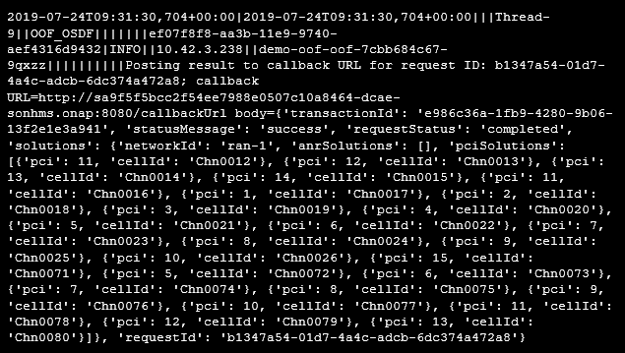
OOF Log – PCI optimization results

Slide 19
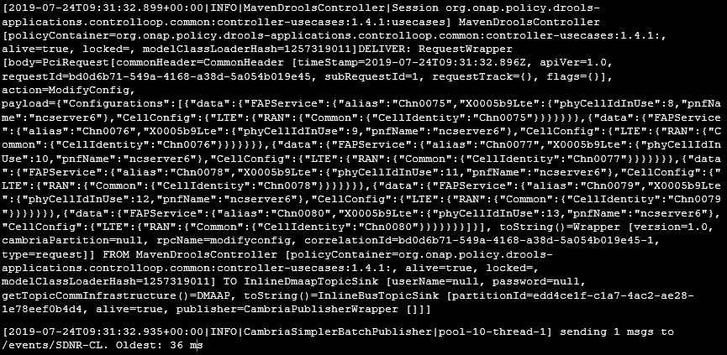
Policy Logs

Slide 20
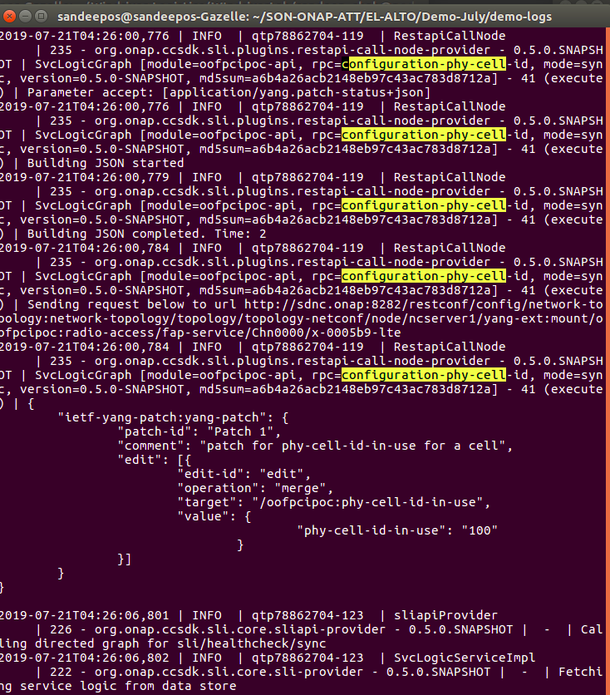
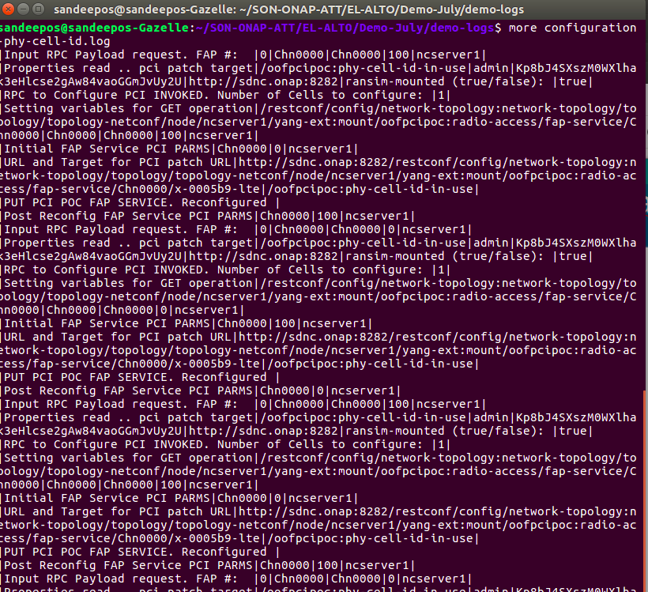
SDNR/Karaf and DG Logs (Config Phy Cell ID)
20

Slide 21
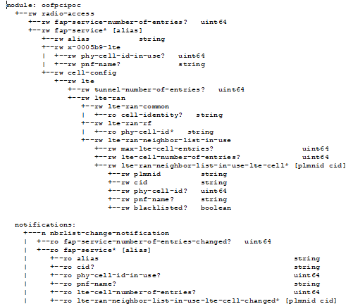
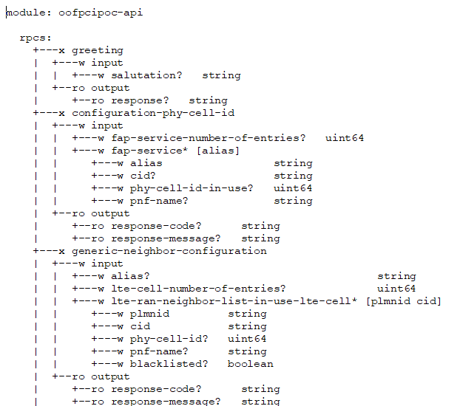
YANG Model Tree for OOF PCI/ANR POC¹
The platform ready to support any YANG Model
Number & List of Cells
PCI and PNF-NAME for a Cell
List of Neigbors
RPC
RPC
Netconf Notification
¹ https://gerrit.onap.org/r/gitweb?p=ccsdk/features.git;a=tree;f=sdnr/northbound/oofpcipoc/model/src/main/yang;h=5b3ef2c03cf516ba716f69076a780a95e96fadc2;hb=refs/heads/dublin

Slide 22
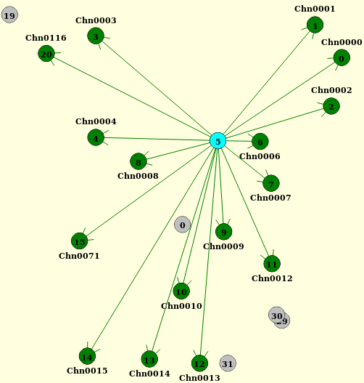
Demo Steps – PCI optimization completed
Before optimization
After optimization

Slide 23
Demo Sequence: Centralized ANR Actions
Step 1: RAN-Sim UI
Step 2: SON-Handler MS Logs
Step 3: Policy Logs
Step 4: SDN-R, RAN-Sim UI
1. Show RAN topology in UI
2. Initiate PM data generation, and specify which neighbors are ‘bad’
1. Show SON-Handler MS receiving PM data from RAN (via VES-Collector)
2. Show SON-Handler triggering ANR update to Policy
1. Show Control Loop in Policy getting activated
2. Show message flowing from Policy to SDN-R
1. Show netconf message from SDN-R to RAN-Sim with ANR updates
2. Show refreshed RAN-Sim GUI with problems solved.

Slide 24
Trigger PM Generation
Specify HO from which cells should be bad/poor.
Relevant for Centralized ANR update
(already shown earlier)

Slide 25
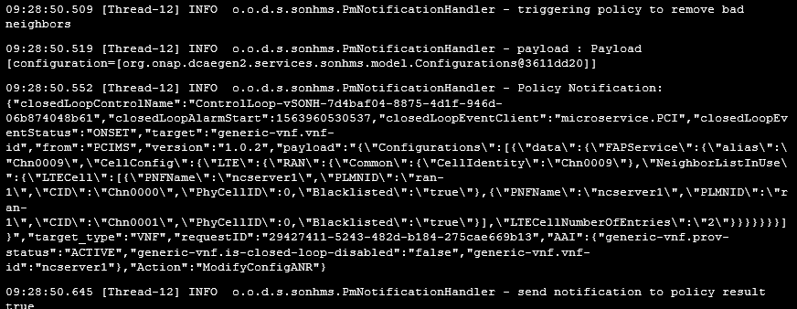
SON-Handler MS Logs

Slide 26
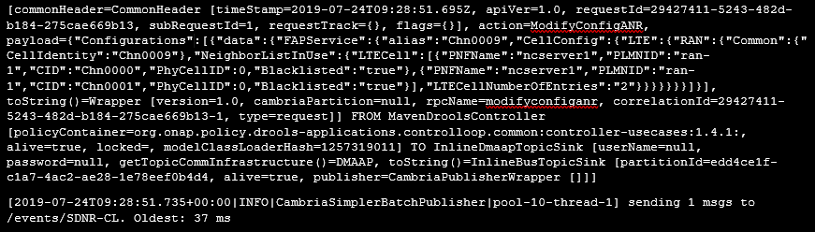
Policy Logs

Slide 27
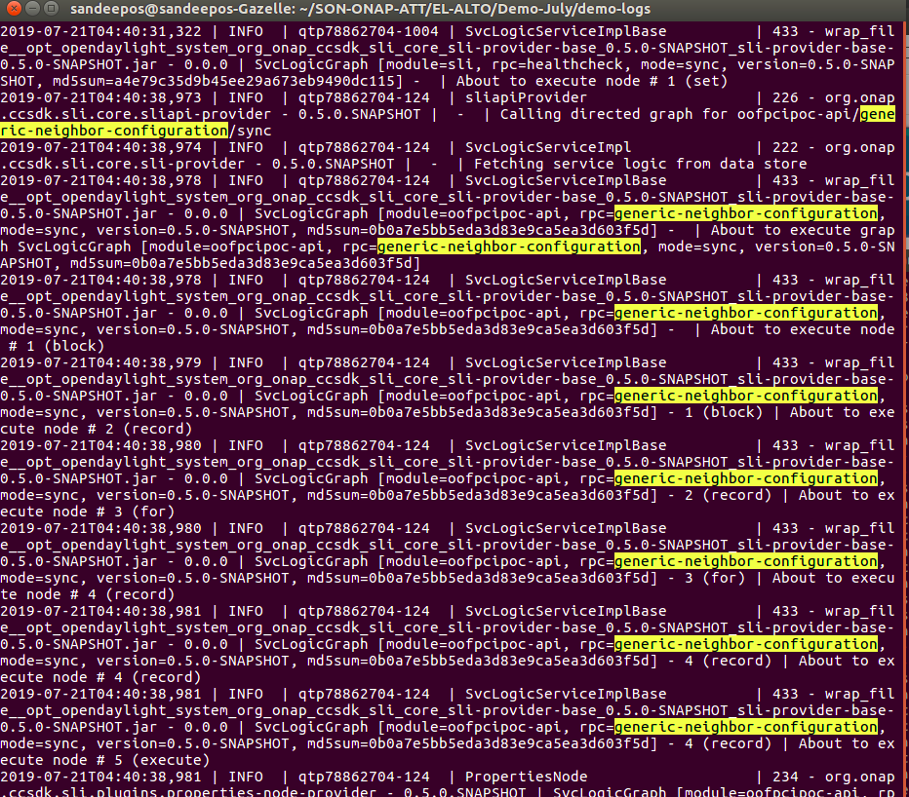
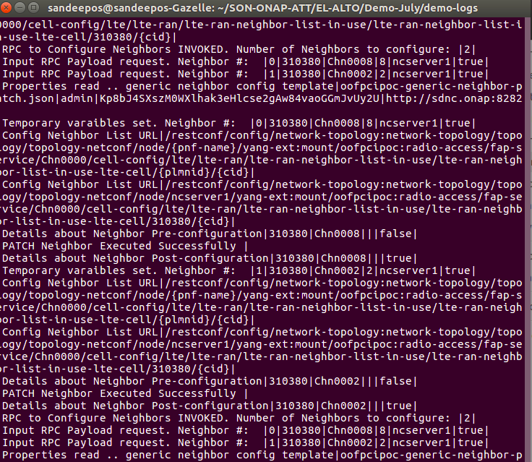
SDNR/Karaf and DG Logs (Neighbor Config)
27

Slide 28
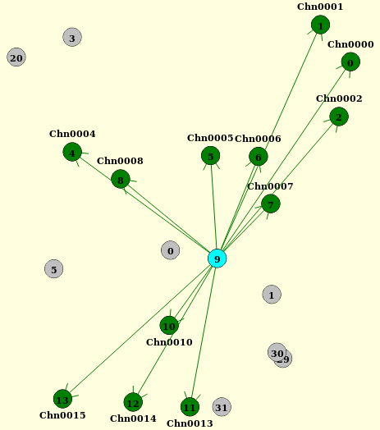
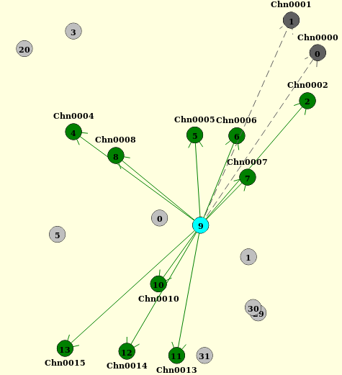
Centralized ANR update completed
Original list of neighbors
HO blacklisted to 2 neighbors after ANR update
HO blacklisted
to chn0001 &
Chn0000 after
centralized
ANR update

Slide 29
ONAP Wireless Lab Installation

Slide 30
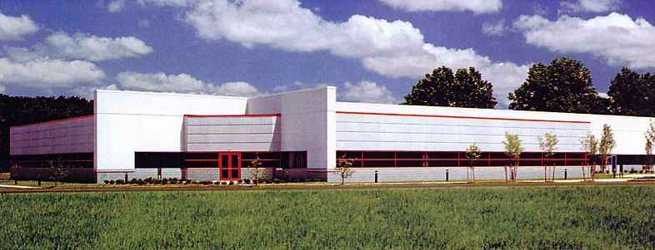
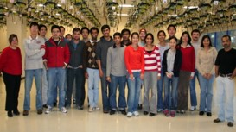
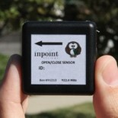
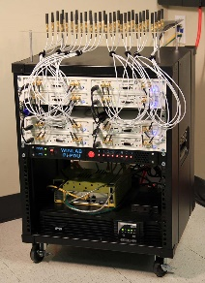
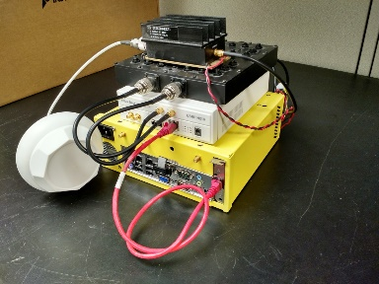
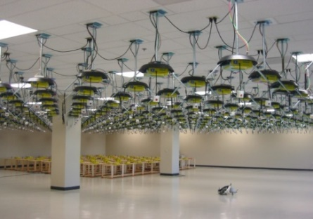
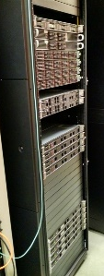
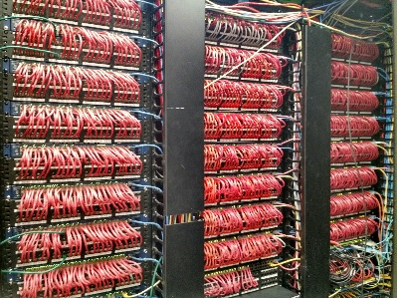
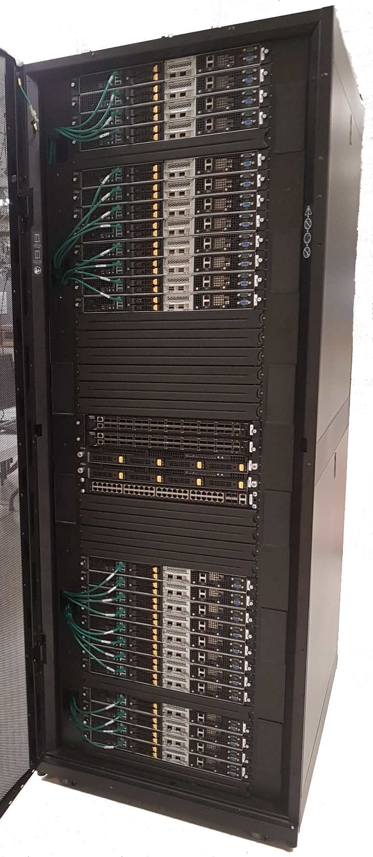
WINLAB at Rutgers University
WINLAB founded in 1989 as a collaborative
industry-university research center with
specialized focus on wireless networking
~25 faculty/staff, most from the ECE and CS departments at Rutgers
~40-50 grad students (80% PhD, 20% MS)
WINLAB Tech Center Facility
Center’s research portfolio spans information theory, radio technology, wireless systems, mobile networks and computing
Extensive experimental research infrastructure including ORBIT & GENI testbeds, SDR, SDN, …
Low Power IoT Device
Massive MIMO
SDR
ORBIT Radio Grid Testbed
GENI Rack
SDN
CloudLab Rack
Selected as an ONAP integration and testing laboratory for North America

Slide 31

WINLAB Designated by NSF as NJ/NYC PAWR Testbed

Slide 32
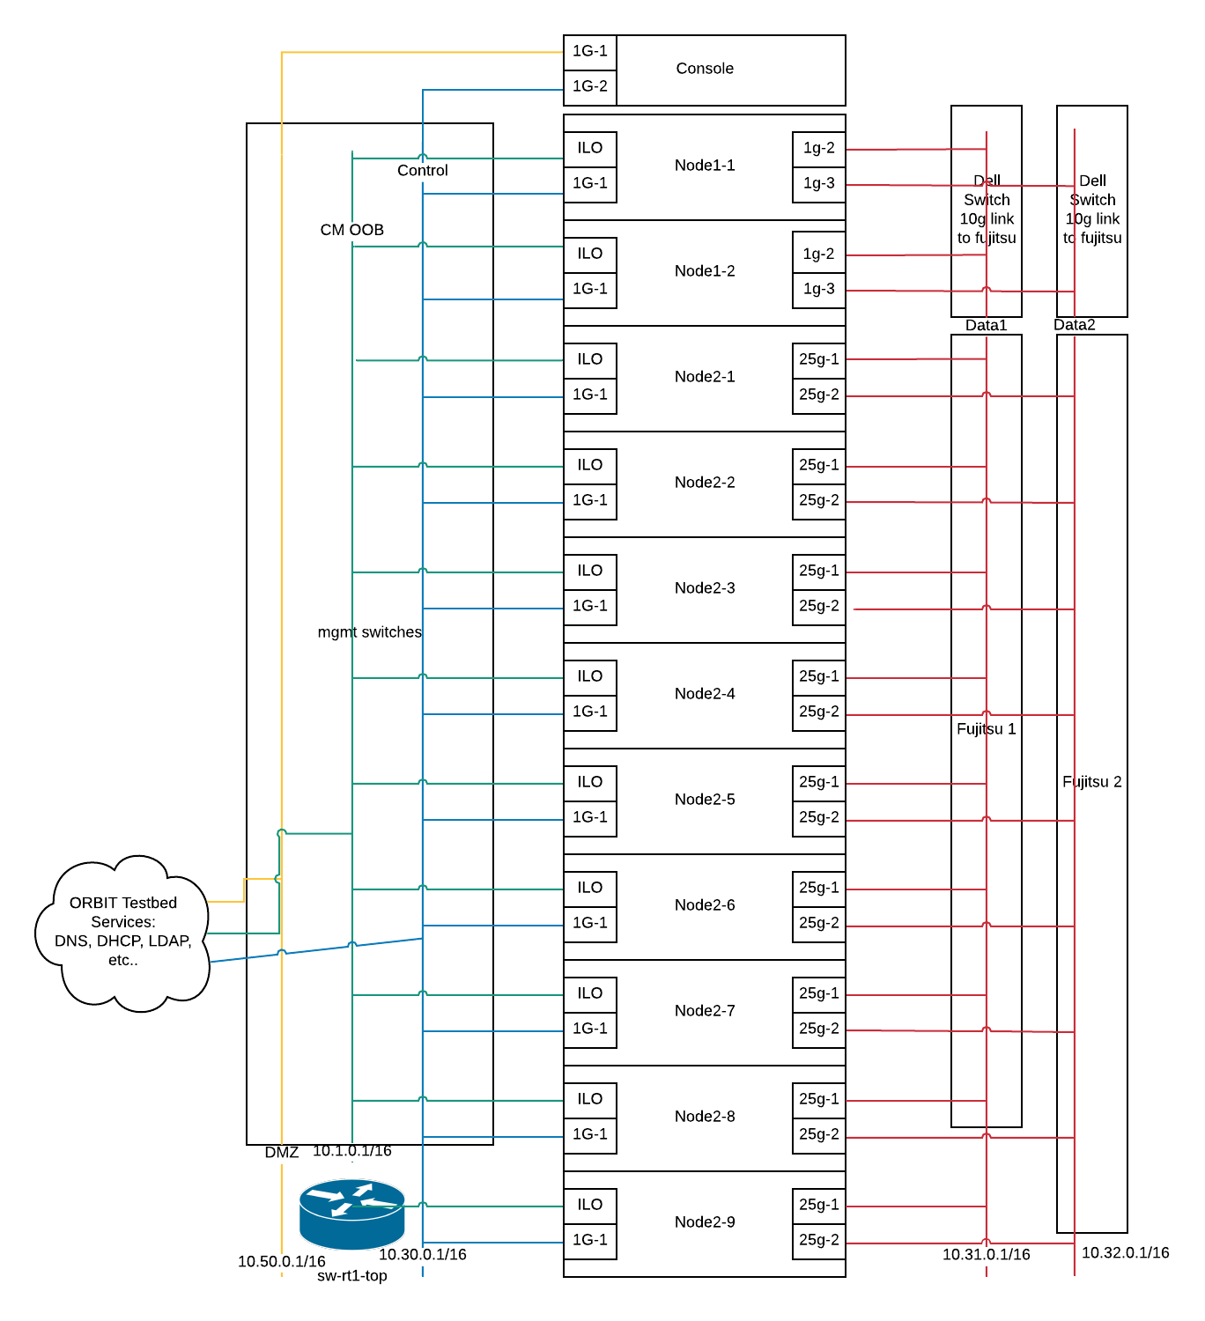
Open Wireless Lab (OWL) at WINLAB/COSMOS
Environment
  Entry point at console located at console.sb10.orbit-lab.org
  10 Ubuntu servers, all managed by OpenStack
  Control Node: Node 1-1
  Compute Nodes: Node 2-1 through 2-9
Access Methods
  One can gain access by requesting an account at WINLAB
  https://wiki.onap.org/pages/viewpage.action?pageId=45298557

Slide 33
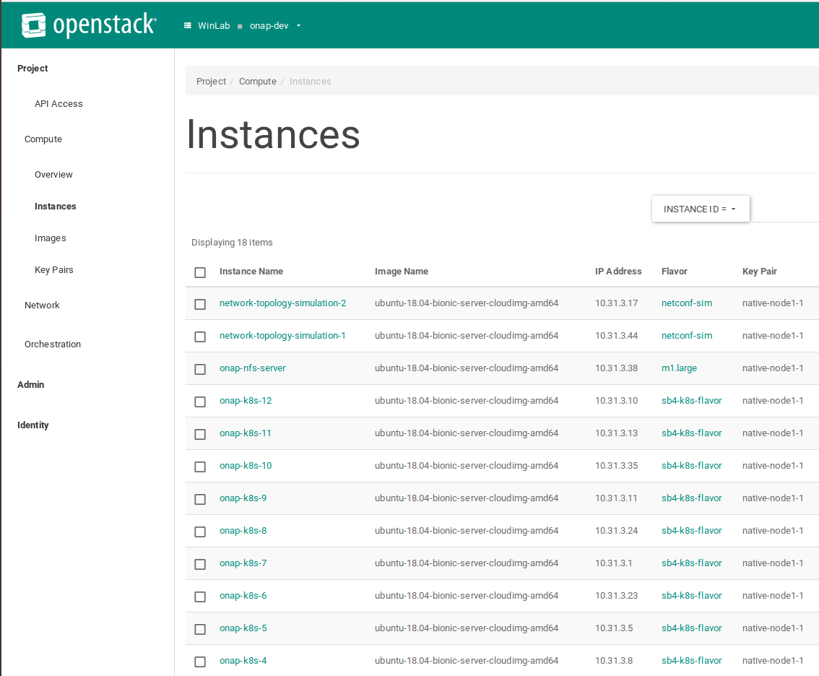
Open Wireless Lab (OWL)
OpenStack Pike installation
ONAP Dublin Installation
  Three Rancher servers
  Twelve Kubernetes nodes
  One NFS server
  Two VMs hosting 10,000 NETCONF simulators

Slide 34
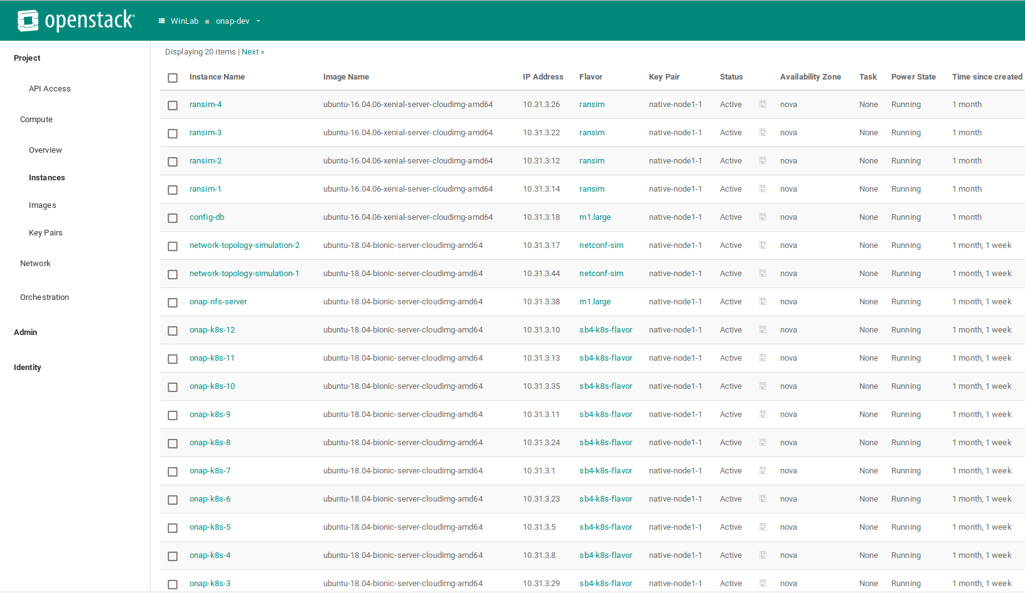
OpenStack Environment
NETCONF server simulators
Configuration database
VMs for Rancher/Kubernetes installation of ONAP

Slide 35
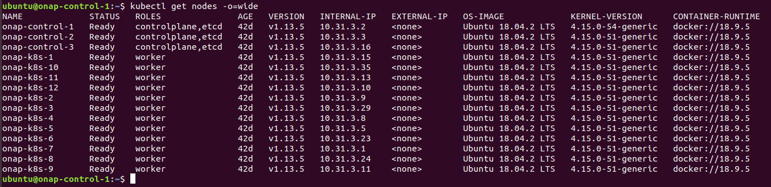
High Availability Rancher-Kubernetes Setup
Open source software Rancher, Helm, Kubernetes and docker are deployed in the VMs to create high-availability Rancher and Kubernetes Cluster environment.
The deployment of the ONAP components is done using ONAP helm charts from the “oom” git repository
  https://onap.readthedocs.io/en/latest/submodules/oom.git/docs/oom_setup_kubernetes_rancher.html#onap-on-kubernetes-with-rancher
High Availability Rancher/Kubernetes environment setup
  Documented at: https://wiki.onap.org/display/DW/SDN-R+on+Rancher+Kubernetes+at+WINLAB

Slide 36
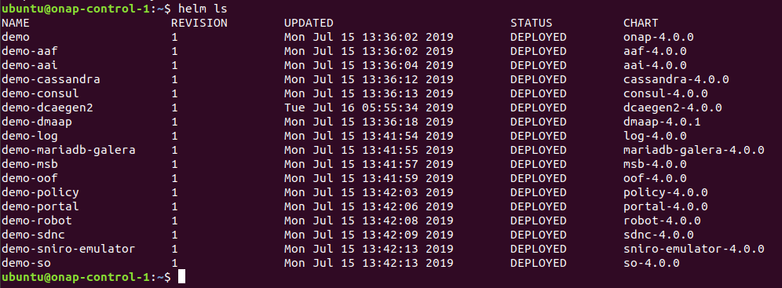
Deployed ONAP modules at WINLAB
  Currently deployed ONAP components at OWL:
    aaf
    aai
    consul
    dcaegen2
    dmaap
    log
    msb
    oof
    policy
    portal
    robot
    sdnc
    SNIRO Emulator
    so

Slide 37
Future Considerations and References
  Goal: Three ONAP Installations
    Stable
    Developer
    Sandbox
      Short experiments, wiped and refreshed every day
    Only stable instance is currently installed
  WINLAB: http://www.winlab.rutgers.edu/
  ORBIT Lab: https://www.orbit-lab.org/
  COSMOS: https://www.cosmos-lab.org/

Slide 38
ONAP Component Enhancements

Slide 39
OOF-PCI Dublin Use Case: Impacts
OOF
Solver enhanced with PCI and ANR joint optimization
DCAE
(SON-Handler MS)
MS on-boarded to DCAE
Policy
New control loop for ANR updates
Config DB and SDN-R/SDN-C
RAN-Sim and GUI
Interface with SON-Handler MS enhanced to obtain ANR inputs, and provide ANR actions after optimization
PM data reception and processing for initiating autonomous ANR updates, and/or invoke OOF for joint PCI-ANR optimization
FM data reception, correlation with neighbor-list-update notification from SDN-R, and initiating PCI optimization actions
Control loop extension to wait for response from SDN-R, and forward it to SON-Handler MS
Yang model extensions to communicate ANR updates to RAN
Update Config DB on reception of neighbor-list-change notification from RAN, PCI/ANR update from Policy
OOF interface enhanced, new interface to VES-Collector, receive response from Policy
Enhancements to generate FM data on collision/confusion detection
Generation and sending of PM data periodically with GUI-based trigger
Handle ANR updates and display in GUI
Enhancements to Honeycomb agent to send PM/FM data over REST interface to VES-Collector
Config DB enhanced with HO flag, and additional APIs
New DB for FM/PM
Honeycomb footprint reduction
RPC’s/DG’s to send Netconf message to RAN simulator upon reception of DMaaP message from Policy
RPC’s/DGs to handle netconf notification from RAN, update ConfigDB, and send DMaaP message

Slide 40
DCAE: SON-Handler MS
New MS fully on-boarded to DCAE
Functional updates for FM/PM handling and centralized ANR

Slide 41
DCAE (with SON-Handler MS on-boarded)
Consul Cluster
OOF
Policy
SDN-R
Consul Cluster
DCAE Platform
DCAE Services
Cloudify Manager
MS - 1
SON Handler MS
MS - n
Inventory API
CBS
PG DB
Service Change Handler
Deployment Handler
Policy Handler
SNMP Trap Coll.
VES Collector
Datafile Collector
HV-VES Collector
CLAMP
SDC
Policy
xNF (RAN node)

Slide 42
SON-Handler MS Architecture
Spring boot application
DB contents
Config information
Processed notifications & alarms (until OOF response is received)
Buffered notifications & alarms
State information
FM/PM processed data
Core Logic
Main thread
Child thread(s) for FM data/SDN-R notification processing
Child thread for PM data processing
Database
REST Interface
DMaaP client
RAN nodes
Could be a CU/DU or a traditional BS.
Other ONAP components
CBS
OOF
SDN-R
Policy
VES-C
Database
PostgreSQL DB
RAN nodes
Implementation details are available at https://wiki.onap.org/pages/viewpage.action?pageId=56131985.

Slide 43
RAN-Simulator (RAN-Sim)
More functionality
Improved efficiency

Slide 44
Approach for RAN Simulator (RANSim) – Dublin - FM
ONAP
OOF
GUI
  Provide Control to User in UI to select a cell and modify neighbor list to simulate collision/confusion
Controller
  Send message to corresponding Netconf Server about the collision/confusion
Netconf Server
  Send configChangeNotification to SDNR
  Send FM/alarm message to VES Collector for collision/confusion. Thus the control loop starts
GUI
  Show the modified PCI values
Controller
  When the modified RAN configuration received, same is updated into DB and informed to UI
Netconf Server
  When the SDNR provides the modified RAN configuration, same is forwarded to Controller
DCAE
SON Handler
Policy
VES Collector
SDNR
Web GUI
REST
Netconf
REST
Simulated
Network
Netconf server 1
RANSim
Controller
Netconf server n
Honeycomb
Websocket
Honeycomb
Extension
Config DB
(MariaDB)
Extension
Yang Model
Yang Models

Slide 45
Approach for RAN Simulator (RANSim) – Dublin - PM
ONAP
OOF
GUI
  Provide Control to User in UI to select a cell and generate PM data
Controller
  Send PM message to corresponding Netconf Server with KPI values. Initially send good values and after few minutes send bad values for selected cell.
Netconf Server
  Send PM message to VES Collector with given KPI values. Thus the control loop starts.
GUI
  Show the ANR updates as dotted lines.
Controller
  When the modified RAN configuration received, same is updated into DB and informed to UI
Netconf Server
  When the SDNR provides the modified RAN configuration, same is forwarded to Controller
DCAE
SON Handler
Policy
VES Collector
SDNR
Web GUI
REST
Netconf
REST
Simulated
Network
Netconf server 1
RANSim
Controller
Netconf server n
Honeycomb
Honeycomb
Websocket
Extension
Config DB
(MariaDB)
Extension
Yang Model
Yang Models

Slide 46
Policy
New control loop for ANR
Control loop extension

Slide 47
Policy
FM/PM data
Policy (Drools)
Policy GUI
RAN/
PNFs
DCAE (VES-Collector)
Fetching of config policy
Drools controller
PolicyConfig :
{
policyType: Config,
policyConfigType: Base,
Param1: Value1,
Param2, Value2
}
PCIAction:
{
controlLoopName: ControlLoop-vANR-fb41f388-a5f2-11e8-98d0-529269fb1459
timeout: 1200
abatement: false
policies:
name: modify PCI config
description:
actor: SDNR
recipe: ModifyConfig
}
Neighbor-list-change notification
Response sent to SON-Handler MS
OOF
SDN-R
DCAE (SON HandlerMS)
Changed PCI values/ ANR updates (DMaaP notification)
Call Recipes of SDN-R
Note: DMaaP is not shown here.
Receive feedback from SDN-R

Slide 48
SDN-R
ODL controller for RAN using Netconf/YANG
Control loop action
CC-SDK and DG integration

Slide 49
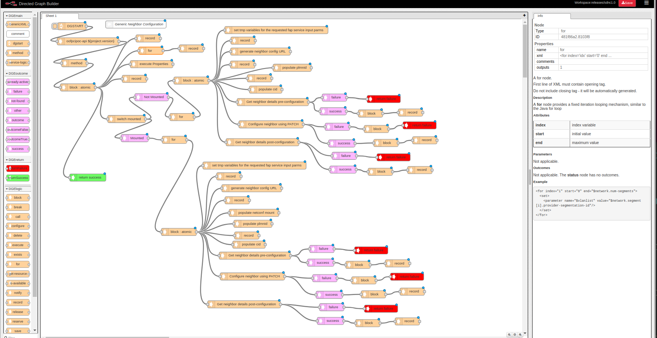
SDNR Development in Support of OOF/PCI/ANR POC
YANG Model (ver1.1) - (Tree, RPC, Notification)
Leveraged existing ONAP components – CCSDK/SDN-C and DMAAP-Listener
Modified and Integrated Oofpcipoc YANG model
Leveraged DG Builder and JSON configuration templates to implement logic for Restconf transactions
Code fix for Restconf PATCH support thru DG (RFC 8072)
Open Items: Consumer/Listener code for Netconf Notification already merged; however, working to address SDNR docker stability issues
Create a Karaf Feature “oofpcipoc” (SDNC Docker)
Repo: CCSDK/features; Folder: features/sdnr/northbound
sdnr is a component-meta feature
Create SLI RPC’s/DG’s to support:
  Notification from RAN simulator and generate DMAAP event (3 and 4a)
  DMAAP event from Policy to initiate NETCONF based configuration towards mounted RAN simulator (10 and 11)
  Required update of JAVA provider/client classes
Update DMAAP-Listener Docker
Support new SDNR DMAAP topics for consumption/publishing
SDN-C Docker Build (based on CCSDK docker image)
DMAAP-Listener Docker Build
Netconf Mount of RAN simulator onto SDN-C platform
YANG Tree
DG

Slide 50
YANG Model Tree for OOF PCI/ANR POC¹
The platform ready to support any YANG Model
Number & List of Cells
PCI and PNF-NAME for a Cell
List of Neigbors
RPC
RPC
Netconf Notification
¹ https://gerrit.onap.org/r/gitweb?p=ccsdk/features.git;a=tree;f=sdnr/northbound/oofpcipoc/model/src/main/yang;h=5b3ef2c03cf516ba716f69076a780a95e96fadc2;hb=refs/heads/dublin

Slide 51
ConfigDB
New APIs
HO Blacklisted flag

Slide 52
ConfigDB System Architecture
Implemented to maintain configuration information of objects (e.g. cell) associated with the RAN network
CRUD operations supported for the POC (for updating ConfigDB)
ONAP Components
Swagger API JSON spec (Dublin)
GET /api/sdnc-config-db/v3/getCell/{cellId}
GET /api/sdnc-config-db/v3/getCellList/{networkId}/{ts}
GET /api/sdnc-config-db/v3/getNbrCellsNetwork/{networkId}
GET /api/sdnc-config-db/v3/getNbrList/{cellId}/{ts}
GET /api/sdnc-config-db/v3/getPCI/{cellId}/{ts}
GET /api/sdnc-config-db/v3/getPnfId/{cellId}/{ts}
PUT /api/sdnc-config-db/v3/createNbr/{cellId}
PATCH /api/sdnc-config-db/v3/modifyNbrHO/{cellId}/{targetCellId}
PATCH /api/sdnc-config-db/v3/modifyPci/{cellId}
PATCH /api/sdnc-config-db/v3/modifyPnfId/{cellId}
DELETE /api/sdnc-config-db/v3/deleteNbr/{cellId}/{targetCellId}
Bulk Upload API
PUT /api/sdnc-config-db/v3/insertData
N
Web Server
REST Interface for READ and BULK UPLOAD
(Java, Spring, Hibernate)
Maria DB

Slide 53
Config-DB Data Model and APIs
  Config DB (MariaDB) used by PCI-H-MS (step 4b) and OOF (step 7)
  Query API (swagger JSON spec) exposed to other ONAP modules
  cellId needs to be globally unique (assumed eCGI) and align with ONAP YANG model, ORAN, 3GPP
  pnf-name/pnf-id indicates netconf server to be used for interactions regarding cells
  ‘ho’ property added to support ANR use case
Cell (Object)
Cell_Nbr_Info (Object)
Attribute | Format
networkId | string
cellId | string
pciValue | uint64
nbrList | list of cellId
lastModifiedTS | timestamp
pnf-id | string
Attribute | Format
cellId | String
target_cell_id | String
ho | BIT(1)

Slide 54
OOF
Joint PCI/ANR Optimization
Code changes for the new ConfigDB API

Slide 55
ONAP Optimization Framework (R4)
ONAP Optimization Framework (OOF) provides a declarative, policy-driven approach for creating and running a wide variety of optimization applications like Homing/Placement, PCI optimization, etc.
Policy Models
HAS
PCI
CM Portal simulator
SON Handler MS
SDNC
SO, VFC
(Homing + TD)
CMSO
FGPS
OOF
PCI, PCI_ANR
Route
HAS
API
OSDF
Policy
Actual policies
CMSO Optimizer
SON Optimizer
Route Optimizer
FGPS
Homing/Placement Optimizer (HAS)
Dependencies on other ONAP Projects
SDNC(R)
A&AI
Multi Cloud
MUSIC

Slide 56
OOF Enhancements for PCI and ANR
Enhancements in SON Optimization Solver and API:
PCI Optimization (optimizer = pci)
  Input: Set of cells, PCI values, neighbor relations
  Output:
  pciSolutions: Optimized PCI assignment without PCI Collision and Confusion
Joint PCI/ANR Optimization (optimizer = pci_anr)
  Input: Set of cells, PCI values, neighbor relations,
  removeable neighbors (neighbor links with poor handover KPI)
  Output response:
  pciSolutions: Optimized assignment of PCI
  anrSolutions: List of links to be blacklisted for handover
Code changes in SON Optimizer to adapt to new ConfigDB API

Slide 57
Integration Testing

Slide 58
Integration Testing
Integration Testing was done at Windriver lab.
TC # | Component(s) | Testcase | Status
IT#001 | DCAE (SON Handler MS) | SON Handler Micro-service successfully on-boarded on to DCAE | Completed
IT#002 | DCAE (SON Handler MS) | SON Handler Micro-service's DB is up and the Micro-service is able to read/write data. | Completed
IT#003 | DCAE (SON Handler MS) | SON Handler Micro-service is able to successfully fetch config policies from Consul. | Completed
IT#004 | OOF and Policy | OOF is able to successfully fetch config policy from Policy | Not applicable
IT#005 | DCAE (SON Handler MS) | SON Handler Micro-service is able to successfully receive a message over DMaaP containing PM/FM data (from VES Collector) | Completed
IT#006 | DCAE (SON Handler MS) and DMaaP | SON Handler Micro-service is able to successfully receive a message over DMaaP containing neighbor list update | Completed
IT#007 | DCAE (SON Handler MS) REST interface | SON Handler Micro-service is able to successfully fetch neighbor list details using REST interface (Config DB APIs) | Completed
IT#008 | DCAE (SON Handler MS) and OOF | SON Handler Micro-service invokes REST API of OOF for PCI optimization | Completed
IT#009 | OOF and Config DB (REST API) | OOF is able to obtain relevant neighbor list information for optimization algorithm from ConfigDB (REST API) | Completed

Slide 59
Integration Testing (continued)
TC # | Component(s) | Testcase | Status
IT#010 | DCAE (SON Handler MS) and OOF | SON Handler Micro-service receives optimization result from OOF (via callback URL) and sends response | Completed
IT#011 | DCAE (SON Handler MS) and Config DB (REST API) | SON Handler Micro-service is able to successfully fetch PNF details from Config DB (using REST API call) | Completed
IT#012 | DCAE (SON Handler MS) and Policy | SON Handler Micro-service is able to send PCI/ANR updates via DMaaP to Policy | Completed
IT#013 | Policy and DMaaP | Policy is able to successfully send a DMaaP message (to SDN-R) with PCI/neighbor list updates. | Completed
IT#014 | Policy and DMaaP | Policy is able to successfully receive a DMaaP message with PCI/neighbor list update response | Completed
IT#015 | DCAE (SON Handler MS) and Policy | SON Handler Micro-service is able to receive PCI/neighbor list update response via DMaaP from Policy, process it and logs the results. | Completed
IT#016 | DCAE (SON Handler MS) | SON Handler Micro-service is able to process PM KPI data, store as needed, and apply rules to recommend removal of a neighbor relationship. | Completed
IT#017 | SDN-R | Upon receiving message from Policy, SDN-R sends netconf message to RAN-Sim. | Not applicable
IT#018 | DCAE (VES Collector) | VES Collector receives VES messages from RAN-Simulator | Completed

Slide 60
El Alto/Frankfurt

Slide 61
OOF-SON El Alto/Frankfurt Plans
El Alto (Maintenance Release)
SDN-R/CC-SDK JIRA items: Complete carryover work and merge into El Alto/Frankfurt
SON-Handler MS: Handle non-functional updates (e.g., periodic config updates from Consul, container image minimization)
Frankfurt – More enhancements towards deployment readiness for ONAP SON
Include other ONAP modules: A&AI, SO, SDC, CLAMP
Alignment with ORAN/3GPP common model for SDN-R
Integrate with real systems – e.g. SDN-R controlling real gNodeB
Demonstrate alignment with Policy Control Loop Co-ordination
Establish ConfigDB role in ONAP – align with A&AI and any new models
PCI/ANR & SON Enhancements
  New cell addition, optimization features
  Incorporate support for ML-based solutions
  Additional SON functions

Slide 62
Links for More Information
Description | Link
OOF-PCI Main Wiki Page | https://wiki.onap.org/display/DW/5G+-+OOF+%28ONAP+Optimization+Framework%29+and+PCI+%28Physical+Cell+ID%29+Optimization
OOF-PCI Dublin Release (Requirements and Test Cases) | https://wiki.onap.org/display/DW/OOF-PCI+Use+Case+-+Dublin+Release+-+ONAP+based+SON+for+PCI+and+ANR (See the child wiki pages for functional & implementation details)
OOF-PCI Dublin Release Plan | 5G - OOF and PCI (Casablanca carry-over items)
OOF SON in R5 El Alto and R6 Frankfurt | https://wiki.onap.org/display/DW/PCI+%28SON%29+in+R5+El+Alto%2C+PCI+%28SON%29+in+R6+Frankfurt
SON-Handler MS Demo video recording | https://wiki.onap.org/download/attachments/53249727/DCAE_Weekly_04252019_Demo-Session1.mp4?version=1&modificationDate=1556202975000&api=v2 (Latter part)
OOF-PCI Dublin PoC Demo video recording | https://wiki.onap.org/download/attachments/68539437/zoom_0.mp4?version=2&modificationDate=1563985740000&api=v2

Slide 63
Thank You!

