Slide 1
Vodafone-iconectiv
VSP Compliance Check SDC-BE Design
February 19, 2019
jguistwite@iconectiv.com

Slide 2
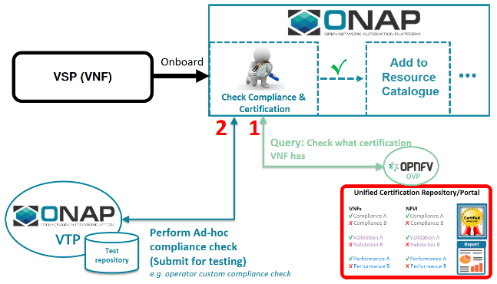
https://wiki.onap.org/pages/viewpage.action?pageId=45305743

Slide 3
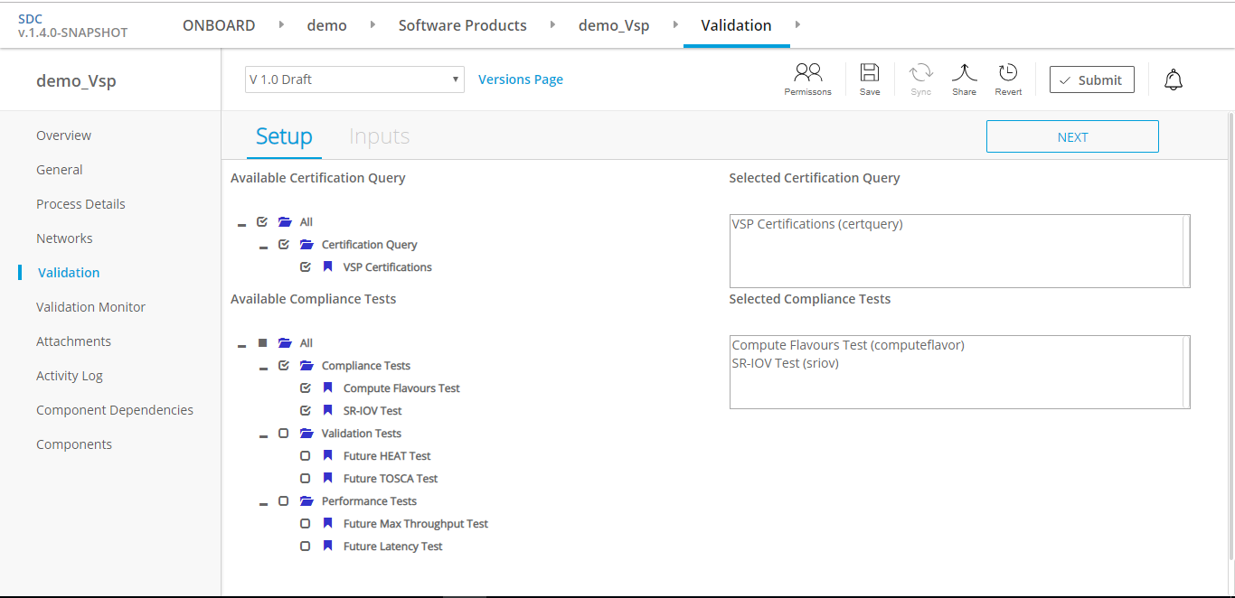
Onboarding UI Changes – Choose Tests to Run

Slide 4
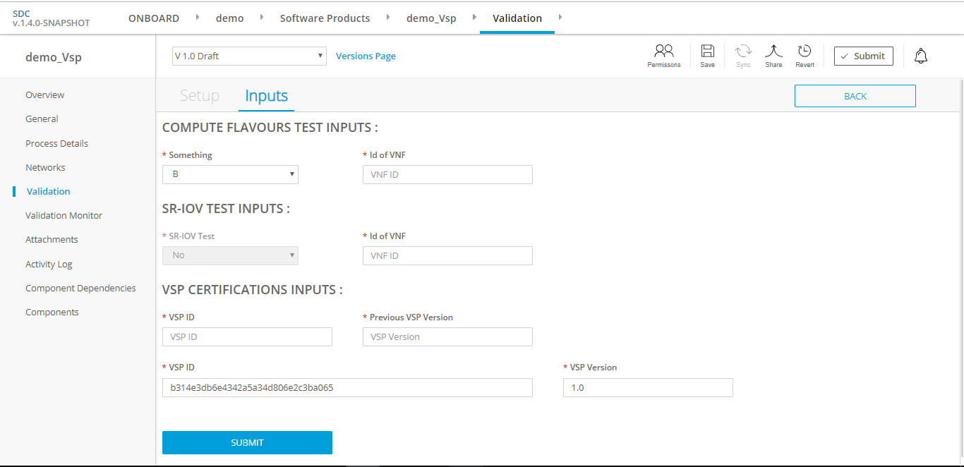
Onboarding UI Changes – Provide Required Inputs

Slide 5
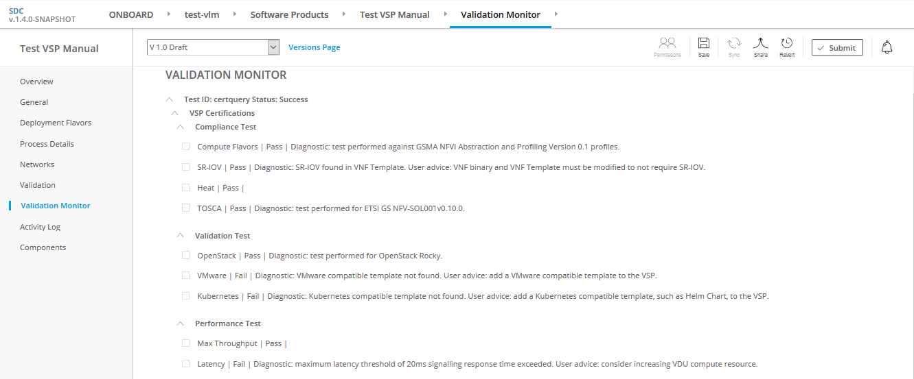
Onboarding UI Changes – Test Results

Slide 6
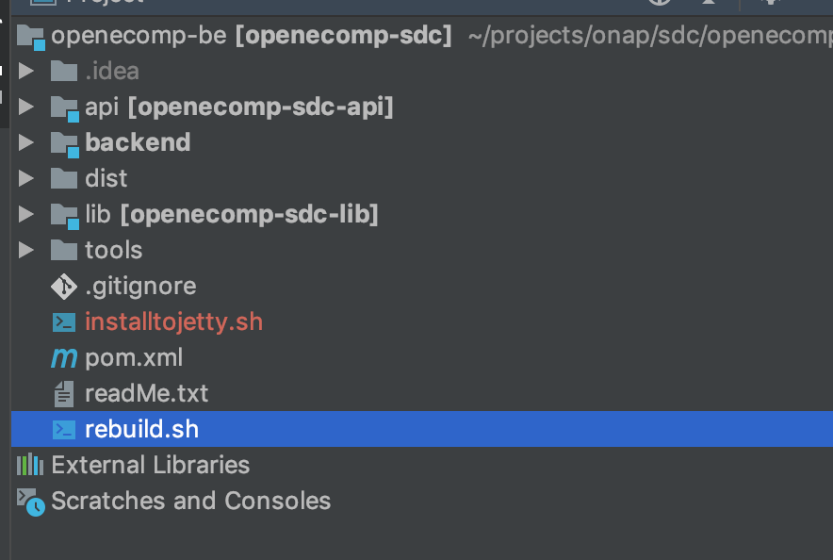
Onboarding Backend Code Structure

Slide 7
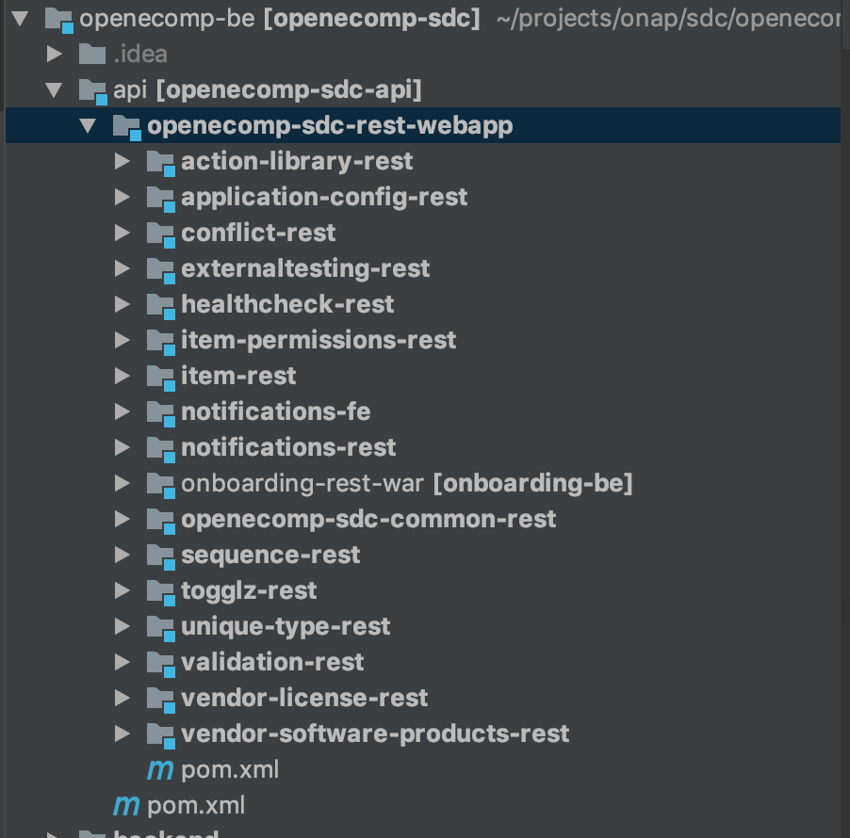
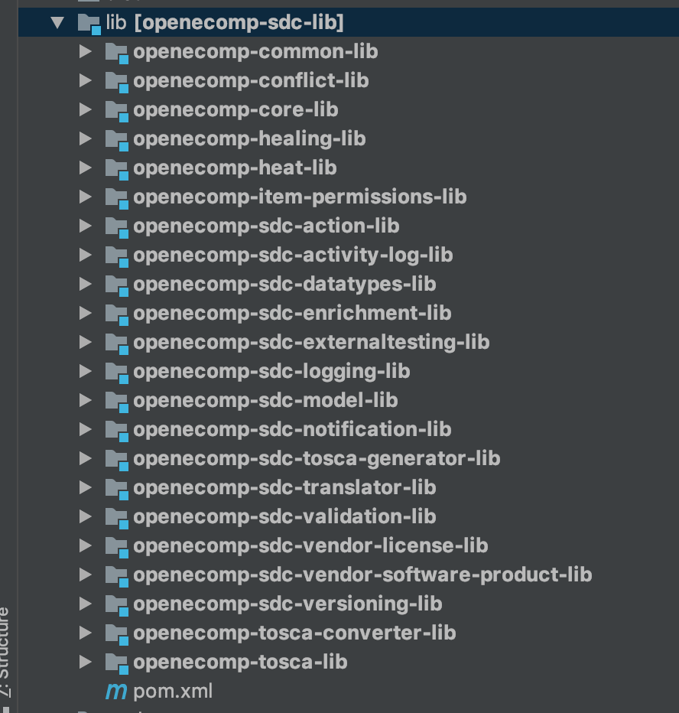
SDC-BE Code Changes

Slide 8
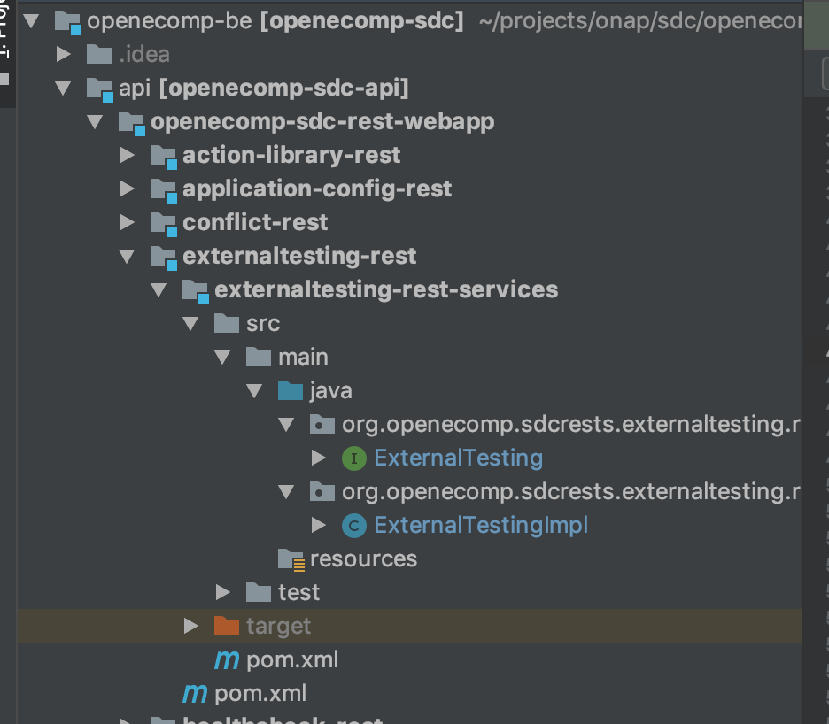
HTTP API Exposed to FE

Slide 9
HTTP API Exposed to FE

Slide 10
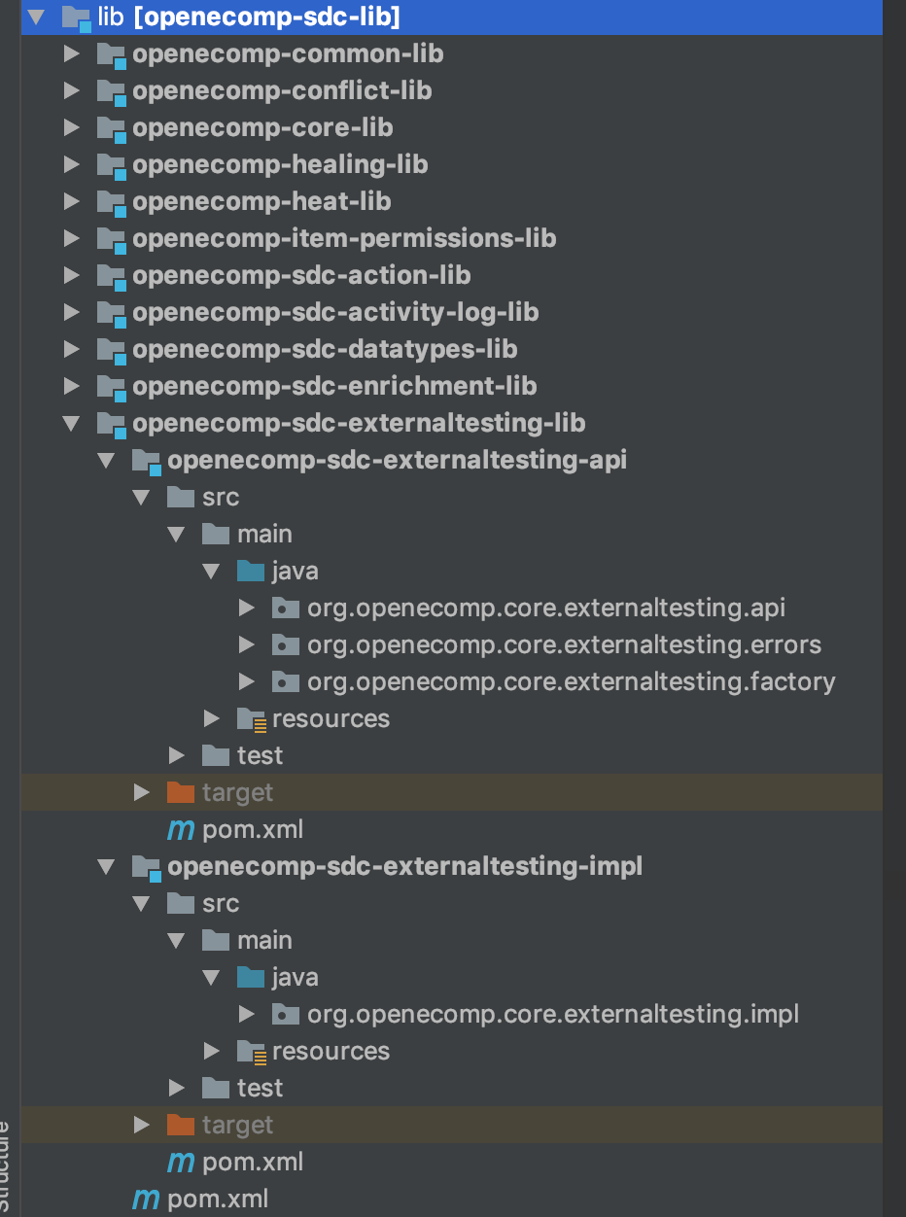
API for FE code & Impl

Slide 11
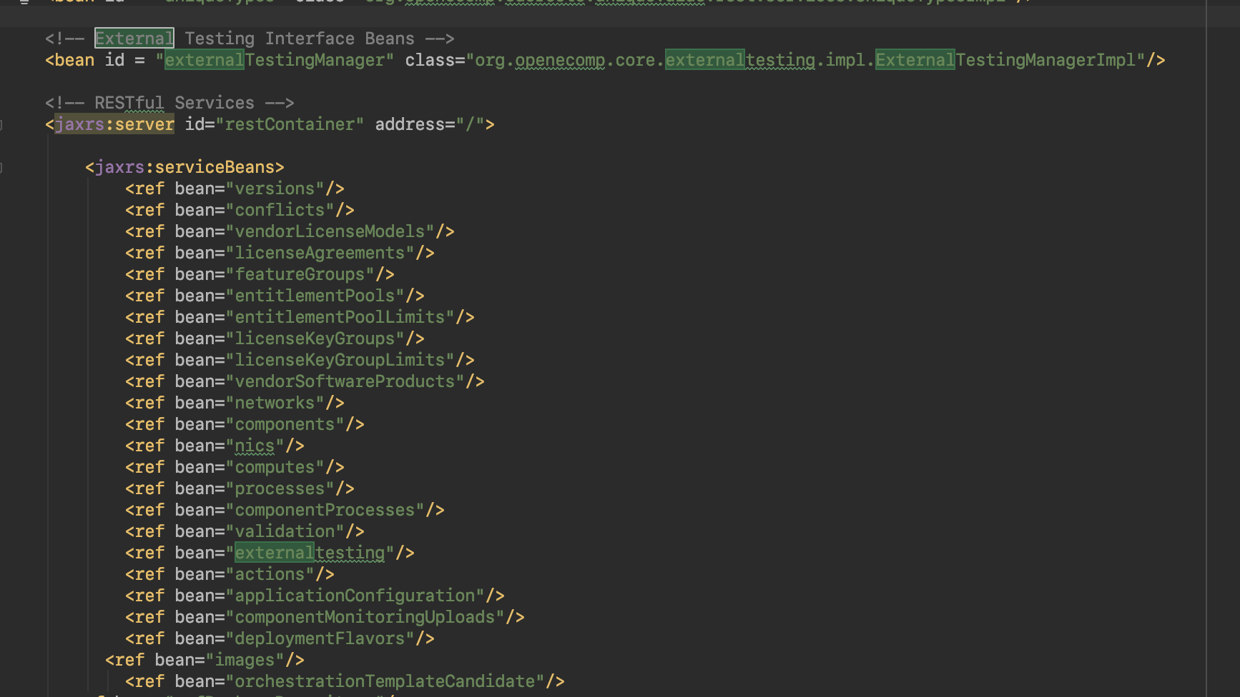
onboarding-rest-war: beans-services.xml

Slide 12
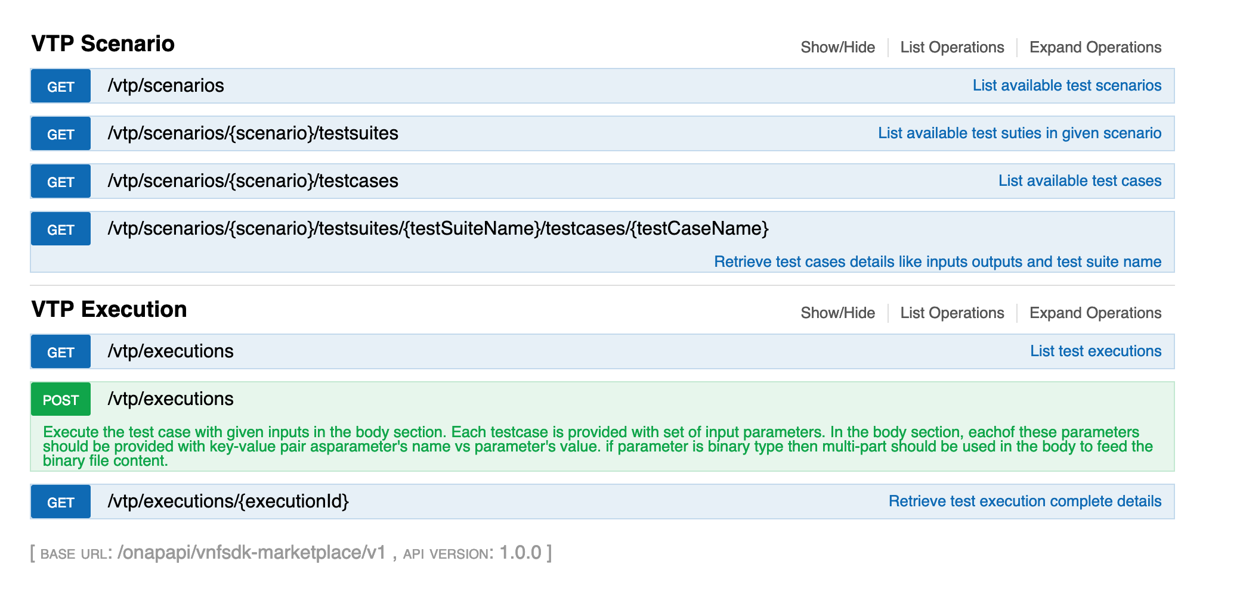
VTP REST API

Slide 13
Configuring SDC-BE
externalTestingConfig:
client:
enabled: true
endpoints:
- id: vtp
enabled: true
title: VTP
url: http://ec2-34-237-35-152.compute-1.amazonaws.com
- id: repository
title: Test Results Repository
url: http://ec2-34-237-35-152.compute-1.amazonaws.com
enabled: true

