Slide 1
VSP Compliance
Vodafone Group iconectiv
Date: 04 December, 2018

Slide 2
Sprints
Sprint 1: Certifications Query.
Sprint 2: Compliance Check: Test cases list request.
Sprint 3: Compliance Check: input parameters request.
Sprint 4: Compliance Check: SR-IOV Check test case.
Sprint 5: Compliance Check: Compute Flavor Check test case.

Slide 3
Sprint 1: Certifications Query.

Slide 4
Mimic VTP API specification
Repository
SDC
plug-in FE
SDC
plug-in BE
request available sections (Hierarchy)
request for available sections (Hierarchy)
fetch section list
response (JSON File)
response (JSON)
request certification for selected sections (VSPid, user-selected sections)
request certification for selected sections (VSPid, user-selected sections)
fetch certification report
response (certification report JSON)
response (certification report JSON)

Slide 5
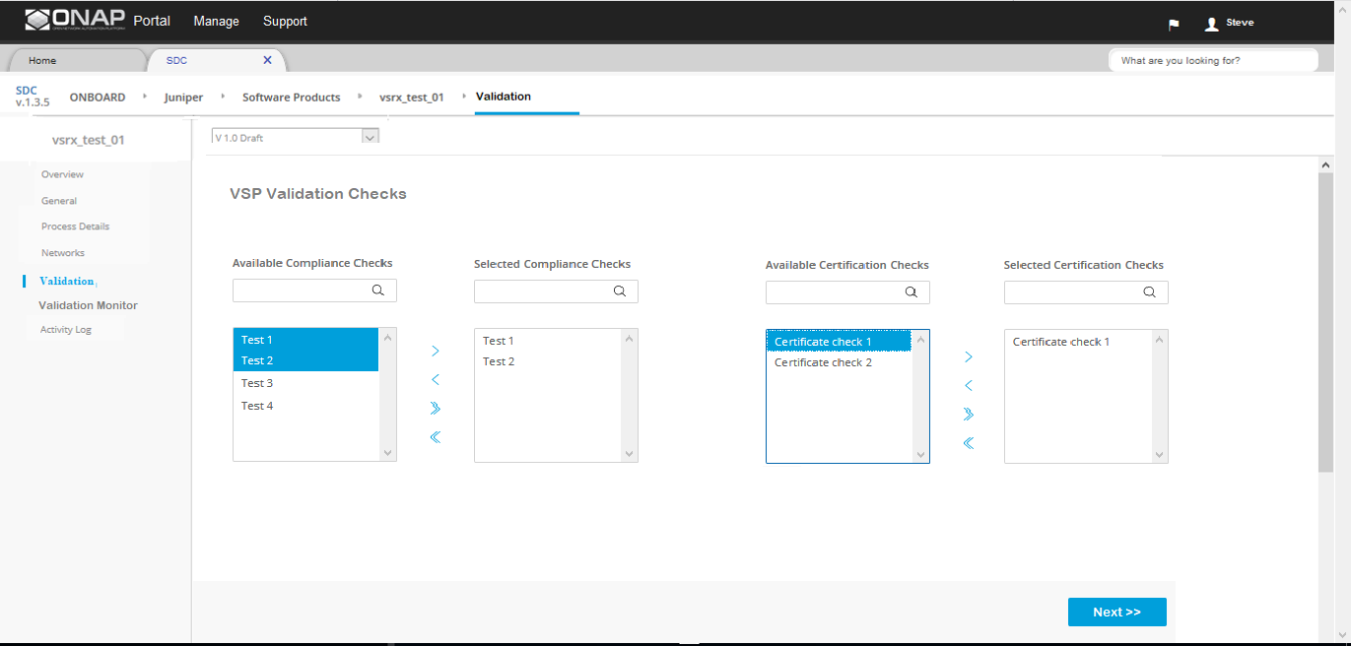
Sprint 1 | Certifications Query – User GUI
Select certification section(s) you are interested in:
- All
  Compliance Certifications
  Validation Certifications
  Performance Certifications
√

Slide 6
Sprint 1 | Certifications Query – User GUI
Content of Certification Query result will contain information like this:
Compliance
  + Heat Pass (230, Notes)
  + Tosca Pass (50, Notes)
Validation
  + OpenStack Pass (70, Notes)
  + Vmware Fail (12, Notes)
  + Kubernettes Fail (4, Notes)
Performance
  + Max Throughput Pass (120, Notes)
  + Latency Fail (30, Notes)

Slide 7
Sprint 2: Compliance Check: Test cases list request

Slide 8
Design Time Flow (part 1)
use existing VTP API specification
VTP/Registry
SDC
plug-in FE
SDC
plug-in BE
Example test cases:
- Compute flavor check as to whether it is supported by underlying NFVI … NFVIid would be an input parameter
- SR-IOV PCIe Pass Through to a specific Network Interface Card as to whether that is available in the underlying NFVI
request for test cases list (VSPid)
request for test cases list (VSPid)
fetch test cases list
response (test cases list)
response (test cases list)
request for input parameters (VSPid, user-selected test cases)
request for input parameters (user-selected test cases)
fetch input parameters list
for selected test cases
response (input parameters)
response (input parameters)

Slide 9
Design Time Flow (part 2)
use existing VTP API specification
VTP/Registry
SDC
plug-in FE
SDC
plug-in BE
request for compliance check
(VSPid, user-selected test cases, input parameters)
parse VNF template and extract VNF metadata
check VNF metadata against registry metadata
store pass/fail results for certifications queries
return pass/fail results
request VNF Template
request for compliance check (VSPid, user-selected test cases, input parameters, VNF Template)
response (pass/fail results)
Example test cases:
  Compute flavor check as to whether it is supported by underlying NFVI … NFVIid would be an input parameter
  SR-IOV PCIe Pass Through to a specific Network Interface Card as to whether that is available in the underlying NFVI
response (pass/fail results) for user action
response (no content)
or
async
response (no content)
response (pass/fail results)
response (pass/fail results) for user action

Slide 10
Sprint 1 | Certifications Query – User GUI
Available Tests:
- All
  - Compliance Tests
    Heat Tests.
    Tosca Tests.
    Compute Flavours test.
    SR-IOV test.
  - Validation Tests
    Future Tests here.
  - Performance Tests.
    Future Tests here.
√
√
√

Slide 11
Sprint 3:

Slide 12
Sprint 4:

Slide 13
Sprint 5:

