Slide 1
ONAP ETSI SO NFVO Architecture
June 16th, 2020
Presented by: Byung-Woo Jun (Ericsson)
Fred Oliveira (Verizon)
ONAP Orchestration Scenarios (a.k.a. ETSI-Alignment) Task Force weekly meeting,
Weekly meeting: Mondays at 12PM UTC, 5AM PT, 8AM ET, 2PM CET, 5:30PM India, 8PM China. https://zoom.us/j/722438866
Dial In: +16699006833,,722438866# US (San Jose) +16465588656,,722438866# US (New York)
ETSI Alignment Support, https://wiki.onap.org/display/DW/ETSI+Alignment+Support (Frankfurt release)
https://wiki.onap.org/display/DW/ETSI-Alignment+Support+for+Guilin (Guilin release)

Slide 2
Agenda & ONAP SO NFVO Requirements
1 | ONAP Hierarchical ETSI-based Orchestration & SO NFVO
2 | ONAP SO NFVO Target Component Architecture
3 | ONAP SO NFVO Component Architecture for Guilin
4 | ONAP SO NFVO Component Interfaces
5 | ONAP SO NFVO Deployment Plan
6 | ONAP SO NFVO Default Workflows
7 | ONAP SO NFVO Invocation
8 | ONAP SO NFVO Sequence Diagrams (Create/Instantiate/Terminate/Delete NS)
9 | References
Requirements:
Support for ETSI NFV NFVO Orchestrator in ONAP SO (ONAP SO ETSI-Aligned Hierarchical Orchestration)
  Enable E2E workflows by orchestrating ETSI NFV compliant Network Services and VNFs.
  This NFVO should provide an ETSI NFV SOL005 v2.7.1 NBI which can onboard ETSI NFV SOL004 and ETSI NFV SOL007 v2.7.1 compliant packages which then can be Life Cycle Managed and monitored.
  This NFVO should use an ETSI SOL003 v2.7.1 SBI to invoke an external VNF Manager.
Rationale:
  Many operators have their own ETSI-compliant NFVOs, and there is a strong desire for ONAP to have both ETSI- and ONAP-compliant NFVO, which is modular and extensible.
  ONAP SO NFVO "platform” is based on ONAP, conforms to ETSI and leverages modular and extensible plugin-based microservice API management.
  For the NFVO platform modular and extensible capabilities in ONAP, operators can focus on the proprietary development of truly differentiating value-added capabilities on top of the NFVO platform.

Slide 3
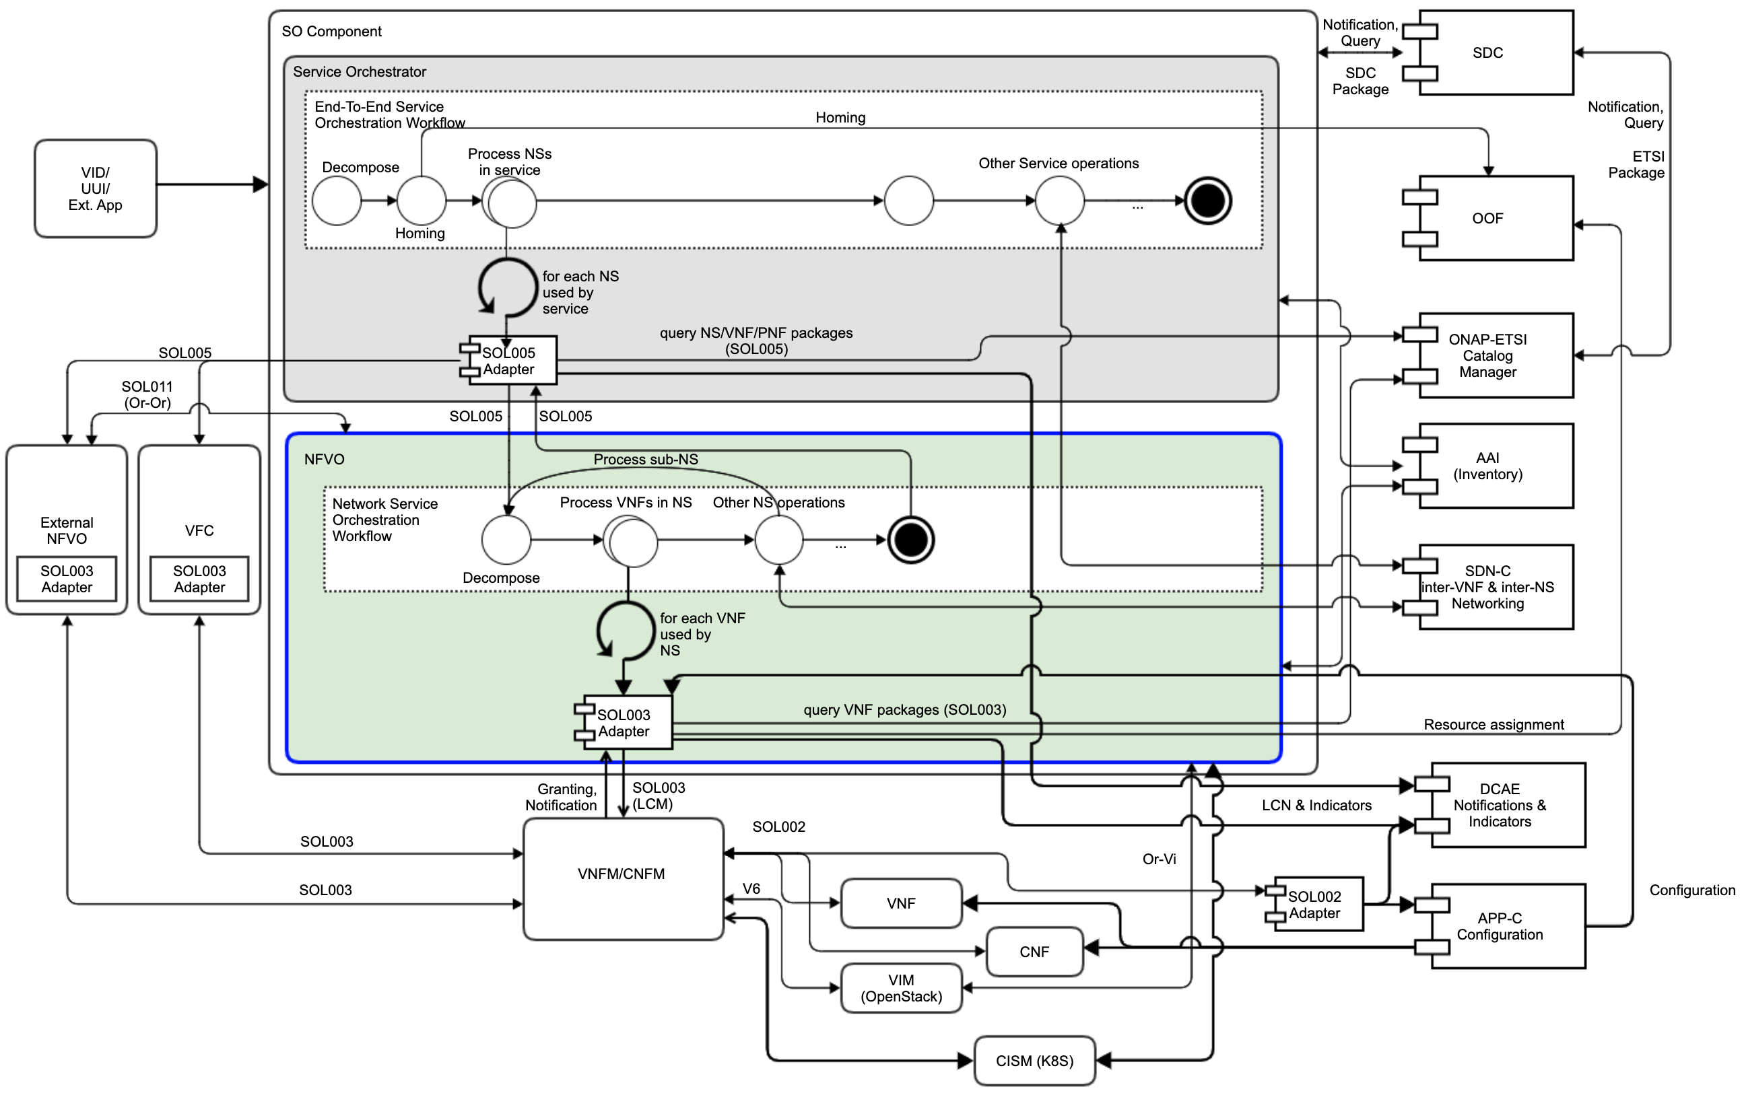
ONAP Hierarchical ETSI-based Orchestration & SO NFVO
SOL007, SOL004,
SOL001
ONAP ETSI-based hierarchical resource orchestration facilitates ONAP orchestration adoption by operators who have their own NFVOs and/or VNFMs and look for ONAP-compliant NFVO base platform
  Make ONAP SO support hierarchical orchestration, conforming to ETSI standards, covering E2E, NS, VNF and CNF orchestration (in the future)
    Delegate NS and VNF/CNF operations to the NFVO and VNFM
  Position SO NFVO to bridge E2E and VNF Orchestration, by providing NS orchestration
  Possibly, support of interface with other peer NFVOs (Or-Or) in the future
SO NFVO Supports
  A Modular and Extensible NFVO platform
  SOL005 NBI
  NS LCM Orchestration for NS
  SOL003 SBI, invoking VNFMs for VNF
  SOL003 Granting Resources
  Package Management for NS/VNF/PNF
  ETSI Or-Vi Interfaces for Virtualized Resource Managements
  A steppingstone for CNF orchestration
  Leverage VFC Database and Business Logic
SOL005
SOL007, SOL004,
SOL001
SOL005
SOL007, SOL004,
SOL001
SOL005
SOL005
SOL003
SOL003
SOL003
SOL002

Slide 4
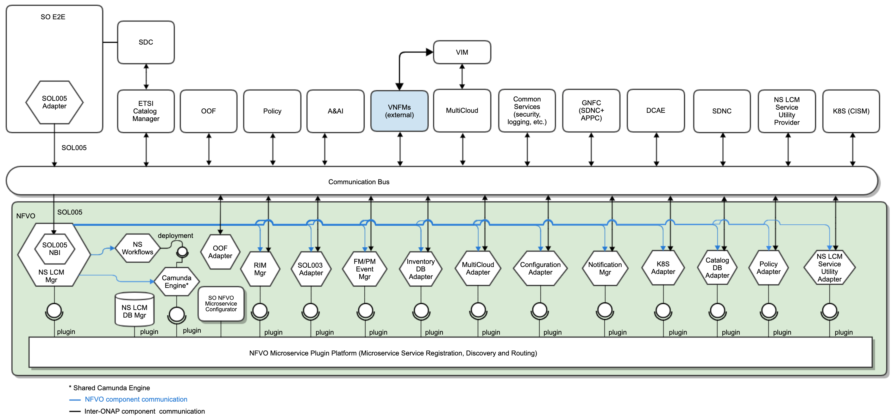
ONAP SO NFVO Target Component Architecture
ONAP SO NFVO is a sub-component of SO and provides ETSI NFV-compliant NFVO functions:
  SOL007 & SOL004 Packages and SOL001 Modeling (thru ETSI Catalog Manager)
  SOL005-compliant NBI
  NS LCM (BPMN-based)
  SOL003-compliant SBI for VNFM invocation
ONAP SO NFVO Platform:
  Is Microservice API management engine¹ + NFVO microservice components + configuration
  Embeds default base NFVO functionalities, which are substitutable and/or extensible
  Allows Operators to add their value-added feature microservices by configuration
  Leverages Microservice API Management (NFVO Microservice Plugin Platform) for microservice registration, discovery, versioning and routing
  Contains SO NFVO Microservice Configurator (possibly UI) which enables microservice function plugins²
  Uses Camunda-based BPMN as the default NS orchestration workflow, but it could be substituted
  Supports Custom BPMN workflow packages, which can be hot-deployed³
we are not building the Microservice service registration, aggregation, discovery and routing engine itself, but we are leveraging the engine's capability to offer configuration of NFVO Microservice components
For Guilin, it could be simple text-based configuration, instead of UI
It depends on the upcoming ONAP SO Custom Workflow capabilities
Note: NS LCM DB Manager persists NS LCM operation data, such as status, job ids, subscription, etc. A&AI stores NS, VNF and VL instances.

Slide 5
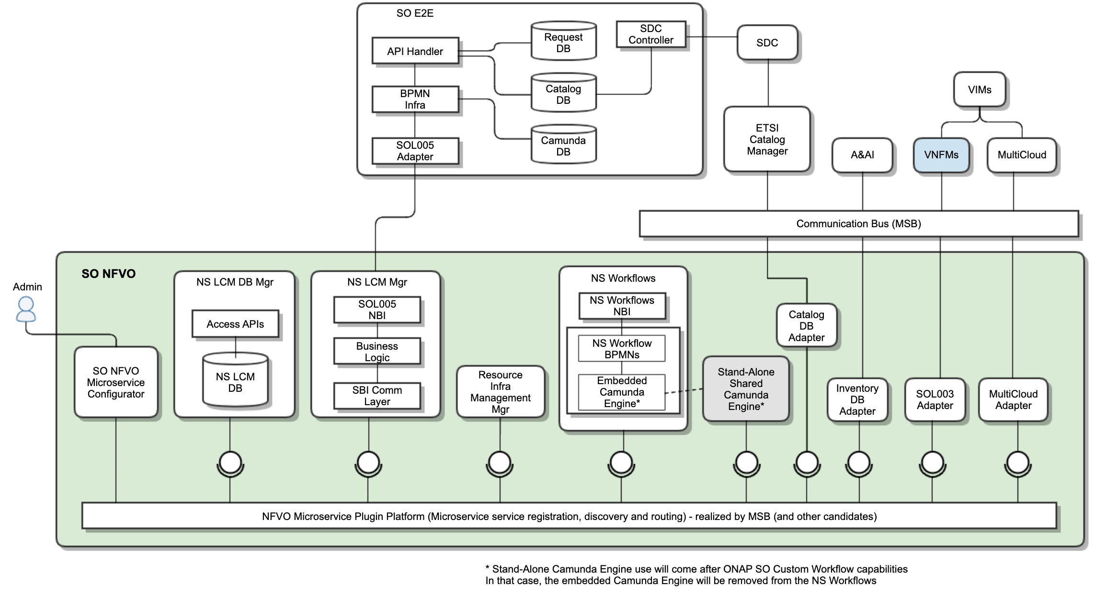
ONAP SO NFVO Component Architecture for Guilin
ONAP SO NFVO is a sub-component of SO and provides ETSI NFV-compliant NFVO functions:
  SOL007 & SOL004 Packages and SOL001 Modeling
    Interfaces with ETSI Catalog Manager for query
    EtsiCatalogMgr swagger for NS, VNF and PNF
  SOL005-compliant NBI
    Supports Create/Instantiate/Terminate/Delete, with Subscription and Notification
    Interfaces based on forge.etsi.org SOL005 swagger
  NS LCM (Create/Instantiate/Terminate/Delete) with Subscription and Notification
    Supports NS, VNFs, VLs orchestration
    Camunda BPMN workflows are defined
  SOL003-compliant SBI for VNFM invocation
    Uses the existing SO SOL003 Adapter
    Interfaces based on forge.etsi.org SOL003 swagger
  Interfaces with MultiCloud for VLs
  Interfaces with A&AI for NS and VNF inventory
  Embeds Camunda engine into the NS Workflows microservice if ONAP SO Custom Workflow deployment is NOT ready for Guilin
  Uses MSB for the NFVO Microservice Plugin Platform engine
  Uses SO NFVO Microservice Configurator for plug-ins
  Leverages VFC NS Instance DB and VFC NS LCM business logic

Slide 6
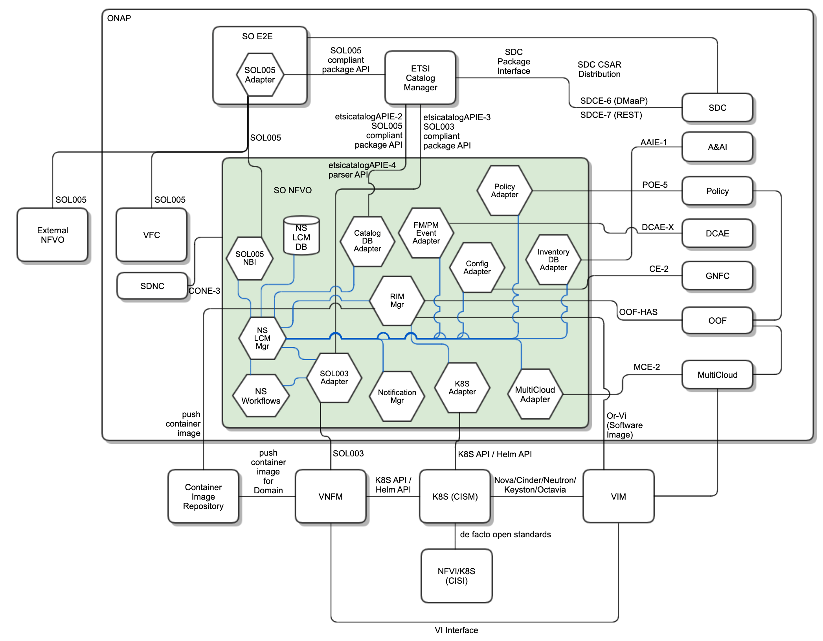
ONAP SO NFVO Component Interfaces
ONAP SO NFVO Interfaces are:
  NFVO inner interfaces (Blue lines)
  Inter ONAP component interfaces (Black lines)

Slide 7
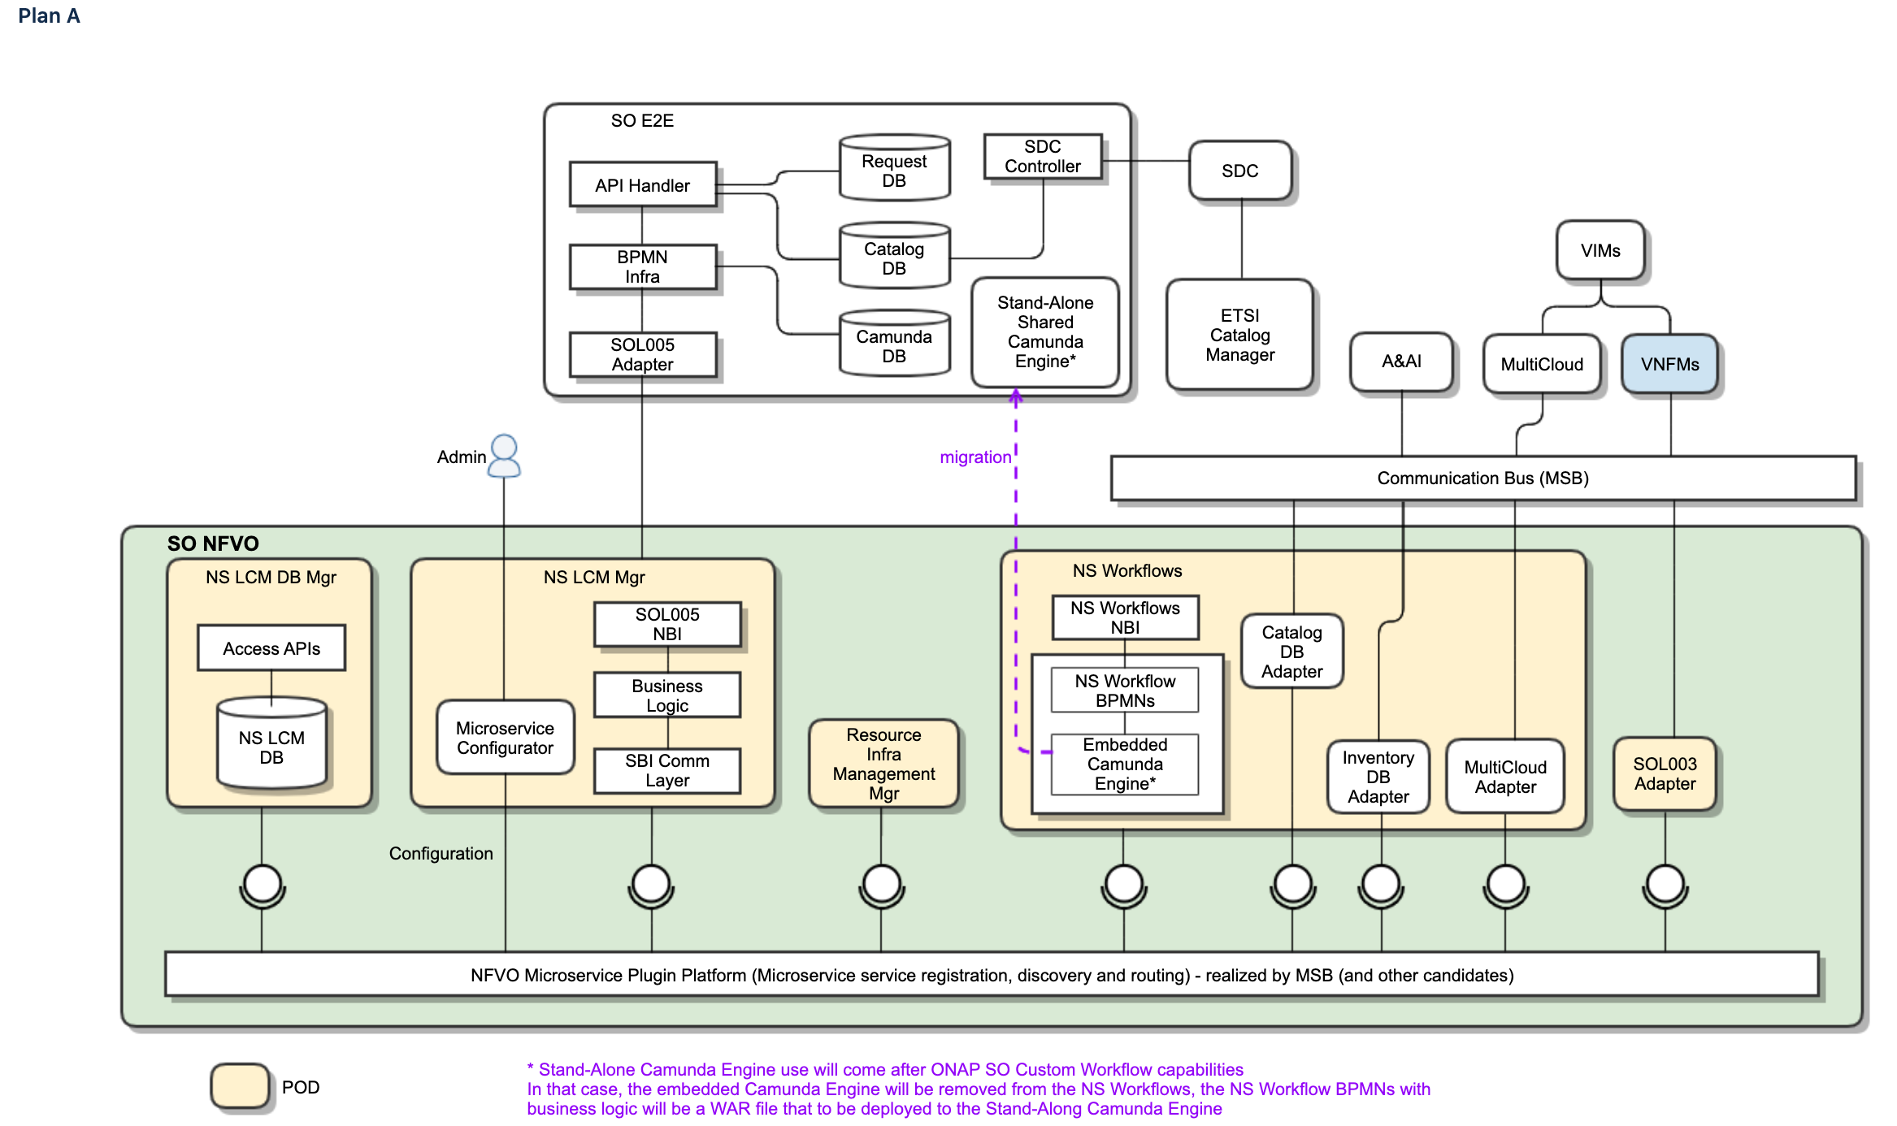
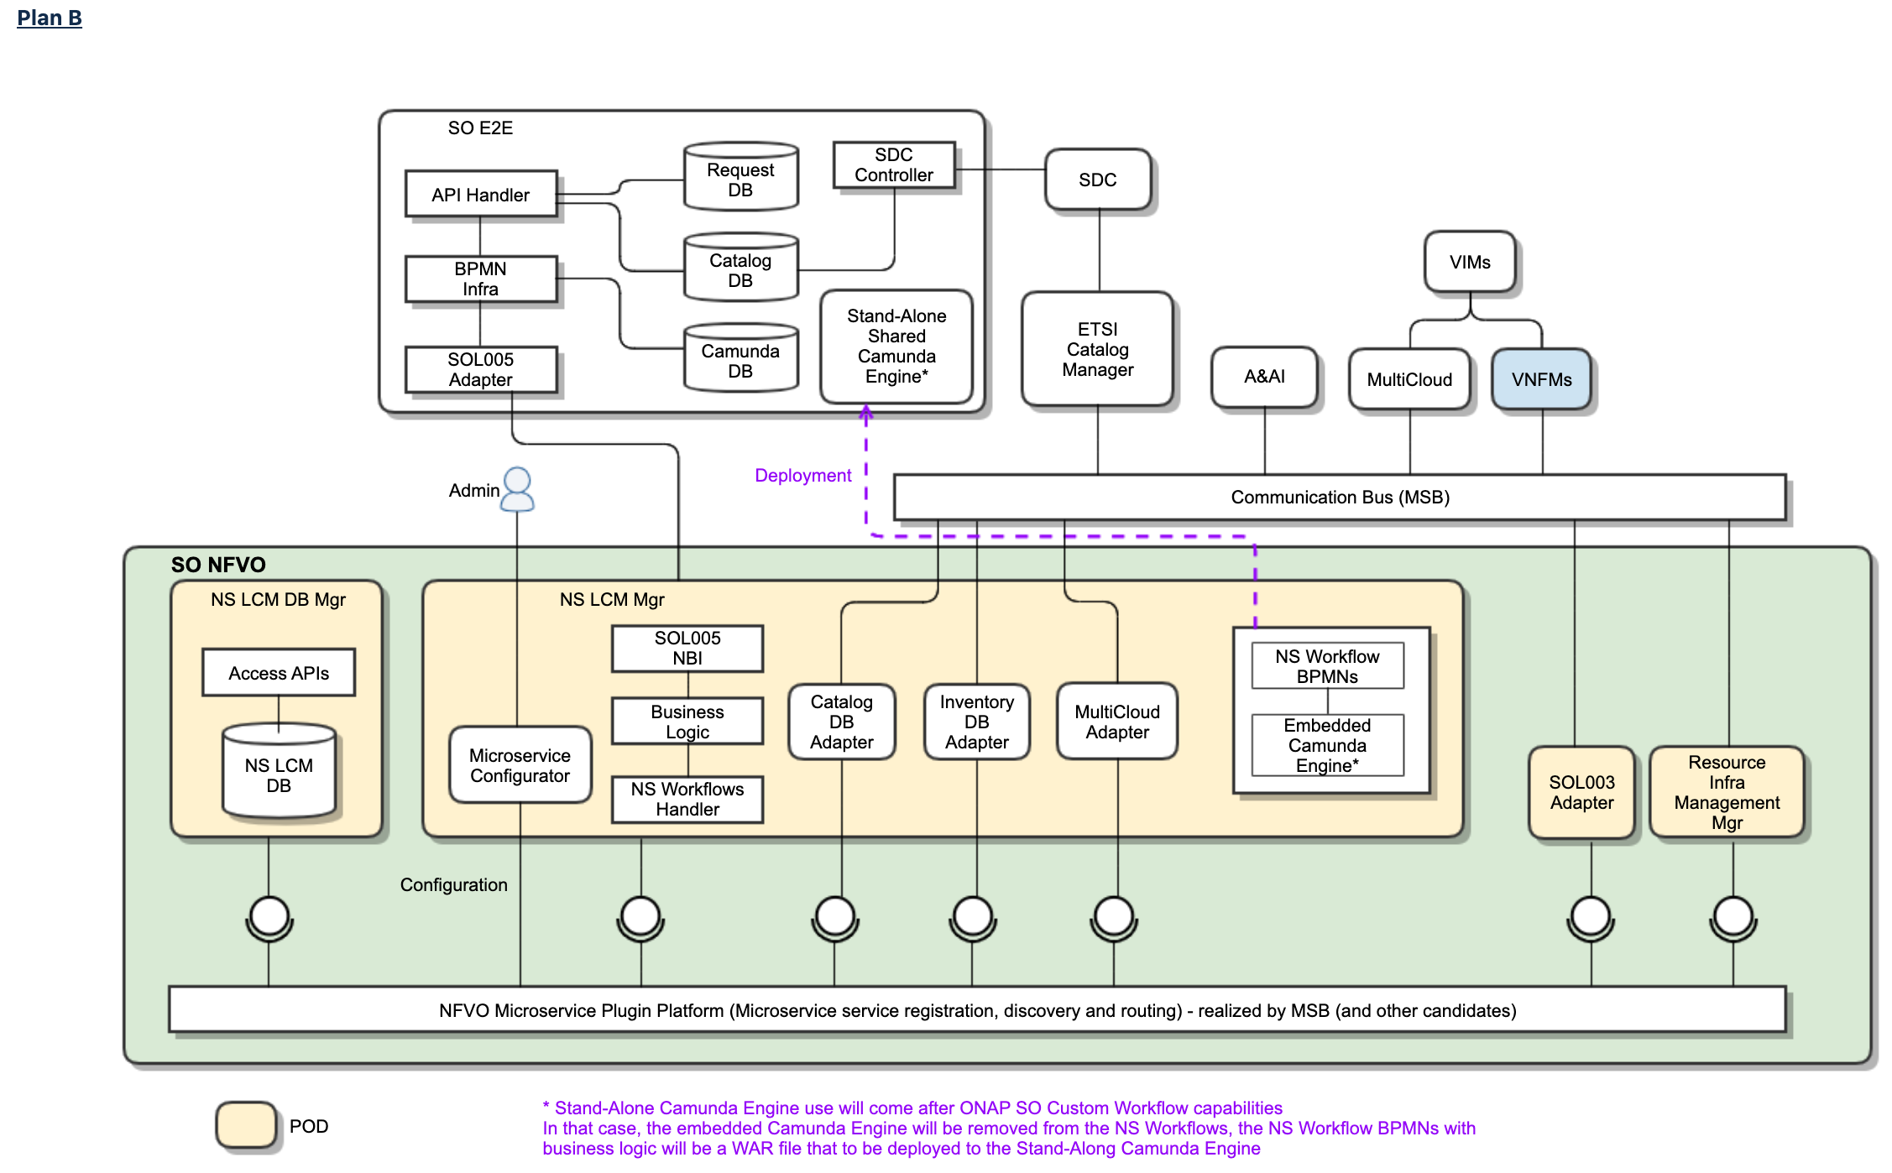
ONAP SO NFVO Deployment Plan
ONAP SO NFVO Deployment Plans
  SO NFVO is an aggregation of NFVO functional microservices.
  There are a couple of candidates as shown, and we will choose one of them.
  It depends on the ONAP SO Custom Workflow project in Guilin. So, the deployment plan could be changed.

Slide 8
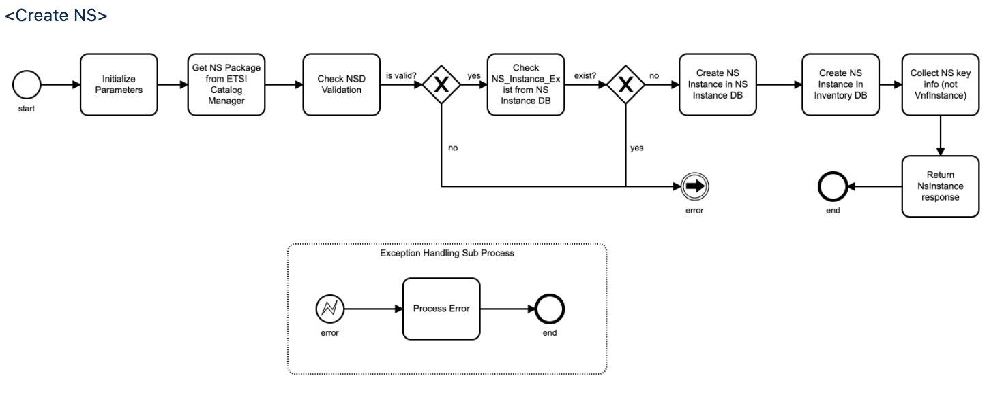
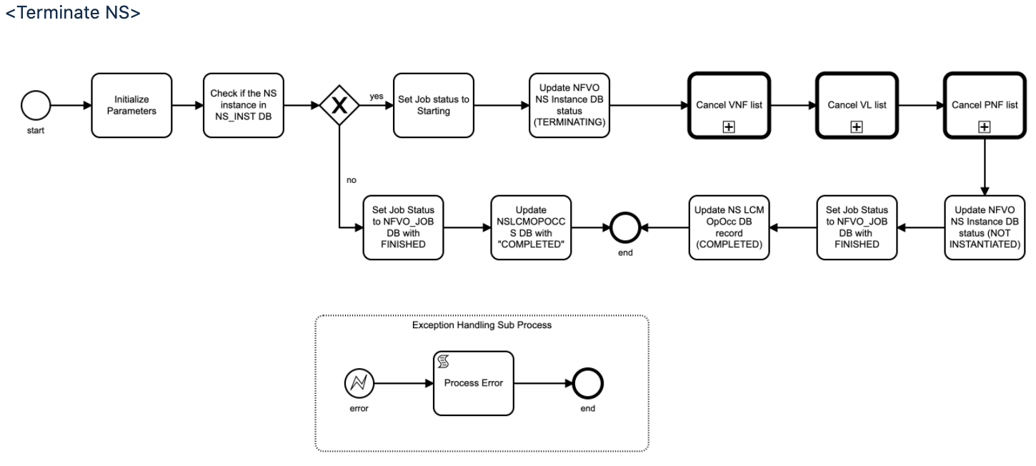
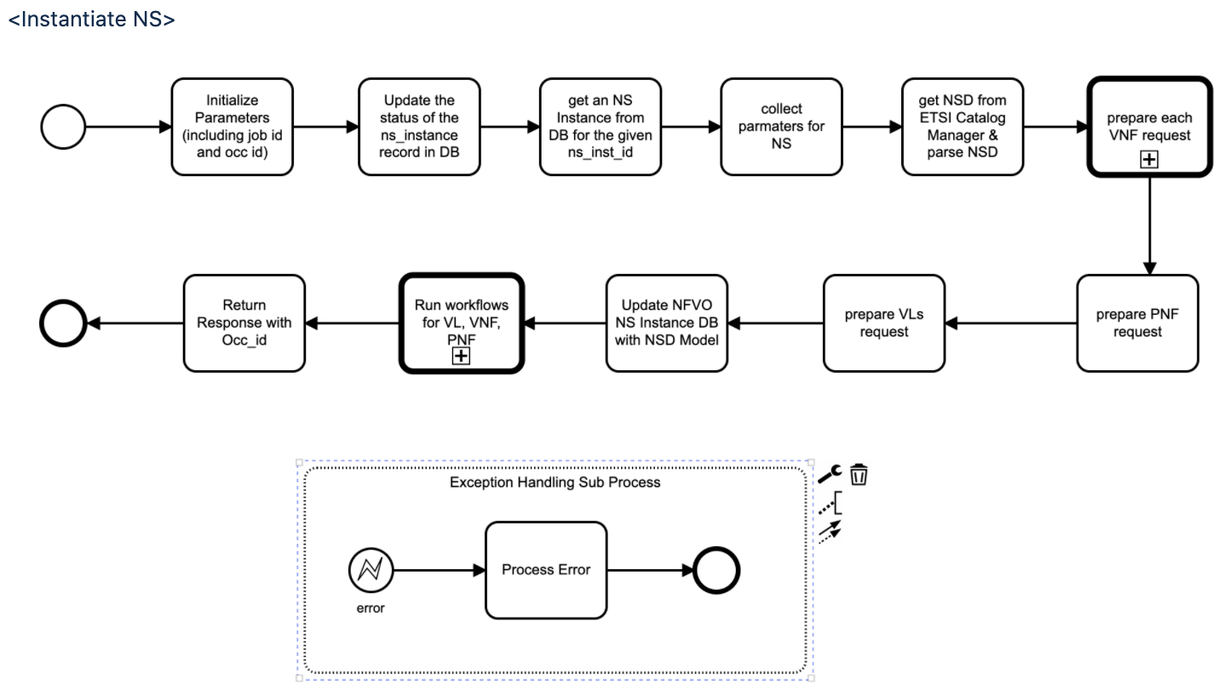
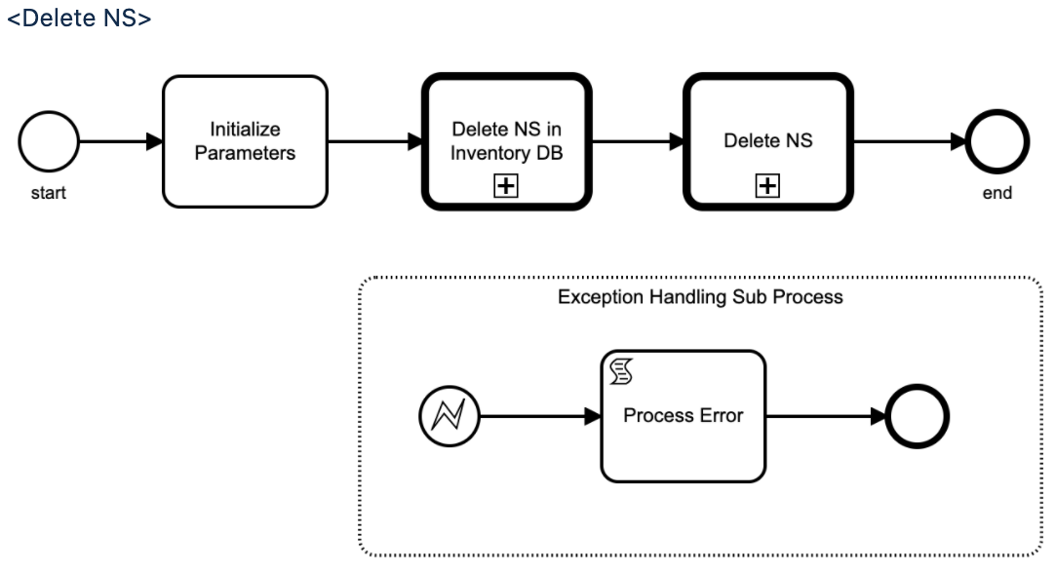
ONAP SO NFVO Default Workflows
These workflows are initial design, and they can be changed as needed
Service Tasks use Java-based business logic, as other ONAP SO workflows
Additional workflows are defined for status, subscription, etc.

Slide 9
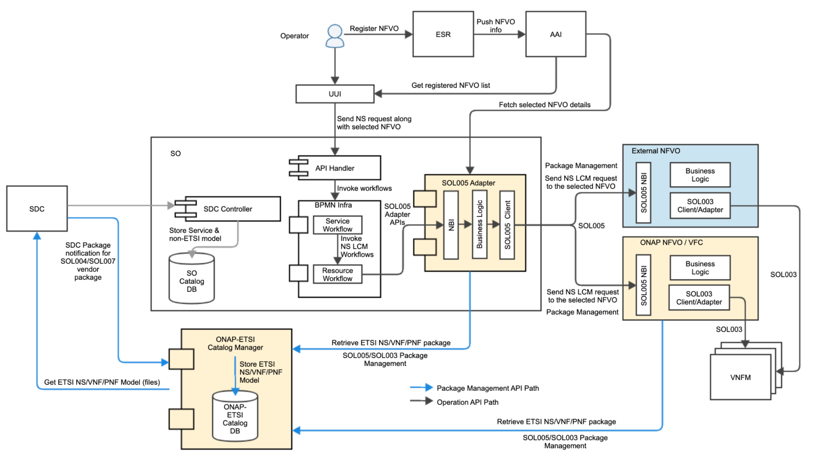
ONAP SO NFVO Invocation
ETSI Catalog Manager receives NS and VNF packages from SDC and stores them into its database
ONAP SO NFVO is invoked by ONAP SO SOL005 Adapter.
  NFVO is registered to AAI through ESR
  UUI gets a registered NFVO list from AAI
  Operator chooses a proper NFVO for an NS request
SOL005 Adapter supports NS and package management through ETSI Catalog Manager as needed for parameters – Guilin enhancement
SOL005 Adapter chooses which NFVO for NS requests
  ONAP SO NFVO (Guilin enhancement)
  VFC
  External NFVO
ONAP SO NFVO supports SOL005 NBI and provides NS orchestration
  It invokes NS workflows (BPMN-based)
  For each VNF that is defined in NSD, it invokes VNFM through SOL003 Adapter
  For each VL that is defined in NSD, it invokes MultiCloud through MultiCloud Adapter
  It queries and/or updates A&AI inventory through Inventory Adapter
Note: ONAP SO NFVO and VFC are ONAP NFVO components, different from External NFVO. Use of ESR for their registration may be not proper. It is under discussion.

Slide 10
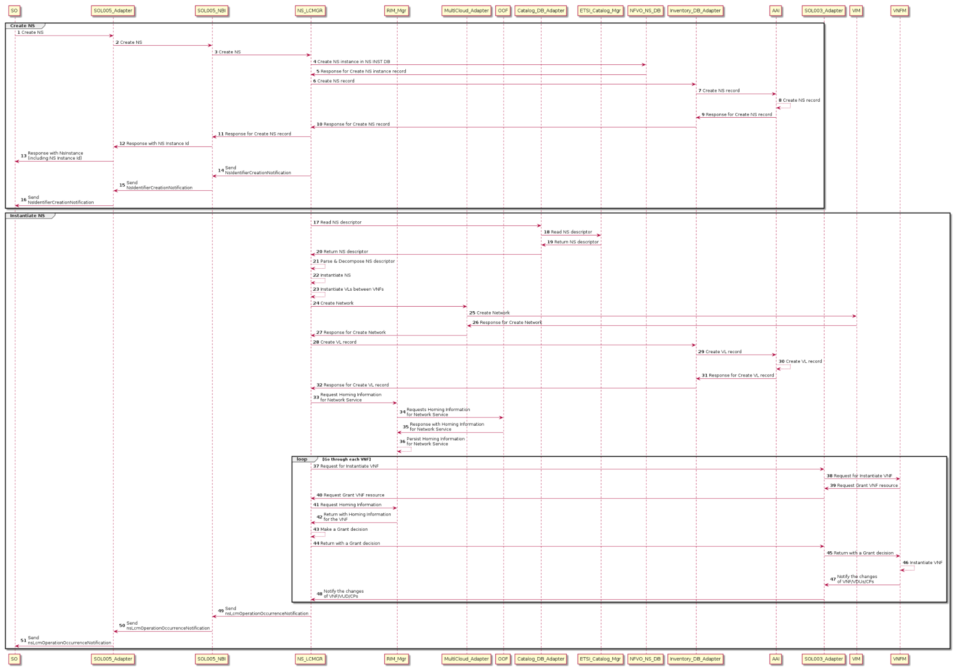
ONAP SO NFVO Sequence Diagram 1/2
- Create NS and Instantiate NS
Create NS and Instantiate NS Sequences
Note: the diagram will be modified as needed.

Slide 11
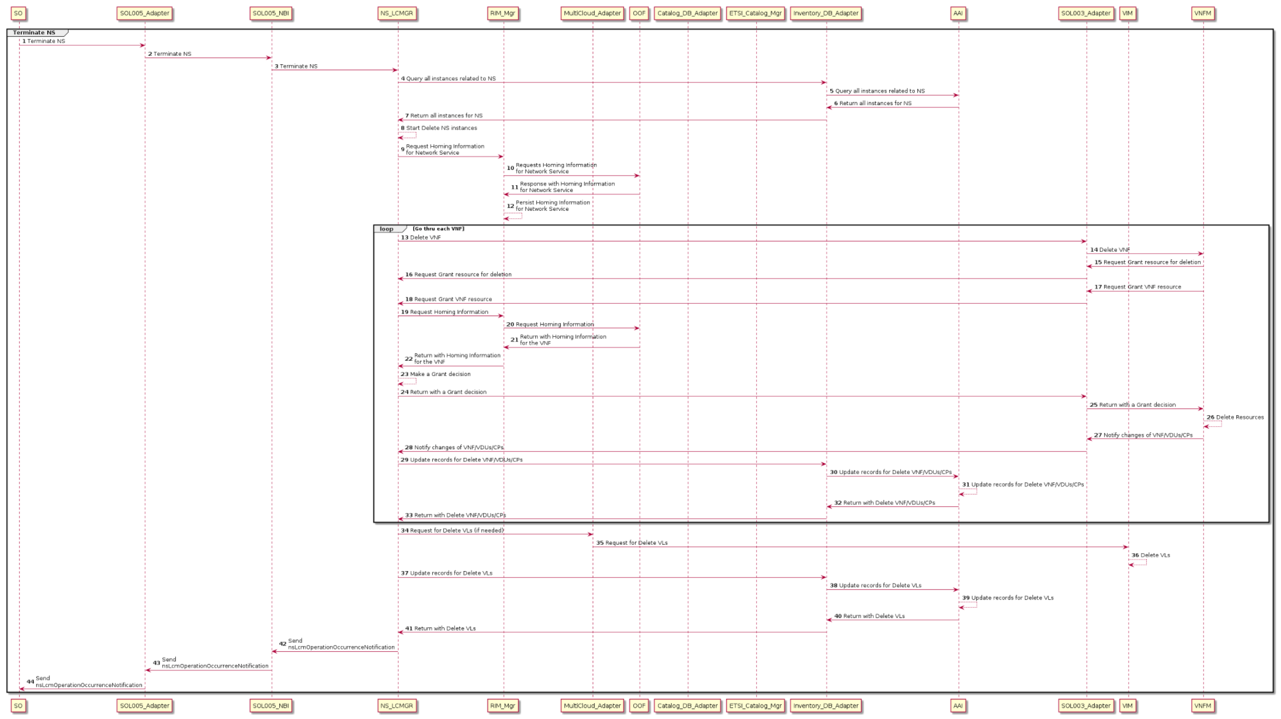
ONAP SO NFVO Sequence Diagram 2/2
- Terminate NS and Delete NS
Terminate NS and Delete NS Sequences
Note: the diagram will be modified as needed.

Slide 12
References
ETSI Alignment Support, https://wiki.onap.org/display/DW/ETSI-Alignment+Support+for+Guilin
ETSI Package Management, https://wiki.onap.org/display/DW/ETSI+Package+Management+%28SDC+Enhancements%29-+Guilin
ETSI Catalog Management, https://wiki.onap.org/display/DW/ETSI+Catalog+Management+%28ETSI+Catalog+Manger%29-+Guilin
Communication Security, https://wiki.onap.org/display/DW/ETSI+Catalog+Management+%28ETSI+Catalog+Manger%29-+Guilin
SOL003 Adapter, https://wiki.onap.org/display/DW/SOL003+Adapter+-+Guilin
SOL005 Adapter, https://wiki.onap.org/display/DW/SOL005+Adapter+-+Guilin
SOL002 Adapter, https://wiki.onap.org/display/DW/SOL002+Adapter+-+Guilin
ETSI Catalog Manager, https://wiki.onap.org/display/DW/Etsicatalog+Documentation
ONAP SO NFVO, https://wiki.onap.org/display/DW/ONAP+SO+ETSI-Aligned+Hierarchical+Orchestration
Orchestration Scenarios (a.k.a. ETSI-Alignment) Task Force weekly meeting,
  Weekly meeting: Mondays at 12PM UTC, 5AM PT, 8AM ET, 2PM CET, 5:30PM India, 8PM China.
  https://zoom.us/j/722438866
  One tap mobile: +16699006833,,722438866# US (San Jose) +16465588656,,722438866# US (New York)

Slide 13
Thank you!

Slide 14
ONAP ETSI-Alignment Roadmaps
Dublin | El Alto | Frankfurt Support | Guilin Proposals | Future Topics
ETSI SOL 2.5.1 support SOL003 Adapter Create VNF Instantiate VNF Terminate VNF Delete VNF Subscription Notification Granting SO ETSI VNF BB Workflows VNFM Simulator in the SO project SDC SOL004 PNF onboarding | ETSI SOL 2.5.1 support CSIT (test automation) for SOL003 Adapter SOL003 Adapter Bug fixes Communication security between SOL003 Adapter and SVNFM HTTPS support SpringBoot-based authentication VNFM Simulator migration to the Integration Test project SDC SOL004 VNF and PNF onboarding | ETSI SOL 2.5.1 support SO & SOL003 Adapter enhancements (Ericsson) SO SOL004 and SOL001 package storage/retrieval support leveraging ETSI Catalog Manager SOL003-based package management API support SOL003 VNF LCM Operations ETSI Catalog Manager (CMCC/ZTE) Storing vendor ETSI packages Providing ETSI package APIs to the SOL003/SOL005 Adapters Software Image delivery SOL005 Adapter (Verizon) Create NS Instantiate NS Terminate NS Delete NS SOL002 Adapter (Samsung) VNF LCM notification AAF-based HTTPS and Authentication – partial OAuth2 support | ETSI SOL 2.7.1 support (Ericsson, Verizon) SDC enhancements (Ericsson, Verizon, Modelling) SOL007 NS package onboarding and design SOL004 VNF/PNF package onboarding SOL001 NSD and VNFD mapping to SDC AID DM SOL003 Adapter enhancements for SO NFVO (Ericsson) NFVO SOL005 Northbound Interface support (Ericsson, Verizon) SOL005 Adapter enhancements (Verizon) ETSI Package Management Add ONAP SO NFVO selection ETSI Catalog Manager enhancements (CMCC/ZTE) OAuth2-based authentication support between SOL002/SOL003/SOL005 Adapters and SVNFM/NFVO ONAP SO embedded NFVO for hierarchical orchestration, as one of the NFVO options – see the hierarchical orchestration section (Ericsson) Move package management, Granting, Software-Image handling from SOL003 Adapter to NFVO NS LCM orchestration support SOL002 Adapter enhancements (Samsung) VNF LCM notification extensions | ETSI-based VNF software upgrade SOL011 Or-Or interface to support multi-domain orchestration. Policy-based Scaling (VNF-level and/or VF-Module-level) SOL003 LCN and translation into DCAE events (FM/PM) SOL003 Adapter VNF Modify (ModifyVnfInfo) VNF Heal VNF Scaling VNF Query SOL003 NBI enhancements for GNFC ready Granting with HPA via OOF High Availability and Fault-Tolerant CNF support SOL005/SOL003 Adapter enhancements FM/PM Additional NS LCM Configuration
✔
✔
✔

