Slide 1


ONAP NF Modeling in SDC
for Casablanca (R3, 4Q 2018)
NF (VNF/PNF) Modeling for R3
SDC Project
Jul 30, 2018 version 2

Slide 2
Modeling ONAP Links
PAGE | LINK
Use case proposal: 5G- RAN deployment, Slicing, SON | https://wiki.onap.org/display/DW/Use+case+proposal%3A+5G-+RAN+deployment%2C+Slicing%2C+SON
5G Functional Requirements Tracking | https://wiki.onap.org/display/DW/5G+Functional+Requirements+Tracking
Casablanca Release Requirements | https://wiki.onap.org/display/DW/Casablanca+Release+Requirements
NFModeling-SDC_R324Jul2018v1 | https://wiki.onap.org/display/DW/Casablanca
Service Design & Creation (SDC) Portal Page | https://wiki.onap.org/display/DW/Service+Design+and+Creation+%28SDC%29+Portal

Slide 3

PNF PnP: MODELING ENHANCEMENTS
DESCRIPTION
PNF MODELING – Modeling enhancements to support 5G PNF in ONAP. Model Inheritance definitions for PNF. SDC modeling improvements from Beijing PnP use case.
PNF SHARING – SDC model updates for PNF characteristics focusing on PNF inter-connectivity.
PNF-SDK – SDK provided from Vendors. This will help modeling the Physical “Box” (PNF) and network functions.
CDT ENHANCEMENTS - Improving CDT to handle complex config templates, multiple templates per PNF, identify different sources for template data, integrating CDT into SDC, expanding CDT usage to other controllers.
PROJECTS
SDC, CDT

Slide 4

PNF ONBOARDING / PNF PACKAGE
DESCRIPTION
PNF Onboarding and PNF Package
PNF PACKAGE DEFINITION – Defining PNF Onboarding Package. Extending framework to work with PNFs. Defining PNF Package framework.
  PNF ARTIFACTS DEFINITION – Vendor specific/provided artifacts to add to the (new PNF) package.
  PNF ARTIFACTS DISTRIBUTION
PROJECTS:
SDC, APP-C

Slide 5
NF Modeling in SDC
IN CASABLANCA (R3)
ONAP and NF Plug and Play for 5G RAN
5G Use Case Team

Slide 6



Design Time (ONAP)
SDC
SDN-C
SDN-R
APP-C
DCAE
AAI
SO
1
Resource Definition
CASABLANCA
PNF Onboarding Package
PNF type
INPUT: PNF Descriptor (PNFD) (Vendor Provider)
ACTION: User builds a resource definition customizing vendor’s PNF description. “blue print” of PNF
OUTPUT: SDC Resource Definition
2
Service Definition
2
Service Definition
2
Service Definition
Customization
of Resource Definition
CASABLANCA
PNF Modeling Enhancements
INPUT: SDC Resource Definition
ACTION: Designer: Customizes the SDC Resource Definition with service specific parameters. Define the PNF types “object Model” e.g. 5G DU, 4G, Legacy DU. Infrastructure services, services for PNF.
OUTPUT: Service Definition
3
Type Modeling Artifacts Distribution
Listener
UEB Listener
Service Change Handler
Listener
INPUT: SDC Service Definitions
ACTION: Type Modeling Artifact (from SDC) are distributed to other ONAP components (DCAE, SO, AAI). SDC artifacts include policies & Work-flows related to that type are defined.
Context-sensitive distribution based on PNF type.
OUTPUT: ONAP components are prepared to manage PNFs of that new type.
Vendor Specific Step

Slide 7
PNF PnP: MODELING ENHANCEMENTS
DESCRIPTION
PNF MODELING – Modeling enhancements to support 5G PNF in ONAP. Model Inheritance definitions for PNF. SDC modeling improvements from Beijing PnP use case.
PNF SHARING – SDC model updates for PNF characteristics focusing on PNF inter-connectivity. DCAE-DS Micro-service modeling.
PNF-SDK – SDK provided from Vendors. This will help modeling the Physical “Box” (PNF) and network functions.
CDT ENHANCEMENTS - Improving CDT to handle complex config templates, multiple templates per PNF, identify different sources for template data, integrating CDT into SDC, expanding CDT usage to other controllers.
PROJECTS
SDC, CDT

Slide 8
PNF ONBOARDING / PNF PACKAGE
DESCRIPTION
PNF Onboarding and PNF Package
PNF PACKAGE DEFINITION – Defining PNF Onboarding Package. Extending framework to work with PNFs. Defining Package framework.
  PNF ARTIFACTS DEFINITION – Vendor specific/provided artifacts to add to the (new PNF) package.
  PNF ARTIFACTS DISTRIBUTION
TOSCA Meta data - main service template, TOSCA template.
Artifact Package. Separated by types of artifacts. Separations by folder for different types. Place artifacts in categories. Anyone can choose which artifacts to receive.
Definitions – Specifies definitions such as CM, FM and PM definitions
Protocols Supported – PNF package. CM Protocol is in PNF onboarding package. (Chef, Ansible, NetConf)
Controller – What is the PNF controller
PROJECTS:
SDC, APP-C

Slide 9
STEP | DESCRIPTION
1 | RESOURCE DECLARATION – A user on the VID performs a Resource Declaration. This uses the Service definition created in SDC. The user on the VID can define known information about the PNF. The user can (optional) provide the following information PNF RESOURCE Definition Resource Type – Type of Resource. NEW type: PNF (pre-defined in SDC) NAME – Name of the PNF type CATEGORY – e.g. Infrastructure TAGS – User-definable tags (default name of the PNF) DESCRIPTION – Textual description CONTACT ID – Designer (user of ONAP) VENDOR – PNF Vendor (e.g. Nokia) VENDOR RELEASE – Vendor release VENDOR MODEL NUMBER – PNF Model value (link to A&AI) EVENTS – Monitoring Event definitions. Define design-time templates. CLAMP (runtime monitoring), DCAD (design time design template attach to VNF). Define templates & attach them. Note: The user may provide whatever information in the above fields they know. Note: Consumer vs Enterprise deployments. Consumer systems pre-registered, distributed throughout a region. For a consumer deployment you might not know the MAC address/Serial number (PND IF) until the PNF connects to ONAP.
2 | SERVICE Definition (uses a PNF) NAME – Name of the Service (mandatory) CATEGORY – e.g. Network L1…L4, VOIP call Control, Mobility TAGS – User-definable tags (default name of the PNF) DESCRIPTION – Textual description of service (mandatory) CONTACT ID – Designer (user of ONAP) (mandatory) PROJECT CODE – ID (mandatory) Ecomp-Generated Naming – Name Naming Policy – Policy to be used to assign a name to a service by SO/SDNC SERVICE TYPE – Type of service SERVICE ROLE – The Role of this service. ENVIRONMENTAL CONTEXT – distributed environments Specific Service(?) – PNF, allotted resource from a CU Service The “basic” model are extended. Inherit (OO) from existing model. Vendor takes standard node types and creates their own extension. CDT (Configuration Design Tool) (GUI) to build artifacts to be used by APP-C (Tosca models) for a configure Template.
3 | DISTRIBUTION – Event Monitoring Templates distributed. (?)

Slide 10
VNF vs PNF Comparison
TOPIC | VNF | PNF
Concept | Application fulfills the role of a network function. | It is a network element, a physical entity, which can implements the role of a network function.
Physical Characteristic | Application without dedicated hardware; Virtualized applications require specific capabilities; Run on different vendor servers. SRIOV, Inter-DPDK. Hardware capabilities. | Has an actual physical asset that is deployed and associated directly with the PNF.
On-boarding | To onboard a VNF is to “bring it into ONAP” i.e. the VNF images, component VNF-C provide descriptors of these NFs. Deployment model, # components, functions. Configuration parameters. VNF is not tied or optimized for a specific hardware, only requiring perhaps some capability to be supported. | For PNF provide the descriptors. Only provide the meta-data. PNF S/W specifically optimized to run on dedicated hardware. (Now) Not the software image. (Future) ONAP will provide the software image repository.
Plug and Play | The model triggers the orchestration. | (See this slide package for PNF Plug and Play) at the end of PnP the PNF can provide service.
Characteristics | 5G CU could be a VNF since there is no need to have an association to a physical environment. | 5G DU must be PNF. PNFs are Elements which may need to interact with the physical environment. PNF is “High-Touch” technology. E.g. Emit radio waves in a geographical area.
Configurability & Deployment | Easily adaptable to functions that you expect. E.g. Packet gateway to reconfigure as different NFs. Services easily create instances reconfigures including deployments (for different applications). Use a different instances of the VNF to provide a new service. For a VNF you can easily “delete” and “create” a new VNF to perform a new function. Configured dynamically. | PNF has a “fixed” set of capabilities but can’t easily reconfigure it. One PNF in multiple services. Different capabilities exposed by the PNF. Reuse the same PNF with different services configuration. For a PNF you would not “destroy” a PNF but rather re-configure it. Can be configured dynamically.
ONAP Interaction | ONAP is started with VNF. VNF is “deployed” on-demand. Control from the ONAP perspective when a deployment of a VNF happens. DCAE – same Configure – Chef, Ansible | PNF do not “deploy” application. Do not use multi-VIM. Only “configure” the application, the PNF is deployed. A technician goes to site and “deploys” a PNF. DCAE – same Configure –Implementation of PNF client. Communication protocol, Client
Design Time Modeling | Model VNF. Templates. Onboarded before. In Run-time. Make sure properly identify specific PNF instance already deployed. Vs a dynamically created instances. VNF instances could be created & instantiated dynamically. SDC may assumed instantiation of network function. | PNF cannot be instantiated, a PNF is only instantiated when it “powers up” and connects to ONAP. Service Orchestration. PNF is instantiated by nature of a PNF installation & commission procedure.
Service Orchestration | VNF cloud, #VM resources consumption, define components implement different functions. Where & What will be deployed. | Physical location, pre-provisioned capabilities, performance monitoring. Components installed. RUs for specific functions.
Resources | VNF dynamically assigned resources. | PNF statically associated (hardware) resources.
Capacity | VNF Capacity can be dynamically changed | PNF is static (number of cells supported)

Slide 11
NF SDC & Modeling
Project Impacts
ONAP and SDC NF Modeling for 5G RAN
5G SDC Project

Slide 12




MODELING PRINCIPLES
Planner Personnel
Optimization
Network Planning
SERVICE MODEL
Services
Application Data
Operational Operator
Functional Aspects
Run-Time
ONAP Service vs ETSI/OPENO/3GPP Service
Orchestrating ONAP component & resources
Provider Personnel
Operators
Technicians
Vendor Personnel
Technician
Developers
Product Support
RESOURCE MODEL
Physical Resources
Application Data
Operational Operator
Physical Aspects
Run-Time
PLATFORM MODEL
ONAP Personnel
(Operator
Governor
Designer
Administrator
Tester)
NF Interconnectivity
ONAP Platform-level information
Design-time Operator
Templates
Meta-data
SDC Design Studio Catalog

Slide 13
ASSETS MANAGED (WIKI)
Resource: a fundamental capability, implemented either entirely in software, or as software that interacts with a hardware device. Each Resource is a combination of one or more Virtual Function Components (VFCs), along with all the information necessary to instantiate, update, delete, and manage the Resource. A Resource also includes license-related information. There are three kinds of Resource:
  Infrastructure (the Cloud resources, e.g., Compute, Storage)
  Network (network connectivity functions & elements); example: a Virtual Network Function (VNF)
  Application (features and capabilities of a software application); example: a load-balancing function
Service: a well formed object comprising one or more Resources. Service Designers create Services from Resources, and include all of the information about the Service needed to instantiate, update, delete, and manage the Service
Product: includes one or more Services packaged with commercialization attributes for customer ordering, billing, and issue resolution. Products are created by Product Managers, and can have one or more "category" attributes assigned by Product Strategists.
Offer: bundling of Products with specific Marketing configurations for selling to customers

Slide 14
SDC COMPONENTS (WIKI)
There are four major components of SDC:
The Catalog is the repository for assets at the Resource, Service and Product levels. Assets are added to the Catalog using the Design Studio.
The Design Studio is used to create, modify, and add Resource, Service, and Product definitions in the Catalog.
The Certification Studio, available in a future release, is used to test new assets at all levels. It will be used for sandbox experimentation, and will include support for automated testing.
The Distribution Studio is used to deploy certified assets. From the Distribution studio, new Product assets, including their underlying Resources and Services, are deployed into lab environments for testing purposes, and into production after certification is complete. In a future release, there will be a way to export Product information to external Business Support Systems for customer ordering and billing.

Slide 15
SDC COMPONENTS (WIKI)
1. Resource Model
(The one, which is defined in SDC, and defines those relevant resource parameters, which characterize services running on top of that resources, or allows these resources to bring relations to other resources in a service definition) Possibly, this is as well an interaction model – how different VNFs interact with each other, what relations are they building?
2. Inventory Model
(The one, which defines, which configuration/instance parameters are stored per resource/service instance – e.g. concrete IPs or Serial Numbers, that are assigned to concrete instances)
3. Configuration Model
(The one, which defines, which configuration parameters are required/exposed as application parameters to e.g. controllers)
4. Event “model”
(How the events, that we`re generating look like – what are their structres/elements/ what is the meta-data that is used around them?)
A side-effect of this one is “interaction model” – so which actions are we taking, when we discover, that there is something wrong with the xNF based on this model contents.

Slide 16
PROJECT IMPACTS FROM ONBOARDING
ONAP Project | IMPACT
SDC/ Modeling | Modeling Project - (No License management impact – See Futures Section) [See follow-on Slides “MODELING”]
VNF-SDK (PNF-SDK) Validation | PNF PACKAGE DEFINITION PNF packages similar to VNF packages. PNF Descriptors, artifacts. In PNF not doing deployment process in SDC. Only PNF configuration. Model a PNF. Onboard PNFs (create templates service configuration). Orchestrate a service on a PNF. Service provisioning. Life cycle: Template/service orchestrated. For PNF every PNF vendor makes this package. Need specific PNF properties. Image details. ONAP updates the image. VALIDATION OF A SDK PACKAGE VNF-SDK (validation, Package definition, verification tool) – package compliant. Allows creation/validation of packages. PNF-SDK validates the package.
WORK FLOW (SDC) | Create work-flow for PNF (Srini) SDC Impacts related to work-flow. ACTION: Sample Work-flow for PNF.
MONITORING (SDC) | Monitoring definitions – SDC has a side monitoring template designer. Way to define monitoring alarms etc; In AT&T there is a project; IN ONAP code is there finalizing code; pluggable modeler for monitoring. DCAE as part of onboarding specify what VES template. DCAE-DS [Design Studio] define microservices for monitoring. How is PNF monitored & correlated. If [x] goes down how is this correlated. SDC would define the Modeling what needs to be monitored and how they would correlated with other events from other NE. Thresholds. [Baby step to process get an alarm from PNF, YAML file describes fault VES event, Fault meta-data; alarms generate]. Alarms raises are documented in SDC. Upload an “Artifact” file (Alarm Dictionary / Fault Meta-data / YAML, YANG). Vendor Specific. Demo and separate discussion. How monitored – processing in DCAE-DS (Design Studio time). Based on design time data DCAE is done in.

Slide 17
DCAE-DS IMPACTS
OVERVIEW - DCAE-DS generates the templates for monitoring the models. DCAE-DS is model-driven. It specifies which monitoring microservice are utilized in monitoring a specific service model. Cloudify blueprints specify the requirements on micro-service and are configured by a user. Configurations are distributed to components who subscribe to that specific type of artifact.
DCAE-DS TEMPLATES – monitoring templates composition of micro-service to be used (open/closed loop). The templates are Cloudify Blueprints. E.g. Micro-Service collectors, analytics, monitoring. VES collectors, holmes. A micro-service that is part of a monitoring flow that a designer can design that can be reused for difference service models. A building block represented by TOSCA models. First needs to be represented by development team. Monitoring template certified.
DCAE-DS GUI - DCAE-DS is a pluggable designer in SDC provides a GUI to the user that selects/composes the micro-services, or use predefined templates, for specific flows. E.g. SNMP type of flow or different protocol. User can configure different micro-services according to requirements to the model.
PNF PLUG AND PLAY – Cloudify Blueprints (for a [1:X] service) has (UUID, Micro-service values, Properties, service specific policies). What are we trying to Monitor? SDC Service-Package attached to VF-Level.

Slide 18

MODELING IMPACTS
Notes:
1) EXTERNALS - Not trying to model the internals of PNFs. What is exposed by the box is what is modeled.
2) INTERRELATIONS - Focus on relations of PNFs/VNFs. Interworking between PNFs/VNFs.
3) VISIBILITY - CP/UP visibility
Not M-Plane (as this is 3GPP standardized)
4) MODELING ANALYSIS - Modeling activity to assess PNF, and check SDC model is sufficient to cover Casa use cases if additional parameters need to be added (e.g. relations between other NFs). Expanding the “Release 0 model” for Casa. PNF type vs PNF instance. Design-time vs Run-time model.
Suggested VES Event Entry - Fault’ Domain Datatypes
For Alarm Dictionary Index (in Dublin)
Alarm Dictionary Index | number | No | Alarm Dictionary Index, (since optional if left blank would mean dictionary is not used)

Slide 19
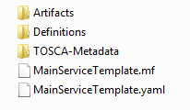

PNF PACKAGE
PNF has no onboarding package.
Just model the PNF from the modeling screens.
PNF PACKAGE
CSAR file
CSAR – decompile info stored in SDC model.
In VNF flow. Onboard the VNF. VNF cataloged as a version to be used. Check-in/check-out. After onboarding can add more artifacts and certify the VNF. A “building block” to be used in different services. Generic, the structure will be the same. E.g. 2000 ports vs 10 ports. “Ports”. How to comm w/ PNF what to do w/ PNF. Specific work-flow or configuration. PNF & VNF similar. SO will orchestrate, already exists in ecosystem.
Modeling of the Service. E.g. Connection point what will connect to the PNF.
ARTIFACTS
DEFINITIONS
PNF – 5G Base Stations
Backhaul Ports – PNF & VNF and want to communicate. In a VNF can describe a port a TOSCA. Model onboarded understand what can connect to what. CP connections. Can see they can connect. Model needs to capture info for modeling parts representing connections. Model allow someone designing service to connections. Or requirements from VNF/PNF from the model. A virtual link. One VNF & PNF connected via virtual network/link.
PNF Work-flows – initialization, triggered when connecting to PNF. Configuration/registration that needs to be done. DNS pre-loaded. Location. Policies attached to PNF, High volume # of PNF deployments, port-allocation. Capabilities. Triggered by orchestrator as part of the instantiation.
PNF Policies -
Tilt – (Antenna Tilt - RF) – not related to PNF / VNF communicate.
Software Version
Modeling Project, VNF-SDK (validation, Package definition, verification tool) – package compliant

Slide 20


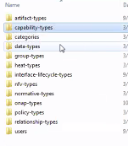
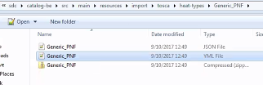
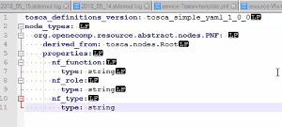
SDC MODELING (Design Time) – Casa R3
SERVICE
SERVICE TEMPLATE
1
1
1
Artifact-Types
Capability-Types
Categories
Data-Types
Group-Types
Heat-Types
Interface-Lifecycle-Types
NFV-Types
Normative-Types
ONAP-Types
Policy-Types
Relationship-Types
Users
N
N
PNF
RAN DU
TEMPLATE
Generic PNF TEMPLATE
PNF TEMPLATE
(OO Inherit & Extend)
Connection Point
N
PNF-Descriptors
Vendor Specific
Template
Controller Type
[“common fields”] …
Vendor-field1

Slide 21
PNFD Definition in ETSI-NFV-IFA014v242
Attribute | Qualifier | Cardinality | Content | Description
pnfdId | M | 1 | Identifier | Identifier of this Pnfd information element. It uniquely identifies the PNFD.
functionDescription | M | 1 | String | Describes the PNF function
provider | M | 1 | String | Identifies the provider of the PNFD.
version | M | 1 | Version | Identifies the version of the PNFD.
pnfdInvariantId | M | 1 | Identifier | Identifies a PNFD in a version independent manner. This attribute is invariant across versions of PNFD.
name | M | 1 | String | Provides the human readable name of the PNFD.
pnfExtCp | M | 1..N | PnfExtCpd | Specifies the characteristics of one or more connection points where to connect the PNF to a VL. See clause 6.6.4.
security | M | 0..1 | SecurityParameters | Provides a signature to prevent tampering.
geographicalLocationInfo | M | 0..1 | Not specified | It provides information about the geographical location (e.g. geographic coordinates or address of the building, etc.) of the PNF. The cardinality 0 is used when the location is unknown.
From Potential PNF template for PNF S/W management & change management (Lixiang,YaoguangWang, ChangMing Bai Hwawei)

Slide 22
Basic Content of PNF template PNF-D (DESCRIPTOR)
Contents | Description
pnfdId | Identifier of this Pnfd information element. It uniquely identifies the PNFD.
provider | Identifies the provider of the PNFD.
PNFD version | Identifies the version of the PNFD.
pnfdInvariantId | Identifies a PNFD in a version independent manner. This attribute is invariant across versions of PNFD. (pnfdInvariatnId would be inside the meta-data in ONAP)
name | Provides the human readable name of the PNFD.
security | Provides a signature to prevent tampering.
pnfInformation | Describes the PNF information
pnfSoftwareVersion | Software Version supported PNFD.

Slide 23
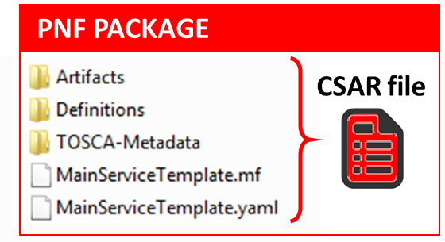

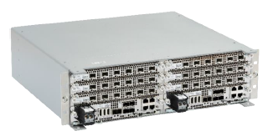
VERSION MODELING
Diagram of Software Version Management for a PNF
PNF-Descriptor (version)
Vendor Provided
PNFD version = 6
PNF-Package (version)
Minimal PNFPackage version = 7.1
(SDC Versions the Package)
PNF Software (version)
[Detected Software, Expected Software]
DETECTED PNF S/W [Part 1] 2.1 [Part 2] 2.2 (A&AI)
ONAP EXPECTED PNF S/W 3.0 (modeling)
PNF Hardware (version)
Hardware Version
Firmware Version
Product Model version
Vendor Release – VID match PNF avail in system
S/W version management – Use casa
Troubleshoot
Network Analysis
Correlation Version
Error Checking
Modeling informational
Network Planning
OPENStack – Image Repository in Glance. In VNF service designer request different version of S/W than is one in PNF itself

Slide 24
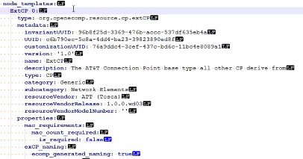
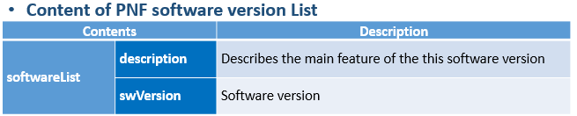
PNF MODELING Information (IN SDC)
Contents | Description
pnfId* | Identifier of this Pnf information element. CORRELATIONID (A&AI). ACTION: Discuss further
pnfType (template)* | Type of Resource. NEW type: PNF (pre-defined in SDC)
Category* | PNF category, e.g. infrastructure
Vendor (template)* | Identifies the vendor of the PNF. MANDATORY
Name* | Provides the human readable name of the PNF.
vendorrelease * | Vendor release. MANDATORY
vendormodelNumber* | PNF Model value (link to A&AI)
functionDescription* | Describes the PNF function
pnfExtConnPt (modelling def. of connection pt not a template) | Specifies the characteristics of one or more connection points where to connect the PNF to a VL. Align ETSI SOL-001. ML: connection pt model in TOSCA TEMPLATE not as properties.
contactId (metadata) | Designer (user of ONAP) ML: Need for this, Audit/tracking, User creates audit log not associated with model itself. 19-Jul – REMOVE THIS PARAMETER
SWversionList (opt) | The EXPECTED software to be supported by the PNF.
PackageVersion (Dublin+) | The version of the PNF Package. 19-Jul – Not going to onboard the PNF, model it from scratch. Define in SDC.
NF Controller | Controller for PNF (APP-C, SDN-R, SDN-C, VF-C)
*Already supported in Beijing
From Potential PNF template for PNF S/W management & change mgmt. (Lixiang,YaoguangWang, ChangMing Bai Hwawei)

Slide 25
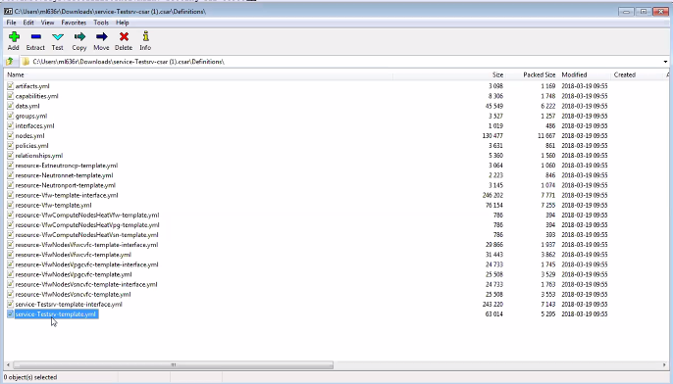
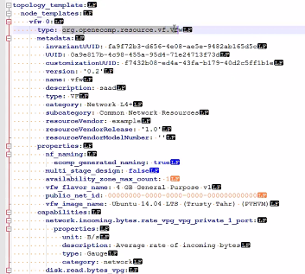
SERVICE LEVEL PACKAGE
Template, TOSCA level template representing some item
On-boarded VNF want instance of that virtual firewall
Place inside all the orchestrator needs

Slide 26
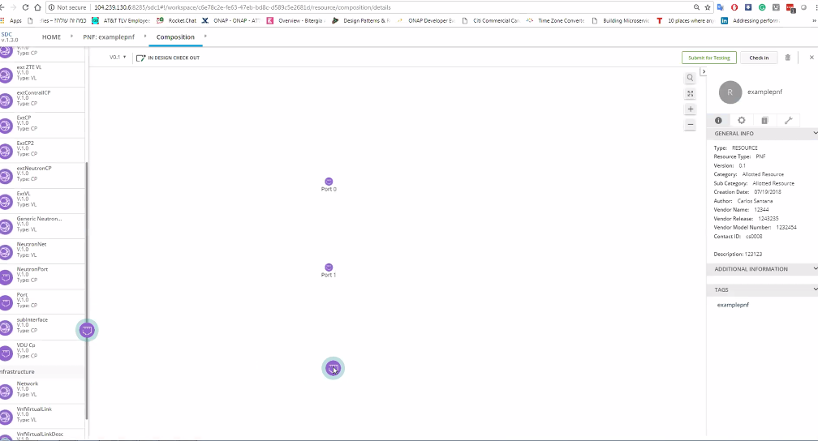
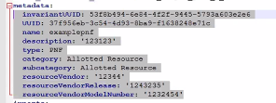
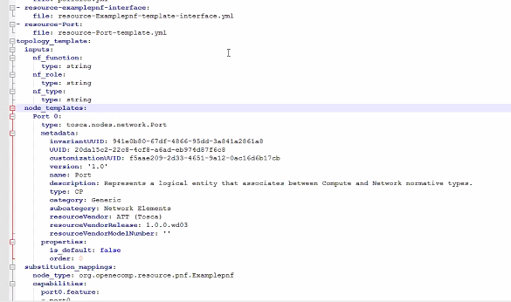
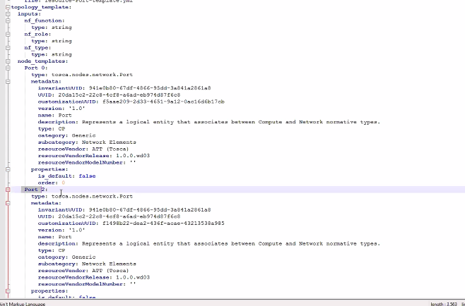
pnfExtConnPt (modelling def. of connection pt not a template) | Specifies the characteristics of one or more connection points where to connect the PNF to a VL. Align ETSI SOL-001. ML: connection pt model in TOSCA TEMPLATE not as properties.

Slide 27
Associating a Controller for a NF
ONAP and PNF Plug and Play for 5G RAN
5G Use Case Team

Slide 28
NF Controller (Casablanca)
PROBLEM STATEMENT
Associating the ONAP Controller (APP-C, SDN-C, VF-C) for a PNF
OBJECTIVES
As automated as possible
Using discovery if possible
Flexible operator could design PersonaA for PNF1, PersonaB for PNF2
RESULT
SO knows which API to use for PNF controller
OTN PNF (CCVPN), Routers, 5G DU are PNFs are early adopters using this
SOLUTION (Casablanca)
Hard-Code controller to PNF.

Slide 29
NF Controller Concepts
ONAP Deployment
j
RUN-TIME
VF-C
SDN-C
SDN-R
APP-C
Technology
Domain
Wireless
RAN
Optical
IoT
PNF-A
PNF-B
PNF-C
VNF-A
VNF-B
VNF-C
PROBLEM DESCRIPTION
Pictured above are three different kinds of PNFs. In orange are wireless (RAN) base stations, such as 5G DU units and their corresponding 5G VNFs. For Optical, there are SOTN PNFs for example as used in the CCVPN use case. Then pictured in green are IoT PNFs. These might include things like smart home units, smart doorbells and the like.
Each of these PNFs fall into a domain category, Wireless, Optical, IoT. These categories are just example categories. There will be many other divisions.
Each of these categories of PNFs & VNFs will have attending Controllers.

Slide 30
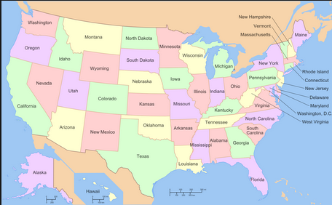
NF Controller Concepts
ONAP PLATFORM TYPE CONTROLLERS
(SDN-C, SDN-R, VF-C, APP-C)
DESCRIPTION
ONAP Platform-Type controllers are SDN-C, SDN-R, VF-C and APP-C. These are specific types of ONAP projects that are controllers to NFs.
DOMAIN CONTROLLERS
Regional Deployment (instances) of Controllers
DESCRIPTION
Domain Controllers are specific instances of ONAP platform-type controllers deployed to a particular region or responsible for a particular region. For example SDN-C deployment #1 responsible for the western part of a country, and SDN-C deployment #2 responsible for the eastern part of a country
EXTERNAL CONTROLLERS
EMS, NMS, OSS
DESCRIPTION
External Controllers that reside outside of ONAP that perform management functions with the PNF and VNFs.
j
ONAP Deployment
RUN-TIME
VF-C
SDN-C
SDN-R
APP-C
SDN-C
SDN-C
PNF
External Controller,
EMS, NMS or OSS

Slide 31
NF Controller PROPOSALS (Goal)
PROPOSAL #1
NF Model (SDC Design Studio)
DESCRIPTION
To have the Controller as an attribute as a NF model is specified in the NF Model. Differences between PNFs & VNFs. The PNF has a req for a physical device, VNF does not. Both NFs need controllers.
Objection to model in SDC is that the VID user may not know the controller. The model designer & The Network Engineering should know.
PROPOSAL #2
Policy Driven
DESCRIPTION
A policy is designed which has the Controller used by the NF.
PROPOSAL #3
Table Driven Association
DESCRIPTION
Table-Driven Look-up solution based on NF function type. For example a controller may support a particular technology domain (wireless/wireline/optical). Controller support domain and auto-populates the tables. Could be a GUI in SDC (a run-time catalog table). The Table could be onboarded. Design-time field. The PNF needs to have a “Technology” domain (a user or designer). Specific images (S/W loads) to specific Controllers.
OTN PNF = “optical” domain = controller-z
OTN PNF w/ S/W load 1.1.1.2 = controller-X
OTN PNF w/ S/W load 1.1.1.3 = controller-y
Scale, US/Europe, W-E coast. REGIONAL
1 “ONAP platform type” SDN-C (SDN-R) VF-C APP-C
2. Domain Controller - Controller-Instances (regional dependent)
ONAP deployment [controller] – Domain Controller – ONAP Controller
3. Vendor / External Controller

Slide 32
NF Controller
Identifying the NF controller
For VNF is part of the Call Flow
VNF gets orchestrated through recipe & DG & Yang models
(assumption is SDNC is the controller)
VNF can have own domain controller
DG pass control VN adaptor to 3rd party controller
PNF controller to be discovered as part of the PnP Flow
Provision PNF manually specify the Controller
SO passes to APPC service instance
SO pulls service info
PNF (CU) must be configured first
CU configuration process (could identify the ONAP controller)
PNF (routers, access pts, RAN 5G DU, CU)
- SDN-C, VF-C, x-controllers
- ONAP SO needs to know what API & Controller for PNF.
-

Slide 33
NOTES: July 17th Modeling Discussion
Seshu
We have talking of a TOSCA event-based flavor given
To the WF entity-based;
SO Trying to adapt – The NF controller modeled-
User on client side selects the controller (also has problems)
If not the UI, the modeler who can understand this is the case
Information that something is a missing point – trying to
Can we have a understanding in des-time; for the controller
SDN-C, APP-C, VF-C, GNF-C etc
Resources compatible w/ this resource type
A designer driven
Designer may not know
PNF PNP does not use OOF
This is a RECURRENT problem (also encountered in Scaling use case)
Alex Vul
PLACEMENT POLICY – POLICY FRAMEWORK
Design times generic, bind specific VNF
Map to OOF.
Mechanism exists.
Log des; phys infrastructure; binding between 2 (by OOF)
Heirarchical orchestration
Policy design by a Human Operator, designs the policy of PNF.
Designer doesn’t know controller;
Chaker AlHakim
Restate the problem
Add an attribute in A&AI
Register a SERVICE. Add service in A&AI.
Best way to register the service controller is providing.
Creating the service don’t know physical/virtual resources.
Srini Vellanki
Workflow designer
SERVICE MODEL – which controller to use

Slide 34
A&AI (Reference)
ONAP and PNF Plug and Play for 5G RAN
5G Use Case Team

Slide 35
ACTIVE INVENTORY (A&AI) IMPACTS
ACTIVE & AVAILABLE INVENTORY (A&AI) PROJECT IMPACTS
New A&AI PNF Parameters | PNF GEOLOCATION - geographical location (e.g. coordinates or address of the building, etc.). Latitude/Longitude. THIS ALREADY EXISTS VIA ASSOCIATION TO THE “COMPLEX” OBJECT. The Complex Object represents a BUILDING or location with geographical information. The AAI PNF will have a UML association to the Complex object. QUESTION: ALTITUDE (is that in the Complex Object?)
Software Version | DETECTED SOFTWARE PNF VERSION(S) – in Run-Time when PNF registers with ONAP it can report its (list) of PNF Software that is currently has installed. This will be tracked in A&AI entry for that PNF. Entry will also have Active/Passive. A&AI already has PNF active S/W version. Graceful roll-out, Fallback. VNF v1.0 restore it (amount of time to maintain S/W)
Homing | PNF [#1:CU/#2:ONAP] CLOUD HOME (CLOUD SERVER LOCATION) – PNF is served by some regional ONAP cloud servers. Serves in “Rehome” PNF. CLLI Code (specifies location, street address, CloudID, physical server is deployed). [Potentially a list of locations] OOF determine the homing of a NF. Anything you home is determined in the context of a deployment. (Homing) Policy used as a f(service). Data center might have been divided into cloud regions. Service VMME running in NE area (distances, regions, tenants where to instantiate PNF). AAI has COMPLEX node. “Physical Location ID” (8 char CLLI code, lat/long = geolocation info of data center. Cloud region doesn’t span data centers. CLLI code used to set PS1 to identify OPs machine.
Manager IP Address | Manager IP Address – provides an additional IP address for the NF that is vendor-specific and relevant to the OAM management of the NF. SUGGESTION (from Christina A&AI PTL) model the NMS as a NF itself (and the NMS will have parameters to represent itself; and then NF can be associated with it). “Manager” != APP-C, SDN-C … “Manager” NMS (EMS).
S/W Image Repository | S/W Image Repository – Where the S/W is located
Christina: This will require schema changes in A&AI to support Passive S/W

Slide 36
ACTIVE INVENTORY (A&AI) IMPACTS
PNF A&AI ENTRY (From Beijing)
• PNF has a “pnf-name” = Key in AAI.
Pnf-name is first 3 letters of vendorName concatenated with serialNumber for a unique PNF instance ID = PNFid = PNF Correlation ID = pnf-name. Example: PNFid = NOK123451ZW3. The PNFid is in A&AI pnf-name field.
PNFid = [VENDOR][SERIALNUMBER]
equip-type (PNF Type). equip-vendor (optional); equip-model (optional); pnf-id (PNF ID) = UUID
(Step 33) adds ipaddress-v4-oam; ipaddress-v6-oam This is the “manager IP Address” which for a DU might be a CU IP address. IP address on the PNF address itself.
(FYI/ ipaddress-v4-loopback-0).
mac-address & serial-number,
PNF:: proxy IP address
Active Software Version
Image Repository (Directory URL, S/W image, URI in OpenStack)

Slide 37

Manager (NMS/EMS) to PNF
ONAP
NMS
Proxy
DCAE
NMS
EMS
Manager
ipaddress
ipaddress-v4-oam;
ipaddress-v6-oam
PNF
PNF
OAM
FCAPS
Logging
SWM
Identity
1. ONAP -> NMS command
2. Relay (NMS trusted source)
3. Network Analytics – (DCAE AA)

Slide 38

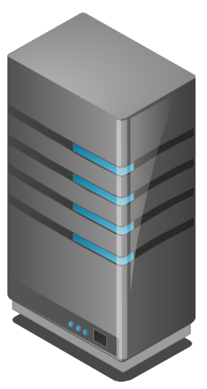
COMPLEX OBJECT
Physical Location
Manhattan
Freedom Tower
123 Main St.
ONAP
Regional Deployment #1
Staten Island
LATA
PNF
Cloud Region
Object
PNF
Controller
Cloud Region #1
Complex
Object
Complex
Object
Complex
Object

Slide 39
PNF Plug and Play
ROADMAP (After Casablanca)
ONAP and PNF Plug and Play for 5G RAN
5G Use Case Team

Slide 40
PNF PACKAGE
ALARM DEFINITIONS
PNF Alarm #22
#22 S/W problem xyz
VES = fault fields; “fault’ domain publish DMaaP
Clamp, Analytic, Holmes – [#22 event]
Dictionary looks up #22 ->
Alarm Dictionary
(Vendor provided)
YAML Definitions
(Vendor provided)
MEASUREMENT DEFS
Measurement
Dictionary
(Vendor provided)
NF PACKAGE
CSAR file
Measurement
Schema
(Vendor provided)
YAML Definitions
(Vendor provided)
Need to define a common “template” that all vendors
Provide dictionaries for. DCAE-DS responsible for reading these files. Closed Loop. Vendor describe alarms being sent. Definition what alarms correlated to (collecting, triggers). CLAMP performs analysis, design of who uses it is SDC. Holmes monitoring micro-services (to receive alarms).
Communication STANDARDS we want to support?
[Data Format]
CONFIGURATION DEFS
Configuration
Schema
(Vendor provided)
YAML Definitions
(Vendor provided)

Slide 41
Alarm Dictionary Usage
ONAP
Micro
Service
ONAP
Micro
Service
SDC
1
Alarm Dictionary provided by vendor
5
Microservice processes the VES Event
Alarm Dictionary
(Vendor provided)
Alarm #999 map to
VES Event eventName fault_Nokia_nfType_alarmName
Alarm Dictionary
Alarm #999
Alarm Dictionary
Mapping Definition
3
SDC Exports CSAR Package
VES Event eventName fault_Nokia_nfType_alarmName
Alarm #999
2
SDC Design Studio Maps the Alarm Dictionary to VES Fault Event
4
Microservice gets VES Event
1
ALARM DICTIONARY
Alarm Dictionary defines all alarms/faults published by xNF (x=V or P)
Based on 3GPP TS32.111, ETSI, and VES document (v6.0)
SDC DESIGN STUDIO MAPS VES FAULT Event to Alarm Dictionary
SDC Design studio does mapping of Alarm dictionary entries to VES Fault Events to produce a “mapping” definition in the CSAR package. (RATHER than mS doing the mapping because it is more model driven)
SDC DISTRIBUTES DEFINITIONS
SDC creates a definition of how to start-up service. SDC exports the CSAR package with the VES Fault to Alarm dictionary mapping definitions.
DEFINITIONS & ARTIFACTS (CSAR PACKAGE)
1. VES-Alarm mapping definition passed by SDC (CSAR Package) to ONAP components
2. DCAE micro-service gets CSAR package
MICRO SERVICE GETS FAULT EVENT
Microservice has subscribed to fault domain DMaaP Topic and receives the VES Fault Event from xNF in run-time.
MICRO SERVICE PROCESSES EVENT
Microservice processes the VES Event using the Alarm Dictionary
2
3
4
5

Slide 42
Alarm Dictionary Usage
ALARM DICTIONARY PURPOSE
DICTIONARY - it allows for a readily accessible body of the entire set of alarms & faults that are managed by a PNF. It would allow for an operator to see all of the alarms & faults of a PNF without having to wait for individual alarms & faults to arrive in ONAP.
Analytics facilitator – A dictionary would allow for a variety of vendor specific (or vendor agnostic) analytics applications to be developed. There are a variety of fields in the Alarm Dictionary that would facilitate such analytics capabilities as correlation, escalation, isolation, recovery actions, self-healing, and life cycle management functions.
GENERAL ANALYTICS – The strength of ONAP is the potential ability to coordinate information from multiple sources, different vendors, and disparate types of NFs. A dictionary can form the foundation for generalized analytics that are vendor agnostic.
FAULT DICTIONARY PURPOSE
FAULTS vs ALARMS - Fault can be a condition encountered in run-time that does not necessarily create a customer-facing alarm. An alarm is intended to result in a visual notification to a service provider to take action. An analogy would be the “Check engine” light in your car which would correspond to an Alarm. A solenoid, a carburetor, or distributor fault all might lead to a “Check engine” light. A driver (service provider) may not be able to directly act on the specific fault (or indeed care about the fault); but when the “check engine” light went on would know to take some action (go to the service station).

Slide 43

NF ALARM DICTIONARY FIELDS (Template)
ALARM FIELD | DESCRIPTION
Alarm Dictionary Index | Gives the Identifier for the alarm. This is also the Identifier that is used in the VES event so it can be used to associate the event with the definition entry. The VES Event EventID would encode the Alarm number which will correspond to the Alarm Index. EXAMPLE: 12345
Alarm Name | Alarm Name which will be used in the Event Name. Note this maps to the alarmCondition in the VES Fault Event in faultevent fields. EXAMPLE: Synchronization Lost
Event Type | Indicates the type of alarm. The types are: Communications Alarm, Processing Error Alarm, Environmental Alarm, Quality of Service Alarm, Equipment Alarm, Integrity Violation, Operational Violation, Physical Violation, Security Service Violation, Mechanism Violation, or Time Domain Violation. Note this maps to the eventCategtory in the VES Fault Event in faultevent fields. EXAMPLE: Quality of Service Alarm
Meaning of Alarm | Provides a descriptive meaning of the alarm condition. This is intended to be read by an operator to give an idea of what happened. EXAMPLE: Synchronization has been lost
Effect of Alarm | Provides a description of the consequence of the alarm condition. When this alarm condition occurs. This is intended to be read by an operator to give a sense of the effects, consequences, and other impacted areas of the system. EXAMPLE: Loss in Quality of Service
Managed Object(s) | Managed object (MO) associated with this Alarm. Note this maps to the eventSourceType in the VES Fault Event in faultevent fields. EXAMPLE: Clock (MO)
Probable Cause | Provides the probable cause qualifier for the alarm. Probable causes are found in 3GPP TS 32.111 Annex B drawn from ITU-T M.3100 and from ITU-T Recommendation X.721, X.733, and X.736 EXAMPLE: lossOfSynchronisation
Probable Cause Number | Probable Cause Number the numeric value associated with the Probable Cause EXAMPLE: 76
Specific Problem | (Optional) It provides further qualification on the alarm than probable Cause. This attribute value shall be single-value and of simple type such as integer or string. Defined in ITU-T Recommendation X.733 Clause 8.1.2.2. Note this is the 3GPP Specific problem not be confused with the specificProblem field of the VES Fault Event in faultevent fields.
Proposed Repair Actions | It indicates instructions for proposed repair actions. These are defined in ITU-T Recommendation X.733 clause 8.1.2.12. EXAMPLE: Reset the BTS, ONAP Controller does x
Clearing Type | Indicates whether the alarm is automatically or manually cleared EXAMPLE: Automatic
Additional Text | This field contain further information on the alarm. This attribute provides vendor specific alarm information. A specific condition for this optional population is when an alarm presented by the EM has different values of perceived severity, and / or alarm type. EXAMPLE: Specific data 10
Associated Fault(s) | Indicates the associated faults that triggered this alarm. List of fault(s) associated with the alarm cross indexed against a vendor provided fault information. EXAMPLE: Fault 99999

Slide 44
NF FAULT DICTIONARY FIELDS (Template)
DEFINITION FIELD | DESCRIPTION
Fault Id | Gives the Identifier for the alarm. This is also the Identifier that is used in the VES event so it can be used to associate the event with the definition entry. EXAMPLE: 99999
Fault Name | Alarm Name which will be used in the Event Name. Note this maps to the alarmCondition in the VES Fault Event in faultevent fields. EXAMPLE: Loss of Synchronization
Fault Description | Provides a descriptive meaning of the alarm condition. This is intended to be read by an operator to give an idea of what happened. EXAMPLE: Synchronization due to PTP IEEE1588 Failure
Managed Object(s) | Managed object (MO) associated with this Alarm. Note this maps to the eventSourceType in the VES Fault Event in faultevent fields. EXAMPLE: Clock (MO)
Effect of Fault | Provides a description of the consequence of the alarm condition. When this alarm condition occurs. This is intended to be read by an operator to give a sense of the effects, consequences, and other impacted areas of the system. EXAMPLE: Loss of synchronization affect QoS
Associated Alarm(s) | Indicates the associated faults that triggered this alarm. List of fault(s) associated with the alarm cross indexed against a vendor provided fault information. EXAMPLE: 12345
Proposed Repair Actions | It indicates instructions for proposed repair actions. These are defined in ITU-T Recommendation X.733 clause 8.1.2.12. EXAMPLE: Reset BTS
Additional Text | This field contain further information on the alarm. This attribute provides vendor specific additional fault information.

Slide 45
PM Dictionary Usage
ONAP
Micro
Service
ONAP
Micro
Service
SDC
1
PM Dictionary provided by vendor
5
Microservice processes the VES Event
PM Dictionary
(Vendor provided)
PM Measurement #123 map to
PM VES Event eventName
PM Dictionary
PM Measurement #123
PM Dictionary
Mapping Definition
3
SDC Exports CSAR Package
VES Event eventName
Measurement #123
2
SDC Design Studio Maps the PM Dictionary to VES Measurement Event
4
Microservice gets VES Event
1
PM DICTIONARY
PM Dictionary defines all measurements published by xNF (x=V or P)
Based on 3GPP TS32.503, ETSI, and VES document (v6.0) [has Cloud scaling counters]
SDC DESIGN STUDIO MAPS VES FAULT Event to PM Dictionary
SDC Design studio does mapping of PM dictionary entries to VES Fault Events to produce a “mapping” definition in the CSAR package.
SDC DISTRIBUTES DEFINITIONS
SDC creates a definition of how to start-up service. SDC exports the CSAR package with the VES Fault to PM dictionary mapping definitions.
DEFINITIONS & ARTIFACTS (CSAR PACKAGE)
1. VES meas mapping definition passed by SDC (CSAR Package) to ONAP components
2. DCAE micro-service gets CSAR package
MICRO SERVICE GETS MEASUREMENT EVENT
Microservice has subscribed to fault domain DMaaP Topic and receives the VES Fault Event from xNF in run-time.
MICRO SERVICE PROCESSES EVENT
Microservice processes the VES Event using the PM Measurements Dictionary
2
3
4
5

Slide 46

APPENDIX
& Meeting Notes

Slide 47
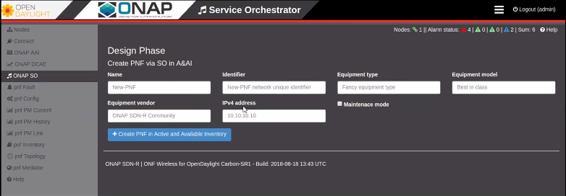
SDN-R in Open Daylight create a A&AI PNF entry

