Slide 1
K8s RB Profile Creation with CDS
Konrad Bańka (Samsung)
Łukasz Rajewski (Orange)
Samuli Silvus (Samsung)
Eric Multanen (Intel)
9.10.2019

Slide 2
K8S Resource Bundle (RB) Profile (1)
Profile: Input Values for Helm Charts Instantiation (+ K8S Resources)
Profile belongs to the K8S RB Definition (equivalent of vf-module definition in ONAP today)
Today’s CNF/RB Flow with K8S Plugin
  Create Definition -> Automatic with SDC model distribution. RB name is the name of the VNF type (see new naming proposal in upcoming slides)
  Create Profile -> Manual today with API of K8s Plugin
  Create Instance
    Creation of Helm Charts in Kubernetes
    Profile name required – Today User Params in VNF API
    So far Preload Parameters are skipped for vFW K8S use case
    Invoked in Mutlicoud by Infra Workload API

Slide 3
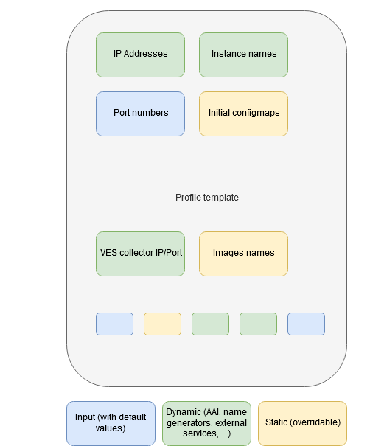
K8S RB Profile (2) – vFW K8S values.yaml (today)
protectedNetworkName: protected-private-net
protectedNetCidr: 192.168.20.0/24
protectedNetGwIp: 192.168.20.100
protectedNetGw: 192.168.20.100/24
#vFirewall container
vfwPrivateIp0: 192.168.10.3
vfwPrivateIp1: 192.168.20.2
vfwPrivateIp2: 10.10.100.3
#Packetgen container
vpgPrivateIp0: 192.168.10.2
vpgPrivateIp1: 10.0.100.2
#Sink container
vsnPrivateIp0: 192.168.20.3
vsnPrivateIp1: 10.10.100.4
#########
ovnMultusNetworkName: ovn-networkobj
demoArtifactsVersion: 1.5.0
dcaeCollectorIp: 10.0.4.1
dcaeCollectorPort: 8081
replicaCount: 1
image:
repository: virtlet.cloud/ubuntu/16.04
tag: latest
pullPolicy: IfNotPresent
nameOverride: ""
fullnameOverride: ""
resources:
memory: 4Gi
#global vars for parent and subcharts.
global:
#Networks
unprotectedNetworkName: unprotected-private-net
protectedPrivateNetCidr: 192.168.10.0/24
protectedPrivateNetGw: 192.168.10.1/24
onapPrivateNetworkName: onap-private-net
onapPrivateNetCidr: 10.10.0.0/16
onapPrivateNetGw: 10.10.0.1/16

Slide 4
(New) K8S Definition handling proposal
Identify the K8S Definition artifact using the VF Module Model Identifiers
These are already present in the in VF Module create call from SO to Multicloud
K8S Definition Artifact is here:
/api/multicloud-k8s/v1/v1/rb/definition/{VF Module Model Invariant ID}/{VF Module Model Version ID}/content
Stored upon Distribution from SDC by Multicloud artifact broker
Eliminates need to invoke pass Definition ID and Version as User Parameters on creation

Slide 5
K8S RB Profile – Upload to K8s Multicloud Plugin (1)
CREATE Profile in K8s Multicloud Plugin
curl -i -d @create_rbprofile.json -X POST http://${K8S_NODE_IP}:30280/api/multicloud-k8s/v1/v1/rb/definition/{VF Module Model Invariant ID}/{VF Module Model Version ID}/profile
{
"rb-name": “{VF Module Model Invariant ID}",
"rb-version": "{VF Module Model Version ID}",
"profile-name": "p1",
"release-name": "r1",
"namespace": "testns1",
"kubernetes-version": "1.13.5"
}
UPLOAD Profile Content
curl -i --data-binary @profile.tar.gz -X POST http://${K8S_NODE_IP}:30280/api/multicloud-k8s/v1/v1/rb/definition/ /{VF Module Model Invariant ID}/{VF Module Model Version ID}/profile/p1/content
Profile Info: ID/Name, release, namespace, K8s ver.

Slide 6
K8S RB Profile – Upload to K8s Multicloud Plugin (2)
Profile tar.gz structure for vFW K8S use case
manifest.yaml
override_values.yaml
testfol
testfol/subdir
testfol/subdir/deployment.yaml
Profile Manifest
---
version: v1
type:
values: "override_values.yaml"
configresource:
- filepath: testfol/subdir/deployment.yaml
chartpath: firewall/templates/deployment.yaml
DYNAMIC: Replacement of selected values from values.yaml
STATIC (Optional): Replacement/New K8S resources in helm package
STATIC (Optional): Configuration files
Configuration file: source and destination

Slide 7
Option 1 – K8s Profile created by CDS (1)
CBA package (CDS package with service model) contains K8s profile template
CDS during resource assignment process resolves parameters and creates profile in K8s plugin
K8s profile name can be derived from vf-module-customization-id – like proposed already before, or from macro flow input
SO invokes infra workload with SDNC parameters created by CDS but they will have no use since profile was already created by CDS – except the optional name of the profile
MultliCloud invokes instantiation of K8s service like it is done today

Slide 8
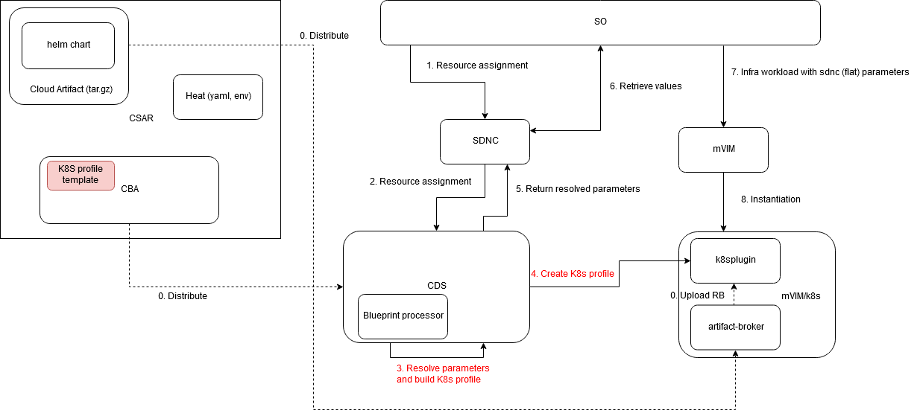
Option 1 – K8s Profile created by CDS (2)
Changes vs Dublin

Slide 9
Option 2 – (Template) K8s Profile distributed from CBA (1)
K8s profile (template) belongs to Cloud Tech Artifact
During the distribution Artifact Broker creates the profile (template)
CDS during resource assignment process resolves parameters and sends them to SDNC
K8s profile name can be derived from vf-module-customization-id – like proposed already before, or from macro flow input
SO invokes infra workload with SDNC parameters created by CDS
MultliCloud invokes instantiation of K8s service with extra parameters used to replace template values from the profile
Required template processing engine in the K8s plugin

Slide 10
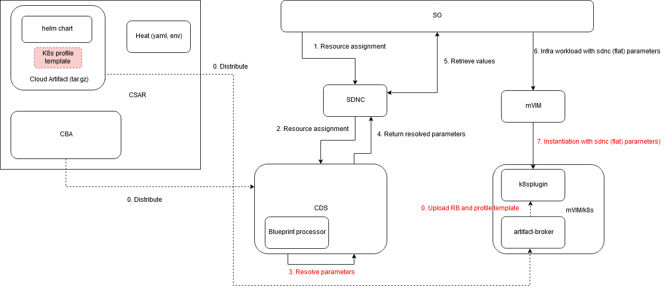
Option 2 – (Template) K8s Profile distributed from CBA (2)
Changes vs Dublin

Slide 11
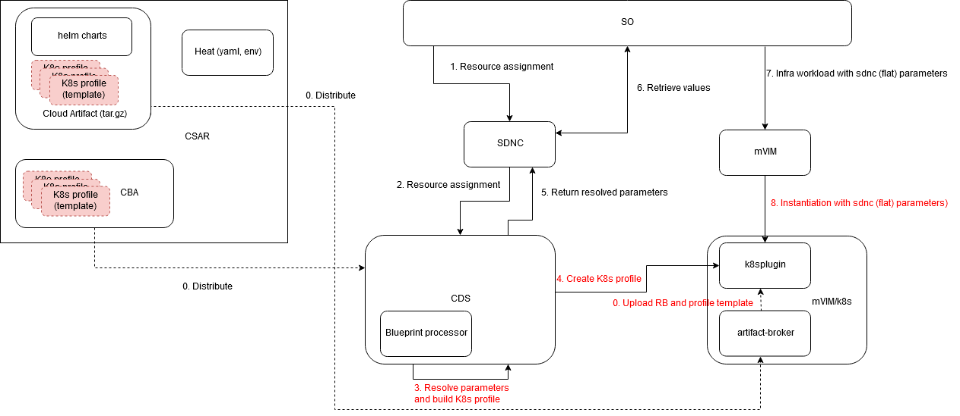
Option 3 – „Combo”
Changes vs Dublin

Slide 12
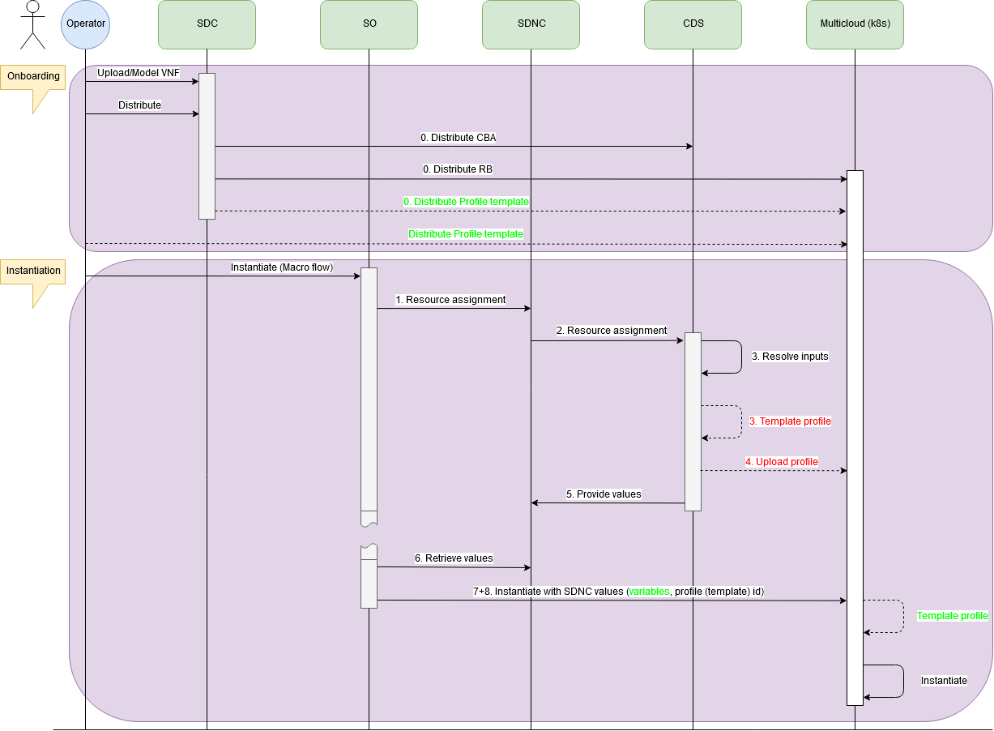
Option 3 – „Combo” – Flow Diagram
Option 1
Option 2

Slide 13
Options with K8S profiling examples
Id | Type of Profile | Profile Source | Profile Processing | CDS Input/Output parameters for | K8S Plugin Instantiation Parameters | Options
1 | No profile | None | None | No CDS | None | ALL
2 | Static profile(s) | External | Manual Upload over K8S Plugin | Input: Profile ID Output: Profile ID | Profile ID | ALL
3 | Static profile(s) | Bundled with Helm package | Auto Upload from VSP by K8S Plugin | Input: Profile ID Output: Profile ID | Profile ID | Option 2, Option 3
4 | Static profile(s) | Bundled with CBA | Auto Upload from CBA by CDS | Input (O): Profile ID Output: Profile ID | Profile ID | Option 1, Option 3
5 | Profile template(s) (k8s compatible) | External | Templating in K8S Plugin | Input: Temp. Profile Info Output: Temp. Profile Info + Values | Profile Template Info + Template Values | Option 2, Option 3
6 | Profile template(s) (k8s compatible) | Template Bundled with Helm package | Auto Upload from VSP by Templating in K8S Plugin | Input: Temp. Profile Info Output: Temp. Profile Info + Values | Profile Template Info + Template Values | Option 2, Option 3
7 | Profile template(s) (CDS compatible) | Template Bundled with CBA | Auto Upload from CBA by CDS Templating in CDS | Input (O): Temp. Profile Info Output: Profile ID | Profile ID | Option 1, Option 3
8 | Profile template(s) (k8s compatible) | Template Bundled with CBA | Auto Upload from CBA by CDS Templating in K8S Plugin | Input (O): Temp. Profile Info Output: Temp. Profile Info + Values | Profile Template Info + Template Values | Option 3

