Slide 1
Service Resolver for ONAP
René ROBERT

Slide 2
The need
Coming from real use-case we had to study

Slide 3
The need (1/3)
Several « service deployment flavors », not really services
ONAP can instantiate telephony service based on several possible models
The customer wants Telephony service
ONAP
Telephony_model_1:
  {
  techno : voip
  vnf_vendor : vendorA
  }
Telephony_model_2 :
  {
  techno: voip
  vnf_vendor: vendorB
  }
Telephony_model_3:
  {
  techno: pstn
  }
If quality = High select Telephony_model_2
If Location = Bearn select Telephony_model_3
BSS
Telephony :
  {
  QualityLevel : High
  Location : Britany
  }
?
No automatic choice
Service level properties
it is not possible to plug a BSS to order a service with options

Slide 4
The need (2/3)
I have onboarded multiple vFirewall service models
ONAP
vFirewall_model_1:
  {
  techno : VNF X
  vnf_vendor : vendorA
  }
vFirewall_model_2 :
  {
  techno: VNF Y
  vnf_vendor: vendorB
  }
vFirewall_model_3 :
  {
  techno: VNF X + VNF LoadBalancing X
  vnf_vendor: vendorA + Vendor C
  }
I want to instantiate the simplest vFirewall but I am not sure which model to use ?
If simple then select vFirewall model 2
?
No automatic choice
The service instantiation requires a human decision
Multiple services models in ONAP for the same service type

Slide 5
The need (3/3)
A vFirewall VNF can support up to N vFirewall service
ONAP
vFirewall_model_1:
  [ {
  techno : VNF X ,
  vnf_vendor : vendorA,
  Service capacity : N,
  },
  {
  techno : service configuration,
  Description: allotted resource to VNF X
  Service Id : uuid
  }]
I need to declare several vFirewall services on same vFirewall VNF
Do I need to instantiate an additional VNF ?
?
No automatic choice
The service instantiation requires a human decision
Sometimes it is not necessary to instantiate all service components

Slide 6
A theoretical solution
Service modeling with composition and rules
(CFS / RFS / instantiation Rules)
An implementation as a proof of the concept
Service Resolver (SR)
https://gitlab.com/Orange-OpenSource/lfn/onap/service-resolver
Note: of course other solutions/implementations might be possible to cover the needs

Slide 7
There is a difference between the service perceived as a ‘know-how’ from the BSS and the service as a technical solution to be delivered to fulfil the customer request.
This service distinction is already existing in standard :
      TMF/SID extract :
      “A CustomerFacingService defines the properties of a particular (…) know-how that represents a realization of a Product within an organization's infrastructure; This is in direct contrast to ResourceFacingServices, which support the network/infrastructure (…)technical solution. “
Our observation about NBI & SO :
  NBI manage RFS ordering and not able to identify from a generic CFS which RFS fulfil.
  SO manage RFS level service delivery orchestration

Slide 8
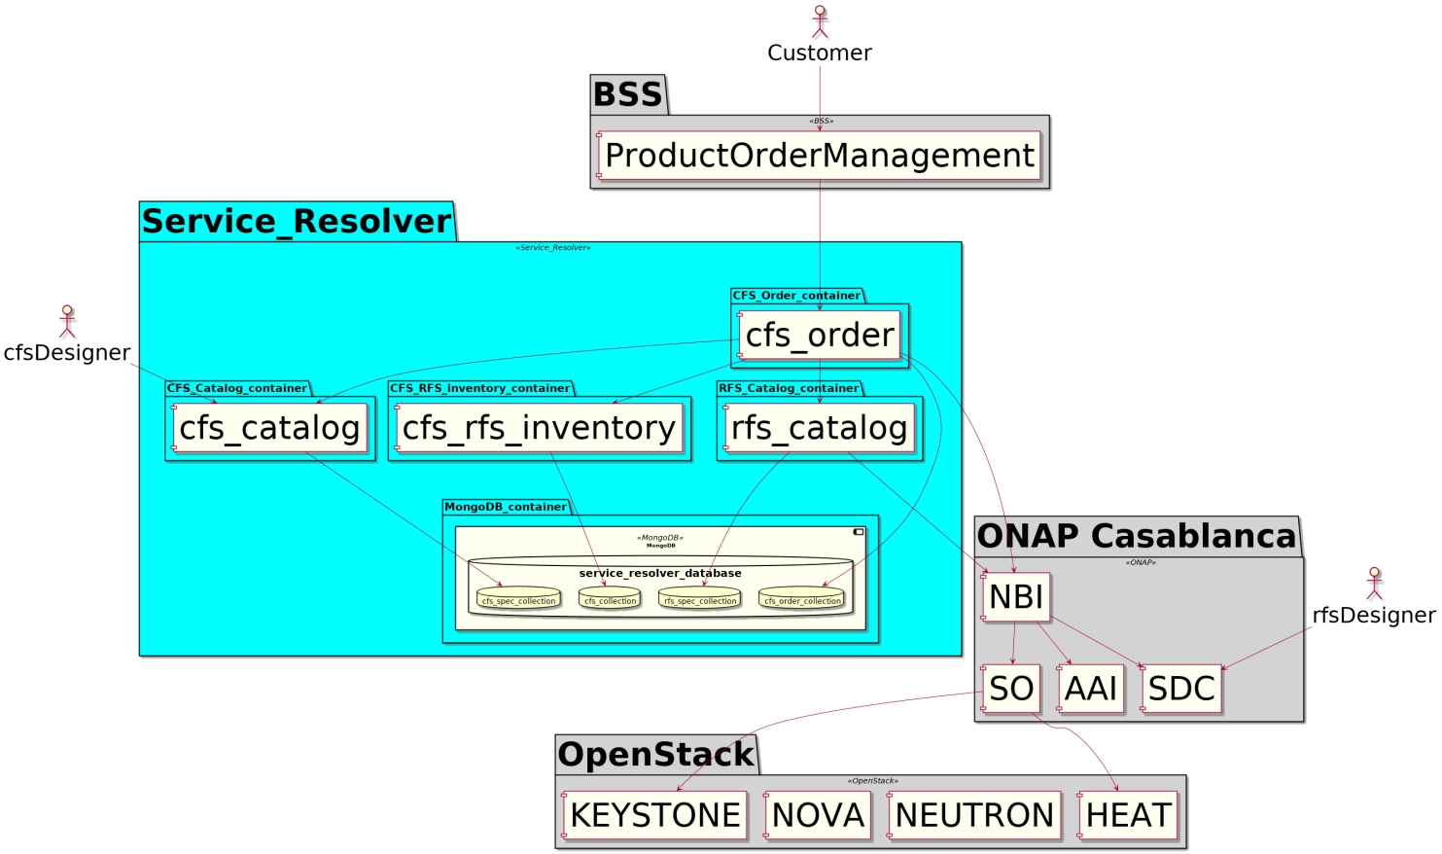
Simulator/stand-alone mode to allow ServiceDesigner to experiment their service definition
Service Resolver for ONAP : component view
A new component (optional)
No impact on existing ONAP component
Based on TM Forum concepts and API definitions (with extensions)

Slide 9
Service Resolver : How to Design a service model (CFS specification)
3 – write the service (CFS spec) model definition in a JSON file using TMF modelling principle
2 – onboard each « sub-services » (RFS spec) in ONAP SDC as it is performed today
4 – for each sub-service (RFS spec) that can be part of the service (CFS spec), identify the instantiation Decision rules
1 – define the master service (CFS spec) and the potential sub-services (RFS spec)
5 – onboard in Service Resolver the service definition (CFS spec) using API (json file content = POST payload)

Slide 10
Service Resolver : instantiation Decision Rules
Rule 1 : Instantiation decision based on a CFS characteristic (= parameter)
Rule 2 : Instantiation decision based on existing RFS instance in a set
Only 3 rules identified today
Rule 3 : Instantiation decision based on service capacity of existing RFS instance
A « set » can be : customer, all, admin domain…
Rules can be chained

Slide 11
Service Resolver : How to instantiate a service (cfs)
2 – send the service order to Service Resolver. Sender can be a BSS or an Ops people.
3 – Service Resolver get service model in service catalog, then evaluate each instantiation rules
1 – define the service Order (CFS level)
4 – Service Resolver send orders (at RFS level) to ONAP NBI component
5 – ONAP NBI, SO and CDS are instantiating the RFS

Slide 12
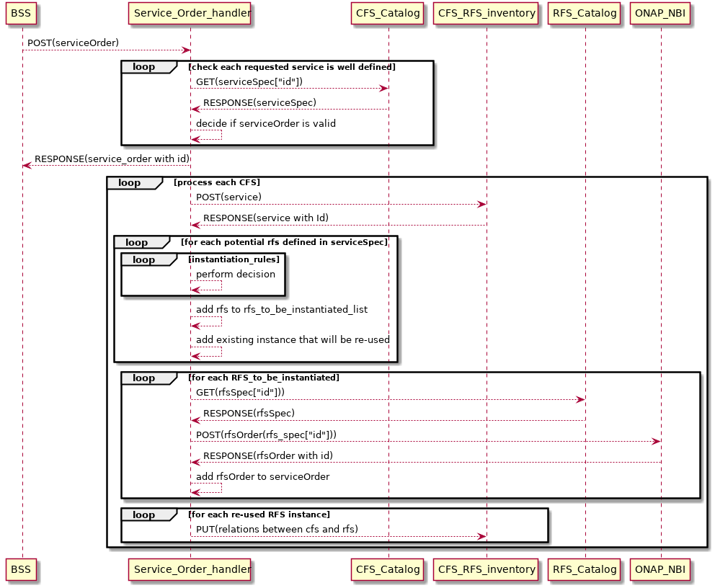
Service Resolver : High level Service Order sequence
Service Resolver

Slide 13
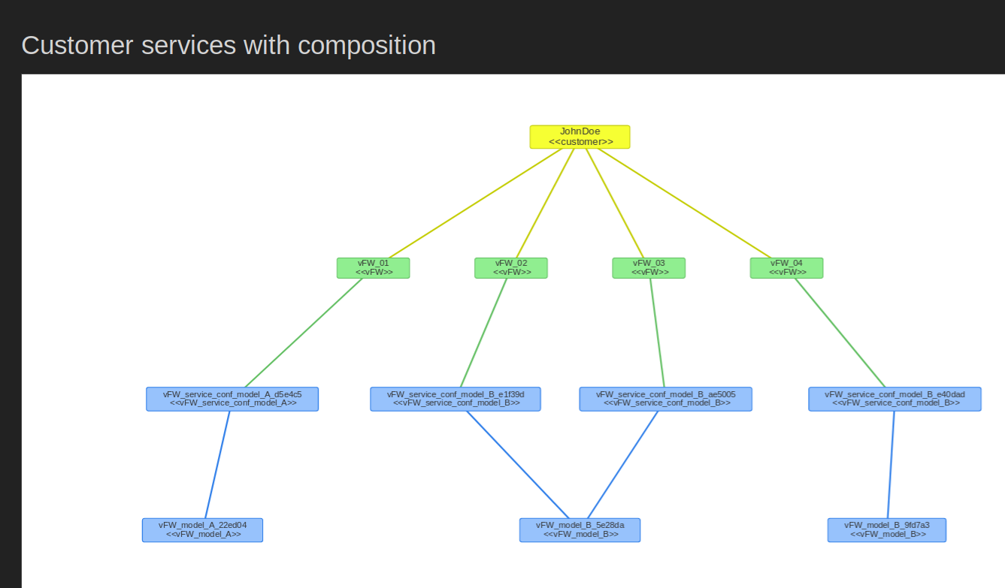
Service Resolver : example for a vFirewall use-case
«vFW model B when ordering an “extended” vFW
vFW configuration on model A (allotted resource)
vFW model A when ordering a “simple” vFW
vFW model B (rfs instance) supporting several vFirewall services (cfs instances)

Slide 14
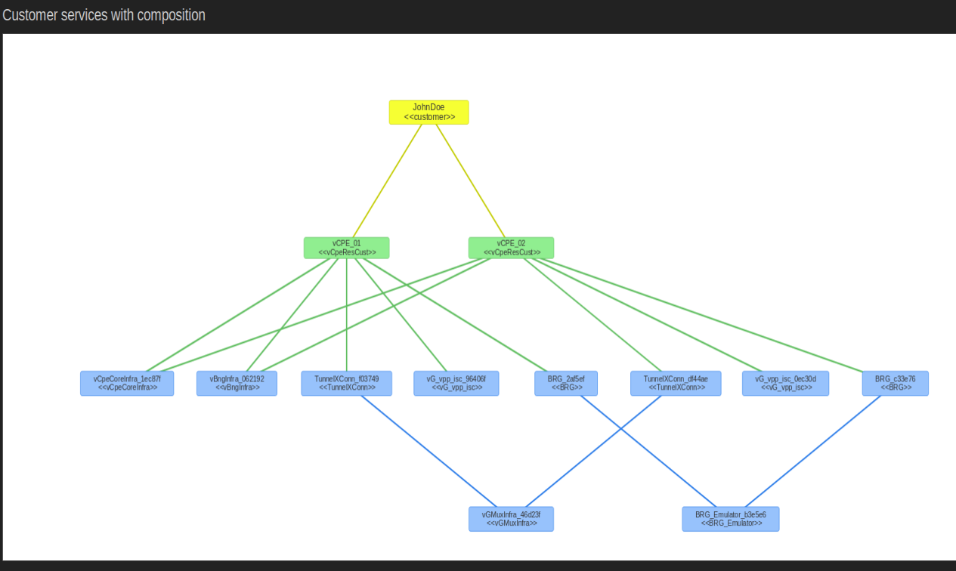
Service Resolver : example for ONAP vCPE use-case
use-case described here : https://wiki.onap.org/pages/viewpage.action?pageId=33068582
« infra » services are instantiated only when they do not exist yet
« infra » services instances are shared between cfs instances

Slide 15
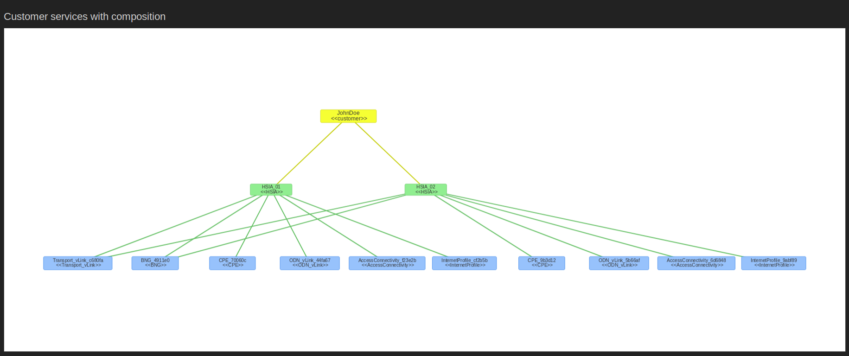
Service Resolver : example for ONAP BBS use-case
use-case described here : https://wiki.onap.org/pages/viewpage.action?pageId=45297636
« infra » services are instantiated only when they do not exists yet
« infra » services instances are shared between cfs instances

Slide 16
SUM-UP
The solution is:
* generic : any kind of service (vFirewall, Internet Access, virtualBox, Network Slice service, monitoring service...)
* model-driven : no need for "per service“ code, only service definition (data in database via API)
* adaptive to the context : the service "solution" is evaluated/defined at the moment a service order is received, based on rules
* standard API based : TMF641 (serviceOrder), TMF633 (serviceCatalog), TMF638 (serviceInventory)
* light : some small (< 100 Mo) docker containers
* usable in simulation mode (without ONAP) to allow Service Designer elaborate/test their service definition before deploying the service definition for real with ONAP
* without impact on ONAP components : no need to modify SDC, SO, AAI, re-using existing BPMN (a-la-carte or BuildingBlocks)
* capacity to automatically send several RFS order in a sequence
* very simple to use : only one Json additional file to define Customer Service
The solution has been Validated by an implementation (full Python based) : Service Resolver
You can install and play with it :
    https://gitlab.com/Orange-OpenSource/lfn/onap/service-resolver

Slide 17
SDC/SO/AAI/Policy solution
SDC :
    possibility to describe/add service properties.
    possibilities to attach several Rules (with chaining possibilities) to each “service component” (*) that compose a Service.
SO :
    capacity to receive a service instance request, get the service definition, process all rules (requests to policy), update AAI at service level, instantiate “ service component” that rules decided to instantiate, update AAI with new “ service component” instance, update relations between “ service component” /”service” for existing “ service component”
    benefit from the new BB approach + CDS controller : only one Order to instantiate service/VNF/Vfmodules/network, with all parameters defined in a “cda” archive.
AAI :
    capacity to store service instance, “ service component” instance, relationships in both way (from “ service component” to service, from service to “ service component” )
    Capacity for a “service component” to be in relation with several services (not possible today for VNF instance
    any service properties with its instantiated value
Policy :
    capacity to implement&run 3 new policy types : param in serviceOrder, existing “ service component” instance in a set, existing “ service component” instance capacity.
      (*) a tricky point :
      “service components” can be themselves services but SO will have to be able to instantiate service composed of services with rules.
      “service component” can be a VNF/VL but AAI will have to be able to manage relations in such a way that a VNF instance can be attached to several services (not the case in Dublin release)

Slide 18
Annex

Slide 19
Service Resolver : High level Modelling
Service Resolver for ONAP
rfsOrder
cfsOrder
is composed of
is composed of
orderItem
orderItem
will contain a
will contain a
cfs
Is based on
cfsSpecification
is composed of
is composed of
InstantiationRules
rfs
Is based on
rfsSpecification
ONAP Casablanca
Is a copy
Is a copy
serviceOrder
(NBI=>SO)
Service instances
(NBI=>AAI)
ServiceSpec
(NBI=>SDC)
A generic model for all kind of services

