Slide 1
5G Bulk PM / PM Control
ONAP R6 Proposal
Ericsson

Slide 2
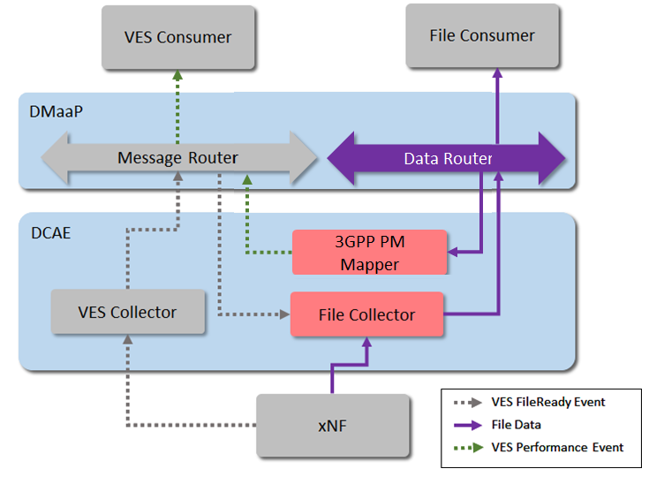
Background and Rationale
Since previous release there is ”data plane” support for Bulk PM in ONAP
  I.e. Bulk PM files can be collected from xNFs and made available for consumers on DMaaP by the means of the VES fileReady event, DataFileCollector and PM Mapper.

Slide 3
Background and Rationale
There is currently no ”control plane” in ONAP to manage PM
  No specific support enabling configuration of PM jobs/subscriptions on xNFs
To better support the complete bulk PM use case, a PM ”control plane” should be introduced in ONAP
  I.e. a means for PM consumers to conveniently define PM subscriptions on (sub)network-level, thereby configuring PM on a set (small or large) of xNF instances in a single subscription
  Different consumers to manage their own subscriptions, independently of each other
ONAP
PM Consum
PM Consumer (File/VES)
”Data plane”, i.e. mechanism to receive PM Bulk files from xNFs and make available to PM Consumers.
”Control plane”, i.e. mechanism for PM Consumers to configure xNF instances to produce desired measurements.
xNF
xNF
xNF

Slide 4
Terminology used in this presentation
PM Subscription
  Defines a list of measurement types and optional parameters such as granularity period and IOC filters
    The idea is to use the PM control model in 3GPP 28.622 specification as a base for measurement related parameters
  A subscription definition is limited to one xNF type, with optional parameters (R6+) to further control the set of xNF instances on which these measurements are to be activated
    xNF filters
    xNF instance identifiers
  Has an activation status
xNF Filter
  This filter can be configured in the PM subscription, as a means to define a subset of the xNF instances available in A&AI. The idea is to match this filter against xNF instance data available in A&AI to filter out unwanted xNF instances

Slide 5
Realization overview 1/2
The central idea is to use control loops for managing PM subscriptions. The PM control loop is realized with a new type of DCAE ”PM Subscription Handler” (PMSH) micro service.
The PM CL is included in SDC service definition
A subscription is created and configured in CLAMP by parameterizing the associated policies, submit and finally deploy the CL in DCAE. Each subscription is handled by its own CL instance
Design/Distribution/Deployment
CLAMP
Delete PM CL
Un-deploy PM CL
SDC
Service & Resource Catalogs
Configure PM CL
Submit PM CL
Deploy PM CL
Parameterize
Instantiate mS
Config
Policy
xNF Resource
CSAR
Service containing
PM CL
CBA
incl PM Transformer
Confg & Oper.
Policies
DCAE
Config
Policy
PMSH mS
(one instance per subscription)
Policy Fwk
Configuration policy
PMSH mS
Blueprint for xNF Type X
Operational policy
Controller
CDS Blueprint Processor
CBA
Design-time flow
Distribution & Deployment flow

Slide 6
Realization overview 2/2
When the subscription is activated, the mS is triggered to query A&AI for existing xNF instances and pushes the PM configuration to the Controller via Policy Fwk, and also to update the PM Mapper configuration
The Controller uses the CBA to create a xNF-specific PM configuration from the generic one, before pushing the configuration to the xNF
The PMSH mS subscribes to notifications for new and removed xNF instances, and adds/removes such instances automatically to/from the subscription
PMSH will also support dynamic subscription changes (limited scope in Frankfurt/R6)
Run-time
CLAMP
Delete PM CL
Un-deploy PM CL
SDC
Service & Resource Catalogs
Configure PM CL
Submit PM CL
Deploy PM CL
Service containing
PM CL
Dynamic subscription change (manual or automatic)
DMaaP
DCAE
PMSH mS
(one instance per subscription)
A&AI
Policy Fwk
”New xNF instance added/removed” event
DMaaP
Trigger operational policy with PM config
Push PM config
Query for xNF instances
Controller
Synchronization of measurement list
CDS Blueprint Processor
Run-time flow
PM Mapper
Push config
xNF

Slide 7
Overview of Proposed PM Control Use Cases
UC# | Use Case Name | Description
UC1 | Create PM Subscription | A user creates a new PM subscription and configures it
UC2 | Activate PM Subscription | A user activates an inactive subscription, which triggers the pushing of the corresponding PM configuration to the matching xNF instances
UC3 | Deactivate PM Subscription | A user deactivates an active subscription, which triggers the deletion of the corresponding PM configuration on the matching xNF instances
UC4 | Modify PM Subscription | A user edits a subscription
UC5 | Configure xNF filter in PM Subscription | A user configures the xNF filter in a subscription
UC6 | Add/Remove xNF Instances To Subscription | A user adds or removes existing xNF instances to/from a subscription
UC7 | Delete PM Subscription | A user deletes a subscription
UC8 | New xNF Instance Added To Network | A new xNF instance is added in ONAP, which triggers the automatic adding of this xNF instance to any subscription with a matching xNF filter
UC9 | xNF Instance Removed From Network | An xNF instance is removed from ONAP, which triggers the automatic removal of this xNF instance from all subscriptions it is currently included in
R6 Scope

Slide 8
R6 Project Impact
Project | Impact summary
DCAE | Addition of new PMSH micro-service Any needed updates to PM Mapper mS to enable dynamic mapping of measurements that are part of active subscriptions
SDC | Ensure SDC can support the policy types for the PM Control use case
A&AI | Ensure A&AI can generate necessary events related to xNF instantiation and removal
CLAMP | Ensure CLAMP can support PNFs in Control Loops CDS Actor in operational policy Configuration policy for the new PMSH mS
Integration | e2e test case New/updated xNF simulator with demo YANG model for PM control Test artifacts: CBA implementing new controller actions with transformation from xNF-agnostic subscription to xNF-specific YANG model Operational policy to forward subscription configuration from PMSH to controller using the CDS Actor

Slide 9
Thank You!

