Slide 1
E2E Network Slicing use case:
Frankfurt status and Roadmap
Participants: CMCC, Wipro, Huawei, AT&T, Amdocs, Verizon, Reliance Jio, Tencent, China Telecom
Authors: LinMeng(CMCC), Swami (Wipro), Chuanyu Chen (Huawei), Borislav Glozman (Amdocs), Shankar P N (AT&T)
January 14, 2020

Slide 2
Overall concept

Slide 3
3GPP Slice Management Functions
Management Function | Key tasks | Remarks
Communication Service Management Function (CSMF) | Responsible for translating the communication service related requirement to network slice related requirements. Communicate with Network Slice Management Function (NSMF).
Network Slice Management Function (NSMF) | Responsible for management and orchestration of NSI. Derive network slice subnet related requirements from network slice related requirements. Communicate with the Network Slice Subnet Management Function (NSSMF) and Communication Service Management Function.
Network Slice Sub-net Management Function (NSSMF) | Responsible for management and orchestration of NSSI. Communicate with the NSMF.

Slide 4
3GPP Slice Management Functions – Roles and mapping to ONAP: Summary
Scenario | CSMF | NSMF | NSSMF*
1 | ONAP | ONAP | ONAP
2 | 3rd party | ONAP | ONAP
3 | 3rd party | ONAP | 3rd party
4 | ONAP | ONAP | 3rd party
5 | 3rd party | 3rd party | ONAP
Notes:
For options 1-4, hybrid NSSMF mapping is also possible, i.e., some NSSMFs within ONAP and some outside ONAP.
Blue – proposed by Orange
We propose that the ONAP architecture should support all scenarios by means of configurable (build-time) options. To be able to do so, following to be considered:
Standardized APIs from NB systems (OSS) to CSMF.
Standardized APIs between NSMF <-> CSMF
Standardized APIs between NSMF <-> NSSMF
Depending on external NSSMF capabilities (i) ONAP to perform part of NSSMF functions as needed (ii) NSMF scope may also be slightly altered based on NSSI information exposed to ONAP (future scope to perform capability query, and adapt accordingly).
Standardized format of FM/PM reporting from NSSMF (this may require plug-ins/ adaptors, and is not in scope of Frankfurt release)

Slide 5
Scope for Frankfurt & Status

Slide 6
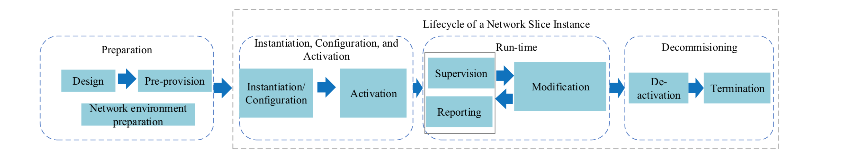
Scoping Use case proposal - NSI Life Cycle view (Frankfurt)
Objective: Demonstrate e2e slice design, Instantiation, including core slice sub-net design and instantiation (see Note)
Ref.: 3GPP TS 28.530
Scope for Frankfurt
Design and pre-provision: Creation of necessary slice/slice sub-net templates. Sub-nets only include Core and RAN (Note).
Instantiation/Configuration & Activation/Deactivation of NSIs (including instantiation/mapping of its constituent slice sub-nets)
Stretch Goal: (RAN) NSSMF functionality within ONAP (as PoC) (under discussion)
Note: RAN subnet requires NSSMF functionality within ONAP to be realized (this is a stretch goal and is under discussion with ArchCom, and may be realized as a PoC for Frankfurt). Transport sub-net is assumed to be pre-created, and part of it is assumed to within core sub-net (for simplicity).

Slide 7
Architectural Scope For Frankfurt
Slice Service/Network Slice instantiation and (de)activation, with core slice sub-net (RAN – stretch goal as PoC, under discussion)
Notes
CSMF and NSMF are within ONAP.
Core NSSMF is external to ONAP.
RAN NSSMF (stretch goal) is within ONAP, RAN NSSMF functionality is simplified greatly as we adopt a bottom-up approach (i.e., all virtual resources are already instantiated and initial configuration done).
UUI
EXT-API
SDC
SO
OOF
CSMF WFs
M1 Status:
Scenario 4 is approved: CSMF and NSMF within ONAP, NSSMF outside ONAP
Only external core NSSMF will be connected to ONAP in Frankfurt
To realize Option 4, Impact in U-UI, SO, EXT-API is approved, Impact in OOF will be re-checked at M2/M3.
NSMF WFs
AAI
NSSMF Adaptor
NSSMF WFs
Policy
SDN-C (R)
ONAP
Part of Scenario 1 (NSSMF in ONAP)
Core NSSMF
CSMF
NSMF
External NSSMF
Internal NSSMF - under discussion
Part of Scenario 4 (NSSMF outside ONAP)

Slide 8
Functional Scope for Frankfurt
CSMF Portal & workflows
5G Service create/delete
On-demand Service activate/deactivate
ONAP Northbound interface to CSMF
Support interface to external CSMF
CSMF
U-UI, SO, OOF, EXT-API, A&AI
NSMF Portal & workflows
Slice instantiate/Terminate
Slice activate/deactivate
Manual NSI/NSSI selection
Manual Service Profile decomposition
U-UI, EXT-API, SO, OOF, A&AI
NSMF
3rd party NSSMF (outside ONAP)
Interface between ONAP and 3rd party (core network) NSSMF
NSSMF within ONAP*
Support basic RAN NSSMF functionality
NSSMF
SO, SDN-C (R)*, A&AI, SO Adaptor to connect to external NSSMF
* SDN-C(R) impacts will not be official part of Frankfurt release (but will be, after Frankfurt). A&AI schema changes only foreseen. There is also impact to config policies (no code changes expected).

Slide 9
Frankfurt Scope: Summary
CSMF within ONAP; NSMF within ONAP; connect external NSSMF (Core)+ NSSMF within ONAP (RAN) (Notes)
Service instantiation requested to ONAP (to CSMF – CSMF is within ONAP for Frankfurt)
CSMF, in turn, triggers network slice “allocation” request to NSMF within ONAP. NSMF invokes:
External core NSSMF (outside ONAP)
Stretch Goal (PoC): (Basic) RAN NSSMF within ONAP (under discussion, may be realized as a PoC for Frankfurt)
Involves network slice instantiation, service <-> slice mapping (manual and automated)
On demand service activate/deactivate requested to ONAP
Activate the service, along with the slice (the NSI bound to the service)
Notes
For Frankfurt Official release, the E2E network slice instance will consist only of Core slice sub-net instances. RAN NSSMF within ONAP may be realized as a PoC, as it is still under discussion with ArchCom.

Slide 10
Impact overview: Frankfurt
ONAP
U-UI
CSMF Portal
NSMF Portal
A&AI(Schema Change)
EXT-API
Service instance
CSMF interfaces (Note 1)
(Config) policies for OOF Optimization
SDC
(test only)
Service Profile
SO
OOF
Slice Profile determination
NST Selection
Policy (test only)
NST
CST
CSMF WF
NSI
NSMF WF
CSMF Policy
NSI Selection
NSST
Service Profile Template
NSSMF Adaptor
NSSI Selection
NSMF Policy
Slice Profile
NSSMF WFs
NSSI
NST
CSMF Functions
Service create/delete;
Service activate/deactivate
NSST (onboarding)
(Note 3)
SDN-C (SDN-R)
RAN NSSMF
RAN (Simulator）
NSMF Functions
Slice instantiate/terminate;
slice activate/deactivate
Manual inputs and adjustment
Notes
CSMF interface refers to CSMF NB interface to CSMF Portal
Blue code will not be part of official Frankfurt.
CN NSSMF (3rd party)
Under discussion

Slide 11
Impact & Status Summary
Component | Impact(s) | Commitment
UUI | CSMF portal: Service creation/deletion; Service (de)activation; Service KPI Monitoring NSMF portal: Slice instantiation (manual intervention) | China Mobile, Huawei
EXT-API | Northbound interface from NSMF to CSMF, Interface from CSMF to northbound systems (OSS, 3rd party apps) | Wipro
SO | CSMF workflows, NSMF workflows, manual intervention, on-demand slice instantiation enhancements, SO adaptor for external NSSMF, workflows for part of internal NSSMF* | China Mobile, Huawei, Wipro
OOF | NST selection, NSI selection, NSSI selection | AT&T, China Mobile, Huawei, Wipro
AAI (Schema Change) | Slice and slice sub-net inventory, service mapping to slice, NST, NSST inventory | Amdocs, China Mobile, Huawei
Policy (Test only) | Config policies for NST, NSI and NSSI selection (no code impact) | Wipro
SDC (Test only) | On-demand slice model updates (no code impact), KPI monitoring requirement template* | Amdocs, China Mobile, Huawei
SDN-C (R)* | Part of NSSMF for RAN | Wipro
Simulators (not part of ONAP) | RAN-Simulator for RAN Core NSSMF Simulator | Wipro: RAN-Simulator China Mobile: Core NSSMF Simulator
* Impacts still under discussion with ArchCom and not approved yet. Code not to become part of official ONAP Frankfurt.

Slide 12
Modeling Aspects
SDC Service Template
5G Run time model needed
A&AI model Design
CST
CSI
service-instance
(CSI)
2
Communication-service-profile
ServiceProfile
Service Profile
service-instance(Service Profile)
3
service-profile
1
NST
NSI
service-instance(NSI)
NSST
NSSI
Slice Profile
service-instance(NSSI)
slice-profile
Note:
New Model
1
To match to ONAP model-driven platform, we use “service-instance” for all run time instance
2
To Make 3GPP CS profile define more clear. Map the Communication Service original requirement as new node “communication-service-profile”
3
To Make 3GPP Service profile define more clear. Map the Service Profile requirement(Brief Info in “service-instance”) , detailed info as new node “service-profile” This means Service Profile = “service-instance” + “service-profile”

Slide 13



SO impacts & Status
SO
A&AI
Create CS (2)
CSMF
CS (2)
CS (1)
S-NSSAI (2)
S-NSSAI (1)
New workflow
Create SP (2)
Create NSI (2)
Share NSSI (2)
Create NSSI (3)
SP (2)
SP (1)
S-NSSAI (2)
S-NSSAI (1)
NSI (2)
NSI (1)
NSSI (3)
NSSI (2)
NSSI (1)
NSMF
S-NSSAI (2)
S-NSSAI (1)
S-NSSAI (1)
S-NSSAI (2)
New workflow
3rd NSSMF
NSSI (1)
S-NSSAI (1)
S-NSSAI: Single Network Slice
Selection Assistance Information
CS: Communication Service
SP: Service Profile
NSI: Network Slice Instance
NSSI: Network Slice Subnet
Instance
NSSMF Adapter
NSSI (2)
S-NSSAI (1)
S-NSSAI (2)
NSSI (3)
S-NSSAI (2)
Status
Work flow of CSMF and NSMF designed.
Presented the feature and APIs to SO team
Resources available, and coding to start.

Slide 14
OOF Impacts & Status
Network Slice Template (NST) selection based on service profile
Multiple options possible to be returned
For Frankfurt, it will be a simple exact match with 1 NST
Network Slice Instance (NSI) selection based on NST(s) and service profile
Multiple options to be returned, preference given to existing NSI reuse
For Frankfurt, it will be a simple exact match with 1 NSI (selected) or none (create a new NSI)
Network Slice Subnet Instance (NSSI) selection based on NSST(s) and slice profile
Multiple options to be returned, preference given to existing NSSI reuse
For Frankfurt, it will be a simple exact match with 1 NSSI (selected) or none (create a new NSSI)
We will use the HAS implementation in OOF for selection with new inventory type (slices), constraints and objective function. The functionality will be further extended beyond Frankfurt.
Status:
APIs defined and reported to OOF team
Resources available, design and implementation ongoing.

Slide 15
A&AI Impacts & Status
service-instance（Communication Service Instance）
service-instance（Service Profile Instance）
service-instance（NSI）
service-instance（NSSI）
*
*
*
*
Allotted resource
*
Old
communication-service-profile
service-profile
slice-profile
New
A&AI node | Remark | URL
Service-instance | Existing | /aai/{version}/business/customers/customer/{customer-id}/service-subscriptions/service-subscription/{service-subscription-id}/service-instances/service-instance/{service-instance-id}
communication-service-profile | New | /aai/{version}/business/customers/customer/{customer-id}/service-subscriptions/service-subscription/{service-subscription-id}/service-instances/service-instance/{service-instance-id}/communication-service-profiles/communication-service-profile/{communication-service-profile-id}
service-profile | New | /aai/{version}/business/customers/customer/{customer-id}/service-subscriptions/service-subscription/{service-subscription-id}/service-instances/service-instance/{service-instance-id}/service-profiles/service-profile/{service-profile-id}
slice-profile | New | /aai/{version}/business/customers/customer/{customer-id}/service-subscriptions/service-subscription/{service-subscription-id}/service-instances/service-instance/{service-instance-id}/slice-profiles/slice-profile/{slice-profile-id}
Status
Only schema change is needed
Schema change has been reported to A&AI team and has been accepted
Resource available and started contributing

Slide 16
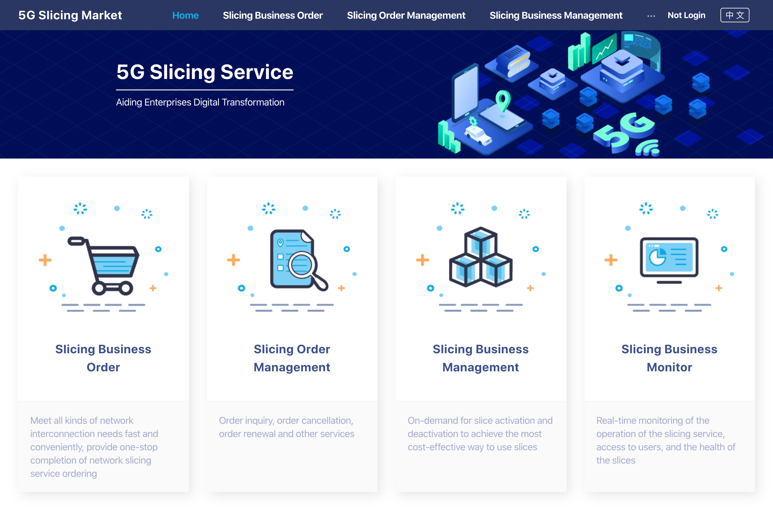
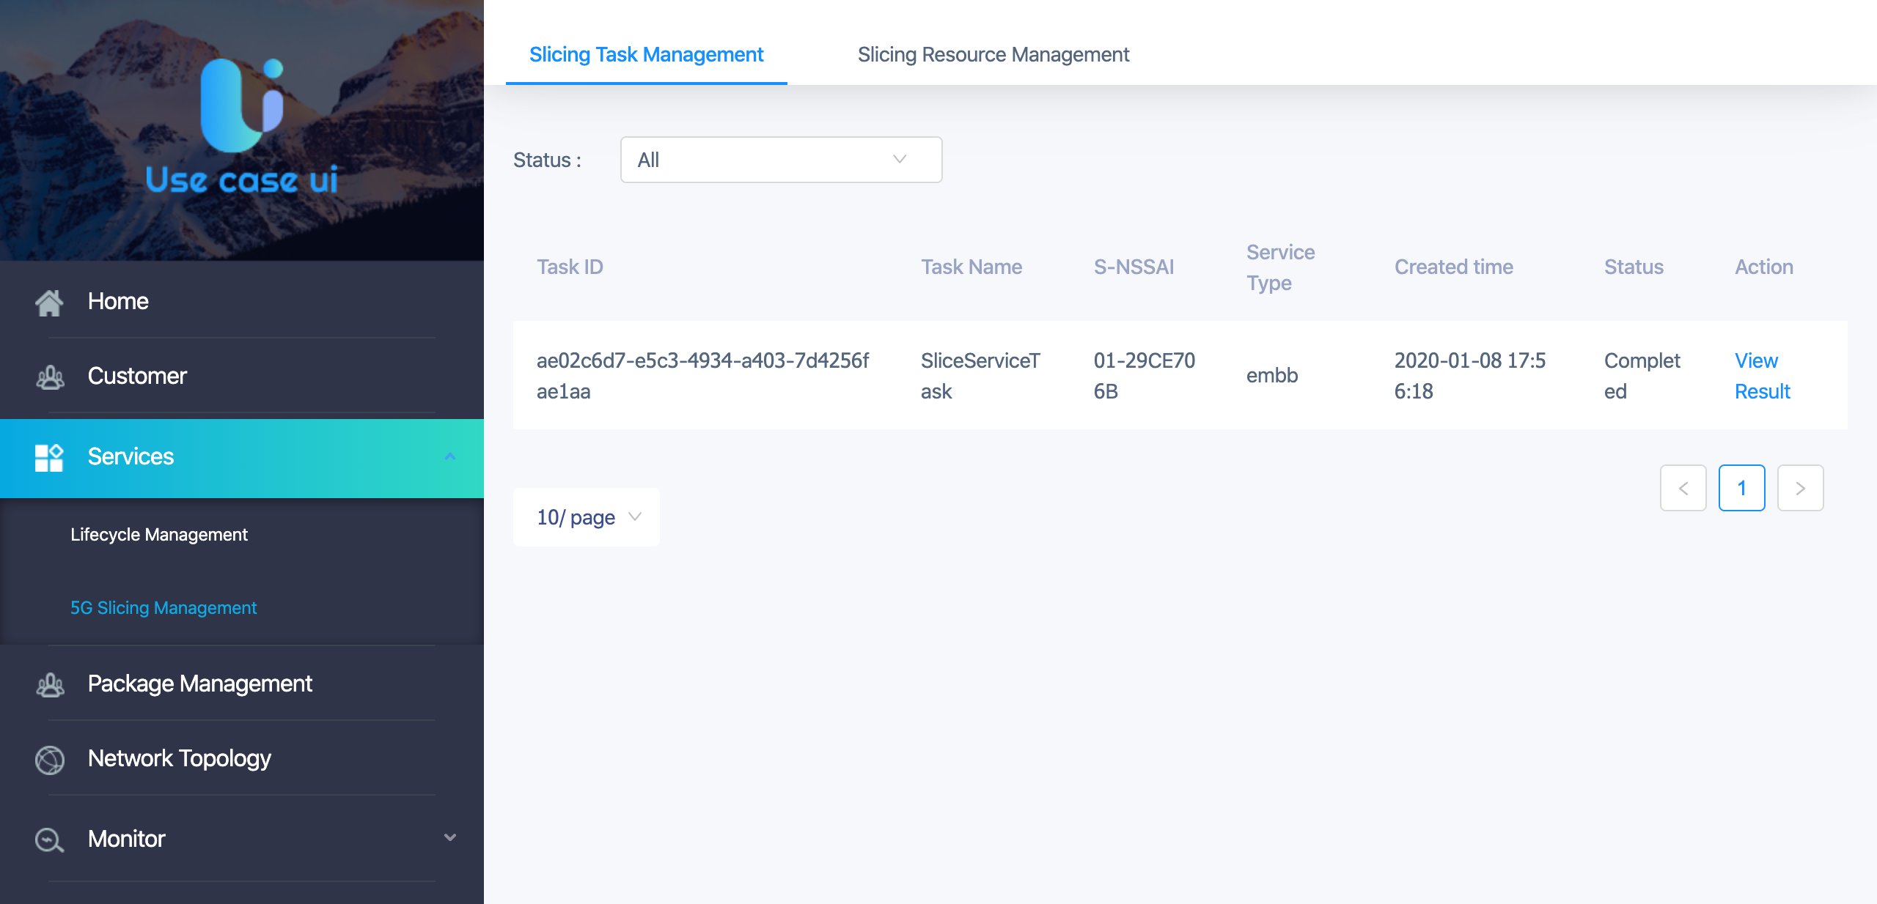
U-UI Impacts & Status
CSMF Portal:
Slicing Business Order :
Communication Service Creation/Termination
2. Slicing Business Management :
Communication Service Activation / Deactivation
NSMF Portal:
Slice Task Management:
Manual Intervention for ServiceProfile Decomposition, NSI Selection, NSSI Selection
Slice Resource Management:
Mapping relations display: Slice Service, NSI, NSSI
Status:
Functions has been reported to U-UI team;
Resource ready and start coding

Slide 17
EXT-API Impacts & Status
Slice creation request from UUI
UseTMF 641 API Create Service Order from UUI, will be mapped by EXT-API to SO API to create the slice
Minor impacts only in EXT-API
Slice activation
  This part is intended to be implemented in EXT-API, however, it will not be integrated with UUI in Frankfurt release.
Status:
Minor impacts only.
APIs defined and reported to EXT-API team
Resources available, design and implementation ongoing.

Slide 18
Assumptions for Frankfurt
Transport sub-net and its slicing is not in scope.
The required transport segment is assumed to be pre-created, and its “selection” will be considered as part of core sub-net (for simplicity).
    Front haul and mid-haul are pre-determined
    Backhaul is ‘selected’ as part of core NSSI selection
Stitching/chaining of RAN and core NSSIs: Shall be done by SO in the role of NSMF.
NSMF <-> NSSMF APIs will be standardized based on 3GPP, starting with a minimum set, and then extended further beyond Frankfurt.
RAN NSSMF may be realized as PoC for Frankfurt (currently under discussion with ArchCom and not yet approved).

Slide 19
Proposed Demo Setup for Frankfurt
ONAP
UUI
Remarks
Only the ONAP components that are impacted are shown in the figure. A simplified version for 5G Network Slice will be launched
NSMF portal is for manual intervention to provide NSI/NSSI inputs.
SO adaptor will be developed to connect to NSSMF.
Yellow part is still under discussion w.r.to NSSMF functionality within ONAP. Won’t be for official Frankfurt.
CSMF Portal
NSMF Portal
SDC
EXT-API
Policy
SO (CSMF + NSMF + NSSMF adaptor + Basic NSSMF WFs)
OOF
A&AI
SDN-C (R) – RAN NSSMF
Core NSSMF (3rd party) Simulated
Simulated RAN (RAN-Sim)

Slide 20
Proposed Demo Highlights
Sequence 1 (Service instantiation)
Sequence 2 (Service activation)
Instantiate a Service (CSMF Portal)
Service profile mapping, NST determination
Manual intervention in NSMF Portal
NSSI bound to NSI, NSI bound to service, inventory updated
Show internal slice creation steps (NSI, NSSI)
Activate a Service (CSMF Portal)
Activate NSI
Activate NSSIs
Determine NSI binding
Update inventory, status, etc.

Slide 21
Proposed Scope for Guilin

Slide 22
Proposed Scope for Guilin
Consider recent 3GPP specs, NSI:NSSI (1:1)
NSSMF implementation inside ONAP
  RAN NSSMF implementation
5G Service KPI Monitoring: Collection of Slice KPI metrics and analysis in DCAE - use metrics also for NSI/NSSI selection
Enhancements to NSI allocation/NSSI allocation mechanism in OOF
UUI enhancements for CSMF/NSMF portals, and EXT-API integration with ETSI/TMF-based APIs
Transport network slicing (IP and Optical): Align with CCVPN team, and implement the first steps
Stretch goals
  Service modification
  Core NSSMF implementation in ONAP
  NSSI and NSI scaling and modification
  Integration with 5G core, and demonstrating e2e traffic flows

Slide 23
Architecture view
Realize Scenario 1 fully
Standardize all APIs for Scenario 3 and Scenario 4, enable ONAP interact with different external CSMF/NSSMFs with minimum changes
ONAP
UUI
CSMF Portal/ External CSMF
EXT-API
EXT-API
SO
OOF
and
CSMF WFs
SO
OOF
NSMF WFs
AAI
All Slice MFs within ONAP
CSMF WFs
NSSMF Adaptor
NSMF within ONAP
AAI
NSSMF WFs
Runtime DB
DCAE
NSMF WFs
NSSMF Adaptor
DCAE
Runtime DB
SDN-C (R)
SDN-C
VF-C
ONAP
RAN NSSMF
Transp. NSSMF
Core NSSMF
NSSMF mapping within ONAP is under discussion

Slide 24
Points to discuss and get feedback
NSSMF mapping in ONAP (see backup slide)
O-RAN alignment (see backup slide)
Service Resolver implementation, alternatives to allotted resource implementation

Slide 25
Thank You!

Slide 26
Backup

Slide 27
NSSMF – Functions and Classification (To be discussed)
Function | Description | Classification | Proposed ONAP Component(s)
NSSI Allocation | Determine if an existing NSSI can be used, or a new one is needed | Orchestration | SO + OOF
 | Determine resources to be allocated to the NSSI (for a new NSSI) | Orchestration | SO + OOF
 | Instantiate/scale up necessary (virtual) resources (using NFVO) | Orchestration | SO (using VF-C) (Note 1)
 | Perform necessary (re) configuration (incl. NSSI stitching configs) | Configuration | Domain controllers (Note 2)
NSSI (De)Activation | (De) Activate the NSSI resources | Configuration | Domain controllers
NSSI Modification | (Virtual) Resource allocation updates | Orchestration | SO (using VF-C)
 | (Re) Configuration of resources | Configuration | Domain controllers
NSSI resource view | Provide details of NSSI resources to NSMF, inventory | Orchestration | SO
NSSI Closed Loop | Perform closed loop control actions such as scaling, healing | Orchestration | SO, Domain controllers (Note 3)
NSSI De-Allocation | Tear down the NSSI and reclaim resources used | Orchestration | SO
 | Update configurations | Configuration | Domain controllers
Point to Consider: SO ends up being CSMF, NSMF and part of NSSMF
Notes
SO triggers the NFVO (ref. 3GPP) to perform all virtual resource allocation & orchestration actions related to an NSSI. NFVO may be slice unaware.
Domain Controllers – include SDN-C (R), VF-C, APP-C.
Closed loop actions related to virtual resource orchestration are triggered by SO, some closed loop actions requiring only reconfiguration may be handled by the Domain controllers without involving SO.
This approach also addresses nesting of slice sub-nets, with SO being the anchor (including the ‘top-most’ NSSMF).

Slide 28

5G Service KPI monitoring( plan is under discussion)
Service Provider
UUI/Portal
CSMF Portal
(Tenant Portal)
NSMF Portal
(Management Portal)
3.1
Tenant
3.1
SDC distributes KPI template to Compute MS in DCAE
2.1 NSSMF reports PM data to ONAP via collector
2.2 KPI Computexternal es MS analyses template and processes data
2.3 Data is stored in DCAE DB
3.1 Tenant /Operator monitors PM KPI
3.2 Operator searches PM KPI from DCAE DB (historic data can also be visualized in DB)
3.2
3.2
EXT-API
Design Time
Run Time
Policy
KPI Compute MS
Config Policy
NST Model
(Including KPI Monitoring )
1
2.3
DB (historic and current KPI)
2.2
NSST Model
DCAE
Impacts
DCAE – New KPI Compute MS, (new) DB
SDC – Slice template enhancements
Policy – Config policies
EXT-API – External interface
SDC
ONAP
Onboard
5G KPI Collector
(VES / REST )
2.1
Enhancement
NSST Model
3rd Party CN NSSMF
New for this use case

Slide 29
O-RAN Alignment
Information models for Network Slicing (instantiation and configuration)
Notification of slice related FM and PM data
Notification of configuration updates from RAN (CM)
Role specification of closed loop actions between ONAP and near-real-time RIC

