Slide 1












Configuration Persistence Service in R8+
Virtual Developer Design Forum (vDDF) / Oct 15, 2020 / version 12
Ben Cheung (Nokia)
Marge Hillis (Nokia)
Shankar N K (AT&T)
Ted Johnson (AT&T)
Claudio Gasparini
Zu Qiang (Ericsson)
Tony Finnerty (Ericsson)
Toine Siebelink (Ericsson)
Michela Bevilacqua (Ericsson)
Jacqueline Beaulac (Ericsson)
Rishi Chail (Ericsson)
Ciaran Johnston (Ericsson)
Joachim Blixt
Pawel Slowikowski (Samsung)
Swami N (Wipro)
Bruno Sakoto (Bell Canada)
Philippe Leger (Bell Canada)
Aditya Puthuparambil (Bell Canada)
Fred Feisullin (Verizon Wireless)

Slide 2


R8 DDF Presentation
TIME | AUG 17, 2020 CPS REQUIREMENTS SubComm AGENDA
10 min | Context for CPS & Agenda – Context for CPS & Basic problems to be addressed
10 min | Overview of CPS – Overview to CPS
15 min | Model Driven CPS Proof of Concept (PoC) & Demo – Overview of the Model-Driven CPS PoC for R7
5 min | R8 & Beyond Roadmap – Model Driven Proof of Concept (PoC) in R7, way forward in R8 Honolulu, New plan & roadmap
10 min | Use Cases using CPS Database – Overview of CPS Applications (State Mgmt)
10 min | Questions & Answers – Q&A
TIME | Q&A Session Post-Session
- | Follow-up questions – Follow-up meetings at CPS Team Call (Fridays)

Slide 3

Context for
Configuration Persistence Service (CPS)
Context

Slide 4
Configuration Persistence Service in R8
TOPIC | PROBLEM | SOLUTION
Heterogeneous Data Sources | Reconciling Multiple domains, multiple vendors, multiple functions and multiple versions | Model Driven Persistence
Shared Data Access | Expensive IO operations that should be shared rather than duplicated | Share Data access through model ownership
Model Handling | Because of the heterogeneous data sources need streamlined approach to support models without having platform life cycle events. | Model Driven Persistence

Slide 5
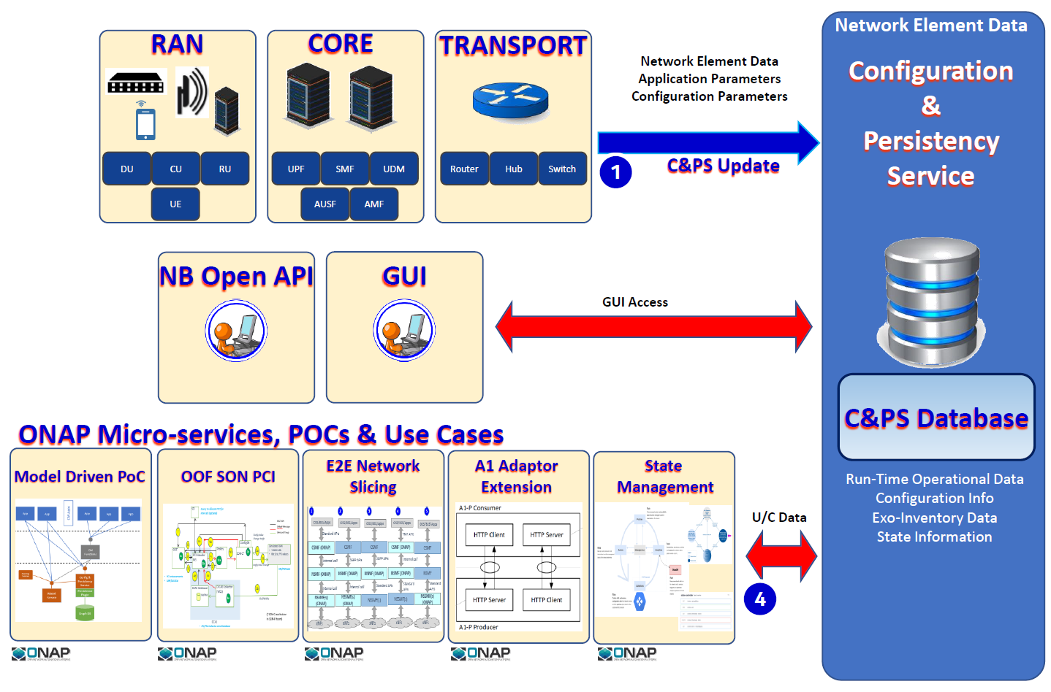
Configuration Persistence Service in R8
Multiple vendors providing equipment / xNF
Several telecom networks one ONAP platform
Evolution of xNF and network standards
ONAP applications and use cases competing for access to the same CM data

Slide 6

Configuration Persistence Service in R8
Shared data analogy of a teacher sharing knowledge with students

Slide 7
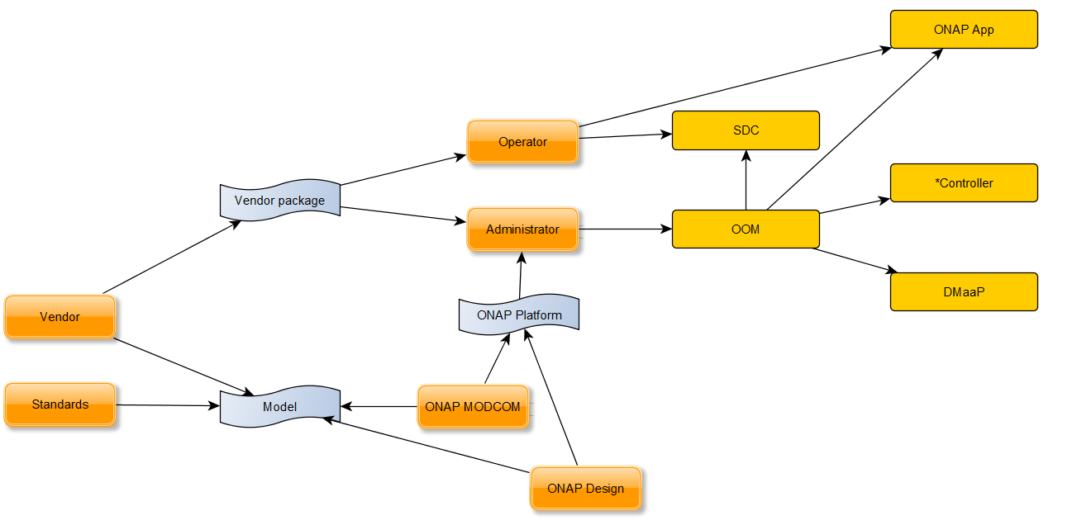
Configuration Persistence Service in R8
Model ingestion during ONAP design & run time

Slide 8
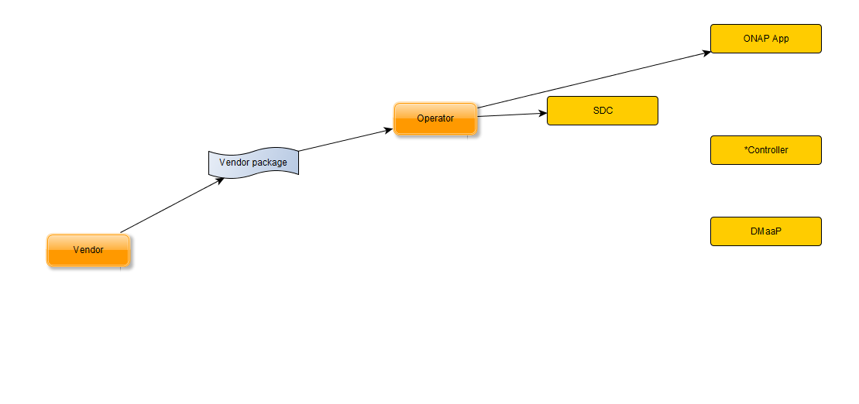
Configuration Persistence Service in R8
Model ingestion with C&PS solution (Run-time)

Slide 9
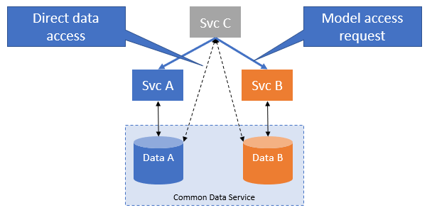
Configuration Persistence Service in R8
Permission & Ownership of data

Slide 10
Configuration Persistence Service in R8
ONAP
CPS Project
CPS
xNF Proxy
O1 compliant entity

Slide 11




Overview for
Configuration Persistence Service (CPS)
Business Case
Architecture S/C
Overview
Technical Flows

Slide 12
Configuration Persistence Service in R8
Executive Summary - The Configuration Persistence Service (CPS) is a real-time service that is designed to serve as a data repository for Run-time Network Element (configuration) data that needs to be persistent applicable to multiple domain (RAN, Transport, and Core). This was explored as a R7 PoC. Focus on storing run-time DATA RELATED to NETWORK ELEMENT instances. In R8, this is being proposed as a stand-alone project.
Business Impact - The ability for service operators to visualize and manage network element data in a network (PNFs, VNFs, and logical constructs) with ONAP is a critical business function because they are key Life Cycle Management (LCM) and OA&M operations. The project has business impacts to enhance the operation of data-handling within ONAP by providing efficient data layer services.
Business Markets - This project applies to any domain (wireless, transport, optical, and wireline) that ONAP may manage. It is not a market or geographical specific capability. It is expected that scaled ONAP installations such as Edge & Core ONAP deployments will also deploy the database across each installation.
Funding/Financial Impacts - This project represents a large potential Operating Expense (OPEX) savings for operators because of the ability to configure networks saving time and expenses.

Slide 13
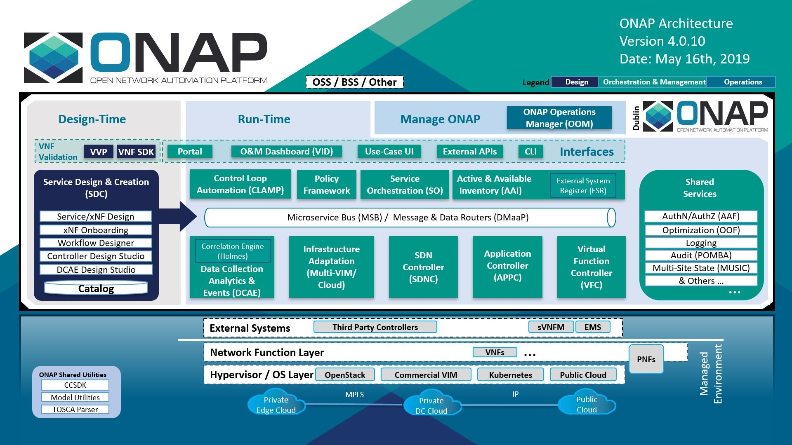

CPS in Architecture Context
Configuration
Persistence Service

Slide 14
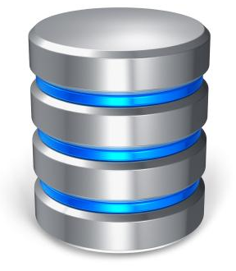

Configuration Persistence Service (CPS)
Configuration
Persistence
Service
Network Element Data
1
Micro-Services & Use Cases
Read/Write
2
Configuration Information
DU/PNF
CU/VNF
CPS Update
Standards Defined VES Event
CPS Database
3
Controller
DU/PNF
CU/VNF
Read/Write
NETWORK ELEMENT DATA
4
Active & Available Inventory (A&AI)
A&AI Sync

Slide 15
Configuration Persistence Service (CPS)
Management Framework Data
Network Element Data
ONAP
RUN-TIME
Configuration
Persistence
Service
DMaaP
Policy DB
1
DCAE Inventory
PNF
VNF
VES
Event
Configuration NameSpace topic
3GPP-Provisioning
DCAE VES
Collector
DCAE
CPS Update
Standards Defined
VES Event
for Configuration
2
SO
SO
DU/PNF
CU/VNF
Service Orchestration
Read
PNF
VNF
Netconf
O1
Controller DB
Controller
APP-C, SDN-C
Read/Write
CPS Database
SDN-C, VF-C, APP-C
CM Notification
Change Config
A&AI DB
Run-Time Operational Data
Configuration Info
Exo-Inventory Data
State Information
(Yang modeled)
DU/PNF
3
A&AI
CU/VNF
A&AI Sync
Real-Time Inventory
Network Element Data
4
U/C DB
Micro-Service
Read/Write
PCI, E2ENS, A1P, MD PoC

Slide 16



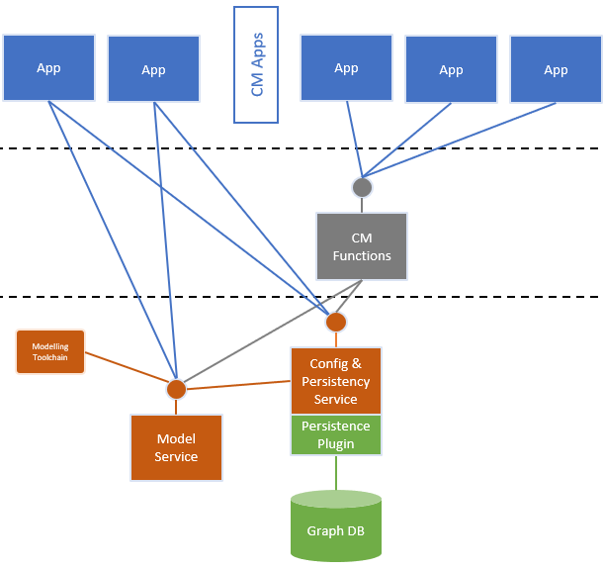
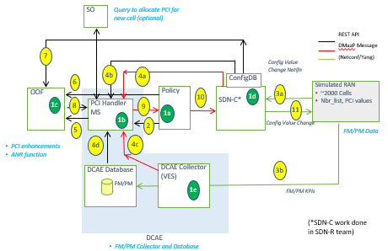
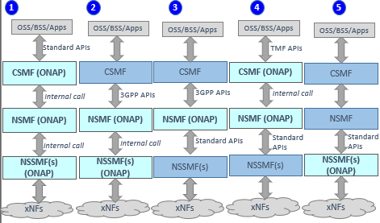
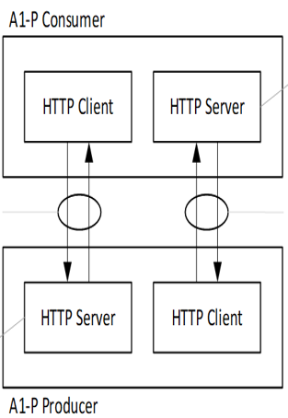
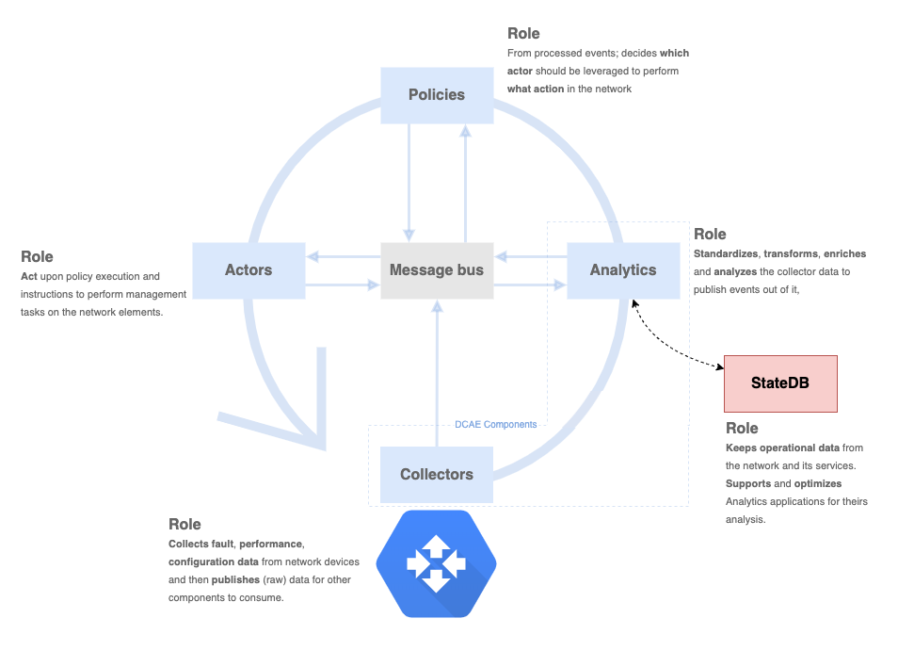
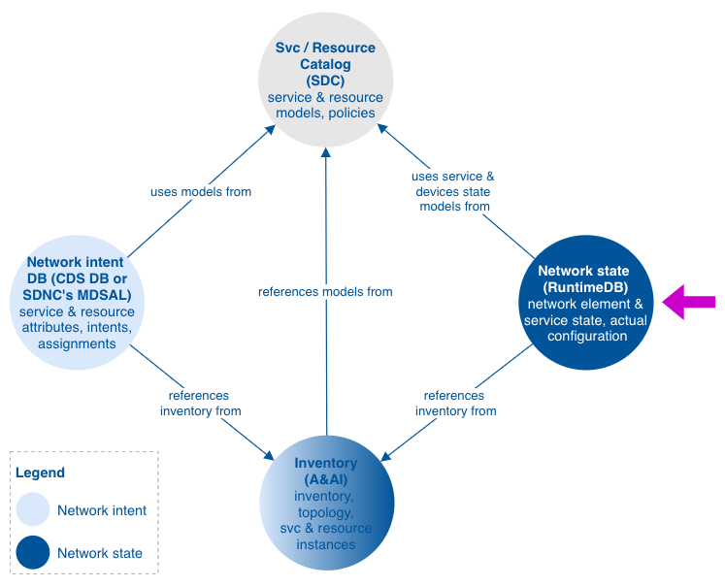
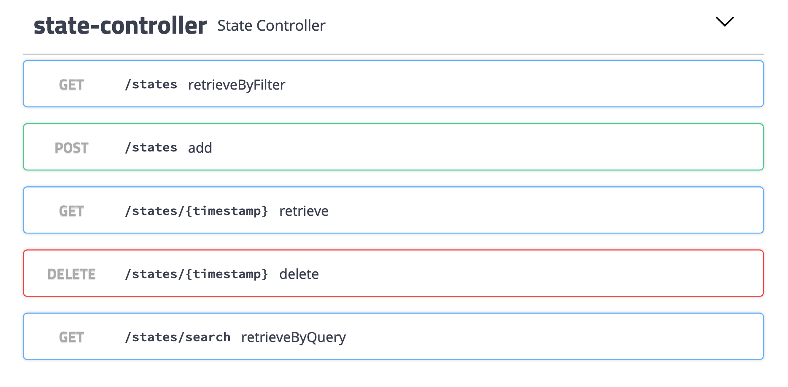
Configuration Persistence Service (CPS)
RAN
CORE
TRANSPORT
Network Element Data
Network Element Data
Application Parameters
Configuration Parameters
Configuration
Persistence
Service
DU
CU
RU
UPF
SMF
UDM
Router
Hub
Switch
1
CPS Update
UE
AUSF
AMF
NB Open API
GUI
GUI Access
CPS Database
ONAP Micro-services, POCs & Use Cases
Model Driven PoC
OOF SON PCI
E2E Network
Slicing
A1 Adaptor
Extension
State
Management
Run-Time Operational Data
Configuration Info
Exo-Inventory Data
State Information
U/C Data
4

Slide 17
CPS READING: PNF Reports Configuration
ONAP
RUN-TIME
Configuration
Persistence Service
DMaaP
DU/PNF
CU/VNF
1
DCAE Inventory
VES
Event
Configuration NameSpace topic
3GPP-Provisioning
PNF
VNF
DCAE VES
Collector
DCAE
Analytics
CPS Update
Standards Defined
VES Event
for Configuration
The PNF has a parameter update
to report. The update originates from the PNF and is reported through a Standards Defined VES event with a configuration NameSpace (3GPP-Provisioning)
Standards Defined VES Event is received by the DCAE VES Collector. DCAE publishes the VES Event onto the DMaaP Bus.
In R8+: CPS as a stand-alone component, subscribes to the DMaaP Topic and gets the DMaaP event from the DMaaP bus to update the internal database. The VES event has a Configuration namespace topic, 3GPP-Provisioning
CPS Database
Run-Time Operational Data
Configuration Info
Exo-Inventory Data
RT Logical & Physical Connections

Slide 18
A&AI Synchronization
ONAP
RUN-TIME
Configuration
Persistence
Service
DMaaP
(1) During Network setup “getall” retrieves from A&AI the ENTIRE A&AI graph. Used to setup the initial view of CPS
(2) Updates additions/deletions of xNFs. “AAI-Event” (operation
Addition / delete)
In R8+: CPSDB is a stand-alone component. Performs “getall” A&AI update and atomic A&AI update. Atomic “updates” from A&AI add/remove of xNF is published by A&AI as an update on DMaaP bus
CPS Database
Run-Time Operational Data
Configuration Info
Exo-Inventory Data
RT Logical & Physical Connections
3
A&AI
A&AI Sync
A&AI DB
Inventory, Listener

Slide 19
CPS WRITING: Micro Service Update
ONAP
RUN-TIME
Configuration
Persistence
Service
DMaaP
A Micro-Service, for example OOF/SON/PCI determines that an update is needed to CPSDB from operation/algorithm. It publishes to the DMaaP bus an update event.
In R8+: CPSDB is a stand-alone component. CPSDB subscribes to the DMaaP topic and gets the DMaaP event off the DMaaP bus to update itself.
CPS Database
Run-Time Operational Data
Configuration Info
Exo-Inventory Data
RT Logical & Physical Connections
4
Micro Service
Read/(Write)
OOF/SON/PCI

Slide 20
CPS WRITING: From Controller SDN-C
ONAP
RUN-TIME
Configuration
Persistence
Service
DMaaP
A
SO, Policy, or Control Loop has determined a parameter update is needed to the xNF. The Controller (SDN-C) eventually gets the configuration update. SDN-C publishes to the DMaaP bus a configuration update event.
E
R8+ The configuration & standards service as a stand-alone component subscribes to the DMaaP topic and gets the DMaaP event off the DMaaP bus to update the internal database. A configuration namespace topic is used, 3GPP-Provisioning
The Controller (SDN-C) also sends a message to the xNF to update the parameter. This may be done via NetConf/O1/Ansible
B
2
DU/PNF
CU/VNF
Controller DB
PNF
VNF
Netconf
O1
Controller
CPS Database
APP-C, SDN-C
Read/Write
SDN-C, VF-C, APP-C
Configuration NameSpace topic
3GPP-Provisioning
CM Notification
Change Config
Run-Time Operational Data
Configuration Info
Exo-Inventory Data
RT Logical & Physical Connections
D
xNF would may send a Standards Defined VES unless xNF configured to suppress event on ONAP origination
C
Controller (SDN-C) gets an ACK back from the xNF that the parameter change was successful.

Slide 21

A&AI vs CPS
Concepts – A&AI conceptually stores Real-time inventory view of connected and “topology” of xNFs that ONAP sees. CPS stores Network Element Data. A&AI and CPS overlaps because they both need to know about Network Element objects so that can managed & orchestrated.
A&AI
CPS
Real-time Inventory
Network Topology
Run-Time Operational Data
Configuration Info
Exo-Inventory Data
RT Connections
Network Element Data
PNF
VNF
Network Element Objects
PNF
VNF
CPS Records

Slide 22

R7 Model Driven Proof of Concept for
Configuration Persistence Service (CPS)
Proof of Concept

Slide 23
R7 Model Driven CPS PoC
Proof Points for PoC
Demonstrate write/read operations for YANG data fragments using CPS and store them in a DB with a very simple generic schema
Demonstrate ability to deploy / upgrade YANG models at run-time
Demonstrate CPS behavior driven by YANG model
Provide architecture vision and roadmap for a target architecture, supported use cases, non-functional requirements towards an ONAP Project
Notes:
PoC, so what do we want to proof….

Slide 24

R7 Model Driven CPS PoC
Use case
Component
Work required
DMaaP
DMaaP
3GPP-Configuration
(NameSpace)
CSAR
R7: Model Deployed
(Base Scope)
2
DCAE
Model Driven
Schema
Update
SDC
1
R7: Select YANG model
(Stretch Goal)
R7: A&AI Stretch Goal
Configuration Persistence Service
R7: Read/Write Data
(Base Scope)
StndDef
VES ++
3
Synchronization
Service
Provider
Interface
4
PNF
A&AI information
to uniquely identify a xNF
5
CPS API
R7: Temporal DB Stretch
A&AI
OOF/SON/PCI
DBMS
Temporal DB
CRUD
E2E Network Slicing
A1 Extension, policies
Mirroring
xNF Configuration Data
Notes:
Scope of CPS, interaction with other components like SDC, DmaaP
Use cases it can eventually support Like synhcronization with A&AI

Slide 25
R7 Model Driven CPS PoC
Use case
Component
Work required
DMaaP
DMaaP
3GPP-Configuration
(NameSpace)
CSAR
R7: Model Deployed
(Base Scope)
2
DCAE
Model Driven
Schema
Update
SDC
1
R7: Select YANG model
(Stretch Goal)
R7: A&AI Stretch Goal
Configuration Persistence Service
R7: Read/Write Data
(Base Scope)
StndDef
VES ++
3
Synchronization
Service
Provider
Interface
4
PNF
A&AI information
to uniquely identify a xNF
5
CPS API
R7: Temporal DB Stretch
A&AI
OOF/SON/PCI
DBMS
Temporal DB
CRUD
E2E Network Slicing
A1 Extension, policies
Mirroring
xNF Configuration Data
Notes:
Scope of the PoC or what we have achieved so far
SPI and implementation for datalayer (model driven)
REST API being developed with use cases in mind
Prepared for Upgrade scenario but require some work still

Slide 26
R7 Model Driven CPS PoC
Community Involvement & Resourcing
Weekly ONAP meeting hosted by Ben Cheung (Nokia)
PoC discussed with and approved by TSC
ONAP R8 Honolulu Project proposal accepted
  Use Cases & requirements : Configuration Persistence Service (CPS)
CPS presentations in many fora, O-Ran PlugFest, LFN Design Developer Forum (DDF) etc.
Resourcing
  Ericsson 3 full-time developers
  Bell Canada 3 part-time developers
Jira backlog, team ceremonies like scrums etc. established
  Developers Landing Page

Slide 27
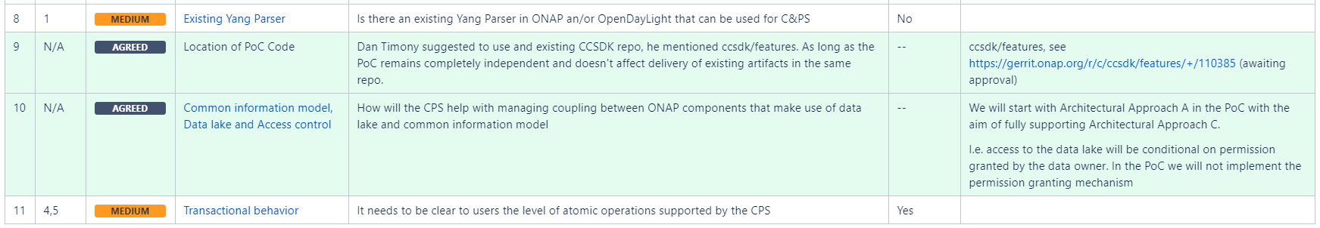
R7 Model Driven CPS PoC
PoC Ways of Working
Base : N/A (new code)
Main dependency : ODL Yang Tools 5.x (probably)
https://javadoc.io/doc/org.opendaylight.yangtools
Design and Architecture discussions ongoing
https://wiki.onap.org/display/DW/Issues+decisions+and+assumptions
Notes:
Example of how we work on Friday
Major architecture decisions etc.

Slide 28
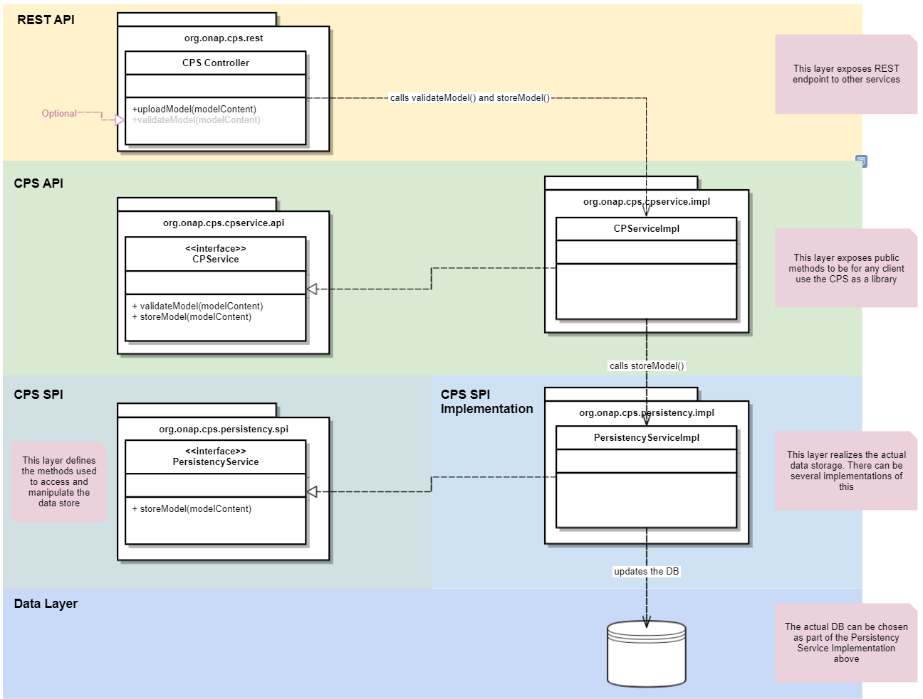
R7 Model Driven CPS PoC
Architecture designed & implemented
Pluggable SPI Implementation (DB Layer)
Notes:
Architecture in place and demo includes some E2E vertical slice interactions

Slide 29
R7 Model Driven CPS PoC
Implementation Status
PoC being developed on Nordix Branch to avoid impacts on production code in CCSDK Repo
Project structure set up completed
  Following ONAP standards and conventions
  Production code Quality (SonarQube & Checkstyle)
ODL Yang Tools integrated
  Parsing of Yang models
  Parsing of Yang data, JSON or XML with validation for given Yang model
First E2E iteration of 2 use cases completed
  Upload & Validate Yang Model (part of proof point 2)
  Upload JSON Data Object (part of proof point 1

Slide 30
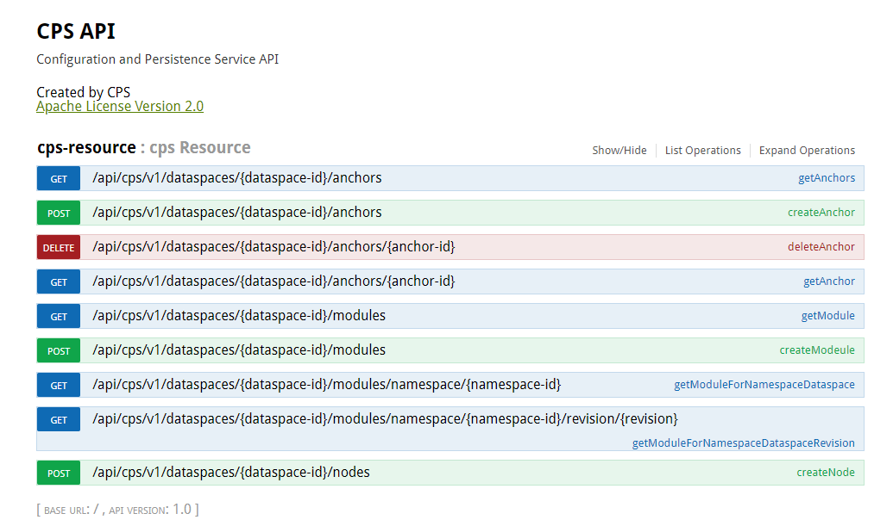
R7 Model Driven CPS PoC
REST API Proposal
Notes:
Future REST API structure being proposed (still under discussion)

Slide 31
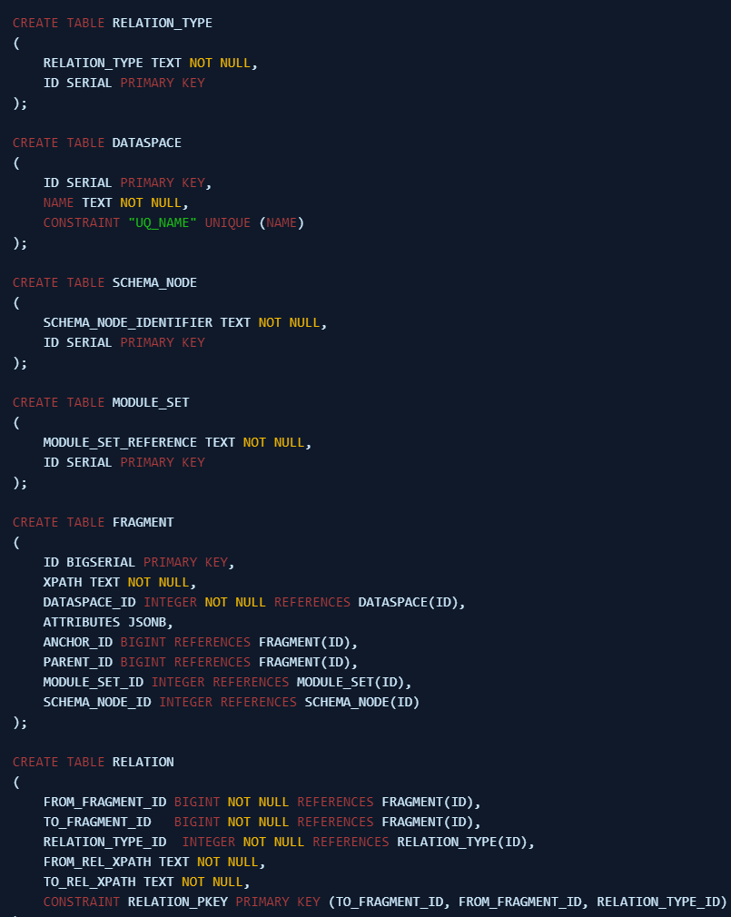
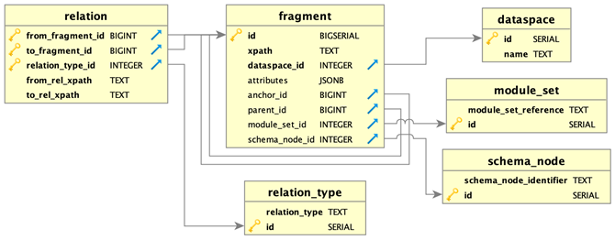
R7 Model Driven CPS PoC
Generic Schema Design Finalized
Can store any modelled data
Portable, can easily be adapted to any DB technology

Slide 32
Early Performance Indicators (DB)
(proof point 4)
R7 Model Driven CPS PoC
Insert
  450 records/sec (up to 2M records)
Queries
  XPath Query (while loading new data) < 100ms
  Tree-Walk (75K objects) count with condition < 1,000ms
Delete
  Delete Tree of 75K objects incl. constraint checks ~ 6 sec

Slide 33
Demos
R7 Model Driven CPS PoC
JSON Data
  Upload valid JSON, store in DB
  Handle invalid JSON
Yang Model File (modules)
  Valid model file, store in DB
  Handle invalid model
Split JSON data for given model
  Split into ‘fragments’ ready for generic DB
  Handle model change

Slide 34
R7 Model Driven CPS PoC
TOPIC | PoC RESULTS
SEED CODE | Seed Code to serve as a basis for CPS has been developed
PROOF POINTS | Create/read CRUD operations using YANG fragments using a simple schema or schema-less repository Deploy & upgrade YANG model fragments at run-time Validate based on YANG Constraints Provide architecture vision and roadmap for a target architecture.
ARCHITECTURE AGREEMENTS | Resolve key architectural Issues necessary for CPS as a stand-alone project
CPS CORE FUNCTIONALITY | Can demonstrate some key CPS operations; basic E2E & integration of Yang parser
PERFORMANCE LIMITS | Early performance indicators tested using generic schema with json-blob storage for attributes

Slide 35




Roadmap for
Configuration Persistence Service (CPS)
Roadmap

Slide 36

CPS Roadmap & R6-R8 Plan
Configuration Persistence Service (CPS) Roadmap –
R6 Frankfurt
R7 Guilin
R8 Honolulu
CPS 1.0
R6 CPS
CC-SDK/SDN-C solution
Evolution of “ConfigDB”
Supporting R6 Use Cases:
SON/OOF/PCI U/C
CPS 1.1
R6 CPS Extensions
Evolution of CC-SDK/SDN-C solution REQ322
Supporting R7 Use Cases:
SON/OOF/PCI U/C
5G E2E Network Slicing
A1 Policy extension (Ericsson)
Model-Driven PoC
Write “base” CPS
Write NE Data
Read NE Data
Access Control
State Management PoC
State Management PoC (BellCA) self-contained
CPS 2.0
R8 CPS stand-alone project proposal
Deprecate CPS 1.0 & 1.1
Project proposals TSC/Architecture S/C
Setup Project Repo
CPS FUNCTIONALITY:
Data Recovery
Model Adaption (Dynamic Schema)
June 2021
June 5, 2020
December, 2020
Legend:
RED text is CC-SDK/SDN-C solution
BLUE text is the PoC & stand-alone project

Slide 37
CPS Roadmap & R8-R10 Plan
Configuration Persistence Service (CPS) Roadmap –
R8 Honolulu
R9 Istanbul
R10 Kyoto
CPS 2.0
R8 CPS stand-alone project proposal
Deprecate CPS 1.0 & 1.1
Project proposals TSC/Architecture S/C
Setup Project Repo
CPS FUNCTIONALITY:
Data Recovery
Model Adaption (Dynamic Schema)
Rx (future) development
CPS FUNCTIONALITY:
Data Auditing Model driven
Topology Traversal
Data Syncing
Rx (future) development
CPS FUNCTIONALITY:
Data Auditing Rules Driven
Data History
Roll-Back
Database Backup
Performance Optimization (Scaling)
June 2021
June 2021
December 2021
Legend:
RED text is CC-SDK/SDN-C solution
BLUE text is the PoC & stand-alone project

Slide 38
State Management Use Case for
Configuration Persistence Service (CPS) in R8
Use Cases

Slide 39
State Management PoC (Bell Canada)

Slide 40
State Management PoC (Bell Canada)

Slide 41
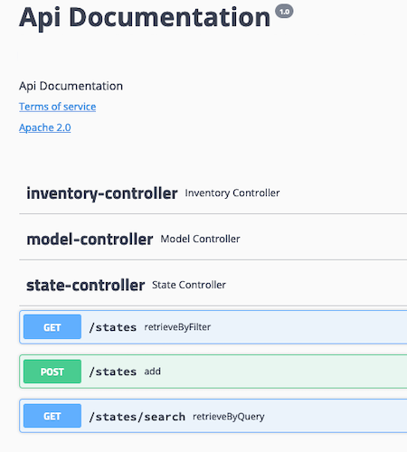
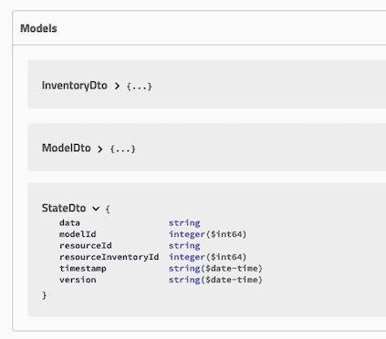
State Management PoC (Bell Canada)

Slide 42
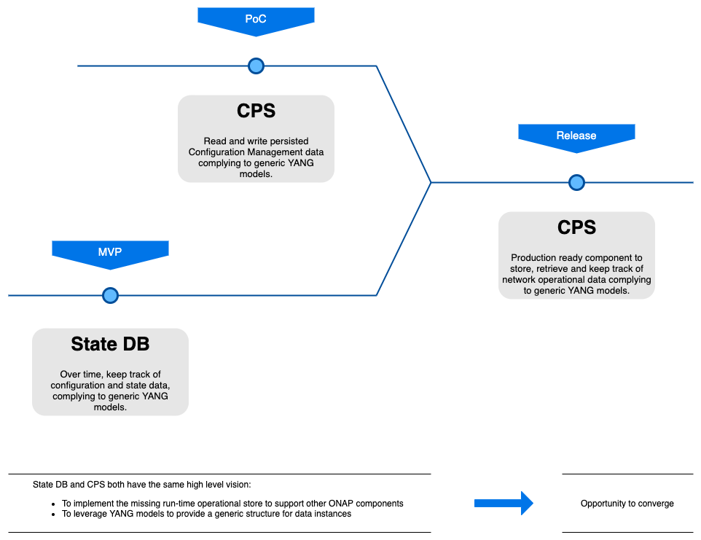
State Management PoC (Bell Canada)

Slide 43
Use Cases for
Configuration Persistence Service (CPS)
Use Cases
Proof of Concept

Slide 44
CPS Use Cases and Proof of Concepts in R8
5G USE CASE | DESCRIPTION
STATE MANAGEMENT POC | Bell Canada led PoC for State tracking and State management using CPS Integration with CPS (as a platform). Have the State management S/W now work with CPS using available swaggers/APIs
OOF - SON (5G) | Optimization and SON functions for 5G RAN. Self-optimization, Self-Healing, Self-configuration.
NETWORK SLICING (5G Use Case) | Network Slicing defines Slices for 5G RAN systems. Network Slicing is a long-lead (multi-release) development. (will be presented in its own lecture at the Virtual Face to Face)
MOBILITY STANDARDS HARMONIZATION/ A1 adapter | A1 adapter: Enhancing the A1 adapter/interface capabilities in ONAP to manage A1 Policies, support multiple A1 targets in the RAN and multi-version A1 interface for different A1 targets, introduce secure TLS communication.

Slide 45
OOF / SON / PCI Use Case
SO
Query to allocate PCI for new cell (optional)
REST API
7
DMaaP Message
Config Value
Change Notifn
(Netconf/Yang)
4b
4a
6
ConfigDB
Policy
SDN-C*
3a
Simulated RAN
~2000 Cells
Nbr_list, PCI values
OOF
DCAE
10
1d
1c
8
PCI Handler MS
9
11
1a
1b
2
5
Config Value Change
FM/PM Data
4d
4c
PCI enhancements
ANR function
DCAE
DCAE Database
DCAE Collector
(VES)
3b
FM/PM
1e
FM/PM KPIs
(*SDN-C work done
in SDN-R team)
FM/PM Collector and Database

Slide 46
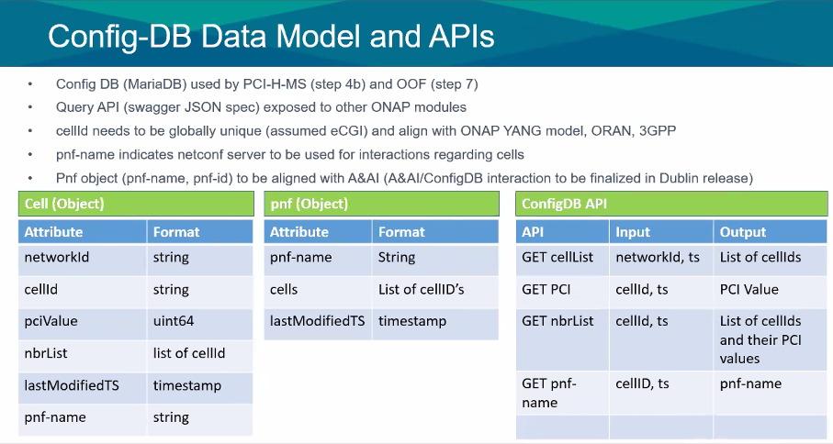
OOF / SON / PCI Use Case

Slide 47
End to End Network Slicing Use Case
1
2
3
4
5
OSS/BSS/Apps
OSS/BSS/Apps
OSS/BSS/Apps
OSS/BSS/Apps
OSS/BSS/Apps
Standard APIs
TMF APIs
CSMF (ONAP)
CSMF
CSMF
CSMF (ONAP)
CSMF
Internal call
3GPP APIs
3GPP APIs
Internal call
NSMF (ONAP)
NSMF (ONAP)
NSMF (ONAP)
NSMF (ONAP)
NSMF
Standard APIs
Standard APIs
Standard APIs
Internal call
Internal call
NSSMF(s)
(ONAP)
NSSMF(s)
(ONAP)
NSSMF(s)
NSSMF(s)
NSSMF(s)
(ONAP)
xNFs
xNFs
xNFs
xNFs
xNFs
3rd party component

Slide 48
End to End Network Slicing Use Case
NetworkSlice | Network Slice NRM | operationalState
NetworkSlice | Network Slice NRM | administrativeState
NetworkSlice | Network Slice NRM | serviceProfileList
NetworkSlice | Network Slice NRM | networkSliceSubnetRef
NetworkSliceSubnet | Network Slice NRM | operationalState
NetworkSliceSubnet | Network Slice NRM | administrativeState
NetworkSliceSubnet | Network Slice NRM | nsInfo
NetworkSliceSubnet | Network Slice NRM | sliceProfileList
NetworkSliceSubnet | Network Slice NRM | managedFunctionRef
NetworkSliceSubnet | Network Slice NRM | networkSliceSubnetRef
ServiceProfile | Network Slice NRM | serviceProfileId
ServiceProfile | Network Slice NRM | sNSSAIList
ServiceProfile | Network Slice NRM | pLMNIdList
ServiceProfile | Network Slice NRM | perfReq
ServiceProfile | Network Slice NRM | maxNumberofUEs
ServiceProfile | Network Slice NRM | coverageAreaTAList
ServiceProfile | Network Slice NRM | latency
ServiceProfile | Network Slice NRM | uEMobilityLevel
ServiceProfile | Network Slice NRM | resourceSharingLevel
ServiceProfile | Network Slice NRM | sST
ServiceProfile | Network Slice NRM | availability
SliceProfile | Network Slice NRM | sliceProfileId
SliceProfile | Network Slice NRM | sNSSAIList
SliceProfile | Network Slice NRM | pLMNIdList
SliceProfile | Network Slice NRM | perfReq
SliceProfile | Network Slice NRM | maxNumberofUEs
SliceProfile | Network Slice NRM | coverageAreaTAList
SliceProfile | Network Slice NRM | latency
SliceProfile | Network Slice NRM | uEMobilityLevel
SliceProfile | Network Slice NRM | resourceSharingLevel

Slide 49
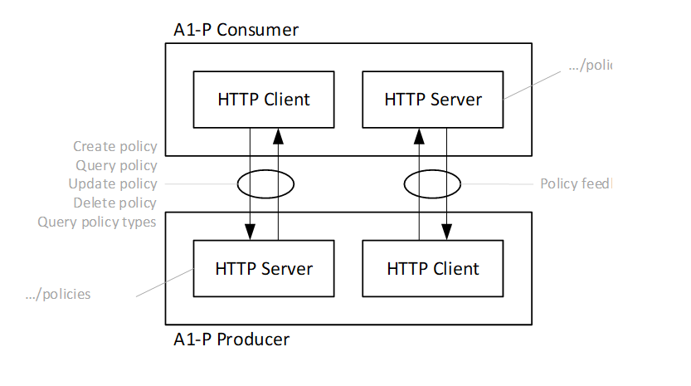
A1 Policy Extension ORAN-ONAP Harmonize
Executive Summary - This requirement enhances the A1 adapter/interface capabilities provided in Rel 6 as part of 5G/ORAN & 3GPP Standards Harmonization requirement ( REQ-38). O-RAN has defined A1 interface specification in the context of the management of 5G RAN elements to provide intent based policies for optimization of the RAN network performance. Planned enhancements for Rel 7 include additional support for managing A1 Policies, multiple A1 targets in the RAN, multi-version support for different A1 targets, and secure TLS communication.

Slide 50

Appendix
Benjamin Cheung

Slide 51
Access, Syncing, Indexing Runtime Config DB
ACCESS TO CPS Database (READ/WRITE):
READ ONLY - Run-Time parameters can be READ by any ONAP platform component and any ONAP plug-in. Examples of ONAP platform components are A&AI, SDC, SDNC etc.
READ/WRITE - Parameters can be READ/WRITE from Controllers, DCAE (future), VES Collector/DMaaP, A&AI, Policy/CLAMP (future) and other components with permission settings.
DEFAULT - SO (future), DCAE, A&AI (indirectly), Controllers (CDS, APPC, SDNC) will have default read/write access to CPS Database
DEFINABLE - Other components will have default read-only access to Configuration Persistence Service but can be given Read/Write access on a per record basis.
SYNCING NEW xNF ADDED or DELETED (A&AI):
ELEMENT SYNC - Software keeps the A&AI elements with the elements in the RunTime Config DB in Sync. When the network first being established, a GetAllPNFs function from A&AI can be used on startup.
A&AI - A&AI is still the master of valid entities in the network and provides a dynamic view of the assets (xNFs) available to ONAP
CPS Database - The CPS Database is a master of the associate (exo-inventory) data associated with the entities.
DYNAMIC VIEW - When a xNF appears or is removed from the system, CPS Database records will be added/removed based on A&AI entries.
LOGIC - When a xNF appears is removed there is logic to determine how and when something is to be updated. There is some intelligence to know what elements of update.
INDEXING:
INDEXING - Data Records will be indexed by xNF (VNF, PNF, ANF). It would be an objective to have a similar indexing mechanism as A&AI. May also need an index to be a logical object ID.
RETRIEVAL - How are data records retrieved efficiently. This relates how the records are indexed.

Slide 52
Dependencies vs Scope
DEPENDENCIES – need to operate
SCOPE
SDC Yang Model (to load schema)
ability to process & translate yang models into schemas
AAF (intra-ONAP security)
Database implementation for Data Persistence
(for example MariaDB)
CPS
Database
DEPENDENCIES – value added
DMaaP (some use cases to work / indirect dependency)
RECEIVE INFORMATION
WRITE INFORMATION
PUBLISH CHANGES
REFERENTIAL INTEGRITY
INGEST PACKAGES
LOGICAL OBJECTS
ASSOCIATIONS
CARDINALITY RULES
LINKING RESTRICTIONS
SYNCHRONIZATION
DATA INTEGRITY & RECOVERY

Slide 53
Configuration Persistence Service (Run-Time)
VES
Event
DCAE VES
Collector
DCAE
PNF
Analytics
PNF #106
RunTimeDB
Controller
APP-C, SDN-C
Read/Write
RECORD ELEMENT
Temperature = 98
- Source of Truth,
- “Access”,
- TAG = xNF association,
Platform ONAP
(App-C, ms#10105)
(for PNF #106)
or Flex-Index
SDN-R, VF-C, APP-C
Other Module
Read
OOF/SON/PCI
PNF #106

Slide 54
PNF #101
PNF #102
PNF #103
A&AI
PNF #101
PNF #104
PNF #102
PNF #103
PNF #104
PNF #101
PNF #102
PNF #103
CPS DB
PNF #104
A&AI correlated/Index to RunTimeDB
Publish changes in A&AI, notification on DMaaP
Indices into Configuration Persistence Service may also use Flex-Index (such as CellID)

Slide 55
CPS Database (Run-Time View)
Cell #1 – Logical Object
PNF #106
Cell #2
Cell #3
CPS Database
RECORD ELEMENT
INDEX = PNF #106
Parameter #1
Parameter #2
Parameter #3
State Info X.733
Associations
{ Logical Object #111 Cell #2 }
Cardinality Rules
Linking Restrictions
RECORD ELEMENT
INDEX = Logical Object #111
Parameter #1
Parameter #2
Parameter #3
State Info
Associations
{ PNF #106 }
Cardinality Rules
Linking Restrictions
RECORD ELEMENT
INDEX = PNF #106
Parameter #1
Parameter #2
Parameter #3
Logical object, Cell #1
Cell Parameter #1
Cell Parameter #2
Cell Parameter #3

Slide 56
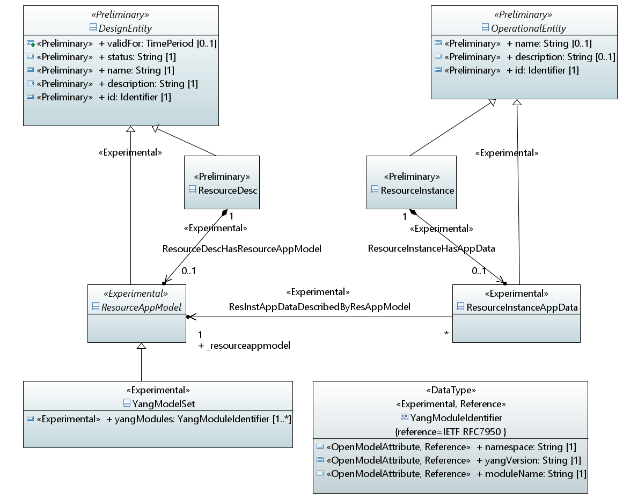
CPS Information Model Design R7
1=Take Model “As Is”
0= Optional

Slide 57
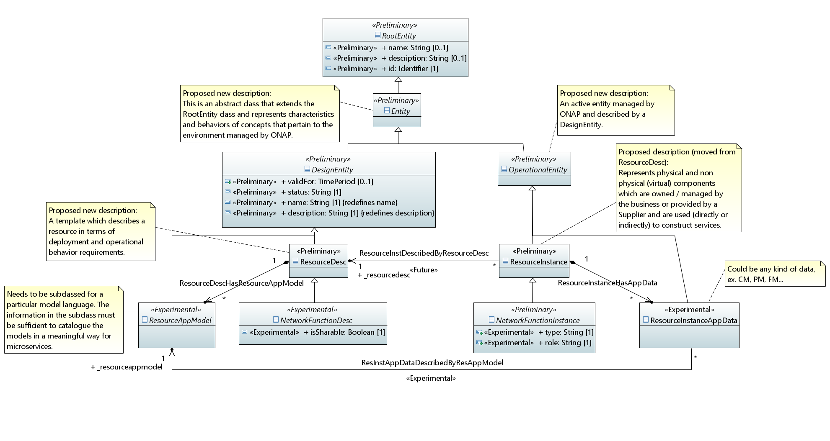
CPS Information Model Design R8

