Slide 1
BBS-Broadband Service
Use case proposal for Dublin release
Contributors: Swisscom, Huawei, Nokia, others are welcome

Slide 2
Summary: BBS (Broadband Service)
Use case Proposal for the Dublin release
Swisscom, Huawei, and Nokia would like to propose the “BBS use case” as a collaboration use case project for the Dublin release
The use case proposes using ONAP for the design, provisioning, lifecycle management and assurance of broadband services.
In a first step, multi-Gigabit Internet Connectivity services based on PON (Passive Optical Network) access technology will be considered.
It covers new scenarios, such as nomadic ONT and subscription plan changes.
It leverages on BBF (Broadband Forum) specifications*.
This use case shows the extensibility of the ONAP platform in supporting the orchestration of Services in many different technology Domains. We believe that this use case will cover several different ONAP components and may also introduce some new platform capabilities:
  A. Nomadic ONT devices
    PNF (Re-)Registration
    Service reconfiguration / service continuity
  B. Subscription plan change
    External API
  C. Data Collection, Analytics and Close-Loop
    Including custom Data collectors and Analytics Microservices
Nomadic ONT
ONAP provisions Broadband Internet Access Service
Customer moves to a new location without notifying the service provider
ONAP re-registers ONT (PNF) in a new location and re-provisions/reconfigures customer service
Gigabit Broadband Internet Access Service
1
Metro A
Other services
RG/ONT
CO X
BNG1
Backbone
Internet
PNF
Gigabit Broadband Internet Access Service
Internet peering
2
BNG2
Metro B
3
RG/ONT
CO Y
PNF
Subscription plan change
ONAP provisions 1Gbps Broadband Internet Access Service
Customer upgrades subscription plan to 10Gbps using customer portal
BSS requests ONAP to change the service for a given customer
ONAP reconfigures customer service to 10Gbps
Metro A
Other services
CO X
BNG1
Backbone
Internet
Gigabit Broadband Internet Access Service
Internet peering
BNG2
Metro B
1
2
RG/ONT
CO Y
(*) https://wiki.broadband-forum.org/pages/viewpage.action?pageId=52265462
3
4
PNF

Slide 3
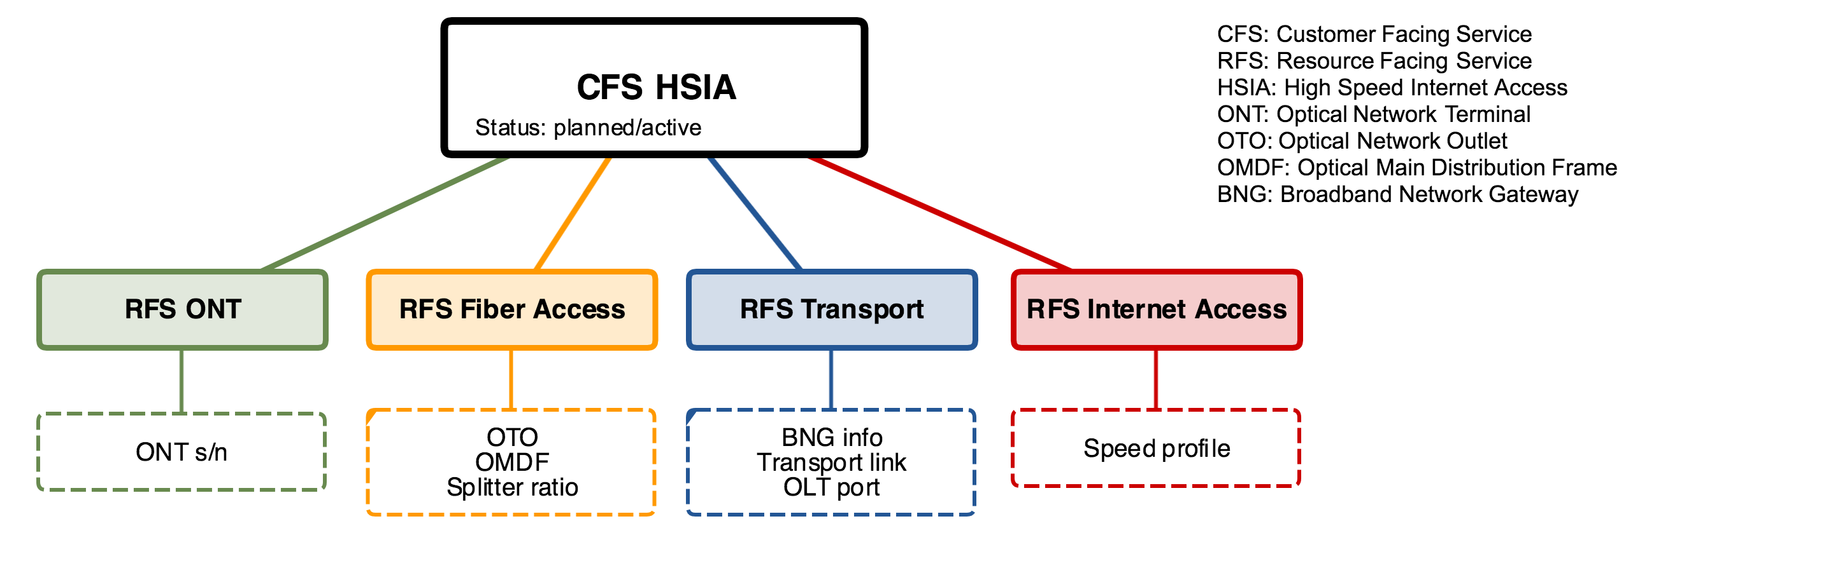
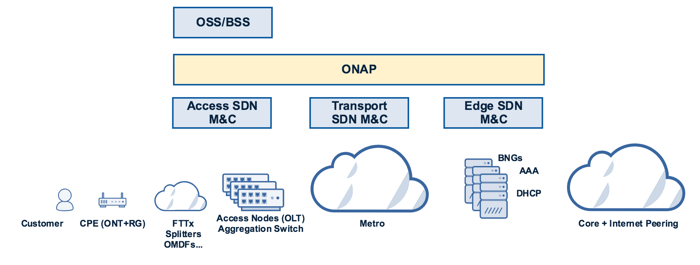
ONAP BBS. E2E CFS Onboarding & Service Design
Discovery

Slide 4
ONAP BBS. CFS Service Ordering and Provisioning
1
Customer orders HSIA
using customer portal
0
CFS HSIA in SDC catalog
6
CFS ready
2
BSS sends CFS order request
3
ONAP creates CFS and waits for ONT registration
4
ONAP orchestrates CFS
5
CFS HSIA provisioned
HSIA

Slide 5
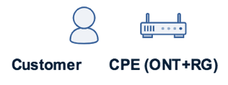
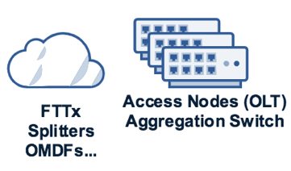
ONAP BBS. Nomadic ONT and Service Reconfiguration
6
Customer moved
Service reconfiguration
3
3
ONAP creates CFS and waits for ONT registration
4
Detect ONT move
5
CFS HSIA provisioned
2
HSIA
HSIA
1
Customer moves to new location and plugs CPE
4
Service
Re-provisioned

Slide 6
ONAP BBS. HSIA Service Subscription Plan Change
1
Customer orders bandwidth upgrade
using customer portal
5
Order ready
2
BSS sends CFS modification request
3
ONAP updates RFS Internet Access
4
CFS HSIA upgraded
HSIA 1Gbps
HSIA 10Gbps

Slide 7
Thank you!
Use case wiki: https://wiki.onap.org/pages/viewpage.action?pageId=45297636
Contact persons:
David Pérez Caparrós <david.perezcaparros@swisscom.com>
Chaker Al Hakim <chaker.al.hakim@huawei.com>
Tim Carey <timothy.carey@nokia.com>

