Slide 1

SDC enhancement - CCVPN
Support Design of List Inputs in Service Template

Slide 2
Background
In Casablanca release,
  The CCVPN service consisted of 3 abstracted nodes: Site, SOTN infra, SD-WAN infra.
  The current SDC is not support multiple sets of inputs in one service template.
Goal of Dublin release
  The CCVPN service should be able to design in one template.
  Service template should support multiple instances inputs, so we can design all resources into one service
List type input will be rational solution.
https://wiki.onap.org/display/DW/CCVPN+DM+Requirement

Slide 3
CCVPN Service Example
CCVPN Service Example
VPN[0].sdwanvpn_topology
VPN[0].sdwanvpn_name
VPN[0].sdwansitelan_list
This inputs are given in the Run-time.
VPN[0]
Inputs
Inputs Example
Sdwanvpnresource
[type=list]
sdwansiteresource
[type=list]
sdwanvpnresource_list:
-[0].sdwanvpn_topology
-[0].sdwanvpn_name
-[0].sdwansitelan_list
Site[0]
Site[1]
Site[2]
…
sdwansiteresouce_list:
- [0].sdwansite_***=
.sdwansitewan_list=
.sdwandevice_list=
- [1] .sdwansite_***=
.sdwansitewan_list=
.sdwandevice_list=
- [2].sdwansite_***=
.sdwansitewan_list=
.sdwandevice_list=
Site[0]. Sdwansite_***
Site[0]. sdwansitewan_list
Site[0]. Sdwandevice_list
Site[1]. Sdwansite_***
Site[1]. sdwansitewan_list
Site[1]. Sdwandevice_list
Site[2]. Sdwansite_***
Site[2]. sdwansitewan_list
Site[2]. Sdwandevice_list

Slide 4
TOSCA Service Template Sample
tosca_definitions_version: tosca_simple_yaml_1_3
description: Enhance_Service
data_types:
org.openecomp.datatypes.vf.sdwanvpnresource:
properties:
sdwanvpn_topology:
type: string
required: true
sdwanvpn_name:
type: string
required: true
sdwansitelan_list:
type: list
entry_schema: org.openecomp.datatypes.vfc.sdwansitelan
required: true
org.openecomp.datatypes.vf.sdwansiteresource:
properties:
…
sdwansitewan_list:
type: list
entry_schema: org.openecomp.datatypes.vfc.sdwansitewan
required: true
sdwandevice_list:
type: list
entry_schema: org.openecomp.datatypes.vfc.sdwandevice
required: true
topology_template:
inputs:
sdwanvpnresource_list:
type: list
entry_schema: org.openecomp.datatypes.vf.sdwanvpnresource
required: true
sdwansiteresource_list:
type: list
entry_schema: org.openecomp.datatypes.vf.sdwansiteresource
required: true
node_templates:
sdwanvpnresource:
type: org.openecomp.resource.vf.Sdwanvpnresource
properties:
availability_zone_max_count: 1
min_instances: 1
sdwanvpn_topology:
get_input: [sdwanvpnresource_list, INDEX, sdwanvpn_topology]
sdwanvpn_name:
get_input: [sdwanvpnresource_list, INDEX, sdwanvpn_name]
sdwansitelan_list:
get_input: [sdwanvpnresource_list, INDEX, sdwansitelan_list]
Declare new list input
Define Data Type of each resource
Get each property

Slide 5
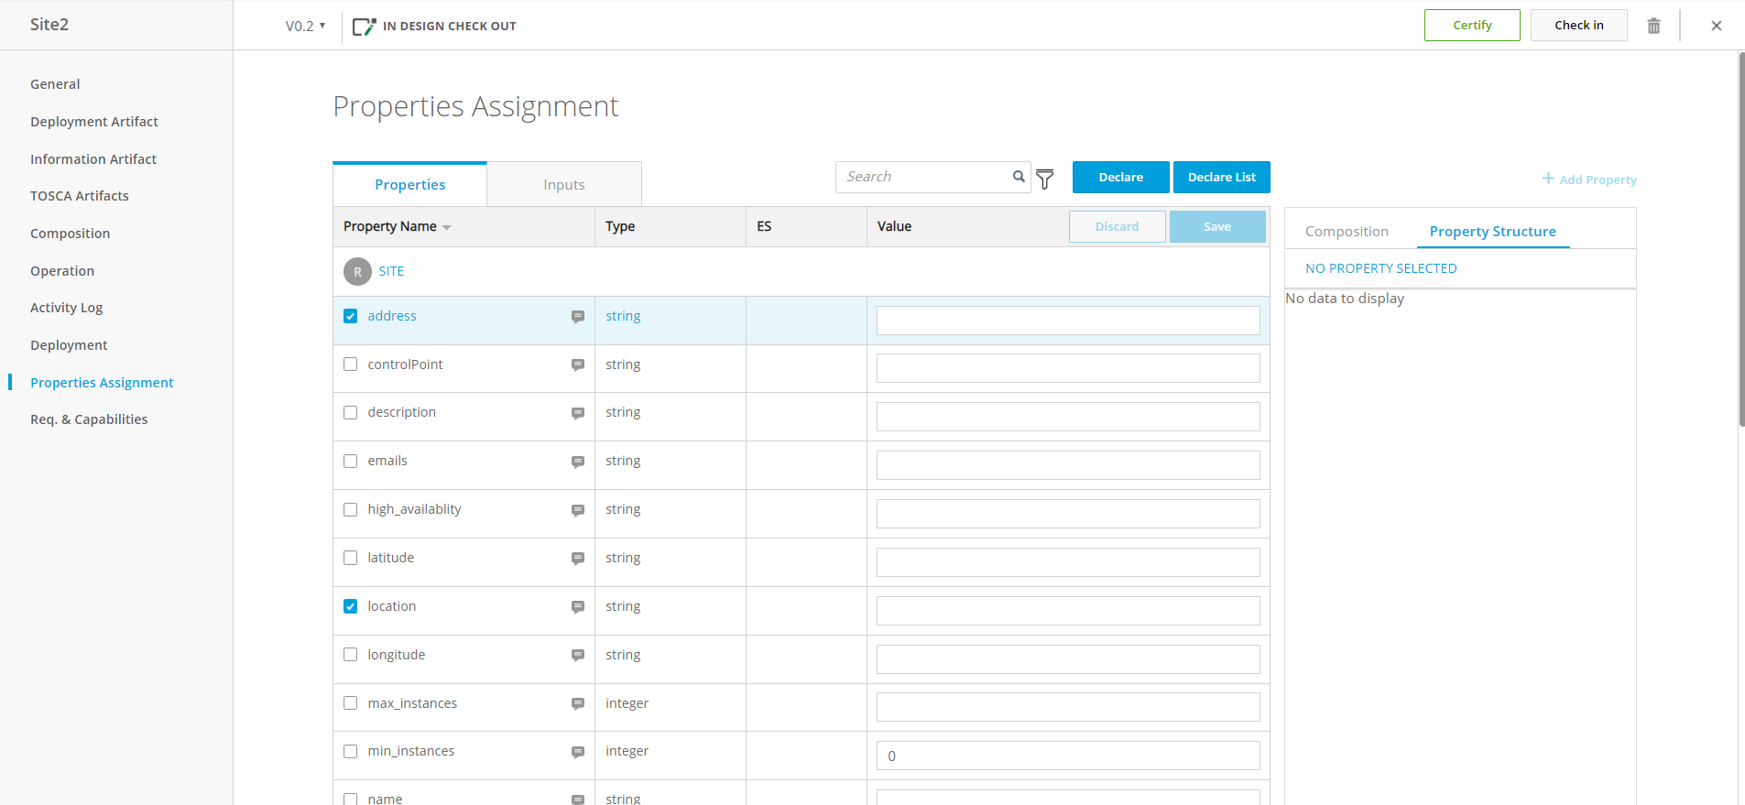
UI Enhancement for List Inputs
2. Click
‘Declare list’
1. Check to properties
to get value from list
Notes:
the followings are users UI operation image we assume.
the operations are similar to what users do in declaring inputs.
first: an user put a check in checkbox of property / of which value will be got from a list in inputs.
then click ‘Declare list’ button.
this button will be added to UI in this enhancement.

Slide 6
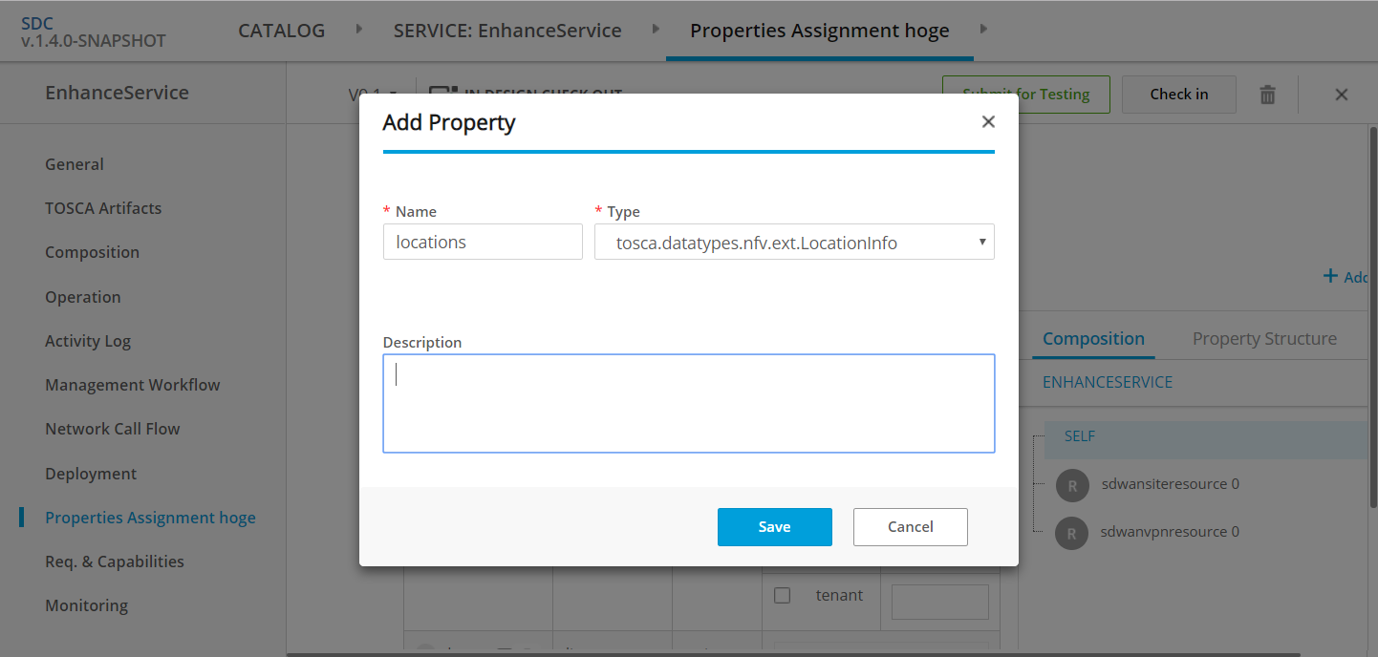

UI Enhancement for List Inputs
Declare List Input
1. input name
□ use existing list
2. data type (entry_schema)
org.openecomp.datatypes.vfc.location
3. Property names
of the data type
(same as checked properties)
Property
address, location
tenant
4. Click ‘SAVE’
Notes:
then this dialog will appear. the user defines a new list input for the property.
user can specify input name,
and data type which means entry_schema of the list in tosca.
this data type will have properties the user selected in previous page.
after clicking ‘Save’ button, REST api to create the list input will be called and database will be updated in backend.

Slide 7
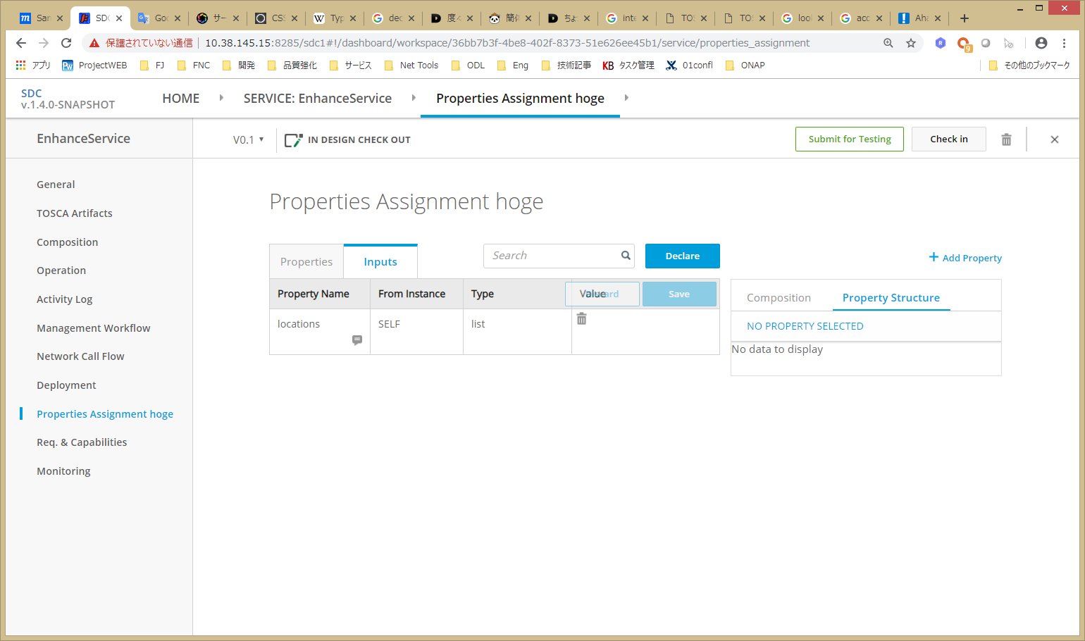
UI Enhancement for List Inputs
SDWANSITE
list type input is declared
Notes:
then,
in ‘inputs’ tab, the new list input will appear.
user can delete it by just click trash icon, then all references to this list will be removed from properties.

Slide 8
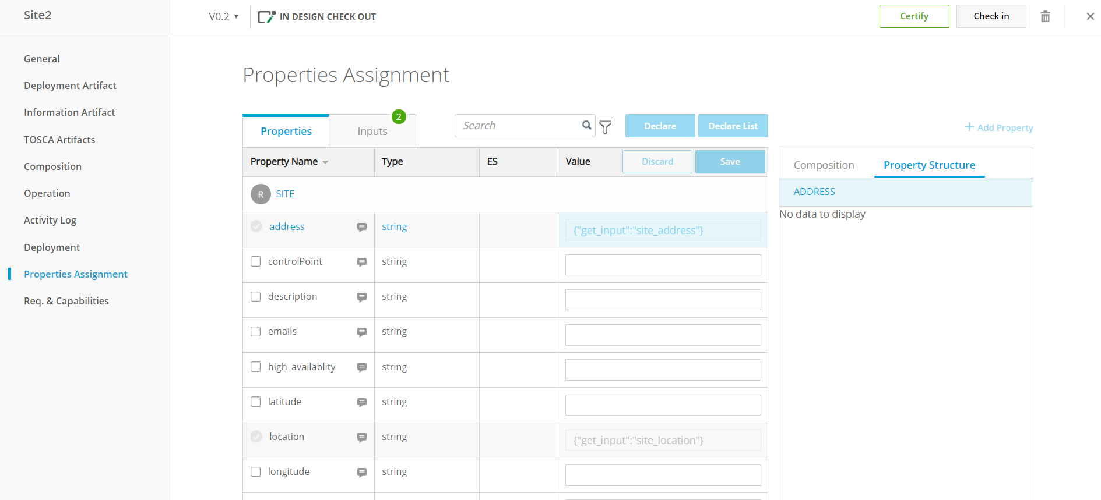
UI Enhancement for List Inputs
{“get_input”:[“locations”,”INDEX”,”address”]}
now the properties refer to item in the list input
{“get_input”:[“locations”,”INDEX”,”location”]}
Notes:
after that the property will be uneditable and have a reference to the property of the list item user specified.
when the user looks into ‘Properties’ tab,
the properties user selected are now uneditable and have references to the item list w/ get_input syntax.

Slide 9
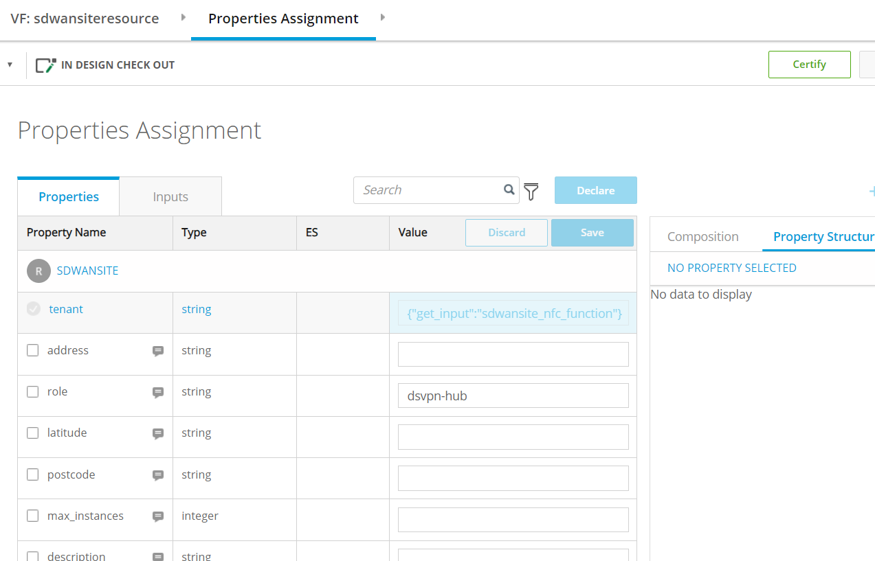
UI to TOSCA Mapping (Properties)
tosca_definitions_version: tosca_simple_yaml_1_2
description: Template for deploying SD-WAN with a variable number
data_types:
org.openecomp.datatypes.vfc.location
properties:
location:
type: string
address:
type: string
topology_template:
inputs:
numberOfSites:
type: integer
locations:
type: list
entry_schema: org.openecomp.datatypes.vfc.location
node_templates:
sdwan:
type: VPN
vpe:
type: vPE
site:
type: VPNSite
properties:
location: { get_input: [ locations, INDEX, location ] }
address: { get_input: [ locations, INDEX, address ] }
location
{“get_input”:[“locations”,”INDEX”,”location”]}
{“get_input”:[“locations”,”INDEX”,”address”]}
Notes:
tosca model corresponding to the property will be generated like this.

Slide 10
UI to TOSCA Mapping (Inputs)
tosca_definitions_version: tosca_simple_yaml_1_2
description: Template for deploying SD-WAN with a variable number of data_types:
org.openecomp.datatypes.vfc.location
properties:
location:
type: string
address:
type: string
topology_template:
inputs:
numberOfSites:
type: integer
locations:
type: list
entry_schema: org.openecomp.datatypes.vfc.location
node_templates:
sdwan:
type: VPN
vpe:
type: vPE
site:
type: VPNSite
properties:
location: { get_input: [ locations, INDEX, location ] }
address: { get_input: [ locations, INDEX, address ] }
Data type will be defined
SDWANSITE
new list input be declared
Notes:
and the declared list input will be like this.
also data type will be defined in tosca.

Slide 11
Code Change Overview
Support designing list inputs (UI)
Support new get_input syntax from TOSCA v1.3
Support “private” data_types in service template
Enhance TOSCA parser to enable to parse models above

Slide 12
Changes in Developer View

Slide 13
Code Change Overview for “Declare List Input” feature
Support designing list inputs (UI)
Support new get_input syntax from TOSCA v1.3
Support “private” data_types in service template
Enhance TOSCA parser to enable to parse models above

Slide 14
Code Changes in Back-End (Declare List Input)
@POST
@Path("/{componentType}/{componentId}/create/listInput")
createListInput(...)
REST (from UI)
InputsServlet
createListInput(...)
add datatype to component
declare an list input
update properties w/ get_input
InputsBusinessLogic
PropertyDeclarationOrchestrator
PropertyDeclarators...
add list input declaration
ToscaOperationFacade
BaseOperation, TopologyTemplateOperation
createAndAssociateDataTypes
addDataTypesToComponent
deleteDataTypeOfComponent
DAO
Titan
add datatype operations

Slide 15
Data Structure in Titan
titan
componentInstances
inputs
Provide new methods to create/update/delete dataType(s)
in ToscaOperationFacade
createAndAssociateDataTypes
addDataTypesToComponent
deleteDataTypeOfComponent
Component
properties
EdgeLabelEnum
.DATA_TYPES
data
Types
VertexTypeEnum.DATA_TYPES
Notes:
this figure describes how datatypes in the component are stored in titan database.
the child vertex will be labeled /ˈleɪbəl/ with DATA_TYPES enum /ɪˈnuːməˌreɪt/ value
and be associated with the parent component object.

Slide 16
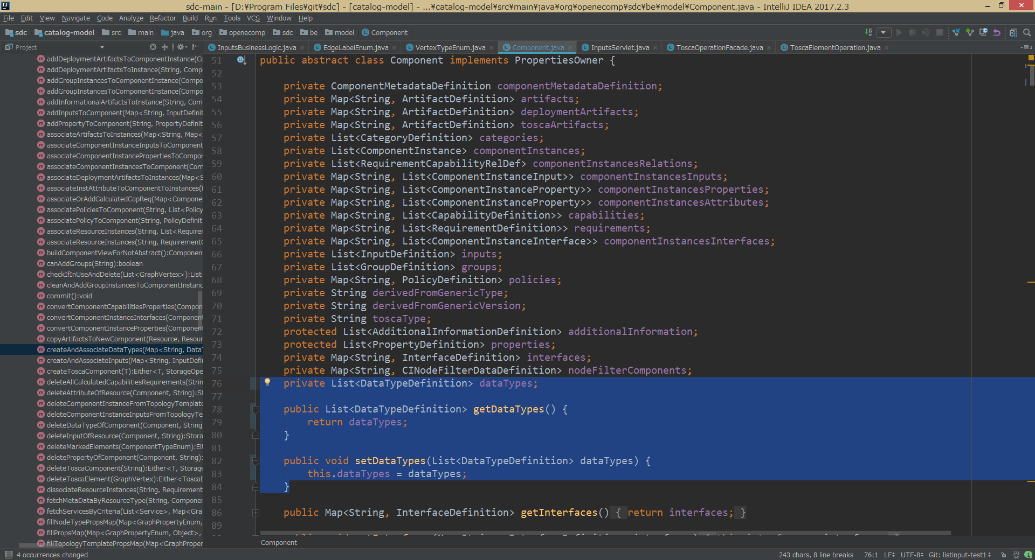
Changes in catalog-model for service-specific datatype
Add “dataTypes”
to Component class
Notes:
related to the titan structure,
in Java data model class
currently ‘Component’ class does not have field for datatype
so we are going to add it.

Slide 17
Changes in catalog-model to support new get_input syntax
Define new private member and methods to the GetInputValueDataDefinition class to judge whether property is declared as list type inputs or not.
GetInputValueDataDefinition
private String propName;
private String inputName;
private String inputId;
private Integer indexValue;
private GetInputValueDataDefinition getInputIndex;
private boolean isList = false;
private SchemaDefinition listSchema;
public SchemaDefinition getListSchema() { return this.listSchema; }
public void setListSchema(SchemaDefinition entrySchema) {
this.listSchema = entrySchema;
}
Use “propName” and “inputName” and “listSchema” to express new ‘get_input’ syntax.
e.g.) get_input: [sdwanvpnresource_list, INDEX, sdwanvpn_topology]
inputName
propName
if listSchema defined
Notes:
This slide shows changes in catalog-model to support new get_input syntax TOSCA from v1.3.
Define new private member and methods to the GetInputValueDataDefinition class to judge whether property is declared as list type inputs or not.
Use “propName” and “inputName” and “listSchema” to express new ‘get_input’ syntax.
Example is below.

Slide 18
Generating TOSCA Model
download tosca model(artifact) rest
ArtifactServlet (no change)
ArtifactBusinessLogic (no change)
add ‘data_types’
convert(generation) logic
get Component
from DB
ToscaExportHandler
add field for datatype
convert Component into TOSCA model
TOSCA model java class
ToscaOperationFacade
ToscaTemplate
DAO
ToscaDataType (new)
Titan
new class represents “data_types”

Slide 19
TOSCA parser changes
JTOSCA
  ToscaTemplate (org.onap.sdc.toscaparser.api.ToscaTemplate)
    Addition of a private variable and property get method for "data_types" field.
  Property (org.onap.sdc.toscaparser.api.Property)
    Modify varidity check method for "get_input" function.
SDC-TOSCA
  SdcCsarHelperImpl (org.onap.sdc.tosca.parser.impl.SdcCsarHelperImpl)
    Addition of a get method for "data_types" field.
  ISdcCsarHelper (org.onap.sdc.tosca.parser.api.ISdcCsarHelper)
    Addition of a get method for "data_types" field.

