Slide 1
OSC release A “Amber”
OAM / O1/ O-RAN IM PoC/Plugfest
Tracy van Brakle || vanbrakle@att.com || last updated 11 November 2019

Slide 2
SMO option = ONAP within OSC rel A
(note: there are multiple operator-selectable options for SMO)
Service Management and Orchestration
Management-Service (MnS)
Opt
Policy
SO
Inventory
Data Analytics
Portal
AAF
LOG
ConfigDB
nonRT-RIC
Message bus (e.g DMaaP)
CDS
HV-VES Collector (FCAPS)
VES Collector (FCAPS)
CCSDK/SDNC - A1 and/or O1
O1*
A1:REST
O1:NetConf/YANG/CM
O1:REST/VES/PM
O1:REST/VES/CM, FM, others
Near-Real-Time RAN Intelligent Controller (RIC)
Standard VES collector
for rare events like CM, FM.
E2
O-CU-CP
E1
O-CU-UP
Infrastructure Management Framework
High Velocity VES collector (HV-VES)
for real-time event streaming needed for PM.
F1-c
F1-u
O-DU
Open Fronthaul
VIM
O-RU
O1*: Interface between Service Management and Orchestration Framework and Infrastructure Management Framework supporting O-RAN virtual network functions.
2019-08: will be available later in document “O-RAN Orchestration”.
Infrastructure
COTS / White Box / Peripheral Hardware & Virtualization layer
~NfVi

Slide 3





WG1 O1 & WG4 Open FH use cases
Physical Network Function (PNF) Plug and Play (PnP)
https://wiki.onap.org/pages/viewpage.action?pageId=40206485
PM Bulk request
https://wiki.onap.org/pages/viewpage.action?pageId=40206494
Basic fault
Basic configuration
OOF-based 5G SON
https://wiki.onap.org/pages/viewpage.action?pageId=40206498
WG4 Open FH – Hybrid M-Plane Model
Equipment vendors participating:

Slide 4
PNF Plug and Play Message flow
Service Management and Orchestration
Management-Service (MnS) Consumer
O-RAN PNF sends VES pnfRegistration – preferred IPv6/TLS
Controller (O1) becomes awareness of the new O-RAN PNF via Message bus
Controller (O1) checks NetConf end-point on the O-RAN PNF (hello-message) – preferred: IPv6/TLS
CDS
Opt
Policy
Portal
AAF
LOG
ConfigDB
SO
PNF Registration Handler
Inventory
2
Simplified view
Message bus (e.g DMaaP)
Controller (O1)
VES Collector
O1:NetConf/YANG/CM
O1:REST/VES/pnfRegistration
3
1
O-RAN PNF
(O-DU or O-RU)

Slide 5
PM Bulk request
Service Management and Orchestration
Management-Service (MnS) Consumer
O-RAN PNF sends VES fileRead – preferred IPv6/TLS
Data analytics triggers the file transfer.
Data analytics requests file transfer – IPv6/TLS/FTPES
O-RAN PNF transfers file and Data analytics processes the file; Format is 3GPP XML (TS 32.435) with gzip compression.
CDS
Opt
Policy
Portal
AAF
LOG
ConfigDB
Data analytics
SO
Inventory
2
Simplified view
Message bus (e.g DMaaP)
File Collector
VES Collector
O1:SFTP
O1:REST/VES/FileReady
3
4
1
O-RAN PNF
(O-DU or O-RU)

Slide 6
Basic Fault Message flow
Service Management and Orchestration
Management-Service (MnS) Consumer
O-RAN PNF sends VES fault – preferred IPv6/TLS
Controller (O1) requests configuration data of affected Managed Object Instance.
Controller (O1) requests affected configuration preferred: IPv6/TLS
Controller (O1) receives configuration data
Controller (O1) updates other ONAP components
CDS
Opt
Policy
Portal
AAF
LOG
SO
ConfigDB
Inventory
Data analytics
2
5
Message bus (e.g DMaaP)
Simplified view
Controller (O1)
VES Collector
O1:NetConf/YANG/CM
O1:REST/VES/fault
4
3
1
O-RAN PNF
(O-DU or O-RU)

Slide 7
Basic Config
Service Management and Orchestration
Management-Service (MnS) Consumer
Operator triggers a modification of configuration data on selected O-RAN PNF
Controller (O1) triggers the change via IPv6/TLS(NetConf
O-RAN PNF processes the edit-conf and after successful processing a configuration VES message is send.
Controller (O1) greps the configuration change from Message Bus (DMaaP)
Controller (O1) updates ConfigDB and Portal
CDS
Opt
Policy
SO
AAF
LOG
Inventory
ConfigDB
Portal
Data analytics
1
4
Simplified view
5
Message bus (e.g DMaaP)
Controller (O1)
VES Collector
O1:NetConf/YANG/CM
O1:REST/VES/configuration
2
3
O-RAN PNF
(O-DU or O-RU)

Slide 8
WG4 Open FH – Hybrid Arch

Slide 9
Timeline
week: 36 | week: 37 | week: 38 | week: 39 | week: 40 | week: 41 | week: 42 | week: 43 | week: 44 | week: 45 | week: 46 | week: 47 | week: 48 | week: 49
Sep-02 | Sep-09 | Sep-16 | Sep-23 | Sep-30 | Oct-07 | Oct-14 | Oct-21 | Oct-28 | Nov-04 | Nov-11 | Nov-18 | Nov-25 | Dec-02
Sep-07 | Sep-14 | Sep-21 | Sep-28 | Oct-05 | Oct-12 | Oct-19 | Oct-26 | Nov-02 | Nov-09 | Nov-16 | Nov-23 | Nov-30 | Dec-07
Setup Test environment
Running Dev and Test environment
Use case clarifications
O-RAN-SC/SMO Development
O-RAN-SC/ONAP Tests
O-RAN PNF Development and tests
Integration tests
Finale SMO/VNF setup
PNF setup
recording
Readout

Slide 10
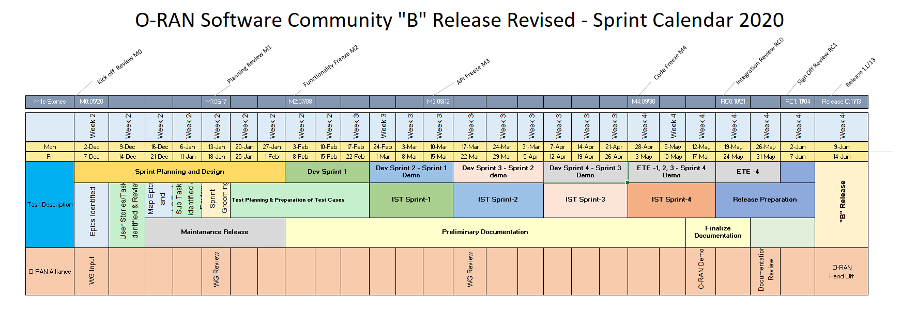
OSC release B “Bronze”

