Slide 1




5G Use Cases for R6 Frankfurt
5G Use Case Subcommittee
ONAP Developer’s Face to Face (June 11, 2019)
Benjamin Cheung, Vimal Begwani, and 5G Use Case Sub-committee
May 22, 2019 version 1

Slide 2
R6 Frankfurt 5G USE CASE & PNF U/Cs SUMMARY
5G USE CASE | DESCRIPTION | Req vs U/C | 5G Specific
BULK PM | Performance Measurements for 5G RAN Bulk Upload. | Requirements | General
FM META DATA & PM DICTIONARY | Support for handling 5G FM Meta Data & support for PM Dictionary & PM Schema | Requirements | General
OOF - SON (5G) | Optimization and SON functions for 5G RAN. Self-optimization, Self-Healing, Self-configuration | Requirements | 5G
NETWORK SLICING (5G Use Case) | Network Slicing defines Slices for 5G RAN systems. Network Slicing is a long-lead (multi-release) development. | E2E Use Case | 5G
5G SERVICE MODELING & DEFINITION (5G) | Defining and modeling a 5G Service (in Design Time) and associated Modeling (Platform Info & Data Model) | Requirements | 5G

Slide 3




5G SERVICE CREATION & MODELING in R6 Frankfurt
5G
Application
Ecosystem
RAN Network Elements
Core Network Elements
Disaggregated Core
Antenna
CU
UPF
SMF
UDM
AUSF
AMF
DU
RAU
Back Haul
RF
N
1
N
1
RU
DU
CU
Edge
Cloud
Centralized
Cloud
Internet
CPRI
Mid Haul
External Content
RAP
RU – Remote Radio Unit
DU – Distributed Unit (5G Base Unit)
CU – Centralized Unit
UPF – User Plane Function
SMF – Session Management Function
UDM – Unified Data Management Function
AUSF – Authentication Service Function
UE
5G SERVICE
RAN Network Elements
DU
RAU
CU
DU
CU
(VNF)
NF/DU #1
NF/CU #1
N
1
N
N
Conn Pt #1
Virtual Link
1
1
…
Conn Pt #3
UPF
(VNF)
AMF
(VNF)
Core Network Elements
NF/DU #n
Resources
Conn Pt #n

Slide 4
5G SERVICE CREATION & MODELING in R6 Frankfurt
This Use Case will introduce support for 5G Service creation and modeling
U/C DESCRIPTION
Wiki
https://wiki.onap.org/pages/viewpage.action?pageId=60888132
R5 CANDIDATE ENHANCEMENTS | IMPACT
Modelling S/C | Evolution of Platform Info & Data model in support of 5G Service ETSI, 3GPP standards for modeling a service (might need alignment) Platform data/information model. A&AI schema (usable)
SDC | Support for creation of a 5G Service (E2E integration only)
Architecture | New Flows for 5G Services
(other U/C Plug and Play, PreOB/Onboarding) | Interactions and E2E integration
R6 Frankfurt CANDIDATE ENHANCEMENTS

Slide 5

Bulk PM (Perf3gpp Event Generation)
Bulk PM File Upload and Perf3gpp Event Generation
VES
Collector
Message
Router
File
Collector
Data
Router
PM
Mapper
Analytics
Application
Bulk PM File Upload and Performance Event Generation
Network Function (NF) establishes a HTTP/TLS connection to the DCAE VES Collector.
NF sends FileReady notification Event to DCAE VES Collector. Event is encoded in JSON and sent via HTTP/TLS. HTTP/TLS connection is set up and torn down every time a FileReady notification event is sent.
DCAE VES Collector publishes the event to on DMaaP Message Router (MR).
DCAE File Collector retrieves the FileReady notification event from DMaaP MR.
File Collector uploads PM File from NF using a secure file transfer protocol; FTPES supported in Casablanca. NF authenticates the connection.
File Collector publishes PM Data to DMaaP Data Router (DR).
PM Mapper retrieves PM Data from DR and generates Perf3gpp events as configured by PM Mapper File.
PM Mapper publishes Perf3gpp events to MR.
Analytics Applications (AA) retrieve the Perf3gpp events of interest from MR. AA analyze the data to produce statistics and KPIs and optimization recommendations.
VNF
PNF
VES
Collector
Authenticate connection
HTTP/TLS
1
1
HTTP/TLS
2
2
Send FileReady event
Publish Event
Upload PM file
3
Retrieve Event
3
4
FTPES
4
5
Publish PM Data + metadata
5
Publish Perf3gpp Event
6
Retrieve Perf3gpp Event
Retrieve PM Data +metadata
6
7
7
8
8
9
9

Slide 6
Bulk PM for R6 Frankfurt
Support the following work items for Bulk PM for 5G xNFs:
UC1: Perf3gpp event creation by 3GPP PM Mapper from Bulk PM XML file
UC2: Closed Loop support using 3GPP PM data (stretch goal)
Additional Requirements: DFC robustness enhancements, DMaaP DR enhancements
U/C DESCRIPTION
Wiki
https://wiki.onap.org/pages/viewpage.action?pageId=40206494
R5 CANDIDATE ENHANCEMENTS | DESCRIPTION
Analytics & Enhancements for Bulk PM | UC2 Closed loop support using PM data: Analytics Applications subscribe to Perf3gpp event of interest or Bulk PM XML file.
Analytics & Enhancements for Bulk PM | UC2 Closed loop support using PM data: Analyze the data.
Analytics & Enhancements for Bulk PM | UC2 Closed loop support using PM data: Notify Policy of desired CM change.
Analytics & Enhancements for Bulk PM | UC2 Closed loop support using PM data: Policy triggers CM update to Controller.
PM Subscription | CM support for configuring PM subscriptions/jobs at NF
Carry Over Items | Carry-over items to complete the on-demand DCAE deployment (option 2 support in PM Mapper and DFC) [No 5G U/C impact]
Operator Defined VES output | Support in PM Mapper for ‘operator defined’ VES Perf3gpp output (enhancements to PM Mapper and DCAE-DS) [No 5G U/C Impact]
Additional File Types | DFC and DMaaP support for additional file types (i.e. based on FileReady content) [No 5G U/C Impact]
R6 Frankfurt CANDIDATE ENHANCEMENTS

Slide 7






PM DICTIONARY in R6 Frankfurt
DESIGN-TIME (SDC)
Descriptor
Onboarding
SDC
Catalog
PM Dictionary (YAML)
PNF
Onboarding
Package
Measurement
& Schema
Service
Designer
Define
Services
DCAE
Design Studio
Define
Templates
CSAR
Package
El Alto (R5) Goal is to enhance the GUI and possibly show in other design time GUIs (e.g. Policy Designer, CLAMP, DCAE DS).

Slide 8
PM DICTIONARY in R6 Frankfurt
Support the following work items for PM Dictionary for 5G xNFs:
Review and finalize VES Event Listener Specification v7.1 and VES Event Registration Specification v3.2 which contains the PM Dictionary format and content.
Onboard the PM Dictionary for an xNF as a PM Dictionary YAML file. Note: Onboarding of the PM Dictionary artifact is covered under the PNF Onboarding Use Case.
Display the PM Dictionary in a GUI to allow an ONAP User to create PM Mapper configuration files for Perf3gpp event generation.
Update VNF Requirements for PM Dictionary artifact.
U/C DESCRIPTION
Wiki
https://wiki.onap.org/pages/viewpage.action?pageId=40206485
R5 CANDIDATE ENHANCEMENTS | IMPACT
VES Specifications | 3GPP effort to align PM/FM with ONAP. Possible modification based on 3GPP outcome. Study done in 2019. Changes to make ONAP aligned. Additional fields might get defined. This might impact the VES specification and would require updates & review. Preliminary findings are available and need to be investigated now. File Ready VES event may be updated.
GUI display of PM dictionary | Display the PM Dictionary in a GUI (either DCAE-DS or SDC-DS GUI) to allow an ONAP User to create PM Mapper configuration files for Perf3gpp event generation.
Extensions of the GUI to other Design time platforms | GUI (either DCAE-DS, Policy GUI and/or SDC GUI) to allow an ONAP User to create Policies for handling alarms
GUI Display functions (Search etc.) | Some basic (or more advanced) “functions” that a user can invoke, such as searching on fields or displaying filtered rows.
R6 Frankfurt CANDIDATE ENHANCEMENTS

Slide 9

FM META DATA in R6 Frankfurt
DESIGN-TIME (SDC)
Descriptor
Onboarding
SDC
Catalog
YML Registration
NF
Onboarding Package
Policy
Designer
P
Add
Policies
P
Policy
Database
CLAMP
Designer
Add Control
Loops
CSAR
Package
DCAE
Design Studio
Define
Templates
El Alto (R5) Goal is to enhance the GUI and possibly show in other design time GUIs (e.g. Policy Designer, CLAMP, DCAE DS).

Slide 10
FM META DATA in R6 Frankfurt
Support the following work items for FM Meta Data for 5G xNFs:
Review and finalize VES Event Listener Specification v7.1 and VES Event Registration Specification v3.2 which contains the FM metadata format and content.
Onboard the FM metadata for an xNF as part of the VES Event Registration YAML file. Note: Processing of the FM meta data is covered the PNF Pre-onboarding & onboarding Use Case
Display the FM metadata in a GUI to allow an ONAP User to create Policies for handling alarms.
Update VNF Requirements for FM metadata artifact.
U/C DESCRIPTION
Wiki
https://wiki.onap.org/pages/viewpage.action?pageId=40206485
R5 CANDIDATE ENHANCEMENTS | IMPACT
VES Specifications | 3GPP effort to align VES and 3GPP fault message. Possible modification based on 3GPP outcome. Additional fields might get defined. This would impact the VES specification and would require updates & review. Creating a new Fault3GPP VES Event. DCAE Collector impact.
GUI Display of FM Meta Data Enhancements | Enhancements to Display the FM Meta data in a GUI. Column-by-field display (where the informational FM meta data fields are each on their own column). NOTE: New Fault3GPP Event may obviate need for changes to GUI.
Extensions of the GUI to other Design time platforms | GUI (either DCAE-DS, Policy GUI and/or SDC GUI) to allow an ONAP User to create Policies for handling alarms
GUI Display functions (Search etc.) | Some basic (or more advanced) “functions” that a user can invoke, such as searching on fields or displaying filtered rows.
R6 Frankfurt CANDIDATE ENHANCEMENTS

Slide 11
OOF & SON in R6 Frankfurt
SO
Query to allocate PCI for new cell (optional)
REST API
7
DMaaP Message
Config Value
Change Notifn
(Netconf/Yang)
4b
4a
6
ConfigDB
OOF
Policy
SDN-C*
3a
Simulated RAN
~2000 Cells
Nbr_list, PCI values
DCAE
10
1d
1c
8
PCI Handler MS
9
11
1a
1b
2
5
Config Value Change
FM/PM Data
PCI enhancements
ANR function
4d
4c
DCAE
DCAE Database
DCAE Collector
(VES)
3b
FM/PM
1e
FM/PM KPIs
(*SDN-C work done
in SDN-R team)
FM/PM Collector and Database

Slide 12
OOF & SON in R6 Frankfurt
Carry-over Items From Dublin:
Control Loop Co-ordination, New cell addition
Enhancements:
Include other ONAP modules, readiness for deployment
  PCI for new cell addition
  SDC – Service creation, CLAMP – Control Loop Deployment
Configuration Management with SDN-R
  Enhance yang model to align with O-RAN and 3GPP models
SON Functionality – enhance PCI, ANR, and add SON function
RAN Simulator – enhance and include in ONAP codebase
U/C DESCRIPTION
Wiki
https://wiki.onap.org/display/DW/OOF-PCI+Use+Case+-+Dublin+Release
R5 CANDIDATE ENHANCEMENTS | IMPACT
OOF | Dynamic and static optimization, DMaaP interface
SDN-R | Enhance Yang model to align with 3GPP and O-RAN Configuration/Operational Database, Config History (e.g. to revert changes) RAN Simulator – enhance and include in ONAP codebase*
DCAE | Functionality enhancement to SON Handler MS
POLICY | Enhance the Policy functionality for Control Loop Coordination
AAI | Models & relationship between Config, Operational DB & AAI
SDC | SON service creation
CLAMP | Control Loop Deployment
R6 Frankfurt CANDIDATE ENHANCEMENTS
* Need guidance re. location of RAN Simulator code. ONAP community can enhance and use as test resource)

Slide 13
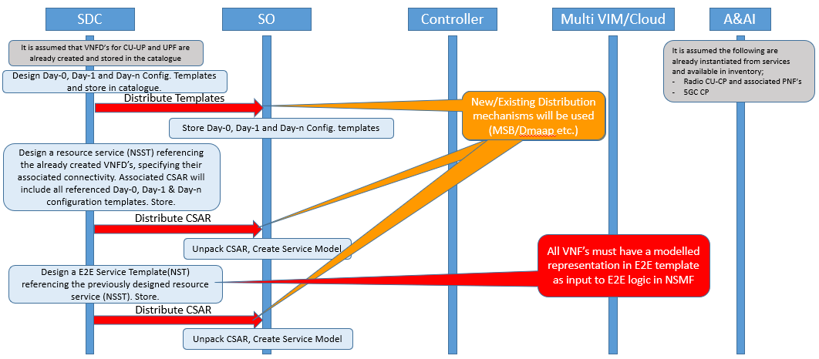
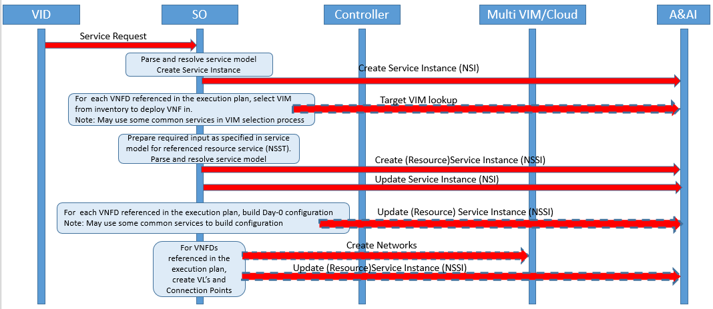
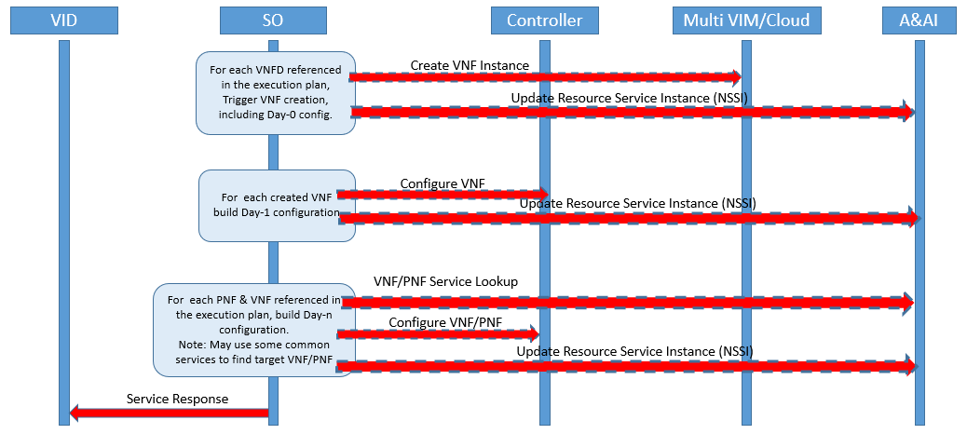
NETWORK SLICING in R6 Frankfurt
1
Design Time
Configuration templates are designed and distributed.
Service templates are designed and distributed
Run Time
Create E2E service instance
Determine VNF placement
Build required input for lower level service
Create resource service instance
Create networks
Instantiate VNF(s), applying Day-0 configuration
Configure instantiate VNF(s) with Day-1 configuration
Configure dependent PNF(s) &/ VNF(s) with Day-1 configuration
2
3
4
5
6
7
8
9
10

Slide 14
NETWORK SLICING in R6 Frankfurt
..Based on identified Use Cases for NW Slicing in Dublin Release.
First proposal outlines the scope of the identified use cases with ambition levels for each.
Use Case Scope and Ambition Levels
Following proposal focuses on flows for Use case 1, Ambition level 1.
Use Case 1 Ambition level 1
U/C DESCRIPTION
Wiki
https://wiki.onap.org/pages/viewpage.action?pageId=38119661
R5 CANDIDATE ENHANCEMENTS | DESCRIPTION
SDC | Support the design and distribution of configuration templates Support the design of nested service templates (see ONAP Network Slice Modelling) Support the distribution of service templates
SO | Support orchestration of nested service templates Support integration with common functions for VNF placement decisions Support parameterization of configuration templates
A&AI | Evolve model to support NW Slicing aspects
Controllers | Support VNF Day-1 configuration Support VNF&PNF Day-n configuration
VID | Provide view of all available templates Provide means to trigger and monitor service instance creation and deletion Provide view of service instances and their dependencies
PoC | Network Slicing PoC to demonstrate something related to NS
R6 Frankfurt CANDIDATE ENHANCEMENTS

Slide 15
R6 Frankfurt General PNF Support U/C SUMMARY
5G USE CASE | DESCRIPTION | Req vs U/C | 5G Specific
PNF PRE-ONBOARDING & ONBOARDING | PNF Package delivery, Pre-onboarding and PNF Onboarding via SDC. | Requirements | General
CONFIGURATION WITH NETCONF | Enhancement to NETCONF support in ONAP supporting 5G and other use cases. | Requirements | General
PNF PLUG AND PLAY | PNF PnP enhancements, R3 Carry-overs, PRH (PNF Registration Handler) enhancements | E2E Use Case | General
PNF S/W UPGRADE | PNF Software upgrade to update the software on a PNF. Use of Ansible/NetConf direct to PNF. | Requirements | General

Slide 16



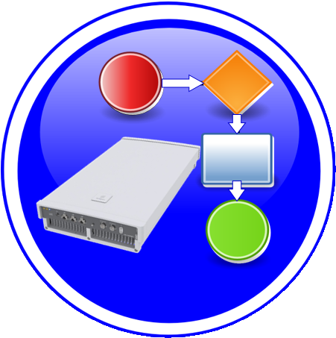

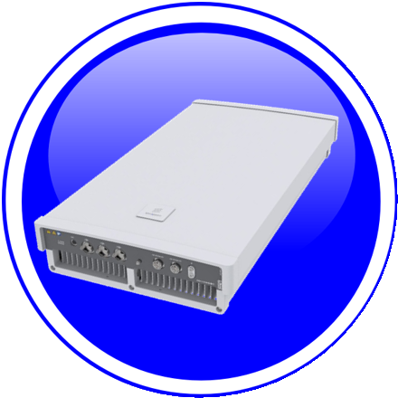



PNF PRE-ONBOARDING/ONBOARDING U/C OVERVIEW
1. PNF Package Delivery: Vendor creates & delivers PNF Package with PNF artifacts
1
2. PNF Pre-Onboarding: PNF-SDK ( ) to (create) PNF Onboarding Package & validates of PNF onboarding package
PNF
Descriptor
2
NF
Registration
3. PNF Onboarding package: Package loaded
3
xNF
SDK
CSAR
Package
PM Dictionary
Schema (YAML)
SDC
Package
creation
SDC
Catalog
SO, AAI,
DCAE etc.
Informational
Artifacts
Onboarding
Distribute
PNF
Onboarding
Package
+VENDOR
META DATA
Configuration
Files
5. ONAP RT Components:
Ingest and use CSAR package
5
Ansible
Playbook
4. SDC: NF OB Package > SDC catalog
4
Package Delivery
Onboarding
Design Time
Run Time
Onboarding Package
NF Descriptor
Platform Model
NF Instance

Slide 17
PNF PRE-ONBOARDING/ONBOARDING in R6 Frankfurt
This Use Case will introduce the support for PNF pre-onboarding (PNF Package, PNF descriptor support) and PNF onboarding (SDC, Design Time, PNF-SDK).
PNF Package delivery by vendor (during Pre-onboarding activities) and PNF Onboarding via SDC in Dublin.
U/C DESCRIPTION
Wiki
https://wiki.onap.org/pages/viewpage.action?pageId=45303641
R5 CANDIDATE ENHANCEMENTS | IMPACT
Modelling | Definition of Platform Info & Data model continues
Resource Data Model | Onboarding PNFD to Platform PNFD mapping development & enhancement
VNF-SDK (PNF-SDK) | Package Validation enhancements notable Package security (option 2 per artifact), SOL004 alignment, License Model Check.
PNF Onboarding Package | Further carry-over development from R4/Dublin for PNF onboarding process.
VNF Onboarding | VNF onboarding, same procedure, same function, but testing/integration was not completed in R4/Dublin.
PNF VSP | SDC procedure to manually create a PNF VSP. (Carry-over from R4).
R6 Frankfurt CANDIDATE ENHANCEMENTS

Slide 18
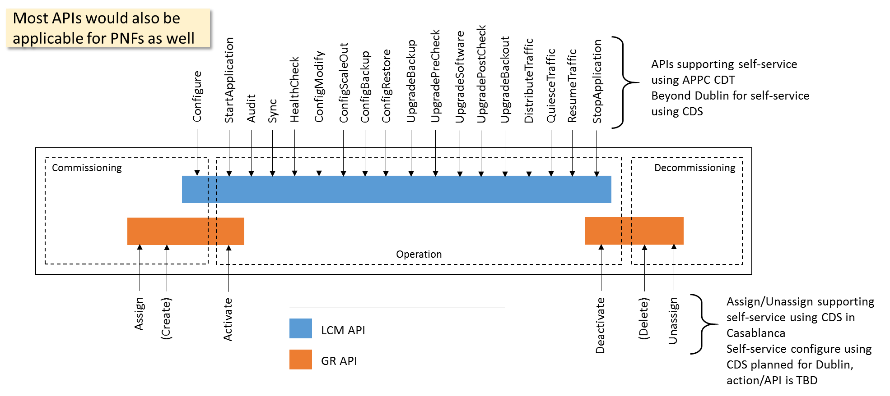
CONFIGURATION WITH NETCONF in R6 Frankfurt
NETCONF assumes that security is provided by the chosen transport protocol
NETCONF over SSH (RFC6242) is mandatory but other options have also been standardized
  NETCONF over TLS with mutual X.509 authentication (RFC7589)
ONAP security sub-committee has recommended use of NETCONF over TLS: Secure Communication to Network Functions
Authenticated client identity passed to NETCONF layer for access control
Client
Server
NETCONF
Transport
- Authentication
- Data integrity
- Confidentiality
- Replay protection

Slide 19
CONFIGURATION WITH NETCONF in R6 Frankfurt
Proposed UC to focus on in Dublin for configuration with NETCONF:
Post-instantiation (triggered by SO), Including final configuration step (36/37) in the PNF PnP UC
Configuration modification (e g triggered by Policy)
Specific requirements on NETCONF support in ONAP:
Officially support both PNFs and VNFs for north-bound controller APIs in the use cases
Support for NETCONF over TLS (RFC7589), Support for YANG 1.1 (RFC7950) modules in addition to YANG 1.0
U/C DESCRIPTION
Wiki
https://wiki.onap.org/display/DW/5G+-+Configuration+with+NETCONF
R5 CANDIDATE ENHANCEMENTS | DESCRIPTION
AAF | Investigate AAF impact for NETCONF over TLS Also needs discussion in Security Committee meeting
Other applications of NetConf | For example PNF Software Upgrade that would use NetConf in R6.
Improvements in Controller | Improvements in Controller to cover entire LCM API, architecture change to allow for U/C to use new capabilities. Used initially for upgrade, and improvements for other APIs/operations.
R6 Frankfurt CANDIDATE ENHANCEMENTS

Slide 20



PNF PLUG AND PLAY U/C Overview
1
Resources Definition/Services Definition
SDC: PNF (physical element) Modeling
Distribution of types
Design Time
PNF Modeling
2
PNF Infrastructure Service Declaration
First part of PNF instantiation
PNF A&AI Entry created
PNF Instance
Declaration
15
16
17
18
19
20
21
22
3
PNF Powers up and Boot-straps
PNF performs a “Plug and Play” procedure
Equipment vendor proprietary steps
PNF
Boot-strapping
4
PNF connects to ONAP via a Registration Event
PNF Registration Handler (PRH) processes the event
PNF
Contacts ONAP
Run-Time (Instances)
25
26
27
28
29
30
31
5
Connection points configured
Second part of PNF service instantiation
PNF configured and ready to provide service
PNF
Activation
34
35
36
37
38
39
40
41
42

Slide 21
PNF PLUG AND PLAY for R6 Frankfurt
This Use Case will continue PNF Plug and Play development started in R3 Casablanca. Functionality that was started but not completed, and introduce some enhancements to improve Plug and Play operation.
U/C DESCRIPTION
Wiki
https://wiki.onap.org/pages/viewpage.action?pageId=40206485
R5 CANDIDATE ENHANCEMENTS | Description
Controller to NF Type Association | Association of Controller to NF Type, so that SO knows which controller to use for a particular NF instance
AAF | Security enrollment enhancements
Controller (VF-C, SDN-C/R) | Service configuration to PNF by controller (Step 37). SDN-C already supports DG & Ansible. NetConf introduction (separate U/C)
VID | VID enhancements to support A&AI Schema Change
A&AI Schema Change | PNF Indexing using pnf-id (instead of pnf-name) as a key for the PNF in A&AI. Migration needed.
SO | SO support for new A&AI schema change.
ESR | Association to External Controller (EMS/NMS). ESR Object
PRH | A&AI adaptations for A&AI schema change and Activated message (PNF successfully activated)
R6 Frankfurt CANDIDATE ENHANCEMENTS

Slide 22
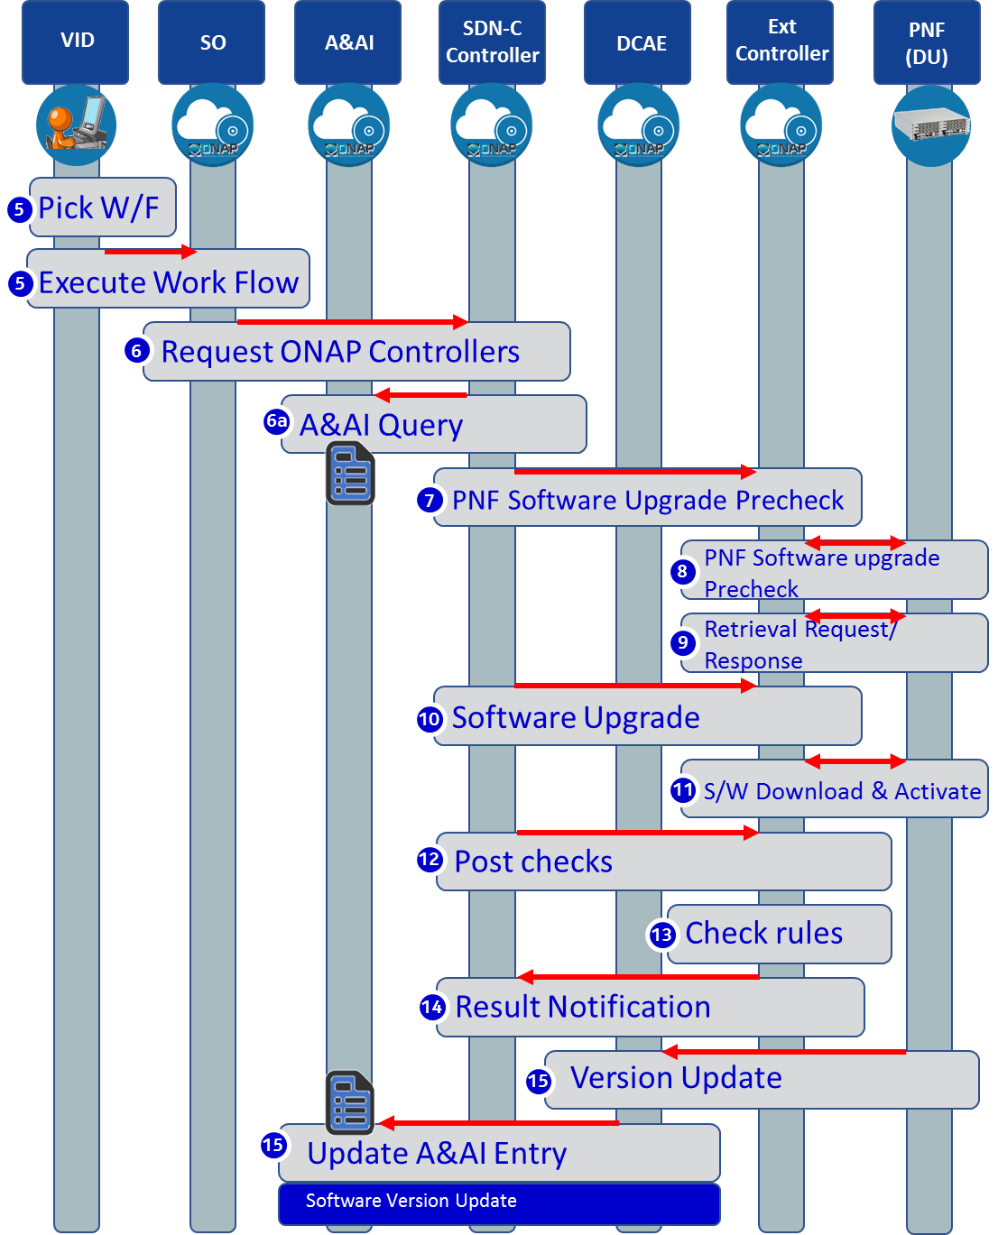
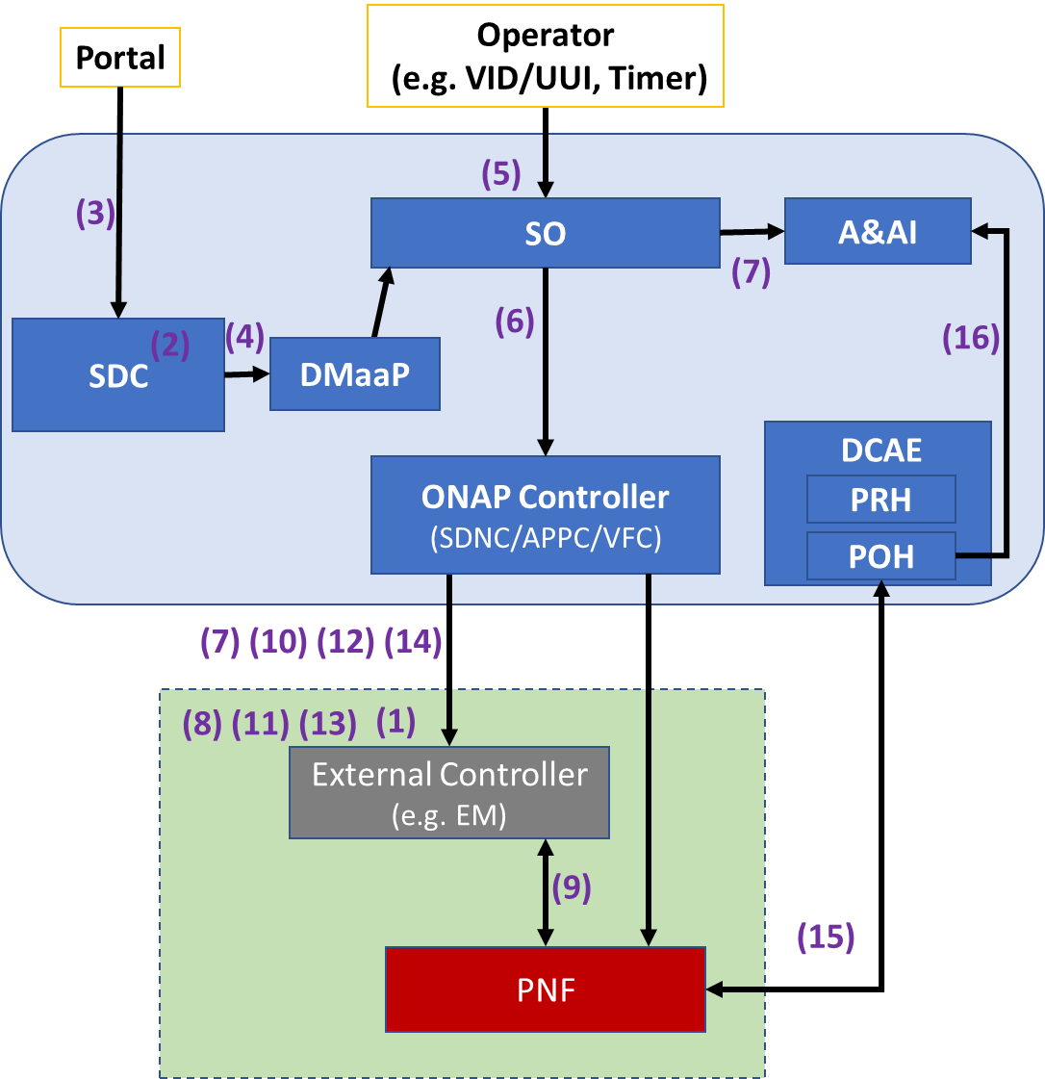
PNF S/W UPGRADE in R6 Frankfurt

Slide 23
PNF S/W UPGRADE for R6 Frankfurt
PNF Software upgrade is one aspect of Software Management. The purpose is to modify the software running on the PNF. This could be used to update the PNF software to a newer or older version of software.
U/C DESCRIPTION
Wiki
https://wiki.onap.org/pages/viewpage.action?pageId=40206485
R5 CANDIDATE ENHANCEMENTS | IMPACT
PNF Reporting its S/W version (NetConf) | PNF sends information regarding its Software Version directly to ONAP through a VES event. (possibly already covered with PNF Registration)
Support of NetConf & Yang models | PNF Software Upgrade using NetConf for direct ONAP to PNF communication.
Software Update Coverage Analysis | Find out what services, control loops, etc. are impacted during and post software update before the PNF software update
Post/Pre PNF SW Update Event Workflows | Deregistration, re-registration
VNF & PNF in-place software upgrade processes alignment | Unifying PNF and VNF entries in A&AI
VID support | Execute the E2E run-time software upgrade workflow.
3GPP Alignment | 3GPP TS32.532 Automated/non-Automated S/W mgmt. API between manager & managed entity (south-bound of controller).
R6 Frankfurt CANDIDATE ENHANCEMENTS

