Slide 1

SDC enhancement - CCVPN
Support Design of List Inputs in Service Template

Slide 2
Background
In Casablanca release,
  The CCVPN service consisted of 3 abstracted nodes: Site, SOTN infra, SD-WAN infra.
  The current SDC is not support multiple sets of inputs in one service template.
Goal of Dublin release
  The CCVPN service should be able to design in one template.
  Service template should support multiple instances inputs, so we can design all resources into one service
List type input will be rational solution.
https://wiki.onap.org/display/DW/CCVPN+DM+Requirement

Slide 3
TOSCA Model Example
tosca_definitions_version: tosca_simple_yaml_1_2
description: Template for deploying SD-WAN with a variable number of sites.
data_types:
org.openecomp.datatypes.vfc.location:
properties:
location:
type: string
address:
type: string
topology_template:
inputs:
numberOfSites:
type: integer
locations:
type: list
entry_schema: org.openecomp.datatypes.vfc.location
node_templates:
sdwan:
type: VPN
vpe:
type: vPE
site:
type: VPNSite
max_instances: { get_input: numberOfSites }
properties:
location: { get_input: [locations, INDEX, location ] }
address: { get_input: [ locations, INDEX, address ] }
Site(s)
VPN
vPE
- Support list type of input.
- entry_schema is defined in data_type.
- The property is got by specifying INDEX from the list.

Slide 4
TOSCA Model Example
CCVPN Service Template
VPN
Inputs
Inputs Example
numOfSites
[type=integer]
requirements
- 3
requirements
requirements
locations
[type=list]
- [0].location=“San Jose”
.address=“sanjose”
- [1].location=“Boston”
.address=“boston”
- [2].location=“Austin”
.address=“austin”
Site[0]
Site[1]
Site[2]
…
x numOfSites
locations[0]
locations[1]
location[2]
requirements
requirements
requirements
This inputs are given in the Run-time.
vPE[0]
vPE[1]
vPE[2]
…
x numOfSites

Slide 5
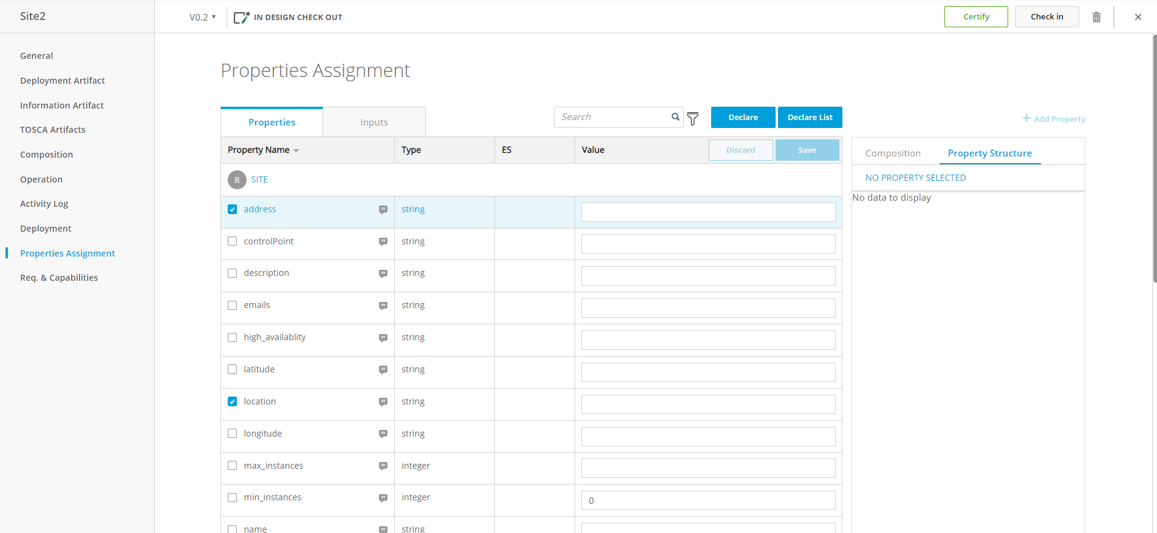
UI Enhancement for List Inputs
2. Click
‘Declare list’
1. Check to properties
to get value from list
Notes:
the followings are users UI operation image we assume.
the operations are similar to what users do in declaring inputs.
first: an user put a check in checkbox of property / of which value will be got from a list in inputs.
then click ‘Declare list’ button.
this button will be added to UI in this enhancement.

Slide 6
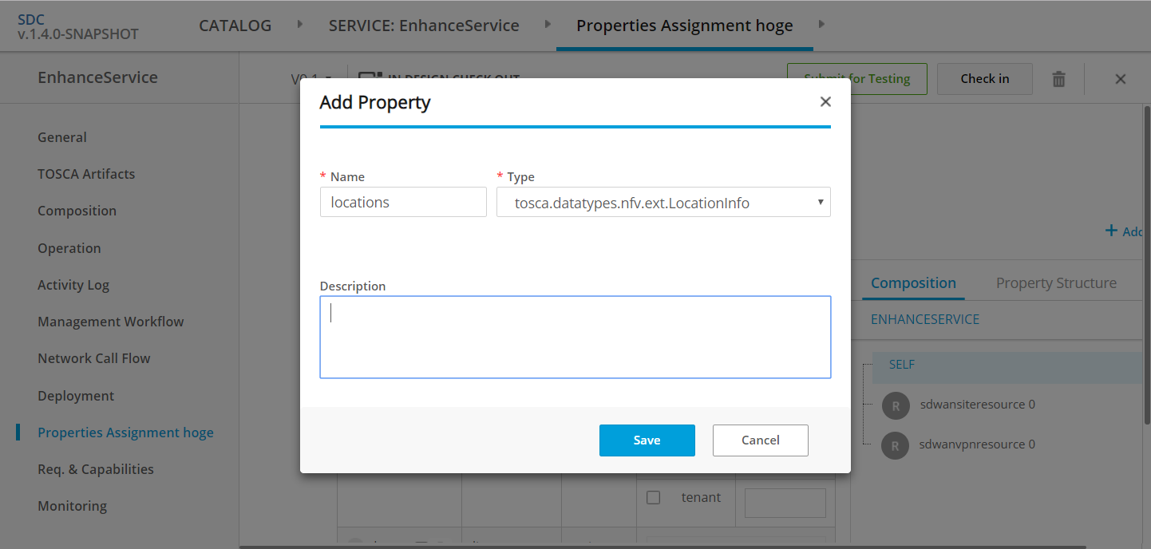

UI Enhancement for List Inputs
Declare List Input
1. input name
□ use existing list
2. data type (entry_schema)
org.openecomp.datatypes.vfc.location
3. Property names
of the data type
(same as checked properties)
Property
address, location
tenant
4. Click ‘SAVE’
Notes:
then this dialog will appear. the user defines a new list input for the property.
user can specify input name,
and data type which means entry_schema of the list in tosca.
this data type will have properties the user selected in previous page.
after clicking ‘Save’ button, REST api to create the list input will be called and database will be updated in backend.

Slide 7
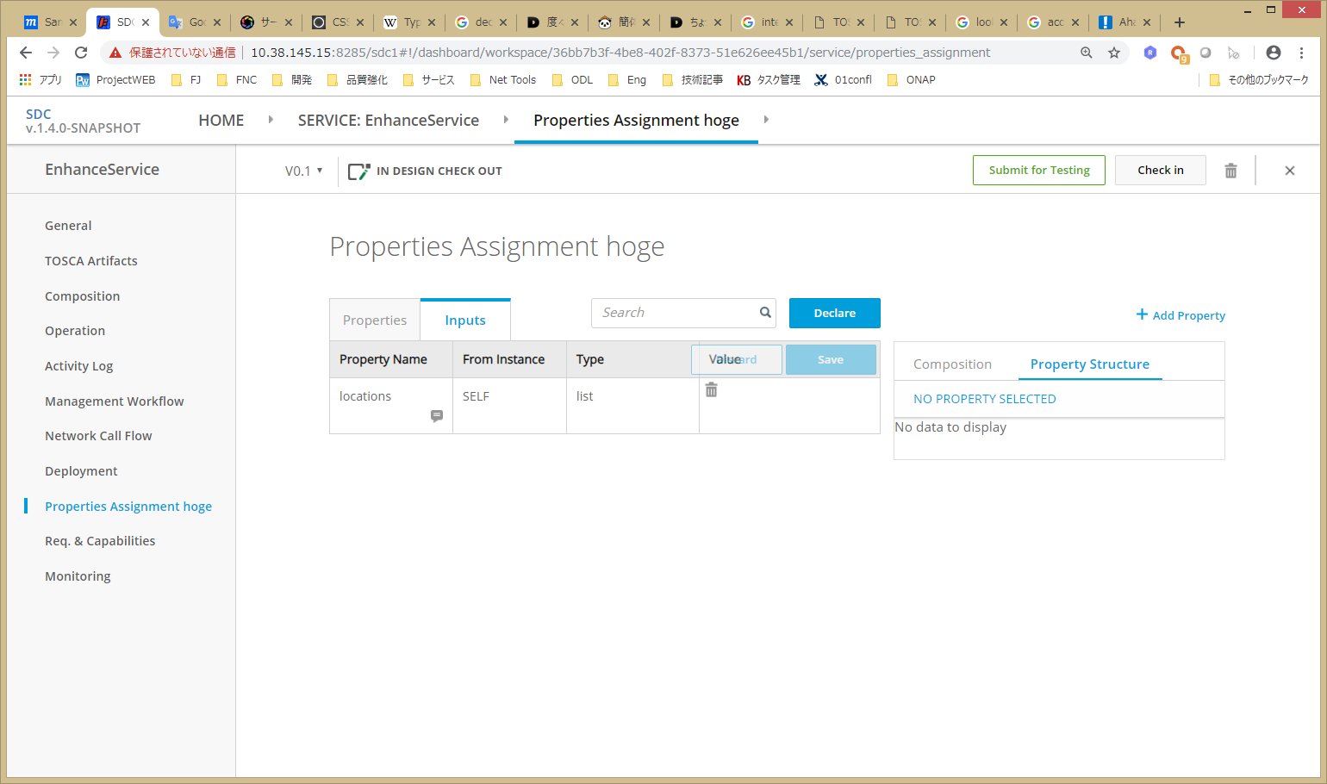
UI Enhancement for List Inputs
SDWANSITE
list type input is declared
Notes:
then,
in ‘inputs’ tab, the new list input will appear.
user can delete it by just click trash icon, then all references to this list will be removed from properties.

Slide 8
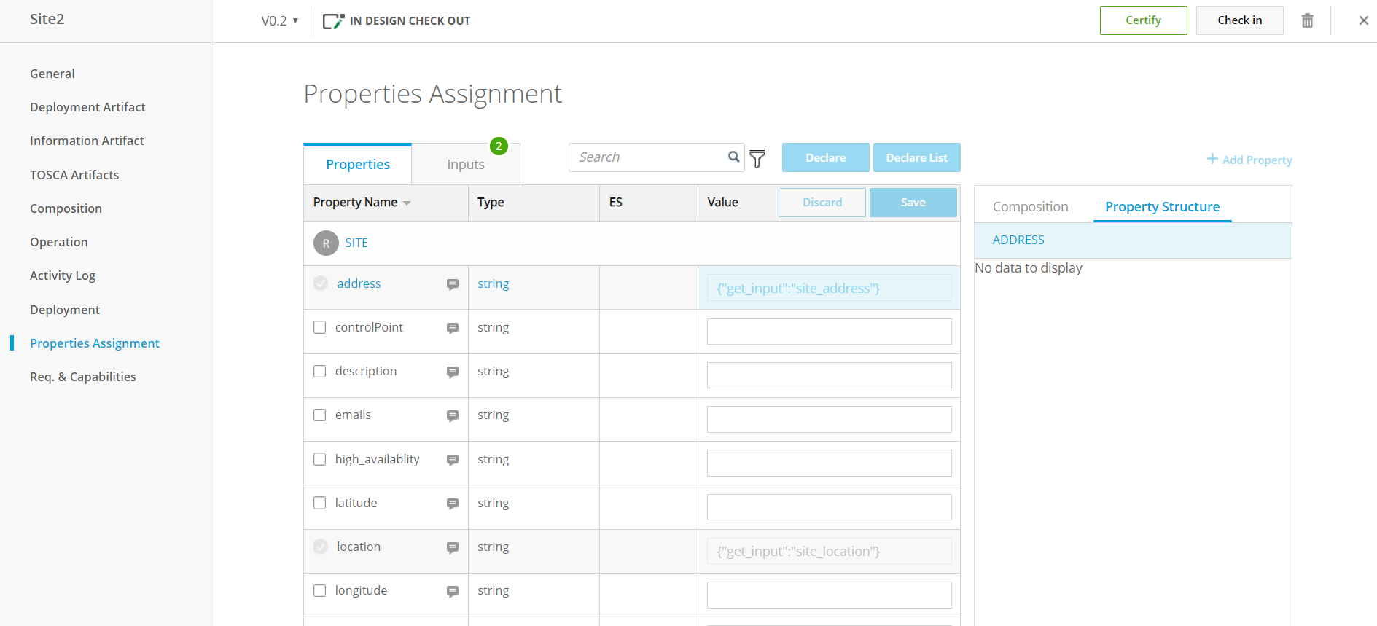
UI Enhancement for List Inputs
{“get_input”:[“locations”,”INDEX”,”address”]}
now the properties refer to item in the list input
{“get_input”:[“locations”,”INDEX”,”location”]}
Notes:
after that the property will be uneditable and have a reference to the property of the list item user specified.
when the user looks into ‘Properties’ tab,
the properties user selected are now uneditable and have references to the item list w/ get_input syntax.

Slide 9
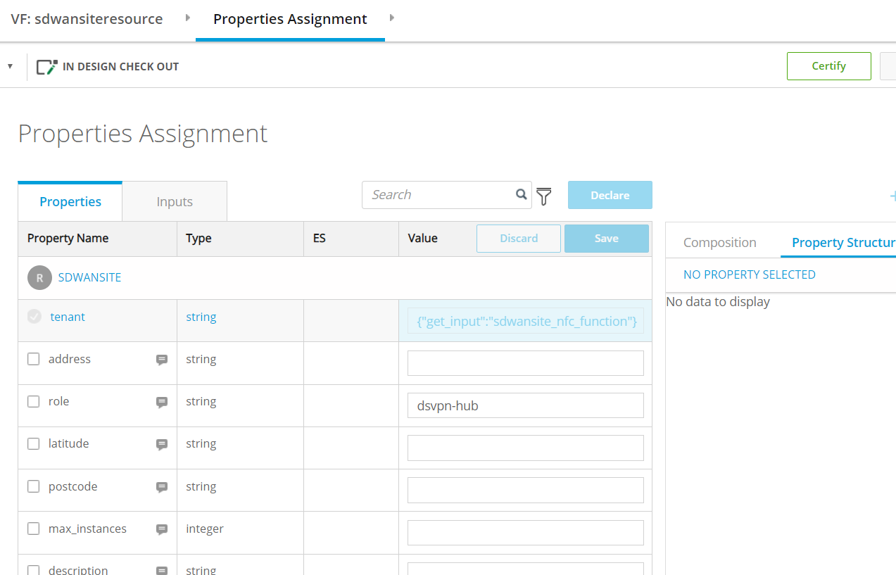
UI to TOSCA Mapping (Properties)
tosca_definitions_version: tosca_simple_yaml_1_2
description: Template for deploying SD-WAN with a variable number
data_types:
org.openecomp.datatypes.vfc.location
properties:
location:
type: string
address:
type: string
topology_template:
inputs:
numberOfSites:
type: integer
locations:
type: list
entry_schema: org.openecomp.datatypes.vfc.location
node_templates:
sdwan:
type: VPN
vpe:
type: vPE
site:
type: VPNSite
properties:
location: { get_input: [ locations, INDEX, location ] }
address: { get_input: [ locations, INDEX, address ] }
location
{“get_input”:[“locations”,”INDEX”,”location”]}
{“get_input”:[“locations”,”INDEX”,”address”]}
Notes:
tosca model corresponding to the property will be generated like this.

Slide 10
UI to TOSCA Mapping (Inputs)
tosca_definitions_version: tosca_simple_yaml_1_2
description: Template for deploying SD-WAN with a variable number of data_types:
org.openecomp.datatypes.vfc.location
properties:
location:
type: string
address:
type: string
topology_template:
inputs:
numberOfSites:
type: integer
locations:
type: list
entry_schema: org.openecomp.datatypes.vfc.location
node_templates:
sdwan:
type: VPN
vpe:
type: vPE
site:
type: VPNSite
properties:
location: { get_input: [ locations, INDEX, location ] }
address: { get_input: [ locations, INDEX, address ] }
Data type will be defined
SDWANSITE
new list input be declared
Notes:
and the declared list input will be like this.
also data type will be defined in tosca.

Slide 11
Classes to be modified in Back-End
FE Proxy
BE
InputsServlet
PropertyServlet
RequirementsServlet
InputsBusinessLogic
PropertyBusinessLogic
RequirementsBusinessLogic
ToscaOperationFacade
Red classes are need
to be modified ?
DAO
Titan
In our understanding
Notes:
this is our thoughts / that which classes in backend to be modified by this coding work.
but we are not sure whether it is correct or not
because we just started to learn SDC a few weeks ago and we only have a superficial knowledge.
so it will be very helpful if you provide advices to us how to / where we should take a look to implement this feature.

Slide 12
Time Schedule
Sun. | Mon. | Tue. | Wed. | Thu. | Fri. | Sat.
March 17 | 18 | 19 | 20 | 21 | 22 | 23
24 | 25 | 26 | 27 | 28 | 29 | 30
31 | April 1 | 2 | 3 | 4 | 5 | 6
Judge
Doc review
Detail Investigation & Documents
Setup development env.
Coding
Doc review
Coding (/w JUNIT Test)
Coding
Code review
Submitting
for review
Unit Testing & SONAR
Final
Submitting
Risk :
The volume of implementation has not been estimated yet.
There are concerns that the target TOSCA models are incomplete and the behavior of the GUI is not clear. We should judge the status of these concerns in time for Dublin by 3/22.

Slide 13
Confirmation
Is there anything we need other the process wrote on the schedule slide?
Do we need status report? (Who should we report to?)

