Slide 1
ONAP Network Slicing Model
5G Use Case Team - Borislav Glozman (Amdocs)
Feb, 2019

Slide 2
Outline
Network Slicing definition
Network Slicing SDC model
SDC features to support Network Slicing model
Information Model
Tosca templates

Slide 3

5G Network Slicing - Services
ONAP 5G: Service Providers (SP) need to support a rich set of advanced 5G services for mission critical communications, such as
enhanced Mobile Broad Band (eMBB)
Ultra-Reliable, Low-latency Communications (URLLC )
massive Internet of Things (mIoT)
Disaggregated Core
AMF
PCF
NSSF
NRF
CU-CP-H
UPF
SMF
UDM
AUSF
CU-CP-L
Internet
RU
DU
CU-UP
Centralized
Cloud
UE/CPE
Front Haul
Mid Haul
Back Haul
External Content
Edge Cloud

Slide 4
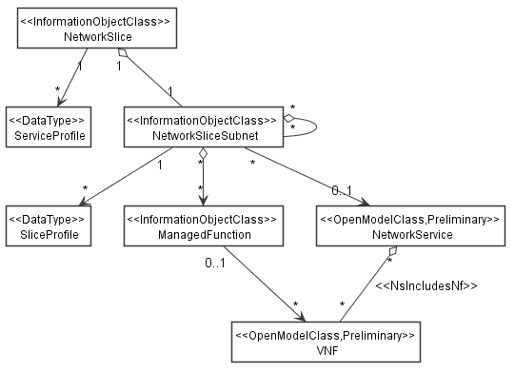
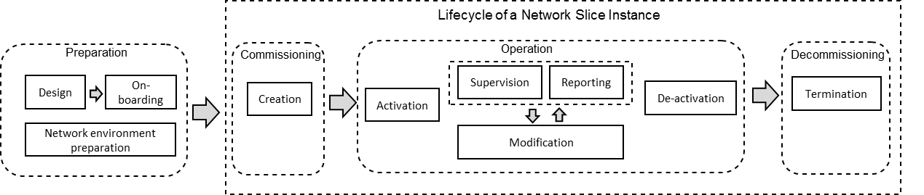
3GPP 5G Network Slicing Concept leveraged by ONAP
3GPP TS 28.541
3GPP TR 28.801
A service instance is realized by one or more network slice instances (NSIs), that in turn consists of network slice subnet instance(s) (NSSIs).

Slide 5
ONAP Network Slicing – Design Steps
ONAP Service Designer define TOSCA templates for the reusable tasks:
Model a RAN NSST, defining parameters that represent set of cells (tracking area), bandwidth, latency, priority etc.
Model a CN NSST with parameters like “capacity” and others
Model a suitably isolated transport network template for connecting the RAN to Core Network with QoS, bandwidth, resiliency and other parameters
Model a Network Slice Template to be used to instantiate, modify, and remove the Network Slice (Network Slice as a Service)

Slide 6
Network Slice modeling
The proposal is to have different models for different network slices and slice segments.
There should be a model for eMBB slice and a different model for URLLC slice. The models will differ by composition of the comprised network slice segment services.
Some models can have shared RAN while dedicated Core and Transport, others can have shared RAN, Core and Transport while yet others can have dedicated RAN, Core and Transport.
The models should have parameters that operator will need to fill upon instantiation of the network slice / segment. The intention is to keep the number of these parameters as low as possible in order to reduce the need for operator to provide too much data. Internally the parameters should be interpreted into multiple services parameters as needed.
For example: E2E slice maximum latency. This parameter will be on the Network Slice level, it will be mapped to segment level parameters and will be used in orchestration and homing to fulfill the required slice behavior. The orchestrator shall have a workflow associated to this slice with the ability to select segments according to allowed latency, and calculate the total maximum latency, summarizing the latency of each segment.

Slide 7
Example: eMBB Network Slice
eMBB SVC
PNF
eMBB-NS
Transport Network
VNF
eMBB-NS
Shared
Properties:
TAs:
Latency: TBD
Mobility: fully mobility
resourceSharing: shared
Dedicated
eMBB-NSS
5G-RAN-NSS
LTE-EPC-NSS
RIC
TRANS-NSS
VL
CU-CP
EPC-CP-SVC
TN
VL
DU
CU-UP
EPC-UP-SVC

Slide 8
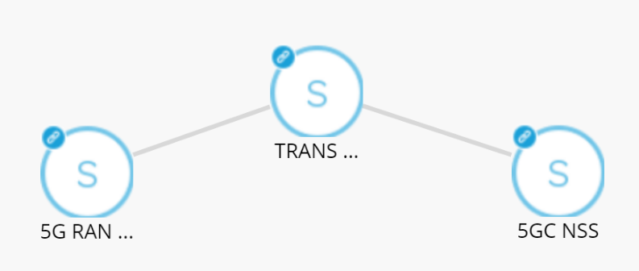
Example of 5G eMBB Network Slice Segment modeling
Example eMBB NSS consists of 5G-RAN-NSS, 5GC-NSS and TRANSPORT NSS.
eMBB-NSS

Slide 9
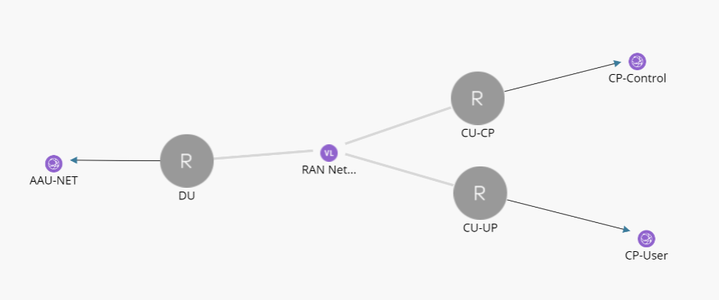
Example of RAN NSS modeling
Example 5G RAN NSS consists of DU, CU-CP and CU-UP and virtual links between them.
There are also External Connection Points.

Slide 10
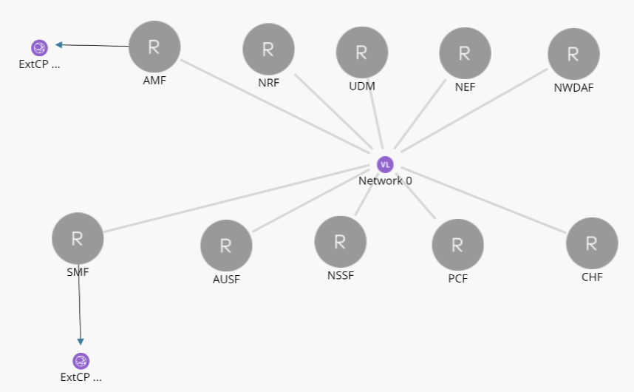
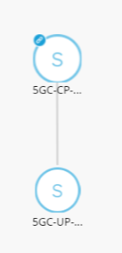
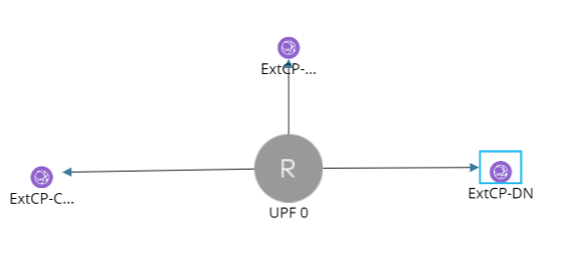
Example of 5G Core modeling
Example 5GC NSS consists of 5GC-CP-SVC, 5GC-UP-SVC and virtual links between them.
There are also External Connection Points.
5GC-CP-SVC
5GC-UP-SVC

Slide 11
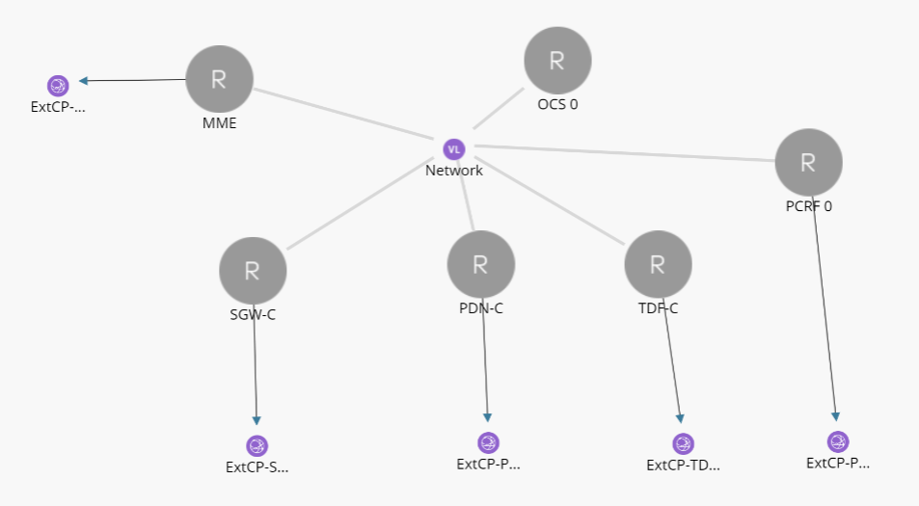
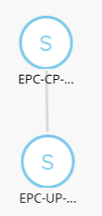
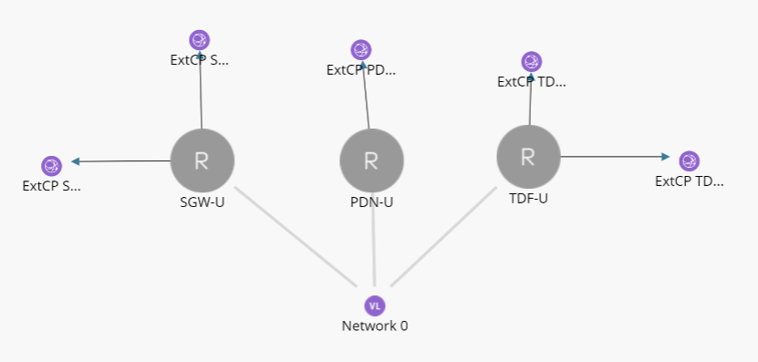
Example of EPC NSS modeling
Example EPC NSS consists of EPC-CP-SVC, EPC-UP-SVC and virtual links between them.
There are also External Connection Points.
EPC-CP-SVC
LTE-EPC-NSS
EPC-UP-SVC

Slide 12
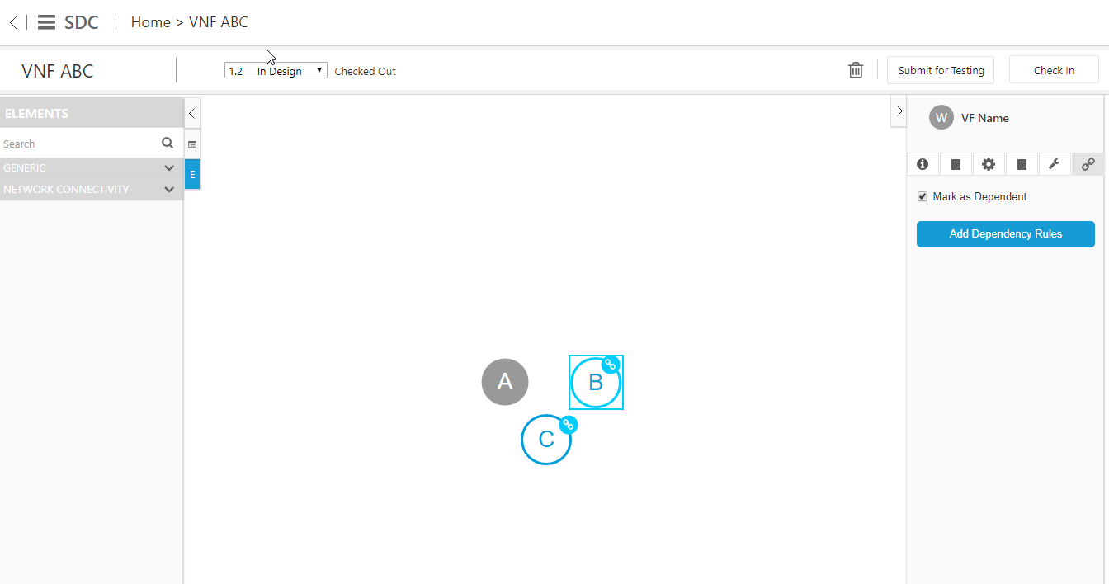
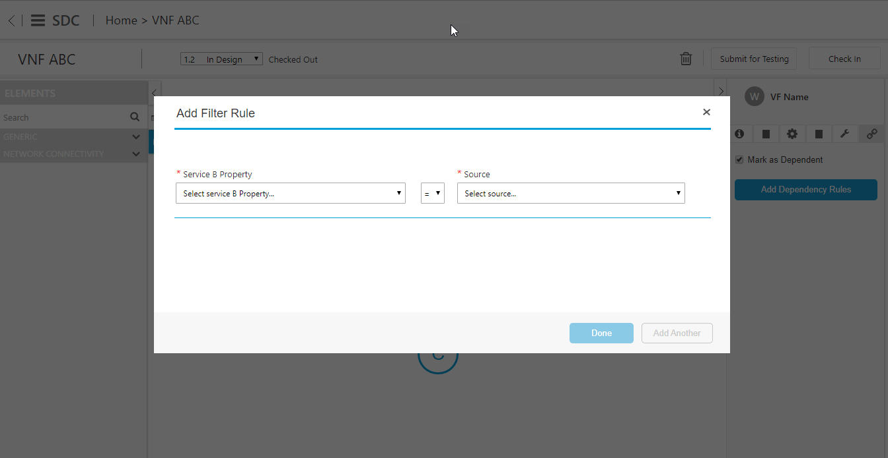
Service Modelling enhancements - Amdocs contribution in SDC
FEATURE | DESCRIPTION
Service dependencies | In Beijing there is the ability to model hierarchies, however there is no way to declare if the child service should have their own lifecycle or not i.e. is it an association or composition. In Dublin the ability to define rules on the child for the orchestrator to find an existing service instance of the correct specification will be added, this feature will use a TOSCA node filter in the model.
NEW

Slide 13
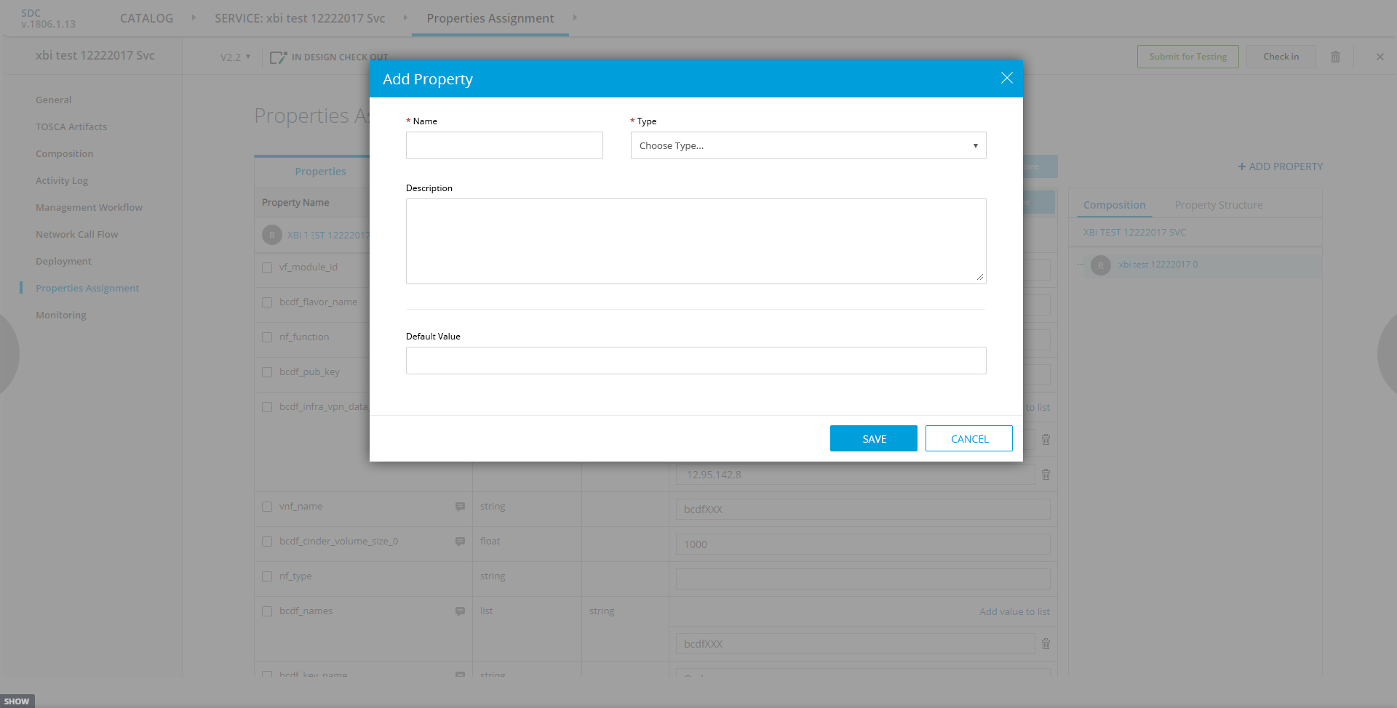
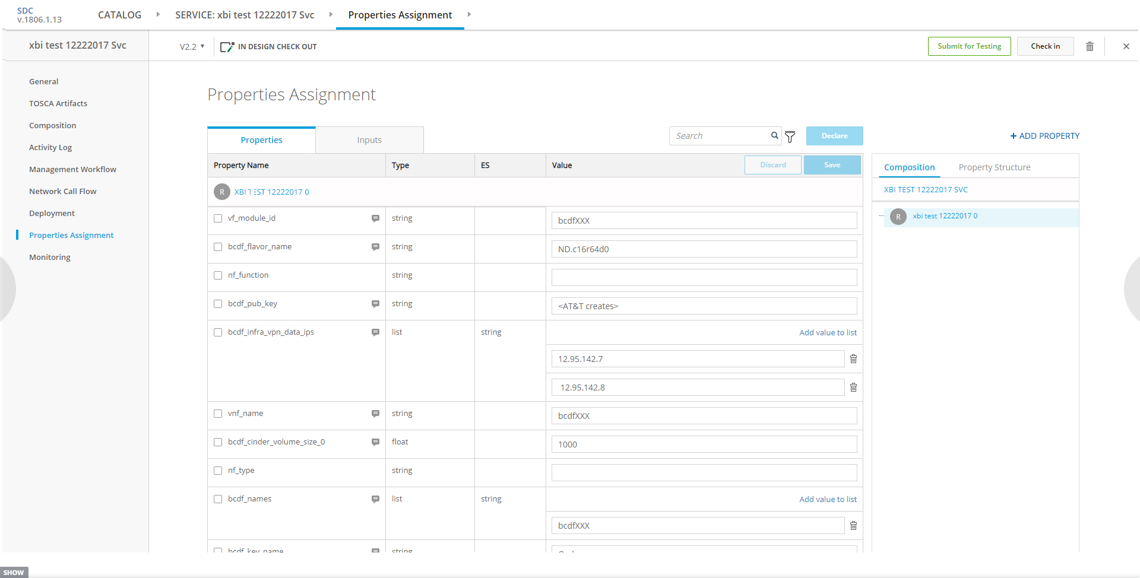
Service Modelling enhancements - Amdocs contribution in SDC
FEATURE | DESCRIPTION
Service properties top down modelling | In Beijing there is no way to define top down properties on a service you can only promote properties from children limiting the ability to model inputs used in processing the service. In Dublin the ability to add properties will be added to a Service and VNF
NEW

Slide 14
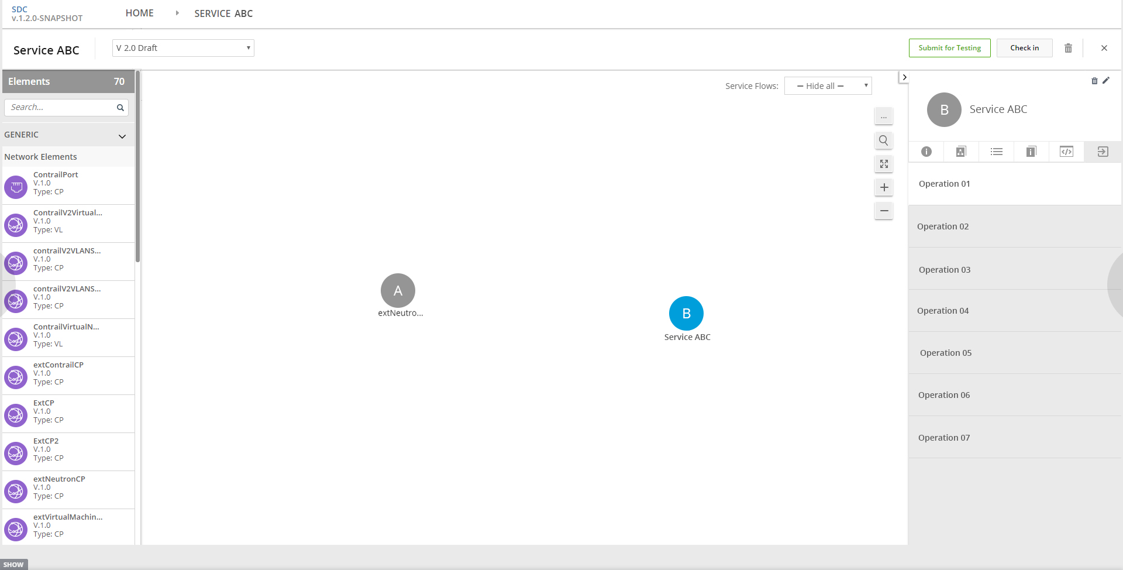
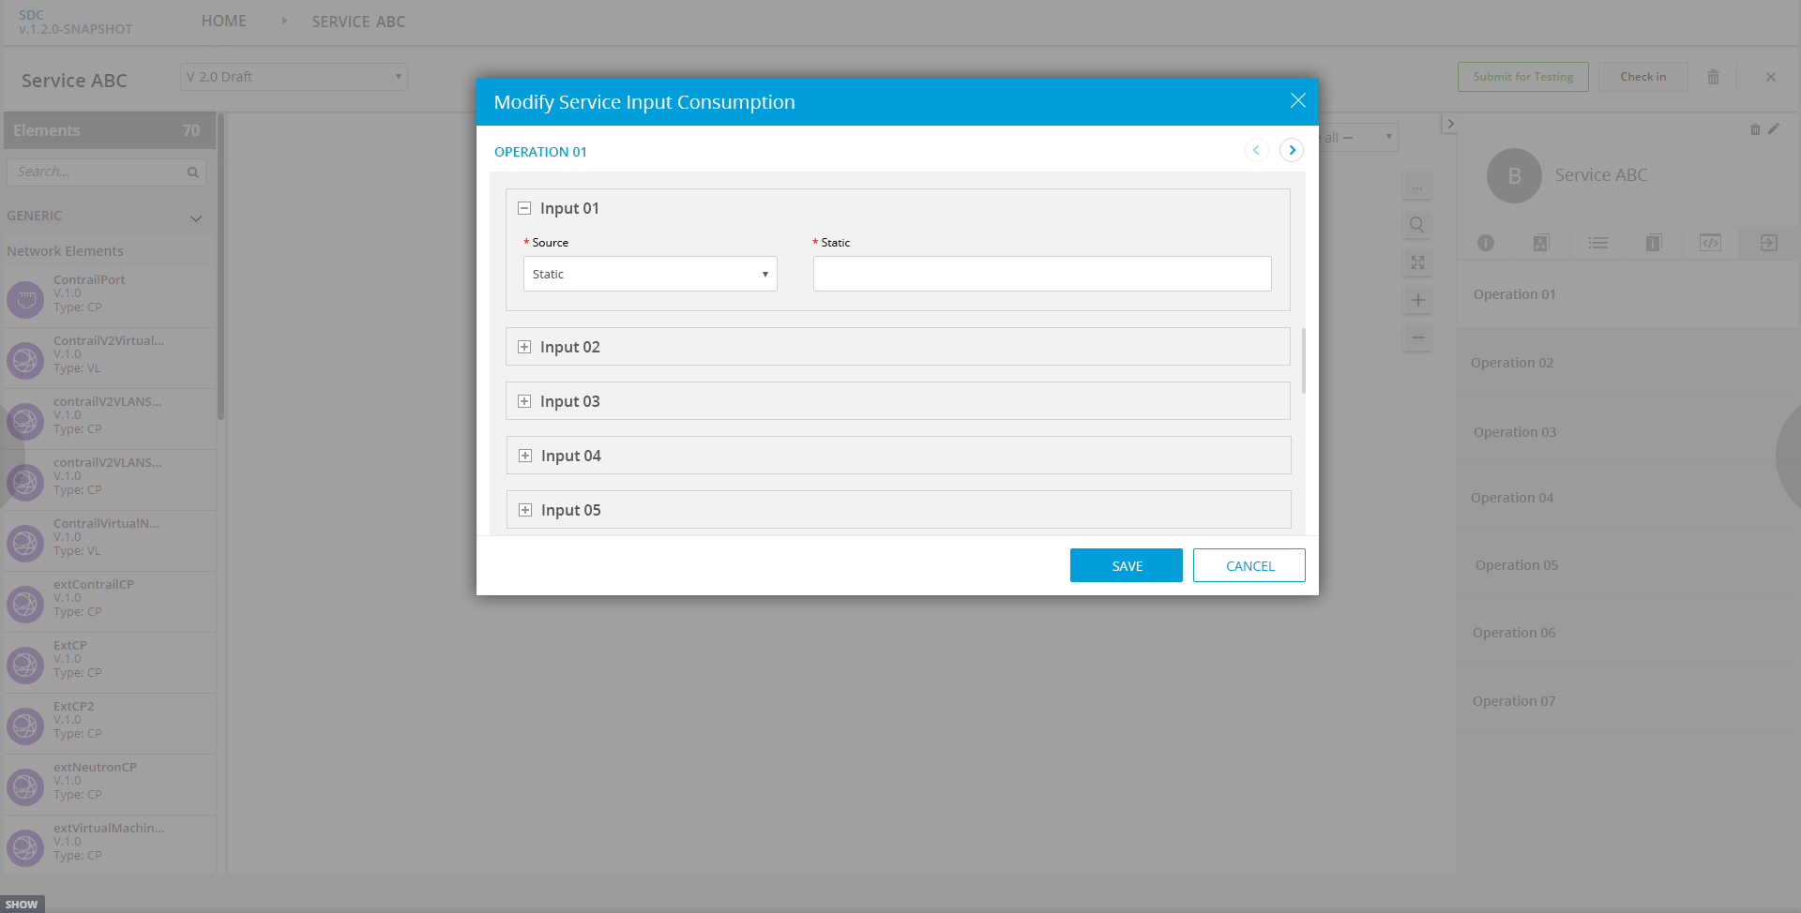
Service Modelling enhancements - Amdocs contribution in SDC
FEATURE | DESCRIPTION
Service operations (with associated workflows) | In Beijing operations were added to VNFs including mapping of the properties needed by each operation, additionally workflows were added and an association to a given operation in support of change management. In Dublin this same pattern will be replicated on a service. In addition we will allow creating of workflows in context of operation
NEW

Slide 15
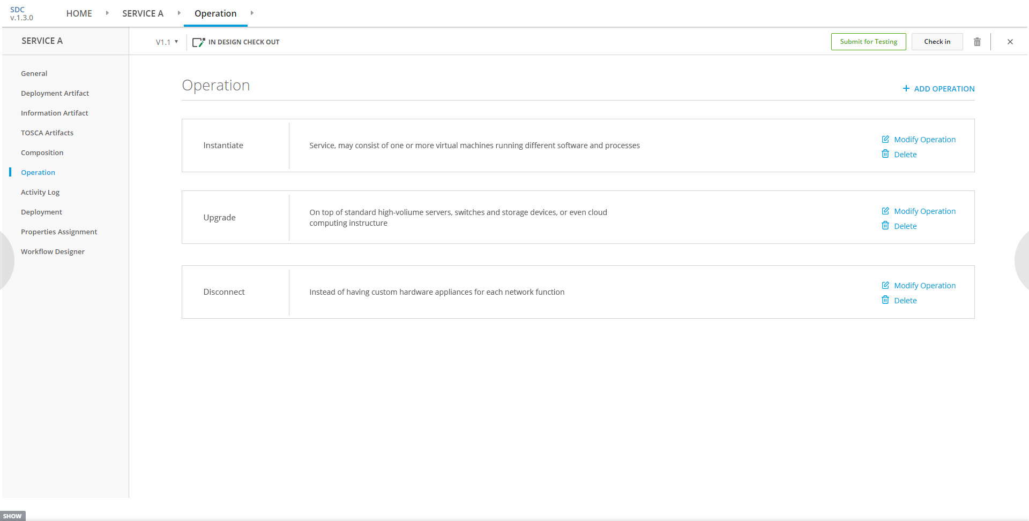
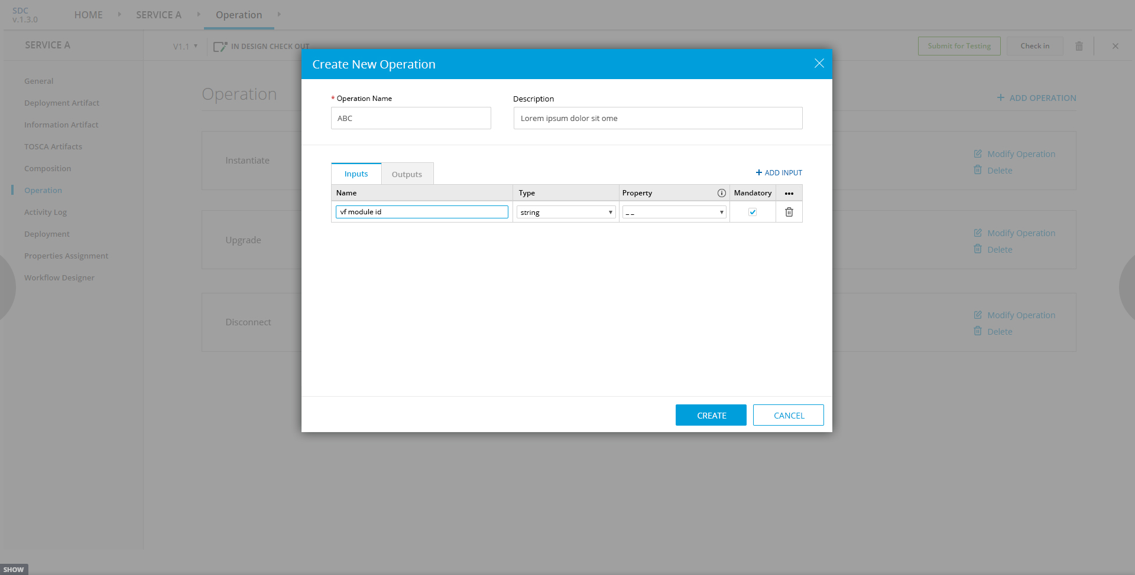
Service Modelling enhancements - Amdocs contribution in SDC
FEATURE | DESCRIPTION
Consumption of service children operations | In Beijing there is no way to assign a value to a child (service or VNF) operation input. In Dublin the ability to define child operation input data including mapping from other children, static values and input properties
NEW

Slide 16
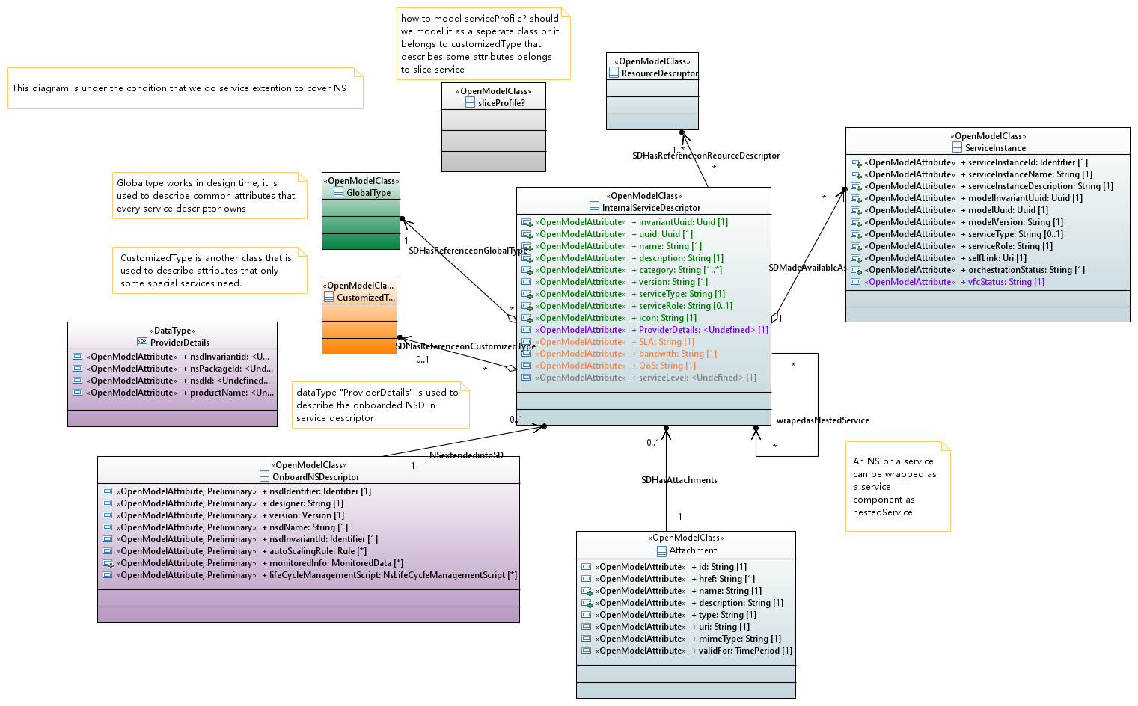
Information model
Hold 3GPP TS 28.541 NRM parameters
Add here a Class which will hold information:
Sharing (Boolean)
Filter Rules (List o FilterRule)
FilterRule class will hold properties for nested service selection according to which Tosca Node Filter will be created.

Slide 17
Tosca template example
tosca_definitions_version: tosca_simple_yaml_1_1
metadata:
invariantUUID: 64139478-5b7c-4da9-bf3e-5f4a8f0f4243
UUID: 8ec2fed7-a759-43b0-aafd-b9cd6b8dbced
name: eMBB NSS
description: Enhanced Mobile Broad Band Network Slice Subnet
type: Service
category: Network Service
serviceType: ''
serviceRole: ''
instantiationType: A-la-carte
serviceEcompNaming: false
ecompGeneratedNaming: false
namingPolicy: ''
environmentContext: General_Revenue-Bearing
imports:
- nodes:
- datatypes:
file: data.yml
- capabilities:
file: capabilities.yml
- relationships:
file: relationships.yml
- groups:
file: groups.yml
- policies:
file: policies.yml
- annotations:
file: annotations.yml
- service-eMBB NSS-interface:
file: service-EmbbNss-template-interface.yml
- resource-serviceProxy:
node_types:
org.openecomp.nodes.netaas_proxy:
org.openecomp.nodes.5gcnss_proxy:
org.openecomp.nodes.5grannss_proxy:
topology_template:
node_templates:
TRANS NSS:
5G RAN NSS:
type: org.openecomp.nodes.5grannss_proxy
directives:
- selectable
node_filter:
properties:
- RAN Latency:
less_than:
- eMBB NSS
- Latency
- Mobility:
equal:
- eMBB NSS
- Mobility
- ResourceSharing:
equal:
- eMBB NSS
- ResourceSharing
metadata:
requirements:
capabilities:
5GC NSS:
substitution_mappings:

Slide 18
Thank you

