Slide 1
ONAP Seccom access management
Natacha Mach
December, 2019.

Slide 2

Open issue
Subject:
user management (at ONAP level) and access control are not (well) implemented.
This concerns mainly all components.
➔ Usually only one common account e.g. admin with associated privileged rights, without any customization of the access rights perimeter.
Potential impact: no partitioning of the data and services accessed by users.
ONAP_COMPONENT
User_A
Tenant_T1
Tenant_T2
Access without predefined perimeter = customized access rights.
Could instanciate other users’ services, or on other organisations’ tenants.
Service_S1
Service_S4
Service_S2
Service_S5
Service_S3
Service_S6
User_B

Slide 3
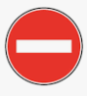
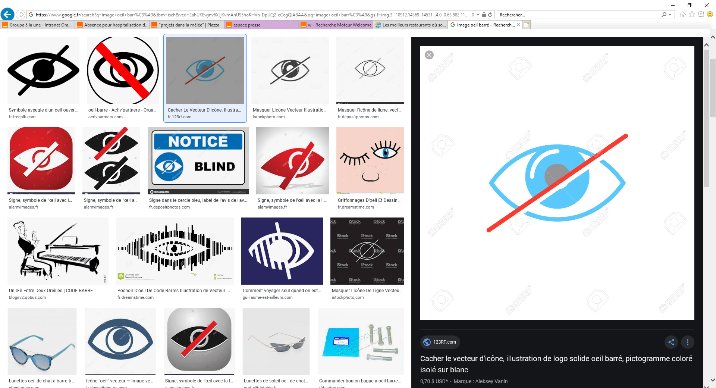
To be solved? Proposal?
Users should instanciate services only on their tenants, and only their own services.
Users cannot have the knowledge of other users’ services, neither other organizations.
ONAP_COMPONENT
User_A
Tenant_T1
Tenant_T2
Access without predefined perimeter = customized access rights.
Service_S1
Service_S4
Service_S2
Service_S5
Service_S3
Service_S6
User_B

Slide 4
Sensitive information storage
Are there clear guidelines regarding the storage of sensitive informations?
  Credentials ➔ ongoing with K8S secrets.
Some informaiton do not have the adequate treatment
  e.g. storage of credentials and URI in the AAI?
  Credentials in the DCAE?

Slide 5
Thank you

