Slide 1
ONAP JIRA for modeling
Ericsson,
Michela Bevilacqua
2018/11/20

Slide 2
ONAP Dublin Modeling Requirement: today in wiki page
Modeling High Level IM Brainstorming wiki page:
what is the status of this proposal ????
Following are a few development areas to consider.
Resource
  PNF
  Allotted (Contribution Posted)
  Network Function (perhaps related to rooting descriptors and instances below)
Service
  Network Service
  Service Instance (Runtime)
Infrastructure
  Multi-VIM/Clouid
Common
  VES (Some Material Posted)
  License
  Rooting Descriptors and Instances
  Policy
Other
  Onboarding and Runtime Model Classes
Resource IM wiki page: req list :
Allotted Resource
VES Model
Abstract NF
PNFD
VNF Instance Update
Common IM wiki page: no req list, a contribution only
Policy
Service IM wiki page: no req list
Service Instance
Service IM with NS
Infrastructure IM wiki page: no R4 page, no req page
Papyrus: no R4 page, no
Data Model wiki page: no req list
TIDM pages

Slide 3
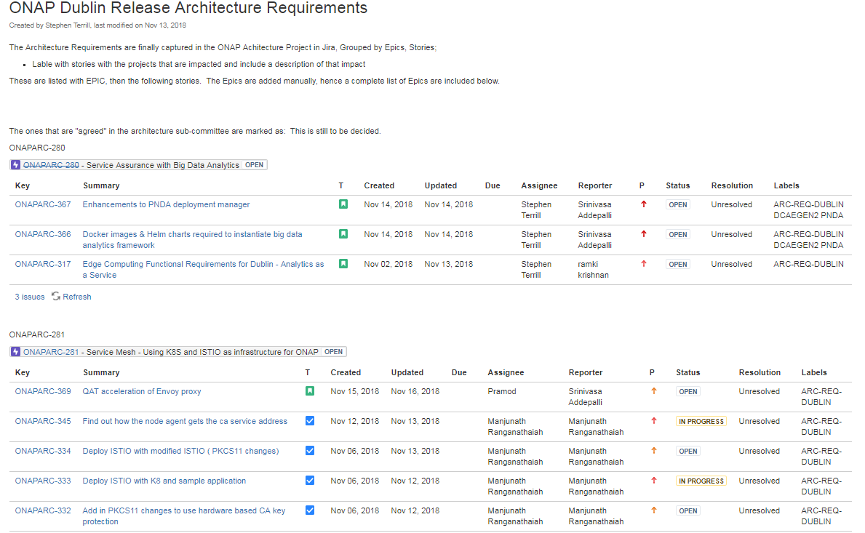

Slide 4
WHY JIRA
Problem of WIKI confluence
  Too many wiki pages,
  Too Difficult to find the relevant updated information….old pages mixed with the new ones…
JIRA introduces:
  Single Ordered and updated list of ongoing activities across teams (IM/DM) in a single place
  Link jira ticket to wiki pages for MoM, Reports…details…
  Filter and order per labels as “REQ-DUBLIN”, “EXPERIMENT NEW PROPOSAL”
  Reporter identification
  Introduce priorities per task
  Introduce dependencies across modelling tasks (i.e. Allotted resource introduction has IM/DM tasks) or development tasks
  Contextual attachments
  Comments can be provided by the community per task

Slide 5
Proposals for ONAP Modeling subcommittee
Introduce ONAP Dublin Release Modelling Requirements across IM/DM teams
Use Jira tool to track all the ongoing activities of the ONAP modelling subcommittee
ONAP modelling subcommittee teams can refer to specific jira tasks in wiki pages
Jira tasks can refer to ONAP modelling subcommittee wiki page active

Slide 6
ONAP Dublin Release Modeling Requirements
ETSI NS
  NS is it a resource or Service ? (a jira task)
ETSI VNF
  “Onboarding data model”: ETSI VNF new data type in onboarding model
  Onboarding data model: ETSI VNF node type updates
Allotted Resource and application
  Internal data model:
Abstract Network Function
  Do we need a Common NF for VNF, PNF, ANF Descriptors ?
VES
  VES IM
License
  License IM
Policy
  Policy IM
ETSI PNF
  PNFD IM
  PNFD Onboarding data model
  PNFD Internal data model
  PNFD mapping

