Slide 1
Secure Communications between xNFs and ONAP
ONAP SECCOM
August 20, 2019

Slide 2
Background certificate handling
For avoiding confusion this material will be focused in securing external interfaces.
Note: Several components uses third party
software for setting up mTLS with xNF.
ONAP
B
A
C
xNF
= internal (K8s)
= external (xNF)

Slide 3
Background from Dublin
Currently not a centralized solution as there are components not using AAF for external mTLS
  AAF CA is made available and AAF currently generates a certificate which can be installed into, e.g DCAE. – link
  This functionality is primarly intended to be used for internal ONAP communication. No seperate files or certificates
  are provided for external mTLS (including trusted cert).
Each component has a slighly different solution including file format (PEM/PKCS12/JKS)
DCAE VES collector
  Documentation
DCAE HV-VES collector
  Documentation
DCAE Data File collector
  Documentation
SDNC/OpenDaylight
  Documentation

Slide 4
Background from Dublin targets
Project | Description
AAF | AAF provides an API that allows SO (or some ONAP component) to trigger the IAK/RV scenario execution and returns the IAK, RV and CA URL.
AAF | AAF is able to execute the scenario to obtain an Initial Authentication Key (IAK) and Reference Value (RV) from a SP CA on behalf of a VNF.
AAF | AAF is able to be initialized as RA to the Service Provider (SP) CA.
AAF | AAF is able to act as a CA for lab/test environments where there is no SP CA and to be able to provide X.509v3 certificates to VNFs using CMPv2 protocol as specified by RFC 4210.
Not ready
Not ready
Not ready
Not ready
Security communications between xNFs and ONAP (PA3)

Slide 5
Frankfurt security enhancements

Slide 6
Certificate handling for External interfaces
Standalone PKI mgmt
Why not only supporting SCEP?
Non-standardized protocol
IETF states it as a historical and instead refers to use standardized protocols and CMPv2.
SCEP Vulnerability note – link
RFC for SCEP (draft) - link
CA
Hierarchy
CA
Hierarchy
Why not using SCEP?
Non-standardized protocol
IETF states it as a historical
IETF refers to instead use CMPv2
SCEP Vulnerability note - link
RA
CMPv2
CMPv2
ONAP
AAF
mTLS
“RA”
PNF
…
Trusted Cert.
DCAE
Trusted Cert.
SDN-C
Notes:
In the last session we showned this reference overview solution where the suggestion was to use CMPv2 for external certificate handling with the service providers CA for ONAP.
It is important to remember that what protocol is used by xNFs for enrollment is separate from protocol used by ONAP components.
For ONAP components, there have been some recent discussions that the SCEP protocol might solve this, and that we do not need to complement with CMPv2. Sure, SCEP, or the Simple Certificate Enrollment Protocol, is a legacy solution that many still are using in the industry. Backwards compability to legacy systems might be needed for some, but it is not a secure long-term solution.
SCEP is still a non-standardized protocol as it never left the draft. You could expect properitary solutions to vary.
IETF clearly states in the RFC draft, that SCEP is a historical protocol and is not recommended to be used in new systems
IETF refers instead to use standardized solutions, where CMPv2 is suggested, for ensuring long term security.
SCEP is also said to be vulnerable, as it does not strongly authenticate certificate requests.
This might not always apply depending on the propiertary solution.
There are also several reasons for why CMPv2 is needed.

Slide 7
CMPv2 recommendations according to 3GPP
Operator root certificate is pre-installed.
RA/CA
SEG
Vendor root certificate is pre-installed.
CMPv2
IPsec
Enrolled base station certificate is used in IKE/IPsec.
3GGP cleary states that CMPv2 is the recommended protocol to be used by the radio base station today. CMPv2 is therefore an established protocol for certificate management that vendor CA’s and operator CA’s today already supports
Vendor-signed certificate of base station public key is pre-installed.
base station
The base station obtains the operator-signed certificate on its own public key from RA/CA using CMPv2.
3GPP: TS 33.310
Notes:
3GGP cleary states that CMPv2 is the recommended protocol to be used by the radio base station today. This is therefore an already established protocol for PKI management that vendor CA and operator CA’s today already supports, if they follow 3GPP.

Slide 8
Certificate handling for External interfaces
Standalone PKI mgmt
CA
Hierarchy
CA
Hierarchy
ONAP CMPv2 - Use Cases
ONAP internal components to receive certificates from external CA that already today uses CMPv2.
xNF might require certificate via AAF and external CA according to 3GPP.
RA
CMPv2
CMPv2
ONAP
AAF
mTLS
“RA”
xNF
…
Trusted Cert.
DCAE
Trusted Cert.
SDN-C
Notes:
With the already established CMPv2, this could be used in ONAP for easier external CA integration. We mentioned that there are already today two use cases which would require CMPv2.
ONAP internal components to receive certificate from external CA that already today uses CMPv2
xNF requires to receive certificate via AAF and external CA. However, this UC is only valid in the case a CMPv2 server will be in ONAP.

Slide 9
CMPv2 recommendations according to 3GPP
CMPv2 protocol should be used as specified in RFC 4210 and RFC 4211
As RA/CA, an operator may deploy:
  Alternative 1: Stand-alone CA implementing a CMPv2 server
  Alternative 2: CA having delegated certain tasks to an RA, which in this case
  operating the CMPv2 server
.
3GPP: TS 33.310
Notes:
CMPv2 usage is standardized in RFC 4210 and the Certificate Request Format in RFC 4211.
As discussed in last session there are two alternatives for deployment. I will briefly just mention them as I assume you are now familiar with them.

Slide 10
CMPv2 solution alternative 1
Standalone PKI mgmt
CA
Hierarchy
CA
Hierarchy
Pros
Easier integration for ONAP components to have one centralized CMPv2 client.
Cons
Vendors can not use assumed CMPv2 client in the xNF
directly via a RA in ONAP
CMPv2 server
RA
CMPv2
CMPv2 client
CMPv2 client
ONAP
AAF
mTLS
RA
xNF
CSR
…
Trusted Cert.
DCAE
Trusted Cert.
SDN-C

Slide 11
CMPv2 solution alternative 2
Standalone PKI mgmt
CA
Hierarchy
CA
Hierarchy
Pros
Vendors can utilize assumed CMPv2 client in the xNF
directly via a RA in ONAP
Cons
CMPv2 client in ONAP components requires implementation support
RA
CMPv2
CMPv2
CMPv2 server
CMPv2 client
ONAP
CMPv2 client
AAF
mTLS
RA
xNF
CSR
CSR
…
CMPv2 client
CSR
Trusted Cert.
DCAE
Trusted Cert.
CSR
CMPv2 client
SDN-C

Slide 12
Recommendations
PKI management for commercial deployments are assumed to be located outside ONAP. Industry standardized protocols for ONAP interaction with service providers CA is required. CMPv2 should be the targeted protocol.
  Alternative 1, with a CMPv2 client should be the targeted solution for Frankfurt
  Logical placement would be to have this CMPv2 client in AAF
.

Slide 13
Modification of Dublin targets
Project | Description
AAF | AAF provides an API that allows SO (or some ONAP component) to trigger the IAK/RV scenario execution and returns the IAK, RV and CA URL.
AAF | AAF is able to execute the scenario to obtain an Initial Authentication Key (IAK) and Reference Value (RV) from a SP CA on behalf of a VNF.
AAF | AAF is able to be initialized as RA to the Service Provider (SP) CA.
AAF | AAF is able to act as a CA for lab/test environments where there is no SP CA and to be able to provide X.509v3 certificates to VNFs using CMPv2 protocol as specified by RFC 4210.
Valid
Valid
Conflict
Conflict
Security communications between xNFs and ONAP (PA3)
Notes:
This recommended target is in direct conflict with the two previosly Dublin targets as they will not apply.
Regardless of CMPv2 solution, AAF will still be required to support IAK/RV functionality.

Slide 14
Recommendations
Suggestion is to integrate CMPv2 client with current AAF legacy solution for ONAP certificate handling.
This for using one centralized certificate handling procedure both for internal and platform external interfaces.
Development of CMPv2 client
Integrate with AAF CertMan
Validate over external interface
Standalone
PKI mgmt
1
2
3
ONAP
CA
Hierarchy
CMPv2
client
AAF
CertMan
CMPv2
server
…
CSR
DCAE
SDN-C
Notes:
In more details, the suggestion is then to integrate the CMPv2 client with current AAF legacy solution based around AAF CertMan. This for using one centralized certificate handling procedure both for internal and platform external interfaces. Thus, the creation of Certificate Signing Request in AAF and internal behavior will still be the same. I have then divided the work into three phases.
Development of CMPv2 client, which for instance include investigation for what is present today in open source and can be reused. Maybe it is possibly part of OpenSSL.
Second step is then to integrate with AAF CertMan and the legacy ONAP solution.
Then we also need to validate over external interface towards a CMPv2 server.

Slide 15
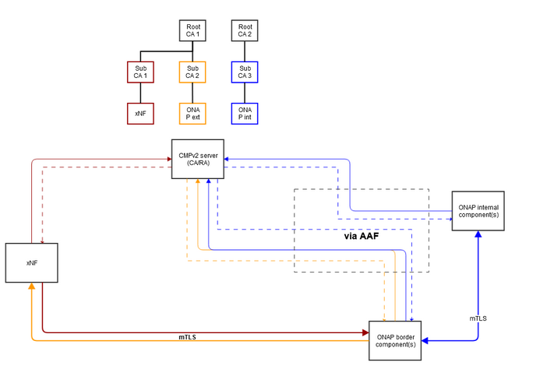
Recommendations
CMPv2 profiling to be used according to RFC 4210
Acquisition of IAK/RV is usually performed before CMPv2 is initially used.
ONAP internal components should have
certificates signed by different root CA.
ONAP border components should have
two certificates: external and internal.
Notes:
When talking about CMPv2, the recommended profiling to be used should be according to RFC 4210.
It is worth having in mind that, when performing the provisiong of the IAK and RV, this is usually not made with CMPv2 but instead before CMPv2 is used, out of band.
For a final recommendation. Seperation of CA root trees for internal and platform external interfaces would enhance security. As we can see in the picture to the right, which was actually made by Pawel from Nokia. In this proposal, we have one seperate Root CA that is shared between xNF, in red, and for ONAP border components, in orange. For internal ONAP components we are then having a seperate Root CA, that could be seen in blue. CMPv2 server is then assumed to be located outside of ONAP, and the components will interact with it in a centralized way via AAF and its planned CMPv2 client.

Slide 16
Suggested Frankfurt targets
Summary
Project | Description
AAF | AAF provides an API that allows SO (or some ONAP component) to trigger the IAK/RV scenario execution and returns the IAK, RV and CA URL.
AAF | AAF is able to execute the scenario to obtain an Initial Authentication Key (IAK) and Reference Value (RV) from a SP CA on behalf of a VNF.
AAF | AAF MUST support CMPv2 and is able to initialize a CMPv2 client to the Service Provider CA.
AAF | AAF MUST be able to provide X.509v3 certificates to ONAP components from a service provider CA using CMPv2 protocol as specified by RFC 4210 and RFC 4211. (Related to SECCOM-204)
AAF | AAF certificate management solution MUST be integrated and utilize the CMPv2 client for external PKI management capabilities with service providers CA.
ONAP security requirements | Update ONAP security requirements certificate management (“crypto” series) Possible add/modify requirements for above release targets. ONAP SHOULD use a centralized certificate management solution. ONAP SHOULD use separate CA root structures used for internal and platform external interfaces in commercial deployments.
SECCOM | Update wiki for Secure communication to Network Functions.
SECCOM | Revisit VNF Certificate enrollment proposal for Dublin. (Initial modification mentioned later in this material)
New
New
New
New
Notes:
For a summary of initial suggested targets for Frankfurt.
We first have two unchanged legacy targets from Dublin regarding IAK and RV functionality.
Then we have the first new target, saying that AAF is able to support CMPv2 and to initialize a CMPv2 client. I’m sorry for the wording here as it might not be expected to write them as possible ONAP requirements, instead of short target descriptions.
The next target, is regarding the ability for AAF to provide x509 certificate to ONAP components from a service provider CA using CMPv2 protocol. It is related to an already existing ONAP security requirement.
We then also have an integration target between the AAF legacy certificate management solution and the proposed CMPv2 client.
These three requirements, could then even possibly go into ONAP security requirements.
Additionally, it could be worth considering whether to define requirements for ONAP components to use a centralized management solution and for separating the CA root structures depending on internal and external interfaces.
We need to update wiki for secure communication guidelines, and also revisit VNF certificate enrollment proposal for Dublin. This I will briefly touch later in this material.

Slide 17
Related ONAP security requirements
Name | Jira ticket | Current requirement formulation
Crypto-1 | SECCOM-204 | AAF MUST support installation of certificates using CMPv2, for ONAP external mTLS communication.
Crypto-6 | SECCOM-209 | ONAP MUST provide the capability of allowing certificate renewal. ONAP MUST provide the capability of allowing certificate revocation.
Crypto-7 | SECCOM-210 | ONAP MUST provide the capability of testing the validity of a digital certificate by validating the CA signature on the certificate.
Crypto-8 | SECCOM-211 | ONAP MUST provide the capability of testing the validity of a digital certificate by validating the date the certificate is being used is within the validity period for the certificate.
Crypto-9 | SECCOM-212 | ONAP MUST provide the capability of testing the validity of a digital certificate by checking that the certificate has not been revoked.
Crypto-10 | SECCOM-213 | ONAP MUST provide the capability of testing the validity of a digital certificate by recognizing the identity represented by the certificate "Subject" field.
Crypto-11 | SECCOM-215 | ONAP MUST support the use of X.509 certificates issued from any Certificate Authority (CA) that is compliant with RFC5280.

Slide 18
Other topics to be discussed further
Acquisition of IAK/RV.
  Technical discussion possibly needed as this acquistion may vary depending on PKI solution. Initial assumption is that this process it not fully standardized.
Community CMPv2 server for testing
  For validating AAF CMPv2 Client
Revocation handling of certificates
  CRL/OSCP, any targets from AAF?
...

Slide 19
VNF Certificate Enrollment
Modification from Dublin targets

Slide 20
Summary of Impacts for Security Enhancements for Dublin
Project | Description
AAF | AAF is able to be initialized as RA to the Service Provider (SP) CA.
AAF | AAF provides an API that allows SO (or some ONAP component) to trigger the IAK/RV scenario execution and returns the IAK, RV and CA URL.
AAF | AAF is able to execute the scenario to obtain an Initial Authentication Key (IAK) and Reference Value (RV) from a SP CA on behalf of a VNF.
AAF | AAF is able to act as a CA for lab/test environments where there is no SP CA and to be able to provide X.509v3 certificates to VNFs using CMPv2 protocol as specified by RFC 4210.
DCAE | DCAE supports xNF authentication using the certificate and an identity list; no HTTP username/password required. Basic Auth is still supported for backward compatibility.
DCAE | DCAE replaces storage of passwords with storage of hashes.
Controllers | Controllers support Netconf/TLS for Configuration Management
VNF Requirements | Update VNF Requirements in the areas above, namely certificate management, authentication and Netconf/TLS support.

Slide 21
Problem statement
When a VNF is instantiated, it needs a way to obtain a certificate from the Service Provider’s (SP) CA that allows it to communicate with DCAE (via HTTP/TLS).
PNFs generally come with vendor certificates issued by the vendor’s factory CA that use the PNF serial number or MAC address as the identity.
This allows a SP to pre-provision the vendor’s factory root certificate into its CA and even pre-provision the PNF identity to authorize the PNF to request a certificate.
This pre-provisioning is not possible for a VNF. A VNF has no vendor certificate and no inherent identity.
Two options are supported by 3GPP for VNFs using CMPv2 as described in RFC 4210.
Option 1: PKCS#12 bundle is installed on the VNF at instantiation time.
  A proxy entity performs Certificate Enrollment with the CA on behalf of the VNF to request a PKCS#12 bundle from the CA and this is installed in the VNF during or after instantiation.
Option 2: VNF performs certificate enrollment with a one time use Initial Authentication Key (IAK)
  A proxy entity requests an IAK and Reference Value (RV) from the CA on behalf of the VNF. The IAK and RV are provisioned on the VNF during or after instantiation.
  After instantiation, VNF performs certificate enrollment with the CA via CMPv2 using the IAK to protect the Certificate Signing Request (CSR). The RV identifies the IAK to the CA.
Option 2 is still the preferred solution.
  AAF acts as the RA for the VNF in commercial deployments. (Not compliant)
  AAF provides an API to trigger AAF to obtain an IAK and RV on behalf of the VNF.
  AAF requests an IAK and RV on behalf of the VNF during the instantiation workflow and passes these to the VNF during instantiation.
  AAF acts as the CA for VNF certificate enrollment in an ONAP test/lab environment.
Notes:
first statement regarding having a RA inside of AAF will be non compliant and to be removed.

Slide 22
Stage B : Service Instantiation Part 1
Service Instantiation Part 1
Precondition: At ONAP deployment time, AAF CertMan is configured to be a CMPv2 client for the operator’s CA.
Service Provider (SP) decides to instantiate a new service instance in ONAP.
VID User or BSS/OSS system triggers Service Instantiation which includes a VNF.
SO triggers OOF for Homing assignments. This assigns the VNF to a cloud location.
SO creates AAI entries for Service and VNF.
SO calls Openstack to assign cloud resources. Note: Alternately, SO may call M-Cloud which calls Openstack (TBD).
SO updates AAI entry with cloud resources.
SO triggers SDN-C to create the network connections that Service needs.
SDN-C creates network and assigns UUID. SDN-C updates AAI entry.
SDN-C notifies SO that connections are created.
SO triggers AAF to gets an IAK/RV for the VNF, the CA root certificate, and the CA URL (new AAF API)
AAF gets an IAK/RV for the VNF, the CA root cert, and the CA URL.
BSS / OSS / VID
SO
OOF
SDN-C
AAF
AAI
OpenStack
B1
New Service
B2
B1
Service Instantiation
B2
B3
Homing Assignments
B3
B4
Create AAI Entry for Service and VNFs
B4
B5
Assign cloud resources
B5
Update AAI with cloud resources
B6
B6
Trigger create NW connections
B7
B7
B8
B8
Create network, assign UUID, update AAI
B9
B9
NW connections complete
B10
Request VNF IAK/RV, CA root cert, CA URL
B11
B10
B11
Get IAK/RV for VNF, CA root cert, CA URL
Notes:
Otherwise, the current version of this material is not affected much by the change and I will not go through the current sequences. That applies for the Service Instantiation parts…

Slide 23

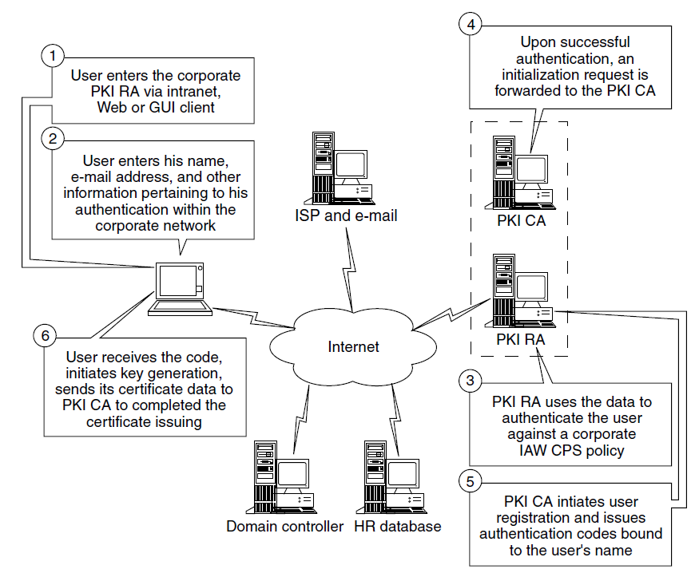
Stage C: VNF Security Credentials
VNF IAK/RV Obtained from CA
SO triggers AAF to request IAK/RV from CA. (New API)
AAF creates a request for IAK/RV.
AAF submits request to CA.
CA verifies request is from the RA and creates response containing IAK and RV.
CA sends response containing IAK, RV.
AAF returns IAK, RV, CA root cert and CA URL to SO
SO
AAI
AAF
CA
B8
C1a
B8
Request VNF IAK/RV
C1b
C1a
Create request for IAK/RV
C1c
C1b
Submit initialization request (ir) to CA
C1d
C1e
Verify request came from AAF
Create IAK and RV
C1c
This flow is based on Exhibit 92.3 of Information Security Handbook
C1d
IAK, RV
C1e
IAK, RV, CA root cert, and CA URL

Slide 24
Stage D : Service Instantiation Part 2
Service Instantiation Part 2
SO updates ENV File with Controller SSH username & public key and CA URL & CA root certificate.
SO triggers Multi-Cloud (M-Cloud) to instantiate the VNF, passing the HEAT Template/ENV File.
M-Cloud uses Openstack to assign IP address, form the VNF FQDN, update DNS and instantiate the VNF, passing Controller SSH username and public key, CA URL and root certificate and the VNF FQDN.
VNF starts up and begins to initialize. If certificate data has been configured, VNF performs certificate enrollment.
M-Cloud updates AAI with instantiation info.
M-Cloud notifies SO when instantiation is done.
SO triggers the appropriate Controller to run a Healthcheck on the newly instantiated VNF.
Controller uses Ansible/SSH and a Playbook or REST/HTTP/TLS to request Healthcheck status of VNF. VNF responds.
Controller notifies SO that Healthcheck is complete.
SO updates AAI with Healthcheck results.
VNF
Openstack
M-Cloud
SO
Controller
DCAE
AAI
D1
Update ENV
D1
D2
Trigger Instantiation
D2
D3
Instantiate VNF
D4
D3
Start up & Cert Enroll
D5
Update Instantiation Information
D6
Instantiation Complete
Trigger Healthcheck
D4
D7
Ansible/SSH or REST/HTTP/TLS
D5
D8
Healthcheck request & response
D6
D9
Healthcheck Complete
D7
D10
Update Healthcheck Information
D8
D9
D10

Slide 25
Stage D : Service Instantiation Part 2
Service Instantiation Part 2
Controller configures the VNF for service via Ansible, Chef or NetConf over SSH or Netconf over TLS. SSH uses public key authentication. TLS uses certificate.
VNF activates itself according to the service configuration. If not done at step D4, VNF uses IAK/RV to perform certificate enrollment.
Controller notifies SO that service is configured.
SO updates AAI with configuration info.
SO informs service initiator that service is active.
AAI publishes to DMaaP that a new service is active. DCAE is listening for these events.
DCAE starts monitoring the service.
VNF
OpenStack
M-Cloud
SO
Controller
DCAE
AAI
Ansible/SSH or CHEF/SSH or NETCONF/SSH or NETCONF/TLS
D11
Service Configuration & Response
D11
D12
D12
Activate &
Cert Enroll
D13
Config Complete
D13
D14
Update Service Configuration
D14
Inform
User
D15
D15
New Service
D16
D16
Monitor
Service
D17
D17

Slide 26
Stage E : VNF Certificate Enrollment
Certificate Enrollment with IAK/RV
Certificate Enrollment can occur after VNF instantiation if the necessary information is passed during instantiation (CA URL, IAK, RV, CA root certificate, VNF FQDN). Else it can be performed during Activation if the necessary information is configured during Service Configuration. Note that the VNF must automatically perform certificate enrollment.
VNF generates a key pair and Certificate Signing Request (CSR), and protects CSR with the IAK.
VNF submits IAK protected CSR directly to CA using CMPv2.
CA verifies CSR using the IAK and RV and creates response containing a certificate bundle. RV is used by CA to identify the IAK.
CA sends certification response containing the signed certificate.
VNF sends certificate confirmation. If CA does not receive the certificate confirmation within the prescribed time period, the certificate is revoked.
CA sends confirmation ack.
VNF
CA
E1
Generate key pair
Create CSR with VNF FQDN as CN and SAN
Sign CSR with private key
Protect CSR with IAK
E2
Request IAK protected signed CSR
Initial registration/certification (ir)
Verify IAK/RV
Verify possession of private key
Sign certificate
E1
E3
E2
E4
Certification response (ip), Signed certificate
E3
E5
Cert Confirmation
E4
E6
Confirmation ack
E5
E6
Notes:
initial change in Stage E for VNF certificate enrollment, where instead of the VNF sending its protected CSR towards AAF, and the previous RA, we will send it directly towards the CA using CMPv2, accordingly with 3GPP.

Slide 27
References
Security Dublin Priorities (PA4)
xNF Communication NETCONF TLS (SECCOM 2019-02-20)
3GPP TS 33.310 (v16.1.0)
Security communications between xNFs and ONAP (PA3)

Slide 28
Thank You!
Notes:
And this was everything I had for this session. Thank you.

