Slide 1
E2E Network Slicing use case: Overview, Closed Loop Automation & Intelligent Operation
Participants: CMCC, Wipro, Huawei, AT&T, IBM, LTTS, DT, TIM, QCT, Amdocs, Tech Mahindra, Reliance Jio, Tencent, China Telecom, highstreet technologies
Presenters: Swaminathan S (Wipro), Lin Meng (CMCC), Henry Yu (Huawei)
February 03, 2021

Slide 2
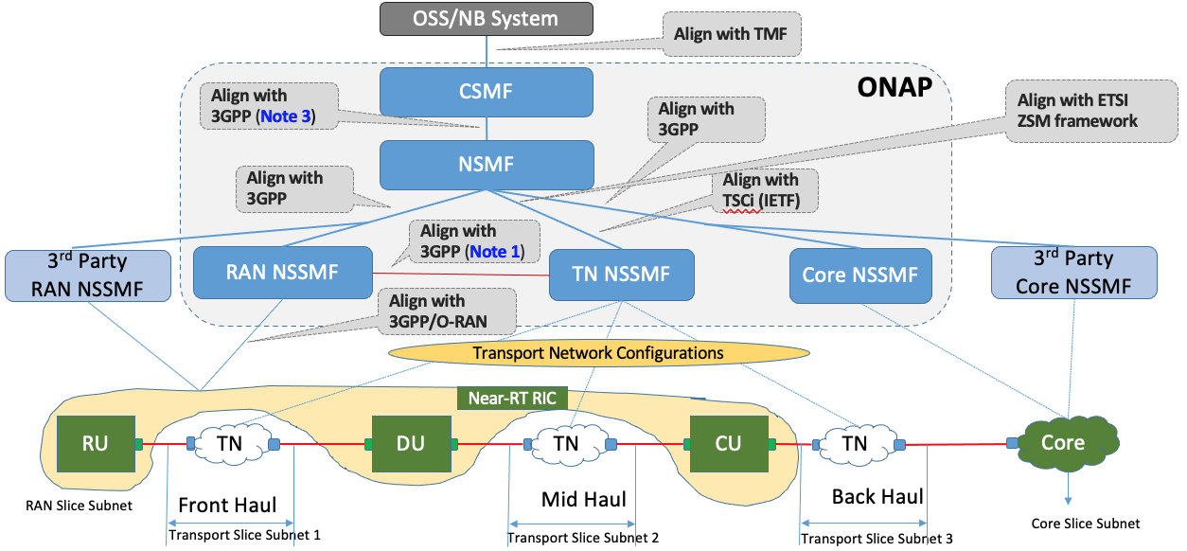
Overall objectives
Objectives
Implement ONAP- based Slice Management functions defined by 3GPP (CSMF + NSMF + NSSMF)
Demonstrate e2e slice design, instantiation and operation, including RAN, Core and Transport slice sub-nets
Provide flexible architecture choices to operators for deployment scenarios (ONAP based xMF or 3rd party xMF)

Slide 3

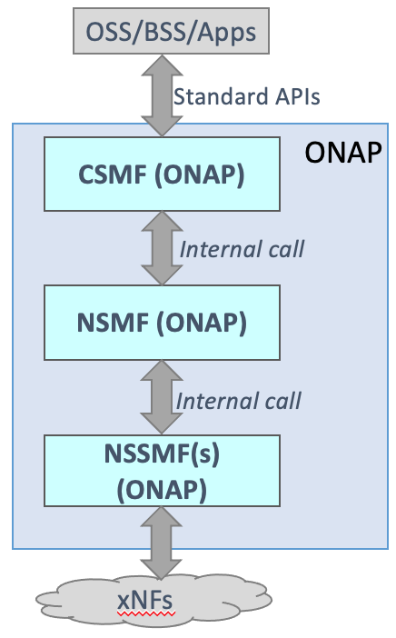
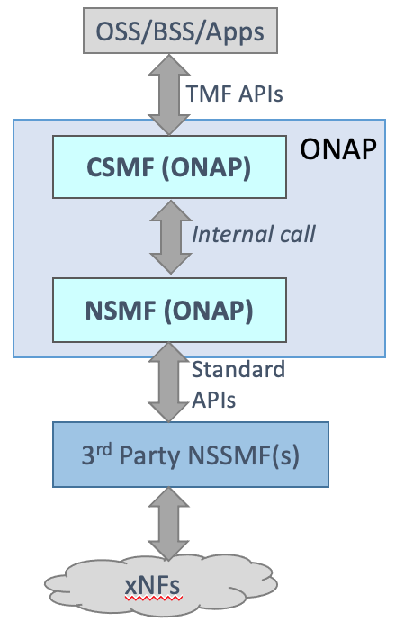
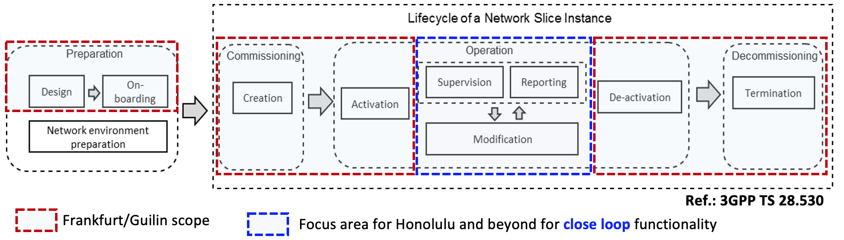
Current Status of E2E Network Slicing Use Case
Frankurt release (2019.09 - 2020.06)
CSMF within OANP + NSMF within ONAP + connect external Core NSSMF
Guilin release (2020.06-2020.12)
Frankfurt deliveries + extenal RAN NSSMF + RAN NSSMF within ONAP + TN NSSMF within ONAP + Core NSSMF within ONAP
Honolulu release and beyond (2021 ~ )
Enhancement of existing functions and extension of close loop scenarios (WIP)
From
Architecture
View:
+
From
NSI LCM
View:

Slide 4
Intelligent Slicing: Overview
Introduction : Use data (e.g., QoE data, network data, etc. ) from various sources as input and do analysis based on AI algorithms to obtain network capabilities that can match the SLA of tenants, and then dynamically adjust the service capabilities of network slices while using optimal resources. It mainly consists of the following three scenarios:
1
Commissioning-Initial resource Assignment
2
3
Runtime-monitoring
Closed-loop Update
Determine the initial resource assignment and configuration for a new slice by intelligent analysis based on SLA requirement. For e.g.:
Determine the resources in each domain especially for RAN
Guarantee the existed slices SLA when creating a new slice
Evaluate the SLA fulfillment and real time monitor QoE based on the QoE model trained by ML algorithms.
The QoE model is used to describe the relationship between the QoE collected from AFs and the KPIs produced by ONAP or network data from Core & RAN NFs.
The QoE model is mainly used in measuring and predicting QoE.
Considering the limited resource and changing condition like the Signal to Noise Ratio and users on the slice, the initial resource configuration may not be able to satisfy the slice SLA during the lifecycle of the slice. ONAP can adjust or update the resource configuration of the slice in a close loop way triggered by the analysis of SLA fulfillment.
SLA fulfillment is evaluated based on the analysis of QoE info and KPIs.
KPI Monitoring for Honolulu
QoE Monitoring is beyond Honolulu
Closed loop control triggered by RAN KPI monitoring for Honolulu
Not for Honolulu

Slide 5






Closed Loop: Overview
Optimization（OOF）
Co-ordination, Decisions
(Policy)
Provide general close loop framework by leveraging SON framework within ONAP
Modular design : construct building blocks of close loop which includes data collection, analysis, optimization, decision and coordination, action.
The close loop framework could be used to realize intelligent slicing scenarios including:
Initial resource assignment
Slice resource re-allocation optimization
Cross slice resource re-allocation optimization
Slice KPI Monitoring
Slice QoE Monitoring
Slice KPI Guarantee
Slice SLA Guarantee
……
DCAE
Data Collection,
& Analysis
(DCAE)
Action
(SO)
Control loop
Domain
Controllers
5G network
FM, PM data
5G Network

Slide 6
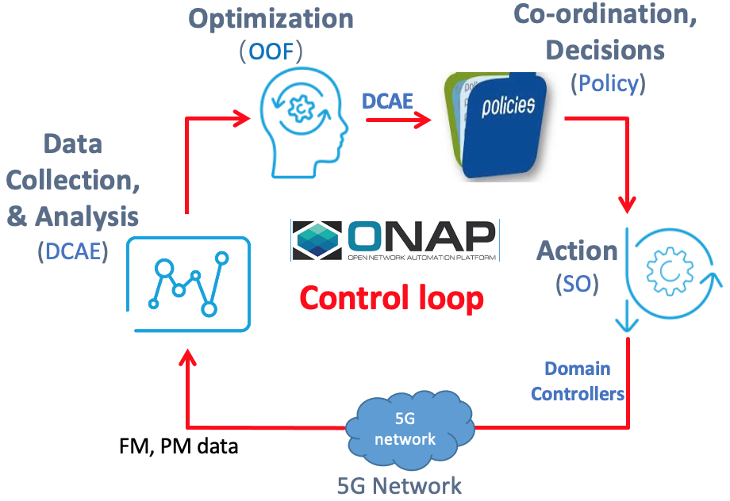
Current Status of Intelligent Slicing
DONE:
NST Selection
NSI/ NSSI Selection
TBA:
resource re-allocation optimization
WIP:
NSI/NSSI Selection
NSSI Resource reconfiguration
TBA:
Initial resource assignment & resource reallocation
Slice KPI Guarantee
Slice SLA Guarantee
Intent based decision
Started in Frankfurt
Enhance in Guilin and beyond
Started in Frankfurt
Enhance in Guilin and beyond
DONE:
PM/FM Data Collection
WIP:
Slice Analysis Micro Service
KPI Calculation Micro Service
Network Capability report (from NSSMF to NSMF)
TBA:
Data collection configuration
NRM Data storage
Matured ML algorithms for prediction
Intent triggered analysis
DONE:
Design
Creation
Activation
Deactivation
Termination
WIP:
Modification triggered by supervision
TBA:
Modification triggered by Requirement change
Modification during the time of slice allocation
Intent based actions
Started in Guilin
Enhance in Honolulu and beyond
Started in Frankfurt
Enhance in Guilin and beyond

Slide 7
RAN Slicing – Current Implementation aligned with O-RAN
Select RAN NSSI, determine RAN slice sub-net resources and then configure the RAN slice sub-net including allocation of ‘resources’ for a slice sub-net instance and configuration of RAN for a slice sub-net instance (including cell configuration)
Consume necessary PM/FM info from RAN, for simple Closed Loop Actions/Intelligent Slicing
Re-configure/re-allocate RAN resources
Assumptions
All RAN xNFs are created and pre-configured
Config DB is assumed to contain cell details including PNF mapping, etc.
Southbound interface from SDN-C (R) will be netconf for CM, and VES for FM/PM. For FM/PM we will align with O-RAN/3GPP.
ONAP
RAN slice inventory
List of cells, DUs, CUs with details of active slices
Capacity & Capability of RAN subnet
O1
O1
RAN
Near RT-RIC
RUs
DUs
CUs
Note: O2 interface not considered in scope for RAN Slicing, as the RAN xNFs are assumed to be pre-instantiated as part of the preparation phase.

Slide 8
Closed Loop Flows of Slicing Scenarios in ONAP
ONAP
The PM data collected from RAN in Step 1 is DL/UL PRB used for data traffic.
The configuration update determined by Slice Analysis MS and triggering Policy in Step 4 is slice specific throughput guidance for Near-RT coverage area (i.e., at Near-RT RIC level).
Notes
DFC and VES Collector are not shown in the flow but are used.
Step 8 is over O1, it will eventually be over A1.
Config DB which contains RAN config info is not an official ONAP component. This will be implemented as part of CPS in H-release and beyond.
Slice Analysis MS
Policy
SO (RAN NSSMF)
4
5
2
6
3
PM Mapper
Config DB (Note 4)
SDN-R
7
DCAE
8
O1 (Note 2)
1
O1
CUs
RAN
Near RT-RICs
DUs
RUs

Slide 9
ML-based Closed Loop Flows
ONAP
The PM data collected from RAN in Step 1 is PDU sessions requested, setup successfully & failures.
The configuration update determined by ML MS and triggering Slice Analysis MS in Step 3 is slice specific maxNumberofConns for each cell (i.e., cell level for each S-NSSAI).
Notes
DFC and VES Collector are not shown in the flow but are used.
ML MS is onboarded to DCAE, but not an official ONAP component. Later we will onboard using Acumos DCAE adaptor.
Config DB which contains RAN config info is not an official ONAP component. This will be implemented as part of CPS in H-release and beyond.
DCAE
Slice Analysis MS
Policy
SO (RAN NSSMF)
6
7
4
8
5
ML MS (offline trained)
Config DB
(Note 4)
3
CCSDK/SDN-C (SDN-R)
9
2
PM Mapper
O1 (Note 2)
10
RAN
1
O1
Near RT-RICs
CUs
DUs
RUs

Slide 10
Core Slicing: Creation of new Core NSSI
NSSMF->NFVO Interaction
NFVO Orchestration Flow
OOF
AAI
4
SO
CSMF
NSMF
2
3
serviceOrder API
with slicing
parameters
Call E2ESericeInstance
API with serviceType=CST
UUI
ExtAPI
E2E Workflow
5
Call service Instance API
1
Core NSSMF Workflow
7
Macro Workflow
6
8
9
10
11
CDS
Multi-cloud
K8s Plug-in
K8s Cluster
Slice Lifecycle Flows (Existing)
NSSMF – NFVO Flow (New)
Solution based on ONAP Frankfurt release features

Slide 11
Core Slicing: Reuse existing Core NSSI
NSSMF->NFVO Interaction
NF Configuration Flow
(Day 1/n configuration)
OOF
AAI
The Slicing requirements would require in some cases to re-use the existing NSSI. In such cases the NFVO would need to configure specific NFs.
4
SO
CSMF
NSMF
2
3
serviceOrder API
with slicing
parameters
Call E2ESericeInstance
API with serviceType=CST
UUI
ExtAPI
E2E workflow
5
1
6
Core NSSMF Workflow
Macro workflow
7
9
10
CDS
Multi-cloud
K8s Plug-in
K8s Cluster
8
Slice Lifecycle Flows (Existing)
NSSMF – NFVO Flow (New)
Solution based on ONAP Frankfurt release features

Slide 12

Transport Slicing future roadmap: Closed-loop Automation
4
ONAP
2
1
3
Self-service provisioning
Four Types of Closed-loop Automation
Network design & deploy
Network Assurance
Service provisioning and activation:
  Days ➔ Minutes
Network planning and deployment:
  Weeks ➔ Days
Network troubleshooting and restoration:
  Hours ➔ Minutes
Traffic prediction based auto network planning:
  Months ➔ weeks
Phy. network controllers
On-line Plan
Auto Deploy
Topo & Service
Performance & Alarm
Intelligent
Analysis
Maintain & Optimize
NEs
CPE
Optical network
Optical network
CPE
2021：New CPE online and deployment (and auto service activation)
2018：L2 service
2019：L1 service
2020：Transport Slicing
2022+：Network performance prediction based service disruption prevention

Slide 13
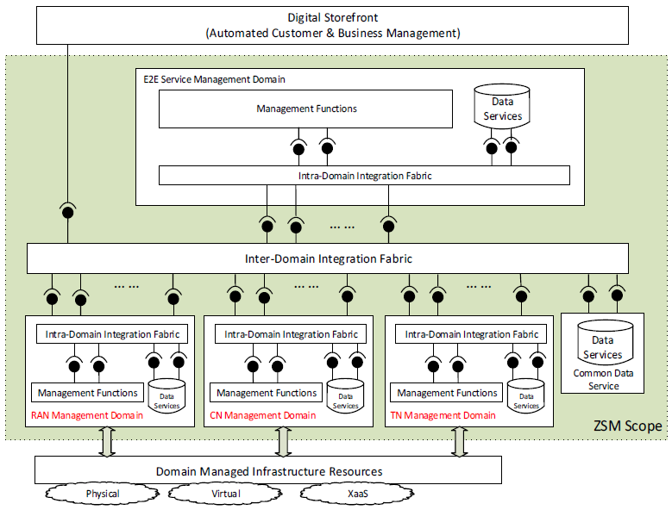
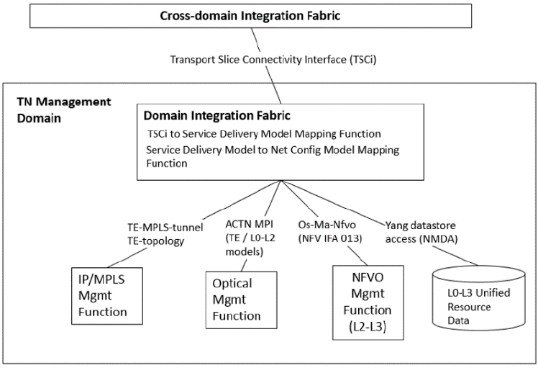
Transport Slicing: Adopting ZSM 003 architecture and IETF models
ETSI ZSM E2E Network Slicing Architecture
Logical View of the IETF Transport Slicing Solution

Slide 14
Transport Slicing: Implementation on ONAP
External interface of TSC NBI
ONAP
UUI
EXT-APIs
ONAP
CSMF
OOF
SO
NSMF Work Flow
AAI
NSMF
Policy
TN NSSMF Adaptor
TS definition model (based on TSCi info model)
Internal APIs (TSCi)
SDC
TS implementation models (e.g., te-topology, te-tunnel, etc.)
TN NSSMF
TN NSSMF Work Flow
Generic-resource-API
Optical Domain Controller
SDNC
TSC NBI-to-SBI Mapping
Existing ONAP code with modifications
TS: Transport Slice
TSC: Transport Slice Controller
TSCi: Transport Slice Connectivity Interface
NBI: Northbound interfaces
SBI: Southbound interfaces
ACTN: Abstract & Control of TE Network
MDSC: Multi-Domain Service Coordinator
PNC: Physical Network Controller
ACTN MPI: ACTN MDSC to PNC Interface
AAI: Active and Available Inventory
OOF: ONAP Optimization Framework
SO: Service Orchestrator
SDNC: SDN Controller
SDC: Service Design and Creation
UUI: Usecase User Interface
EXT-API: External API
ACTN MPI Adaptor (SBI)
New ONAP code for TN NSSMF Functionality
Optical domain controller

Slide 15
Transport Slicing future roadmap: ONAP, ZSM, IETF collaboration
Year 2020
Year 2021
Year 2022
ZSM
Trans. slicing demo (on TN MD features)
Transport closed-loop demo
Adopting ZSM 009 for transport closed-loop
Adopting ZSM 003 architecture
evaluation/ feedback of closed-loop demo
Evaluation/ feedback of the demo
Implementation of trans. slicing
Implementation of trans. closed-loop
ONAP
Frankfurt release
Guilin release
Honolulu release
R9 release
R10 release
Feedback and Comments on TSCi draft
Adopting MP2MP models/solutions
Adopting transport closed-loop models/solutions
Adopting TSCi information model
IETF
First version of TSCi draft
Second version of TSCi draft
MP2MP trans. Slicing solution
Transport closed-loop models and solutions

Slide 16
Potential Areas for collaboration with ETSI ZSM
ONAP alignment with ZSM 003
  End-to-end network slice orchestration
  ONAP alignment with ZSM 009
  Implementation of various Control Loops (with/without analytics and AI/ML) at NSMF (e2e network slice) and NSSMF (slice subnet) level
  Concepts such as hierarchical Closed Loops (NSMF & NSSMFs, Non-RT RIC/SMO and Near-RT RIC) can be taken forward
  Co-ordination of actions in hierarchical Closed Loops (e.g., NSMF and NSSMF), and in multi-domain Closed Loops
ONAP demo at ZSM

Slide 17
Potential collaboration with ITU FG AN

Slide 18
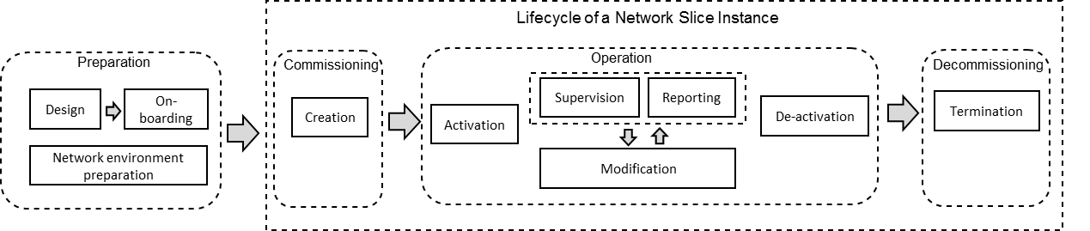
Potential collaboration with ITU FG AN
Autonomous Network Slicing (end-to-end and in RAN/Core/Transport sub-nets) based on intent(s) – self-instantiation; dynamic adaptation (re-configuration, scaling); self-prediction, root-cause identification and self-healing; self-optimization of network resources; proactive notification to inventory on capacity exhaustion.
Instantiation/reuse of appropriate slice (sub-net) based on self-learning
Intent-based network slice instantiation & life cycle management
Closed Loop Automation: ML-based prediction, root cause identification and self-adaptation

Slide 19
Potential collaboration with ITU FG AN
Inputs to/from ITU FG AN, particularly related to Closed Loop Automation & Machine Learning
ONAP-based demos/presentations
Topics for discussion
ML models and framework
  Distributed ML-based Control loops
  Federated learning, federated slicing
  Interaction between closed loops and analytics functions across planes (control, orchestration and OSS)
  Control Loop co-ordination (after action is determined, before action is determined, during action determination)
  Cross-domain control loops, federated slicing & control loops
  Multi-vendor ecosystem for control loops
  (Enhanced) SON and Control Loops

Slide 20
E2E Network Slicing Alignment with SDOs
Standards Body | Alignment Reference(s)
3GPP (Rel. 16) | TS 28.530 (Concepts, requirements) TS 28.531 (Slice and Slice sub-net LCM) TS 28.541 (Network Resource Models) TS 23.501 (Procedures in Control Plane) TS 28.552 and TS 28.554 (PM and KPIs)
TMF | TMF 641 (Service Order – CSMF NB) TMF 628 (PM and KPI monitoring – just started)
ETSI | ZSM 002 ZSM Framework ZSM 003 E2E Network Slicing Architecture ZSM 009 Closed-loop Automation
IETF | draft-rokui-5g-ietf-network-slice-00 draft-ietf-teas-actn-vn-yang RFC 8795: YANG models for TE topologies
O-RAN | O1 (RAN Configuration, notifications, PM data) – in progress O2 (not started yet) A1 – just started RAN architecture and functional split (Non-RT RIC, Near-RT RIC, SMO) – in progress
ITU FG-AN | TBA

Slide 21
References
3GPP TS 28.530 (Overview)
3GPP TS 28.531 (Management Procedures)
3GPP TS 28.541 (NRM)
3GPP TS 28.552, TS 28.554 (PM and KPIs)
3GPP TS 23.501 (Control Plane flows)
ETSI ZSM 002, 003, 009
https://wiki.onap.org/display/DW/E2E+Network+Slicing+Use+Case+in+R6+Frankfurt
https://wiki.onap.org/display/DW/E2E+Network+Slicing+Use+Case+in+R7+Guilin
https://wiki.onap.org/display/DW/R8+E2E+Network+Slicing+use+case

Slide 22
Thank You!

